Slide 1
Tax Map
What a Lagos business owes under Nigeria's 2025 tax laws, with the section behind every line, checked by a second agent.
Tofarati Farinu · Team ISEGUN (solo) · Track 2: The Agent That Can Explain Why
Built with
Zetaris
Meterless
NVIDIA Nemotron
Cursor · Claude Code

Slide 2
The problem and who it is for
Nigeria's 2025 reform rewrote the tax code into four federal Acts, and obligations still arrive from three tiers of government. A shop owner in Ikeja has no single place to read what applies to her. A general chatbot answers from memory: no section, no way to check, and the law changed this year.
Three tiers, one question
Federal
Nigeria Revenue Service
VAT, companies income tax, development levy
Who it is for
What they get
Lagos State
Lagos State Internal Revenue Service
Personal income tax, PAYE, premises registration
Lagos SME owners and their accountants
Junior revenue officers who field these questions daily
Anyone building a compliance tool who needs a statute-grounded pattern
What applies to them, and what they are exempt from
The exact section behind each line, openable in full
A second check that sets aside what the law does not support
Ikeja LGA
Ikeja Local Government
Shop rates, tenement rate, signboard permits

Slide 3
The solution
One rule: the statute text is the source of truth, the model is the reader, and the code enforces it.
Researcher agent
Critic agent
Answer page
Navigates a generated map of the Acts, browses Parts, reads sections in full, drafts obligations and exemptions
Judges every line against the quoted text and the Acts' own definitions; keeps, qualifies or sets aside
Plain-words lines, the law behind each, a tax map by collecting authority, the receipts
What the code enforces, not the prompt
Read before cite: a claim may cite only a section fetched in full
Verified quotes: the Critic's quote must be verbatim in the cited text
Definitions attached by code: 271 terms from the interpretation sections
Claims-only coverage checklist across six obligation areas
Levies: "may collect", never an amount; relevance to the business filtered
Placement by collecting authority under NTAA s. 3

Slide 4
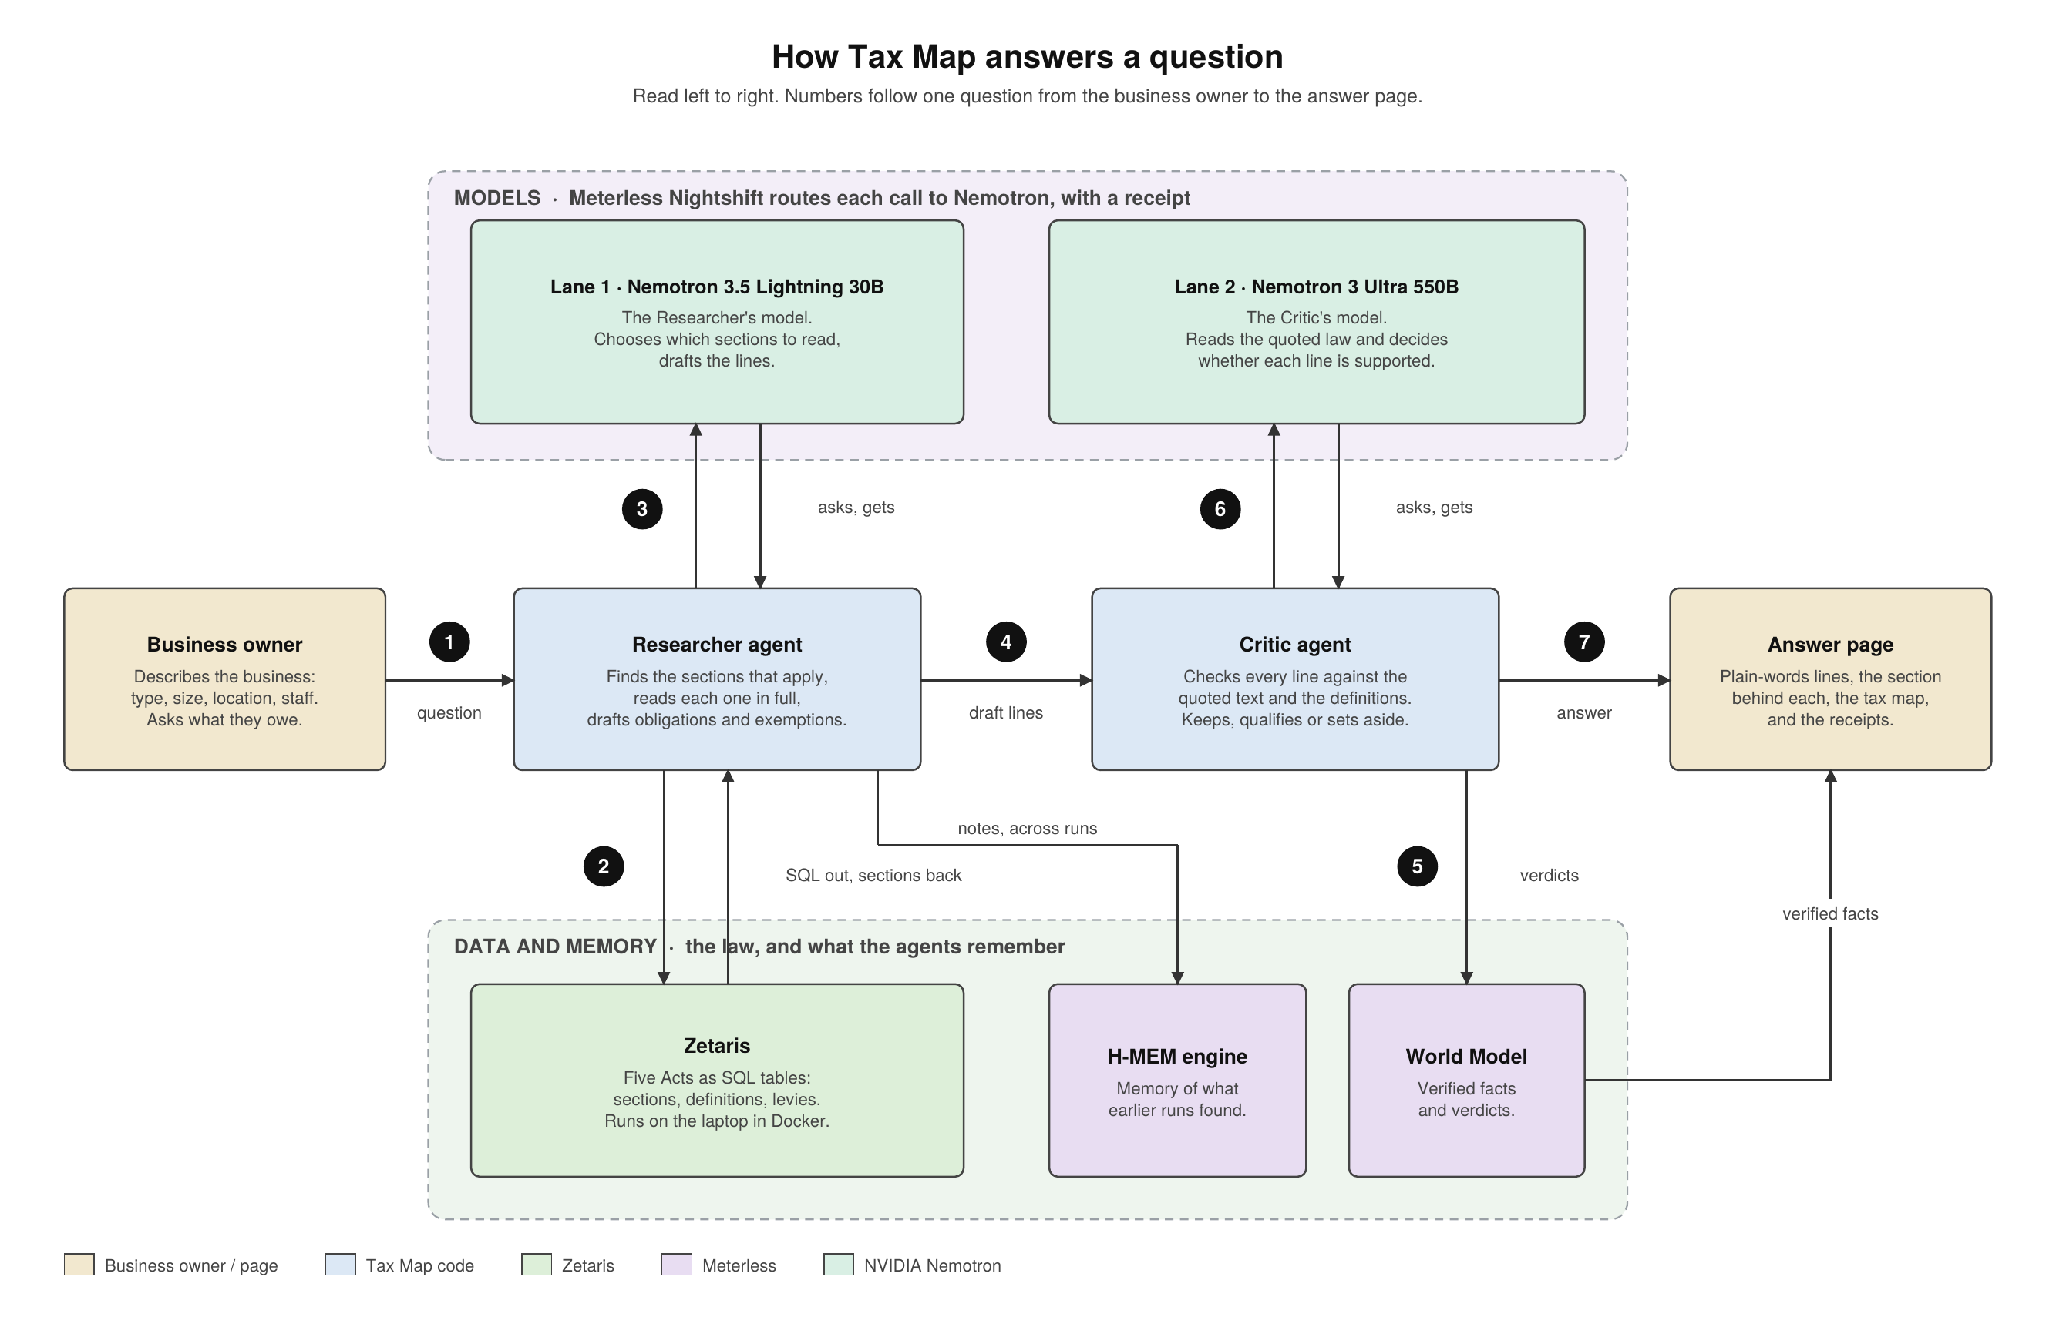
Agent workflow

Slide 5
Technical stack
App
Data
Models and memory
Node 20, TypeScript, Express
Plain HTML, CSS and JS; no framework, no CDN
Server-sent events stream each step
245 tests (vitest); none touch the network
pdfplumber parser: five Acts to section-level JSON
Zetaris REST tables over pinned GitHub raw JSON
Cached views: 40 s to 0.4 s per query
Nemotron 3.5 Lightning 30B: Researcher
Nemotron 3 Ultra 550B: Critic
Meterless Nightshift 1.2.3 gateway, signed receipts
Meterless H-MEM and World Model engines
454 + 39
271
7/7 · 8/8
245
statute sections and schedule items
defined terms attached automatically
engine conformance, H-MEM and World Model
tests passing in a clean clone

Slide 6
How I used Zetaris and Meterless
Zetaris: the data layer
Meterless: the power layer and the engines
Five Acts parsed to JSON and served from pinned GitHub commits as Lightning REST tables
Views taxmap.sections, taxmap.acts and taxmap.levies; the agent writes ordinary SQL
Caching the views cut queries from 40 s to 0.4 s; the app re-caches on startup
A judge can run the agent's exact SQL in the Zetaris SQL Editor
Nightshift is the app's primary AI provider: every model call goes through it, lane-pinned, with a signed compute receipt
H-MEM: tiered memory, hashed embeddings, forgetting curve, cross-run promotion, JSONL trust ledger (7/7)
World Model: content-hashed graph, idempotent 10-stage ingest, claim context builder (8/8)
Three bugs reported with repros; two fixed in Nightshift 1.2.3
Zetaris answers "what does the law say"; Meterless carries every model call and remembers what the agents found and verified.

Slide 7
What was different about how I used the sponsors
NVIDIA Nemotron
Grounding by code
Cursor and Claude Code
Two agents, two Nemotron models, one job each: a fast drafter and a large judge
Every receipt names the model; the demo shows a 550B judge striking a 30B draft
No other model anywhere in the product path
The Critic's quote is checked against the statute text in code, so a hallucinated citation cannot survive
Definitions are attached by code from the Acts' own interpretation sections
Levies: "may collect", never an amount; placement by NTAA s. 3
Built from written prompts; I reviewed every file and ran every test
The organisers dropped the Cursor requirement on 22 Oct; both tools are disclosed in the README
LICENSE, NOTICE and SOURCES with document hashes
Where each sponsor sits in the product
Zetaris: the law
Meterless: calls + memory
NVIDIA: both agents
Cursor · Claude Code: the build

Slide 8
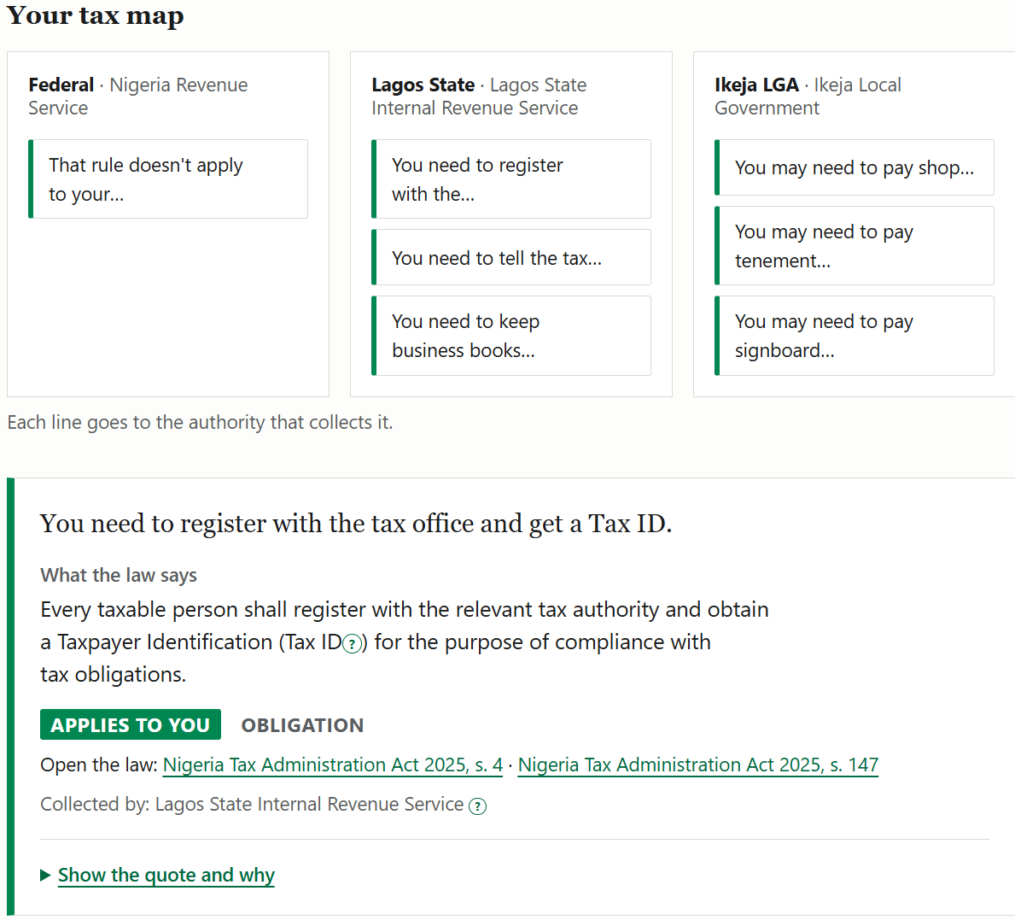
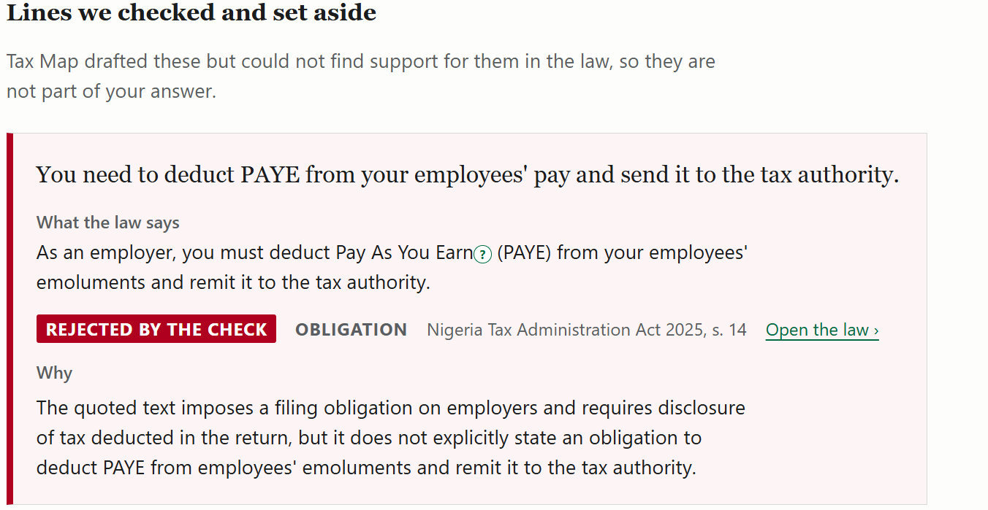
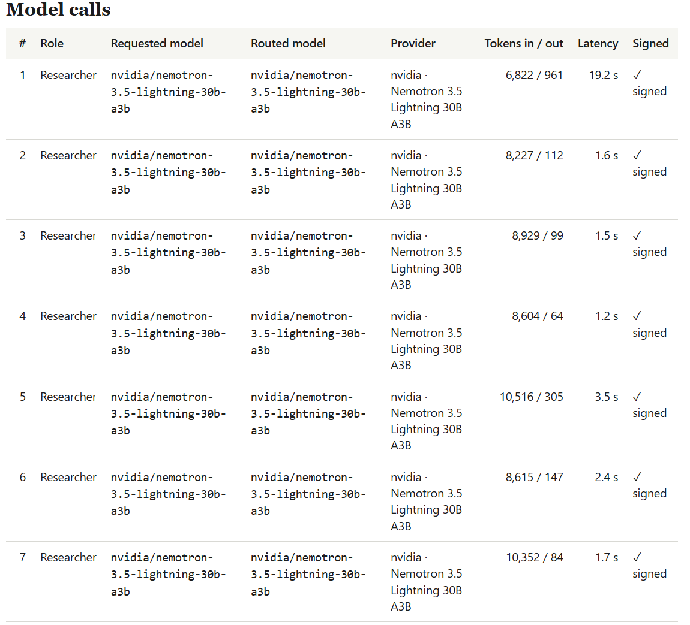
Product visuals
A set-aside line with its reason and the disapplying quote
Results page: summary, tax map by authority, claim cards
Receipts: every call on Nemotron, signed
Notes:
Replace the three grey frames with screenshots: results page at 820 px (large), a set-aside card (top right), the receipts table (bottom right). Insert > Pictures, then resize to the frame.

Slide 9
Future enhancements
Lagos State and local law
Schedules
Load the Lagos State Harmonised Taxes and Levies Law and Ikeja's bye-laws so the State and LGA columns cite local instruments, with rates
Parse the Schedules of the 2025 Acts (rates and allocations) so the agents can cite them
Instant answers
More profiles
Precompute answers for common business profiles from the World Model; serve them at once, dated, with a Run again button
Companies, partnerships and other States; owner residence separate from business location
Known limits today
Federal Acts plus the 1998 allocation only; live runs take 6 to 12 minutes and vary between runs; sample mode replays a recorded run; not legal advice

Slide 10
Every line cites the law.
Every call has a receipt.
github.com/tman6290/tax-map · Tofarati Farinu · ISEGUN

