Slide 1



NEURO DATASET 2: EMOTION DECODING FROM EEG
University of Washington, Seattle
Spring 2023

Slide 2
OUTLINE
Dataset Background
About the Dataset
Problem Description

Slide 3
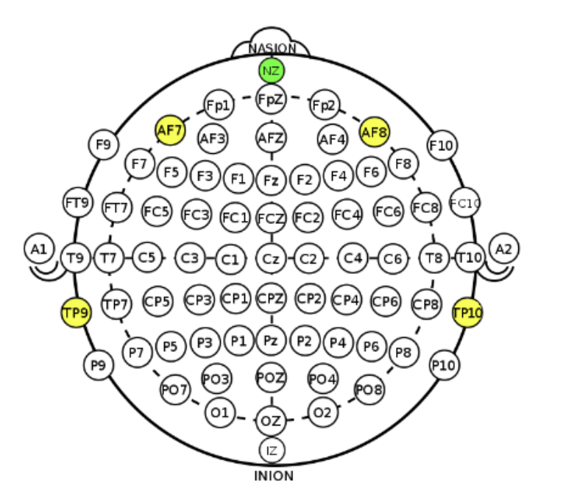
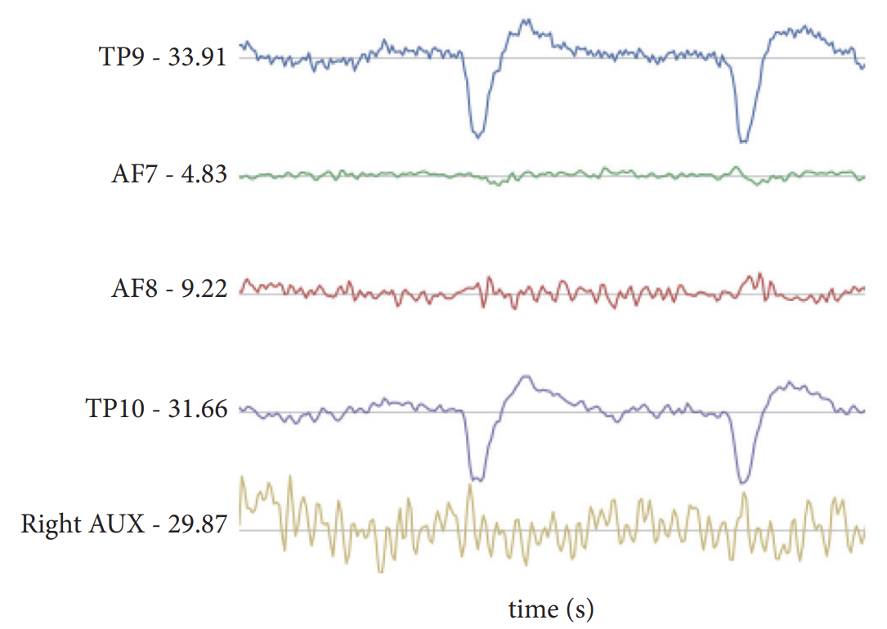
EEG Brainwave Recording
Front
Left
Right
Back
International Standard EEG Placement System
Raw EEG data stream example
Notes:
In this course, we will be using PyTorch as our main deep learning framework

Slide 4

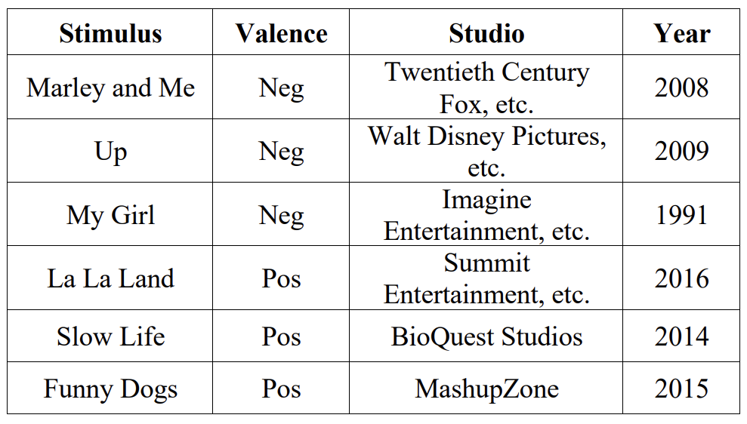
Dataset Collection
Subject having their EEG brainwave recorded during stimulus
3 minutes per emotional state
Includes neutral state with no stimulus
Notes:
In this course, we will be using PyTorch as our main deep learning framework

Slide 5
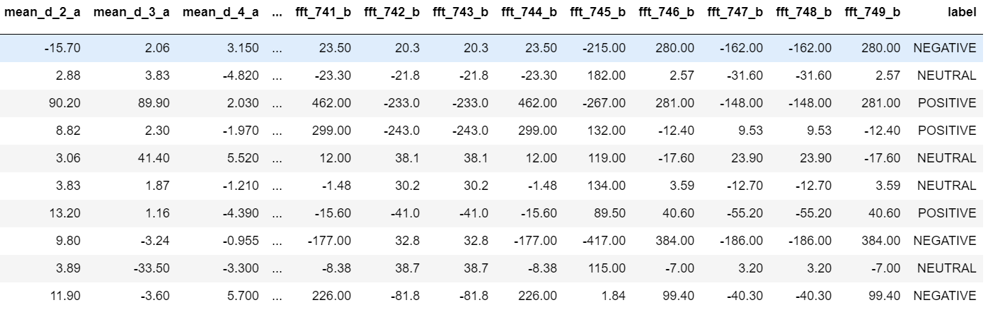
About the Dataset
Statistical/Analytic features from EEG
Emotional State
2132 datapoints (rows)
2549 features (columns)
_a (subject A), _b (subject B)
Notes:
In this course, we will be using PyTorch as our main deep learning framework

Slide 6
Problem Description
EEG Features
Emotion State
mean_d_2_a
mean_d_3_a
fft_741_b
Positive
Neutral
Negative
Your NN Model
…
Input
Output
Notes:
In this course, we will be using PyTorch as our main deep learning framework

Slide 7
References
[1] J. J. Bird, L. J. Manso, E. P. Ribiero, A. Ekart, and D. R. Faria, “A study on mental state classification using eeg-based brain-machine interface,”in 9th International Conference on Intelligent Systems, IEEE, 2018.
[2] J. J. Bird, A. Ekart, C. D. Buckingham, and D. R. Faria, “Mental emotional sentiment classification with an eeg-based brain-machine interface,” in The International Conference on Digital Image and Signal Processing (DISP’19), Springer, 2019.
Notes:
In this course, we will be using PyTorch as our main deep learning framework

