Slide 1


DBI202 PE MARKING TOOL
Course: PRN292 Instructor: ThoPN3
Group 4: SE1428
Student: Phung Dang Long Vu (Leader)
Student: Tran Quang Khai
Student: Vu Ngoc Anh
Student: Tran Tien Manh
Student: Nguyen Quang Tung
Student: Vu Tuan Nam

Slide 2
TABLE OF CONTENTS
01
03
02
04
Description
Summary
Timeline
Function detail

Slide 3

Solution
Problem

Slide 4
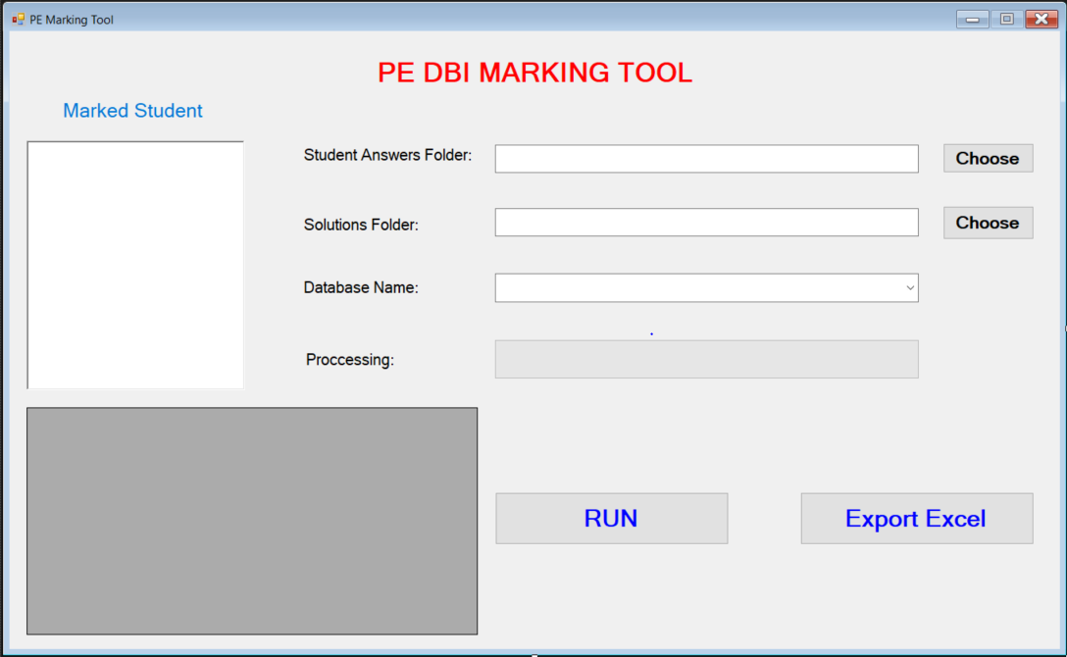



Description
The program helps lecturers to marking DBI202 PE test in multiple students with high accuracy
The program can export marked result to Microsoft Excel file.
Program base on C# Window Form language , SQL Server language, Microsoft Excel.
I1. Expected Interface

Slide 5
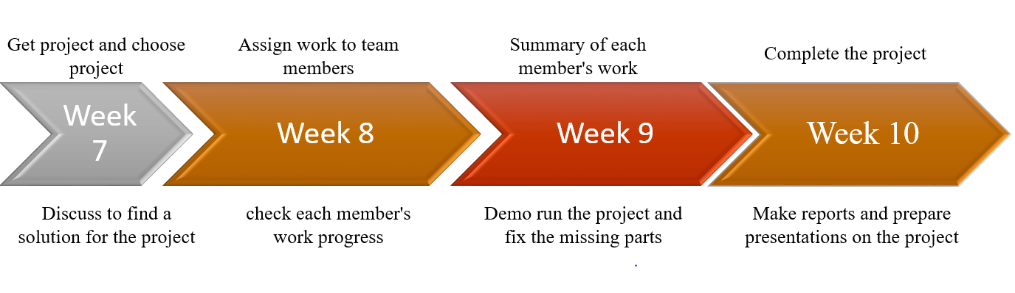
Timeline
F1. First overview timeline

Slide 6
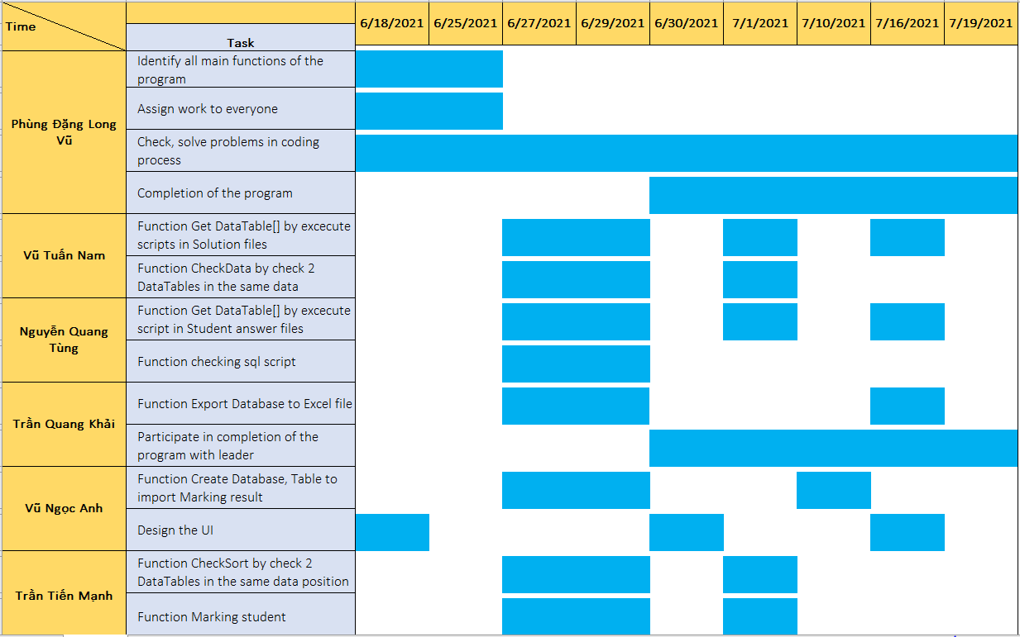
Timeline
F2. Final overall progress of the project

Slide 7
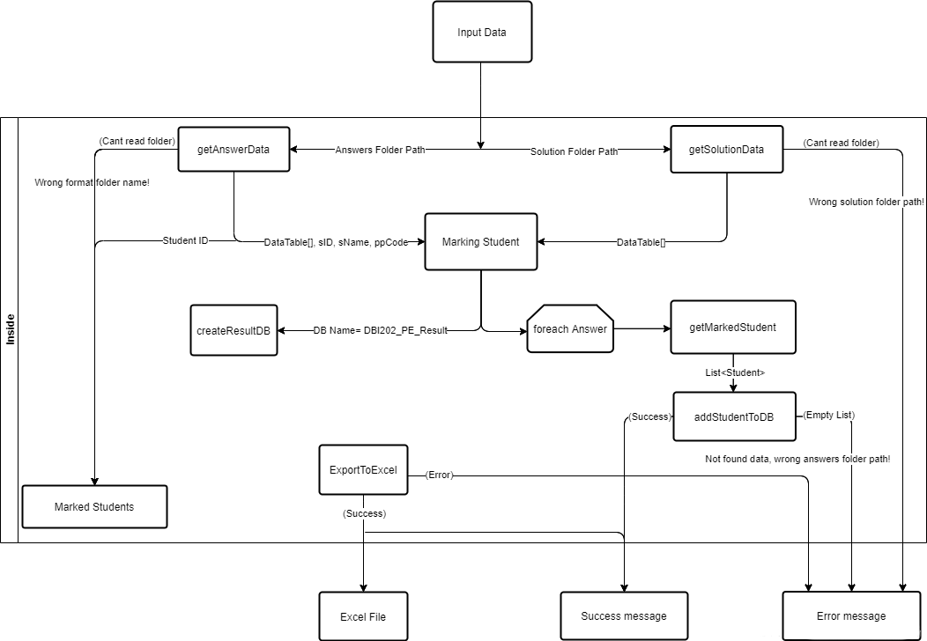
Function detail
F3. Functional Flow Chart

Slide 8
01
OVERVIEW

Slide 9

Check file input(Student and solution)
- Check format folder solution and folder of student - Check if the student’s file and the answer file are in correct format - if it’s not correct, no more grading - if it is correct, then pass the other test steps
Ex:
HE141333_GiangBD_DBI202_09(student file)
Summer_2020_PE_DBI202_000111(solution file)
I2. Student Folder Example

Slide 10
Check if the file is correct “ *.sql ” file
Check if the sentences in the answer are in the correct format
Return the list of answers(DataTable)
Check if the student’s answer are in the correct format and how many have done
If not, return null
If yes, get the data of each sentence
=> Compare with the answer of the solution
=> Check if the answer’s data has enough rows and enough columns compared to the solution

Slide 11
Check DataTable Result of student and Result temple are the same
Check if student’s result have enough rows and columns to match the sample result.
If there are enough rows and columns, then check if the data at each position to match the sample result.

Slide 12
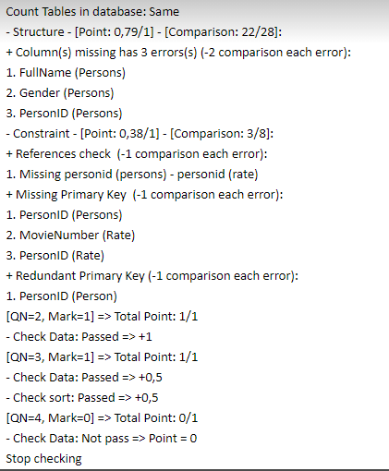
Detailed scoring function
Detailed grading of each sentence
Check if the student’s have the solution to that question (file)
Check if student’s result has enough data, The data in Solution match position with Sample result or not => if not return detailed error else=> Scoring according to the regulations of each part
if it is correct, then pass the other test steps
I3. Marking Detail Example

Slide 13
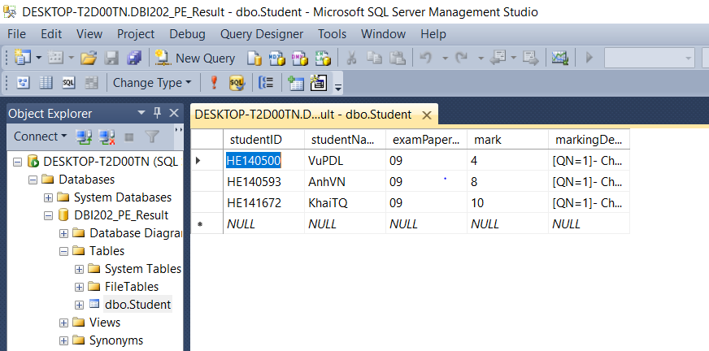
Save the score result to the database
Use List<Student>
Get all file Student answers folders
Get all file Files from solution folders
Use split to slice and get student information
Perform the grading and get the scoring results stored in the database
I4. Example of marked student data

Slide 14
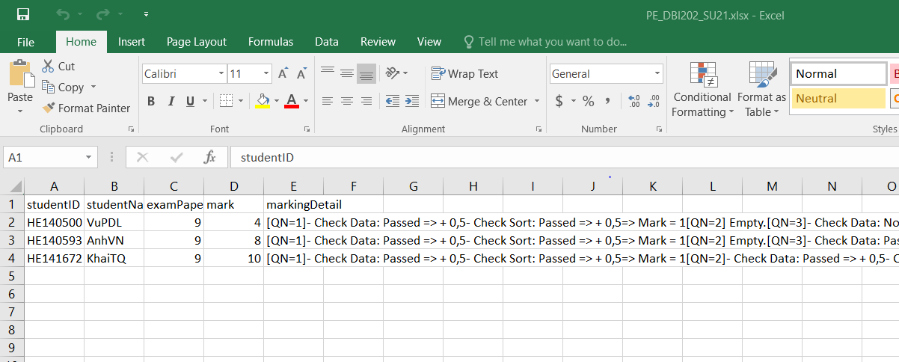
Export data from database to Excel file
I5. Example of Exported Excel file

Slide 15
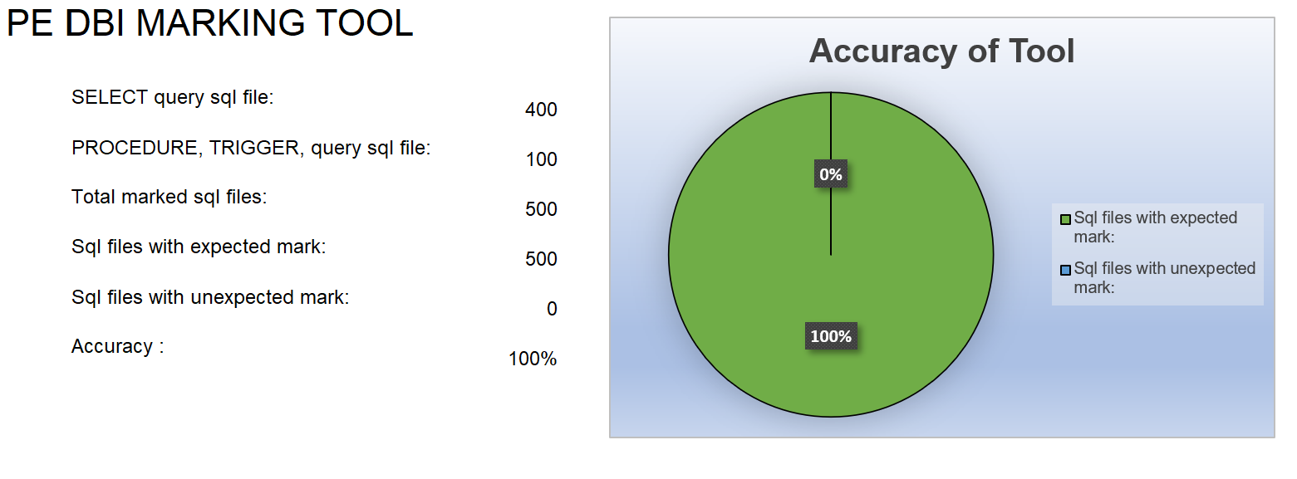
Summary
C1. Tool accuracy

Slide 16

Please, keep this slide for attribution.

