Slide 1
Federated
Named-Entity Recognition
Jennifer Andersson, Lovisa Hagström, Kätriin Kukk, Thibault Marette
Notes:
Lovisa

Slide 2

The Problem
The santa association wants to detect vital information in text to develop an accurate naughty list.
However, each country in the federation has little data and cannot share it.
⛄️🇩🇰
🤶🏼🇳🇴
Bernt Hagtvet er professor i statsvitskap ved Universitetet i Oslo og fast skribent for Dag og Tid.
🎅🏻🇸🇪
Notes:
Lovisa

Slide 3


The Solution
Use Named-Entity Recognition to automatically detect named entities in text.
Leverage federated learning to share data resources.
⛄️🇩🇰
NER
🤶🏼🇳🇴
Bernt Hagtvet er professor i statsvitskap ved Universitetet i Oslo og fast skribent for Dag og Tid.
🎅🏻🇸🇪
Notes:
Lovisa

Slide 4
What is Named-Entity Recognition?
⛄️🇩🇰
NER
🤶🏼🇳🇴
Bernt Hagtvet er professor i statsvitskap ved Universitetet i Oslo og fast skribent for Dag og Tid.
🎅🏻🇸🇪
Notes:
Lovisa

Slide 5
What is Named-Entity Recognition?
Person real or fictional characters and animals
Organisation any collection of people
Location geographical places and buildings
Product artificially produced entities
Bernt Hagtvet er professor i statsvitskap ved Universitetet i Oslo og fast skribent for Dag og Tid.
Apple announced their new iCase.
Transformer encoder models are typically trained to detect named entities in some language.
Did you eat the last apple?
Notes:
Lovisa

Slide 6
From NER to Federated NER
Problem: Each federation wants to collaborate but cannot share their own data.
We leveraged Federated Learning for NER.
⛄️🇩🇰
🤶🏼🇳🇴
🎅🏻🇸🇪
Notes:
Thibault

Slide 7
From NER to Federated NER
Problem: Each federation wants to collaborate but cannot share their own data.
We leveraged Federated Learning for NER.
⛄️🇩🇰
NER
🤶🏼🇳🇴
🎅🏻🇸🇪
Notes:
Thibault

Slide 8
From NER to Federated NER
Problem: Each federation wants to collaborate but cannot share their own data.
We leveraged Federated Learning for NER.
⛄️🇩🇰
NER
🤶🏼🇳🇴
Bernt Hagtvet er professor i statsvitskap ved Universitetet i Oslo og fast skribent for Dag og Tid.
🎅🏻🇸🇪
Notes:
Thibault

Slide 9
From NER to Federated NER
Problem: Each federation wants to collaborate but cannot share their own data.
We leveraged Federated Learning for NER.
⛄️🇩🇰
NER
🤶🏼🇳🇴
Bernt Hagtvet er professor i statsvitskap ved Universitetet i Oslo og fast skribent for Dag og Tid.
🎅🏻🇸🇪
Notes:
Thibault

Slide 10
From NER to Federated NER
Problem: Each federation wants to collaborate but cannot share their own data.
We leveraged Federated Learning for NER.
⛄️🇩🇰
NER
🤶🏼🇳🇴
Bernt Hagtvet er professor i statsvitskap ved Universitetet i Oslo og fast skribent for Dag og Tid.
🎅🏻🇸🇪
Notes:
Thibault

Slide 11
From NER to Federated NER
Problem: Each country wants to collaborate but cannot share their own data.
We leveraged Federated Learning for NER.
In the real-world, we need a few practicalities:
A dataset
A model
A machine to deploy our implementation
⚙️
A framework to simulate communication
Notes:
Thibault

Slide 12
UNER: a unified dataset corpora for NER tasks
We use new datasets from UNER project, a recent effort to develop consistent NER benchmarks in many languages.
Dataset features:
3 tags: Person Organisation and Location.
Solving in and inter dataset ambiguities using clear and common annotation guidelines.
Heterogeneous data to simulate the federated setting.
Dataset | Language | #sentences | Content
sv_talbanken | Swedish | 4 303 | Professional prose
da_ddt | Danish | 5 512 | Fiction, nonfiction, news, Speech
nob_norne | Norwegian (bokmål) | 16 309 | Literature, newspapers, government publications
nno_norne | Norwegian (nynorsk) | 14 878 | Literature, newspapers, government publications
Notes:
Thibault

Slide 13
Base model overview
We used Facebook’s XLM-RoBERTa as a pre-trained model.
Transformer-based language model pre-trained on 100 different languages
Multilingual model without sacrificing per-language performance
Can determine language on the input
Fine-tuning the model for our project
Setting hyperparameters based on the one reported in the research paper
Warm Up phase
Perform early stopping based on validation loss
Notes:
Thibault

Slide 14
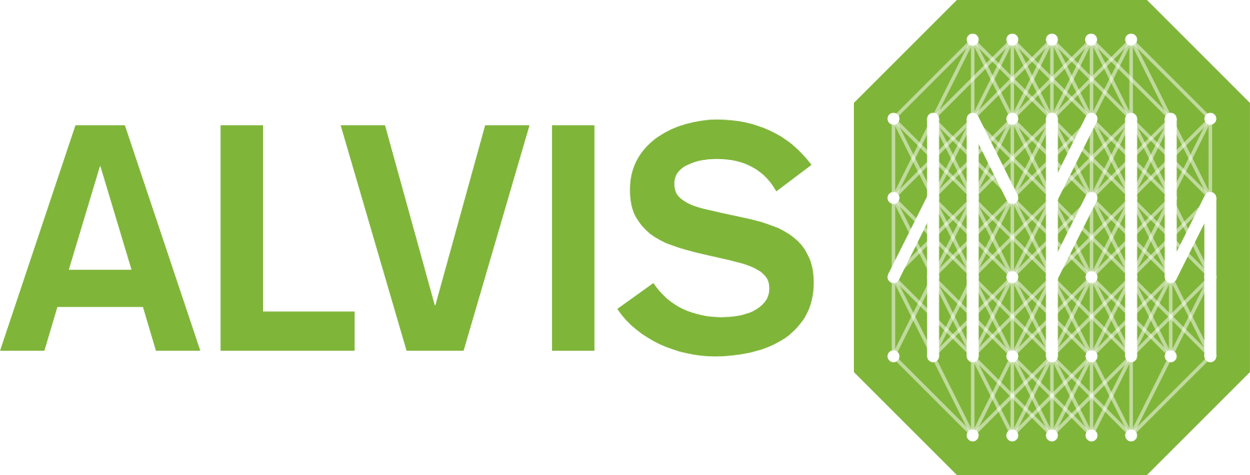
Model deployment
Requested access to national NAISS ressource Alvis
Deployed our implementation on a small cluster (4 NVIDIA Tesla A40 GPUs with 48GB RAM)
Each client runs on a separate GPU within the node.
Notes:
Thibault

Slide 15
Federated Learning with Flower
Flower → open-source framework for federated learning
Notes:
Jennifer Motivate flower (controllable/modular, can be integrated with FEDn, simulated)

Slide 16
Federated Learning with Flower
Flower → open-source framework for federated learning
Easy to transition from centralized ML to federated ML
framework agnostic → builds on top of existing DL frameworks
compatible with Python, Android, iOS, C++ etc
Notes:
Jennifer Motivate flower (controllable/modular, can be integrated with FEDn, simulated)

Slide 17
Federated Learning with Flower
Flower → open-source framework for federated learning
Easy to transition from centralized ML to federated ML
framework agnostic → builds on top of existing DL frameworks
compatible with Python, Android, iOS, C++ etc
Scalable and flexible → move seamlessly from prototyping to production
Prototyping in simulation mode (on your laptop or GPUs in a cluster)
Smooth transition to production mode, with little to no changes in your code
Notes:
Jennifer Motivate flower (controllable/modular, can be integrated with FEDn, simulated)

Slide 18
Federated Learning with Flower
Flower → open-source framework for federated learning
Easy to transition from centralized ML to federated ML
framework agnostic → builds on top of existing DL frameworks
compatible with Python, Android, iOS, C++ etc
Scalable and flexible → move seamlessly from prototyping to production
Prototyping in simulation mode (on your laptop or GPUs in a cluster)
Smooth transition to production mode, with little to no changes in your code
Flower Datasets → benchmarking made easy
Notes:
Jennifer Motivate flower (controllable/modular, can be integrated with FEDn, simulated)

Slide 19
Federated Learning with Flower
Client handles:
Each client trains model based on its individual data partition
(i.e. language)
Notes:
Jennifer

Slide 20
Federated Learning with Flower
Client handles:
Each client trains model based on its individual data partition
(i.e. language)
Flower handles:
Coordinating communication between server and clients
Combining client model updates into a global model
Orchestrating simulation mode
Notes:
Jennifer

Slide 21
Federated Learning with Flower
Client handles:
Each client trains model based on its individual data partition
(i.e. language)
Flower handles:
Coordinating communication between server and clients
Combining client model updates into a global model
Orchestrating simulation mode
Code structure:
Server app, client app and task.py
Notes:
Jennifer

Slide 22
Federated Learning with Flower
Client handles:
Each client trains model based on its individual data partition
(i.e. language)
Flower handles:
Coordinating communication between server and clients
Combining client model updates into a global model
Orchestrating simulation mode
Code structure:
Server app, client app and task.py
🤶🏼
⛄️
🎅🏻
server_app.py
client_app.py
NER
task.py
Notes:
Jennifer

Slide 23
Federated Learning with Flower
Client handles:
Each client trains model based on its individual data partition
(i.e. language)
Flower handles:
Coordinating communication between server and clients
Combining client model updates into a global model
Orchestrating simulation mode
Code structure:
Server app, client app and task.py
We use PyTorch Lightning and
the FedAvg aggregation strategy
🤶🏼
⛄️
🎅🏻
server_app.py
client_app.py
NER
task.py
Notes:
Jennifer

Slide 24
Results
Baseline
Trained and evaluated on a single dataset
Monitored validation loss on all 4 datasets
10 epochs, limited number of steps per epoch, early stopping
Evaluated using precision, recall and F1
Federated learning
Each client was training and evaluating on their own dataset
10 rounds, 1 epoch per round, limited number of steps per epoch
At the end of each round the global model is updated
Evaluated using precision, recall and F1
S1 | S2 | S3
da_ddt + sv_talbanken | S1 + nno_norne | S2 + nob_norne
Notes:
Kätriin; We have a baseline setup so that we could figure out whether using federated learning was beneficial compared to just training on the available dataset in each case

Slide 25
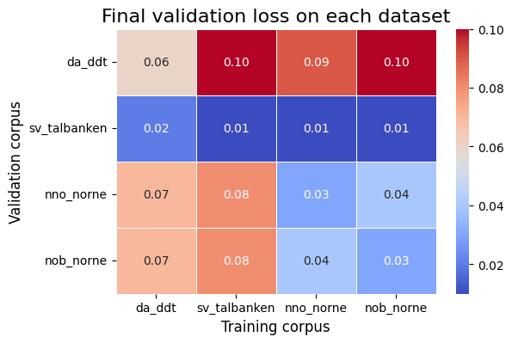
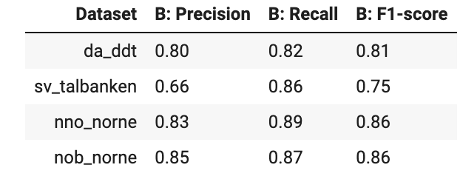
Results: Baseline
Notes:
Kätriin

Slide 26
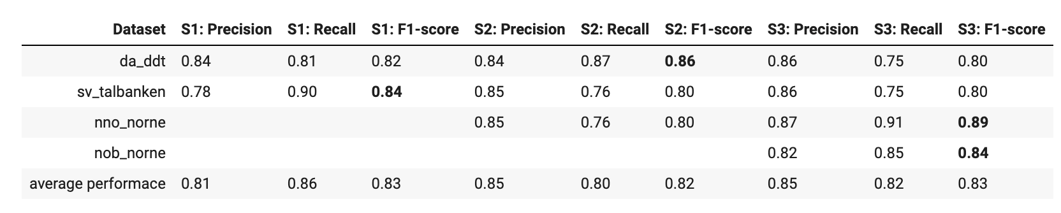
Results: Baseline (above) vs Federated learning (below)
Notes:
Kätriin; mention dataset composition affecting the results

Slide 27
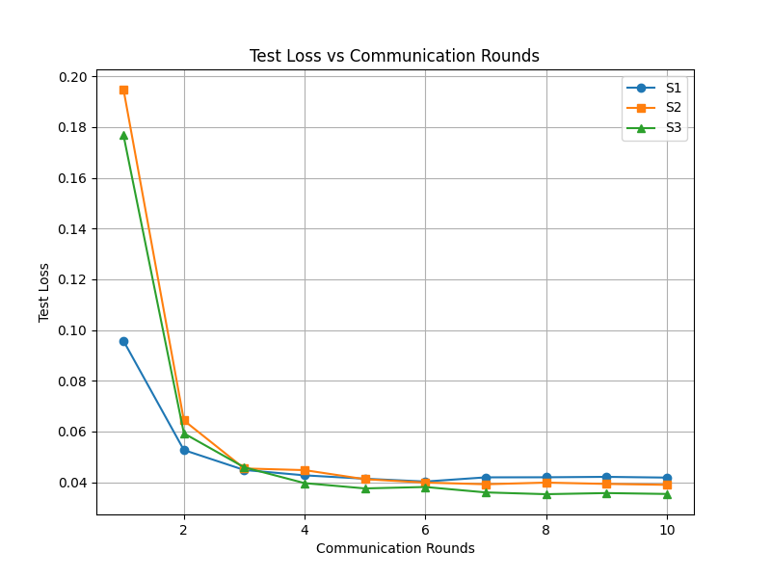
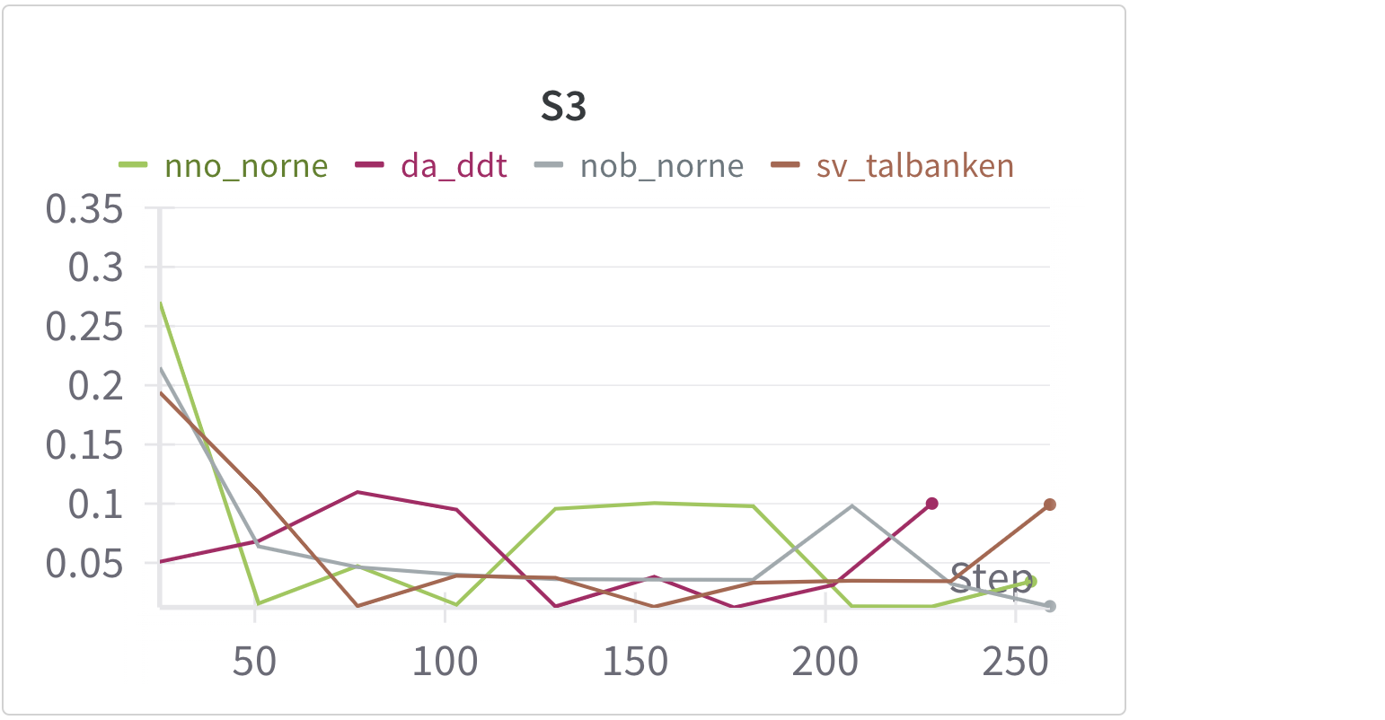
Results: Test loss aggregated (left) and per dataset (right)
Notes:
Kätriin

Slide 28
Discussion
In 3 cases out of 4, the best F1-score was achieved in a federated setup
Federated learning seems more beneficial for small datasets than for large ones
Results are sensitive to dataset composition
Competition between datasets
Communication issues when sending model parameters back and forth
Limitations
Used one small model
Only tried one federated setup
Notes:
Kätriin
For smaller datasets, federated learning helps improve model performance.
Vice versa for bigger datasets (Norwegian)
Results are sensitive to dataset composition.
After some training steps, there seems to be a “competition” between datasets, S3 is potentially a good example for this (nno_norne vs da_ddt) despite smooth aggregated convergence
Wider implications: Federated learning is useful for situations with small datasets. Similarity between datasets is also important to consider. However, insights are limited to one small model and one federated setup.
Communication is a big weakness of FL, especially for NLP which comes with quite big models.

Slide 29
What’s Next?
⛄️🇩🇰
NER
🤶🏼🇳🇴
🎅🏻🇸🇪
Notes:
Jennifer https://github.com/scaleoutsystems/fedn/tree/master/examples/flower-client

Slide 30
What’s Next?
⛄️🇩🇰
NER
🤶🏼🇳🇴
Investigate different aggregation strategies and possibility of using federated learning to enhance performance on rare language datasets
Scale up experiments further and investigate federated performance using a large number of clients in a truly federated setting
Explore integration with FEDn
🎅🏻🇸🇪
Notes:
Jennifer https://github.com/scaleoutsystems/fedn/tree/master/examples/flower-client

Slide 31
What’s Next?
⛄️🇩🇰
NER
🤶🏼🇳🇴
Investigate different aggregation strategies and possibility of using federated learning to enhance performance on rare language datasets
Scale up experiments further and investigate federated performance using a large number of clients in a truly federated setting
Explore integration with FEDn
🎅🏻🇸🇪
Notes:
Jennifer https://github.com/scaleoutsystems/fedn/tree/master/examples/flower-client

Slide 32
Thank you for listening!
Notes:
Jennifer

