Slide 1
Kar Global Sales Analysis
Presented by Group 2:
Sam Gilmore, Tim Marlett, Katie Schuman, & Chris Waycott

Slide 2
Why we chose this data set
Data set
Randomized from Kar Global—Sam’s former employer
Used with permission
Dealer to dealer consignment space—differs from standard sales organizations
Equal sale distribution across region not expected
Corporate/International Region only conducts sales, not buys

Slide 3
Questions asked
Questions
Which regions have the highest and lowest conversion rates?
How does conversion rate correlate with number of units sold?
How many bids does it take to sell a car?
Why we asked them
Wanted to use real-world data to identify trends for use in decision-making
These data were in fact used to determine who returned from furlough

Slide 4
Summary of findings
Overall
Data analysis matched hypothesis
Regional differences and territory hotspots were evident
Positive correlations
Number of cars sold and number of cars listed
Number of cars sold and conversion rate
Question 1:
East has the highest conversion rate and Corporate/International has the lowest
West is the lowest standard region (honorable mention)
Question 2:
Conversion rate and number of units sold is a positive correlation
Question 3:
It takes approximately 9.41 bidders to sell a car

Slide 5
Data analysis and cleanup
Feat. Jupyter notebook #1

Slide 6
Analysis process
Feat. Jupyter notebook #2

Slide 7
Summary of conclusions & implications

Slide 8
Which region has the highest and lowest conversion rates?
Question one

Slide 9
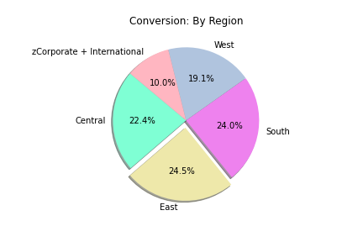
Conversion rate conclusions
East has the highest conversion rate
Corporate/International has the lowest
West is the lowest standard region
Why it matters
Higher conversion indicates higher buyer engagement

Slide 10
How does conversion rate correlate with number of units sold?
Question two

Slide 11
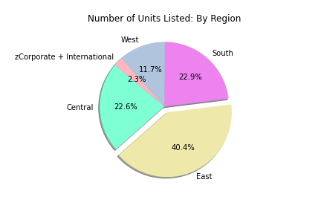
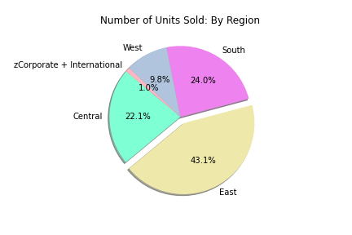
Units sold and listed per region
Units Listed
Units sold

Slide 12
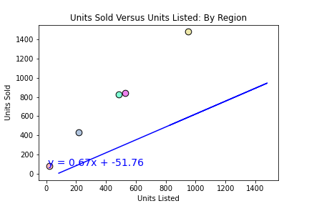
Units sold versus units listed
Positive Correlation
As units listed go up, so do units sold
Conversion is calculated from these data
Calculated by taking units listed and divided by units sold

Slide 13
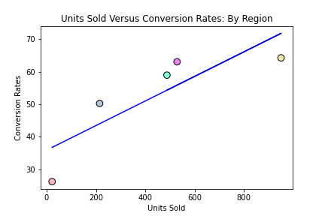
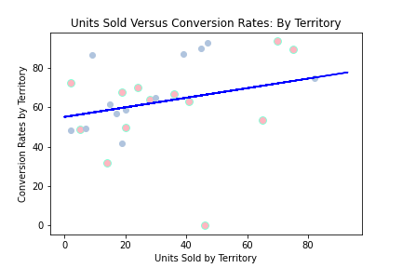
Units sold versus conversion rates
Across regions
Across territories

Slide 14
how many bidders does it take to sell a car?
Question three

Slide 15
context
Auction format
Any number of dealers can bid on a car but the car can only sell once
20,753 bidders
2,205 cars sold
Therefore it takes, on average, 9.41 bidders to sell a car

Slide 16
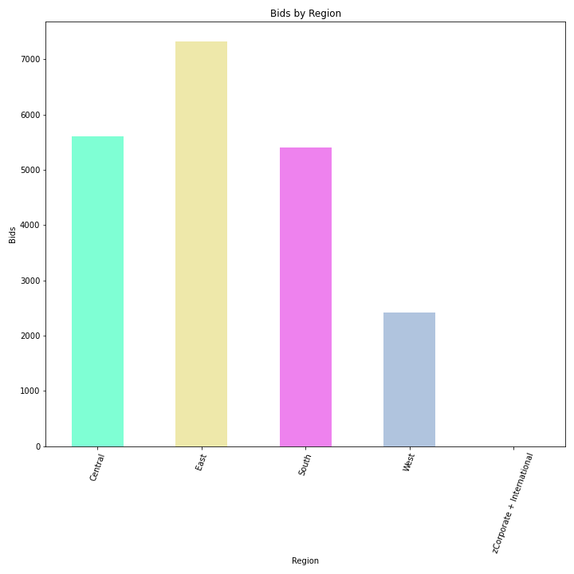
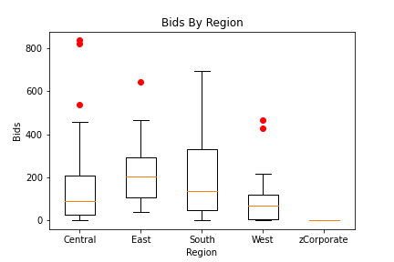
number of bids per region
Considering Hot Spots

Slide 17
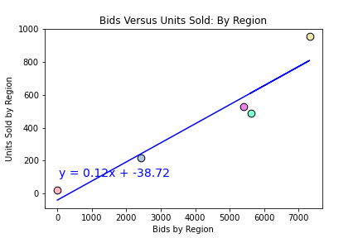
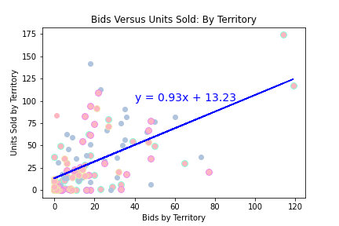
number of bids
More bids equals higher chance to sell
Average total bids per region
Overall: 171.51
Central: 170.03
East: 215.29
South: 200.07
West: 93.04
Corporate/International: 1
Why it matters
Generating interest means a higher chance of a sale

