Slide 1
IP PBX Solution
Tiziano Martorelli
Vonage Challenge

Slide 2
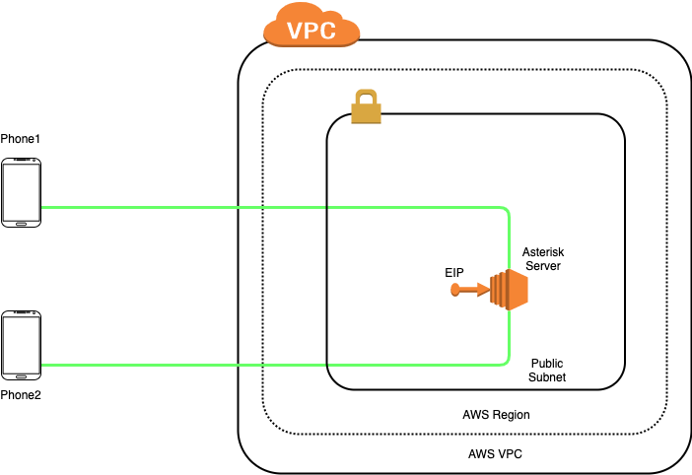
AWS Infrastructure
Ec2 instance
AMI Build in Packer
Elastic IP

Slide 3
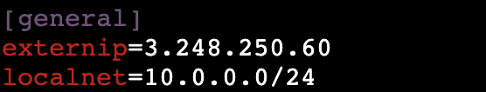
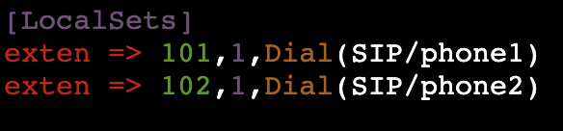
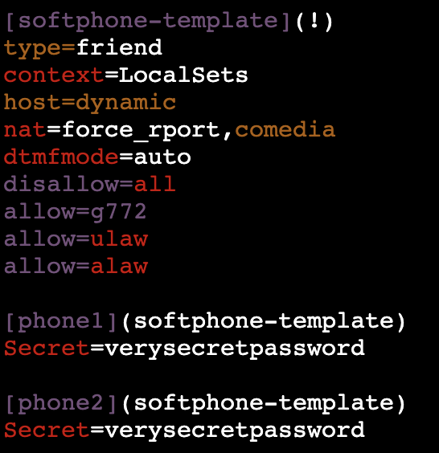
Asterisk Server Configuration
/etc/asterisk/sip.conf
/etc/asterisk/extension.conf
Configuration required to bypass
NAT issues
Calls Routing
Softphones template and phone configuration

Slide 4
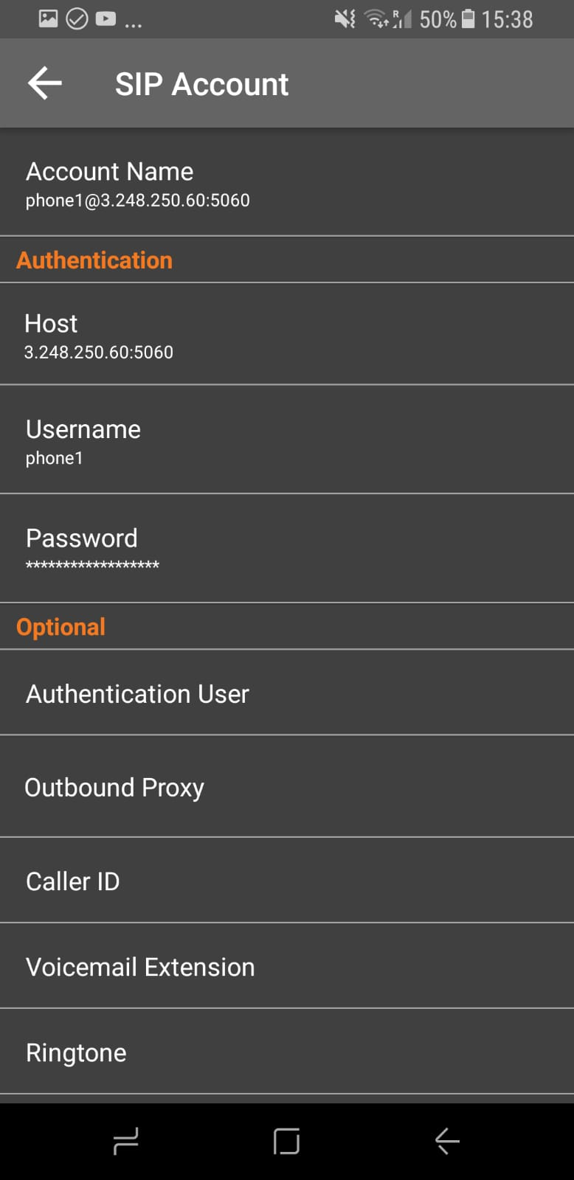
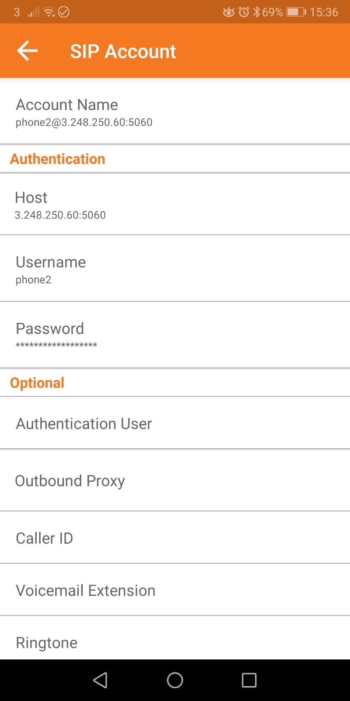
Softphones - Configuration
Phone1
Phone2

Slide 5
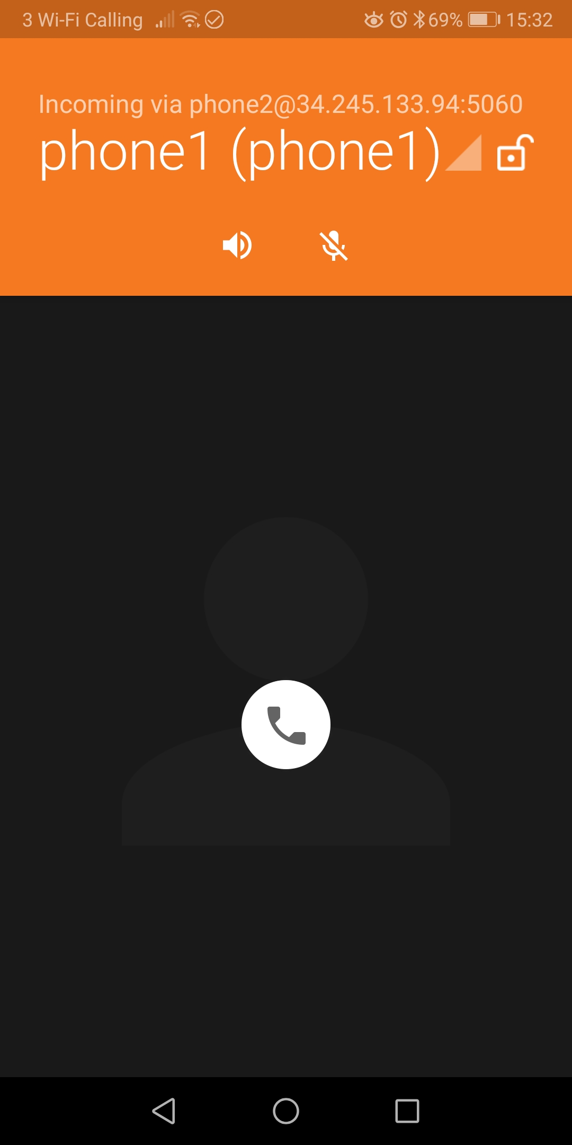
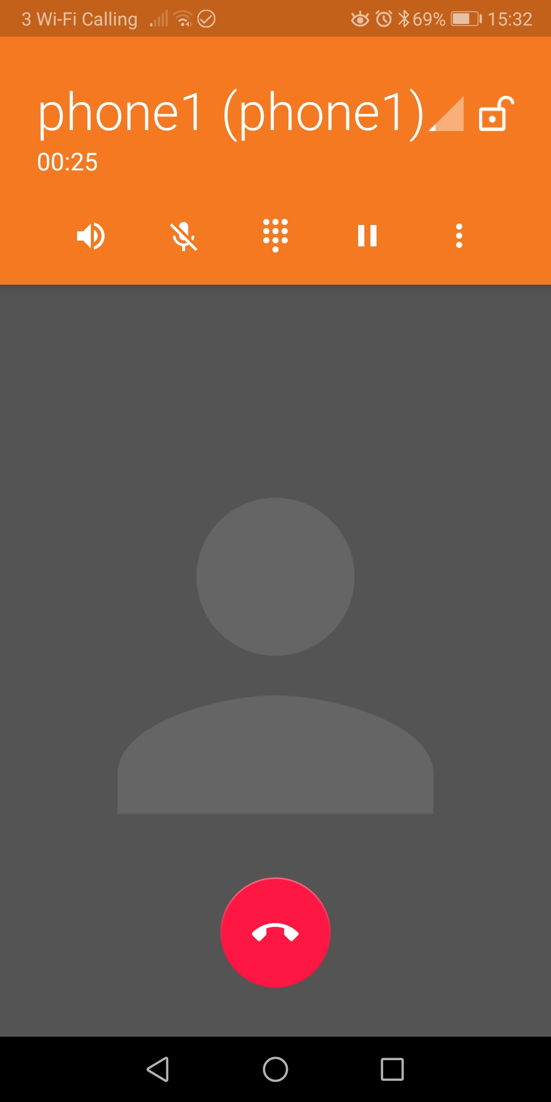

Softphone - Call
Ringing
Call Established

Slide 6
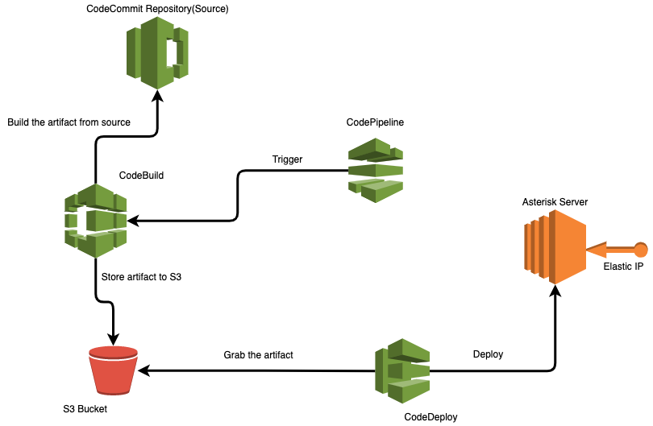
Asterisk - Automated Deployment Solution
(Possible solution)
Asterisk’s configuration folder is stored in CodeRepository.
Changes affecting any config file trigger CodePipeline’s pipeline.
The pipeline starts a new build through CodeBuild and generates an artifact that is stored in an S3 bucket.
CodeDeploy then deploys the changes on the EC2.

Slide 7
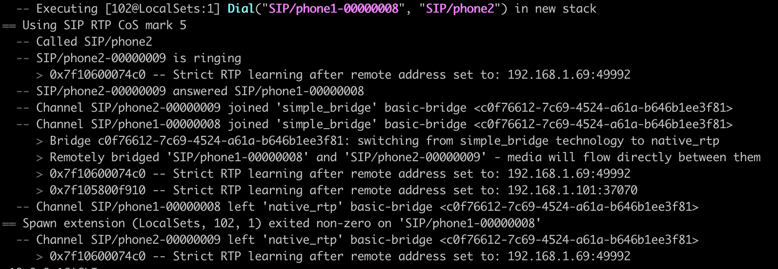
Asterisk - SIP Call Log

Slide 8
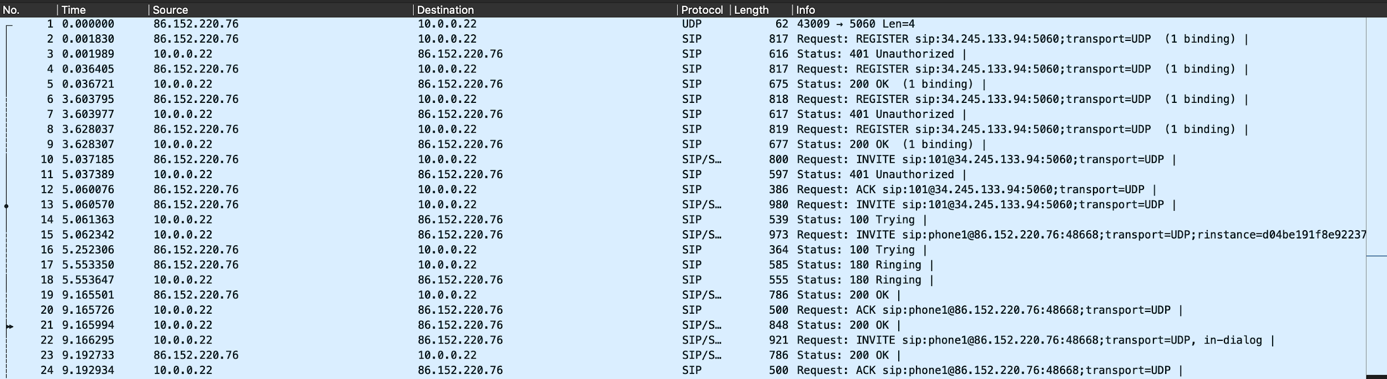
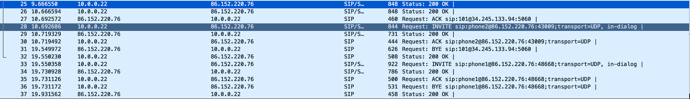
Wireshark Packets Capture
Devices registrations (REGISTER)
Call establishment (INVITE)
Call termination (BYE)

Slide 9
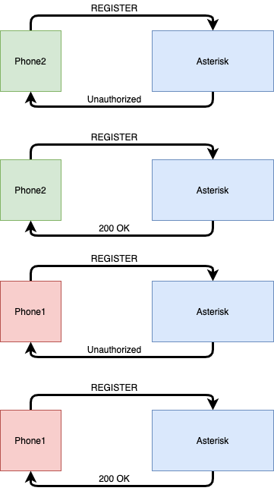
Wireshark - Packets Analysis
Successful new registraion

Slide 10
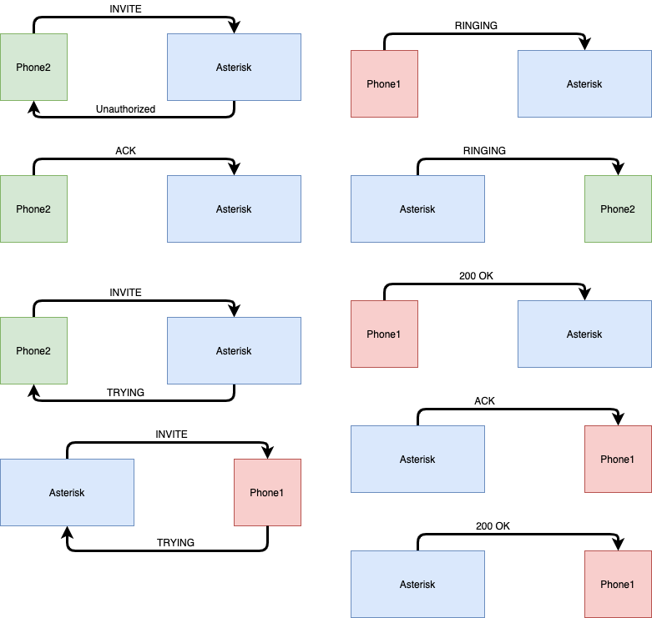
Wireshark - Packets Analysis
Ringing and call establishment

Slide 11
Security and Improvements
Firewall / Security Groups
Extensions
Administration
Other tools

Slide 12
Security and Improvements - Firewall/SG
Open inbound rules only for necessary services.
Port 22 for SSH (Restricted only for management IPs)
5060 UDP ( SIP Registration)
10000 to 20000 (RTP - Media Transport) only if RTP traffic goes through the server. This doesn’t happen in this configuration.

Slide 13
Security and Improvements - Extensions
Restrict the IP address ranges from which SIP clients are allowed to connect.
If this is deployed in an office, restrict connections to port 5060 to IP addresses within the locations where the phones are located.
If you must accept connections from internet addresses not within your control, consider blocking country-specific IP address ranges.
Set allowguest=no in sip.conf to prevent unauthenticated clients from making calls.
Set alwaysauthreject=yes in sip.conf to prevents attackers
from being able to determine if a SIP Extension exist via
brute force.

Slide 14
Security and Improvements - Administration
Set bindaddr=127.0.0.1 in manager.conf to ensure that the Asterisk management interface is not open to the world and try to use strong passwords for UNIX users, databases and administrative front-ends.

Slide 15
Security and Improvements - Other tools
If Asterisk is exposed to the internet, you may experience bruteforce attacks. This often occurs at high rate and may impair the Asterisk service and/or the instance.
A useful tool to avoid this kind of issues is Fail2ban.
Fail2ban scans log files and bans IPs by dynamically setting iptables rules to reject traffic for a specific amount of time.

Slide 16
Challenges
Nat issues: During the tests i was continuously building and destroying instances. After the first time i was only receiving audio on one caller. The problem was caused by a wrong IP set for the externip SIP setting.
Bruteforce attacks: Malicious users discovered my Asterisk server and started try random SIP extensions to get access to a user and make calls. The attempts were so frequent that the server stopped working properly. Fixed by adding an iptables rejecting rule.
Catalina issues: For some reason using the softphones on two macbook laptops i experienced that no audio was coming through the call. I suspect this is due to Catalina’s security settings. I used two phones.

