Slide 1
Test Case
By Thomas

Slide 2
Basic slide with text:
Hi, my name is Thomas and I am writing a test case! It has multiple sentences. If this text ends up where it is supposed to be, I will know that my code works. Yay! ^D^

Slide 3
Bullet points:
C++
How to read a file
Object-oriented programming

Slide 4
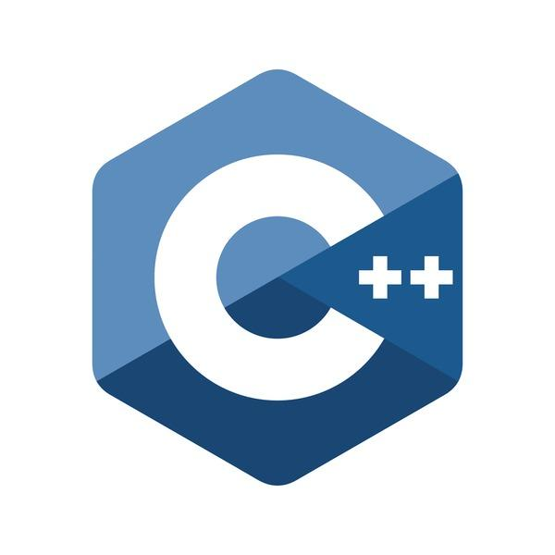
Slide with Image:
This is the C++ logo. Wowzers!

