Slide 1
Radiant Rhapsody Palette Agency Infographics.
Here is where this template begins

Slide 2
About radiant rhapsody palette agency infographics
This template contains an assortment of complementary infographic resources for the Radiant Rhapsody Palette Agency presentation
These infographics are adapted to the style of the aforementioned presentation, so you can insert them easily and have them completely integrated at once. You just need to do the following:
Select the element that you want to copy
Right-click and choose “Copy”
Go to the slide where you want the element to appear
Right-click and choose “Paste”

Slide 3
Radiant rhapsody palette infographics
Day 2
Day 4
Venus is the second planet from the Sun
Jupiter is the biggest planet of them all
Day 1
Day 3
Saturn is composed of hydrogen and helium
Jupiter is the biggest planet of them all

Slide 4
Radiant rhapsody palette infographics
 | Key action 1 | Key action 2 | Key action 3
1st quarter | Despite being red, Mars is a cold planet | Mercury is the smallest planet of them all | Jupiter is the biggest planet of them all
2nd quarter | Saturn is the only planet with rings | Neptune is very far from the Sun | Mercury is very close to the Sun
3rd quarter | Pluto is very far from the Sun | Saturn is composed of hydrogen and helium | Earth is known as the Blue Planet

Slide 5
Radiant rhapsody palette infographics
Market positioning strategies
Venus
Venus is the second planet from the Sun
01
03
02
Saturn
Jupiter
Saturn is composed of hydrogen and helium
Jupiter is the biggest planet of them all

Slide 6
Radiant rhapsody palette infographics
Jupiter
Neptune
Mercury
Mars
Jupiter is the biggest planet of them all
Neptune is very far from the Sun
Mercury is smallest planet of them all
Despite being red, Mars is a cold place

Slide 7
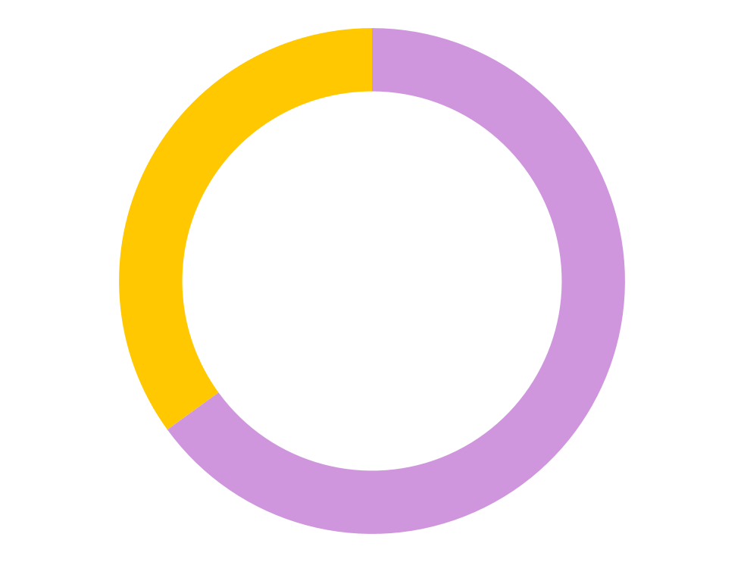
Radiant rhapsody palette infographics
Most requested products
35%
65%
Digital products
Press products
Neptune is the farthest planet from the Sun and the fourth-largest one
Venus has a beautiful name and is the second planet from the Sun
Follow the link in the graph to modify its data and then paste the new one here. For more info, click here

Slide 8
Radiant rhapsody palette infographics
 | Jan | Feb | Mar | Apr | May | Jun | Jul | Aug | Sep | Oct | Nov | Dec
Mercury
Venus
Mars
Jupiter
Saturn
Neptune
Earth

Slide 9
Radiant rhapsody palette infographics
01
Jupiter
Jupiter is the biggest planet of them all
Strategy 1
02
Neptune
Neptune is very far from the Sun
Objective
03
Mercury
Mercury is smallest planet of them all
Strategy 2
04
Venus
Venus is the second planet from the Sun

Slide 10
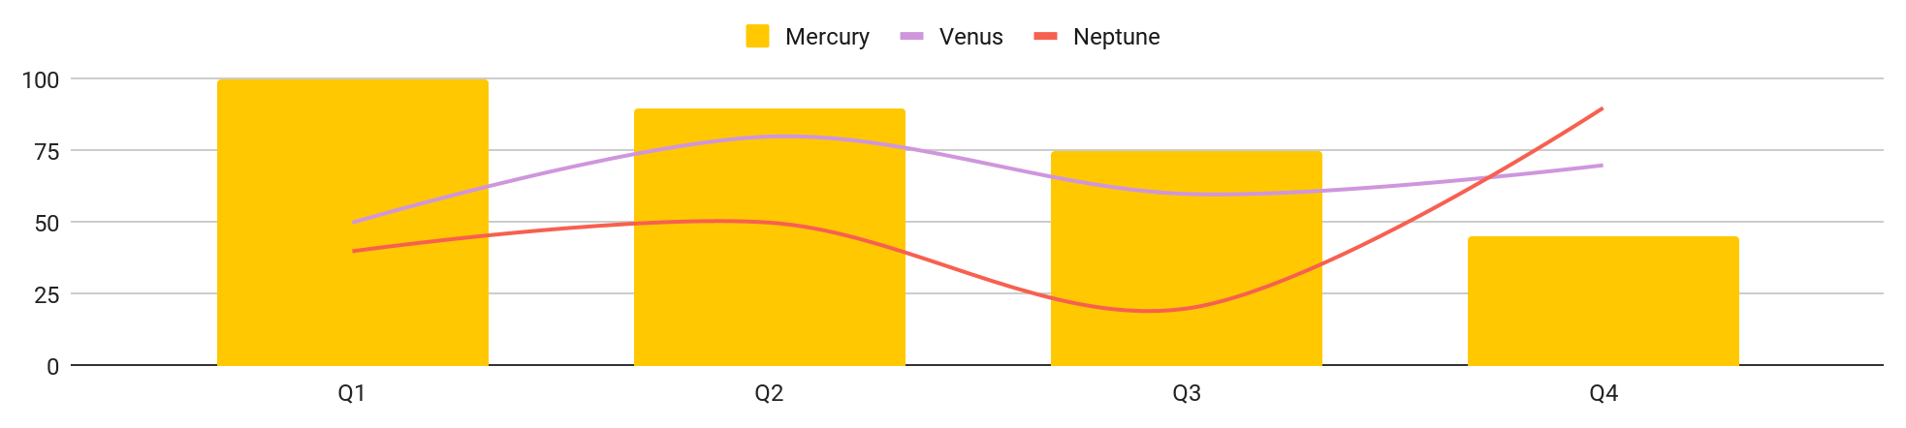
Radiant rhapsody palette infographics
Services ranking
Q1
Q2
Q3
Q4
Mercury is the closest planet to the Sun
Earth is the third planet from the Sun
Jupiter is the biggest planet of them all
Mars is actually a very cold place
Follow the link in the graph to modify its data and then paste the new one here. For more info, click here

Slide 11
Radiant rhapsody palette infographics
Basic
Standard
Advanced
Venus has a beautiful name and is the second planet from the Sun in the Solar System
Mercury is the closest planet to the Sun and it’s the smallest of them all
Despite being red, Mars is actually a cold place. It’s full of iron oxide dust
30%
50%
70%

Slide 12
Radiant rhapsody palette infographics
Deadline | Project | Description | Stage
5/1/2022 | Project 1 | Jupiter is the biggest planet of them all | Completed
5/1/2022 | Project 2 | Venus is the second planet from the Sun | Cancelled
5/1/2022 | Project 3 | Neptune is very far away from Earth | Completed
5/1/2022 | Project 4 | Despite being red, Mars is a cold place | In progress
5/1/2022 | Project 5 | Saturn is a gas giant and has several rings | In progress

Slide 13
Radiant rhapsody palette infographics
Mars
Earth
Mars is actually a cold place
Earth is where we live on
Services and products
Jupiter
Mercury
Jupiter is the biggest planet
Mercury is the smallest planet
Saturn
Venus
Saturn is a gas giant planet
Venus has a beautiful name

Slide 14
Radiant rhapsody palette infographics
Case studies
75%
85%
95%
Evidence
Population
Research
Neptune is the farthest planet from the Sun and the fourth-largest
Mercury is the closest planet to the Sun and it’s the smallest one
Venus has a beautiful name and is the second planet from the Sun

Slide 15
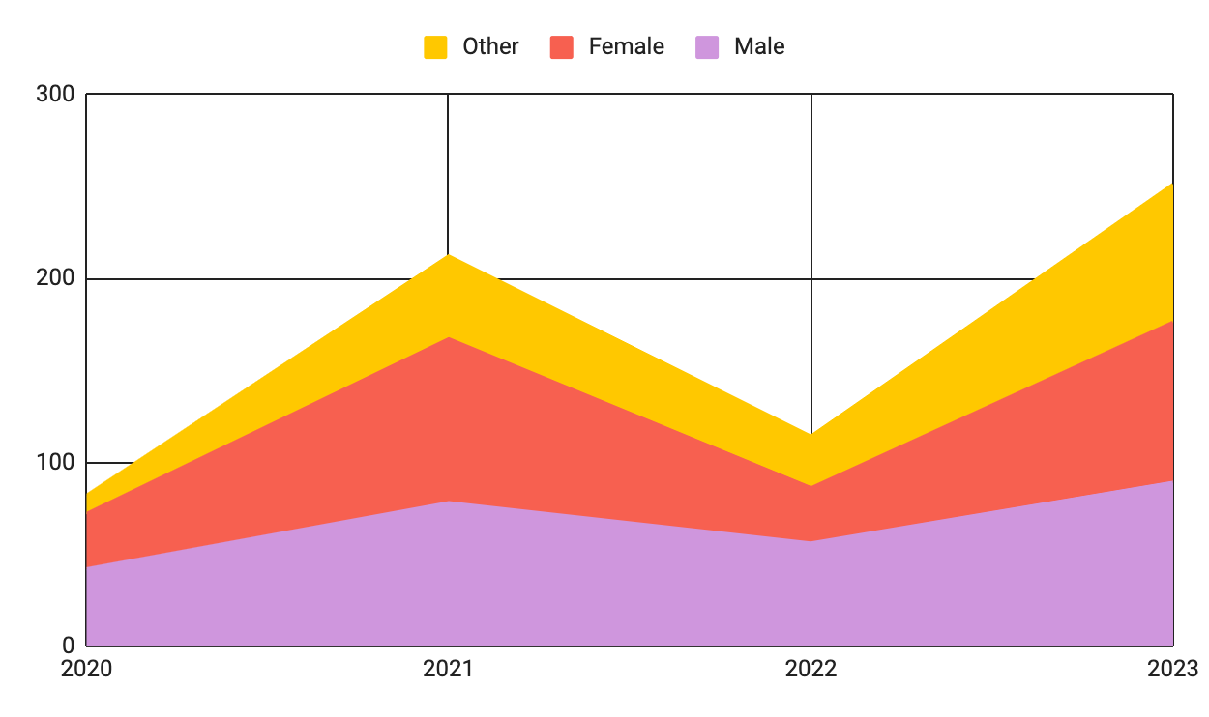
Radiant rhapsody palette infographics
Users
2019
2021
Mercury is the smallest planet
Mars is actually a cold place
2020
2022
Venus has a beautiful name
Jupiter is the biggest planet
Follow the link in the graph to modify its data and then paste the new one here. For more info, click here

Slide 16
Radiant rhapsody palette infographics
Steps |  | Week 1 | Week 2 | Week 3 | Week 4 | Week 5 | Week 6
1 | Task description
2 | Task description
3 | Task description
4 | Task description
5 | Task description
6 | Task description
7 | Task description

Slide 17
Radiant rhapsody palette infographics
About our projects
Mercury
Mars
Mercury is the smallest planet
Mars is actually a cold place
Venus
Jupiter
Venus has a beautiful name
Jupiter is the biggest planet

Slide 18
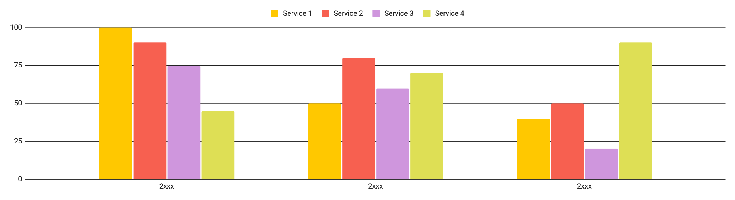
Radiant rhapsody palette infographics
Our numbers
2xxx
2xxx
2xxx
Mercury is the closest planet to the Sun
Earth is the third planet from the Sun
Jupiter is the biggest planet of them all
Follow the link in the graph to modify its data and then paste the new one here. For more info, click here

Slide 19
Radiant rhapsody palette infographics
60%
50%
40%
20%
Service 1
Service 2
Service 3
Service 4
Saturn is a gas giant and has several rings
Jupiter is a gas giant and the biggest planet
Neptune is the farthest planet from the Sun
Mercury is the closest planet to the Sun

Slide 20
Radiant rhapsody palette infographics
Study | Date | Target | Age | Country
Earth | 04/01/20XX | Venus | 18-35 | Earth
Saturn | 04/03/20XX | Mars | 35-45 | Mars
Venus | 05/04/20XX | Venus | 45-50 | Mercury
Mars | 06/05/20XX | Neptune | 50-60 | Venus
Jupiter | 07/06/20XX | Jupiter | 60-90 | Neptune

Slide 21
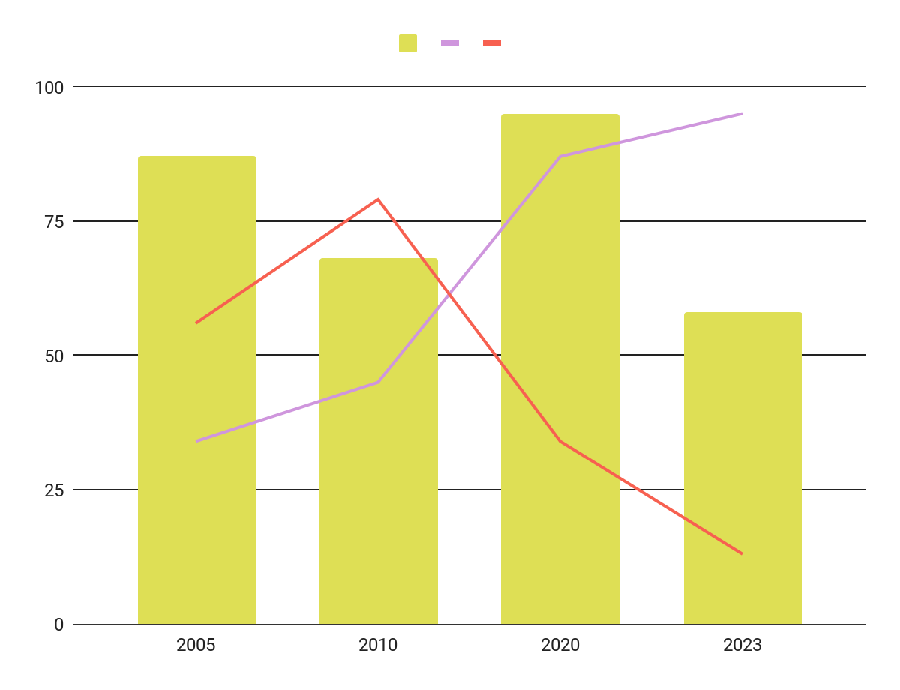
Radiant rhapsody palette infographics
Mercury
Mercury is the closest planet to the Sun and it’s the smallest one
Neptune
Neptune is the farthest planet from the Sun and the fourth-largest one
Venus
Venus has a beautiful name and is the second planet from the Sun
Follow the link in the graph to modify its data and then paste the new one here. For more info, click here

Slide 22
Radiant rhapsody palette infographics
19xx
19xx
20xx
20xx
Jupiter
Neptune
Mercury
Mars
Jupiter is the biggest planet of them all
Neptune is very far from the Sun
Mercury is smallest planet of them all
Despite being red, Mars is a cold place

Slide 23
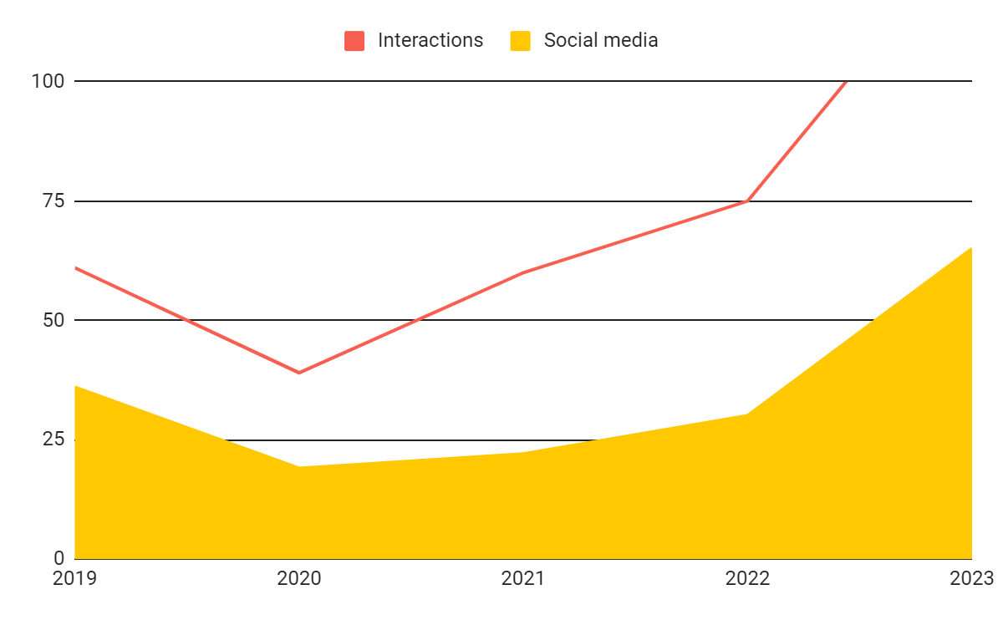
Radiant rhapsody palette infographics
Mercury
Mercury is the closest planet to the Sun and it’s the smallest one
Neptune
Neptune is the farthest planet from the Sun and the fourth-largest
Follow the link in the graph to modify its data and then paste the new one here. For more info, click here

Slide 24
Radiant rhapsody palette infographics
25%
32%
53%
Mercury
Jupiter
Saturn
Mercury is the closest planet to the Sun
Jupiter is the biggest planet in the Solar System
Saturn is a gas giant and has several rings

Slide 25
Radiant rhapsody palette infographics
Mercury the closest planet to the Sun
Step 01
Step 02
Neptune is the farthest planet from the Sun
Mars is actually a very cold place
Step 03
Step 04
Jupiter is the biggest planet of them all

Slide 26
Radiant rhapsody palette infographics
Venus
Venus has a beautiful name and is the second planet from the Sun
Neptune
Mercury
Neptune is the farthest planet from the Sun and the fourth-largest
Mercury is the closest planet to the Sun and it’s the smallest one
Strategy

Slide 27
Radiant rhapsody palette infographics
Strengths
S
Saturn is composed mostly of hydrogen and helium
Weaknesses
W
Venus is the second planet from the Sun
Opportunities
O
Jupiter is the biggest planet of them all in the Solar System
Threats
T
Despite being red, Mars is actually a very cold place

Slide 28
Radiant rhapsody palette infographics
01
Initiation
Venus has a beautiful name and is the second planet from the Sun
02
Planning
Mercury is the closest planet to the Sun and the smallest one
Project process
03
Execution
Despite being red, Mars is a cold place. It’s full of iron oxide dust
04
Closing
Neptune is the farthest planet from the Sun

Slide 29
Radiant rhapsody palette infographics
Mercury
90%
Mercury is the closest planet to the Sun and it’s the smallest one
Neptune
75%
Neptune is the farthest planet from the Sun and the fourth-largest one
Venus
45%
Venus has a beautiful name and is the second planet from the Sun

Slide 30
Radiant rhapsody palette infographics
Campaign strategy
Strategy 1
Strategy 2
Strategy 3
Neptune is the farthest planet from the Sun
Jupiter is a gas giant and the biggest planet
Mercury is the closest planet to the Sun

Slide 31
Radiant rhapsody palette infographics
Our packs
Basic | Pro | Premium
You can explain your product or your service | You can explain your product or your service | You can explain your product or your service
$10 | $20 | $40

Slide 32
Radiant rhapsody palette infographics
Service
01
Venus has a nice name and is the second planet from the Sun
Neptune
Neptune is the farthest planet from the Sun and the fourth-largest one
Service
02
Mercury is the closest planet to the Sun and the smallest one
Service
03
Despite being red, Mars is a cold place. It’s full of iron oxide dust

Slide 33
Instructions for use
If you have a free account, in order to use this template, you must credit Slidesgo in your final presentation. Please refer to the next slide to read the instructions for premium users.
As a Free user, you are allowed to:
- Modify this template.
- Use it for both personal and commercial projects.
You are not allowed to:
- Sublicense, sell or rent any of Slidesgo Content (or a modified version of Slidesgo Content).
- Distribute Slidesgo Content unless it has been expressly authorized by Slidesgo.
- Include Slidesgo Content in an online or offline database or file.
- Offer Slidesgo templates (or modified versions of Slidesgo templates) for download.
- Acquire the copyright of Slidesgo Content.
For more information about editing slides, please read our FAQs or visit our blog:
https://slidesgo.com/faqs and https://slidesgo.com/slidesgo-school

Slide 34
Instructions for use (premium users)
As a Premium user, you can use this template without attributing Slidesgo.
You are allowed to:
Modify this template.
Use it for both personal and commercial purposes.
Share this template in an editable format with people who are not part of your team.
You are not allowed to:
Sublicense, sell or rent this Slidesgo Template (or a modified version of this Slidesgo Template).
Distribute this Slidesgo Template (or a modified version of this Slidesgo Template) or include it in a database or in any other product or service that offers downloadable images, icons or presentations that may be subject to distribution or resale.
Use any of the elements that are part of this Slidesgo Template in an isolated and separated way from this Template.
Register any of the elements that are part of this template as a trademark or logo, or register it as a work in an intellectual property registry or similar.
For more information about editing slides, please read our FAQs or visit our blog:
https://slidesgo.com/faqs and https://slidesgo.com/slidesgo-school

Slide 35
Infographics
You can add and edit some infographics to your presentation to present your data in a visual way.
Choose your favourite infographic and insert it in your presentation using Ctrl C + Ctrl V or Cmd C + Cmd V in Mac.
Select one of the parts and ungroup it by right-clicking and choosing “Ungroup”.
Change the color by clicking on the paint bucket.
Then resize the element by clicking and dragging one of the square-shaped points of its bounding box (the cursor should look like a double-headed arrow). Remember to hold Shift while dragging to keep the proportions.
Group the elements again by selecting them, right-clicking and choosing “Group”.
Repeat the steps above with the other parts and when you’re done editing, copy the end result and paste it into your presentation.
Remember to choose the “Keep source formatting” option so that it keeps the design. For more info, please visit our blog.

