Slide 1
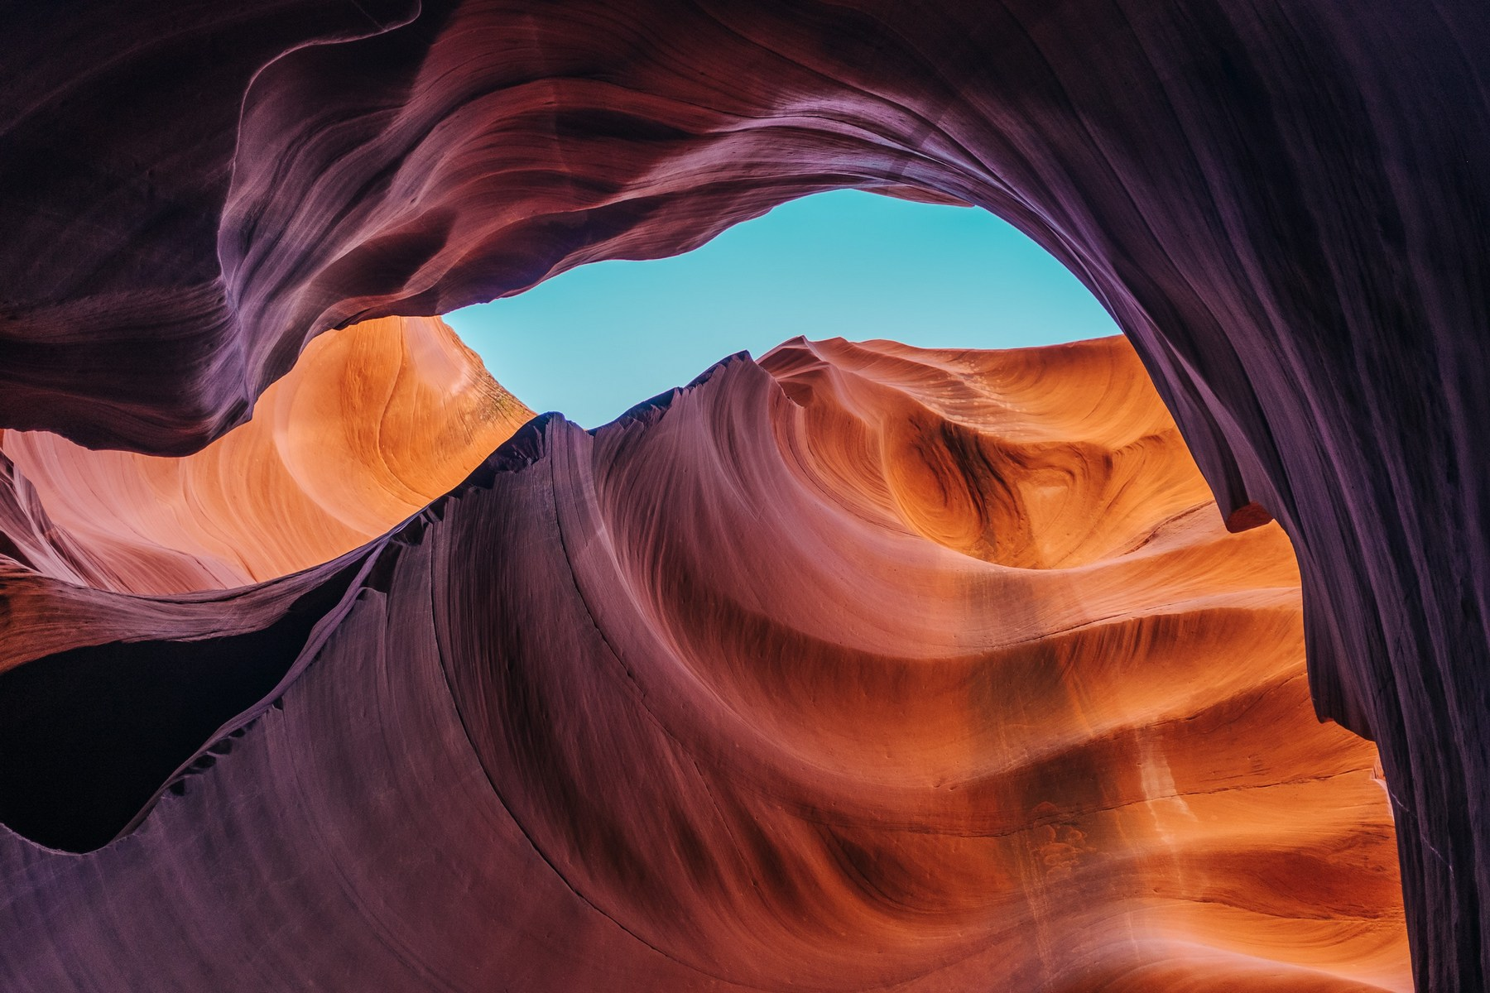
Workout for Kids Infographics
Here is where this template begins

Slide 2
About workout for kids infographics
This template contains an assortment of complementary infographic resources for the Workout for kids presentation
These infographics are adapted to the style of the aforementioned presentation, so you can insert them easily and have them completely integrated at once. You just need to do the following:
Select the element that you want to copy
Right-click and choose “Copy”
Go to the slide where you want the element to appear
Right-click and choose “Paste”

Slide 3
Workout for kids infographics
Month, 20XX - Main exercises
Week 1 | Earth is the third planet from the Sun
Week 2 | Jupiter doesn’t have a solid surface
Week 3 | Mercury is quite a small planet
Week 4 | Mars is actually a very cold place

Slide 4
Workout for kids infographics
45%
Saturn is the planet with rings
Routine A
60%
Venus has a beautiful name
Routine B
80%
Mars is actually a cold place
Routine C

Slide 5
Workout for kids infographics
Workout benefits
Muscles
Joints
Mars is actually a very cold place
Venus has a beautiful name
Stability
Strength
Saturn is the planet with rings
Jupiter is a huge gas giant

Slide 6
Workout for kids infographics
Weekly plan
Mon | Tue | Wed | Thu | Fri
8 am / 9 am | 9 am / 10 am | 8 am / 9 am | 9 am / 10 am | 8 am / 9 am
Jump | Run | Stretch | Hop | Dance
Jupiter Venus | Moon Saturn | Mercury Neptune | Earth Jupiter | Sun Ceres

Slide 7
Workout for kids infographics
Exercise 2
Exercise 4
Exercise 6
Saturn is a planet that has many rings
Pluto is considered a dwarf planet
Despite being red, Mars is a cold place
20%
50%
75%
35%
60%
90%
Exercise 1
Exercise 3
Exercise 5
Neptune is very far from the Sun
Venus is the second planet from the Sun
Earth is the third planet from the Sun

Slide 8
Workout for kids infographics
Main steps for practicing yoga
Breathing
Mercury is the closest planet to the Sun and the smallest of them all
Warm up
Venus has a beautiful name and is the second planet from the Sun
Cool down
Earth is the third planet from the Sun and the only one that harbors life
Meditation
Despite being red, Mars is a cold place. It’s full of iron oxide dust

Slide 9
Workout for kids infographics
Training plan
Phases | Oct | Nov | Dec | Jan | Feb
1
2
3
4

Slide 10
Workout for kids infographics
15’
25’
35’
45’
300 cal.
550 cal.
700 cal.
900 cal.
Exercise 1
Exercise 2
Exercise 3
Exercise 4
Earth is the place on which we live
Mars is actually a very cold place
Mercury is quite a small planet
Saturn is a gas giant and has rings

Slide 11
Workout for kids infographics
Step 04
Stretch
Run
Saturn is a planet that has rings
Earth is the place on which we live
Step 03
Step 02
Jump
Walk
Venus has a beautiful name
Mars is actually a very cold place
Step 01

Slide 12
Workout for kids infographics
Training in groups
Group 1
Group 2
Group 3
Group 4
swimming
Hopping
Skipping
Dancing
Jupiter is the biggest planet of them all
Saturn is a gas giant and has several rings
Earth is the only planet known to harbor life
Mars is a cold place full of iron oxide dust

Slide 13
Workout for kids infographics
Limbering benefits
Flexing benefits
Jupiter doesn’t have a solid surface
Earth is the place on which we live
Neptune is very far from the Sun
Mercury is a very small planet
Mars is actually a cold place
Saturn is a planet that has rings
Ceres is considered a dwarf planet
Neptune is one of the ice giants
45%
55%

Slide 14
Workout for kids infographics
Day 1
Day 2
Day 3
Saturn has many rings
Pluto is a dwarf planet
We all live on Earth
Earth is our home
Venus is a hot planet
Mars is made of basalt
Jupiter is a huge giant
Neptune is an ice giant
Jupiter is a big planet
Mars is a cold planet
Saturn is a gas giant
Mercury is very small

Slide 15
Workout for kids infographics
Group activity
Mercury is very small
Routine A
Venus is a hot planet
Saturn has many rings
Routine B
Mars is a red planet
Pluto is a dwarf planet
Earth is the planet with life
Routine C
Jupiter is a gas giant

Slide 16
Workout for kids infographics
Completed exercises
Routine A
Routine B
Routine C
3/5
2/5
4/5
Neptune is the farthest planet from the Sun
Mercury is the closest planet to the Sun
Despite being red, Mars is actually a very cold place

Slide 17
Workout for kids infographics
Warm up
Training
Venus is the second planet from the Sun
Earth is the place on which we all live
Saturn is a gas giant and has several rings
Mercury is the closest planet to the Sun
Hydration
Nutrition

Slide 18
Workout for kids infographics
Stretch
Saturn is a gas giant and has several rings
Breathe
Venus is the second planet from the Sun
Pace
Key steps to train
Despite being red, Mars is a cold planet
Focus
Jupiter doesn’t have a solid surface
Rest
Earth is the only planet that harbors life

Slide 19
Workout for kids infographics
Some useful concepts
Warm-up | Low-intensity physical activity to prepare the body
Stretch | To lengthen and elongate muscles and improve flexibility
Hydrate | To consume fluids to maintain proper body hydration
Pace | Speed and intensity at which exercises are performed
Rest | Allowing the body adequate time to recover and repair

Slide 20
Workout for kids infographics
Bike
Jupiter is the biggest planet of them all
Dance
Saturn was named after a Roman god
After school!
Jump
Mercury is the closest planet to the Sun
Swim
Venus is the second planet from the Sun

Slide 21
Workout for kids infographics
Most used tips to train
75%
Patience
Saturn is a gas giant and has several rings
50%
Consistency
Earth is the only planet that harbors life
70%
Safety
Mars is a cold place. It’s full of iron oxide dust
90%
Positivity
Jupiter is the biggest planet of them all

Slide 22
Workout for kids infographics
Group 1
Routine
Group 2
Completed
Saturn is a planet that has rings
In progress
In progress
Jupiter is the biggest planet of them all
Completed
Completed
Despite being red, Mars is a cold place
In progress

Slide 23
Workout for kids infographics
Routine A
Routine B
Routine C
Crawling
Balancing
Hopping
Neptune is the fourth-largest planet in the Solar System
Jupiter is the fourth-brightest object in the night sky
Mercury is the closest planet to the Sun and the smallest of them all
Results | Results | Results
75/100 | 80/100 | 95/100

Slide 24
Workout for kids infographics
Supervision
Hydration
01
06
Mars is a cold place. It’s full of iron oxide dust
Mercury is the closest planet to the Sun
Warm up
Rest
02
05
Venus is the second planet from the Sun
Jupiter is the biggest planet of them all
Technique
Cool down
03
04
Earth is the only planet that harbors life
Saturn is composed of hydrogen and helium

Slide 25
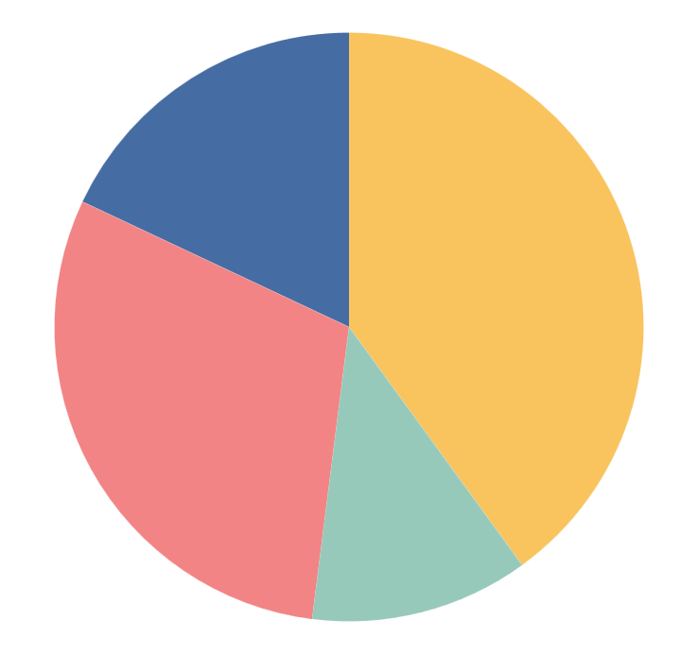
Workout for kids infographics
40%
30%
Group 1
Group 3
Jupiter is big
Neptune is far
Earth has life
Mars is very cold
12%
18%
Group 2
Group 4
Follow the link in the graph to modify its data and then paste the new one here. For more info, click here
Venus is hot
Mercury is small
The Sun is a star
Saturn has rings

Slide 26
Workout for kids infographics
Ceres is located in the main asteroid belt
Neptune is very far from the Sun
Pluto is considered a dwarf planet
Mercury is the closest planet to the Sun
The Moon is Earth’s only natural satellite
Earth is the place on which we live
For chest:
For biceps:
Despite being red, Mars is a cold place
Jupiter is the biggest planet of them all
Saturn is a gas giant and has several rings
The Sun is the closest star to our planet
Uranus is the seventh planet from the Sun
Venus is the second planet from the Sun
For back:
For calves:

Slide 27
Workout for kids infographics
Best moves for warming up:
Mars is a cold place. It’s full of iron oxide dust, which gives the planet its reddish cast
Earth is the third planet from the Sun and the only one that harbors life in the Solar System
Neptune is the farthest planet from the Sun and the fourth-largest in the Solar System

Slide 28
Workout for kids infographics
Team A
Team C
Mars is a very cold place
Venus has a beautiful name
Team B
Team D
We all live on planet Earth
Saturn has several rings
Team C
Team E
Neptune is very far from us
Mercury is very small planet

Slide 29
Workout for kids infographics
Mo | Tu | We | Th | Fr | Sa | Su
 |  |  |  |  |  | 1
2 | 3 | 4 | 5 | 6 | 7 | 8
9 | 10 | 11 | 12 | 13 | 14 | 15
16 | 17 | 18 | 19 | 20 | 21 | 22
23 | 24 | 25 | 26 | 27 | 28 | 29
30 | 31
Month:
October 20XX
Day:
Thursday 19th
08:00 | Mars is a very cold place
08:30 | Earth harbors life
09:00 | Saturn has several rings
09:30 | Jupiter is a huge planet

Slide 30
Workout for kids infographics
Progressive difficulty
Exercise 1
20%
Mars is actually a cold place
Exercise 2
30%
Saturn is a planet that has rings
Exercise 3
40%
Earth is the place on which we live
Exercise 4
50%
Pluto is considered a dwarf planet
Exercise 5
60%
Venus has a beautiful name

Slide 31
Workout for kids infographics
Routine A
Routine D
Pluto is considered a dwarf planet
25%
Jupiter is an enormous planet
60%
Routine B
Routine E
Venus is the second planet from the Sun
40%
Saturn is a planet that has rings
75%
Routine C
Routine F
Mars is actually a very cold place
55%
Earth is the place on which we live
95%

Slide 32
Workout for kids infographics
Final results | Routine A |  | Routine B
 | Test 1 | Test 2 | Test 1 | Test 2
Group 1 | Insert results | Insert results | Insert results | Insert results
Group 2 | Insert results | Insert results | Insert results | Insert results
Group 3 | Insert results | Insert results | Insert results | Insert results
Group 4 | Insert results | Insert results | Insert results | Insert results

Slide 33
Instructions for use
If you have a free account, in order to use this template, you must credit Slidesgo in your final presentation. Please refer to the next slide to read the instructions for premium users.
As a Free user, you are allowed to:
- Modify this template.
- Use it for both personal and commercial projects.
You are not allowed to:
- Sublicense, sell or rent any of Slidesgo Content (or a modified version of Slidesgo Content).
- Distribute Slidesgo Content unless it has been expressly authorized by Slidesgo.
- Include Slidesgo Content in an online or offline database or file.
- Offer Slidesgo templates (or modified versions of Slidesgo templates) for download.
- Acquire the copyright of Slidesgo Content.
For more information about editing slides, please read our FAQs or visit our blog:
https://slidesgo.com/faqs and https://slidesgo.com/slidesgo-school

Slide 34
Instructions for use (premium users)
As a Premium user, you can use this template without attributing Slidesgo.
You are allowed to:
Modify this template.
Use it for both personal and commercial purposes.
Share this template in an editable format with people who are not part of your team.
You are not allowed to:
Sublicense, sell or rent this Slidesgo Template (or a modified version of this Slidesgo Template).
Distribute this Slidesgo Template (or a modified version of this Slidesgo Template) or include it in a database or in any other product or service that offers downloadable images, icons or presentations that may be subject to distribution or resale.
Use any of the elements that are part of this Slidesgo Template in an isolated and separated way from this Template.
Register any of the elements that are part of this template as a trademark or logo, or register it as a work in an intellectual property registry or similar.
For more information about editing slides, please read our FAQs or visit our blog:
https://slidesgo.com/faqs and https://slidesgo.com/slidesgo-school

Slide 35
Infographics
You can add and edit some infographics to your presentation to present your data in a visual way.
Choose your favourite infographic and insert it in your presentation using Ctrl C + Ctrl V or Cmd C + Cmd V in Mac.
Select one of the parts and ungroup it by right-clicking and choosing “Ungroup”.
Change the color by clicking on the paint bucket.
Then resize the element by clicking and dragging one of the square-shaped points of its bounding box (the cursor should look like a double-headed arrow). Remember to hold Shift while dragging to keep the proportions.
Group the elements again by selecting them, right-clicking and choosing “Group”.
Repeat the steps above with the other parts and when you’re done editing, copy the end result and paste it into your presentation.
Remember to choose the “Keep source formatting” option so that it keeps the design. For more info, please visit our blog.

