Slide 1
Bank Marketing
Tahar Masmaliyev, Abdulla Akhundzada
Applied Machine Learning
March 10, 2026
Resampling · Model Selection · Classification · Regression
Dataset: UCI Bank Marketing
45,211 clients · 16 features
Target: Term Deposit Subscription
Moro et al. (2011) · EUROSIS

Slide 2
Agenda
01
Dataset & EDA
Bank Marketing — 45k clients, class imbalance, feature overview
02
Classification
Logistic Regression · LDA/QDA · Naïve Bayes · Comparison
03
Regression
Linear vs Poisson — predicting campaign contact count
04
Resampling
K-Fold CV (K=5,10), LOOCV, Bootstrap — MSE vs polynomial degree
05
Model Selection
Subset Selection · Ridge & Lasso · PCA Regression · PLS
06
Results & Conclusions
Model comparison, key findings, limitations

Slide 3
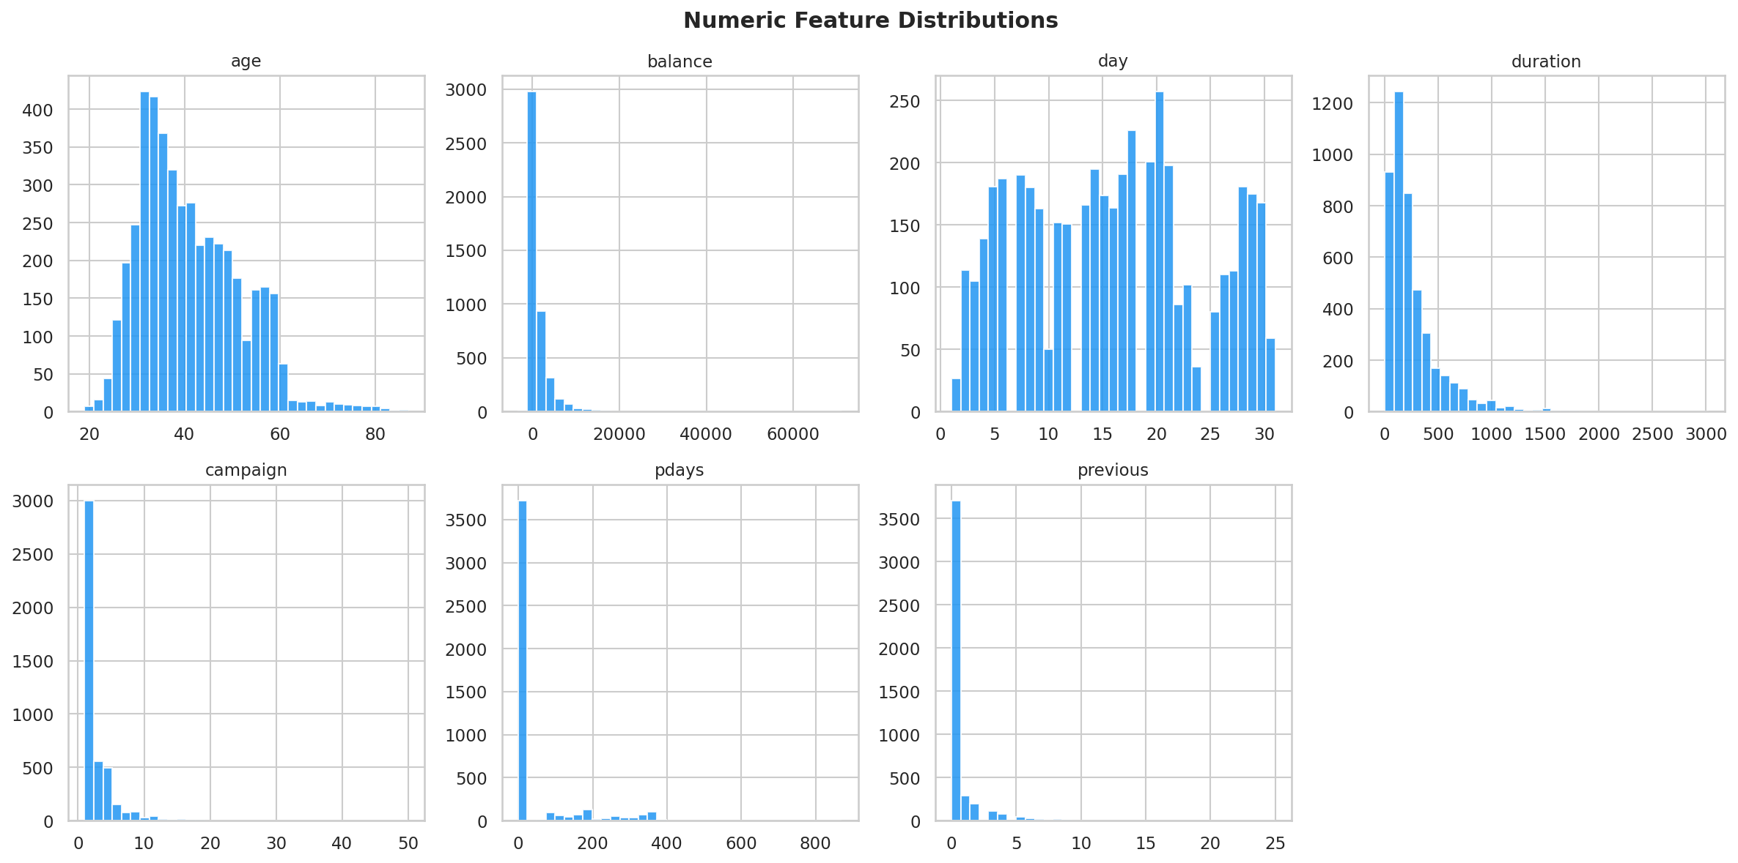
01 · DATASET
Bank Marketing Dataset — Overview & EDA
45,211
16
11.7%
88 / 12%
Total Clients
Raw Features
Subscription Rate
Class Imbalance
Feature Groups
📁 plots/eda_distributions.png
Numeric Feature Distributions
Type | Features
Numeric (7) | age, balance, day, duration, campaign, pdays, previous
Binary (3) | default, housing, loan
Categorical (6) | job, marital, education, contact, month, poutcome
Target | y — subscribed a term deposit?
📁 plots/eda_target.png
Subscription Rate by Job & Target Balance

Slide 4
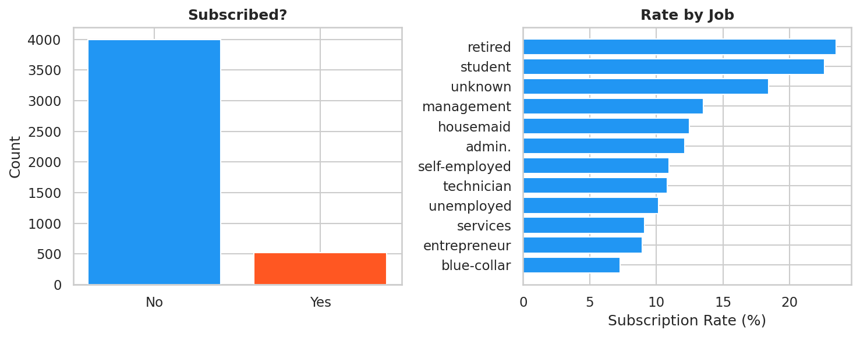
01 · DATASET
Overview & EDA – Imbalanced Dataset

Slide 5
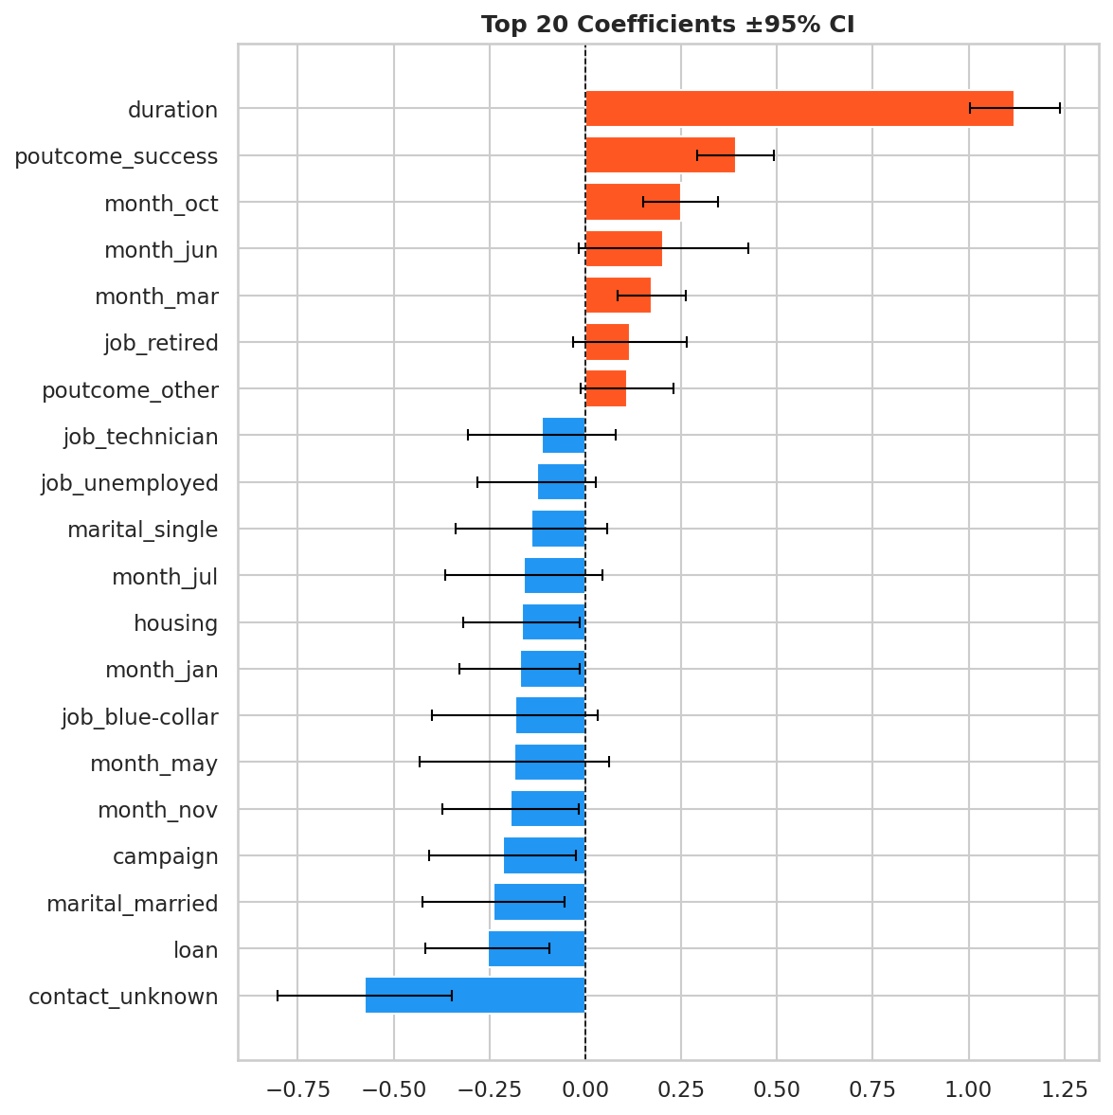
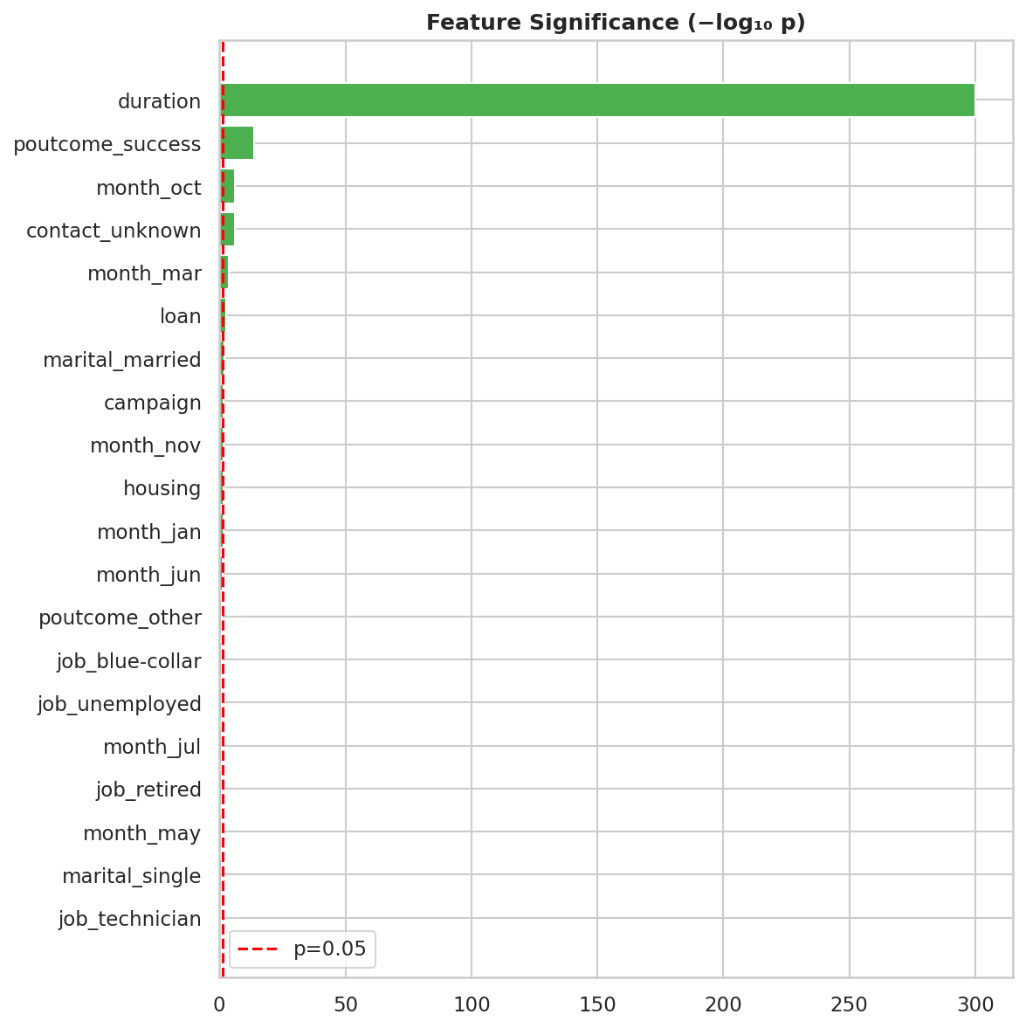
02 · CLASSIFICATION
Logistic Regression — Inference & Confounding
Model & Inference
P(Y=1|X) = σ(Xᵀβ) — logistic sigmoid
SE from Fisher information: Cov(β̂) = (XᵀWX)⁻¹
Wald Z-statistic · Two-sided p-value
Odds Ratio = exp(β̂ⱼ)
📁 plots/lr_pvalues.png
Feature Significance (−log₁₀ p)

Slide 6
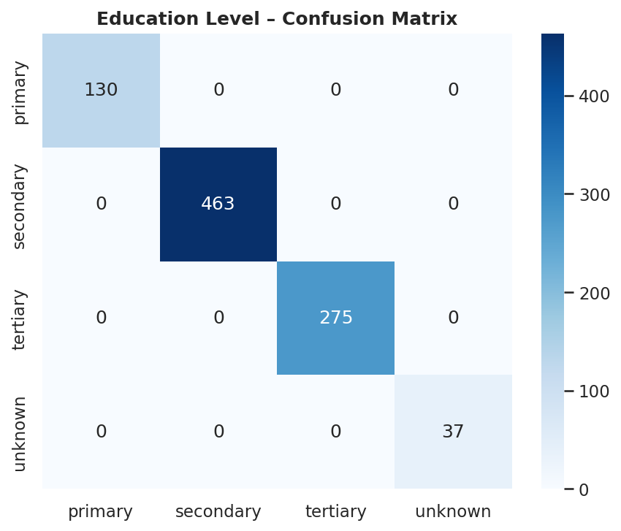
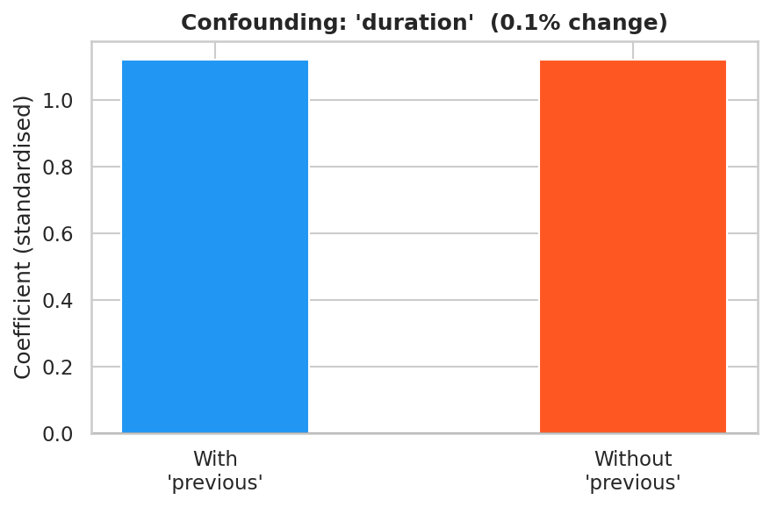
02 · CLASSIFICATION
Logistic Regression — Inference & Confounding
Confounding Analysis
Exposure: duration · Confounder: previous
Compare β(duration) with vs without previous
Criterion: >10% change → confounding

Slide 7
02 · CLASSIFICATION
Discriminant Analysis — LDA & QDA
LDA — Linear
QDA — Quadratic
[FILL]
[FILL]
[FILL]
Shared covariance Σ across classes
Linear decision boundary
Optimal threshold via Youden's J
J = TPR − FPR maximised
Class-specific covariance Σₖ
Quadratic decision boundary
More flexible, needs more data
Regularisation:
reg_param = 0.1
LDA AUC
QDA AUC
Opt Threshold
📁 plots/lda_projection.png
LDA Projection onto LD1
📁 plots/lda_roc_threshold.png
LDA ROC Curve + Youden's J Threshold Analysis
📁 plots/lda_qda_roc.png
LDA vs QDA ROC Comparison

Slide 8
02 · CLASSIFICATION
Naïve Bayes & Full Model Comparison
Gaussian Naïve Bayes
📁 plots/model_comparison_roc.png
Assumes feature independence: P(X|Y) = ΠP(Xⱼ|Y)
Per-class Gaussian: P(Xⱼ|Y=k) = N(μₖⱼ, σ²ₖⱼ)
Fast baseline — independence violated here
Competitive AUC despite assumption
ROC Curves: LR · LDA · QDA · Naïve Bayes
Model Comparison
Model | Accuracy | Precision | Recall | F1 Score | ROC AUC
Logistic Regression | [FILL] | [FILL] | [FILL] | [FILL] | [FILL]
LDA | [FILL] | [FILL] | [FILL] | [FILL] | [FILL]
QDA | [FILL] | [FILL] | [FILL] | [FILL] | [FILL]
Naïve Bayes | [FILL] | [FILL] | [FILL] | [FILL] | [FILL]

Slide 9
03 · REGRESSION
Linear vs Poisson Regression — Campaign Contacts
Linear Regression
Poisson Regression
📁 plots/regression_comparison.png
Actual vs Predicted: Linear & Poisson
E[campaign|X] = Xᵀβ
Assumes Gaussian errors
Can predict negatives
Symmetric residuals
E[campaign|X] = exp(Xᵀβ)
Log-link → non-negative
Var = E (equidispersion)
Correct for count data
📁 plots/regression_residuals.png
Residual Plots
⚠ Overdispersion Check
Var(campaign) >> Mean(campaign) → overdispersed
Poisson equidispersion (Var = Mean) violated
Negative Binomial regression recommended
Poisson still preferred over Linear for count data

Slide 10
04
Regression target: account balance (€)
Resampling Methods
All methods estimate test error across
polynomial degrees 1–5
K-Fold Cross-Validation (K=5, K=10)
LOOCV (K=n)
Bootstrap (OOB)
MSE vs Polynomial Degree

Slide 11
04 · RESAMPLING
Cross-Validation: K = 5, K = 10, LOOCV
Theory
📁 plots/resample_cv_mse_degree.png
MSE vs Polynomial Degree — K=5, K=10, LOOCV
CV(K) = (1/K) Σ MSEₖ
Method | Bias | Variance | Cost
K=5 | Moderate | Low | Fast
K=10 | Low | Low | Moderate
LOOCV | Very low | High | Very slow
💡 Key Finding:
Degree 1 (linear) is optimal across all CV methods — polynomial features overfit due to limited balance-campaign signal. K=5 and K=10 agree closely; LOOCV (subsampled) confirms the trend.

Slide 12
04 · RESAMPLING
Bootstrap Resampling — OOB Error Estimation
Bootstrap OOB Estimator
📁 plots/resample_bootstrap_mse_degree.png
Bootstrap vs CV K=5: MSE vs Degree
Draw B samples of size n with replacement
OOB set ≈ 36.8% of data (never selected)
Err̂ᵇᵒᵒᵗ = (1/B) Σ MSE on OOBᵦ
Gives full sampling distribution of MSE
B = 200 iterations in this analysis
📁 plots/resample_bootstrap_dist.png
Bootstrap MSE Sampling Distribution (Degree 1)
Bootstrap vs CV
Both give consistent MSE estimates
Bootstrap uniquely provides 95% CI on error
95% CI: [FILL IN from dashboard]

Slide 13
05
Target: account balance (€)
Features: 10 numeric-origin predictors
Model Selection
Why balance?
80% / 20% train-test split
All models evaluated on same held-out set
2a · Forward Stepwise — Cp, AIC, BIC, Adj-R², CV
2b · Ridge & Lasso Shrinkage — Bias-Variance tradeoff
2c · PCA Regression — MSE vs components
2c · PLS Regression — vs PCR & full OLS

Slide 14
05A · SUBSET SELECTION
Forward Stepwise Selection — Criteria
Mallow's Cₚ
AIC
📁 plots/subset_selection_criteria.png
(RSS + 2kσ̂²) / n
n·ln(RSS/n) + 2(k+1)
Cp · AIC · BIC · Adj-R² · CV MSE vs #Predictors
Estimates test MSE; penalises added params
Information-theoretic; moderate penalty
BIC
Adjusted R²
n·ln(RSS/n) + ln(n)·(k+1)
1 − RSS/(n−k−1) / TSS/(n−1)
Stronger penalty; selects fewest features
Penalises added predictors via df
+ 5-fold CV MSE for honest evaluation
[FILL]
[FILL]
[FILL]
[FILL]
[FILL]
Cₚ opt
AIC opt
BIC opt
Adj R²
CV opt

Slide 15
05B · SHRINKAGE
Ridge & Lasso Regularisation
Ridge (L2)
Lasso (L1)
📁 plots/shrinkage_cv_mse.png
CV MSE vs λ — Ridge & Lasso
‖y − Xβ‖² + λ‖β‖²
Closed-form: (XᵀX + λI)⁻¹Xᵀy
Shrinks all coefs toward 0
Never exact zero
Optimal λ: [FILL]
‖y − Xβ‖² + λ‖β‖₁
L1 induces exact sparsity
Automatic feature selection
Optimal λ: [FILL]
Non-zero coefs: [FILL] / 10
📁 plots/shrinkage_bias_variance.png
Bias–Variance Tradeoff
📁 plots/shrinkage_coef_paths.png
Coefficient Shrinkage Paths: Ridge (left) · Lasso (right)

Slide 16
05C · DIM. REDUCTION
PCA Regression vs Partial Least Squares
PCR — Principal Component Regression
PLS — Partial Least Squares
📁 plots/pca_mse_variance.png
PCA: MSE vs Components + Scree Plot
Z_k = XV_k (top k eigenvectors of XᵀX)
Unsupervised: maximises variance in X
Components may not predict y well
Needs more components than PLS
Supervised: maximises Cov(Xw, y)
Components carry predictive signal
Fewer components needed vs PCR
Outperforms PCR when y-relevant
📁 plots/pca_vs_pls.png
PCR vs PLS vs Full OLS Test MSE
[FILL]
[FILL]
[FILL]
Full OLS MSE
PCR Best MSE
PLS Best MSE
📁 plots/pca_biplot.png
PCA Biplot: PC1 vs PC2

Slide 17
06 · RESULTS
Final Model Comparison — All Methods
Method | Approach | Test MSE (€²) | R² | Key Advantage
OLS (all features) | Baseline | [FILL] | [FILL] | Max flexibility
Forward Stepwise | Subset Selection | [FILL] | [FILL] | Interpretable, sparse
Ridge (λ=[FILL]) | L2 Shrinkage | [FILL] | [FILL] | Keeps all features
Lasso (λ=[FILL]) | L1 Shrinkage | [FILL] | [FILL] | Automatic selection
PCR (k=[FILL] comp.) | Unsupervised Dim. Red. | [FILL] | [FILL] | Handles collinearity
PLS (k=[FILL] comp.) | Supervised Dim. Red. | [FILL] | [FILL] | Max predictive signal
📁 plots/model_selection_final_comparison.png
Test MSE & R² Bar Chart — All Models

Slide 18
Conclusions & Key Takeaways
🔍 Classification
LR & LDA achieve AUC > 0.90. Call duration is the strongest predictor but post-hoc. Previous campaign success is the best actionable predictor.
📊 Resampling
K=10 CV is the practical optimum — low bias, manageable cost. Bootstrap confirms estimates and adds 95% CI on test error. Degree 1 (linear) is optimal throughout.
🎯 Subset Selection
BIC selects the most parsimonious model. CV MSE confirms BIC choice is honest. AIC/Cp are more lenient; Adj-R² tracks closely with CV.
🔧 Shrinkage
Lasso's sparsity is practically valuable — eliminates irrelevant features automatically. Ridge performs well when all features contribute. Both reduce overfitting vs OLS.
📐 PCA vs PLS
Questions?
PLS reaches minimum test MSE with fewer components than PCR. Both can outperform full OLS under collinearity.
Moro et al. (2011) · UCI Bank Marketing · ESM'2011 EUROSIS

