Slide 1
Contest 2
Tim Mastny and Catherine Rivier

Slide 2
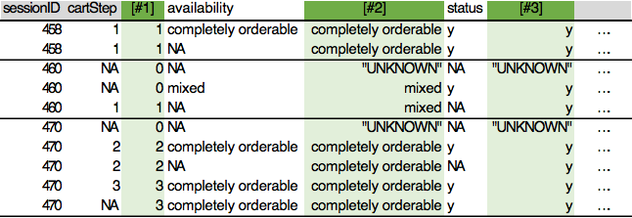
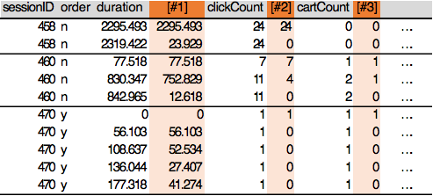

Variable Manipulation/Derivation
NA SUBSTITUTIONS:
Reviewed each case for best logical option.
Standard was NA -> 0, with these exceptions:
Salutation was 78% 2, so NA -> 2
Age mean was ~44, so NA -> 44
LastOrder was low for repeating customers, so NA -> 1999 (2x highest number)
CustomerID assigned unique value per SessionID when NA
NA FILL-IN LOGIC:
Per each SessionID, filled in with last non-NA value:
CartStep
Availability
Status
STEP CALCULATIONS:
Per each SessionID:
Duration per step
ClickCount added per step
CartCount added per step
TIME CALCULATIONS:
Converted Day from 1,5-7 -> 5-8
Converted Hour to circular X and Y values
Created HourWithinWeek (Day*24 + Hour)
Created new variables from simple KMeans clusters on #2 and #3

Slide 3
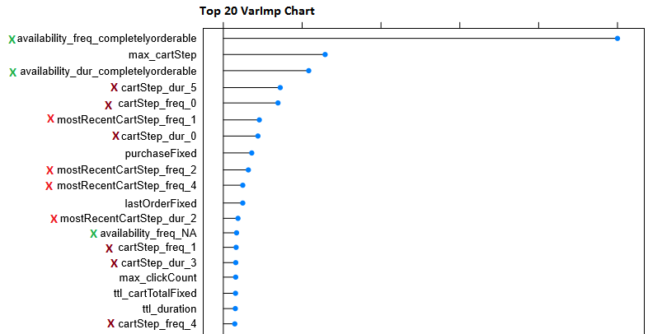
Variable Aggregation
All aggregation done by SessionID
Some grouped as-is (same per SessionID)
Some MIN or MAX or MEAN values (some both)
A few took COUNTS and DURATION per each DISTINCT VALUE
Step, and MostRecentStep (all “MostRecent_” as derived on prior slide)
Status, and MostRecentStatus
Availability, and MostRecentAvailability
Most proved highly predictive:
Marked with X: From Counts/Duration per Distinct Value

Slide 4
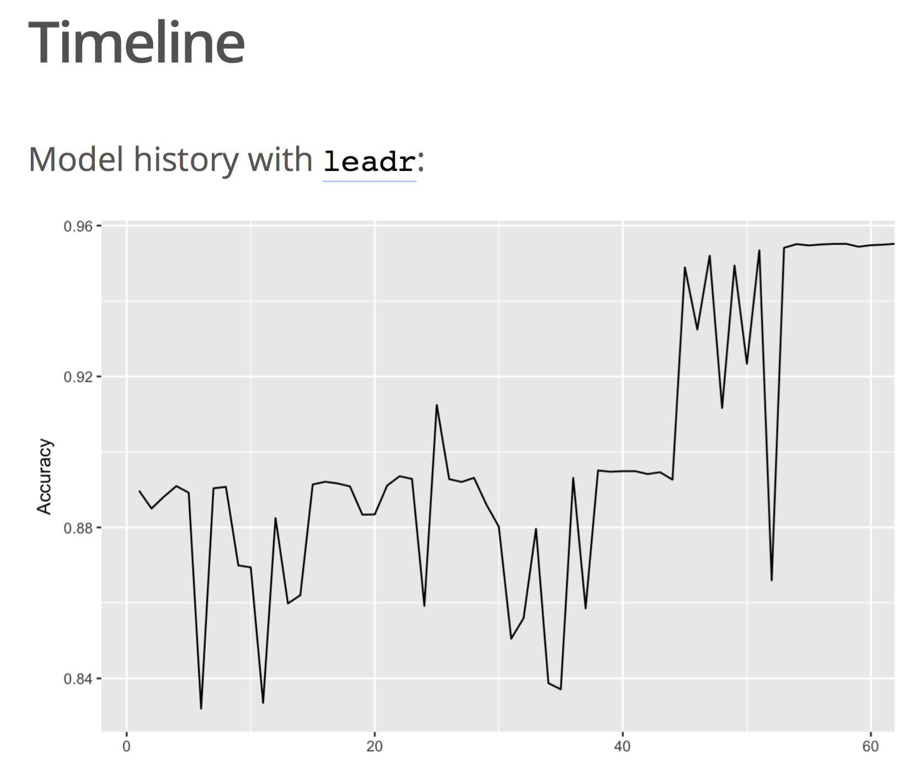

Slide 5
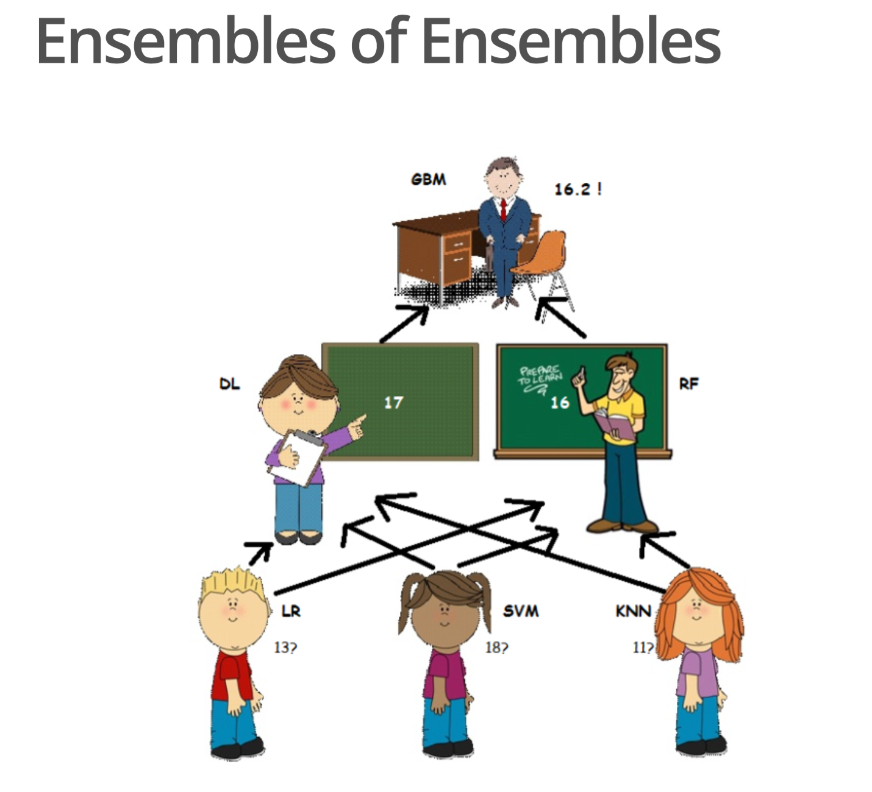

Slide 6
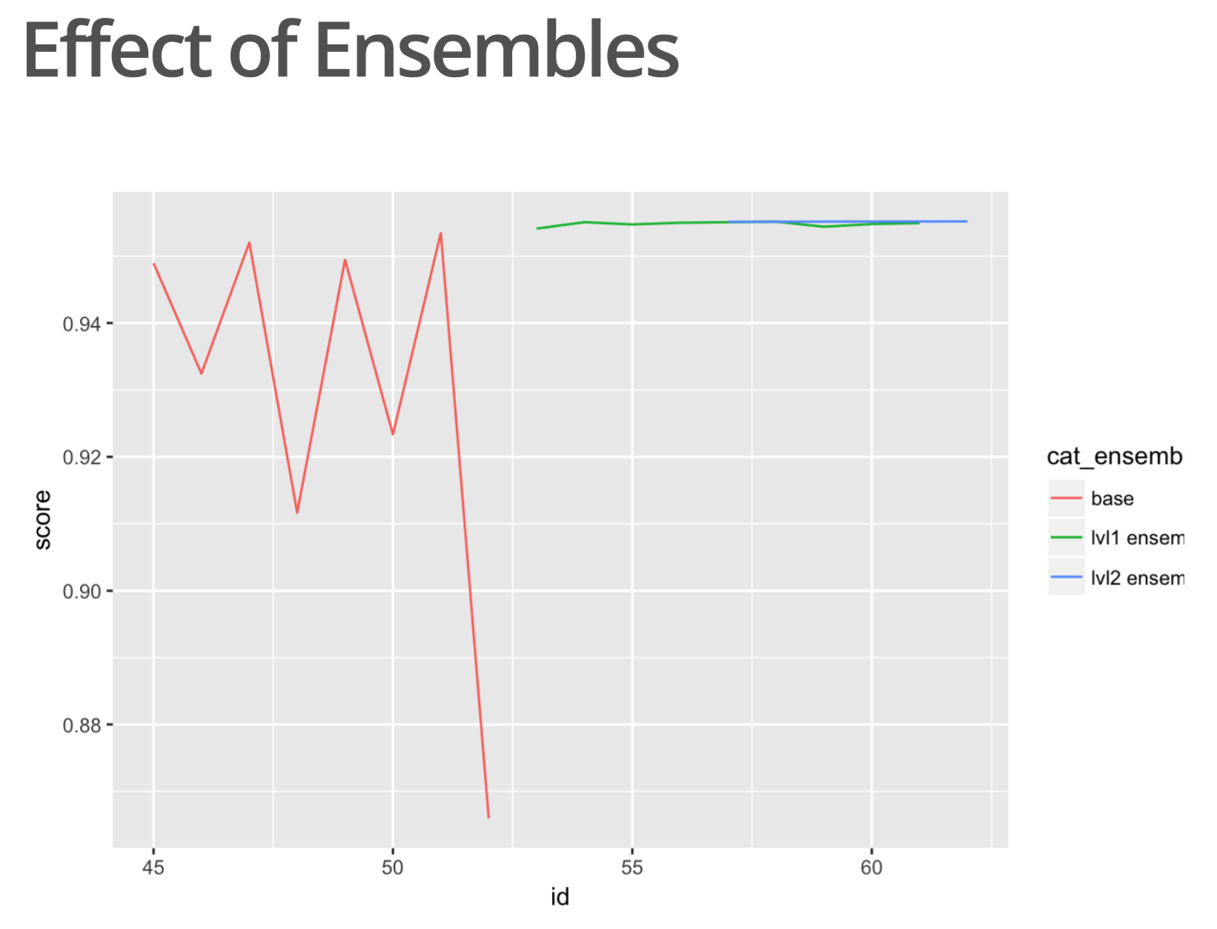

Slide 7
