Slide 1
Understanding drivers of gross cpo
Data Science Case Study – JET CS & Fraud
Ahmad Mathusin
6 December 2025
Notes:
---
This presentation explores the causes behind spikes in Gross Cost Per Order (CPO) within JET Customer Support and Fraud Prevention. We will analyze key drivers using data science techniques and propose strategic recommendations to effectively manage and reduce these costs.

Slide 2
content
Executive Summary
Context and Importance of Gross CPO in Customer Support and Fraud Prevention
Data Science Approach & Modelling Framework
Key Findings: Drivers of Gross CPO Spikes
Strategic Insight
Recommendations and Next Steps
Conclusion
Notes:
We will begin by understanding the context and significance of Gross CPO in customer support and fraud prevention. Next, we will discuss our data science methodology for analyzing Gross CPO. Then, we will review key findings on factors driving CPO spikes, and finally, present strategic recommendations and next steps.

Slide 3

Executive Summary Insights
Gross CPO shows a clear upward shift from June onward, indicating a structural change in operational performance.
Policy Change 1 is the largest long-run driver
Delivery performance (End-to-End time, Undelivered/Bad Orders) drives short-run spikes.
Automation changes contribute to moderate but persistent effects.
Key Insights
Implications
  CPO is driven by policy decisions + operational fulfilment quality.
  Reducing delays and improving order quality will have immediate impact.
  Reviewing Policy Change 1 offers the biggest structural improvement.
Notes:
Image source: Microsoft 365 content library
Gross CPO experienced significant changes driven primarily by Policy Change 1, fluctuations in end-to-end (E2E) time, and fulfilment quality issues. The most influential drivers were operational shifts and process adjustments leading to varying performance. To address these, we recommend focusing on process optimization, quality improvements, and policy realignment to stabilize and enhance outcomes.

Slide 4
Context and Importance of Gross CPO in Customer Support and Fraud Prevention
Notes:
This section introduces the JET CS and Fraud Prevention function, defines Gross CPO, and explains why rising Gross CPO poses a significant business impact that warrants detailed analysis.

Slide 5

Understanding Gross CPO
Role of Customer Support
  JET CS and Fraud Prevention help customers address order issues, ensuring strong support and protection.
What Is Cost Per Order (CPO)?
  CPO calculates compensation expenses divided by the total number of successful orders, serving as a crucial business metric.
Gross CPO
  Gross CPO measures the direct compensation cost paid out, highlighting how efficiently customer complaints are resolved.
Notes:
Image source: Microsoft 365 content library
The JET CS and Fraud Prevention function ensures customers receive support when facing order issues. A key metric, Cost Per Order (CPO), reflects compensation expenses divided by total successful orders. CPO includes Gross and Net components; Gross CPO specifically measures the direct cost of compensation paid out, highlighting efficiency in resolving customer complaints.

Slide 6

Business Impact of Rising Gross CPO
Business Context
Gross CPO = compensation paid / good orders
→ core indicator of customer experience cost.
Recent operational and policy changes introduced variability:
    Automation rollout
    Removal of manual checks
    Logistics & delivery process changes
Problem Statement
Gross CPO has increased noticeably since June.
Objective: Identify what is driving this rise and quantify the impact of operational and policy drivers.
Outcome needed: actionable insights to stabilise CPO and guide operational decisions.

Slide 7
Data Science Approach to Analyzing Gross CPO
Notes:
Here we describe the methodology used to analyze Gross CPO data, including data collection, driver selection, and the modeling techniques applied.

Slide 8

Data Collection and Preprocessing
Dataset
59 weekly observations
Key variables identified:
  Policy flags (PC1, PC2)
  Automation effectiveness
  Order quality metrics (Bad, Undelivered Orders)
  Delivery performance (E2E Time, Radius, Assignment Time)
  Restaurant supply indicators
Sort data chronologically
Apply time-series differencing for stationarity
Feature selection for true drivers of Gross CPO
Preprocessing
Notes:
---
Relevant data was gathered from operational systems and cleaned to ensure accuracy. This preprocessing was critical to creating a reliable dataset for analysis.
Image source: Microsoft 365 content library

Slide 9
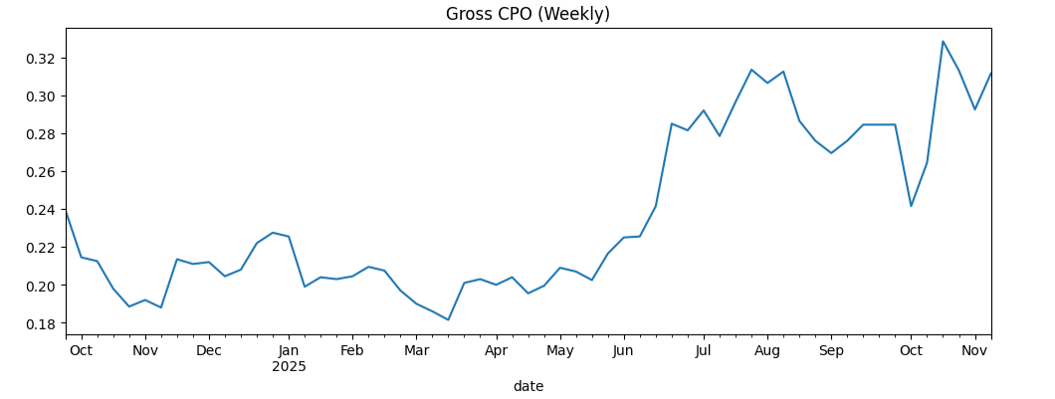
Stationarity & model choice
Why VAR?
Low sample size (59) → regression risks overfitting
Weekly frequency
Many interrelated operational variables
Drivers exhibit autocorrelation and interact over time
VAR captures lagged effects, mutual dependencies, and enables IRF + FEVD analysis
Stationarity Check
ADF: series non-stationary → first differencing required.
  p-value < 0.05 → stationary
  p-value ≥ 0.05 → not stationary (differencing required)
Drivers also differenced for consistency.
Notes:
---
Potential drivers such as operational changes, customer behavior, and seasonality were identified based on domain knowledge and initial data exploration.
Image source: Microsoft 365 content library

Slide 10
Modelling framework
Model Setup
Feature Selection: True Drivers
Avoid data / target leakage
Exclude all post-order contact, compensation, and ETA accuracy metrics
Avoid duplication / perfect correlation
Exclude Bad Orders and Undelivered Orders if already represented inside % Bad + Undelivered Orders.
Avoid circularity
Gross CPO = compensation / good orders
Exclude post-order timeliness classifications
Exclude metrics that are transformations of others
Exclude % Brand 1 Recook: If Brand 1 volume is small, this injects noise and collinearity with Bad Orders.
Including Good Orders as a driver creates mathematical dependence; a bad modelling practice.
VAR model (multivariate AR model) fitted on differenced CPO + selected drivers
Lag order chosen via AIC optimisation
Stability and residual diagnostics passed
Notes:
---
Potential drivers such as operational changes, customer behavior, and seasonality were identified based on domain knowledge and initial data exploration.
Image source: Microsoft 365 content library

Slide 11
Key Findings: Drivers of Gross CPO Spikes
Notes:
This section highlights the main factors contributing to spikes in Gross CPO as revealed by our analysis.

Slide 12
Impulse Response Functions (IRF): Concept & Interpretation
What IRFs Tell Us
How Gross CPO responds when a driver changes suddenly (“shock”).
The shape of the response indicates persistence or decay.
Good for evaluating short-run operational impact.
Interpretation
Upward response → driver increases compensation pressure.
Quick decay → short-lived effect.
Persistent response → structural or systemic influence.
Notes:
---
We employed regression models and feature importance analysis to quantify the impact of different variables on Gross CPO spikes, ensuring actionable insights.
Image source: Microsoft 365 content library

Slide 13
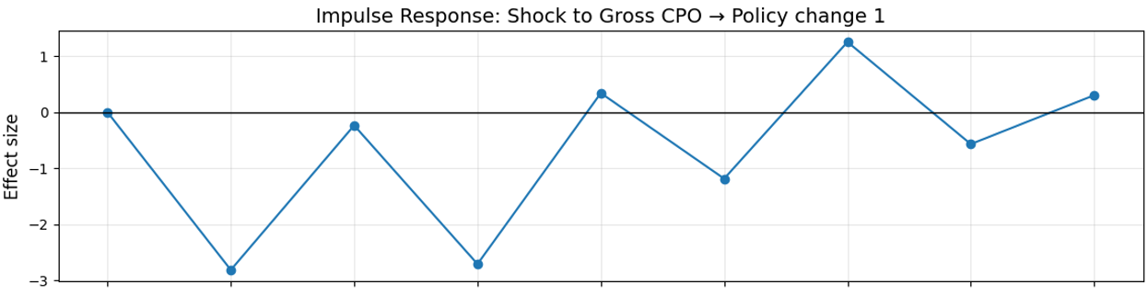
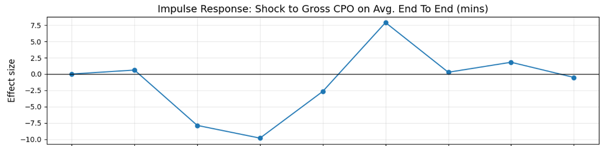
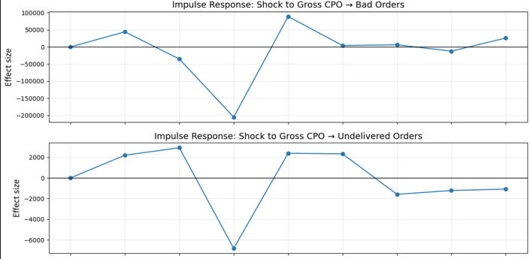
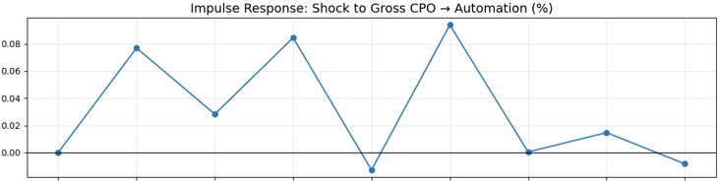
IRF: Key Findings
Short-Run Dynamics
Policy Change 1: immediate and persistent upward effect on CPO.
Avg. E2E Time: consistent increase over several weeks.
Bad / Undelivered Orders: sharp but short-lived spikes → immediate customer dissatisfaction effect.
Automation (%): moderate uplift with gradual decay.
Policy change 1
Avg. E2E Time
Effect Size
Bad Orders
Implication
Both policy and operational performance meaningfully shape CPO behaviours.
Undelivered Orders
Automation (%)
0
1
2
3
4
5
6
7
8
Weeks After Shock
Notes:
---
We employed regression models and feature importance analysis to quantify the impact of different variables on Gross CPO spikes, ensuring actionable insights.
Image source: Microsoft 365 content library

Slide 14
Forecast Error Variance Decomposition (FEVD):
Concept & Role
What FEVD Shows
How much each driver explains the variance in Gross CPO over an 8-week horizon.
Provides a ranking of long-run driver importance.
Complements IRF by describing structural influence, not short-run reactions.
Notes:
---
We employed regression models and feature importance analysis to quantify the impact of different variables on Gross CPO spikes, ensuring actionable insights.
Image source: Microsoft 365 content library

Slide 15
FEVD: Key findings
8-week horizon
Top Contributors
Policy Change 1 (~ 15.2%)
Avg. End-to-End Time (~ 10.95%)
Undelivered Orders (~ 7.54%)
Bad Orders (~ 7.29%)
Automation (%) (~ 7.27%)
Secondary Drivers
Radius to Delivered (~4.3%)
% HQ Orders (~3.2%)
Policy Change 2 (~3.2%)
Long Assignment (~2.4%)
Restaurant Count (~1.8%)
Top Contributors | FEVD
1. Policy Change 1 | 15.2%
2. Avg. End-to-End Time | 10.95%
3. Undelivered Orders | 7.54%
4. Bad Orders | 7.29%
5. Automation (%) | 7.27%
Secondary Drivers | FEVD
1. Radius to Delivered | 4.3%
2. % HQ Orders | 3.2%
3. Policy Change 2 | 3.2%
4. Long Assignment | 2.4%
5. Restaurant Count | 1.8%
Notes:
---
We employed regression models and feature importance analysis to quantify the impact of different variables on Gross CPO spikes, ensuring actionable insights.
Image source: Microsoft 365 content library

Slide 16
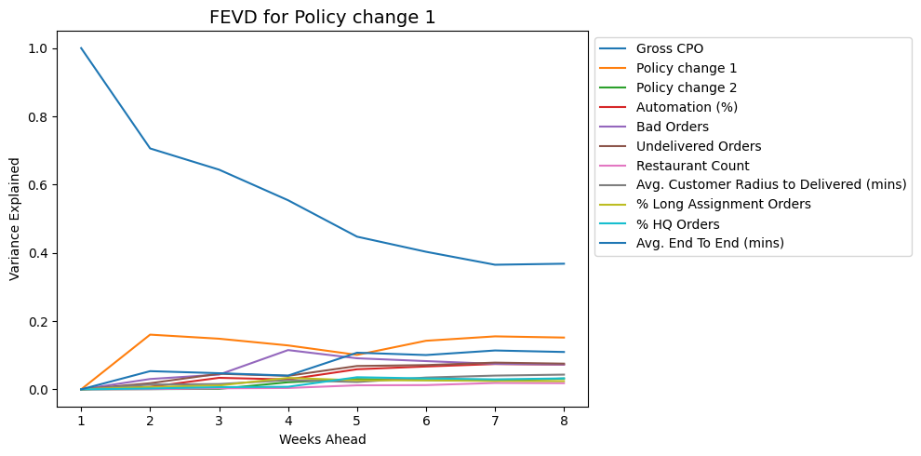
FEVD: Key findings deep dive
8-week horizon
FEVD findings for Policy Change 1
Policy Change 1 varies largely in sync with Gross CPO and several operational KPIs.
The VAR model identifies it as part of the same systemic shift affecting compensation
This suggests PC1 aligns with a period of operational deterioration, creating shared variance between policy and operational metrics.
Notes:
---
We employed regression models and feature importance analysis to quantify the impact of different variables on Gross CPO spikes, ensuring actionable insights.
Image source: Microsoft 365 content library

Slide 17
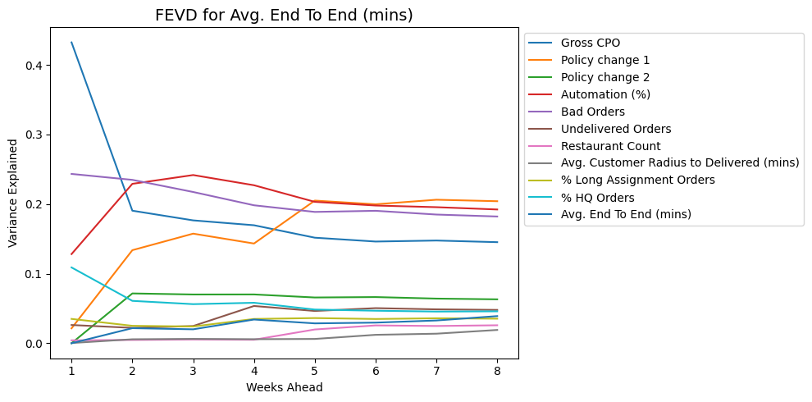
FEVD: Key findings deep dive
8-week horizon
FEVD findings for Avg. E2E (mins)
Avg. E2E Time is primarily explained by three interacting forces:
1️⃣ Operational quality (Bad Orders)
2️⃣ Automation-related process change
3️⃣ Policy Change 1
These system-wide changes jointly increased volatility in delivery performance.
Notes:
---
We employed regression models and feature importance analysis to quantify the impact of different variables on Gross CPO spikes, ensuring actionable insights.
Image source: Microsoft 365 content library

Slide 18
FEVD: Key findings deep dive
8-week horizon
FEVD findings for Undelivered Orders
Undelivered Orders are explained by a combination of operational quality, automation changes, and policy shifts:
Gross CPO (co-movement)
Bad Orders
Automation (%)
Policy Change 1
When operations deteriorate → Undelivered Orders rise → Gross CPO rises.
Automation and policy shifts introduced additional volatility into delivery success.
Notes:
---
We employed regression models and feature importance analysis to quantify the impact of different variables on Gross CPO spikes, ensuring actionable insights.
Image source: Microsoft 365 content library

Slide 19
Strategic insight
Combined Interpretation: IRF + FEVD
Root Cause Narrative

Slide 20

Combined Interpretation: IRF + FEVD
Policy Change 1
strong shock response (IRF)
largest contribution (FEVD)
Delivery performance (E2E Time)
persistent IRF effect
large FEVD share
Order quality issues
strong immediate IRF spikes
meaningful FEVD
Automation
medium-term consistent effect
major structural driver
key operational pressure point
direct customer compensation triggers
operational tuning needed
Overall: Gross CPO rise is due to
policy-driven behaviour change + deterioration in fulfilment quality and delivery speed.

Slide 21

Root Cause Narrative
Primary Driver
Policy Change 1 fundamentally altered compensation behaviour, increasing baseline CPO.
Operational Drivers
Slow delivery (E2E time) increased compensation likelihood.
More undelivered/bad orders led to frequent short-run CPO spikes.
Automation rollouts introduced process instability.
Minor Drivers
HQ order mix, assignment delays, and restaurant count have smaller influence.

Slide 22
Recommendations and next steps
Notes:
We conclude with actionable recommendations to address Gross CPO spikes and outline plans for ongoing monitoring and collaboration.

Slide 23
recommendations
Structural
Reassess Policy Change 1 for unintended compensation effects.
Operational
Improve delivery workflows to reduce E2E time.
Strengthen fulfilment quality processes.
Process/Tech
Introduce monitoring controls on automation rollouts.
Build a recurring VAR-based monitoring framework.
Notes:
---
Focus interventions on operational processes and customer segments identified as high-impact drivers to optimize Gross CPO efficiently.
Image source: Microsoft 365 content library

Slide 24

Continuous Monitoring and Model Refinement
Continuous Data Tracking
  Implement ongoing monitoring systems to track Gross CPO accurately over time.
Regular Model Refinement
  Update analytical models frequently to reflect changes in business environments and maintain accuracy.
Adaptive Business Analytics
  Use refined models to adapt strategies according to evolving market and operational dynamics.
Notes:
---
Establish continuous tracking of Gross CPO and refine analytical models regularly to adapt to evolving business dynamics.
Image source: Microsoft 365 content library

Slide 25

Cross-Functional Collaboration
Encourage Ongoing Collaboration
  Foster continuous communication among teams to maintain alignment on cost management goals.
Include Key Stakeholders
  Engage data science, customer support, and fraud prevention teams in decision-making processes.
Align on Cost Initiatives
  Ensure all departments agree on cost management initiatives to maximise impact and efficiency.
Notes:
---
Encourage ongoing collaboration between data science, customer support, fraud prevention, and other stakeholders to ensure alignment on cost management initiatives.
Image source: Microsoft 365 content library

Slide 26
Conclusion
Importance of Managing Gross CPO Spikes
Effectively managing Gross CPO spikes improves operational efficiency and drives profitability for the organisation
Role of Data Science Insights
Utilizing data science helps identify patterns and inform strategic decisions to control costs and reduce fraud risk.
Strategic Actions
Implementing targeted strategies in JET CS and Fraud Prevention enhances overall operational performance.
Several clear interventions can stabilise and reduce CPO.
Key Drivers
Policy and operational factors jointly drive variation
Notes:
Understanding and managing Gross CPO spikes is critical for operational efficiency and profitability. Through data science insights and strategic actions, JET CS and Fraud Prevention can better control costs and enhance performance.

