Slide 1

Lending Club predict interest rate By Tzega Abera

Slide 2

Problem statement and objective
Lending Club is a peer-to-peer platform connecting borrowers with investors
Interest rates are assigned to each loan considering variables such as credit score, employment history, loan amount, and loan purpose
Project objective: develop a regression model to predict the interest rates

Slide 3
Stakeholders, constraints success metrics
Stakeholders:
Borrowers
Lenders
Constraint
Market Volatility: Macroeconomic Factors
Regulatory Factors
Model Limitations
Success metrics:
Prediction Accuracy
Notes:
Market Volatility: Interest rates are influenced by various economic factors and market conditions. Rapid fluctuations in financial markets and changes in economic indicators can introduce volatility, making it challenging to accurately predict interest rates.
Regulatory Factors: The lending industry, including P2P lending, is subject to regulatory frameworks and policies. Regulatory changes, such as new lending regulations or interest rate interventions by central banks, can introduce uncertainty and impact interest rate predictions.
Macroeconomic Factors: Interest rates are influenced by broader macroeconomic factors such as inflation rates, unemployment levels, GDP growth, and fiscal policies. The complexity and interconnectedness of these factors pose challenges in accurately predicting interest rate movements.
Model Limitations: Interest rate prediction models have inherent limitations. Assumptions made in model development, the choice of predictive variables, and the model's ability to capture all relevant factors can impact the accuracy of predictions. It is important to understand and acknowledge these limitations.
accuracy of the interest rate predictions themselves. This can be measured by comparing the predicted interest rates with the actual interest rates observed over a specific time period. Common metrics used to assess accuracy include mean absolute error (MAE), mean squared error (MSE), or root mean squared error (RMSE).

Slide 4
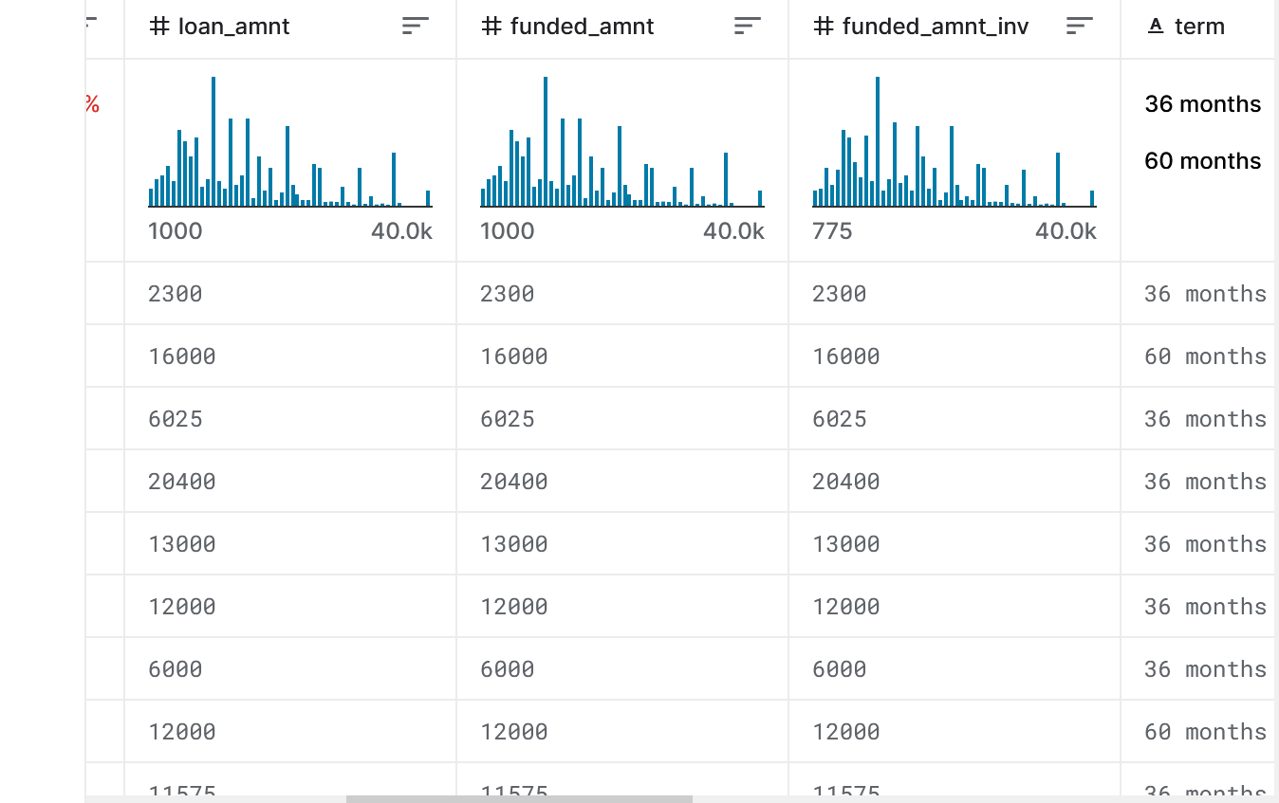
Dataset
Goal: develop a data-driven model that can forecast interest rates based on historical data and relevant features.
Dataset: Lending Club from Kaggle database
Historical loan data, including borrower profiles, loan characteristics, and corresponding interest rates.
The data frame contained 887, 379 rows and 74 features
Notes:
https://www.kaggle.com/datasets/husainsb/lendingclub-issued-loans
To determine the relevance of columns in predicting interest rates, a domain knowledge-based analysis was conducted. The following columns were assessed for their potential impact on interest rates:
'int_rate': This column represents the target variable, the interest rate, and is directly relevant for the prediction task.
'loan_amnt': Higher loan amounts may be associated with higher interest rates due to increased risk.
'annual_inc': Borrower's annual income is an important factor considered by lenders, where higher incomes may result in lower interest rates.
'mths_since_last_delinq': The number of months since the borrower's last delinquency can impact creditworthiness and, in turn, interest rates.
'revol_bal' and 'revol_util': Higher revolving credit balances and utilization may indicate a higher risk for lenders, potentially leading to higher interest rates.
'tot_coll_amt' and 'tot_cur_bal': These columns reflect the borrower's credit history and financial stability, which can influence interest rates.
'total_rev_hi_lim': The total revolving credit limit provides information about the borrower's available credit and debt capacity, influencing interest rates.
'term_in_month': Loan term in months can affect interest rates, with longer terms potentially carrying higher risks and rates.
'empl_length': The length of employment can be an indicator of job stability, where longer employment histories may result in lower interest rates.

Slide 5

Cleaning the Data
Dropped irrelevant columns
Handled missing values by removing columns with more than 80% missing values
Imputed missing values with median/mean values
Reduced dataset to 53 columns
Notes:
onverted 'emp_length' column to numbers only
Extracted numeric values from the 'term' column and added a new column 'term_in_month'
Converted the 'earliest_cr_line' column to the datetime format
Calculated the average values of the 'earliest_cr_line' and 'last_credit_pull_d' columns and filled NaN values with their average
Investigated three columns with the same amount of missing values
Checked if these three columns have missing values in the same rows and share a common pattern of missing data
Checked the number of missing values in each column and created a heatmap of missing values
Dropped rows with missing values in all three columns
Calculated the average value of the 'last_pymnt_d' column and filled NaN values with the average

Slide 6
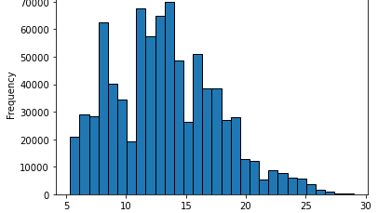
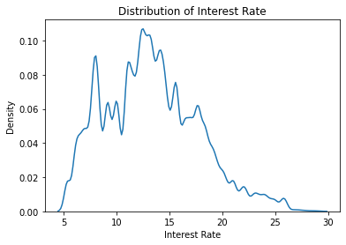
Exploratory data analysis
Dependent Variable Selection: 'int_rate' variable for regression analysis
Examined the distribution of interest rates using a histogram
Notes:
Found that the interest rates ranged from approximately 6% to 28%
Calculated descriptive statistics such as mean, median, mode, minimum, maximum, and standard deviation
Observed a slightly positively skewed distribution of interest rates

Slide 7
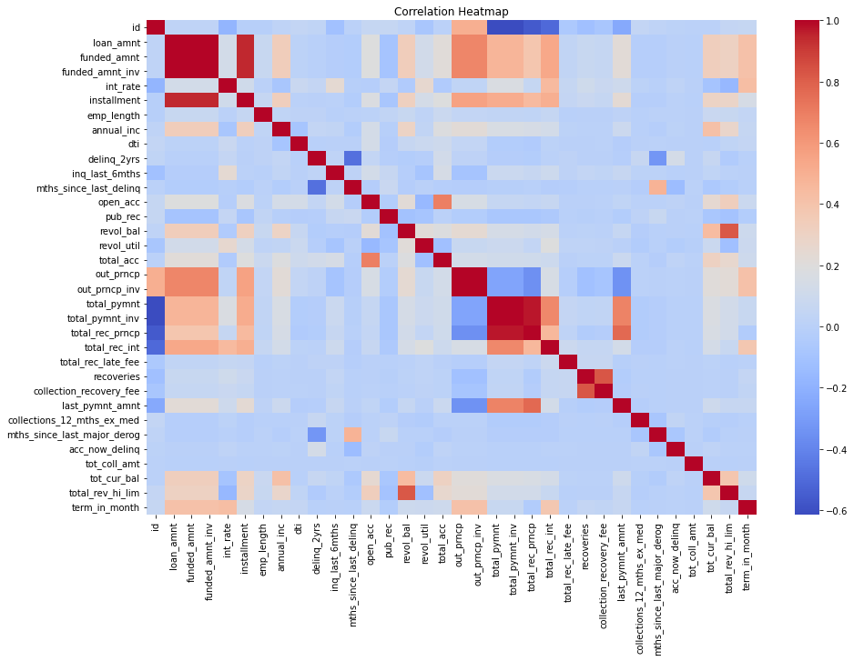
Exploratory data analysis
Correlation heatmap to visualize the relationships between numerical variables
Identified variables such as 'term_in_month', 'total_rev_hi_lim', 'total_rec_int', and 'annual_inc' that have some correlation with interest rate, though not very strong

Slide 8
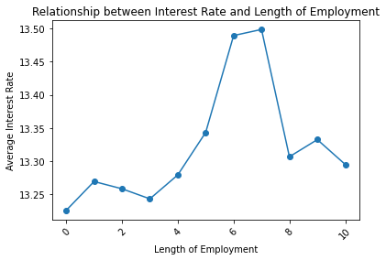
Exploratory data analysis
Relationship between interest rate and length of employment
non-linear relationship, with a drop-in average interest rate for individuals with 8 to 10 years of employment

Slide 9
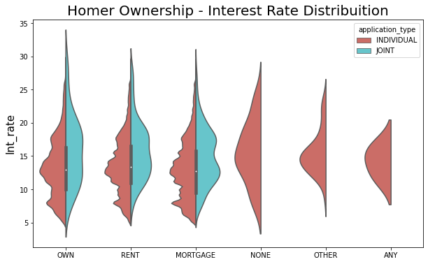
Exploratory data analysis
Visualization: distribution of interest rates based on homeownership status using a violin plot
Notes:
The "MORTGAGE" category has the highest count of observations (412,331) and a mean interest rate of approximately 13.02%. It also has the highest standard deviation of around 4.44, indicating a wider spread of interest rates within this category.
The "RENT" category has the second-highest count of observations (322,643) and a slightly higher mean interest rate of around 13.66% compared to the "MORTGAGE" category. The standard deviation is also relatively high at approximately 4.33.
The "OWN" category has a lower count of observations (82,039) compared to "MORTGAGE" and "RENT" categories. It has a slightly lower mean interest rate of around 13.33% and a similar standard deviation of approximately 4.45.
The "NONE" and "OTHER" categories have smaller counts of observations (42 and 45, respectively) compared to the other categories. They have relatively higher mean interest rates of around 15.49% and 15.39%, respectively. The standard deviations for these categories are also smaller compared to "MORTGAGE" and "RENT".

Slide 10
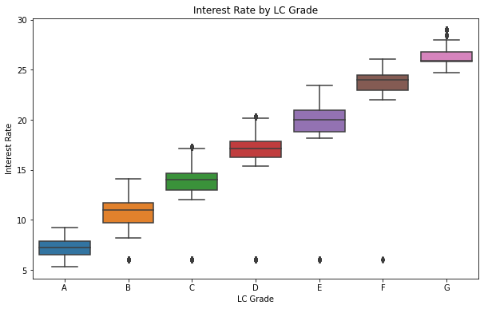
Exploratory data analysis
Relationship between interest rate and LC grade using a box plot
Found that higher LC grades were associated with lower interest rates

Slide 11
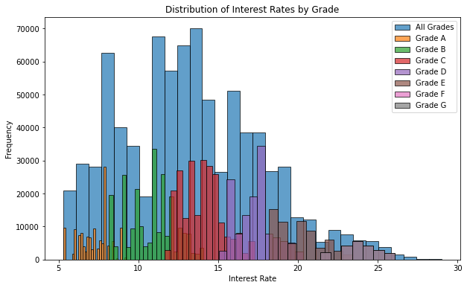
Exploratory data analysis
Distribution of Interest rates by Grade

Slide 12


Model Building
Built three different models :
Ridge regression,
Random Forest Regression
XGBoost.
Notes:
These models were chosen for the analysis because they offer different advantages and capabilities. Ridge regression provides a simple and interpretable linear model, while Random Forest Regression and XGBoost can handle non-linear relationships and capture complex interactions between variables. The combination of these models allows for a comprehensive analysis and comparison of their performance in predicting the interest rate in the lending dataset.

Slide 13
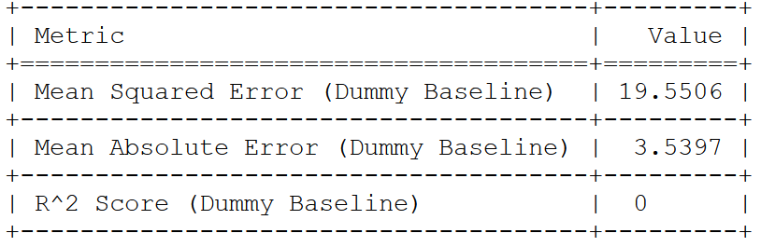
Model Evaluation
A dummy baseline model was implemented

Slide 14
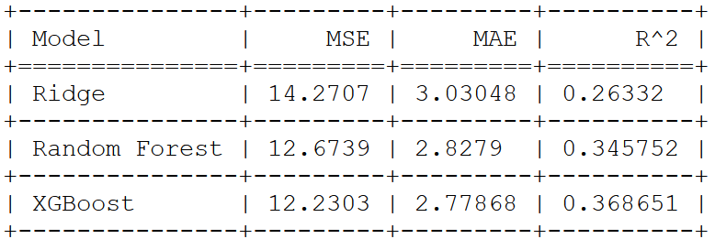
Model Evaluation
The XGBoost model outperforms the other two models in terms of mean squared error (MSE) and mean absolute error (MAE).
The XGBoost model achieved an MSE of 12.23 and an MAE of 2.7
on average, its predictions have a smaller deviation from the actual interest rates compared to the other models.
Notes:
Although the regression models (Ridge regression, Random Forest Regression, and XGBoost) outperformed the dummy baseline model, there is still room for improvement in their performance.
Based on the results obtained, the XGBoost model outperforms the other two models (Ridge regression and Random Forest Regression) in terms of mean squared error (MSE) and mean absolute error (MAE). The XGBoost model achieved an MSE of 12.23 and an MAE of 2.7, indicating that, on average, its predictions have a smaller deviation from the actual interest rates compared to the other models.
Furthermore, the R^2 score, which represents the goodness of fit of the model, indicates that the XGBoost model provides a better fit to the data compared to the other models. A higher R^2 score suggests that a larger proportion of the variance in the target variable (interest rate) is explained by the model. Therefore, the XGBoost model demonstrates a stronger ability to capture the underlying patterns in the data and make accurate predictions.

Slide 15
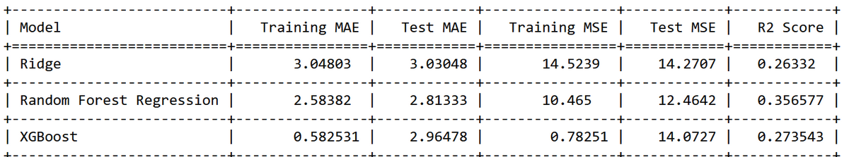
Model Evaluation
Random Forest Regression model achieves lower test MAE and MSE
This means it can generalize to unseen data better
Higher R2 score indicats a better fit and ability to explain the variance in the target variable.

Slide 16
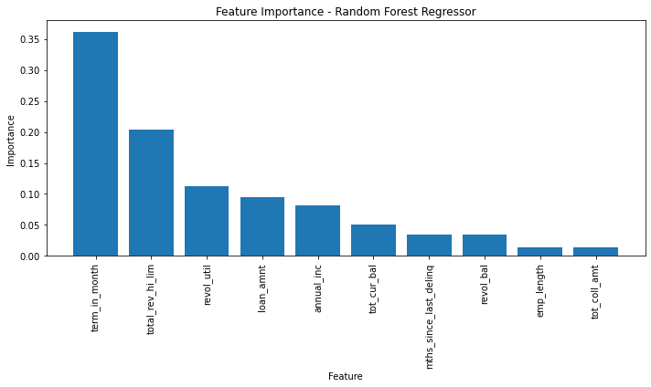
Feature Importance
Random Forest Regressor model Feature importance analysis

Slide 17
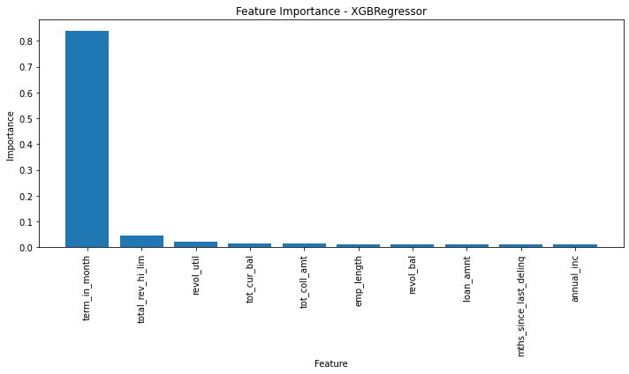
Feature Importance
XGBoost Regressor model Feature importance analysis

Slide 18
Findings and Recommendations
The predictor variables selected for this project provide insights into the borrower's creditworthiness, financial stability, and risk profile, which influence the interest rates assigned by lenders.
Model performance: XGBoost model showed lower training errors, it exhibited higher test errors, indicating potential overfitting. Random Forest Regression model demonstrated a better balance between training and test errors and achieved a higher R2 score, suggesting better overall performance and generalization.

Slide 19
Further Research and Analysis:
Feature engineering: Exploring additional transformations or combinations of the existing predictor variables to enhance the model's predictive power and capture more complex relationships
Refine the Random Forest Regression model by further fine-tuning of hyperparameters (number of trees, maximum depth, or minimum sample split)

Slide 20
Findings and Recommendations
Use the model for scenario analysis:
The developed model can be leveraged to conduct scenario analysis
Simulate the impact of different variables on interest rates

Slide 21

References
https://www.kaggle.com/datasets/husainsb/lendingclub-issued-loans https://www.kaggle.com/code/dhananjayashok/lending-club-interest-rate-prediction-and-eda

