Slide 1

Superkart sales forecast

Slide 2

Motivation
A sales forecast is a prediction of future sales revenue based on historical data, industry trends, and the status of the current sales pipeline. Businesses use the sales forecast to estimate weekly, monthly, quarterly, and annual sales totals. It is extremely important for a company to make an accurate sales forecast as it adds value across an organization and helps the different verticals to chalk out their future course of action.
Forecasting helps an organization plan its sales operations by region and provides valuable insights to the supply chain team regarding the procurement of goods and materials. An accurate sales forecast process has many benefits which include improved decision-making about the future and reduction of sales pipeline and forecast risks. Moreover, it helps to reduce the time spent in planning territory coverage and establish benchmarks that can be used to assess trends in the future.

Slide 3
Approach
Dataset Exploration and Preprocessing:
The analysis begins with importing data from the 'SuperKart.csv' file using panda’s library. This dataset contains 8,763 records across 12 columns.
There are 16 different product types and fruits and vegetables have been sold the highest number of times (1249).
There are 4 unique stores in the dataset.
The revenue generated from the sale of a particular product at a certain outlet varies from 33 to 8000 with 50% of the values lying above 2762.
The 75th percentile of Store_Id is 0. It indicates that the vast majority of these stores doesn't have unique identifier.
The mean store sales is approx. USD 34,640, whereas the median of the store sales is approx. USD 34,523. This indicates that the Product_Store_Sales_Total distribution is only slightly skewed towards the right side.

Slide 4
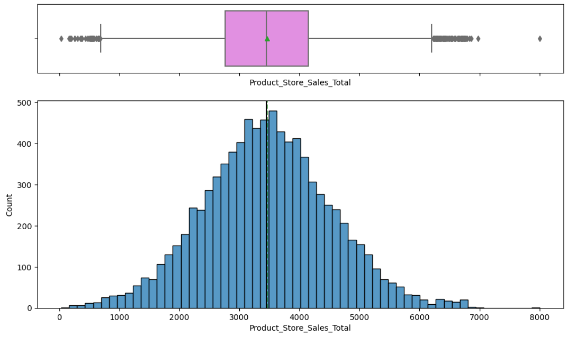
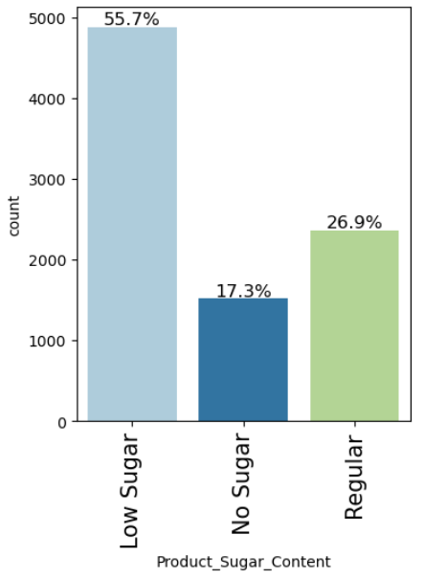
Cont.
The revenue generated from each product at a particular store is normally distributed with mean and median lying around 3500 as shown below.
Around 56% of the products are having low sugar followed by 27% products which are having regular sugar content. Around 17% of the products are having no sugar content.

Slide 5
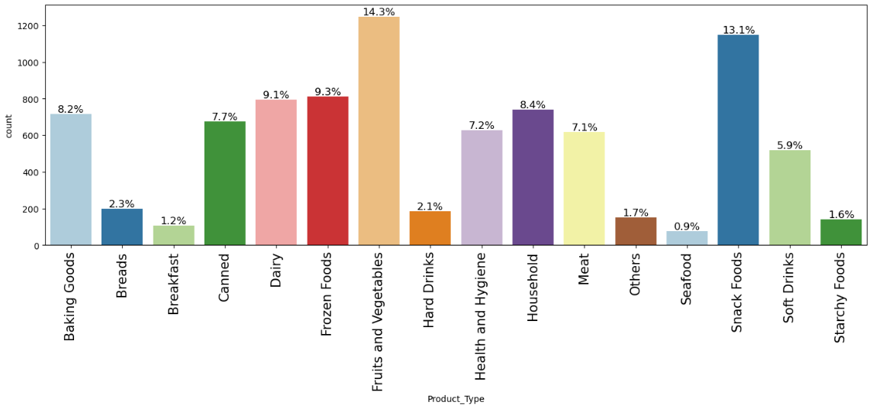
Cont.
Fruits and vegetables (14%) and Snack Foods (13%) have been bought the highest number of times from all the stores combined.
Seafood (1%) has been bought the lowest number of times.
The highest product type which is Fruits and Vegetables is 14 times of the lowest product type which is sea food.

Slide 6
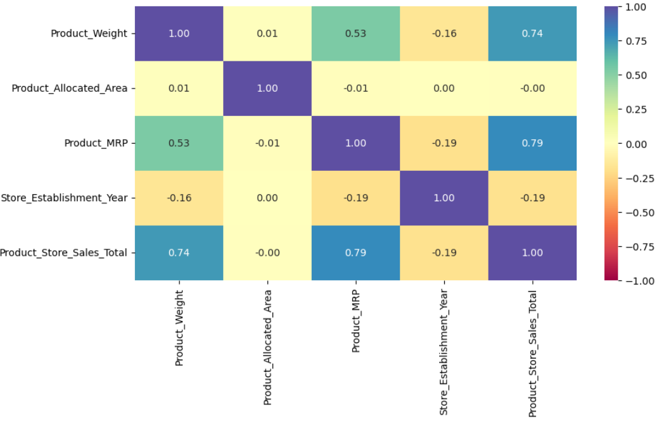
Cont.
Let’s the relationship among different variables. The heat map is shown below:
Product weight and product MRP are highly correlated with our target variable i.e Product_Store_Sales_Total.
Product weight and product MRP are moderately correlated with each other.
There is not much correlation among the rest of the variables.
Store_Establishment_Year is highly negatively correlated with our target variable i.e Product_Store_Sales_Total.

Slide 7
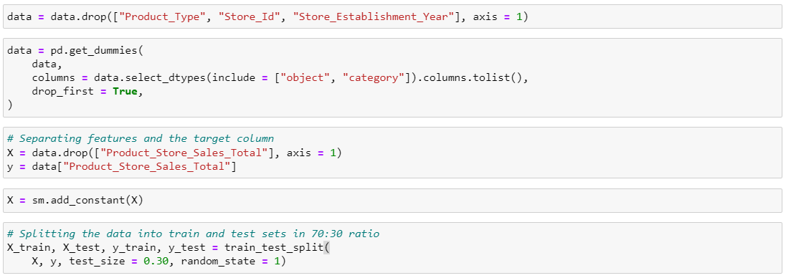
Cont.
So far we have done lots of exploratory data analysis let’s prepare the data for machine learning models.
We want to forecast the Product_Store_Sales_Total.
Let’s encode categorical features and drop the unnecessary columns
Let’s split the data into train and test data.

Slide 8
Cont.
Building ML Models:
Linear Regression: After fitting the training data into the linear regression model the model has been tested on the test dataset, which was splitted above in the data preprocessing section. After testing the model the results are quite promising as shown below.
Random Forest Regressor: After fitting the training data into the linear regression model the model has been tested on the test dataset, which was splitted above in the data preprocessing section. After testing the model the results are quite promising as shown below.

Slide 9
Comparison b/w models
Lower RMSE: The Random Forest model's lower RMSE compared to the Linear Regression model indicates that it is making more accurate predictions. Since RMSE penalizes larger errors more severely, this also suggests that the Random Forest model has fewer large errors in its predictions than the Linear Regression model.
Higher R^2 Score: An R^2 score of over 90% is typically considered very high and indicates that the model's predictions closely match the observed data.
Model Comparison: When comparing the two models, the Random Forest Regression not only has a higher R^2 score but also a lower RMSE, which generally suggests that it is the better model for this problem.

Slide 10
Recommendations
Prioritize inventory and marketing efforts on high-revenue products like fruits, vegetables, and snack foods.
Develop targeted strategies for each store based on their unique sales patterns and customer demographics.
Implement dynamic pricing strategies for products with high elasticity, identified through the analysis.

