Slide 1
$Fet-Ter
Fetch.AI Hackathon 2025 Dubai

Slide 2
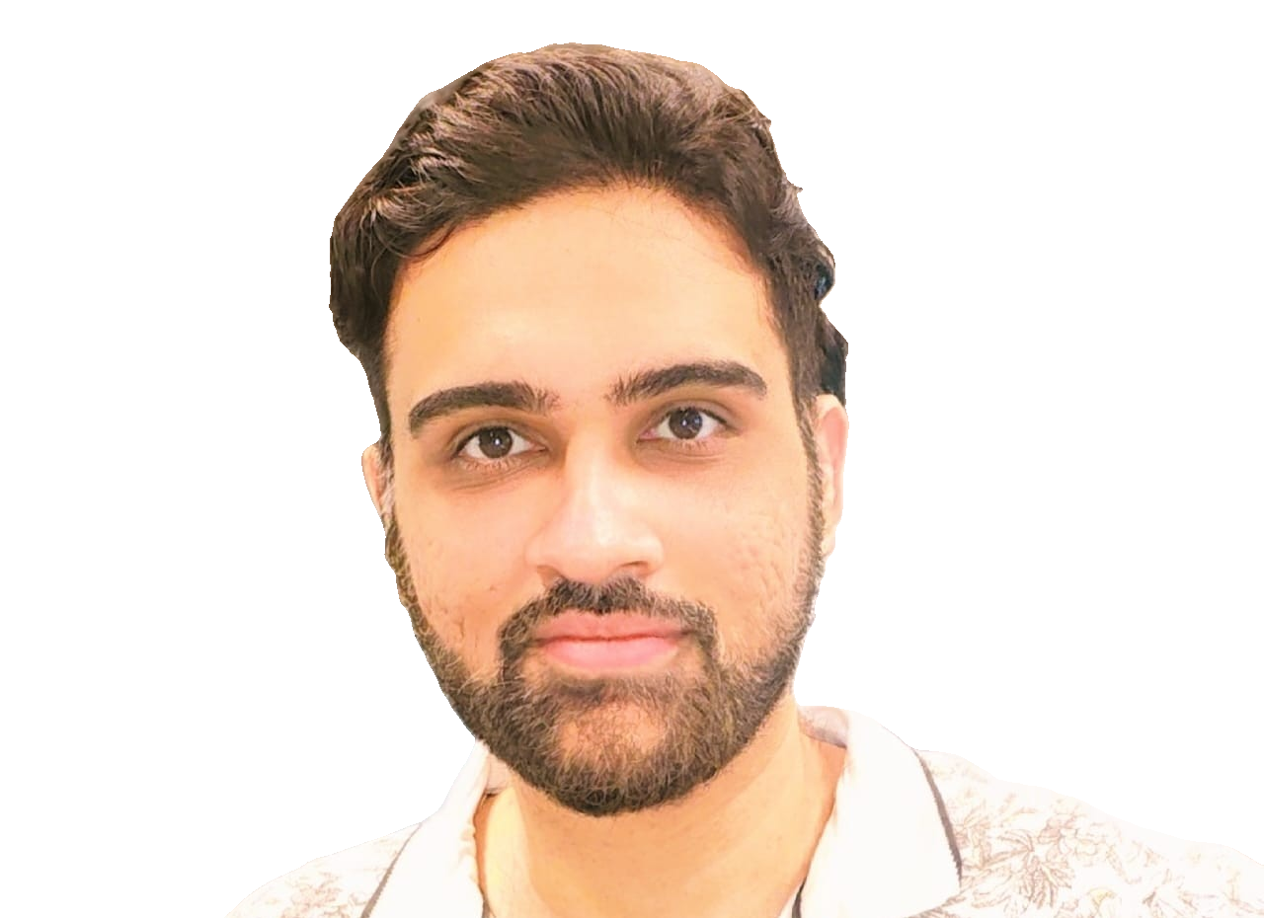
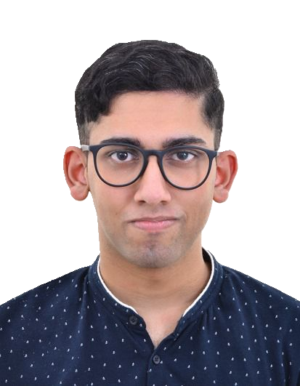
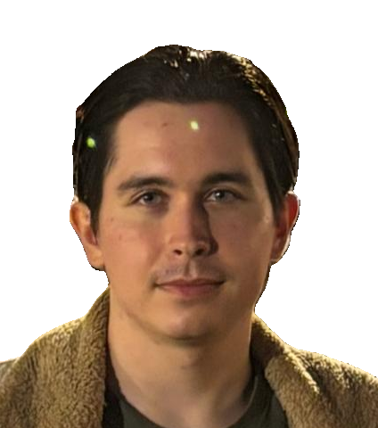

The TEAM
Raj Rangwani
Joe perinchery
Timur mazitov
Software Developer
Software Developer
Software Developer​

Slide 3
What we are building
Crypto Trading Adivsor
Based on Market Price Action of $FET coin:
Buy/Sell/Hold

Slide 4
future plans
More Coins
Buy / Sell to Open
Buy / Sell to Close

Slide 5
Thank You
Raj Rangwani,
Joe Perinchery,
Timur Mazitov

