Slide 1
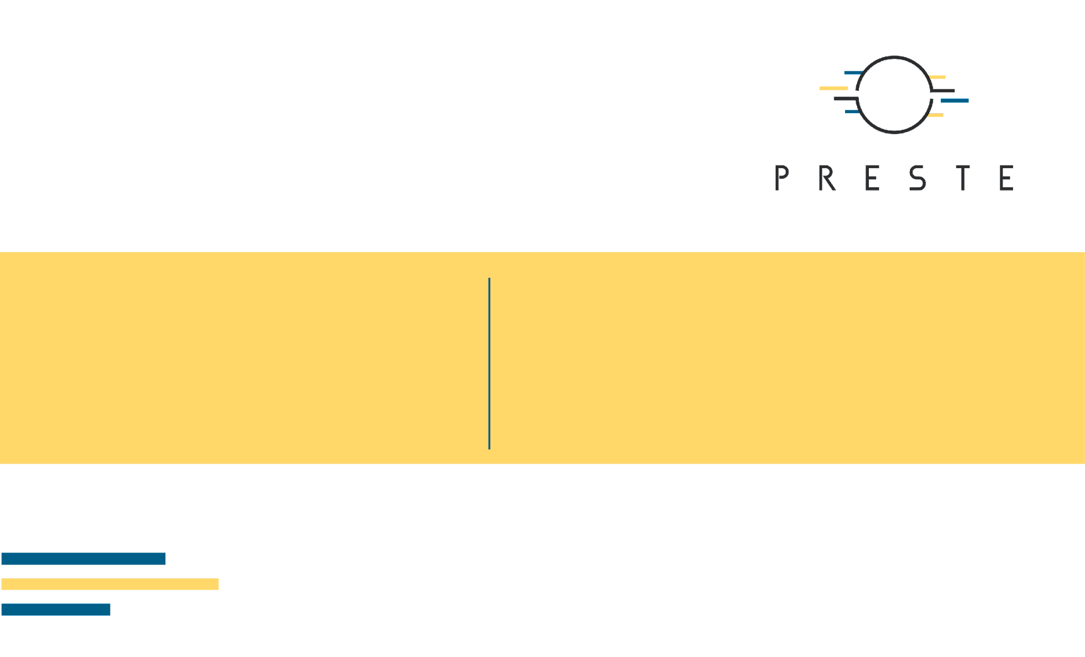
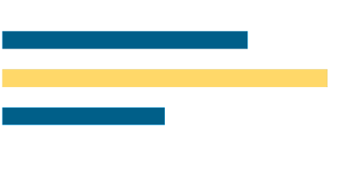
From Nonlinear Regression
to Classification
Polynomial regression · Symbolic regression · Regression zoo · Logistic regression · Classification metrics

Slide 2
What's for today
What if
Polynoms
Regression zoo
Classification
Evaluate
Non-linear data
Curved model
A linear model for every use case
Logistic regression
Metrics

Slide 3

1. When linear regression is not enough
A straight line is just a modelling assumption.

Slide 4
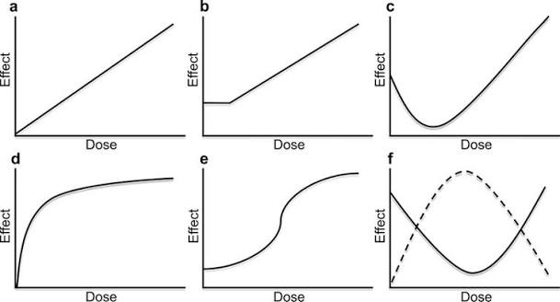
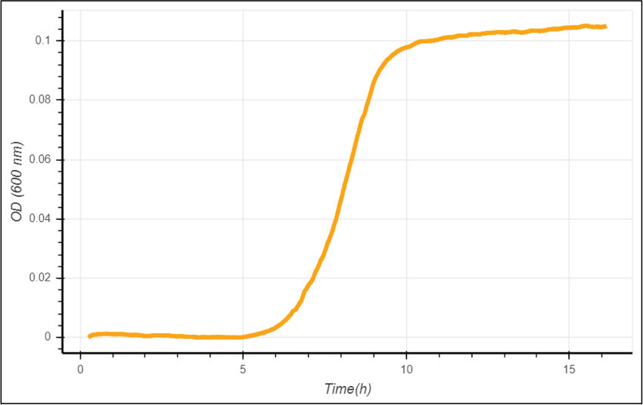
Many biological (and other) relationships are nonlinear
Dose–response
Growth
Physiology
Saturation, thresholds and sigmoidal responses.
Acceleration followed by a plateau or carrying capacity.
Optimal ranges, U-shaped and threshold effects.

Slide 5
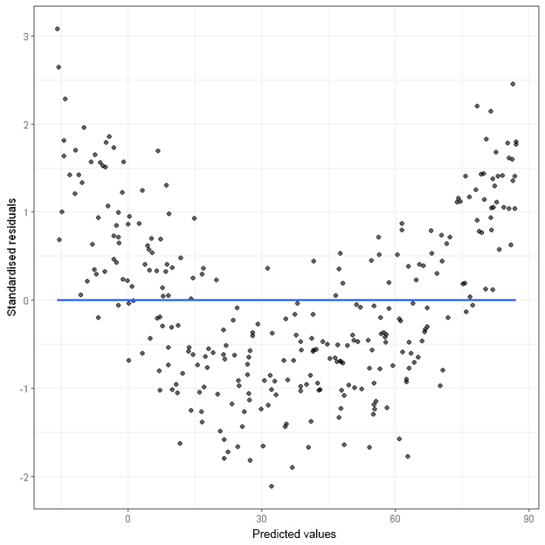
Residual diagnostic

Slide 6
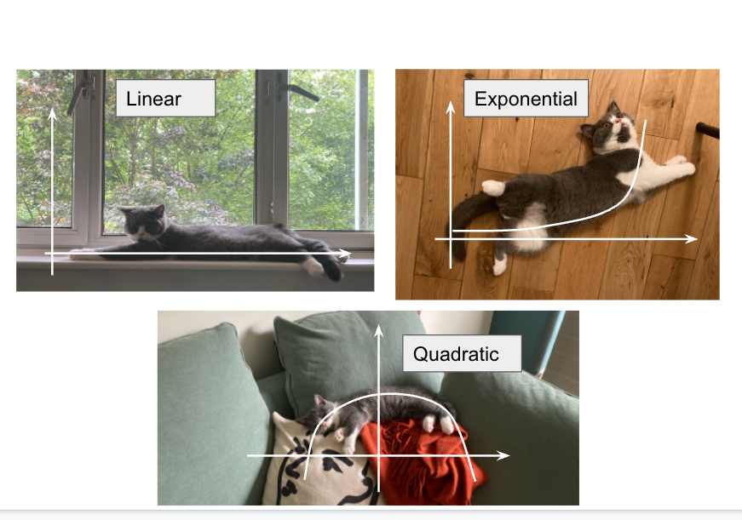
2. Polynomial regression
A linear model can learn nonlinear relationships after feature transformation.

Slide 7
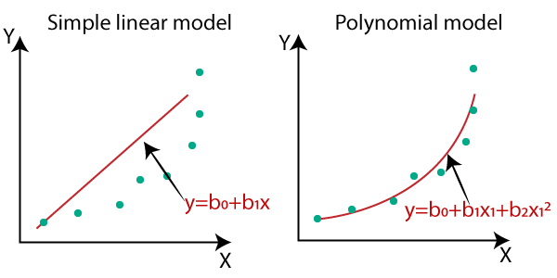
Add nonlinear features, keep a linear model
ŷ = β₀ + β₁x + β₂x²

Slide 8
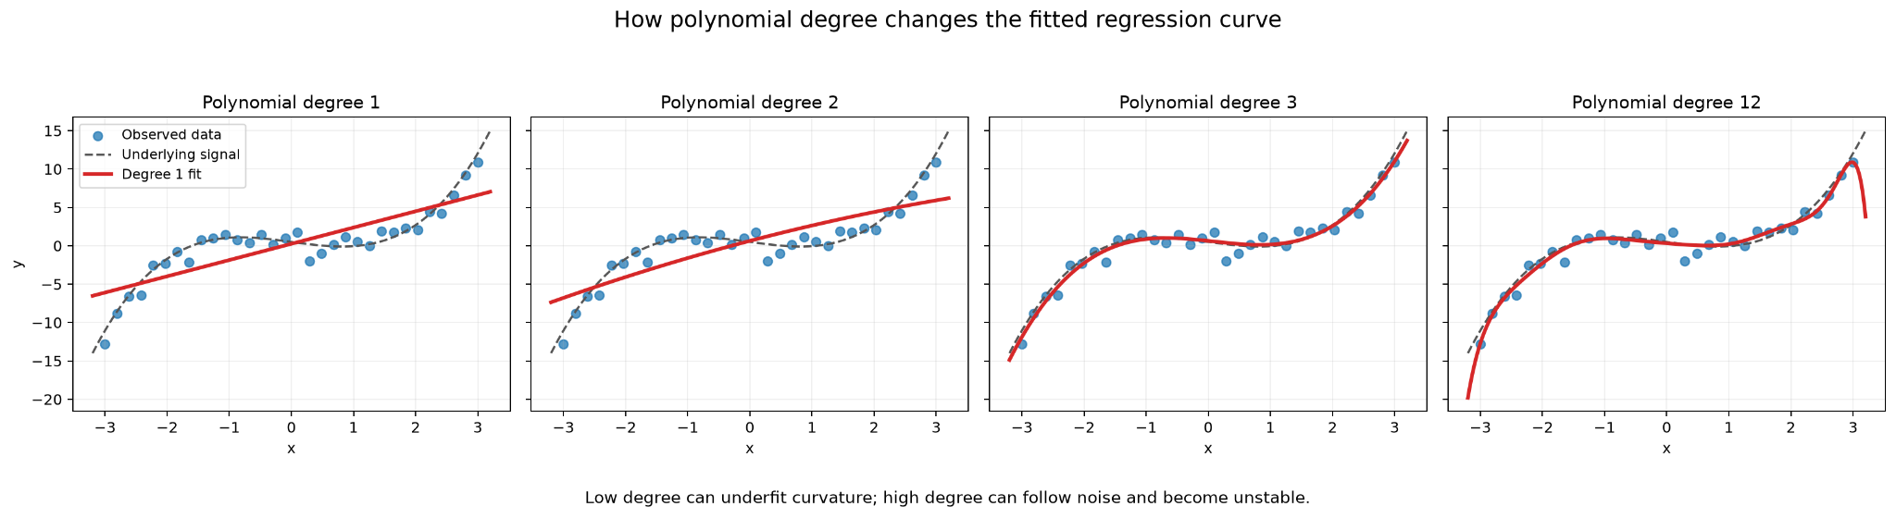
Polynomial degree controls flexibility
Degree 1
Degree 2–3
High degree
Straight line — often underfits curved relationships.
Smooth curvature with moderate flexibility.
Can follow noise and become unstable.

Slide 9
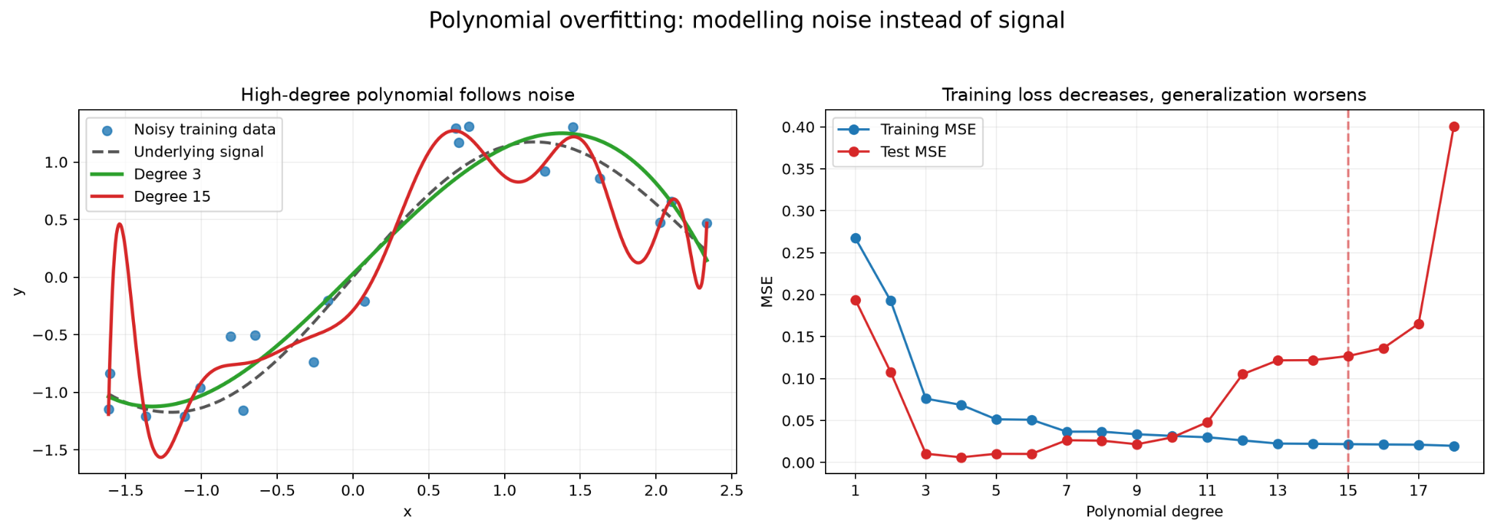
Polynomial regression: limitations
• Degree and included terms are chosen by the analyst.
• Feature count grows rapidly with predictors and degree.
• High-degree models extrapolate poorly.
• A good polynomial fit does not imply a biological mechanism.
• Train/test evaluation remains essential.

Slide 10

3. Symbolic regression
What if the mathematical form itself is unknown?

Slide 11
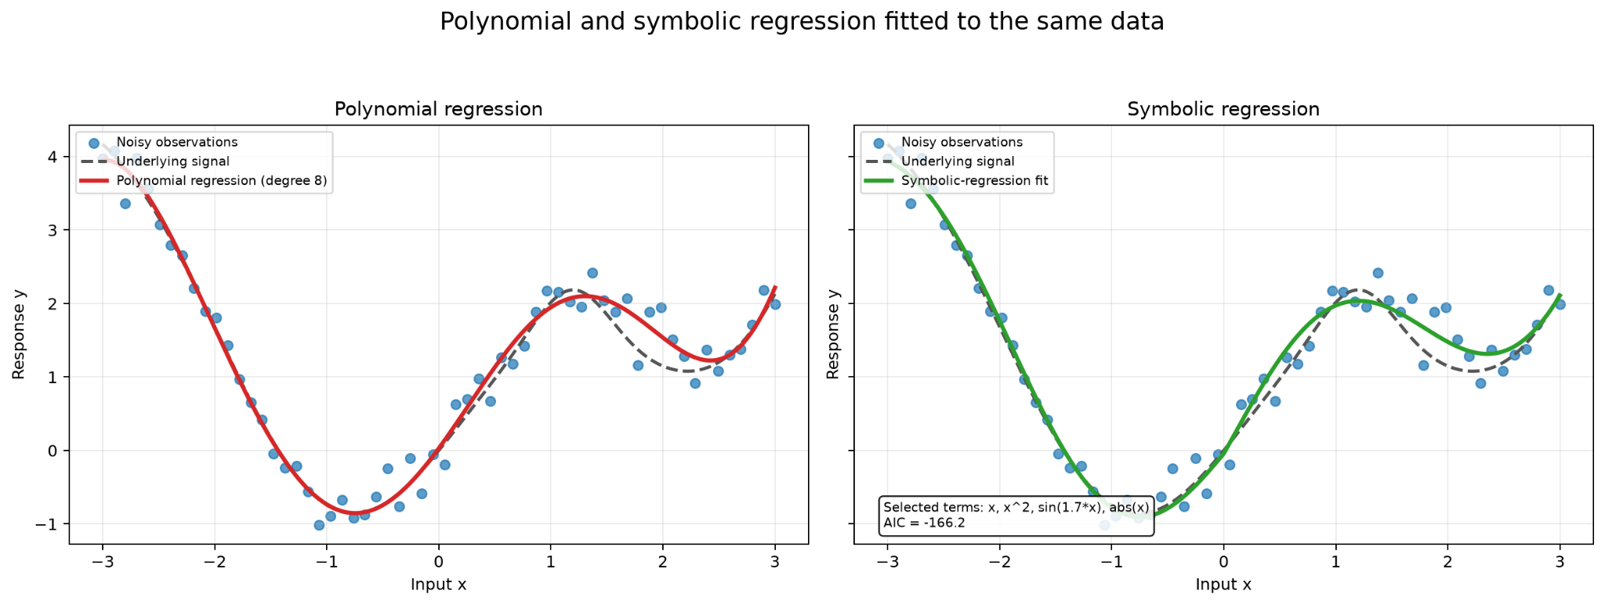
Polynomial versus symbolic regression
Polynomial regression
Symbolic regression
We choose the equation structure and algorithm estimates coefficients.
The algorithm searches expression structure and numerical constants.
ŷ = β₀ + β₁x + β₂x²
ŷ = β₀ + 3sin(x) + 0.5x²

Slide 12
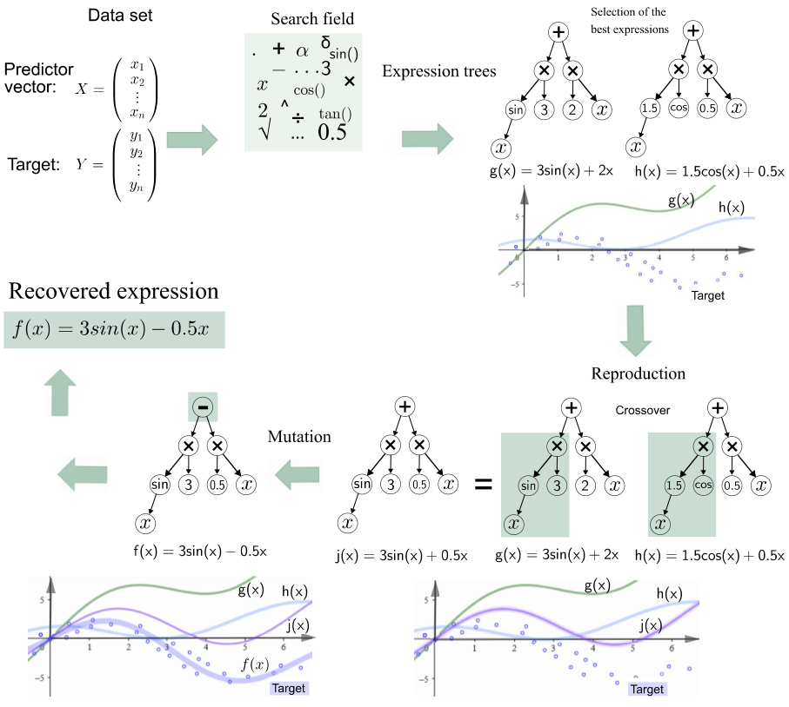
Searching a space of equations
• Candidate operators may include +, −, ×, ÷, powers, log, exp or trigonometric functions.
• Each candidate equation is evaluated on predictive error.
• Complexity must also be penalized or constrained.
• The result can be an explicit human-readable equation.

Slide 13
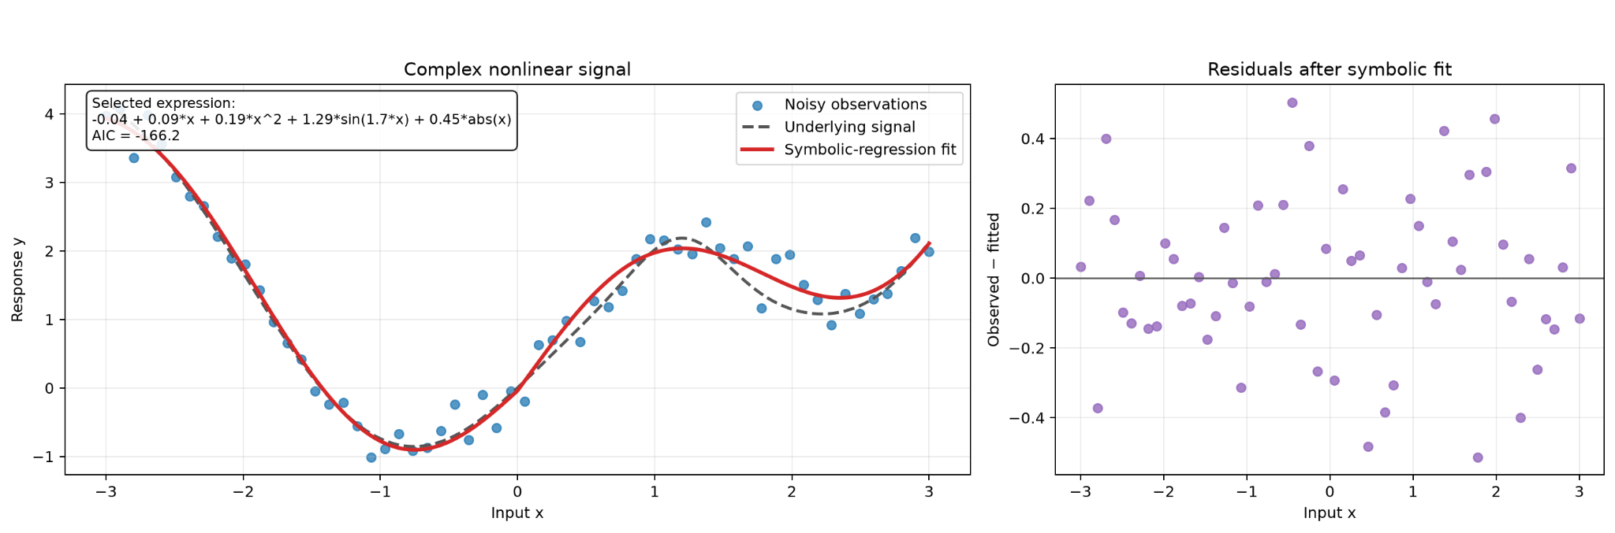
Why use symbolic regression?
Interpretable does not mean mechanistic - still no causal discovery.

Slide 14
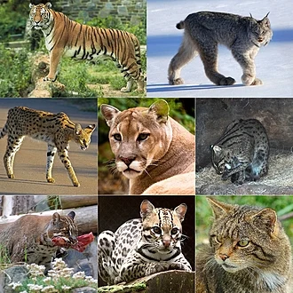
4. Regression zoo
Less-common regression methods worth recognizing.

Slide 15
A map of regression families
Basis/Regions
Representation
Structure
Splines · MARS · GAM · LOESS
If you want curvature.
Robust · Quantile · Poisson · NB
If you deal with something different from mean
Mixed effects · Survival · GP · Bayesian
If your experimental design was awful

Slide 16
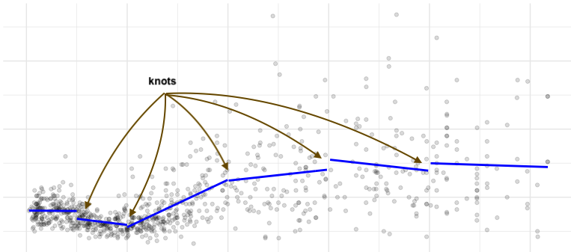
Splines bend the model
Idea
Smooth curves are built from local basis functions joined at knots.
Growth curves, dose–response, age effects, physiological trajectories.

Slide 17
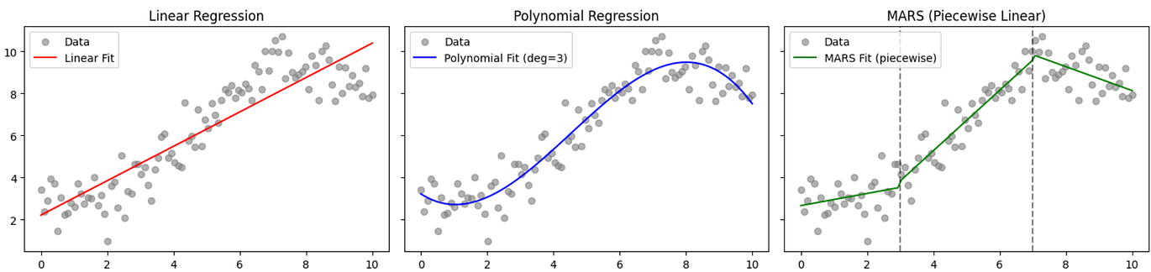
MARS - Multivariate Adaptive Regression Splines
How it works
Builds hinge functions such as max(0, x−t), chooses knots/interactions, then prunes terms.
QSAR, nonlinear biomarker effects, interaction screening, environmental exposure modelling.

Slide 18
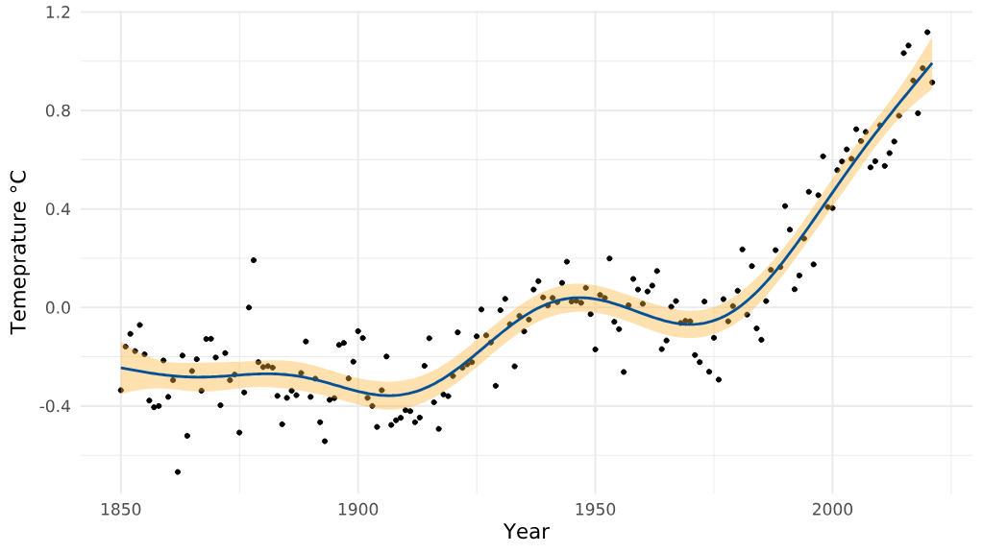
GAM - Generalized Additive Models
Each predictor gets its own smooth function.
Useful for age effects, dose–response and trajectories.
g(E[Y]) = β₀ + f₁(x₁) + f₂(x₂) + … + fₚ(xₚ)

Slide 19
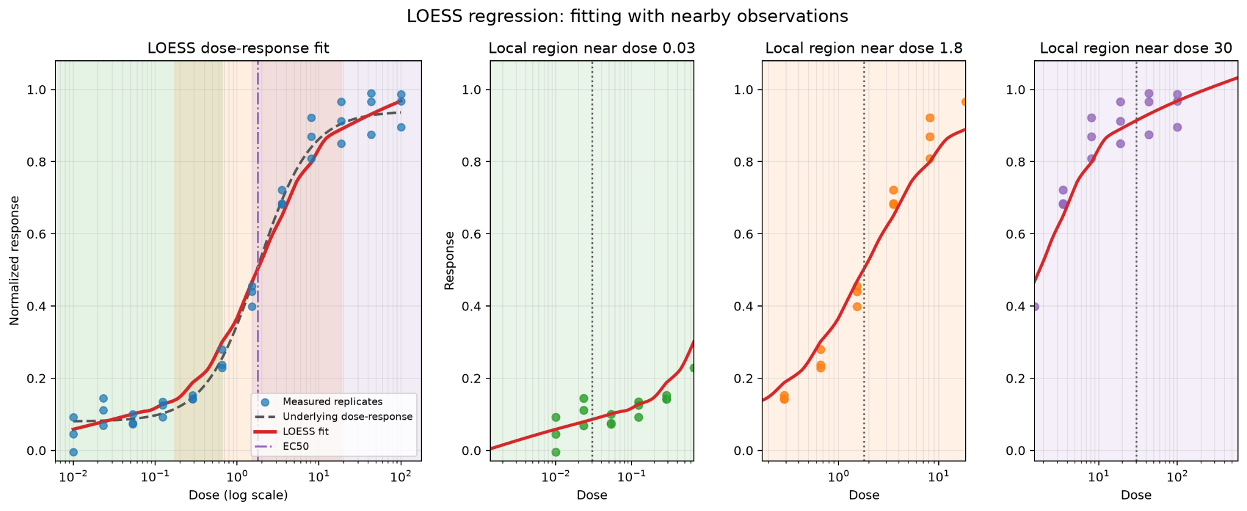
LOESS / LOWESS
Mechanism
Fit a small weighted regression around each query point using nearby observations.
Exploratory trend lines, expression time courses, assay calibration and visualization.

Slide 20
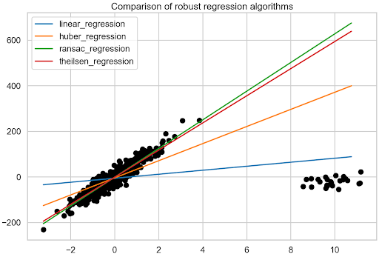
Robust regression when there are a lot of outliers
OLS
Squared errors make extreme residuals very influential.
Robust alternatives
Huber / LAD(Least Absolute Deviations) reduce the influence of extreme observations without simply deleting them.

Slide 21
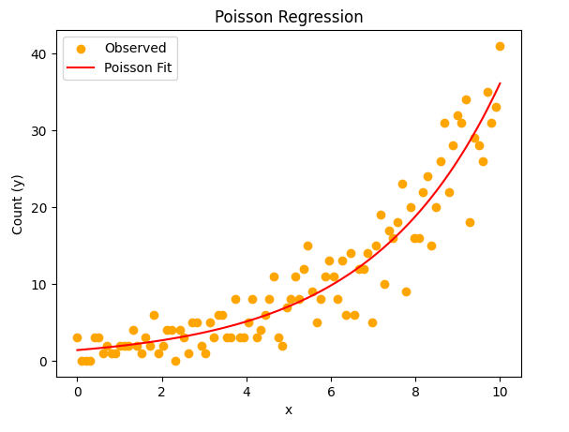
Count regression
Poisson and Negative binomial
Count outcomes/events.
RNA-seq, colony counts, mutation/event counts, ecological abundance.

Slide 22
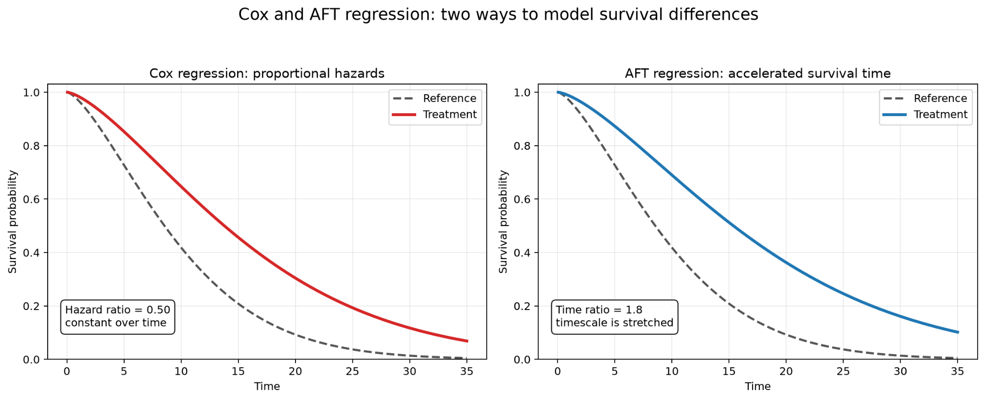
Survival regression
Cox / AFT
Models time-to-event while accounting for censored observations.
Overall survival, relapse, device failure, time to biological event.

Slide 23
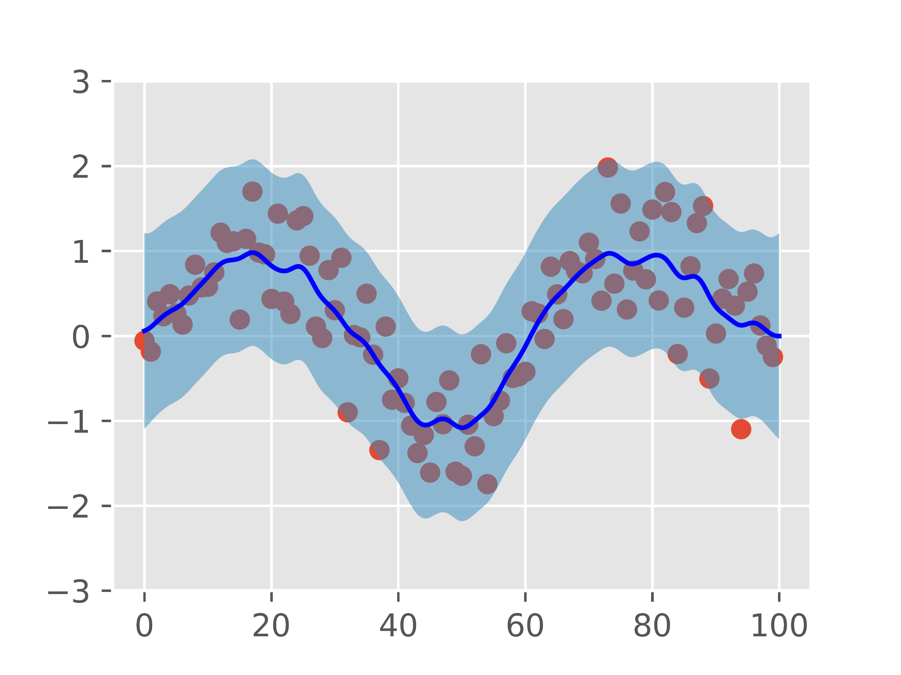
Gaussian Process Regression
f(x) ~ GP(m(x), k(x,x′))
A kernel defines similarity and a probability distribution over plausible functions.
What do we get?
• Nonlinear prediction
• Predictive uncertainty
• Flexibility controlled by the kernel
Where is it useful?
Small-data experiments, dose–response surfaces and Bayesian optimization.

Slide 24
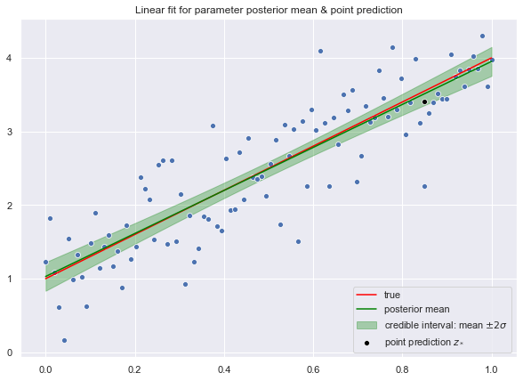
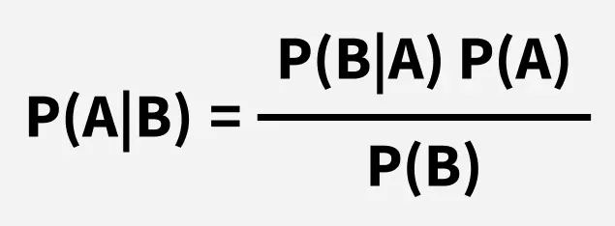
Bayesian regression
Prior information is updated by the observed data.
Prior × likelihood → posterior
Parameters are distributions rather than single point estimates. Uncertainty propagates into predictions.

Slide 25
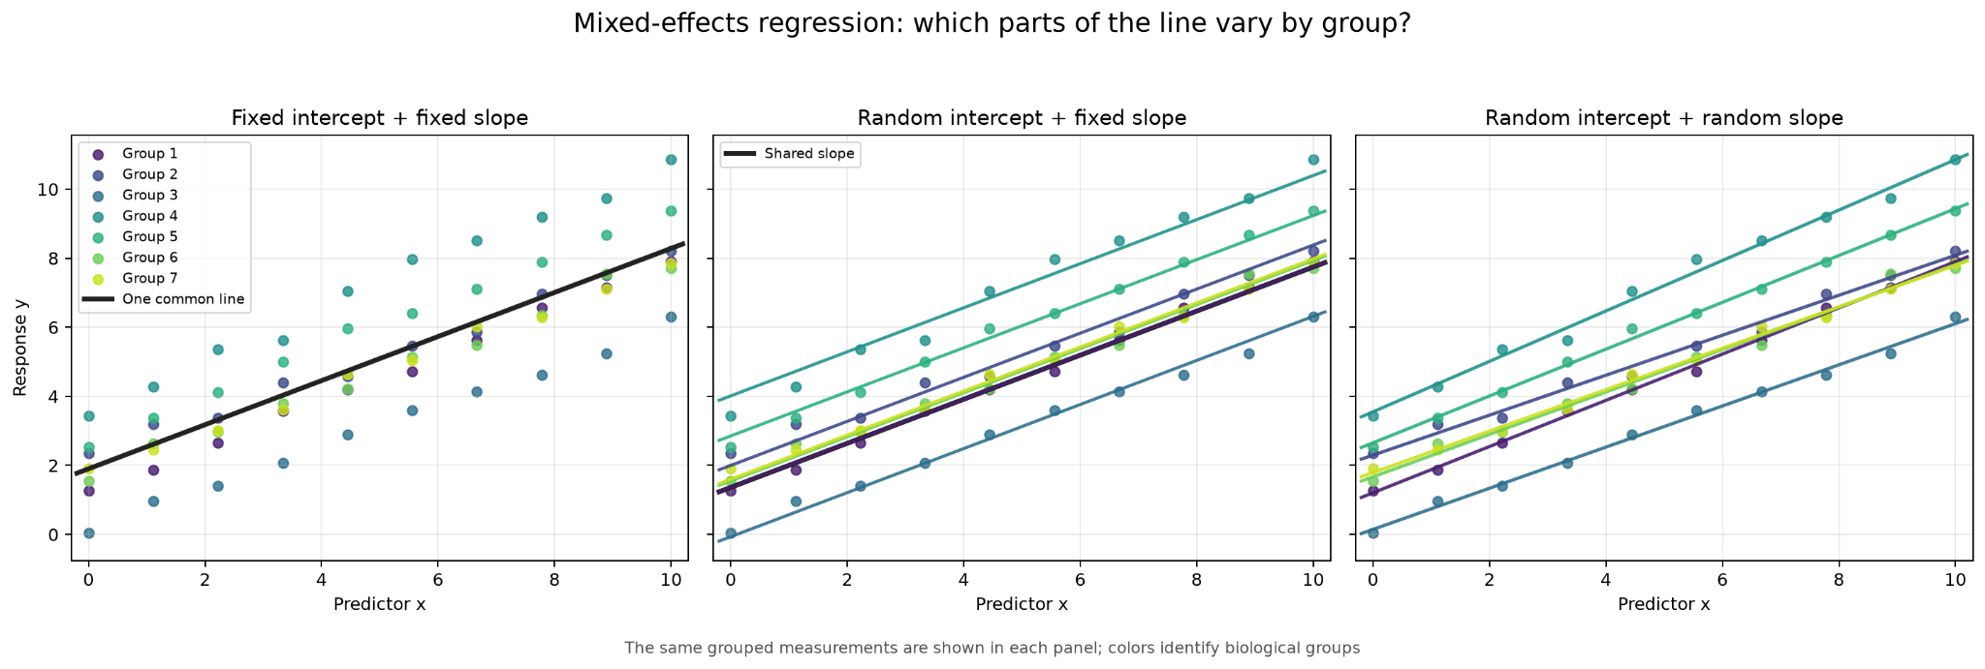
Mixed-effects regression - great for hierarchical data
yᵢⱼ = β₀ + β₁xᵢⱼ + bᵢ + εᵢⱼ
Fixed effect: β₁
Random effect: bᵢ
Use when rows cluster
Population-level effect.
Subject / batch deviation.
Repeated measures, donors, centres.

Slide 26
Which regression method should you think of?
• Smooth nonlinear relation → splines / GAM
• Piecewise changes + interactions → MARS
• Outliers dominate → robust / Huber / LAD
• Effects differ across outcome distribution → quantile regression
• Many correlated predictors → PLSR / PCR / regularization
• Counts → Poisson / negative binomial
• Repeated measures → mixed-effects
• Time-to-event → survival regression
• Small nonlinear data + uncertainty → Gaussian process
• Need an explicit discovered equation → symbolic regression

Slide 27
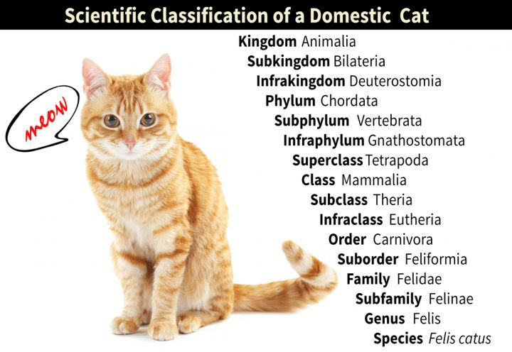
5. From regression to classification
What changes when the target is a category?

Slide 28
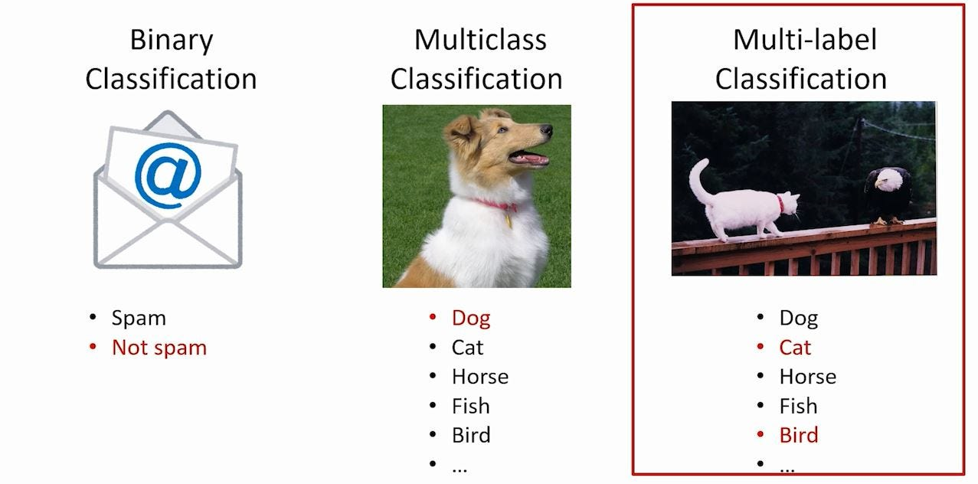
Classification label types
Binary
Multiclass
Multilabel/fuzzy
Two mutually exclusive classes.
Dead - alive.
Cytosol - nuclei.
Effect - no effect.
One class among K possibilities.
Cat - dog - frog - any other animal
Dead - sensitised - irritated - necrotic
Several labels may be true simultaneously.

Slide 29
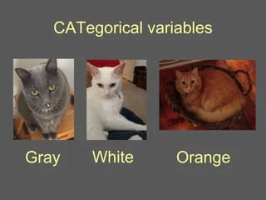
6. Logistic regression
A linear score transformed into a class probability.

Slide 30
Math behind it
Start with the familiar linear model.
For classification, model the probability of class 1.
Transform probability to log-odds, which range from −∞ to +∞.
Invert the logit to recover a probability between 0 and 1.

Slide 31
How to interpret coefficients
logit(p) = b₀ + b₁x
Coefficient b₁
Odds ratio = eᵇ¹
Change in log-odds of Y = 1 for a +1 unit change in x.
How many times the odds are multiplied for a +1 unit change in x.
Example: b₁ = 0.69 = e⁰·⁶⁹ ≈ 2

Slide 32
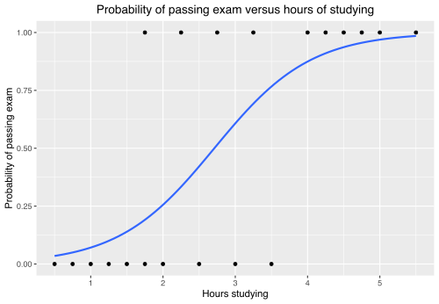
The sigmoid maps score to probability
The linear score z can range from −∞ to +∞.
The sigmoid compresses it to a probability from 0 to 1.

Slide 33
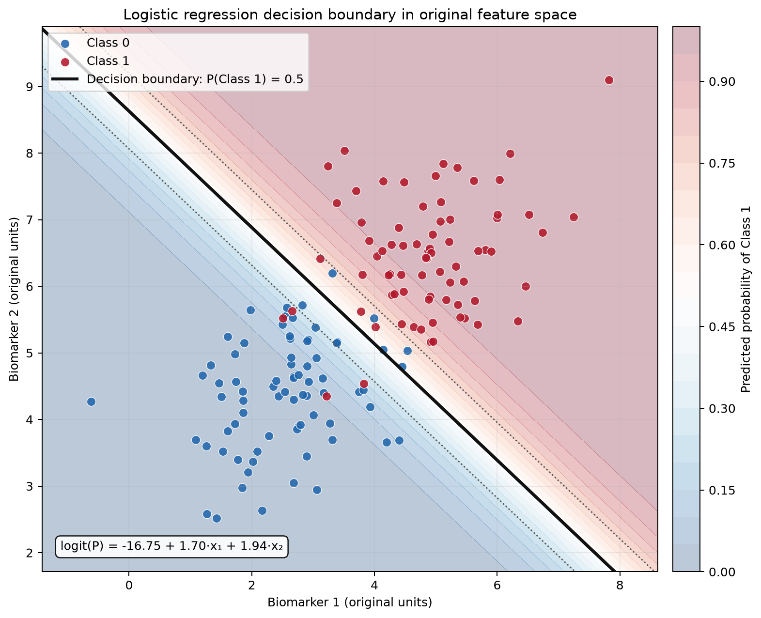
Logistic regression is a linear classifier
Probability
The sigmoid makes the probability response nonlinear.
The default decision boundary remains linear in the original feature space.

Slide 34

7. Probability, threshold and decision
The model produces a probability, a threshold converts it into a class.

Slide 35
Probability is not a class
The model outputs P(Y = 1 | x), not a final class label.
Model output
Threshold
Decision label
p = 0.73
Class 1
t = 0.50 Class 1 | t = 0.80 → Class 0

Slide 36
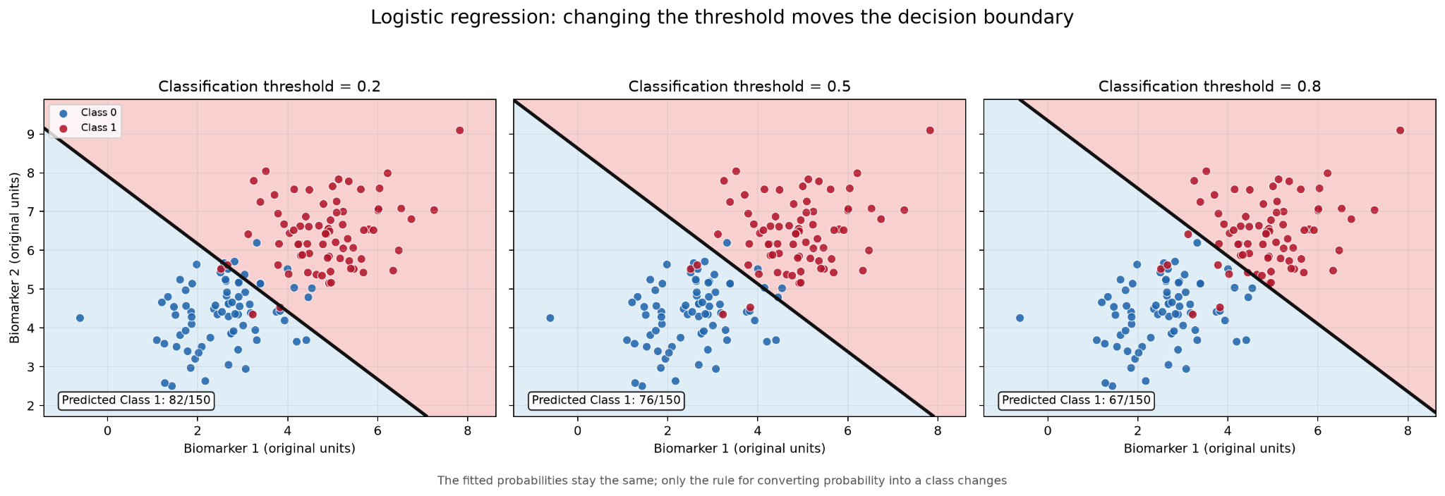
How to select threshold
Lower threshold → more positives → ↑ sensitivity, usually ↓ specificity
Higher threshold → fewer positives → ↑ specificity, usually ↓ sensitivity

Slide 37

8. Classification metrics
A classifier can be wrong in more than one way.

Slide 38
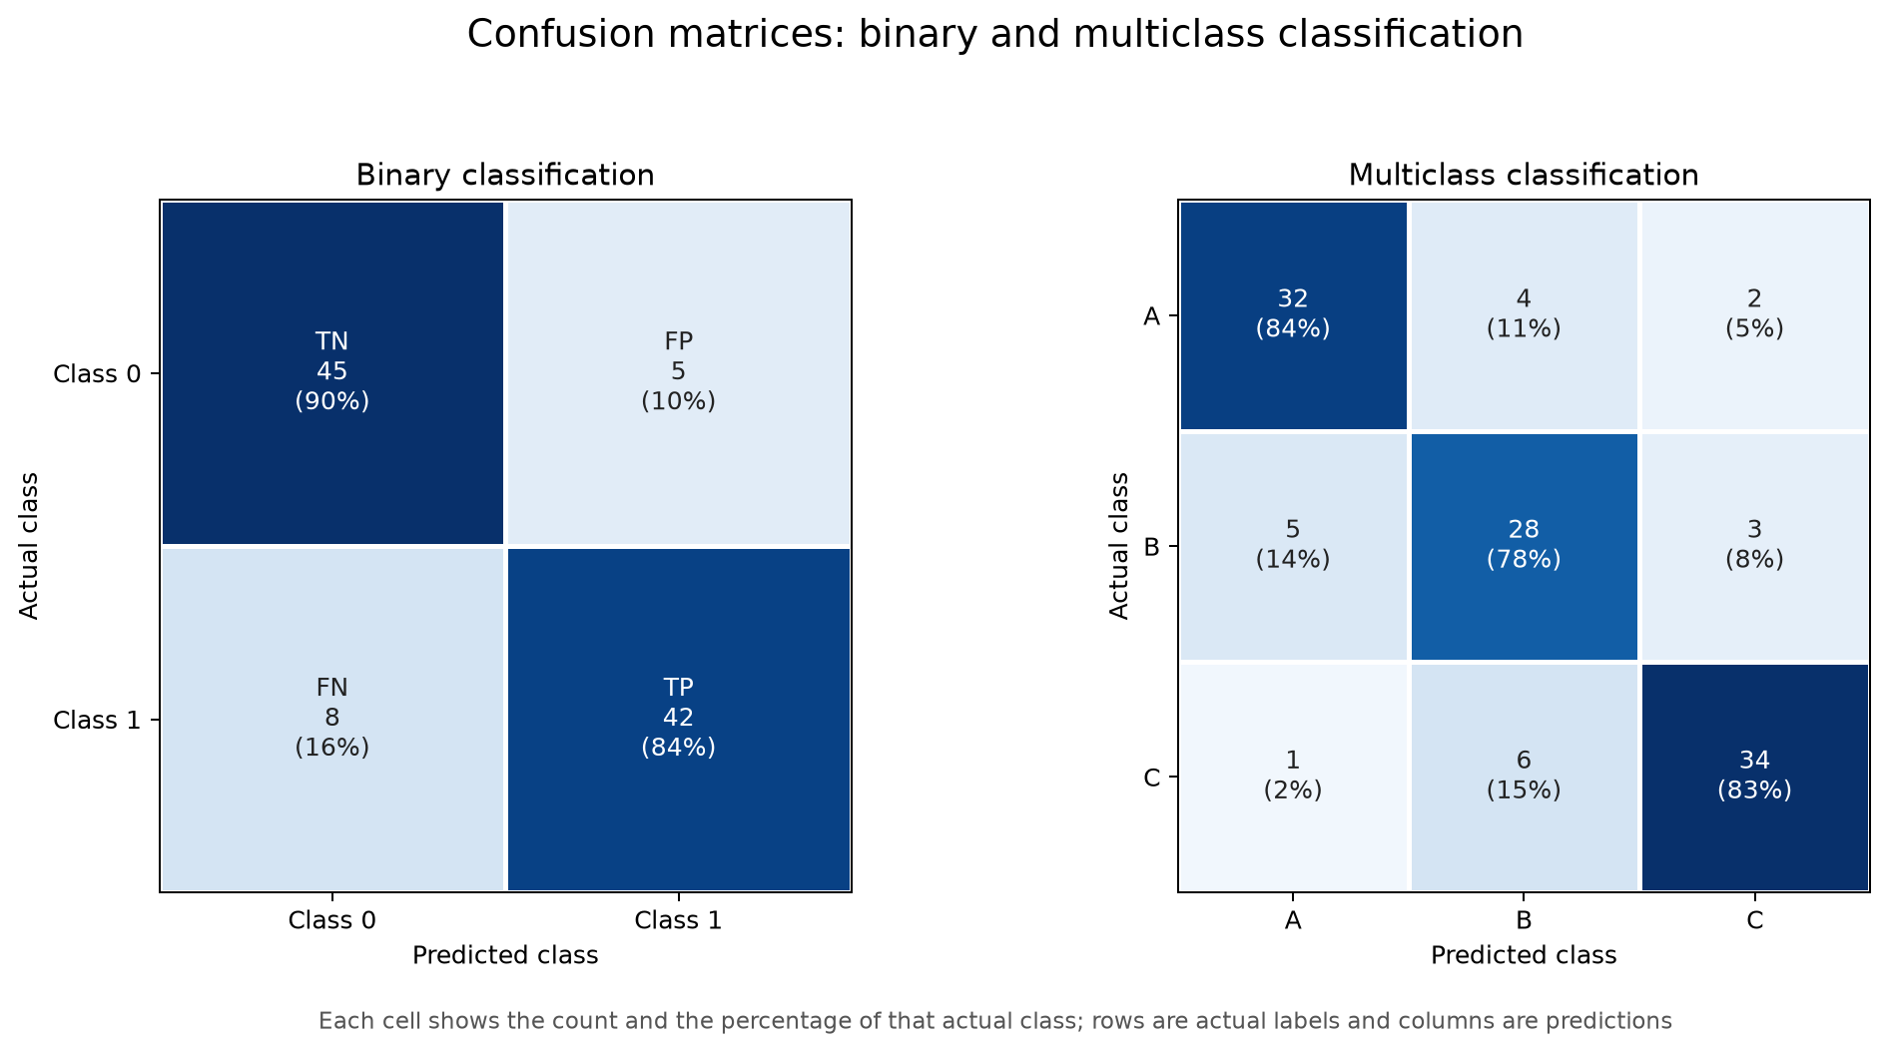
Confusion matrix

Slide 39
When accuracy is not accurate
Sensitivity / Recall
Specificity
TP / (TP + FN)
TN / (TN + FP)
Of all true positives, how many did we detect?
Of all true negatives, how many did we reject correctly?
Precision
F1
TP / (TP + FP)
2 × Precision × Recall / (Precision + Recall)
Of predicted positives, how many were actually positive?
Balances precision and recall in one score.

Slide 40
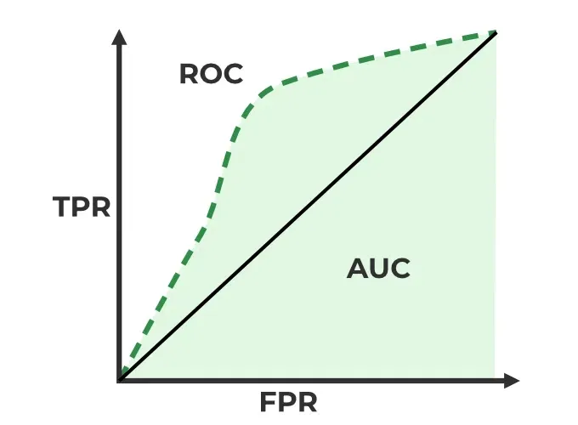
ROC curve
Each point = one threshold
TPR = Sensitivity
FPR = 1 − Specificity
AUC
Summarizes ranking / discrimination across thresholds. Shows model accuracy independent of the threshold

Slide 41
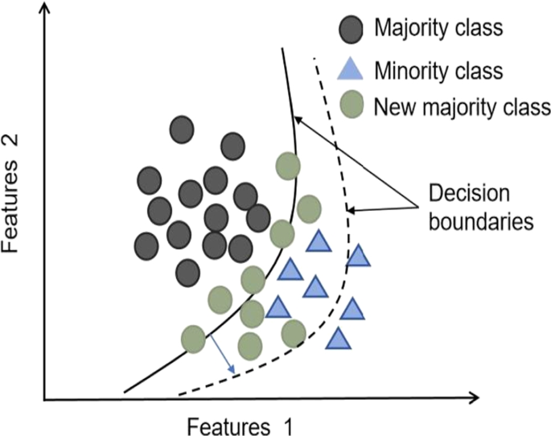
Class imbalance
• Choose metrics that match the scientific objective.
• Use stratified splitting when appropriate.
• Consider class weights or threshold adjustment.
• Resampling changes the training distribution.
• Do not automatically balance prevalence that is scientifically meaningful.

Slide 42
Practical 3
Regression
Classification
Competition
Predict a continuous target. Compare models and validation strategies.
Predict a categorical target. Optimize probabilities, thresholds and metrics.
Released: 80% with targets.
Hidden: 20% for final scoring.
Submit predictions for both tasks, the best scoring one will get a prise..

