Slide 1
Document and Content Analysis
Character Recognition
Thomas Breuel

Slide 2
OCR steps
cut apart pages into text lines and images
cut apart each text line into characters
recognize each character
re-assemble the page text

Slide 3
page → text lines
(Talked about this last time.)

Slide 4
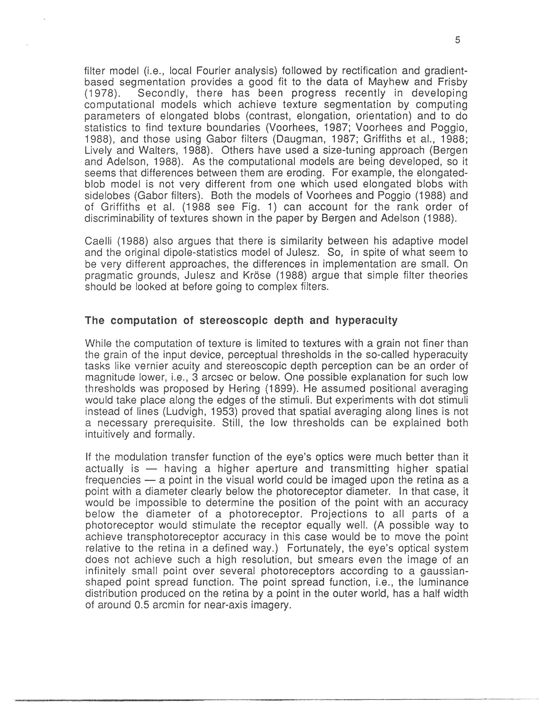
original page
book/0005.png

Slide 5
text lines
0005/0001.png
0005/0002.png
0005/0003.png
0005/0004.png
0005/0005.png
0005/0006.png ...

Slide 6
text line → characters
How do you cut apart a line of text into characters?

Slide 7
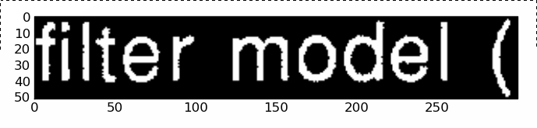
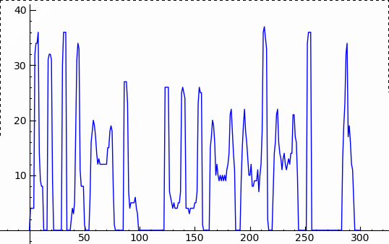
segmentation by projection

Slide 8
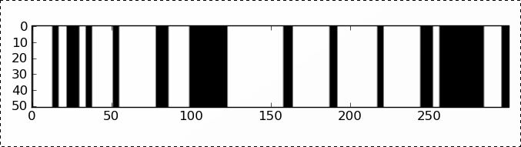
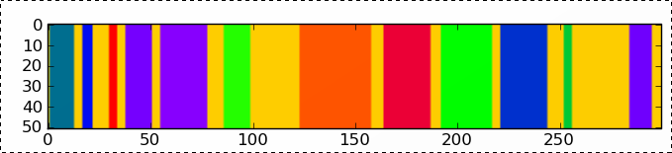
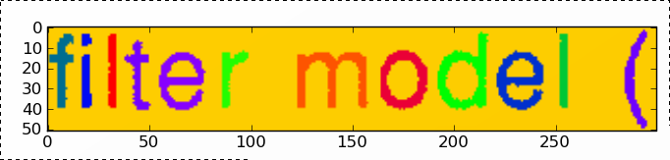
segmentation by projection
compute segmentation
components
label connected
components
“and” with original
binary image

Slide 9
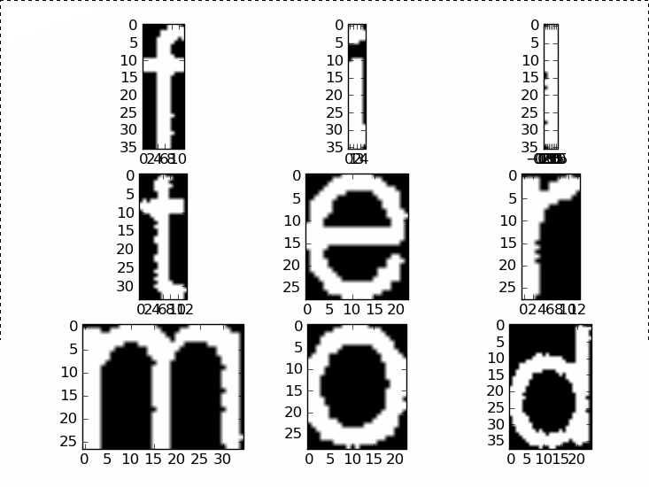
segmentation by projection

Slide 10
segmentation by projection
input
  binary text line image
algorithm
  project along the vertical axis
  find low/zero regions in projection profile
  generate an image where those “bands” are set to 0, all other values are 1
  label connected components
  intersect the connected components with the original binary image
output
  color-coded segmentation image

Slide 11
recognition by template matching

Slide 12
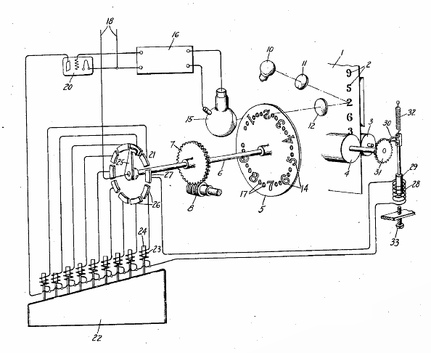
recognition by template matching
Handel, 1933

Slide 13
recognition by template matching
idea
  put different templates on top of each character
  see which template matches best
  return the identity associated with the template

Slide 14

correlation
(Simple) correlation is like convolution, except that the offset is added,
rather than subtracted.
(Normalized or statistical cross-correlation is something different.)

Slide 15
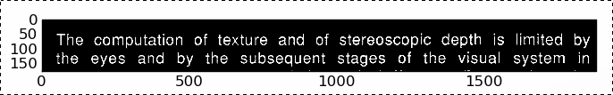
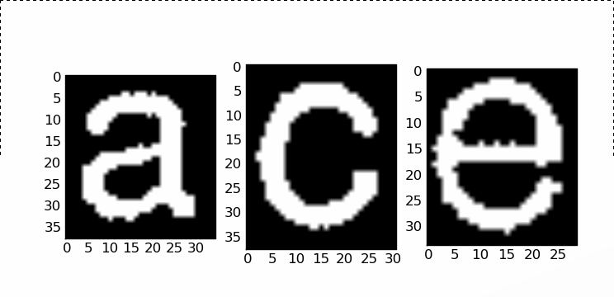
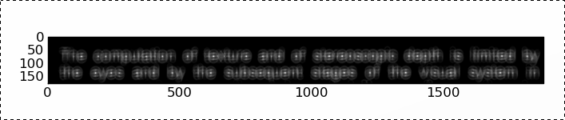
template matching

Slide 16
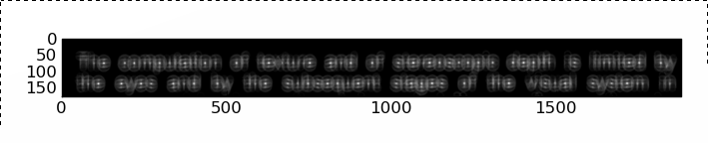
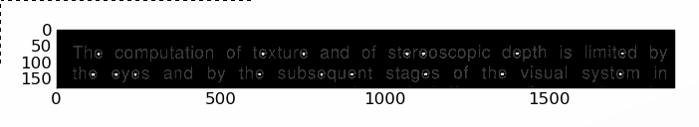
detection threshold

Slide 17
template matching
above example
  pick a template and slide it across entire image
  inefficient: many places matched that needn't be
real-world recognition
  partition the image into character subimages
  take each character
  slide the template around each character a little bit
  compute the maximum correlation as quality-of-match
  return the best matching template

Slide 18
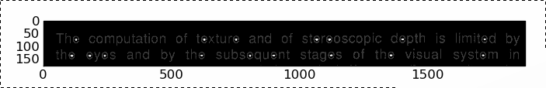
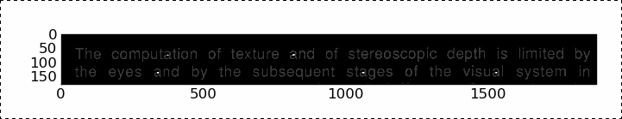
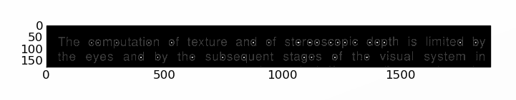
template matching
template_e
template_a
template_c

Slide 19
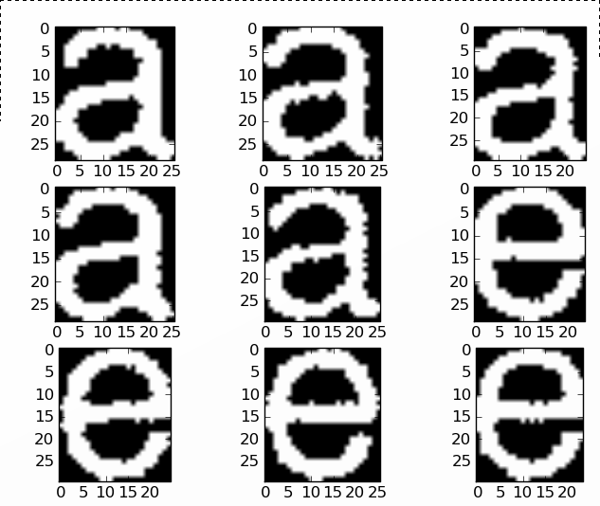
recognition by template matching

Slide 20
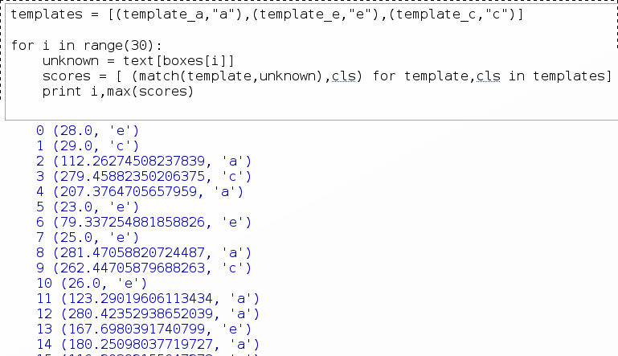
template matching

Slide 21
text line recognition
text line segmentation
  compute vertical projection profile
  threshold
  segment into characters
recognition
  extract each character
  match against a list of templates
  return the character code of the best-matching template

Slide 22
Are we done?

Slide 23
problems
segmentation by projection
  italics, ligatures, kerning
  touching / broken characters
recognition by template matching
  slow
  bad recognition accuracy
    size, shape variation, noise, italics
    new fonts etc.
    thresholds?

Slide 24
better segmentation

Slide 25
typographic phenomena
To
aﬃne
kerning
touching characters &
ligatures
light
italics

Slide 26
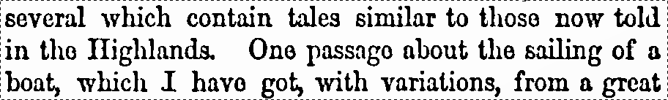
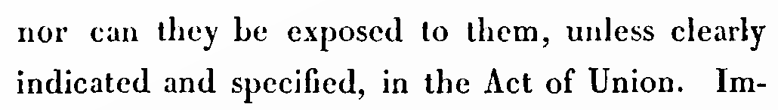
image degradation

Slide 27
“simple approach”
assume that segmentation mostly works
try to recognize things
check the resulting words against dictionary
if it doesn't fit...
  backtrack...
  try to identify characters that can be split/merged...
  try to recognize again
properties
  fast, intuitive... but requires a lot of tuning
  doesn't generalize well to severely degraded

Slide 28
better text line segmentation
better cutting algorithm
  allow curved cuts
  dynamic programming algorithm finds optimal paths
two step
  first, cut characters apart
  second, group character parts together

Slide 29
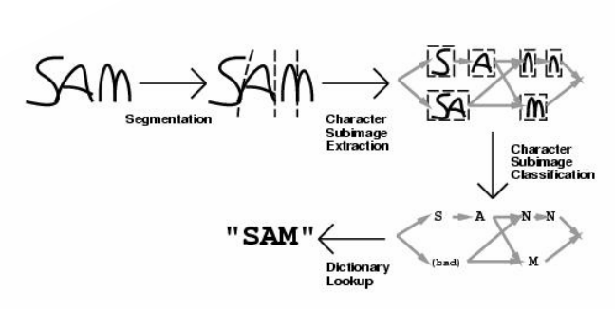
oversegmentation

Slide 30
cuts by dynamic programming
step = 1
diagonal = +0.5
black = +2
2.5
2
2.5
2
2.5
1
1
1
1
1
1
1
1
1
1
1

Slide 31
cuts by dynamic programming
step = 1
diagonal = +0.5
black = +2
14.5
15
15.5
14
14.5
11.5
12
12.5
13
13.5
10.5
11
11.5
12
12.5
9.5
10
10.5
8
8.5
9
7
7
7.5
8
6
6
6.5
5
5
5
7.5
4
4
4
4
6.5
6
6
6
3
3
3
3
5
5
5
5
5
2
2
2
2.5
2
2
2
2
4
4
4
2
1
1
1
1
1
1
1
1
1
1
1

Slide 32
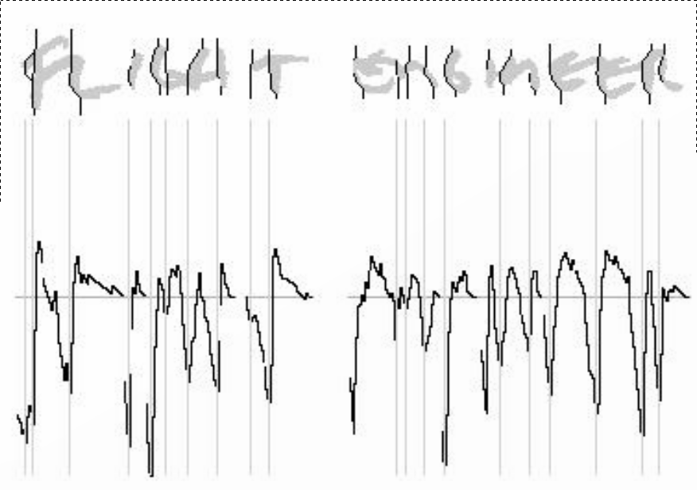
cuts by dynamic programming

Slide 33
cuts by dynamic programming
input
  image of a text line
algorithm
  compute center line of text line
  propagate costs inward
  trace paths outward from center line
    this guarantees a path at every point
  plot costs vs x-position
  pick those cut paths that have a local min.
output
  collections of cut-paths through the image

Slide 34









cuts vs characters
darn

Slide 35
segmentation graph
consider each cut a node in a graph
for every pair of cuts no more than n apart
  consider the edge between the two nodes...
  associate it with the image delimited by the cuts

Slide 36
segmentation graph

Slide 37
segmentation graph
nodes
  cuts
edges
  images delimited by cuts
small encoding of possible segmentations
  exponential # segmentations possible
path through the graph
  a particular interpretation of the input

Slide 38
after classification
*
r
*
*
*
a
n
d
*

Slide 39
after classification
clarri, clarn, darri, darn, clam, dam
l
r
r
i
c
a
n
d
m

Slide 40
segmentation graph interpretation
classifications aren't perfect
each classification has a “cost”
what's the best interpretation of the graph?

Slide 41
after classification
clarri, clarn, darri, darn, clam, dam
0.7
r
r
i
c
l
0.8
0.3
2.3
1.1
a
n
d
0.5
m
0.2
0.3
min cost = 0.3 + 0.5 + 0.3 + 0.2 = 1.3
1.4

Slide 42
questions
how should we compute the “costs”?
should we add them?
can we compare different paths?
what about paths with different lenghts?
what about non-characters?
what about dictionaries?
relationship to HMMs?

Slide 43
better classification

Slide 44
classifiers
0.3
9.5
-7.1
255.3
244
-1
-1
0
1
17.4
class 17

Slide 45
nearest neighbor classifier
def classifier(x):
best_c = -1
best_d = infinity
for v,c in training_examples:
d = dissimilarity(v,x)
if d<best_d:
best_d = d
best_c = c
return best_c

Slide 46
classifiers
a classifier assigns classes to input patterns
classifiers classify based on training data
new patterns are often not identical to known ones, merely similar
classifiers need to generalize to such novel patterns
input patterns are typically real vectors of fixed dimension

Slide 47
what makes classification hard?
variations in position, size, orientation
noise and image degradation
large number of fonts
context-dependence of interpretation

Slide 48
example: size / orientation
a
a
a
a
a

Slide 49
example: context
o
lower case “o”
capital “O”
digit “0”
mathematical circle symbol

Slide 50
example: context
To
lower case “o”
capital “O”
digit “0”
mathematical circle symbol

Slide 51
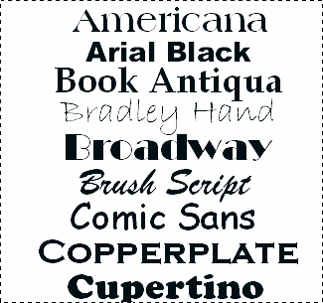
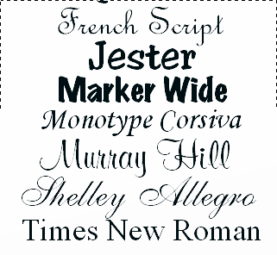
example: font variability
similar to humans
very different as bit patterns

Slide 52
dealing with variability & context
noise removal & preprocessing
text line modeling
size normalization
slant normalization
context-dependent classifiers

Slide 53

text line modeling
char 1: ascender
char 2: no ascender/descender

Slide 54
size normalization
classifier takes fixed dimensional input
characters come in all sizes
absolute size/position is meaningless
relative size/position is important
how do we reconcile this?

Slide 55
approach 1: scanning
locate the baseline and x-height
rescale the line s.t. the x-height is 10 pixels
make the window 30x30
place baseline at y=10, x-height at y=20
  (why not simply make the whole line 30 pixels high?)
center on characters and mask neighbors

Slide 56
approach 2: extract, encode, resize
+ y-pos/x-height + height/x-height
extract each character
rescale to fit into 30x30 bounding box
encode y-position relative to baseline
encode height
units: x-height

Slide 57
normalization by moments
fit into target image of size w x h
compute the centroid of the character
  put the centroid at the center of the image
compute the trace of the covariance matrix
  rescale to given value
compute the slant of the character
  apply a skew transformation to achieve zero slant

Slide 58
normalization by bounding box
fit into target image of size w x h
two possibilities
  rescale anisotropically so that the character fills the target
  rescale by the minimum horizontal / vertical scale
more possibilities
  switch between anisotropic and isotropic
  don't scale up, only scale down

Slide 59
image scaling
image scaling by subsampling
  doesn't work well by itself
  think about thin lines
image scaling by antialiasing + subsampling
  the correct thing to do
  works significantly better

Slide 60
labeling tools

Slide 61
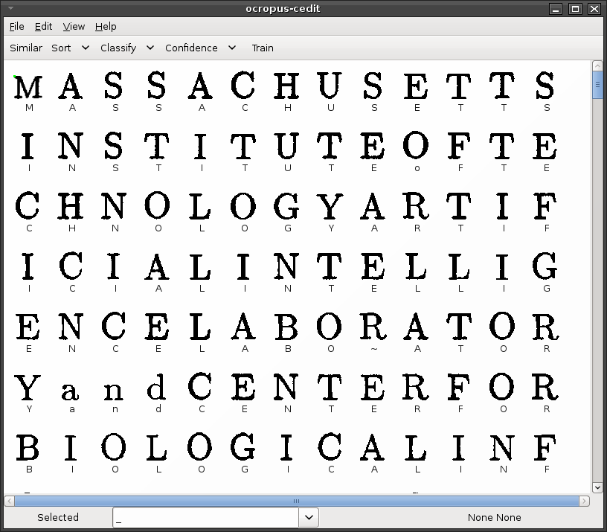

Slide 62
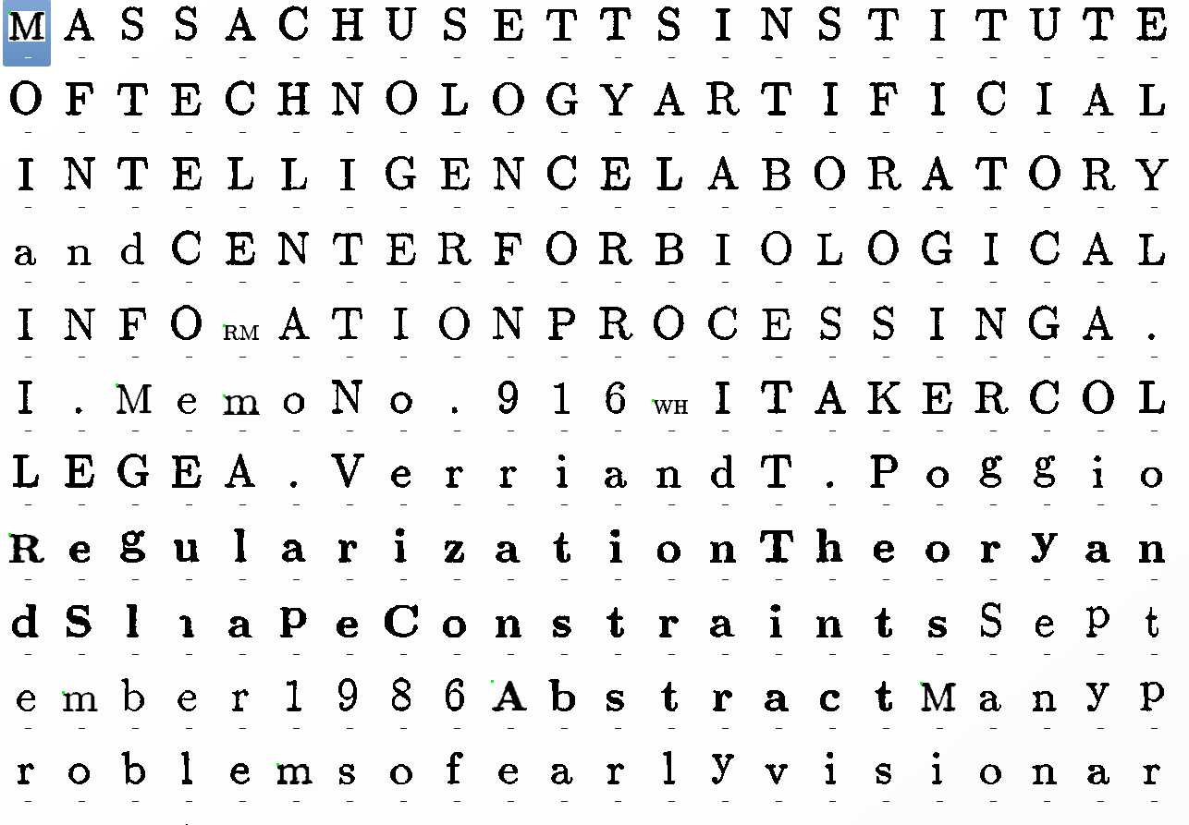

Slide 63
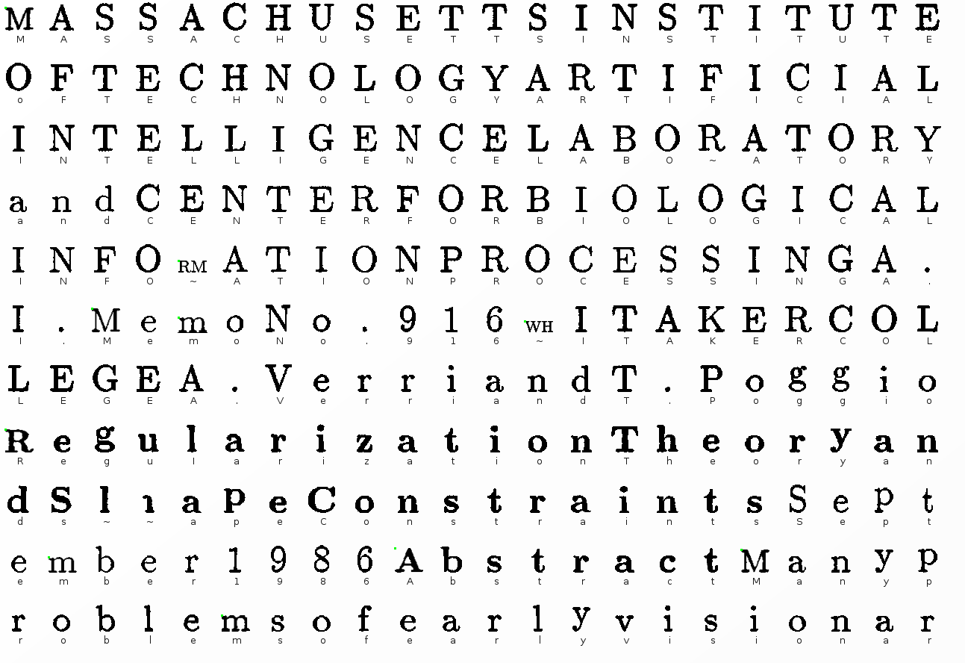

Slide 64
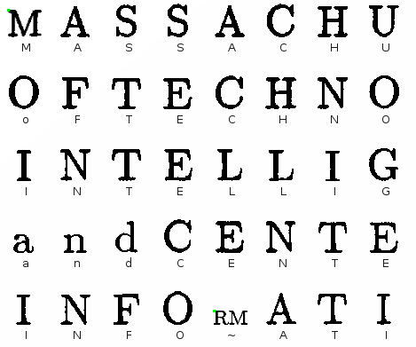

Slide 65
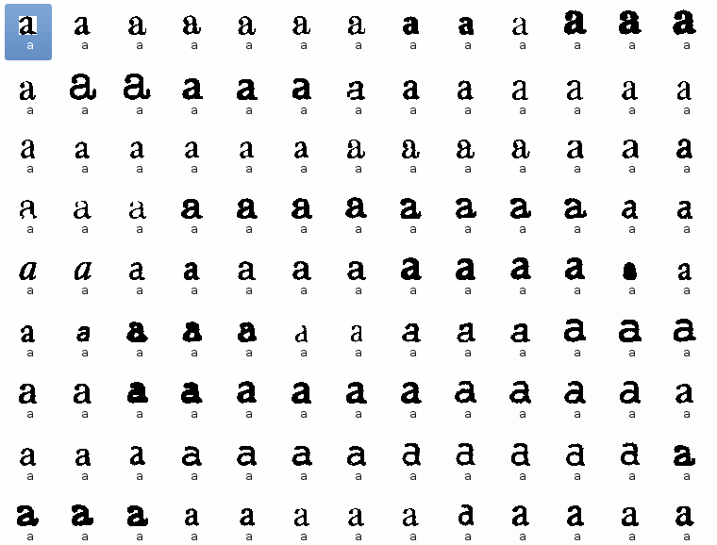

Slide 66
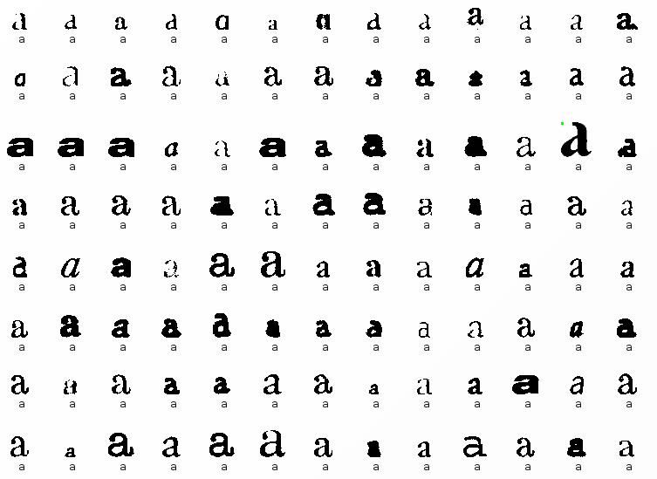

Slide 67
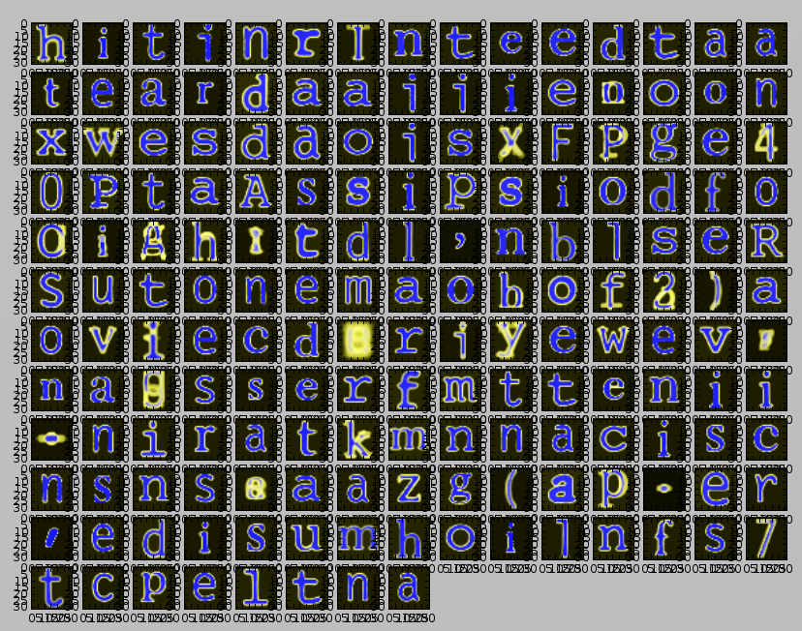

Slide 68
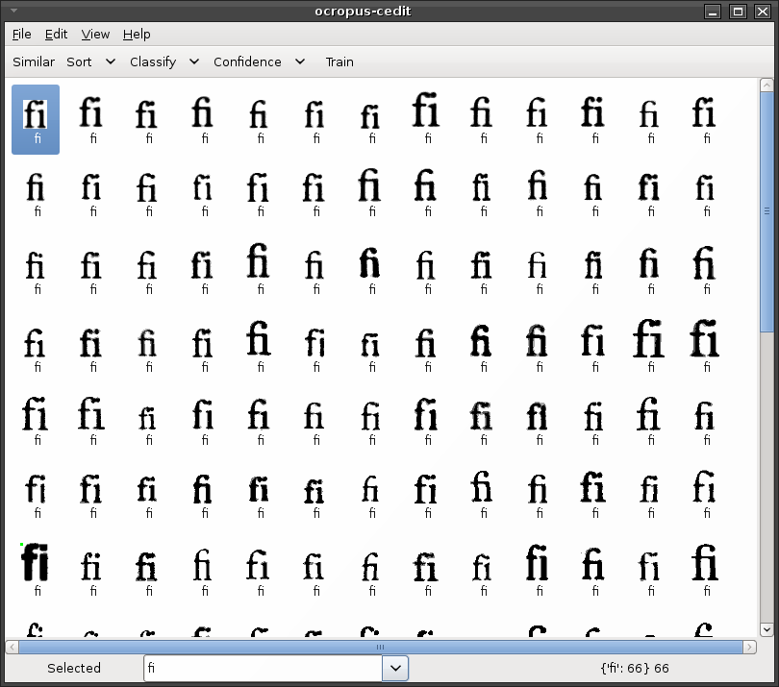

Slide 69
summary

Slide 70
text line recognition
simple approach
  projection-based segmentation into characters
  template matching for character recognition
  dictionary + backtracking
better approach
  dynamic programming segmentation
  segmentation graph
  best path search
  shape normalization prior to classification

