Slide 1
Document and Content Analysis
Layout and Markup
Thomas Breuel

Slide 2
Outline
markup
logical vs physical
TeX, LaTeX, SGML, DocBook, HTML, CSS
wiki formats
microformats
typesetting, page layout, reflow

Slide 3
pre-computer output

Slide 4
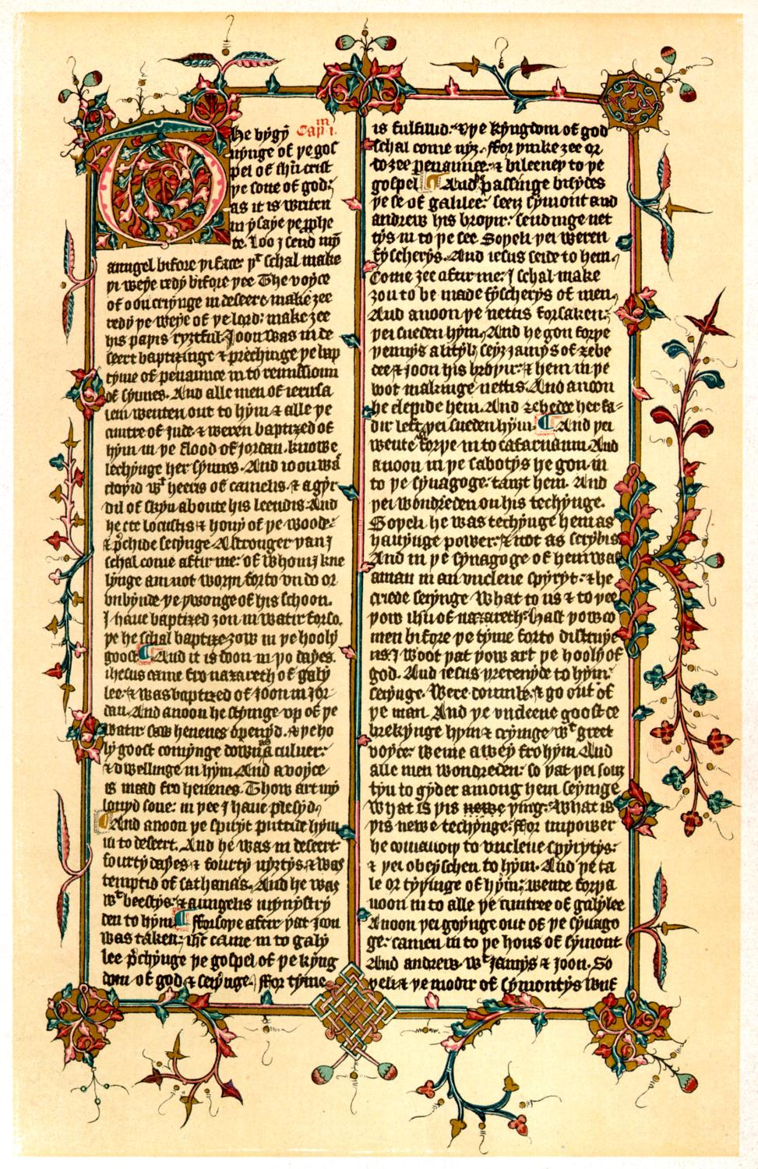
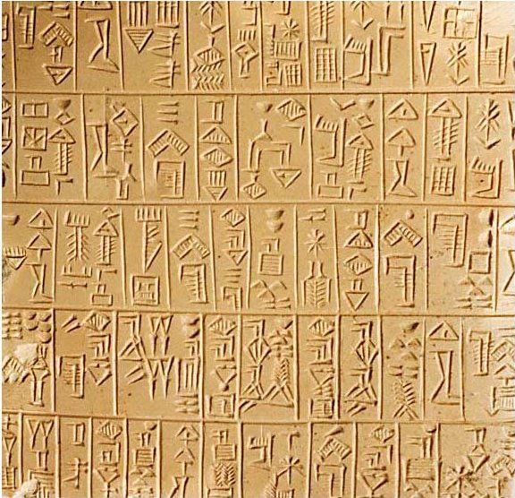
stylus and pen

Slide 5
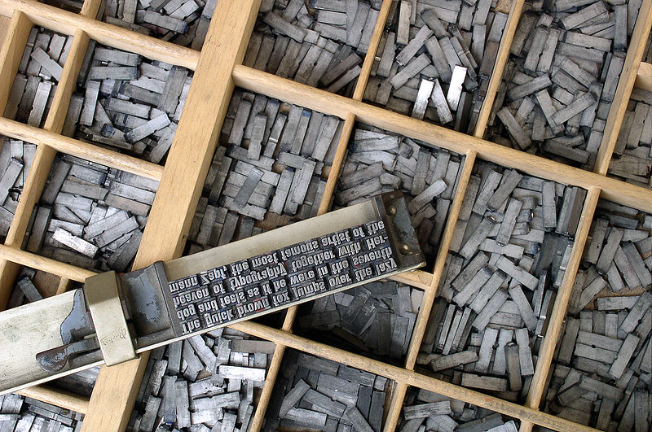
typesetter

Slide 6
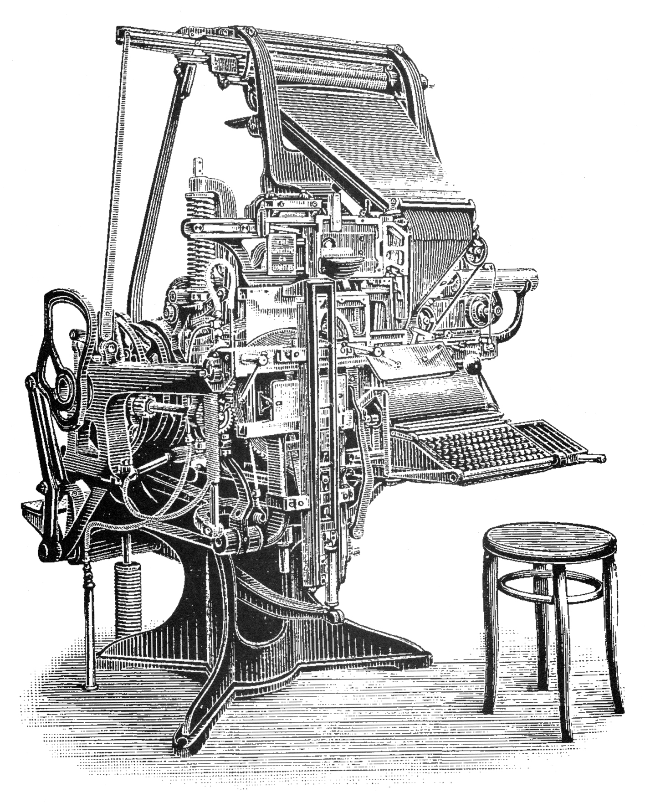
typesetter

Slide 7
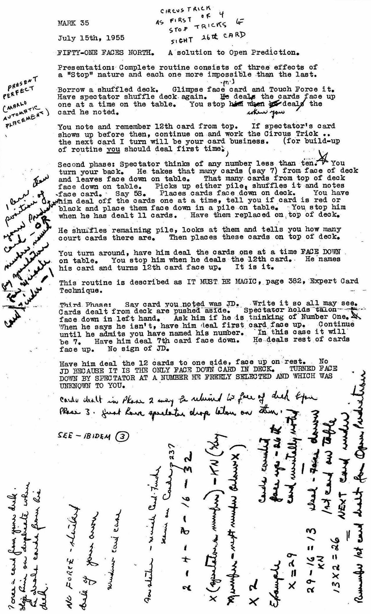
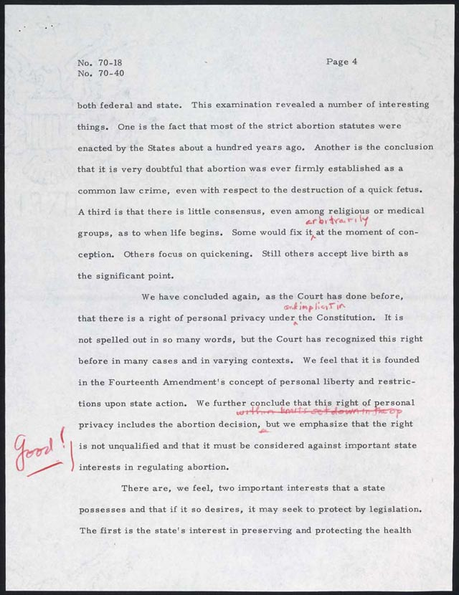
typewriter

Slide 8
pre-computer output
do anything that the medium permits
  arbitrary positioning
  manual annotations
  drawing lines, scribbles, ...

Slide 9
computer printers

Slide 10
printing technologies
teletype
  upper case, monospaced
electronic typewriters, line printers
  full character set, monospaced
photographic typesetting machines
  high quality, proportional spacing
dot matrix, laser printers
  pixel-addressable, render any b/w image

Slide 11
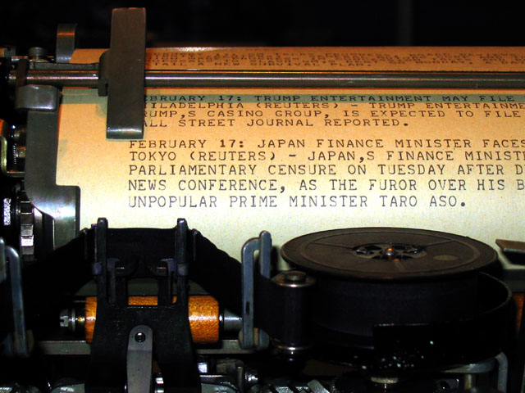
teletype

Slide 12
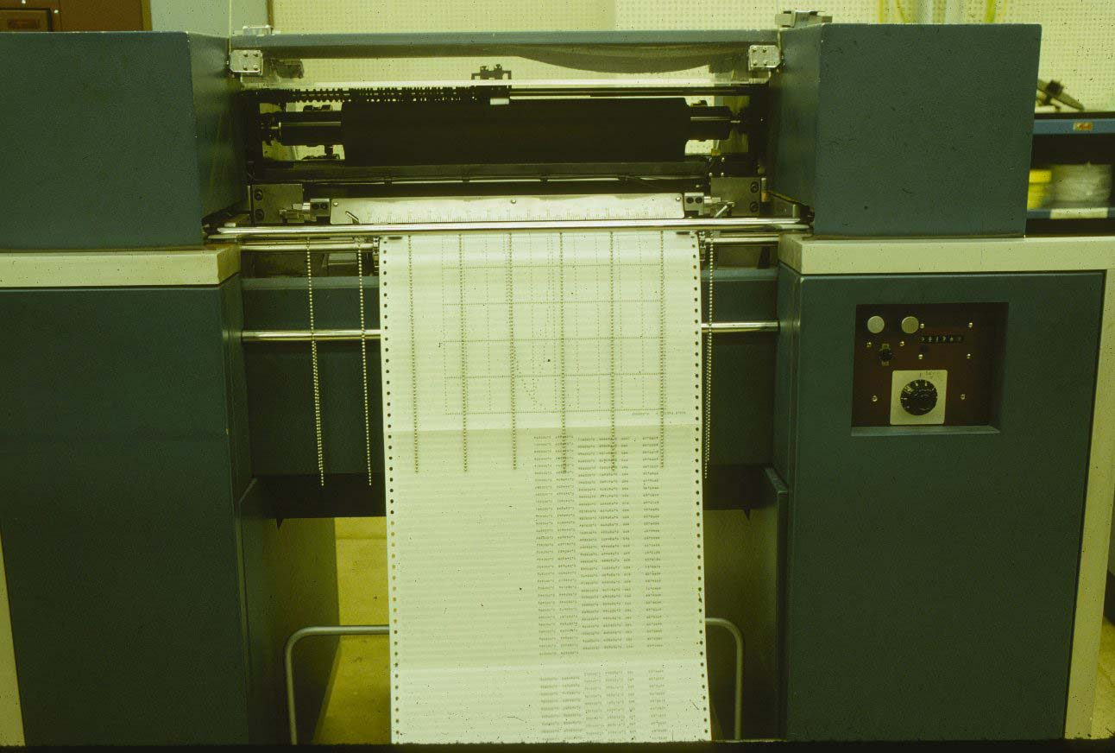
line printer

Slide 13
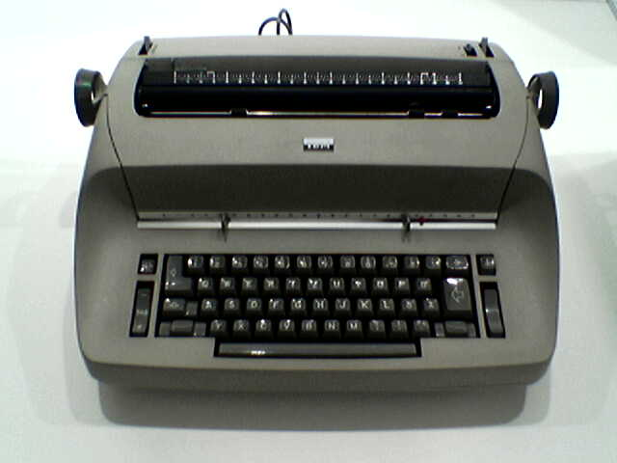
IBM Selectric

Slide 14
editing and markup
typewriter
  everything is manual: character placement, line breaks
early editor
  grid of character model
  each character just gets put where you write it
  pagination done by printer
  long lines fall off the edge
problem
  you have to manually redo layout after any change
  (still beats re-typing)

Slide 15
early markup tasks
output
  line printer
input
  monospaced text from text editor (no WYSIWYG)
automate
  line breaks (no truncation)
  page breaks (other than physical breaks)
  headers / footers / line numbers

Slide 16
RUNOFF
.line length
.indent
.single space
.double space
.begin page
.header
.break
.adjust
.nojust
.fill
.nofill
.space
.center
.literal
Saltzer, 1964
http://mit.edu/Saltzer/www/publications/CC-244.html

Slide 17
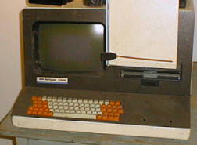
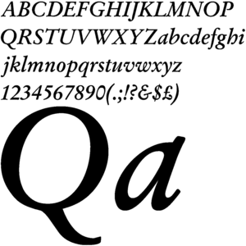
photographic type setting

Slide 18
troff typesetting
troff is an evolution of RUNOFF / roff
  proportional spacing
  multiple fonts
  arbitrary character placement
  macro packages
  mathematics and tables
output
  photographic typesetter (now emulated on modern devices)
  can also output to monospaced device (nroff)
  still used for manual pages

Slide 19
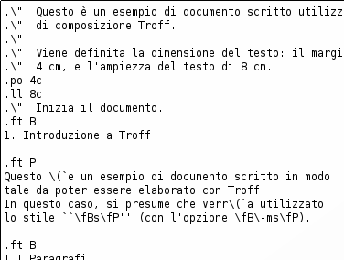
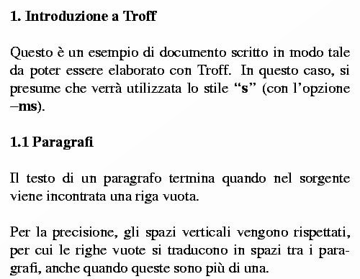
troff input / output

Slide 20
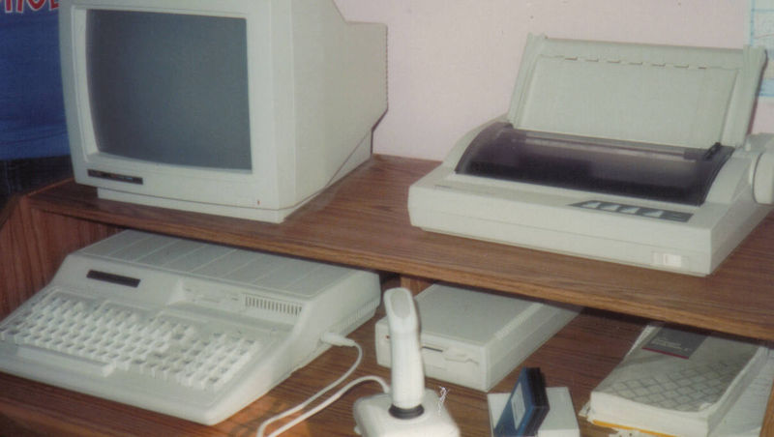
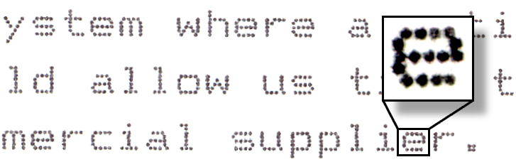
dot matrix printers

Slide 21
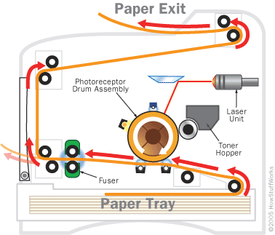
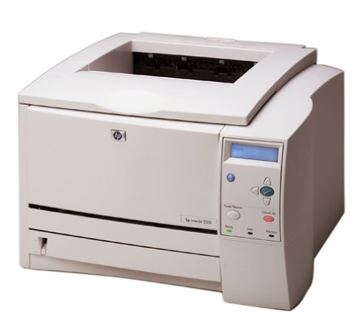
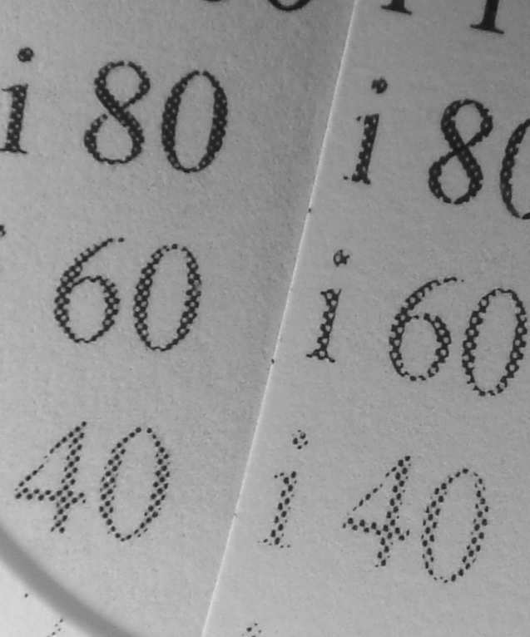
laser printers

Slide 22
TeX / Metafont / LaTeX
new features
  output to bitmapped devices
  scalable fonts in METAFONT
  elaborate built-in macro language
  new hyphenation algorithm
  elaborate optimization algorithms (line/page breaking, ...)
  built-in mathematics support
  syntax partially fixed by LaTeX macro package
  written by Donald Knuth for writing computer science papers

Slide 23
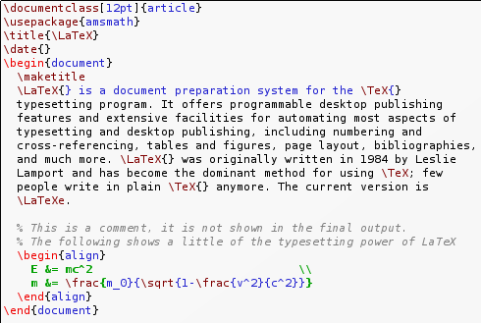
TeX / LaTeX

Slide 24
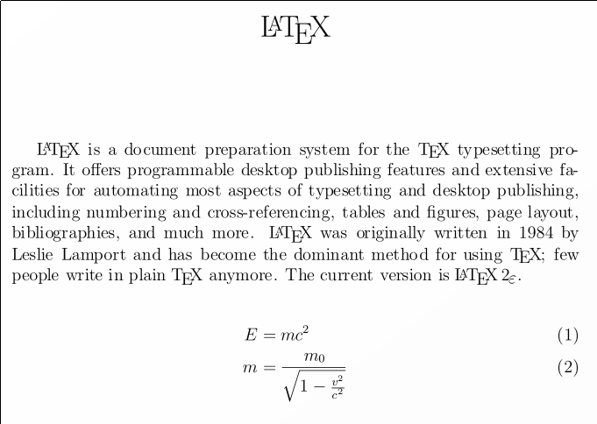
TeX / LaTeX

Slide 25
factors driving markup
input
  monospaced text editors
output
  line printer → typesetter → laser printer
document change
  reflow
  pagination
  style sheets...

Slide 26
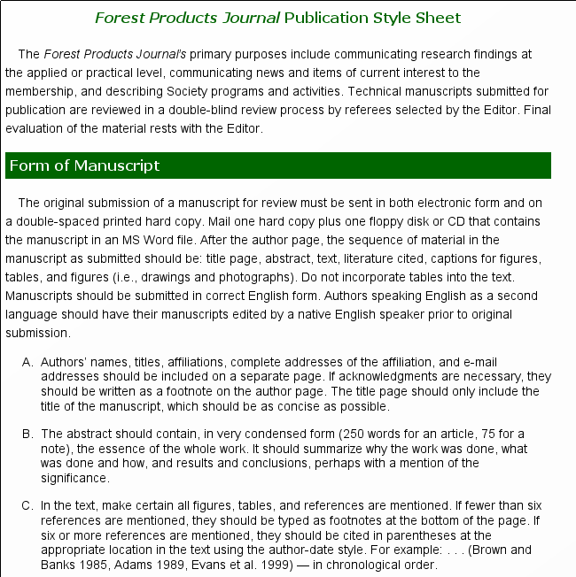
style sheets

Slide 27
physical vs logical markup
\centerline{\bf John Smith}
  typeset “John Smith” in bold face, centered
\author{John Smith}
  “John Smith” is the author
  the style says that the author is typeset in bold face, centered

Slide 28
physical vs logical markup
change of style
  physical markup: edit all instances of markup
  logical markup: just change the electronic style sheet
the evolution of logical markup was driven by editing and printing
using logical markup as semantic information came later

Slide 29
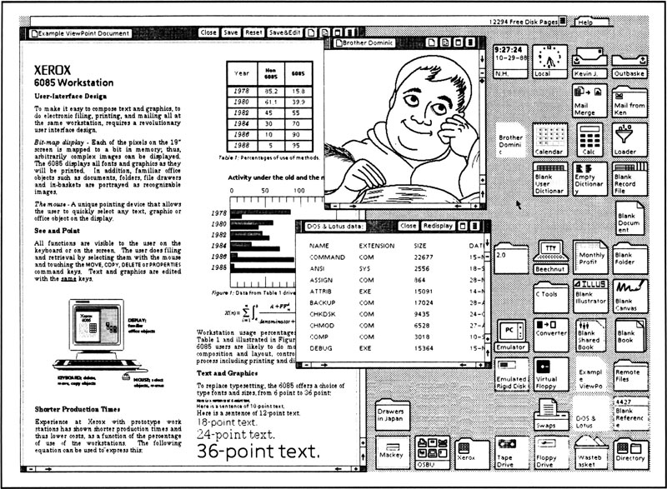
WYSIWYG editing

Slide 30
WYSIWYG editing
WYSIWYG
  what you see is what you get
  enablers: bitmapped displays, fast processors
  display typeset document directly on screen
  line breaks, pagination updated while typing
  algorithms similar to TeX etc.
  easy to change formatting and see effect
big issue...
  how does logical markup work for WYSIWYG

Slide 31
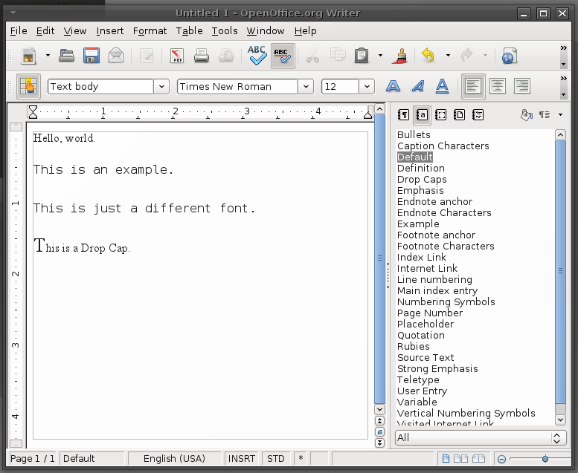
physical vs logical markup

Slide 32
markup
commands embedded in text
  determine formatting after processing
physical markup
  changes appearance directly
logical markup
  changes appearance based on a style sheet
  may convey semantic information

Slide 33
SGML, HTML, XML

Slide 34
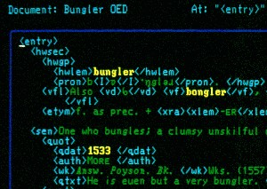
SGML
standard generalized markup language
developed in the 1960's for documentation
specific doc syntax defined by DTD

Slide 35
SGML
abbreviations to make it easier to type
  <QUOTE TYPE=example> instead of “example”
  <ITALICS/word/
  <QUOTE//
  </>
  <QUOTE><ITALICS>word</QUOTE>
(putting lipstick on a dog)

Slide 36
DocBook
SGML, now XML
semantic markup—computer documentation
widely used for open source now
  Linux Documentation, Gtk+, KDE, ...
non-WYSIWYG

Slide 37
XML
successor to SGML
cleaned up syntax and semantics
better defined
document schemas and tools
transformation languages (XSLT, ...)

Slide 38
XML vision (?)
web sites send semantically marked up data to web browser
web sites send XML → HTML transformation rules to browser
browser puts the two together and renders a page
client-side XSLT

Slide 39
HTML
initially
  simplified SGML syntax
  specific set of tags (similar to troff)
  mostly physical markup
  some hypertext facilities
now
  styles, style sheets, semantic markup
  XML-based variant

Slide 40
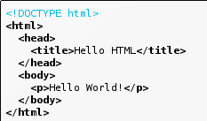
HTML

Slide 41
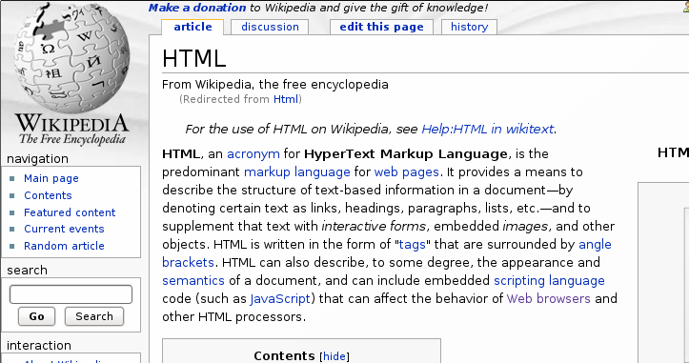
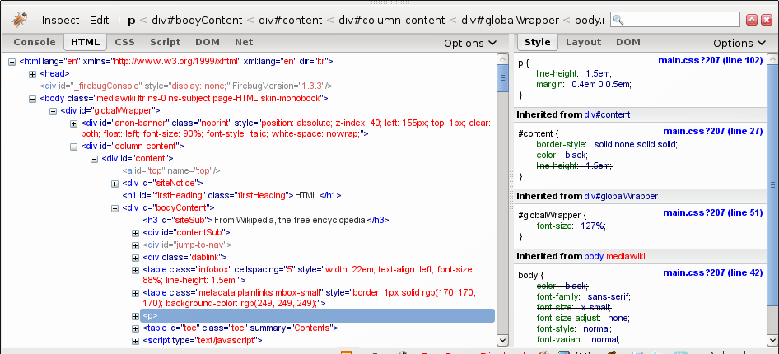
HTML DOM
DOM Tree

Slide 42
HTML + CSS
<h1>This is a Section</h1>
<h2>This is a Subsection</h2>
Hello, world.
h1 { color: white; background: orange !important; }
h2 { color: white; background: green !important; }
This is a section.

Slide 43
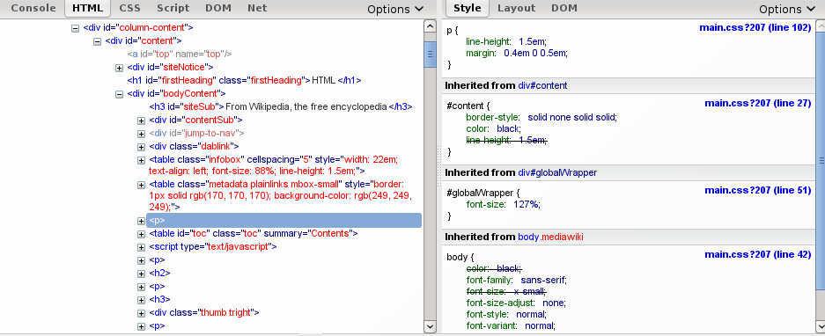
Cascading Style Sheet

Slide 44
HTML + CSS
HTML/styles associated by patterns
  tag names, DOM path, style attribute
styles are “cascading”
  many sources of style information
  (document, browser, server, ...)
  styles are combined by overriding lower priority styles with higher priority ones
  priorities are determined by order and explicit declaration
CSS syntax itself is not XML

Slide 45
CSS + word processing
Google Docs
  on-line word processor (use with Google account)
  formatting determined by (optional) CSS style sheets
  Google Docs > Edit > Edit CSS...

Slide 46
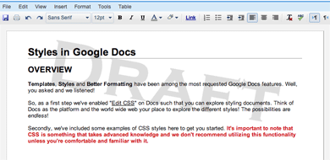
Google Docs + CSS
body {
background-image: url('File?id=ad8wdwbvms_890m8v5pjdm_b');
background-repeat: no-repeat;
background-position: 50% 20px;
}

Slide 48
HTML + CSS
only addresses style sheets for rendering
what about semantic information?

Slide 49
wiki markup

Slide 50
problems with HTML
non-WYSIWYG editing
  hard to type
  tricky syntax, hard to learn
  even simple text requires lots of “noise”
WYSIWYG editing
  didn't used to be supported in browsers
  hard to add semantic information

Slide 51
wiki markup etc.
=== Mouth ===
Cats have highly specialized [[tooth|teeth]] for the killing of prey and the tearing of meat. The [[premolar]] and [[Molar (tooth)|first molar]] together compose the [[carnassial]] pair on each side of the mouth, which efficiently functions to shear meat like a pair of [[scissors]]. While this is present in [[Canidae|canids]], it is highly developed in felines. The cat's [[tongue]] has sharp spines, or [[Filiform papilla|papillae]], useful for retaining and ripping flesh from a carcass. These papillae are small backward-facing hooks that contain [[keratin]] which also assist in their [[Personal grooming|groom]]ing.
As facilitated by their oral structure, cats use a variety of vocalizations for [[cat communication|communication]], including meowing, purring, hissing, growling, squeaking, chirping, clicking, and grunting.<ref name=Channel3000Meows/> Their types of [[Cat body language|body language]]: position of ears and tail, relaxation of whole body, kneading of paws, all are indicators of mood.

Slide 52
wiki markup
input
  plain simple text comes out OK
  section headings are simulated (“===”)
  a few special characters are used for links
output
  output is reflowable HTML with different fonts, styles
  line breaks in the input are not heeded (unless marked)

Slide 53
reStructuredText
reStructuredText is an easy-to-read, what-you-see-is-what-you-get plaintext markup syntax and parser system. It is useful for in-line program documentation (such as Python docstrings), for quickly creating simple web pages, and for standalone documents.

Slide 54
reStructuredText
This is a paragraph. It's quite
short.
This paragraph will result in an indented block of
text, typically used for quoting other text.
*This* is **another** one.

Slide 55
Microformats

Slide 56
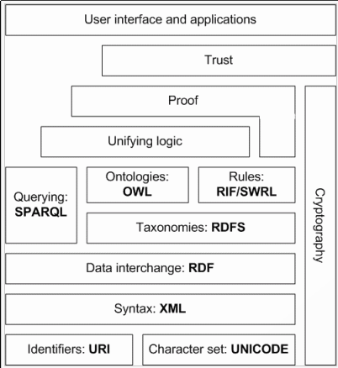
semantic web
XML, XML Schema, RDF, RDF Schema, OWL, SparQL, RIF, ...
prescription (?)
  change to XML
  express your information according to some schema
  ...
  profit ???

Slide 57
adding semantic information
use case:
  publish business vCard, visitor incorporates with one click
  publish calendar/event information, add to calendar from web
  publish bibliography, incorporate from browser
generally
  add semantic information to web pages
  allow users to pick up and use information easily

Slide 58
solution: microformats
microformats
  are valid HTML that renders correctly in common browsers
  incorporate semantic information
  are equivalent to XML formats

Slide 59
common microformats
  XHTML Friends Network (XFN)
    social relationships
  hCard
    represents people, companies, organizations, places
  hCalendar
    iCalendar embedding for events, appointments
  hReview
    reviews of products, services, etc.
  hAtom
    embed Atom feeds directly in your page
  hResume
    resume semantics (LinkedIn uses it)

Slide 60
microformats services
Technorati
Flickr (geo microformat)
Yahoo (reviews, search, etc.; in and out)
LinkedIn
Technorati
Magnolia

Slide 61
microformat ingest
directly by user
  Operator, Tails extensions for Firefox
  recognize microformats in-line and add to address book
indirectly
  search engines, web crawlers recognize microformats
  semantic information is used to enhance services, search

Slide 62
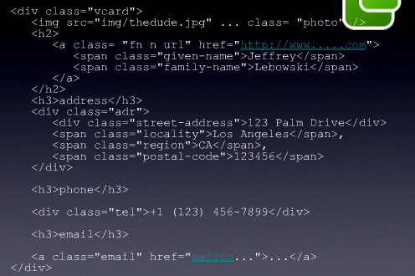
microformat styling

Slide 63
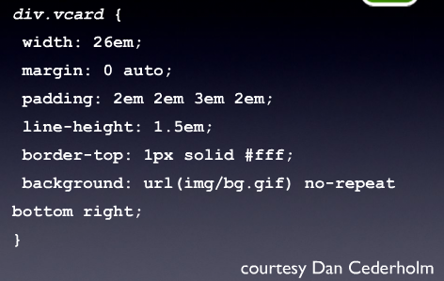
microformat styling

Slide 64
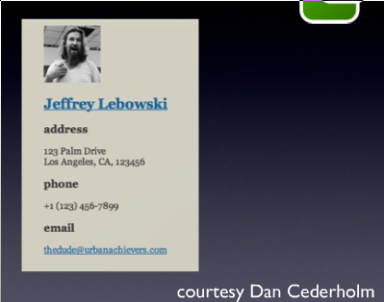
microformat styling

Slide 65
semantic data via microformats
LinkedIn
Corporate
Recruiting
Database
Address Book
Application

Slide 66
microformats
use HTML markup for semantics
fully compliant HTML, renders correctly
parallels historical development
in common use already

Slide 67
microdata
HTML5 standard
item{prop,type,value,id}=...
DOM and JavaScript support
otherwise like microformat

Slide 68
layout

Slide 69
plain text reformatting
input
  some text with long lines, line breaks, paragraphs
output
  nicely formatted text, filled paragraphs, page breaks
  word breaking? hyphenation?
examples
  fmt — simple text formatter
  par — handles quoting

Slide 70
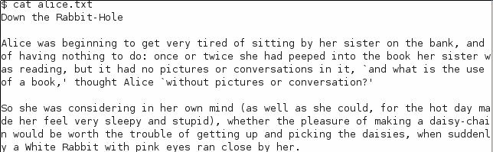
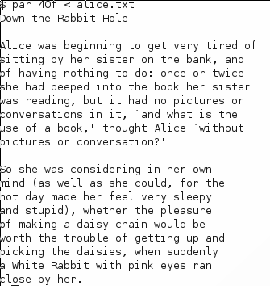
plain text reformatting

Slide 71
plain text reformatting
questions
  algorithm?
  hyphenation?
  right justification?
  what do you do with really long words?

Slide 72
typesetting

Slide 73

typesetting

Slide 74
typesetting

Slide 75
typesetting

Slide 76
floats

Slide 77
floats

Slide 78
headers / footers
header text
special
variables:
page number,
date, author, etc.
footer text

Slide 79
widows, orphans, ...
Section 3

Slide 80
glue
target size
minimum size
maximum size
cost of changing size
used by optimizer to make better tradeoffs

Slide 81
page layout
page layouts are defined in terms of boxes
boxes get filled with source text
floats get inserted as needed
formatting is a global optimization problem
  floats affect available space
  widows, orphans, line breaks, etc. may require reformatting
  flexible glue allows optimizer to work

Slide 82
hOCR

Slide 83
formatting vs recognition
formatting language (TeX, etc.)
  describe how text is supposed to be laid out
  instructions and hints to a formatting program
OCR description languages
  describe the visual appearance of laid out text
  used for interpreting layouts

Slide 84
communications & type setting model
logically
marked up
text
logically
marked up
OCR
output
box-based
page
layout
model
OCR
data
structures
printed
page
markup and typesetting languages
hOCR format

Slide 85
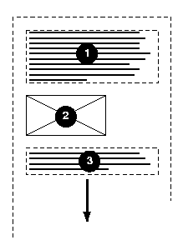
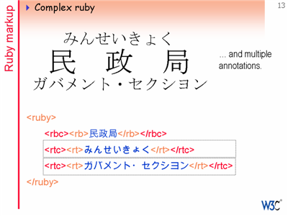

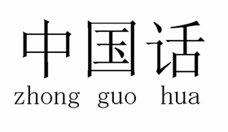
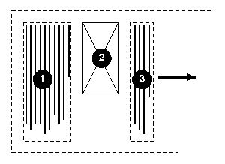
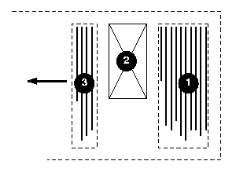
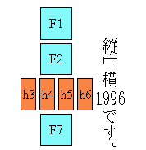

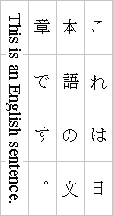
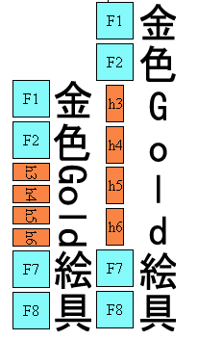
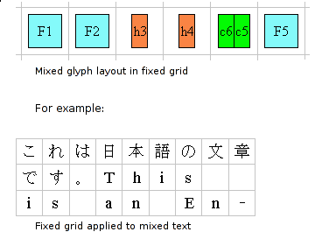

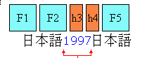
HTML / CSS3 markup

Slide 86
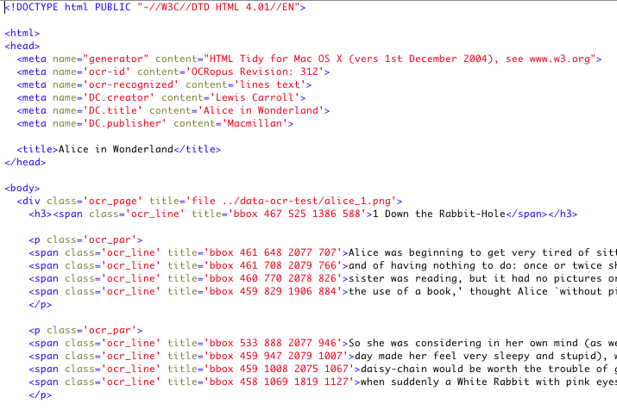
hOCR Example
standards-compliant
HTML
compatible with other
embedded HTML formats
separation of
presentation and OCR markup
embedded
geometric information
full access to Unicode
and CSS3

Slide 87
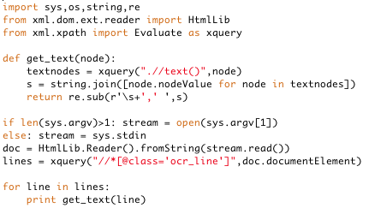
hOCR processing is simple

Slide 88
hOCR levels of markup
logical structure
  documents, sections, paragraphs, ...
per-page layout
  columns, floats, images, ...
engine specific
  boxes, words, ...
style, script, language, writing direction
  CSS-standard fonts, languages, etc.
metadata
  indicate capabilities (absence from doc insuff.)

Slide 89
additional hOCR information
geometric information
  bounding boxes or polygons
  polygons compressed for character segmentation
font / style information
  standards CSS font/style information
  recommended inline
segmentation / recognition alternatives
  per character in elements
  larger units via <INS> / <DEL> revision tags

Slide 90
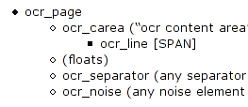
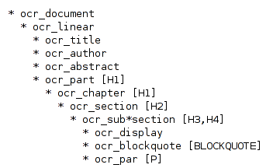
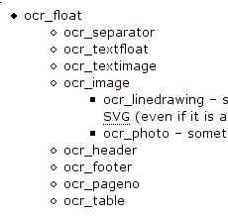



overview of hOCR markup elements
logical markup
engine-specific
page layout
special

