Slide 1
Document and Content Analysis
Statistics and OCR
Thomas Breuel

Slide 2
OCR errors

Slide 3
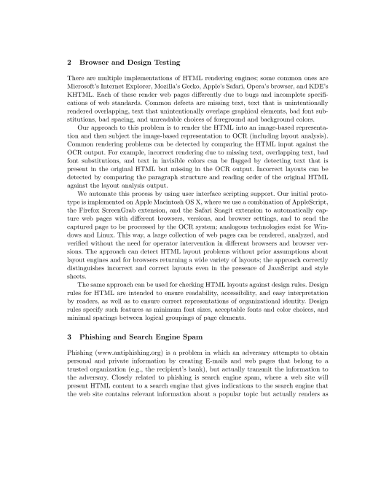
commercial OCR – clean input
2 Browser and Design Testing
There are multiple implementations of HTML rendering engines; some common ones are Microsoft's Internet Explorer, Mozilla's Gecko, Apple's Safari, Opera's browser, and KDE's KHTML. Each of these render web pages differently due to bugs and incomplete specifi­ cations of web standards. Common defects are missing text, text that is unintentionally rendered overlapping, text that unintentionally overlaps graphical elements, bad font sub­ stitutions, bad spacing, and unreadable choices of foreground and background colors.
Our approach to this problem is to render the HTML into an image-based representa­ tion and then subject the image-based representation to OCR (including layout analysis)...

Slide 4
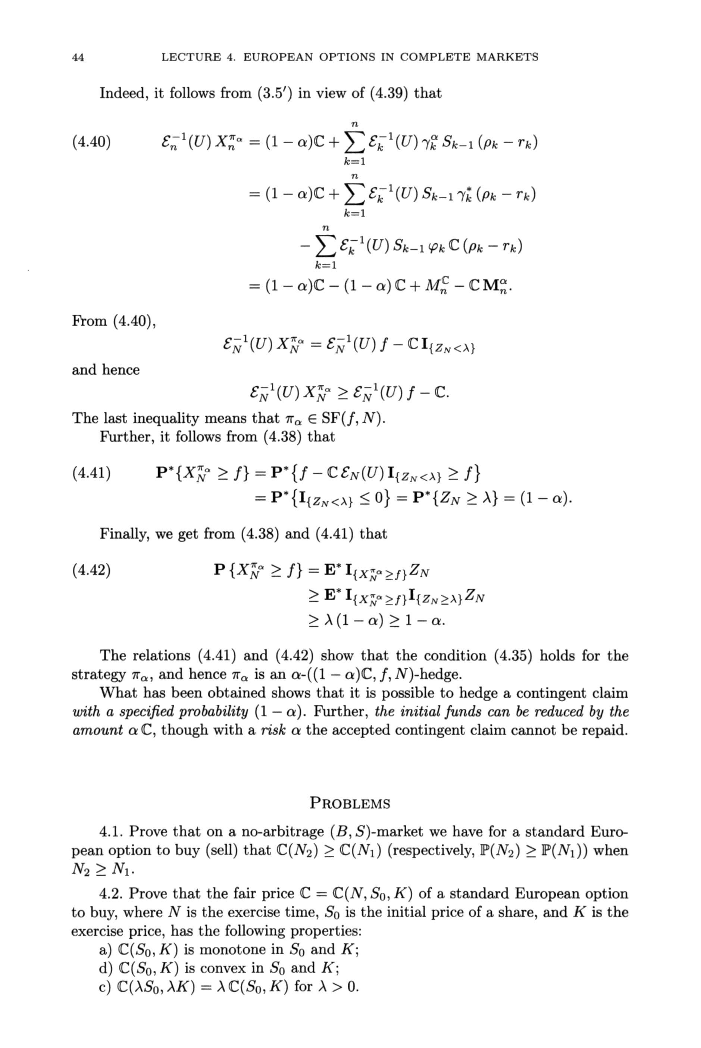
commercial OCR – scientific publications
Indeed, it follows from (3.5') in view of (4.39) that (4.40) S k=l fc=i = (1 - a)C - (1 - a) C + From (4.40), �^(u)x^=� and hence The last inequality means that TTQ 6 SF(f,N). Further, it follows from (4.38) that (4.41) P'{X# > /} = P*{/ -C�N(U) I{ZN f} = P'{I{ZN< 0} = P*{ZN > A} = (1 - a). Finally, we get from (4.38) and (4.41) that (4.42) P{X^>/}=E'IW� > A(l-a) > 1-a. The relations (4.41) and (4.42) show that the condition (4.35) holds for the strategy na, and hence TTQ is an a-((l - a)C, /, A^)-hedge. What has been obtained shows that it is possible to hedge a contingent claim with a specified probability (1 � a). Further, the initial funds can be reduced by the amount a C, though with a risk a the accepted contingent claim cannot be repaid. PROBLEMS 4.1. Prove that on a no-arbitrage (B, 5)-market we have for a standard Euro- pean option to buy (sell) that C(7V2) > C(Ni) (respectively, P(JV2) > P(M)) when 4.2. Prove that the fair price C = C(N, So, K) of a standard European option to buy, where N is the exercise time, So is the initial price of a share, and K is the exercise price, has the following properties: a) C(S0, K) is monotone in So and K; d) C(So, K) is convex in So and K; c) C(\S0,XK) = A C(S0,K) for A > 0.

Slide 5
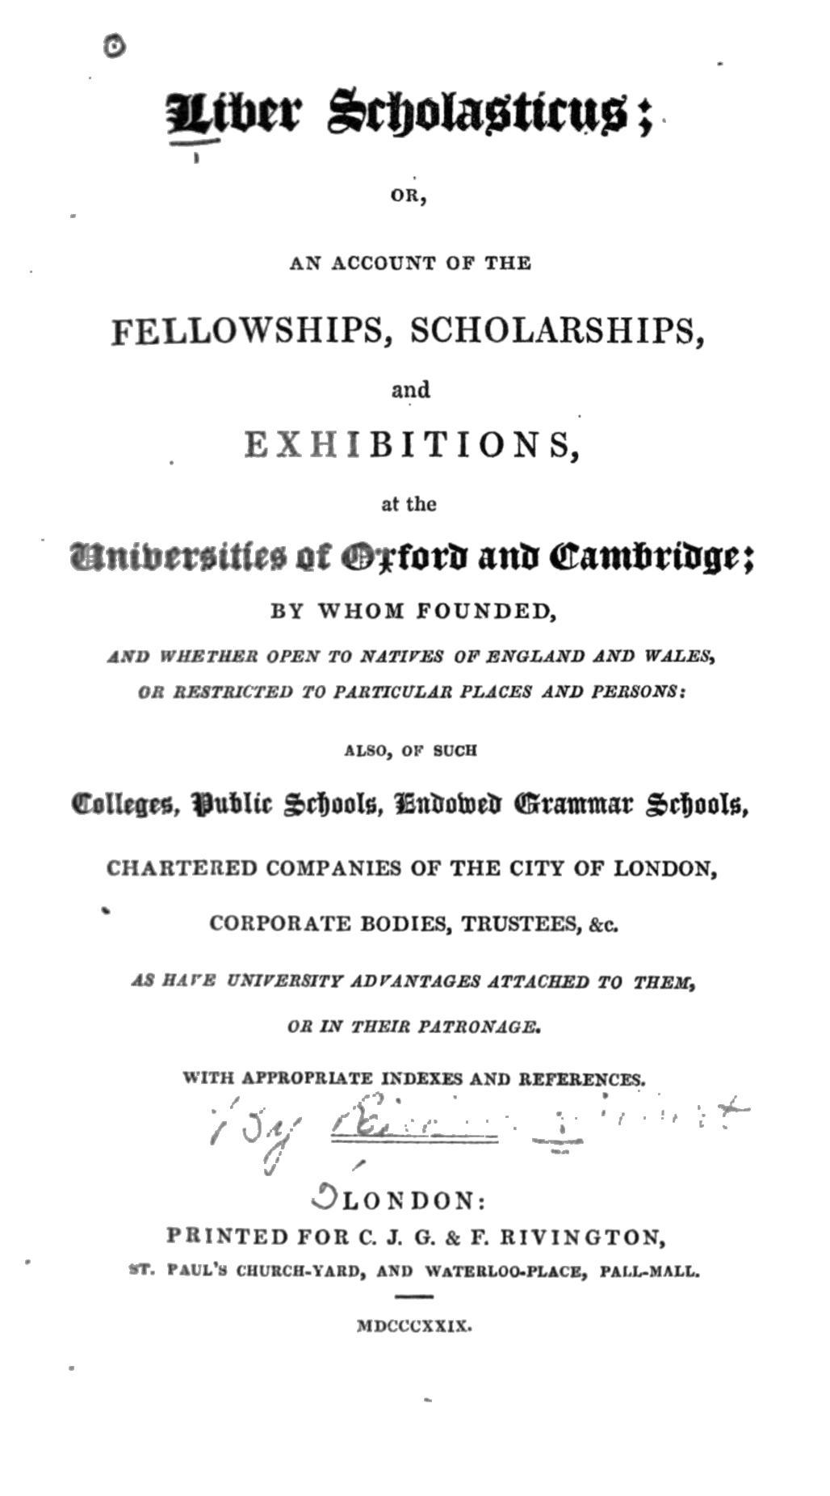
commercial OCR – unusual fonts
OR,
AN ACCOUNT OP THE
FELLOWSHIPS, SCHOLARSHIPS,
and
EXHIBITIONS,
at the
attttonvitto of <C2><A9>Tforfc anft <E2><82><AC>amfitiU0
BY WHOM FOUNDED,
J.VJ> UHKrilKK OPEff TO IfATIfES OF SNOLAND AND WALES,
Ott RKiTRICTEU TO PARTICULAR PLACES AND PERSONS;
ALSO, OF SUCH
CoKrgrs, IJutlir $rf)ool6, Kniutotti (Grammar 5rf)ool
CHABTERED COMPANIES OF THE CITY OF LONDON,
CORPORATE BODIES, TRUSTEES, &c.
At BArS OXlrESSJTY ADrANTAOES ATTACHED TO TBEX,
OS IN THEM PATRONAGE.
WITH APPROPRIATE INDEXES AND REFERENCES.
^LONDON:
PRINTED FOR C. J. O. & F. RIV1NGTON,
. PAl L's Cllf RCII.YAlin, AMI WATERLOO.PLACE, PALUMALL.
MDCCCXXIX.

Slide 6
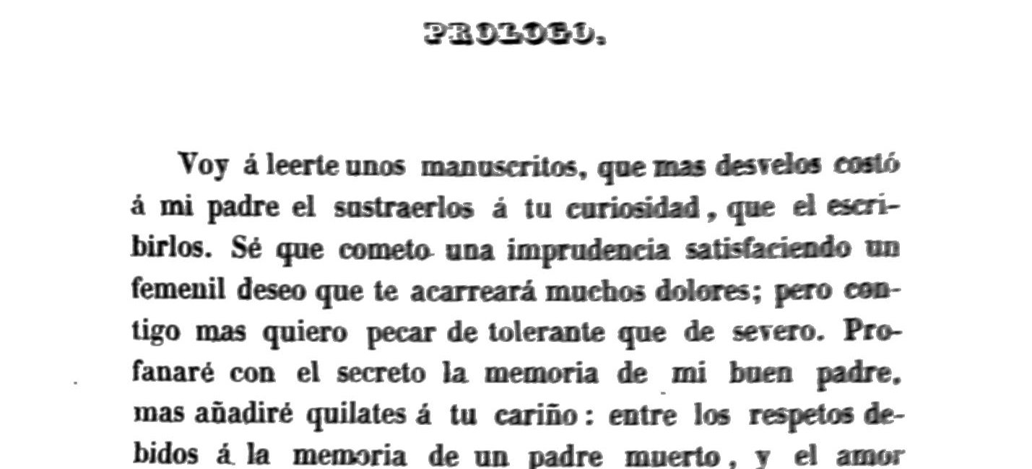
commercial OCR – languages
â¬*Mlnv-
Toy aleertennof n^m^ritn. qaeva* desTdos eosto
4 mi padre d snstnerlos a tu oniosidad, qae d eseri-
birlos. Se" qne cometa ana impradtncia iilirfirirÂ«dn on
femenil deseo qne te aearreara modiM dokns; pcro ew-
tigo mas quiero pecar de tolerant* qne de wrcro. Pra-
fanart COD el secrete la memoria de mi boen padre.
mas anadirt qoilates a tu carioo: eatre 1Â« respeto* de-
bidos a. la memoria de on padre nmerlo, j d amor

Slide 7
measuring OCR accuracy
identify the better OCR system
guide development & improvements
monitor production processes
charge penalties during production

Slide 8
OCR errors = typos?

Slide 9
kinds+sources of OCR errors
preprocessing
  thresholding, page frame detection, ...
layout analysis
  block detection, text/image segmentation, line finding, ...
character segmentation
  touching characters, split characters
character recognition
  shape confusions, unknown chars, new fonts, ...
language modeling
  out of dictionary words, ...

Slide 10
character-level errors
confusions
  character shape confusions
insertions
  high threshold → noise
  non-text elements
  low threshold → split characters
  confusable characters
deletions
  low threshold → missing characters
  high threshold → touching characters
  page-elements touching characters

Slide 11
OCR errors = typos + much more

Slide 12
string edit distance
“number of corrections necessary”
motivated by manual correction
assign costs to...
  changing a character
  inserting a character
  deleting a character
implement using dynamic programming alg.

Slide 13
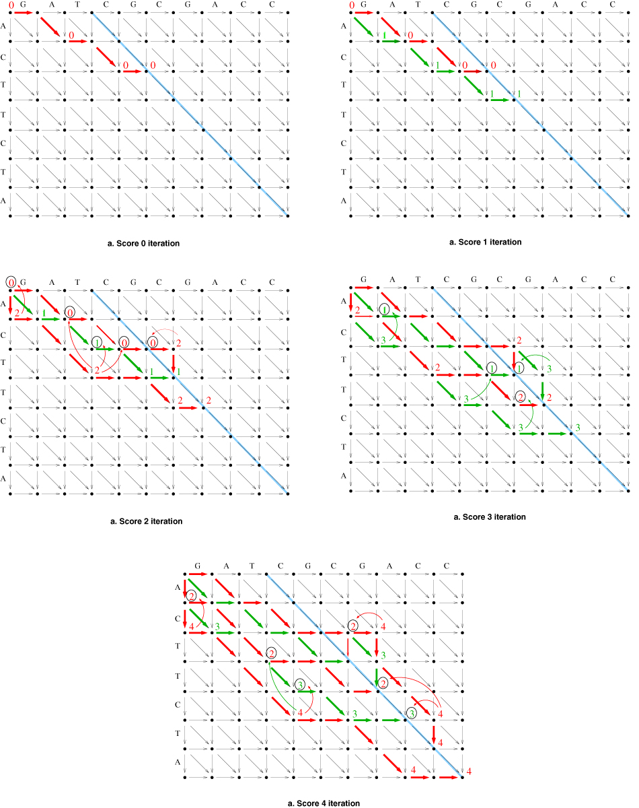
string edit distance

Slide 14
layout errors?
aaaaaa
aaaaaa
aaaaaa
aaaaaa
aaaaaa
bbbbbb
bbbbbb
bbbbbb
bbbbbb
bbbbbb
correct
aaaaaa aaaaaa ... bbbbbb bbbbbb ... cccccc cccccc ... dddddd dddddd ...
actual
cccccc
cccccc
cccccc
cccccc
cccccc
dddddd
dddddd
dddddd
dddddd
dddddd
aaaaaa aaaaaa ... cccccc cccccc ... bbbbbb bbbbbb ... dddddd dddddd ...

Slide 15
string edit with block move
basic operations
  insert character
  delete character
  change character
  move a block of characters (cut+paste)
block move cost is a parameter

Slide 16
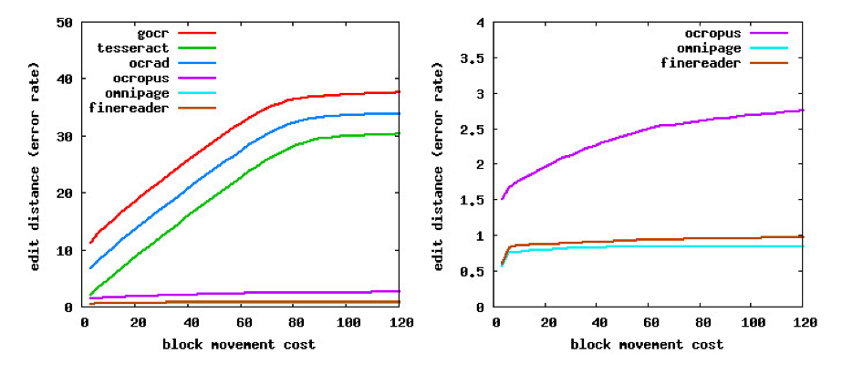
OCR evaluation w/block move cost

Slide 17
ground truth
“The quick
brown
fox jumped
over the
lazy dogs”
The quick
brown
fox jumped
over the
lazy dogs
“Thc ouick
brown
fox jumped
ovcr the
la2y dogs”

Slide 18
manual keying
“Thc ouick
brown
fox jumped
ovcr the
la2y dogs”
“The quick
brown
fox jumped
over the
lazy dogs”
The quick
brown
fox jumped
over the
lazy dogs
“Thc ouick
brown
fox jumped
ovcr the
la2y dogs”
“The quick
brown
fox jumped
over the
lazy dogz.”

Slide 19
ground truth
true ground truth
  source document
usual ground truth
  manual keying
    error rates comparable to OCR
  sources of errors
    typos, language bias (e.g., names), ...
  solution
    double keying with reconciliation
    triple keying with reconciliation
    typists who don't know the language

Slide 20
double keying, triple keying?
what's the actual error rate?
statistical correlations between typists?

Slide 21
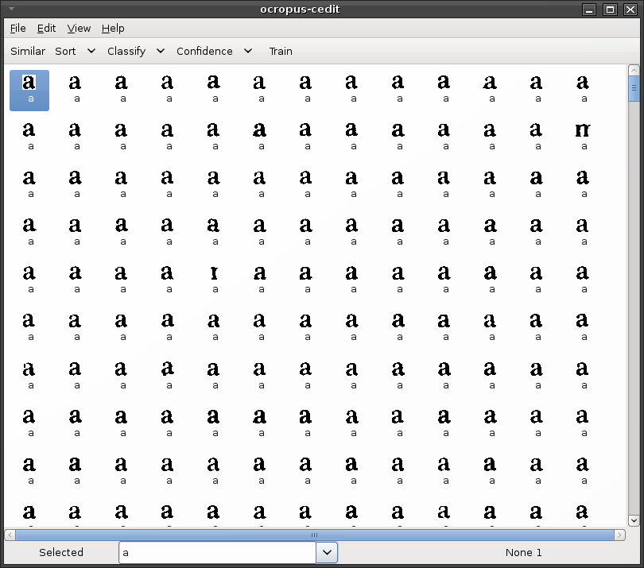
carpet correction

Slide 22
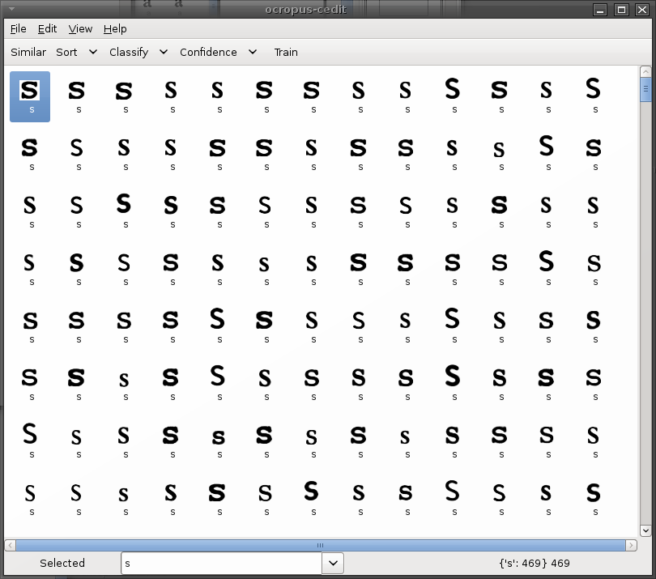
cluster correction

Slide 23
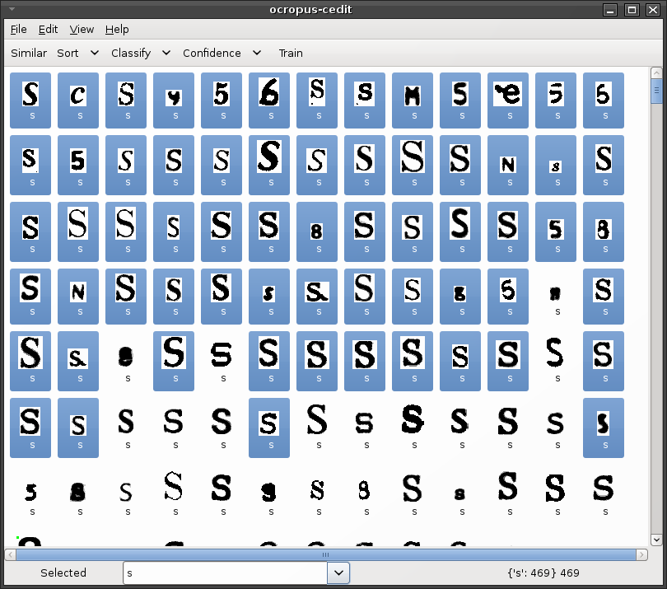
active learning

Slide 24
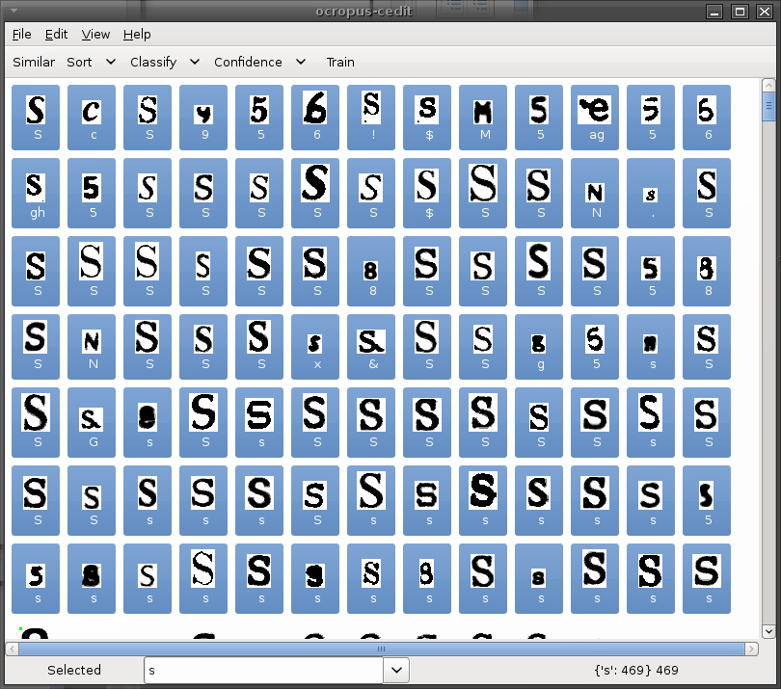
semi-supervised learning

Slide 25
correction support
carpet correction
  display one class at a time
cluster correction
  reduce # characters by clustering similar ones
active learning
  identify most important characters to be re-classified
semi-supervised learning
  use existing classifier to help with transcription

Slide 26
layout evaluation
indirect layout evaluation
  edit distance with block move
direct layout evaluation
  compare geometric partition of documents

Slide 27
approaches to correction

Slide 28
spell checking
simple idea...
  people mistype... use spell correction
  OCR system mistype... use spell correction

Slide 29
spell correction
divide the source text into words
for each word, look it up in the dictionary
if not found...
  find best matching word(s) by edit distance
  if unique, replace
  if not unique, resolve ambiguity somehow

Slide 30
spell correction issues
kinds of errors
  typos...
    characters close to each other on the keyboard
    phonetic mistakes
    common patterns
  OCR
    segmentation errors “cl”/“d”, “rn”/“m”
    shape confusions “e”/“c”, “2”/“Z”
    noise “.”/
  manual spell correction systems may not be suitable
making it fast

Slide 31
OCR voting

Slide 32
OCR voting
simple idea
  run 3 or more OCR systems
  find corresponding words in the outputs
  pick the word that's most frequently voted for
  break ties somehow

Slide 33
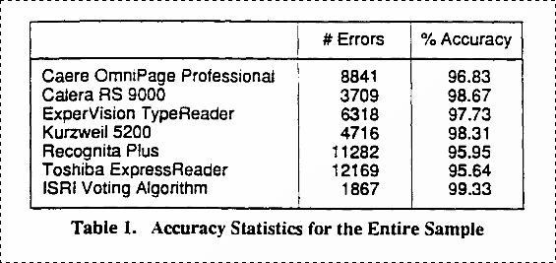

Slide 34
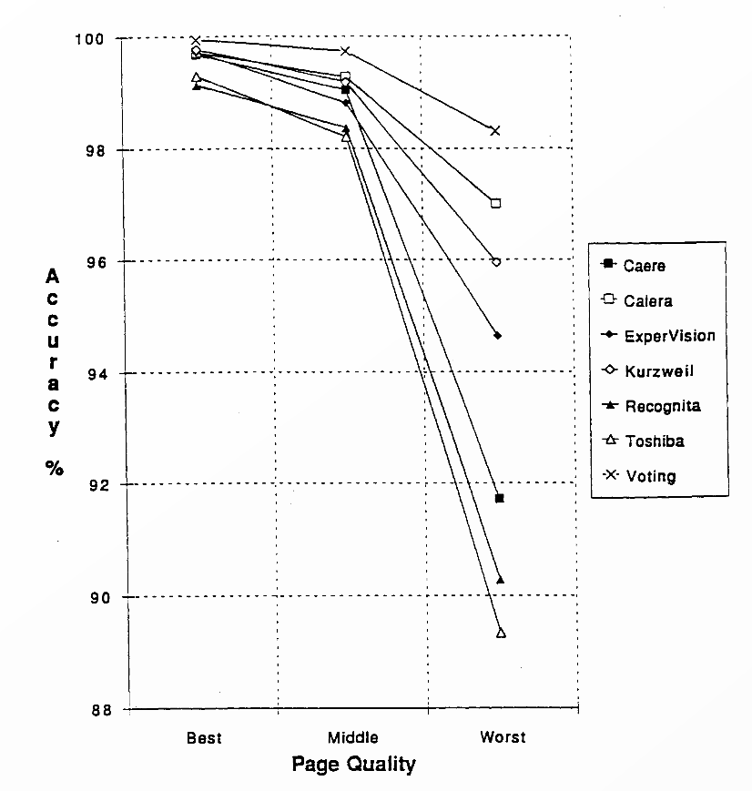

Slide 35
issues with OCR voting
how do we cope with misaligned outputs?
should some systems have precedence?
is the extra processing time worth it?
is the output the best place to combine?
what if I add the same OCR system twice?
character level or word level?

Slide 36
OCR voting statistically
each system tries to compute
arg max_{word} P(word | image)
how do we combine word₁, word₂, word₃?
confidence scores
  return word + f(P(word | image))
  f is usually monotonic (larger for higher posterior probability)
  f may depend on the characters in the word
  how do we compare/combine?

Slide 37
fully statistical OCR

Slide 38
OCR steps
cut apart pages into text lines and images
cut apart each text line into characters
generate segmentation graph
recognize each character
find the best path through the graph
re-assemble the page text

Slide 39
Can we make this probabilistically sound?

Slide 40
Bayes optimal solution
lowest prob. error = highest posterior prob.
arg max P(string | image)

Slide 41
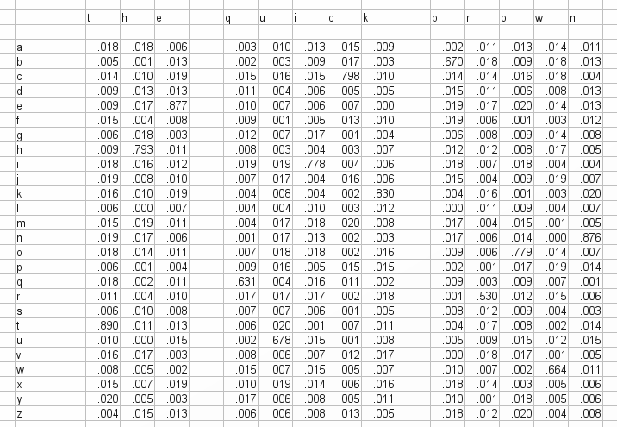
per character scores

Slide 42
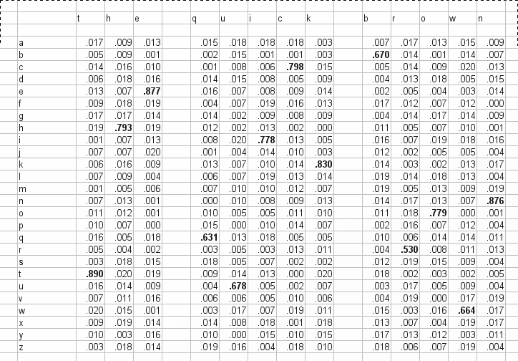
arg max P(c_{i}| x)

Slide 43
arg max P(c_{i}| x)

Slide 44
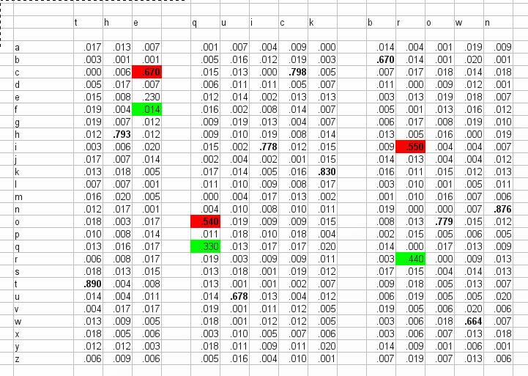
character errors

Slide 45
Bayes formula
(priors as used by classifier)

Slide 46
simple statistical language model
take the per-character probabilities for each word
adjust by word probabilities according to Bayes formula
pick the word with the highest posterior probability
spell correction: P(w) = 1/N if word in dictionary, 0 otherwise

Slide 47
open issues
how do we deal with segmentation variants
“clam” vs “dam”?
how do we compute this efficiently?
let's take a more general approach...

