Slide 1
Document and Content Analysis
Summer 2009
Thomas Breuel
Faisal Shafait

Slide 2
application examples
Google Search Engine
Google Books
Internet Archive
Amazon Kindle
voting machines
legal case files
intelligence analysis

Slide 3
How do you build a web search engine?
What are some of the issues?

Slide 4
How do you build a book reader?

Slide 5
How do you capture a book with a camera?

Slide 6
How do you make sense of the
White House E-mail collection?
John Ashcroft's memos?

Slide 7
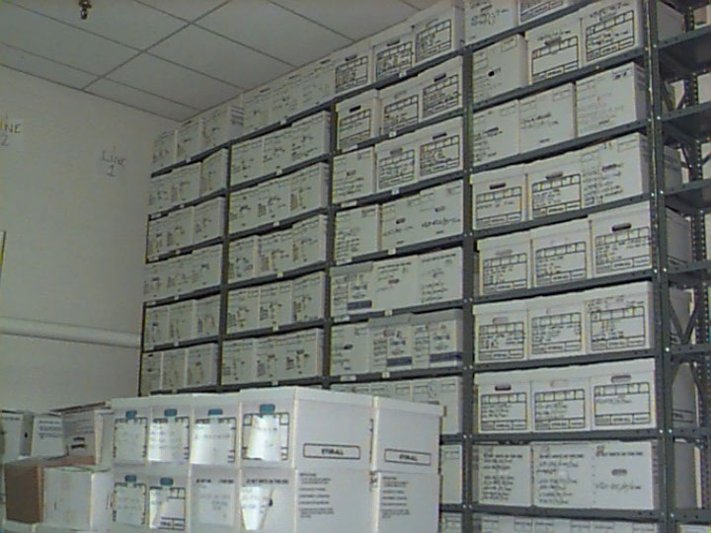

Slide 8
Where does metadata come from?

Slide 9
How do you organize a large collection of documents so that people can find things?

Slide 10
background

Slide 11
what is a document?
contains information
finite chunk of information
intended to communicate something

Slide 12
examples of documents
printed memos, books, etc.
photographs
passports
E-mail message
word processing file
JPEG file
PDF file
...

Slide 13
what do we do with documents?
create
transmit
read / consume
archive
transform
extract information
reformat
organize / categorize
find similar documents

Slide 14
dichotomy
database
document
far more data is stored in documents
than in databases

Slide 15
lectures

Slide 16
document images
document formats and standards (TIFF, JPEG, PDF, PostScript, SVG, OOXML)
basic image processing
mathematical morphology
document image compression (G4, MRC, token based, JPEG, JPEG2000, run-length)

Slide 17
text and encodings
writings systems
character sets and character encodings (ASCII, EBCDIC, Unicode, UTF-8, special coding systems)

Slide 18

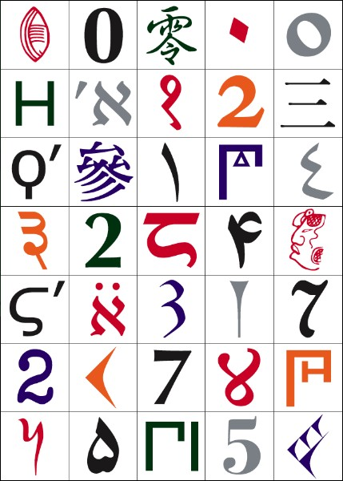

Slide 19
fonts and text rendering
writing direction
ligatures
hyphenation
complex scripts

Slide 20
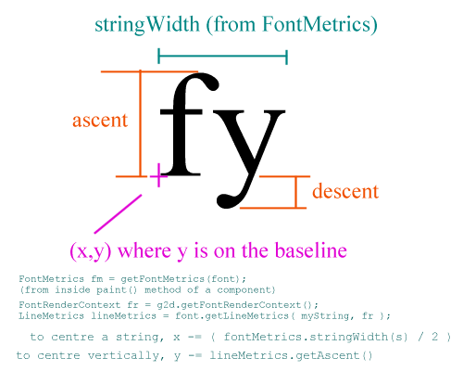
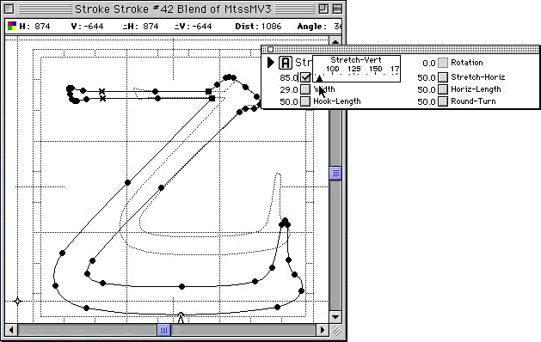

Slide 21
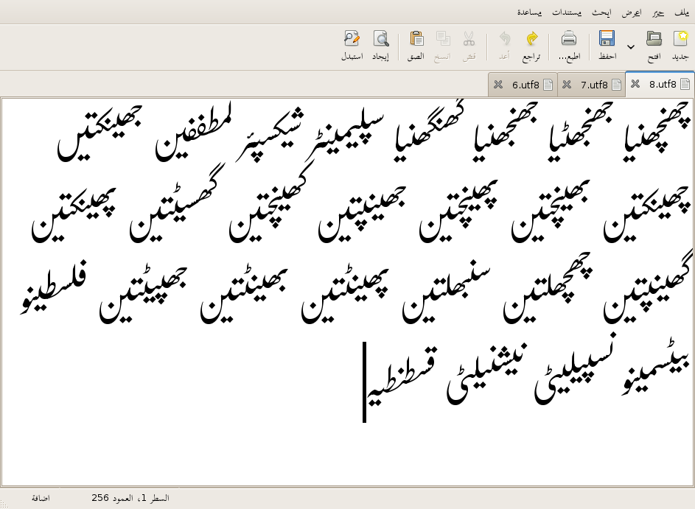

Slide 22
logical markup
HTML, XML
Microsoft Word, ODF, OOXML
DocBook
XSLT
DTD

Slide 23


Slide 24
typesetting
box model
XSL:FO
Word
LaTeX

Slide 25
OCR
preprocessing
page segmentation
character recognition
language modeling

Slide 26
document capture
document capture
page image dewarping
handheld document capture
text-in-images

Slide 27
information extraction
named entity recognition
information extraction
table recognition
genre recognition

Slide 28
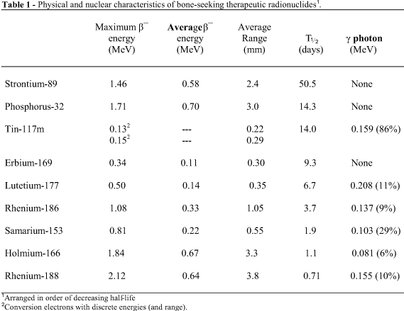

Slide 29
algorithms for search engines
citation and link analysis
authorities and hubs
document clustering
search engine spam detection

Slide 30
document databases
information retrieval
desktop search (Beagle, Tracker, Spotlight)
document databases (Lucene, Solr, ...)
text mining
document databases
query expansion
standards (TEI, METS/ALTO)
scalability

Slide 31
graphics recognition
graph recognition
diagram representation
diagram interpretation
  electrical
  engineering
  general (books)

Slide 32
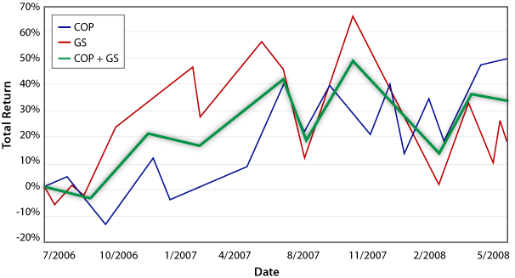

Slide 33
human reading
psychophysics
human-document interaction
eye movements
accessibility

Slide 34
document security
forensics
security features
automatic detection

Slide 35
OMR
techniques
voting machines
voting machine issues

Slide 36
spell checking
grammar checking
and orthographic variation, statistical language modeling

Slide 37
todo

Slide 38
TODO (now)
go to
courses.iupr.org
sign up with your E-mail address and register for the course

Slide 39
course mechanics
instructors
  Thomas Breuel
  Faisal Shafait
weekly meetings Tue 10-11:30 in 48-379
Übungsaufgaben mandatory (department)
oral or written final exam (dep # students)
support
  Moodle courseware site
  secretary@iupr.com, faisal@iupr.com, tmb@iupr.com
  office hours (TBD)

Slide 40
preparations
start familiarizing yourself with...
  Python
  SciPy (including image processing)
  Python Imaging Library
these work on Linux, Windows, Mac
  let us know if you don't have access to them

