Slide 1
Document and Content Analysis
Lecture 04 – Fonts and Font Rendering
Faisal Shafait
14.05.2009

Slide 2
Outline
Font characteristics
Font formats
Font rendering

Slide 3
What is a Font?

Slide 4
What is a Font?
a complete character set of a single size and style of a particular typeface
A letter or symbol in a font is called a glyph
typeface designates a consistent visual appearance or style which can be a "family" or related set of fonts

Slide 5
How is font size measured?

Slide 6
How is font size measured?
Font size is measured in “points”
1pt = 1/72 inch when printed on paper
What about size on screen?

Slide 7
What are typical font families?

Slide 8
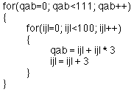
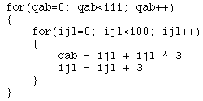
What are typical font families?
Serif vs. Sans Serif
Proportional spacing vs. monospace

Slide 9
How to represent a font?

Slide 10
How to represent a font?
Bitmap fonts
Vector fonts
Stroke-based fonts

Slide 11
Bitmap fonts
Stores each glyph as an array of pixels
Simply collections of raster images of glyphs constitute a font
For each variant, a complete set of glyph images is required
Consider 10 sizes and any combination of bold and italic, how many complete sets of glyphs would be needed?

Slide 12
Advantages of Bitmap Fonts
Extremely fast and simple to render
Easier to create than other kinds
Unscaled bitmap fonts always give exactly the same output

Slide 13
Disadvantages of Bitmap Fonts
A new set of glyph images for each size
Scale poorly to other sizes
Memory intensive

Slide 14
Vector Fonts
Outline of each glyph is represented as a set of lines and curves
Adobe PostScript is a standard example
  Postscript type 1 and type 3
  TrueType
  OpenType

Slide 15
Postscript
PostScript (PS) is a concatenative programming language
Created by Adobe Systems in 1982
Apple LaserWriter shipped with PostScript sparked the desktop publishing revolution in the mid-1980s
best known for its use as a page description language in the electronic and desktop publishing areas
A “Hello World” PS program:
%!PS
/Courier findfont
20 scalefont
setfont
72 500 moveto
(Hello world!) show
showpage

Slide 16
Postscript Fonts
outline font specifications using PostScript file format to encode font information
the glyphs are described with cubic Bézier curves
a single set of glyphs can be resized through simple mathematical transformations

Slide 17
TrueType Fonts
Outline font standard developed by Apple Computer in the late 1980s
Offers font developers a high degree of control over precisely how their fonts are displayed
Microsoft added TrueType into the Windows 3.1 operating system
  Times New Roman
  Arial
  Courier New
A regular TrueType font comes with .ttf extension

Slide 18
OpenType Fonts
Developed by Microsoft and Adobe Systems
Intended to supersede Postscript Fonts and TrueType Fonts
The font character encoding is based on Unicode and can support any script
OpenType fonts can have up to 65,536 glyphs
Fonts can have advanced typographic features that allow proper typographic treatment of complex scripts
Font files are intended to be cross-platform

Slide 19
Vector Fonts
Advantages of Vector Fonts:
Easily transformed by applying a mathematical function to each vector point
Can be scaled to any size without compromising visual quality
Disadvantages of Vector Fonts:
Rendering is slow and compute intensive
Rendering can change shape depending on desired size and position

Slide 20
Stroke-Based Fonts
A glyph's outline is defined by the vertices of individual strokes and stroke's profile.
Advantages:
Reduces number of vertices needed to define a glyph
Editing a font by stroke is easier than editing by outline

Slide 21
How do we render these fonts on screen?

Slide 22
Font rendering is the process of converting text from a vector description (as found in scalable fonts such as TrueType fonts) to a raster or bitmap description

Slide 23
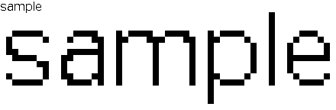
Simple Font Rendering

Slide 24
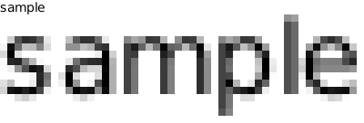
Font Rendering with Anti-aliasing

Slide 25
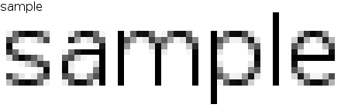
Font Rendering with Anti-aliasing and Hinting

Slide 26
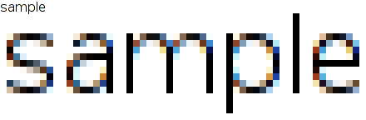
Sub-Pixel Font Rendering

Slide 27
Other Challenges in Font Rendering
Arranging input text
Alignment of bottom point
Glyph substitution based on context
فرانس<- ف ران س (France)
قسطنطنیہ <- ق س ط ن ط ن ی ہ (Constantine)
Ascender line
Mean line
Base line
Descender line

Slide 28
Font Rendering Engines
What they do:
arrange input text from the input sequence to visual sequence
substitute glyphs according to context (e.g. different forms of Arabic characters)
ordering displayed text based on text flow direction (e.g. LTR vs RTL, Horizontal vs Vertical)
Some examples:
Uniscribe (Windows)
Pango (Linux)
Apple Advanced Technology (Mac OS X)

Slide 29
παν語
The name pango is from Greek pan (παν, "all") and Japanese go (語, "language")
Cross-platform
Open source
All major languages are supported
Used as the rendering engine in Mozilla Firefox and Mozilla Thunderbird

Slide 30
A Simple GUI Using παν語
#!/usr/bin/python
import gtk
import pango
quotes = """Excess of joy is harder to bear than any amount of sorrow.
The more one judges, the less one loves.
"""
class PyApp(gtk.Window):
def __init__(self):
super(PyApp, self).__init__()
self.connect("destroy", gtk.main_quit)
self.set_title("Pango Example")
label = gtk.Label(quotes)
gtk.gdk.beep()
fontdesc = pango.FontDescription("Serif bold 16")
label.modify_font(fontdesc)
gtk.Label.set_attributes(label, attlist)
gtk.Label.set_justify(label, gtk.JUSTIFY_CENTER)
fix = gtk.Fixed()
fix.put(label, 5, 5)
self.add(fix)
self.set_position(gtk.WIN_POS_CENTER)
self.show_all()
PyApp()
gtk.main()

