Slide 1
Document and Content Analysis
Summer 2009
Lecture 6
Document Image Analysis
Thomas Breuel
Faisal Shafait

Slide 2
Documents come to us in
  Paper format (letters, books, newspapers, magazine, ...)
  Electronic format (E-Mail, PDF, Word, Web page, ...)
For better handling of documents around us, both formats should be seamlessly interchangeable

Slide 3
Documents come to us in
  Paper format (letters, books, newspapers, magazine, ...)
  Electronic format (E-Mail, PDF, Word, Web page, ...)
For better handling of documents around us, both formats should be seamlessly interchangeable
How do we convert an electronic document to paper format?

Slide 4
Documents come to us in
  Paper format (letters, books, newspapers, magazine, ...)
  Electronic format (E-Mail, PDF, Word, Web page, ...)
For better handling of documents around us, both formats should be seamlessly interchangeable
How do we convert an electronic document to paper format?
How do we convert a paper document into electronic format?

Slide 5
Optical Character Recognition (OCR)

Slide 6
Optical Character Recognition (OCR)
We will talk about OCR in the next FOUR lectures

Slide 7
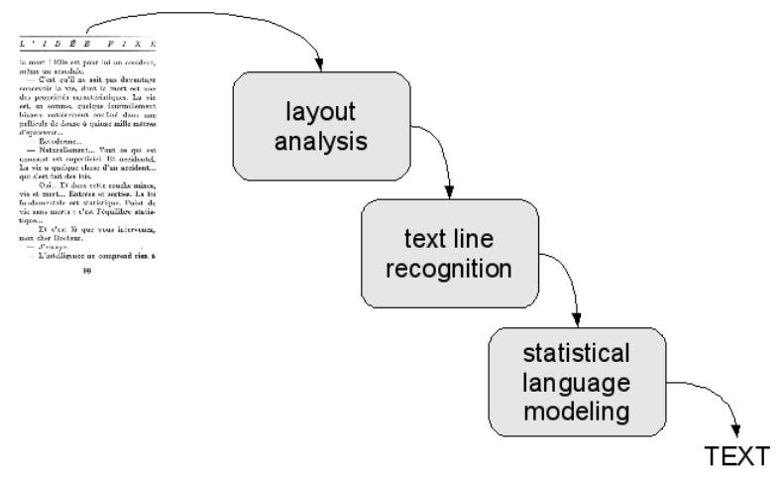
Flow chart for OCR

Slide 8
Outline
Optical Character Recognition
Capturing document images
Binarization
Skew Correction
Page Segmentation
Layout Analysis

Slide 9
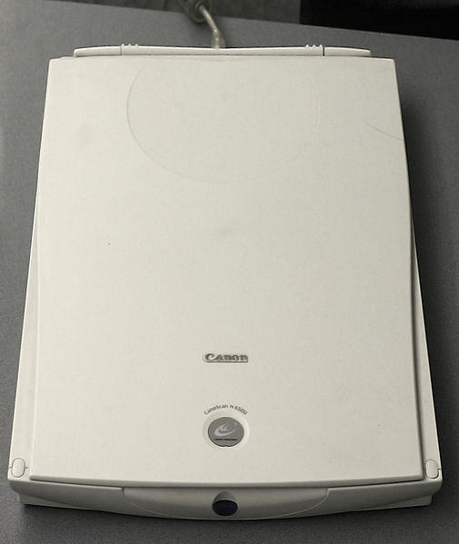
Capturing document images
Flat-bed scanners
  A glass plate with a light source underneath
  Page is placed upside down
  An array of CCD sensors moves over the page and collected the light reflected by the page
  Suitable for processing a few pages occasionally

Slide 10
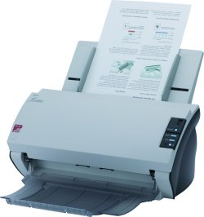
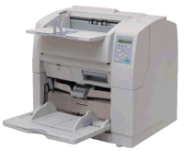
Automatic Feed Scanners
High scan throughput (more than 100 page per minute)
Can not scan bound material (e.g. books)

Slide 11
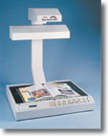
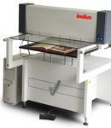
Book Scanners
Scan bound volumes using overhead camera
Some book scanners have automatic page turning (not very reliable)

Slide 12
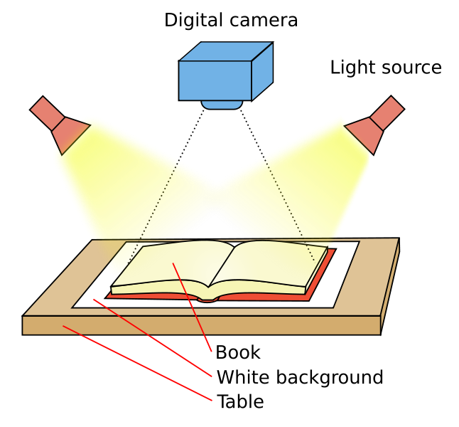
Book Scanners Principle

Slide 13
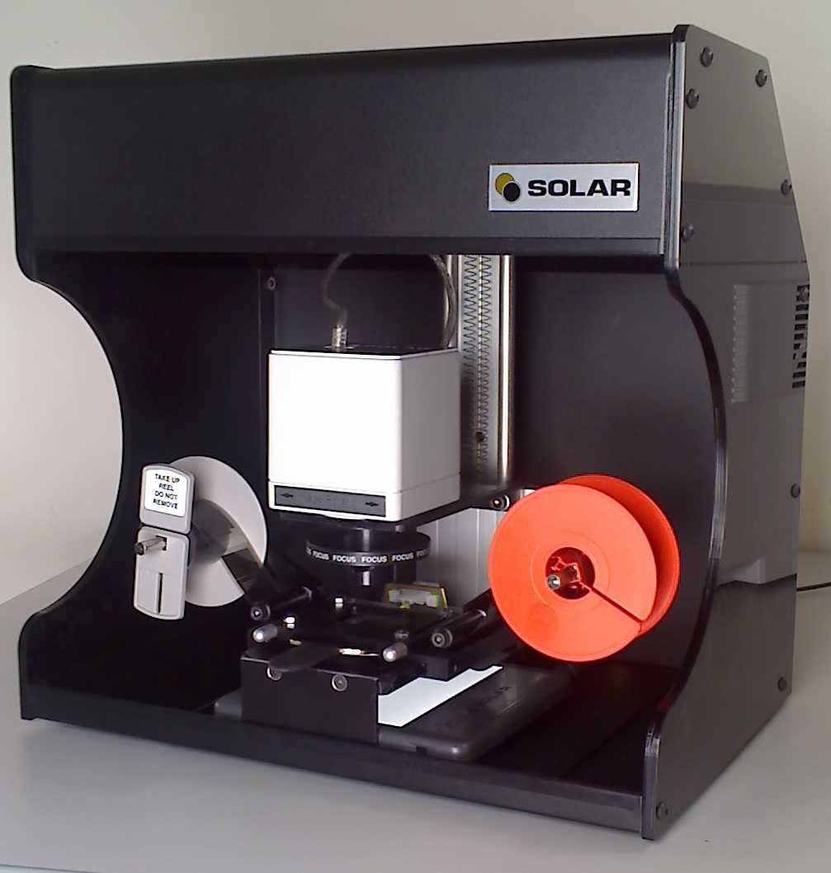
Micro-film Scanners
Scan material that is out-of-print
Used for digitizing historical documents (newspapers, books)

Slide 14
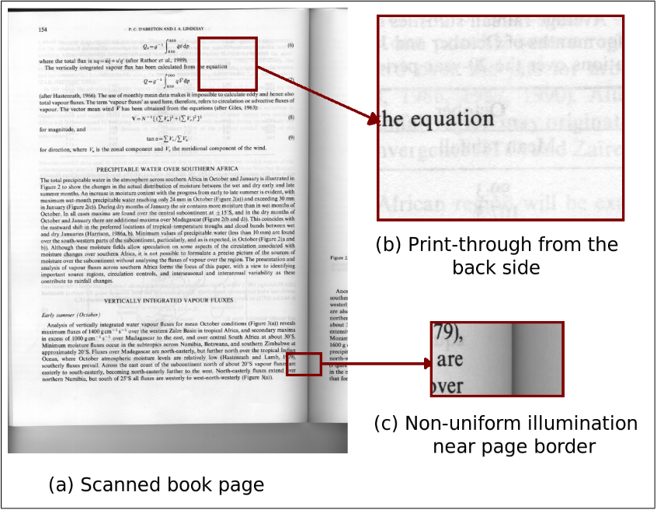
A typical scanned book page

Slide 15
Binarization
Scanners capture a greyscale/color document
Most of the OCR systems work on binary images
Binarization is an important first step in most of the document analysis systems

Slide 16
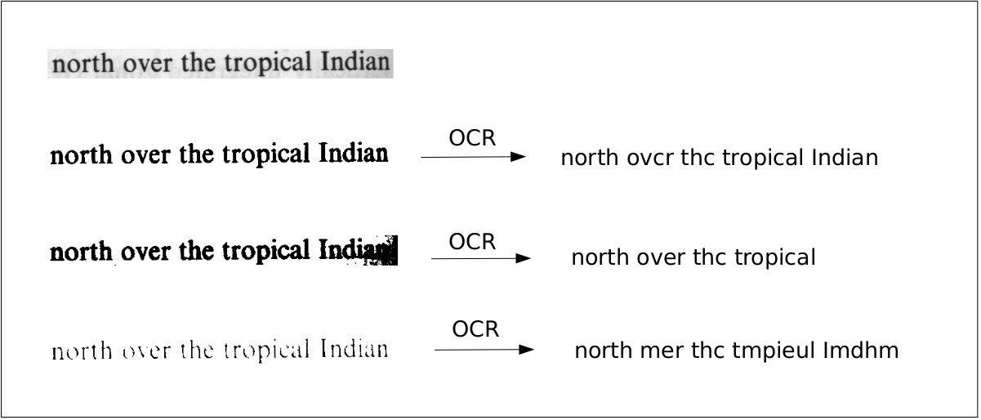
Effect of binarization on OCR

Slide 17
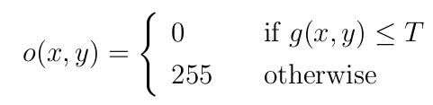
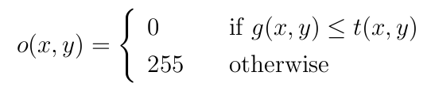
Binarization algorithms
The goal of binarization algorithm is to define a threshold.
Two main classes:
  Global binarization
  Local binarization

Slide 18
Global Binarization
Just set

Slide 19
Global Binarization
set

Slide 20
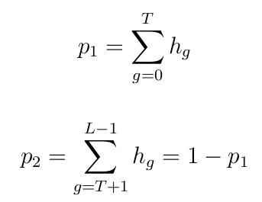
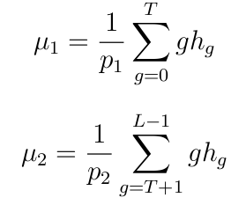

Otsu Global Thresholding
Let be the normalized histogram of the image

Slide 21
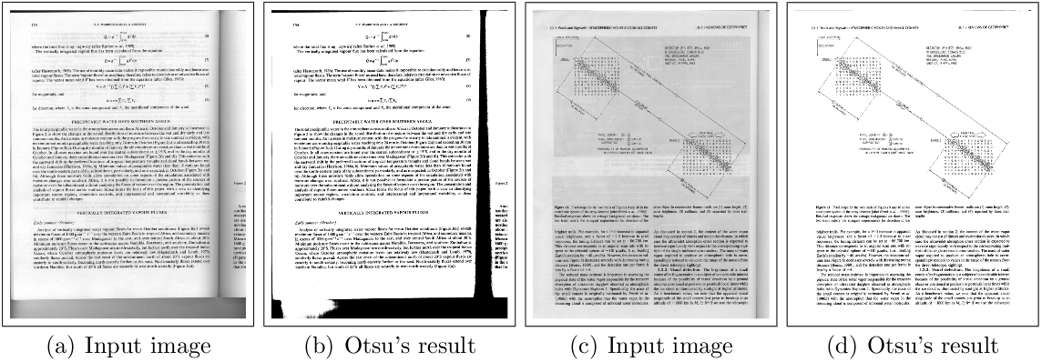
Otsu Global Thresholding

Slide 22


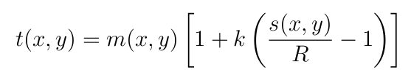
Local Adaptive Thresholding
Adapt to local variations in intensity by taking a window around each pixel
White (1983):
Niblack (1986):
Sauvola (2000):

Slide 23
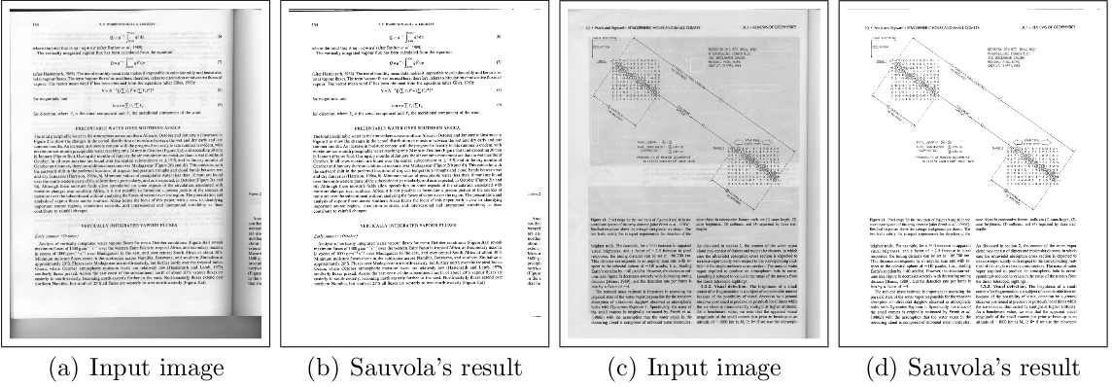
Sauvola Local Thresholding

Slide 24
Local Vs Global Thresholding
Global Thresholding methods are:
  Fast
  Give good results when illumination over a page is uniform
  Fail when there are local changes in illumination
Local Thresholding methods are:
  Slow
  Adapt to local changes in illumination
  Perform well for both uniform and non-uniform illumination

Slide 25

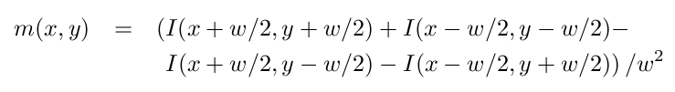
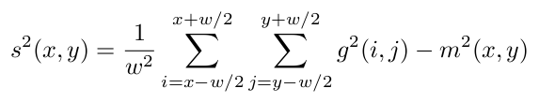
Shafait Binarization (2008)
Use integral images for computing local thresholds
Local mean and variance can be computed in linear time
Same performance as local thresholding in time close to global thresholding

Slide 26
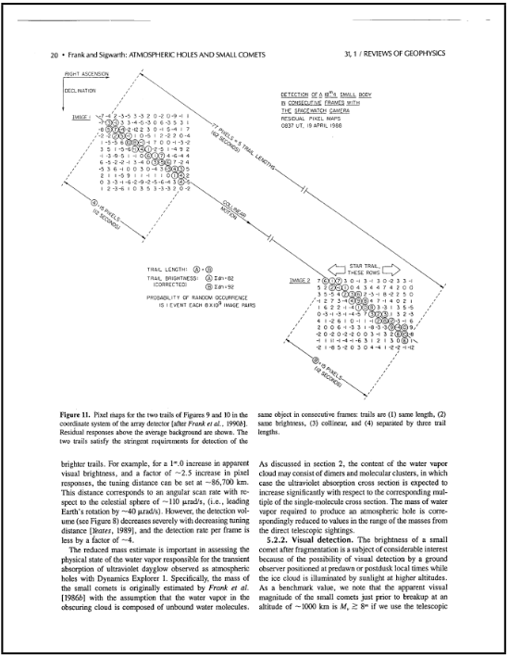
Connected Component Analysis

Slide 27
Connected Component Analysis
Scan the image row by row
When a black pixel is encountered, assign it a label:
  If left neighbor pixel is white, a new label is assigned to the current black pixel
  If left neighbor is black, its label is copied to the current pixel
If the upper neighbor pixel is black, merge the label of the current pixel and that of upper neighbor

Slide 28
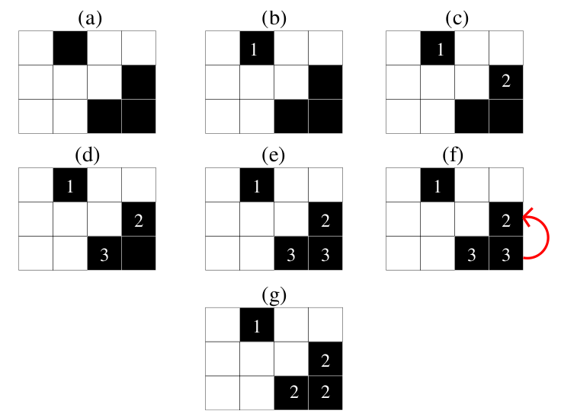
Connected Component Analysis Example

Slide 29
Other Pre-processing Tasks
Orientation detection
Marginal noise removal
Skew correction

Slide 30
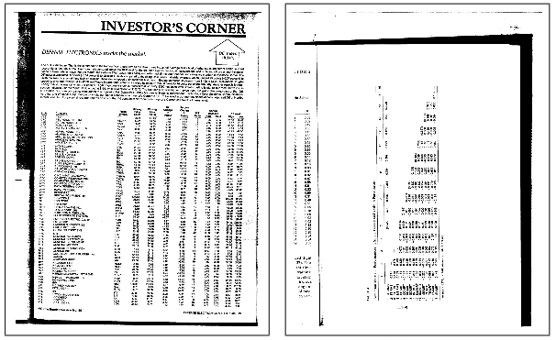
Orientation Detection

Slide 31
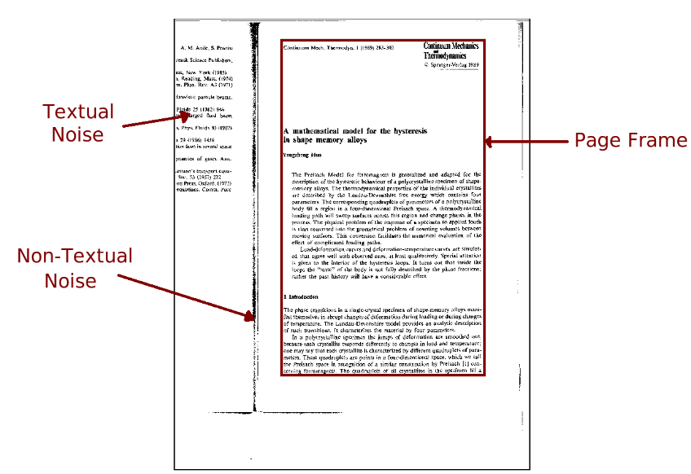
Marginal Noise Removal

Slide 32
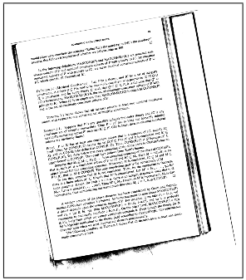
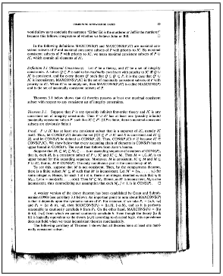
Skew Correction

Slide 33
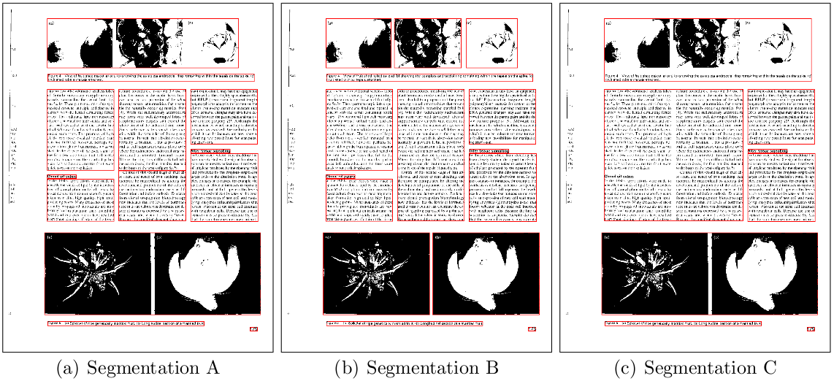
Page Segmentation

Slide 34
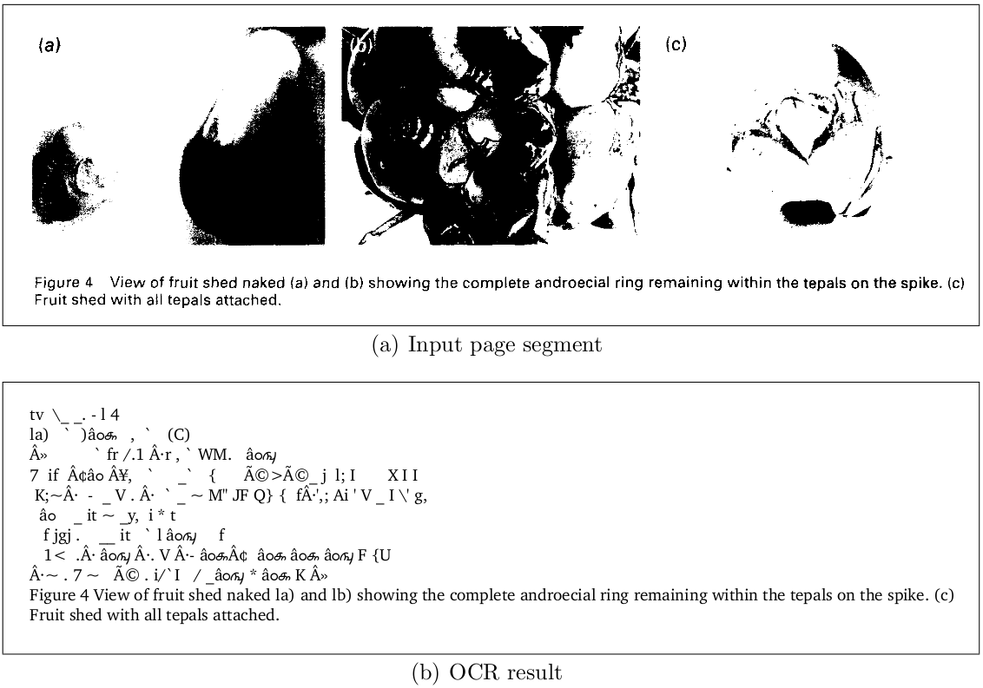
Incorrect Page Segmentation

Slide 35
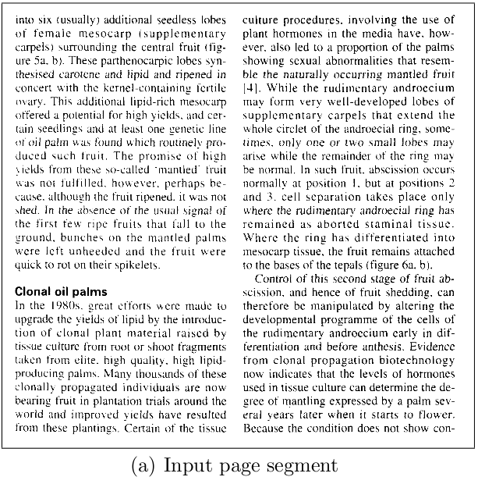
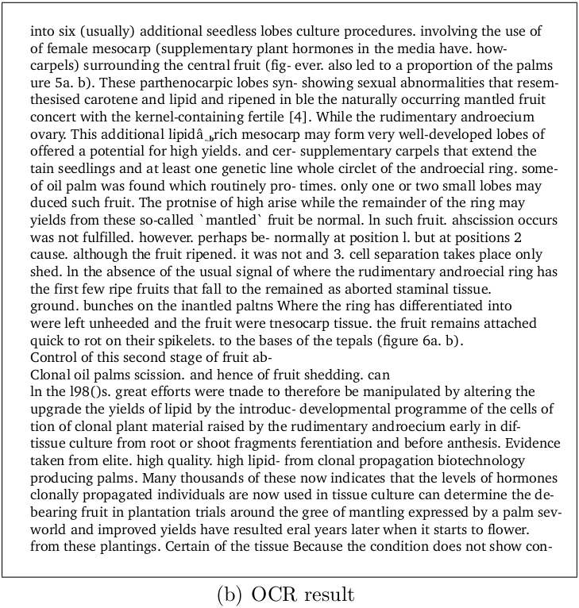
Incorrect Page Segmentation

Slide 36
Page Segmentation Algorithms
Run-length Smearing Algorithm (1982)
Recursive X-Y Cuts (1984)
Whitespace Analysis (1994)
Docstrum (1993)
Voronoi (1998)
RAST (2002) – by Thomas Breuel

Slide 37
Run-Length Smearing Algorithm
Works on binary image
White pixels represented by 0 and black by 1
A binary sequence x is changed into y:
  1's in x remain unchanged in y
  0's in x are changed to 1's in y if the number of adjacent 0's in x is less than or equal to a pre-defined threshold T.
This process is first repeated row-wise and then column-wise to get two distinct images
The two images are combined using AND op.

Slide 38
Run-Length Smearing Algorithm
A smooth final bitmap is obtained by again smearing in horizontal direction.
Connected components in the final bitmap correspond to segments in the image.

Slide 39
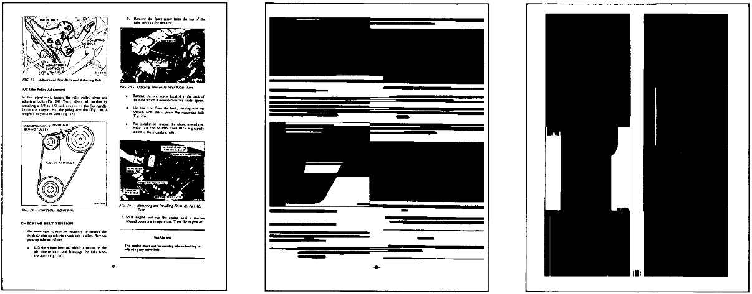
Run-Length Smearing Algorithm
(a) Original Image
(b) Horizontally Smeared Image
(c) Vertically Smeared Image

Slide 40
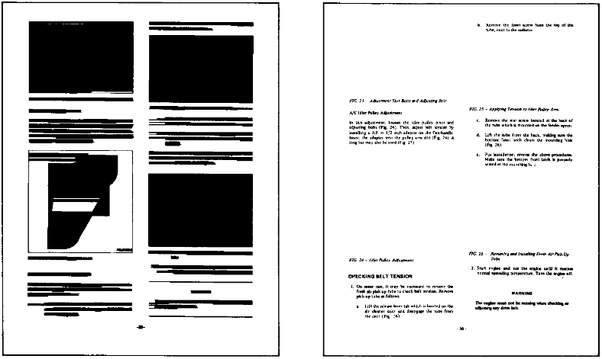
Run-Length Smearing Algorithm
(d) Final Image after Smoothing
(e) Identified text regions

Slide 41
Recursive X-Y Cut Algorithm
Recursive analysis of projection profiles
Projection profiles are obtained in two directions:
  Horizontal: Project the image on the y-axis.
    The length of the projection is equal to the height of the image
    The value at each index of projection is equal to the number of black pixels in that row of the image
  Vertical: Project the image on the x-axis.
    The length of the projection is equal to the width of the image
    The value at each index of projection is equal to the number of black pixels in that column of the image

Slide 42
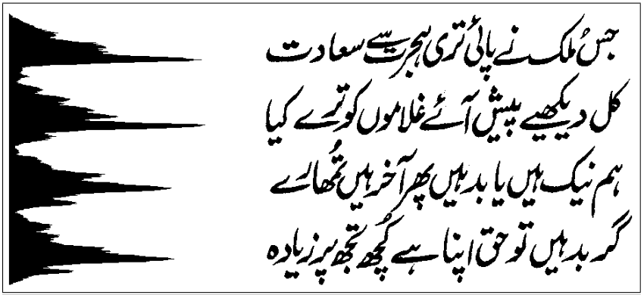
Horizontal Projection

Slide 43
Recursive X-Y Cut Algorithm
Recursive analysis of projection profiles
Compute horizontal and vertical projection profiles of the image.
Compute largest (zero-)valleys in the horizontal and vertical projections
Split the image in the direction of larger valley into two images if
Stop when the image can not be split further

Slide 44
Things to remember
Otsu Thresholding
Sauvola Thresholding
Connected Component Analysis
Run-Length Smearing Algorithm
Recursive X-Y Cut Algorithm

