Slide 1
Document and Content Analysis
Summer 2009
Lecture 9
OCR Training and HMMs
Thomas Breuel
Faisal Shafait

Slide 2
Text Line Recognition

Slide 3
text line recognition
oversegmentation
grouping
character recognition
language modeling

Slide 4
statistical model
Consider segmentations S from some space of segmentations.

Slide 5
segmentation
Per character likelihoods are independent given the segmentation.
Assumption: joint density between string and segmentation depends only on length.

Slide 6
Apply Bayes rule.
For classification, p(x) doesn't matter.
Assume a uniform prior for the segmentations.

Slide 7
Viterbi approximation
Viterbi approximation
Uniform prior on segmentations.

Slide 8
components of model
isolated character classification
Language model (prior over strings).
Density models of characters in correct segmentations.
Per character prior.

Slide 9
components of model (log)
language model costs
per-character costs

Slide 10
summary
arg max_{W} P(W|x) - Bayes-optimal recognition
log P(W|x) ≈ log P(W) + ∑ log f(x_{i},w_{i})
  cost of path through recognition lattice
  cost of path through language model

Slide 11
Finite State Transducers

Slide 12
weighted finite state transducers
a set of states Q
an input alphabet Σ
an output alphabet Γ
initial states I ⊆ Q
final states F ⊆ Q
semi-ring K of weights
a transition relation Q x Σ x Γ x Q x K

Slide 13
weighted finite state transducers
weighted finite state transducers
represent string replacements
with associated costs
abotu → about / 1.0
actualyl → actually / 1.0
aboto → about / 2.0
i snot → is not / 1.0
...

Slide 14
weighted finite state acceptor
special case:
input symbols = output symbols
weighted finite state acceptors
represent sets of strings and
associated weights

Slide 15
special cases
input / output symbols can be “empty” ε
transducers can be non-deterministic

Slide 16
simple example
x:x/0.4
a:A/0.2
b:B/0.2
a:a/0.2
b:b/0.2
x:x/0.4
abbaxabbaxabba → ABBAxabbaxABBA
aaaaaaaxxbbaxbbbbb → AAAAAAAxBBAxbbbbb

Slide 17
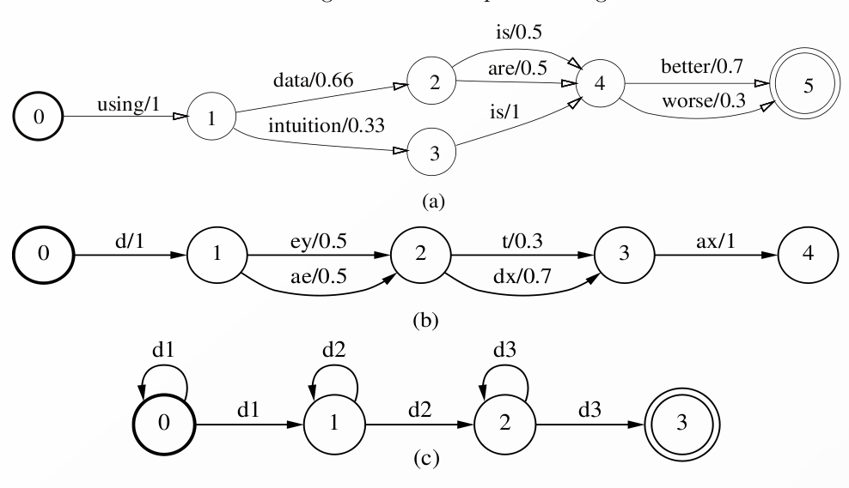
acceptor examples

Slide 18
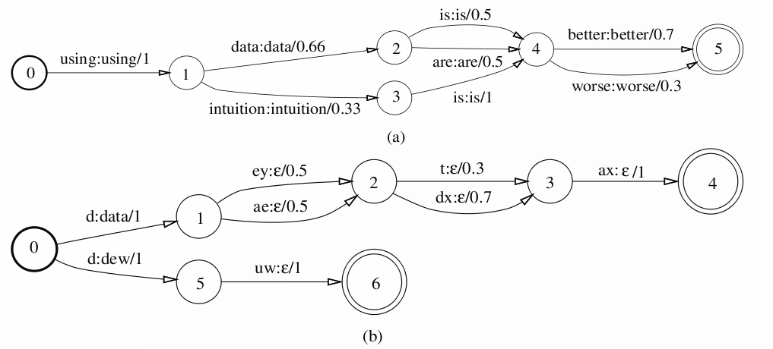
transducer examples

Slide 19
semiring
different operations for combining weights
  along a path — addition
  when paths meet — multiplication
common semirings
  (R,+,x,0,1) — probability semiring
  (R₊ ∪ {∞},min,+,∞,0) — tropical semiring (Viterbi approx.)

Slide 20
basic operations on FSTs
union
  x[T∪S]y iff x[T]y or x[S]y
intersection
  x[T∩S]y iff x[T]y and x[S]y
Kleene closure
  ε[T*]ε, a[T*]b and x[T]y → ax[T]by
concatenation
  uv[T∙S]wx iff u[T]w and v[S]x
composition
  x[T∘S]z iff x[T]y and y[S]z

Slide 21
WFST algorithms
ε-removal
  eliminate empty symbols
determinization
  eliminate non-deterministic transitions
minimization
  minimum number of states/transitions
garbage collection
  remove inaccessible states

Slide 22
WFST algorithms
bestpath
  find the best path through a given WFST
bestpath through composition
  find the best path through a composition of WFSTs
  (without explicitly computing the composed WFST)

Slide 23
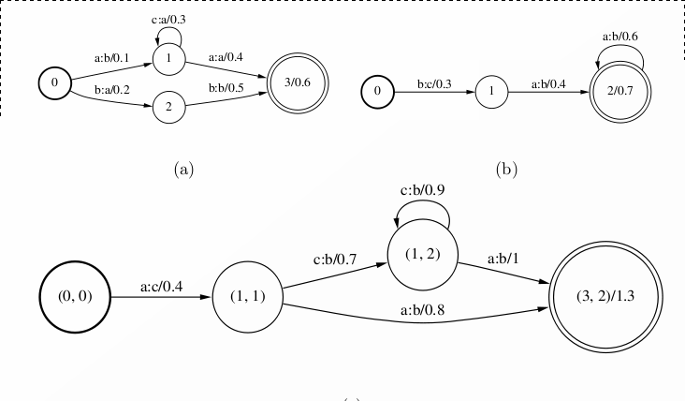
composition

Slide 24
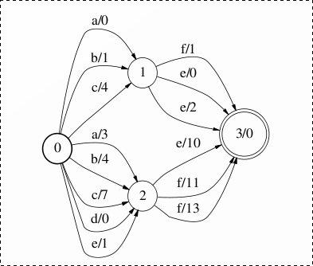
non-deterministic acceptor

Slide 25
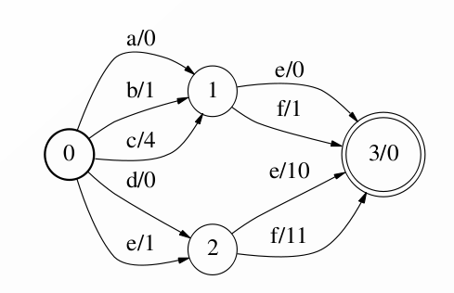
deterministic equivalent

Slide 26
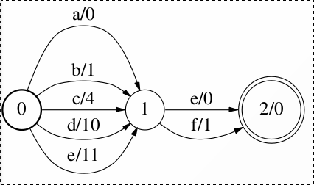
minimized equivalent

Slide 27
Uses of Weighted Finite State Transducers

Slide 28
recall...
OCR produces recognition alternatives
the best alternative may not be the right one
language models re-weight alternatives

Slide 29

lang model for text lines
language model should contain
“Department of Geological Sciences”
allow any repetition of words in the dictionary, separated by spaces or punctuation

Slide 30
constructing a language model
Construct a simple language model from individual words/strings.
“aardvark”
a
a
r
d
v
a
r
k

Slide 31
constructing a language model
ant
aardvark
arboreal
union
axiom
allosaurus

Slide 32
constructing a language model
ant
aardvark
arboreal
minimize
axiom
allosaurus

Slide 33
trie models
d
t
n
t
a
...
...

Slide 34
trie vs minimized
b
a
a
c
c
b
o
b
o
trie
minimized
transducer

Slide 35
constructing a language model
dictionary
word
transducer
union
minimize
word
transducer
concatenate
Kleene closure
word
transducer
word separator

Slide 36
construction by composition
John : name
cat : animal
Jack : name
likes : v/trans
union
Jane : name
hugs : v/trans
sleeps : v/intrans
composition
name
v/trans
animal
name
v/intrans

Slide 37
n-gram probability models
recall n-gram probability models
we're given
P(cl | cl-n ... cl-(n-1))
transduction
  string to itself (i.e., weighted acceptor)
  cost is the product of all the conditional probabilities

Slide 38
constructing an n-gram transducer
a / 1
^a / 2
^b / 2
aa / 1
bb / 1
ab / 2
ba / 3
a$ / 1
b$ / 2
a / 2
epsilon / 1
[a]
[^]
a / 3
b / 2
[$]
b / 2
[b]
epsilon / 2
b / 1
Key idea: each state represents the history; transitions on the last symbol in the string.

Slide 39
modular language model construction
construct language models from...
  strings
  union
  minimization
  Kleene closure
  concatenation
special cases
  trie model
  n-gram model

Slide 40
Training

Slide 41
how do we train an OCR system?
language model
classifier
character frequencies
density model of
character shapes
(character /
non-character
classification)
x_{i} requires knowledge of the correct segmentation S

Slide 42
S is a missing variable
P(c|xi) and P(xi) require isolated characters for training
knowledge of isolated characters requires knowledge of segmentation S
the correct segmentation S isn't usually given or known

Slide 43
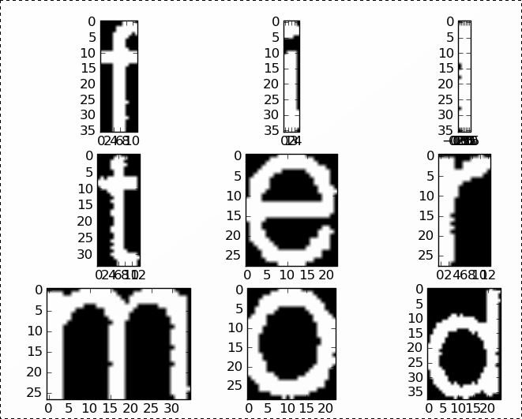
OCR training
GIVEN
“Department of Geological Sciences”
NEEDED
“f”
“i”
“l”
“t”
“e”
“r”
“m”
“o”
“d”

Slide 44
OCR training
recognize
model
training image
recognition lattice
+ corresponding segmentation
convert to WFST
“Department of Geological Sciences”
composition
corresponding transcript
isolated characters
and transcripts
training

Slide 45
OCR training
character recognizers need to be trained on isolated characters
training data is usually given on a per-line basis
therefore, training requires computing segmentation S

Slide 46
OCR training
EM-algorithm
  given an initial classifier, compute W and S for each text line, using the transcription as the language model
    throw away W (it is just the transcription)
    S gives the segmentation into characters
    |S| = |W|
  use S to divide the training image into isolated characters xi
  look up the corresponding wi in W
  use the (x_{i},w_{i}) to train a better model
  repeat until convergence

Slide 47
Relationship to HMMs

Slide 48
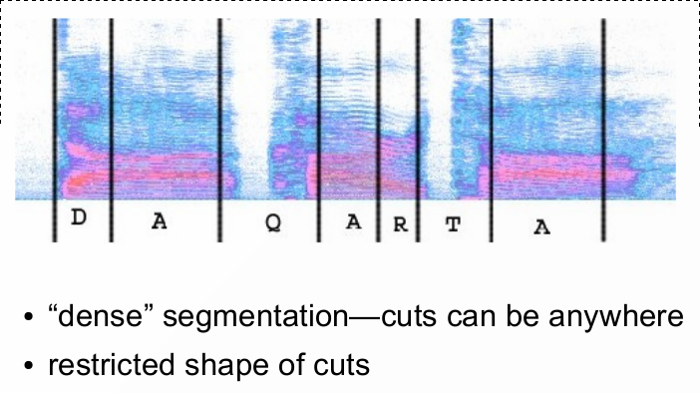
generalization of HMM

Slide 49
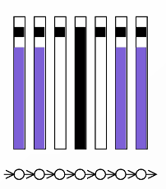
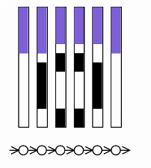
OCR as HMM

Slide 50
OCR as discrete HMM
consider images 8 pixels high
each vertical slice is one of 256 symbols
the input becomes a symbol sequence
  “_ _ _ _ ' ' | ' ' _ _ |: :| _ _”
OCR becomes translating symbol sequences
  “_ _ _ _ ' ' | ' ' _ _ |: :| _ _” → “ TO “

Slide 51
continuous HMMs
discrete HMM
  each input is a discrete symbol c
  each state i is associated with a cost M_{ci}
continuous HMM
  each input is a vector x in R^{n}
  each state i is associated with a density p(x|i)
  (often a normal density)
decoding
  analogous in discrete and continuous case
  usually need different algorithm, though

Slide 52
OCRopus

Slide 53
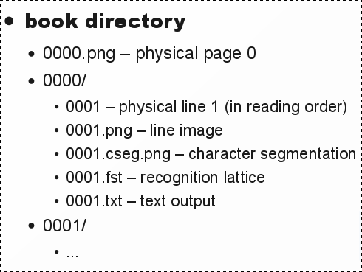
OCRopus representation

Slide 54
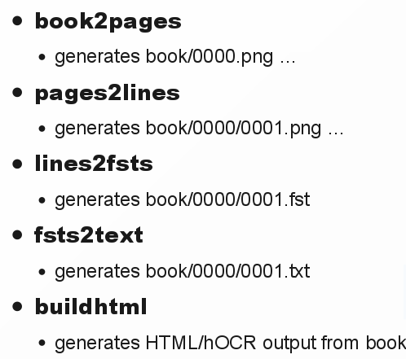
OCRopus commands

Slide 55
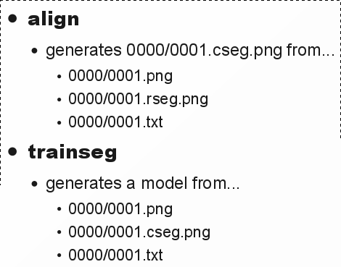
OCRopus commands

Slide 56
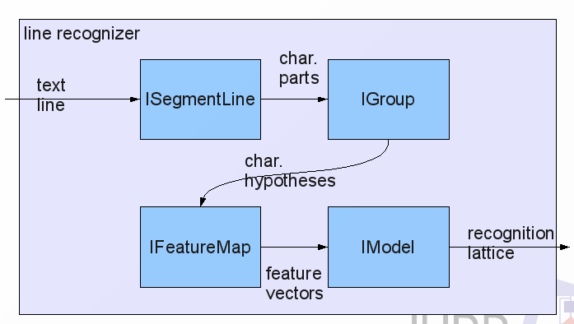

Slide 57
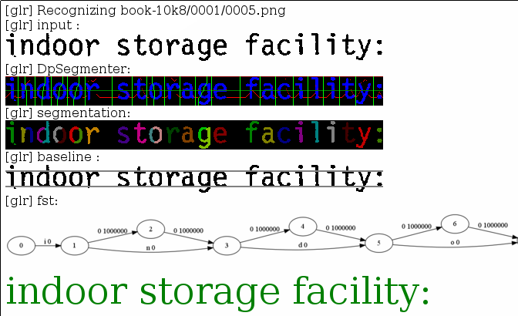

Slide 58
summary
statistical foundations
weighted finite state transducers
building language models
OCR training and EM training
relation to HMMs
OCRopus commands

