Slide 1
Document and Content Analysis
Summer 2009
Lecture 10
Camera-Captured Document Analysis
Thomas Breuel
Faisal Shafait

Slide 2
So far processed scanned documents only!

Slide 3
So far processed scanned documents only!
Scanners produce:
  Flat pages
  Uniform illumination
  Desktop scanners are cheap and produce nice images
  High-End scanners can process large amounts of individual pages pretty quickly

Slide 4
Why would we need cameras to capture documents?

Slide 5
Why would we need cameras to capture documents?
Cameras offer:
  Fast and easy capture for daily use
  Non-contact imaging
  Non-destructive document capture
Besides, most people already have cameras (digital cameras, cell-phone cameras)

Slide 6
To analyze documents captured with a camera, we need to understand the world as a camera sees it!

Slide 7
Parallel Lines
Where do these lines meet?

Slide 8
Intersecting Lines
Where do these lines meet?

Slide 9
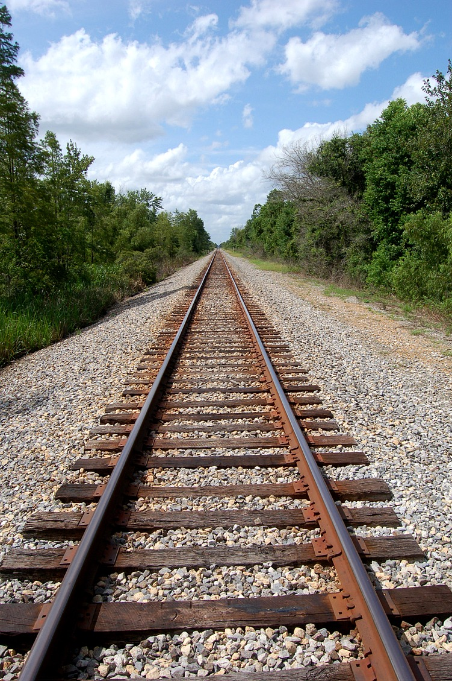
Perspective Distortion
Where do these lines meet?

Slide 10
Cameras introduce several distortions in the image
Camera-captured document analysis needs to handle these distortions
Key distortions relavant to document captures are:
  Perspective distortion
  Uneven page surface

Slide 11
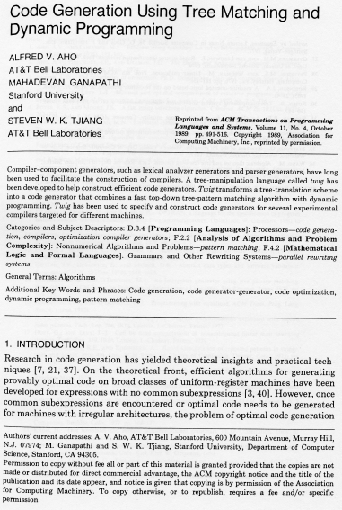
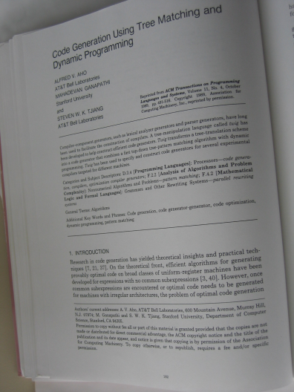
(a) Scanned Book Page
(b) Camera-Captured Book Page

Slide 12
Traditional techniques for document analysis, including those we have studied so far assume a flat page.
What should we do now?

Slide 13
Traditional techniques for document analysis, including those we have studied so far assume a flat page.
What should we do now?
Develop new techniques for camera-captured document analysis
“Straighten” camera-captured documents such that they look the same as scanned documents

Slide 14
Traditional techniques for document analysis, including those we have studied so far assume a flat page.
What should we do now?
Develop new techniques for camera-captured document analysis
“Straighten” camera-captured documents such that they look the same as scanned documents
This straightening is called Dewarping

Slide 15
Dewarping techniques can be divided into two broad categories:
3D-model based approaches
Single camera based approaches

Slide 16
Dewarping
Dewarping techniques can be divided into two broad categories:
3D-model based approaches
  Require specialized hardware
  Careful camera calibration needed
  Stereo-Cameras
  Can do exact reconstruction (dewarping)
Single camera based approaches
  No special setup needed
  Exact reconstruction not possible
  Approximate solutions also quite acceptable

Slide 17
3D Model Based Approaches
Techniques based on 3D computer vision:
  Projective Geometry
  Camera Models
  Stereo Vision

Slide 18
Projective Geometry of 2D
A vector of the projective space P^{n} has n+1 elements
Fundamental property of vectors of a projective space: Scaling equivalence:
Two main reason for choosing the projective space for 3D computations:
  All linear transformations between points (rotation, translation, projection) can be written as matrix-vector multiplications
  Points at infinity can be represented in projective space

Slide 19
Homogeneous Coordinates
Homogeneous coordinates make calculations possible in projective space just as Cartesian coordinates do in Euclidean space.
Cartesian coordinates of a point in 2D Euclidean space are (x,y)^{T}
Homogeneous coordinates of a point in 2D projective space are (x,y,1)^{T}

Slide 20
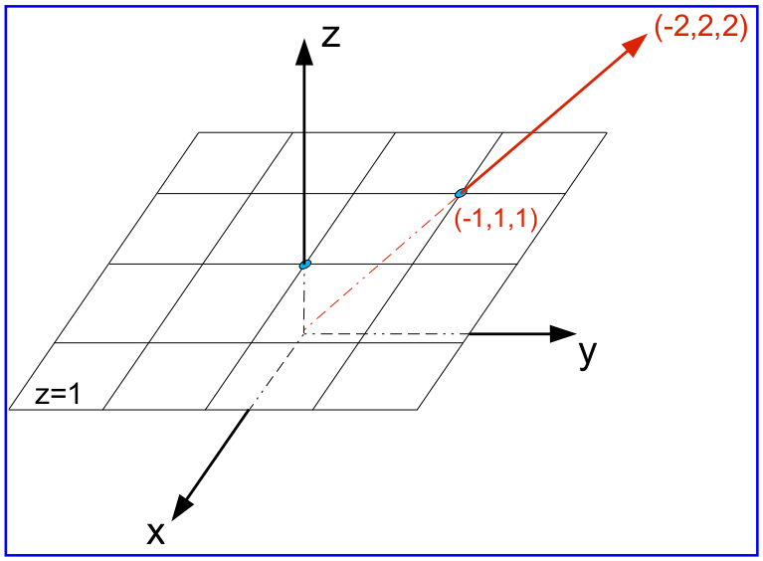
Illustration of Projective Space P²

Slide 21
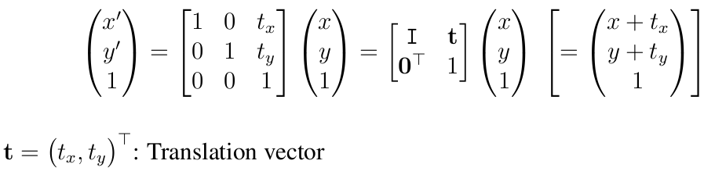
Projective Transformations
Translation
Transformation matrix:
Degrees of Freedom = 2

Slide 22
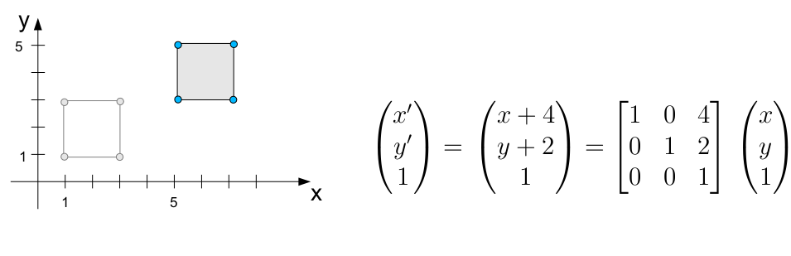
Example of Translation
Invariants: Length, Area, Angles

Slide 23
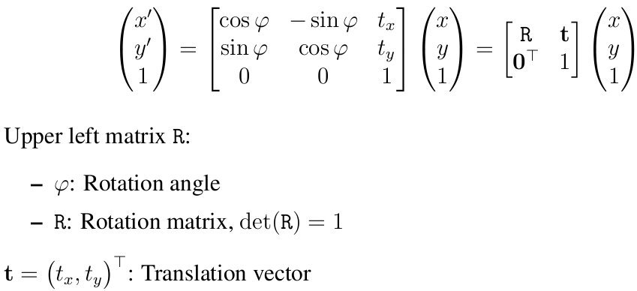
Projective Transformations
Euclidean Transformation
Translation, Rotation
Transformation matrix:
Degrees of Freedom = 3

Slide 24
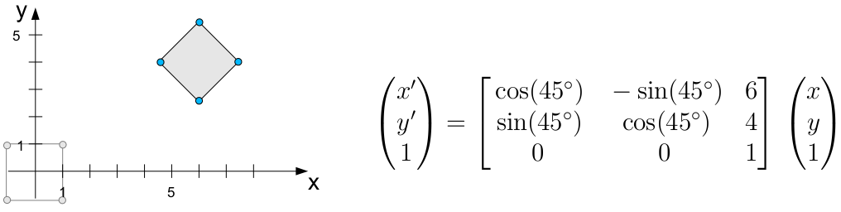
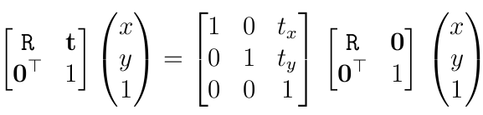
Example of Euclidean Transformation
First translation, then rotation
Invariants: Length, Area, Angles

Slide 25
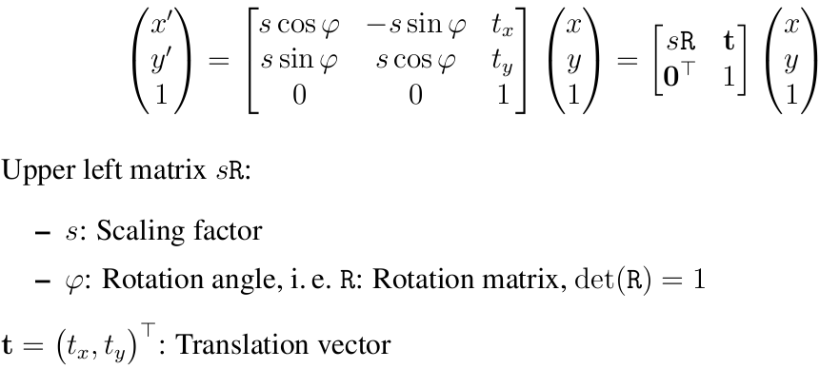
Projective Transformations
Similarity Transformation
Translation, Rotation, Scaling
Transformation matrix:
Degrees of Freedom = 4

Slide 26
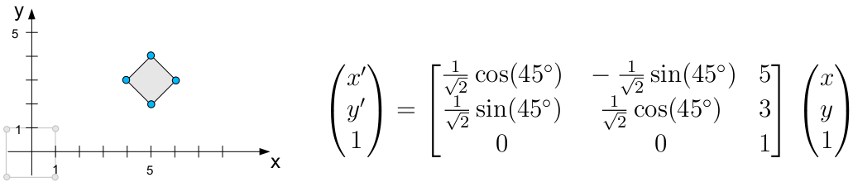
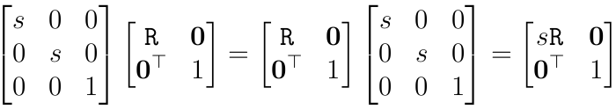
Example of Similarity Transformation
Rotation and scaling are commutative as
Invariants: Relative length, relative area, angles

Slide 27
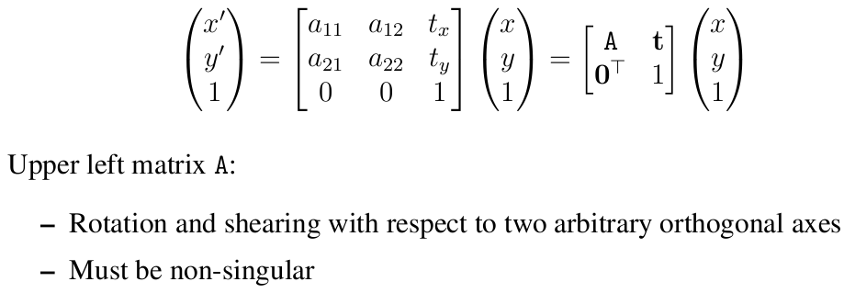
Projective Transformations
Affine Transformation
Translation, Rotation, non-isotropic Scaling
Transformation matrix:
Degrees of Freedom = 6

Slide 28
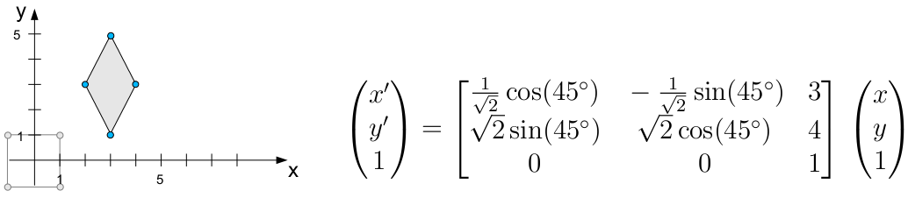
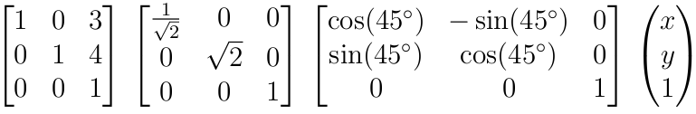
Example of Affine Transformation
This example of an affine transformation can be decomposed to
Invariants: Parallelism of lines

Slide 29
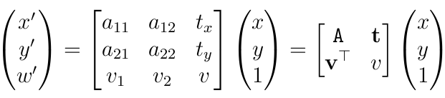
Projective Transformations
Projective Transformation
Includes Affine Transformation
Transformation matrix:
Degrees of Freedom = 8

Slide 30
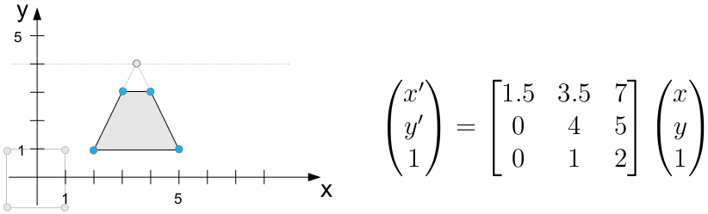
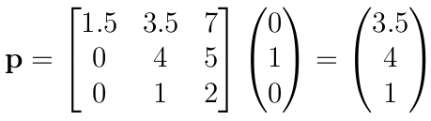
Example of Projective Transformation
Point at infinity in y-direction gets projected to
p is the vanishing point of the lines parallel to
the y-axis

Slide 31
Perspective Distortion
Where do these lines meet?
Projective Geometry can give us the answer!

Slide 32
3D Model Based Approaches
Techniques based on 3D computer vision:
  Projective Geometry
  Camera Models
  Stereo Vision

Slide 33
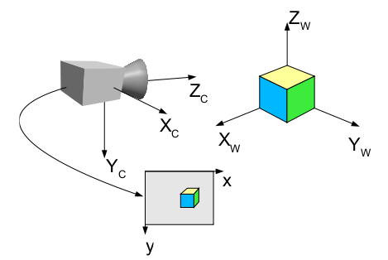
Camera Models
Modeling the projection process consists of transforming point coordinates from
  world coordinates XEw to camera coordinates XEc
  camera coordinates XEc to image coordinates (x, y)

Slide 34
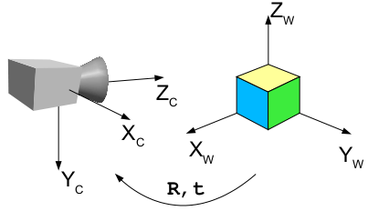

World to Camera Coordinates
The world and camera coordinate systems are related by rotation and translation
Transformation of points is Euclidean in 3D

Slide 35
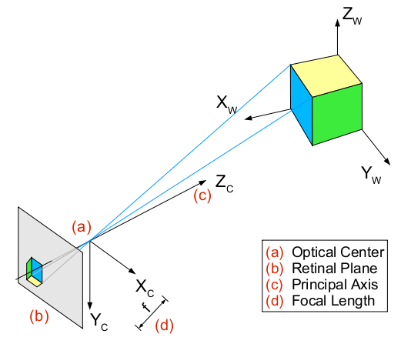
Camera to Image coordinates
Camera models describe projection from camera coordinates to image coordinates mathematically
Easiest model which is suitable for wide range of cameras is the pinhole camera

Slide 36
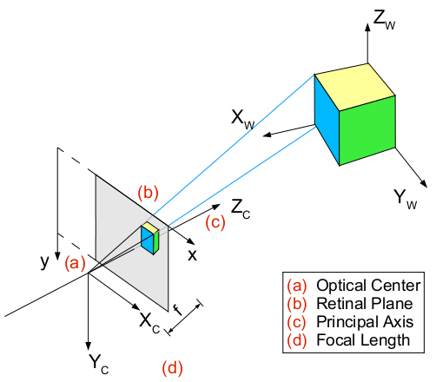
Identical Model with image upright in front of the optical center

Slide 37
Pinhole Camera
Pinhole camera with retinal plane in front of the optical center is easier to describe
Transformation of camera coordinates to image coordinates:
  Canonic projection (independent of camera data)
  Transformation of projected coordinates to image coordinates
By convention:
  Principal axis points in Zc-direction
  Right-handed coordinate systems

Slide 38
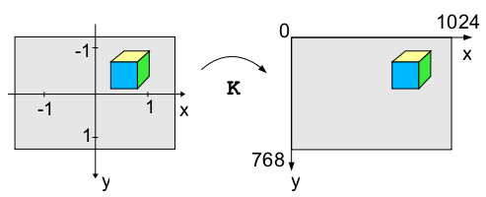
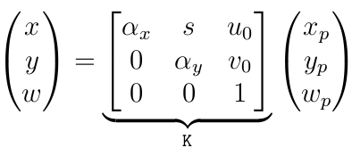
Projected to pixel coordinates
Intrinsic projection to pixel coordinates
Pixel coordinates have origin in upper left corner
Pixel dimensions scale x and y coordinates
Used affine homography is called intrinsic matrix K

Slide 39
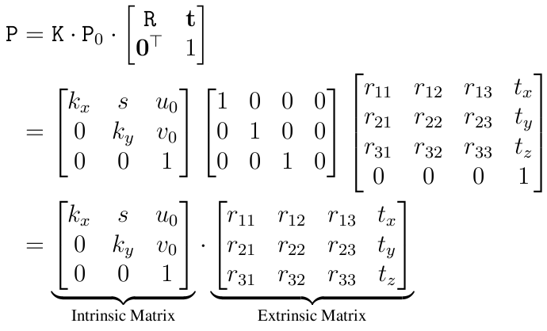
Overall Projection:
These matrices represent internal and external camera parameters

Slide 40
What is all this good for?

Slide 41
What is all this good for?
If we know the intrinsic and extrinsic parameters of a camera, we can use it to do real-world measurements
(widely used in machine vision industry)

Slide 42
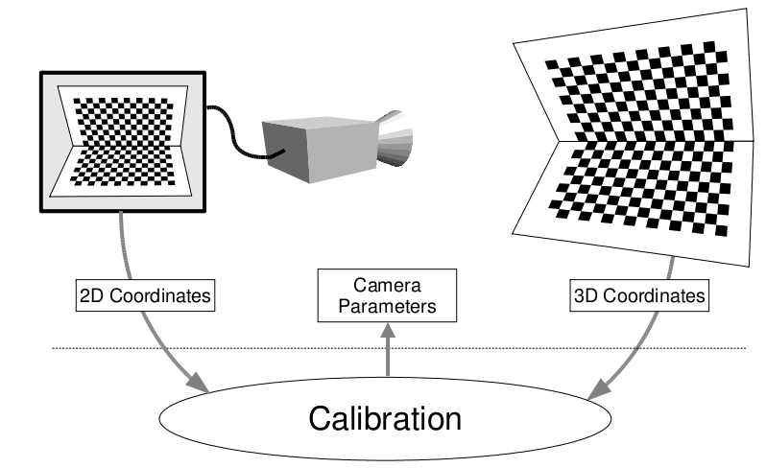
Camera Calibration
Camera calibration: Estimating camera parameters given a set of image/world point correspondences
A Calibration object i.e. a pattern with known world coordinates is used for this purpose

Slide 43
3D Model Based Approaches
Techniques based on 3D computer vision:
  Projective Geometry
  Camera Models
  Stereo Vision

Slide 44
Stereo Vision
So far camera calibration is based on correspondences between the image (2D) and coordinates of a calibration object (2D or 3D)
World coordinates of a calibration object, i.e. image content, have to be known
Typically camera is looking at unknown image content
Correspondences between image points can be established if two or more snapshots of the scene are available
3D reconstruction can be done if relative pose of the two cameras is known (stereo cameras)

Slide 45
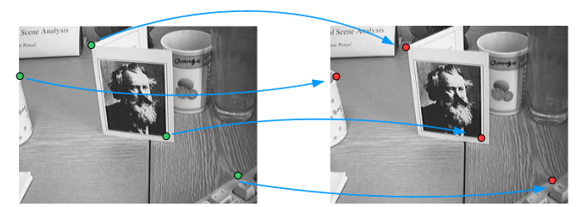
Triangulation
After establishing correspondences between points, the distance of each point from the camera plane can be calculated using Triangulation. Hence the depth information that was lost during the imaging process can be recovered.

Slide 46
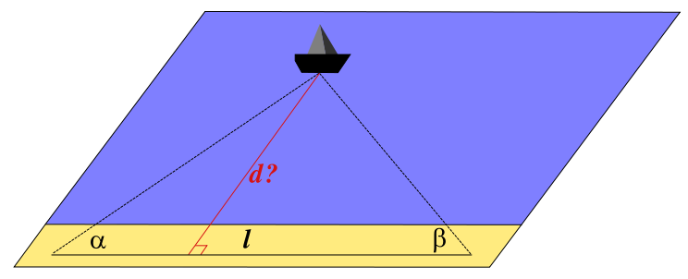
Triangulation
Triangulation is the process of determining the location of a point by measuring angles to it from known points at either end of a fixed baseline, rather than measuring distances to the point directly

Slide 47
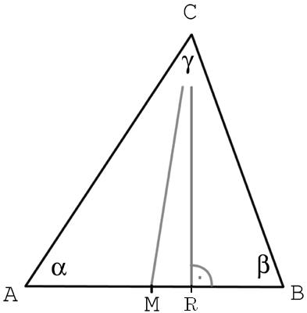

Triangulation

Slide 48
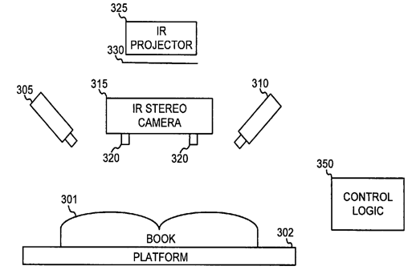
Google's Book Scanner
Infrared light displays a calibration pattern on the book surface
Infrared cameras reconstruct the 3D book surface
Geometric transformations are applied to “flatten” the obtained surface.

Slide 49
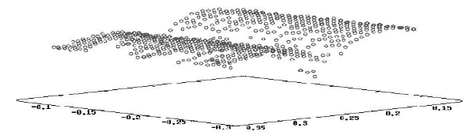
3D Shape Reconstruction

Slide 50
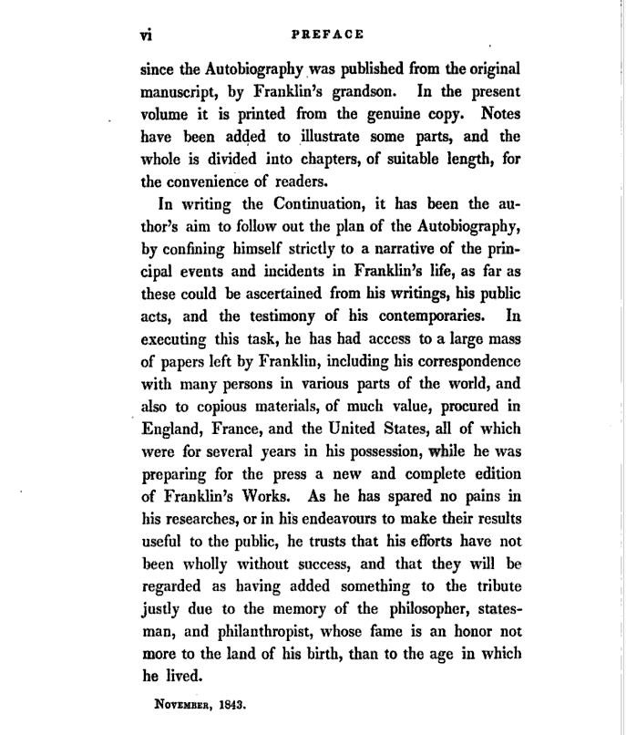
Sample Page from books.google.com

Slide 51
Summary so far
Stereo 3D shape reconstruction and dewarping of books works but needs a lot of geometry (computer vision) and specialized hardware
Not suitable for home users
Capturing documents with a single hand-held camera is much easier but we can not get the 3D shape and hence perfect flattening is not possible

Slide 52
Monocular Dewarping
Developing techniques for dewarping using a single camera is a hot topic of research.
It works pretty well because document images are nicely structured with parallel text lines.
Most of dewarping techniques simple focus on finding text lines in the camera-captured document and then straighten the text lines.

Slide 53
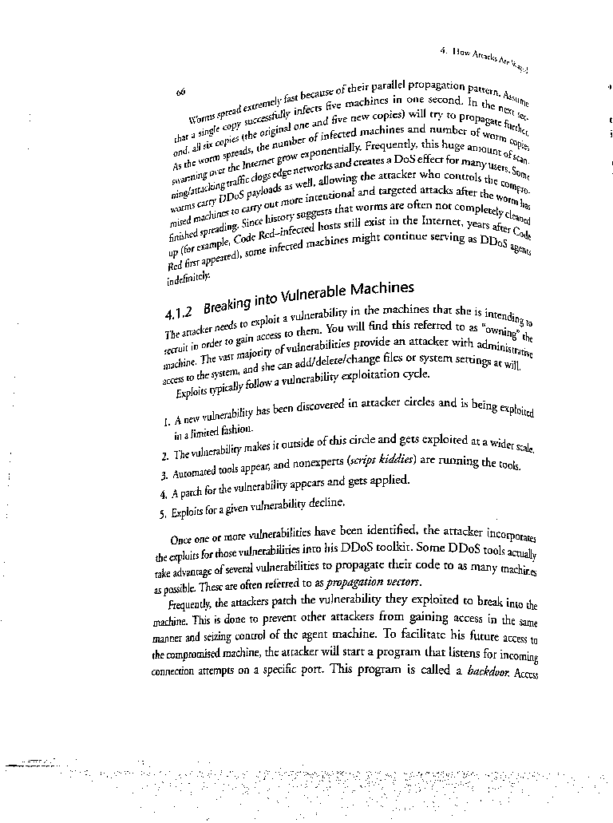
Monocular Dewarping
Input image

Slide 54

Monocular Dewarping
Smoothed image (anisotropic Gaussian Smoothening)

Slide 55
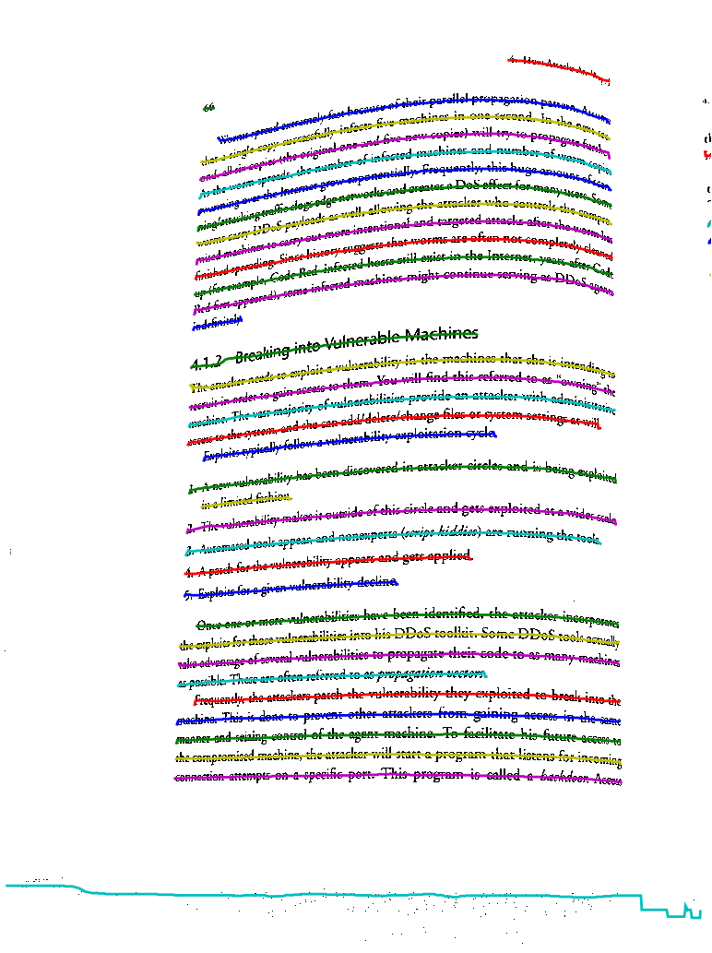
Monocular Dewarping
Text-line detection

Slide 56
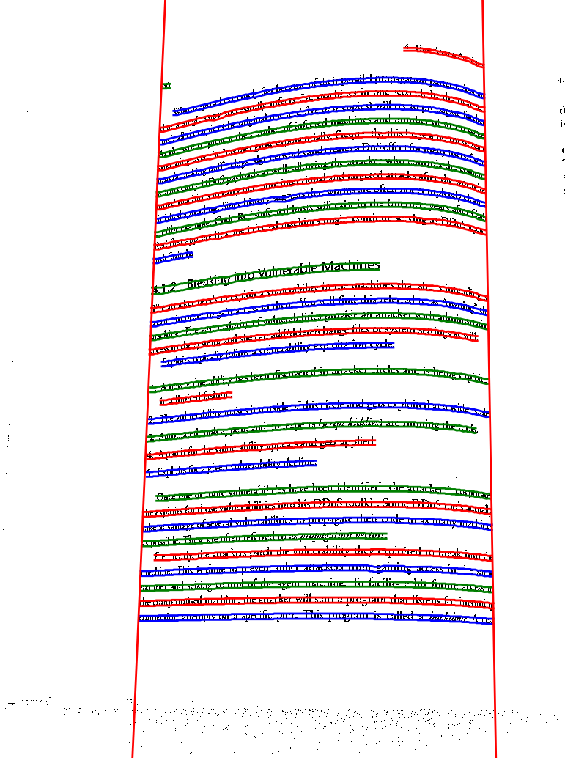
Monocular Dewarping
Estimating baseline and x-line of detected text-lines

Slide 57
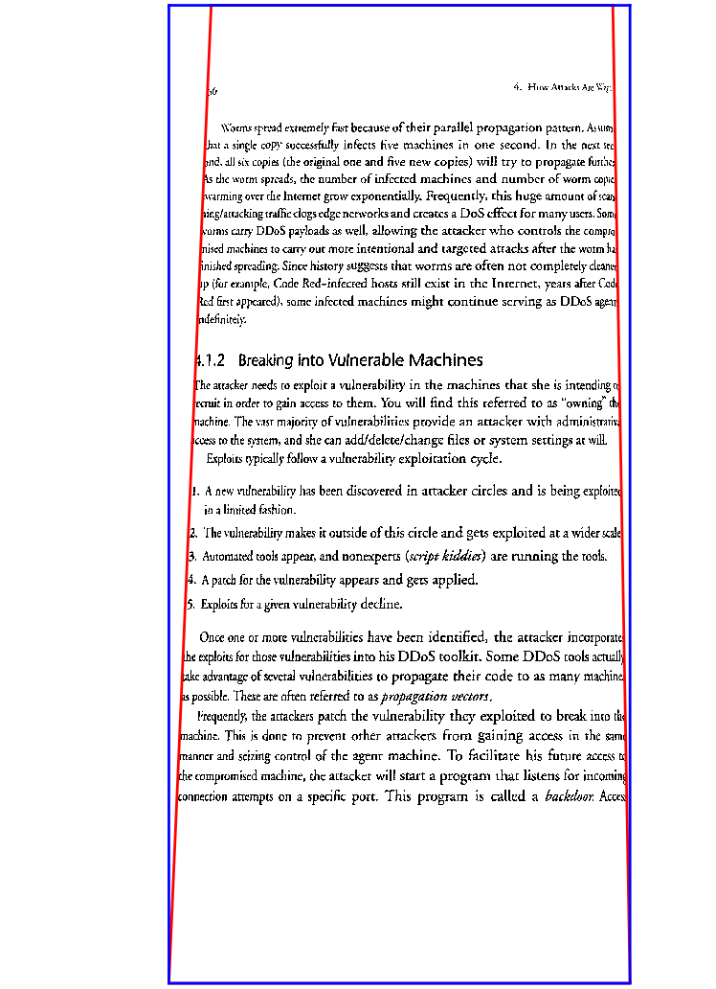
Monocular Dewarping
Correcting geometric distortions: straightening individual curled textlines

Slide 58
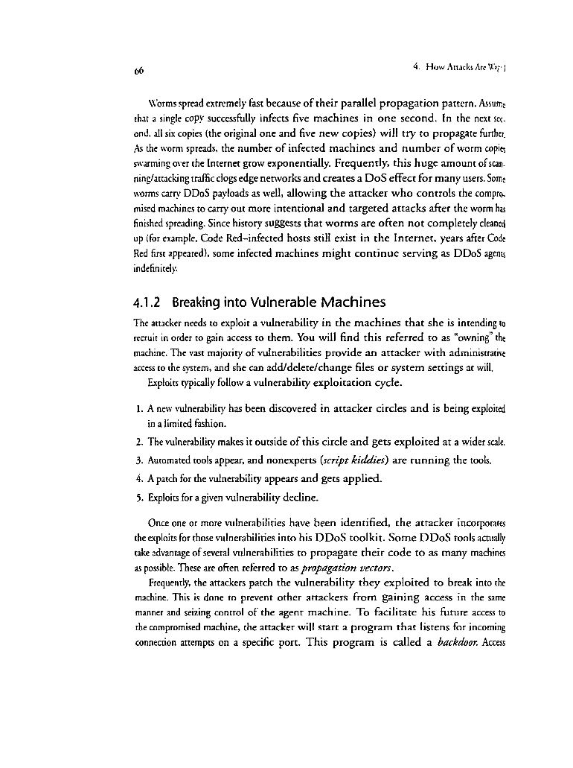
Monocular Dewarping
Correcting perspective distortion: four point homography algorithm

Slide 59
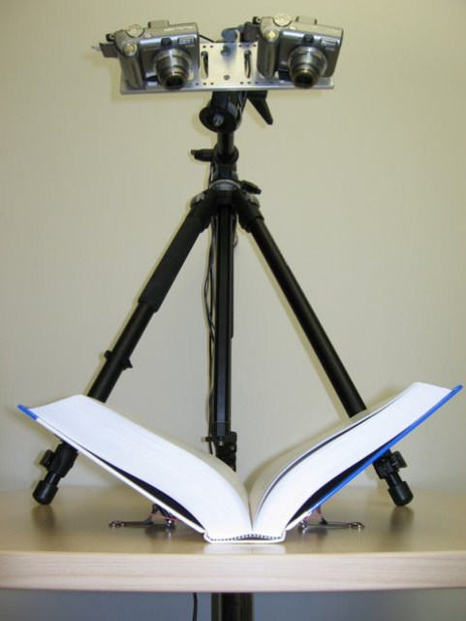
Stereo Dewarping for Home Users
Decapod project at IUPR
Goal: Create high-quality searchable PDFs from personal collections
Scientific Challenges: Making Stereo Dewarping just work
  Use consumer cameras
  Make stereo calibration seamless for the users
HiWi Jobs, Student Projects, Masters Theses available

Slide 60
Summary
Why moving to cameras from scanners
Basics of 3D dewarping
  Projective Geometry
  Camera Models
  Stereo Vision
Dewarping using a single camera

