Slide 1
Document and Content Analysis
Writing Systems and Encodings
Thomas Breuel

Slide 2
Why bother?
string processing
  affects algorithms, regular expressions, etc.
network protocols, domain names, etc.
  security, business success
software internationalization
  translate your software, make it usable by others
document analysis, OCR
  recognize characters
search engines
  deliver better search results

Slide 3
Computer Science Perspective
ASCII
ISO8859-1, ISO8859-15, ShiftJIS, ...
Unicode, UCS-2
Unicode, UTF-16, UCS-4

Slide 4
Language Perspective
Greek, Latin, German, Russian, ...
Arabic
Chinese
Indic Scripts, Urdu
Korean
Japanese

Slide 5
Notational Perspective
alphabet
diacritics
ligatures
spaces
justification
fonts
writing direction
capitalization
radicals
syllables
ruby
hyphenation
phonetics

Slide 6
PRACTICALITIES

Slide 7
practicalities on Linux
controlled by environment variable
LC_...
  LC_MESSAGES – message catalog
  LC_CTYPE, LC_COLLATE – interpretation
  LC_TIME – time format
  LC_PAPER, LC_NAME, LC_ADDRESS, …
LC_ALL > LC_... > LANG > (default)

Slide 8
formats of locale specifications
language[_territory][.encoding][@modifier]
examples
  en_US.ascii
  en_US.utf8
  de_DE.utf8
  de_DE.utf8
  de_DE.iso8859-15

Slide 9
how do you type it?
different keyboard layouts
  with shift characters, a few hundred different characters
  beyond that, need more...
input methods (SCIM, UIM, ...)
  simple keyboard mappings with shift keys
  dead keys
  alphabetic → syllabic (“ka” → ka-syllable)
  alphabetic → logographic
  radical → logographic

Slide 10
how do you type it?
on-screen keyboard
  select from grid
various keyboard shortcuts
  Control-Shift-..., M-u …, etc.
quoting
  \u1234, \U12345678

Slide 11
OpenOffice
OpenOffice is Unicode-capable
good way to experiment with text

Slide 12
Firefox
Firefox is highly multilingual
supports many encodings (change on the fly)
supports plug-ins for input methods
in addition: web sites with transliteration

Slide 13
UNIX / Linux
universally 8-bit strings, no null characters
common codings: UTF-8, ISO8859-15
global “locale” setting
some file systems know encoding

Slide 14
LANGUAGES

Slide 15
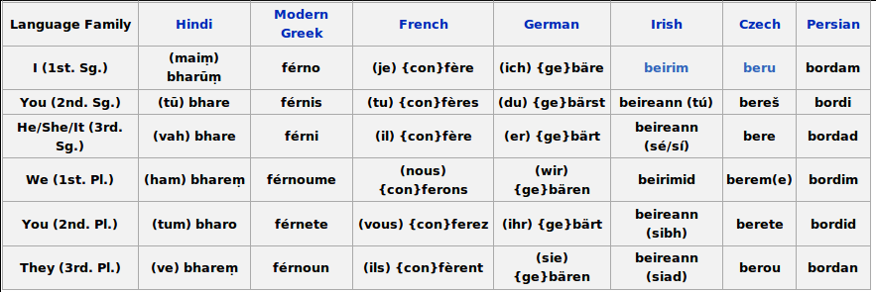
Modern Indo-European

Slide 16
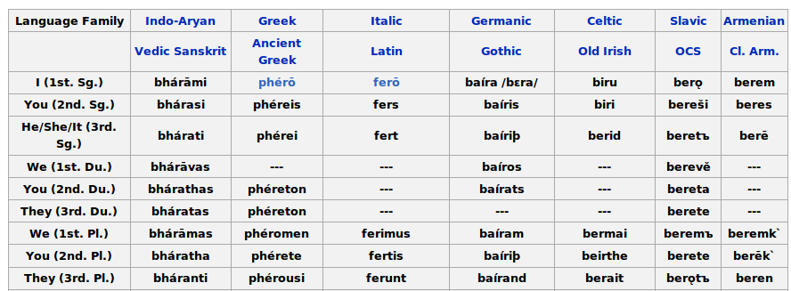
Older Indo-European

Slide 17
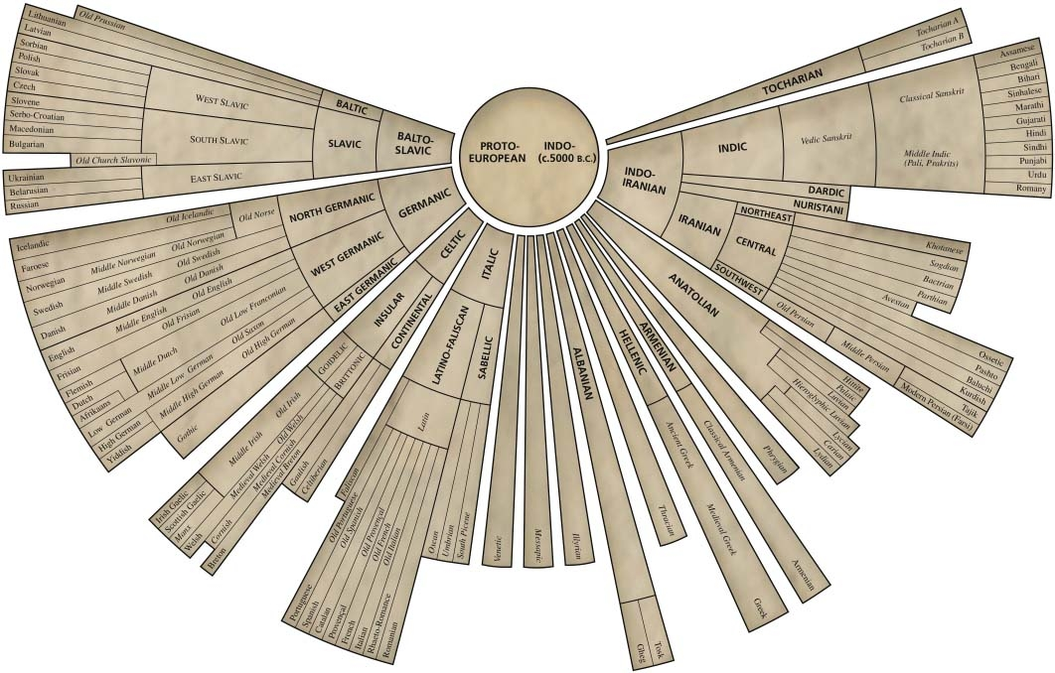

Slide 18
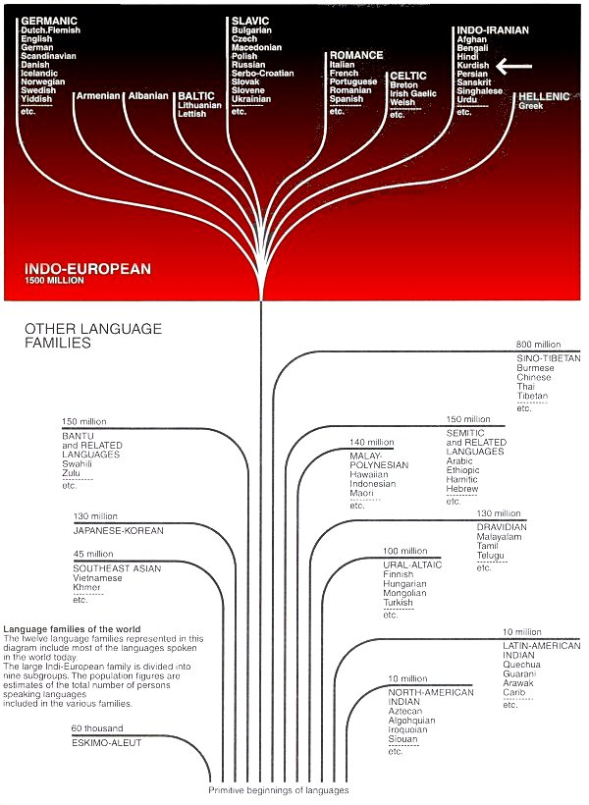

Slide 21
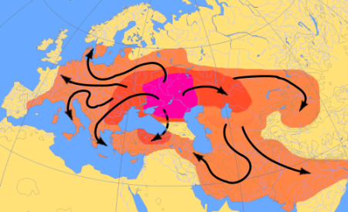
Kurgan Hypothesis 4000-1000BC

Slide 22
Historical Linguistics
language change
  migration
  language change
  language contact
more evolved = ...
  simpler or more complex grammar?
  smaller or larger vocabulary?

Slide 23
HISTORY OF WRITING

Slide 24
Cuneiform
Egyptian
Hieroglyphics
3000BC
Writing Systems of the World
?
Phoenician
Alphabet
2000BC
800BC
Greek
Aramaic
Chinese
Pictographs
Hebrew
Brahmi
Latin
Mayan
Glyphs
Nabatean
Chinese
Japanese
Arabic
Indic
Scripts
English
German
...
Cyrillic
Persian,
Urdu

Slide 25
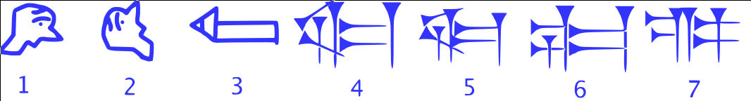
Cuneiform
logographic writing
  picture = idea (“I <3 :-)”
syllabic writing
  picture → idea → sound (“2 b or not 2 b”)
mix (“I <3 2 :-)”)
stylus in clay → adapt shapes
about 3000 BC

Slide 26



Evolution of Chinese

Slide 27
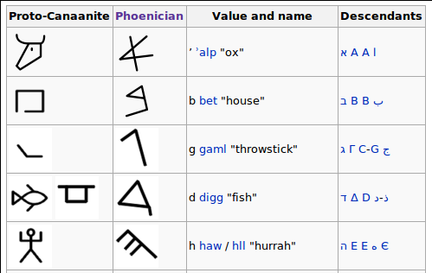
Phoenician Alphabet

Slide 28
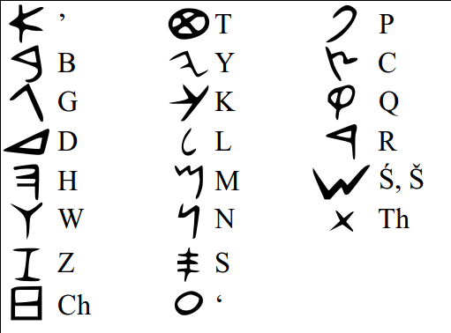
Phoenician Alphabet

Slide 29
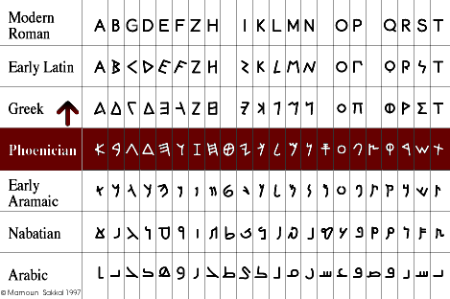
Alphabet Relationships

Slide 30
Writing Systems
pictures
logographic writing systems
syllabic writing systems
alphabetic writing systems

Slide 31
Writing Systems
evolution driven by...
  writing instruments
    brush, chisel, knife, stylus, pen, ...
  writing surfaces
    stone, wood, paper, claly tablets, ...
  population of writers
    priests, merchants, …
  language & language change
    loss of sounds, new sounds, ...

Slide 32
EVOLUTION OF ALPHABETIC WRITING SYSTEMS

Slide 33
A B C D E F G H I K L M N O P Q R S T V X Y Z

Slide 34
a b c d e f g h I k l m n o p q r s t v x y z

Slide 35
addition of lower case letters
origin in handwritten manuscripts
  emphasis important letters at the beginning
  start changing letter forms
  codify case and start using for semantic distinctions

Slide 36
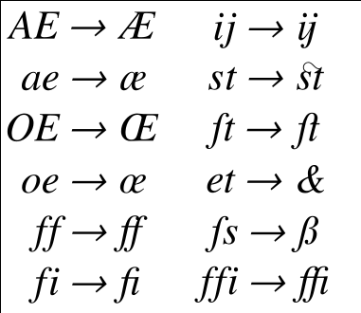
Latin Script Ligatures

Slide 37

Latin Script Diacritics

Slide 38
origin of ligatures and diacritics
writing convenience
common pairs thought of as “one letter”
improved appearance
space savings

Slide 39
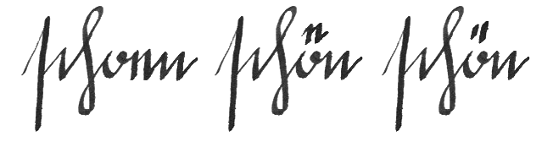
evolution of the umlaut

Slide 40
general evolutionary mechanisms
structurally, alphabets evolve by...
  wholesale change in “standard font”, letter style
  adding ligatures
  adding diacritics
  disuse of letter forms
  creation of new letter forms
  borrowing of letter forms
alphabets can become more complicated

Slide 41
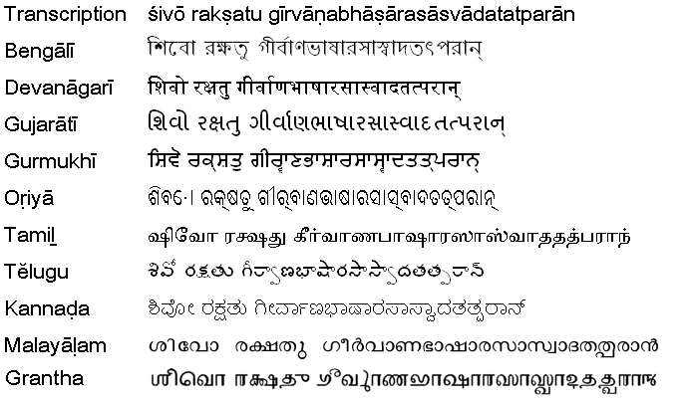
Indic Scripts

Slide 42
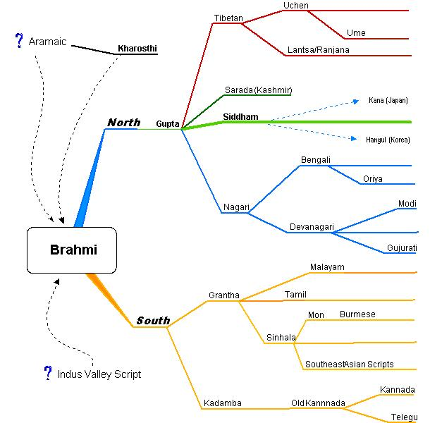
Indic Scripts

Slide 43
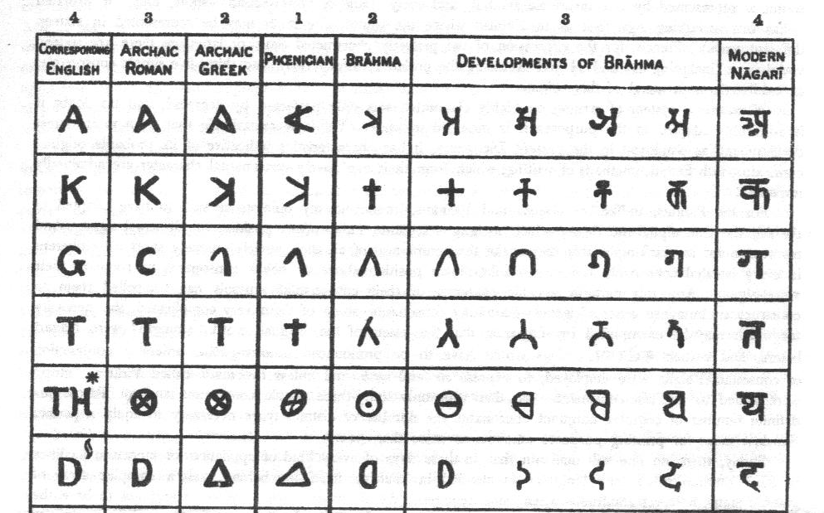
Indic Scripts

Slide 44
Brahmi → Modern Indic Scripts
change in appearance/style
addition of staff line
addition of many new letter forms
addition of many ligatures
addition of many diacritics

Slide 45
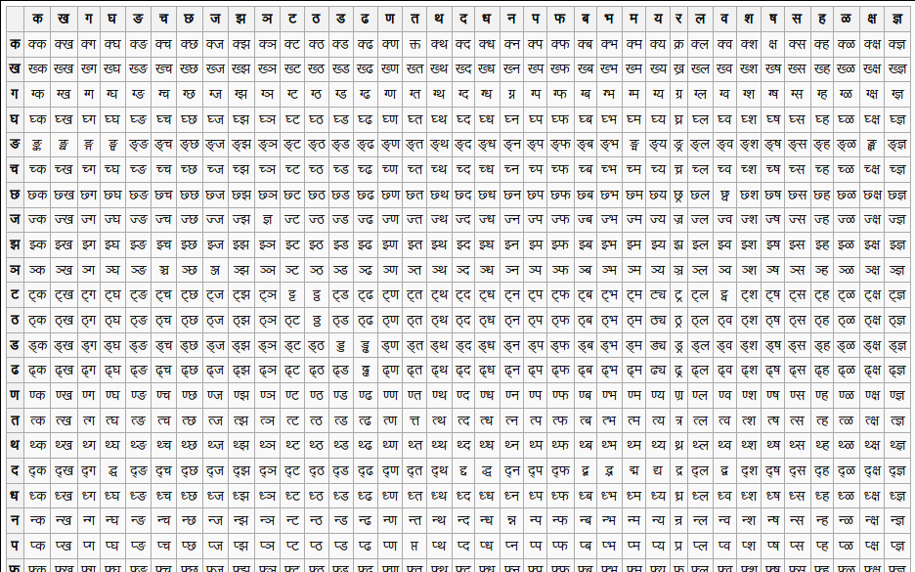
Devanagari Ligatures
(these are just some of pairs; there are many more, including triples etc.)

Slide 46
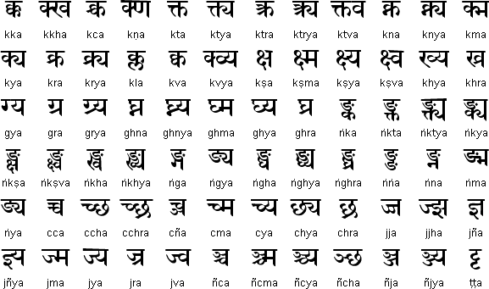
Devanagari Ligatures

Slide 47
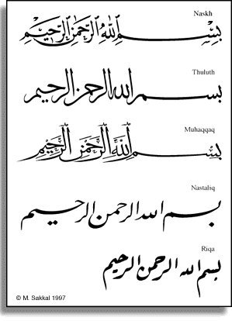
Arabic → Urdu, Persian

Slide 48
Arabic → Urdu, Persian
new letter forms
new diacritics
extensive new ligatures
  probably about 20000
  as many/more than # words

Slide 49
CHARACTER SETS

Slide 50
character sets
computers deal with numbers
character set =
assignment of characters to numbers

Slide 51
character sets
BCD = 4 bits / character
  digits only
BCDIC = 6 bits / character
  : A-Z 0-9 + - * / ( ) $ = (space) , . # [ ] % " _ ! & ' ? < > @ \ ^ ;
EBCDIC = 8 bits / character
  upper, lower, digits, punctuation, control
  letters are not contiguous
ASCII = 7 bits / character
  upper, lower, digits, punctuation, control

Slide 52
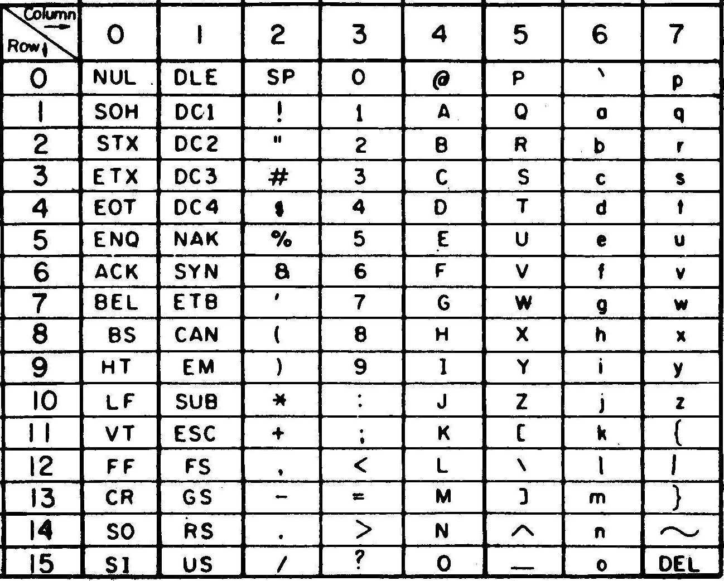
ASCII

Slide 53
ASCII
ASCII developed out of telegraph codes
adequate for message transmission
most output printed
  special characters via overprinting
  a+BS+' a+BS+“ e+BS+^ c+BS+,
  inconvenient for terminals, processing

Slide 54
INTERNATIONALIZATION WITH 8-BITS

Slide 55
8-bit Extended Ascii
processors have 8 bit storage units
ASCII is 7 bits
use the extra bit for extra characters
this is “extended ASCII”

Slide 56
8-bit extended ASCII
Latin script
  ISO 8859-1, ISO 8859-15
  Windows-1252
Greek
  ISO 8859-7, Windows-1253
Russian
  ISO 8859-5, Windows-1251
Hebrew
  ISO 8859-8, Windows-1255

Slide 57
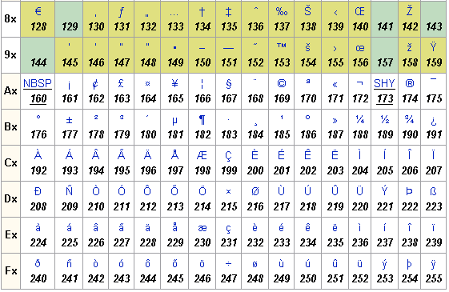
Windows-1252

Slide 58
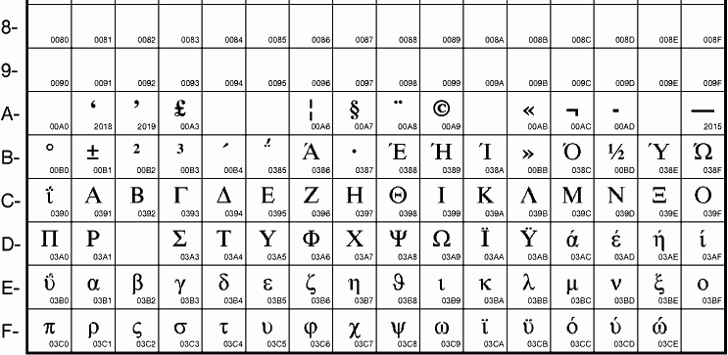
ISO8859-7

Slide 59
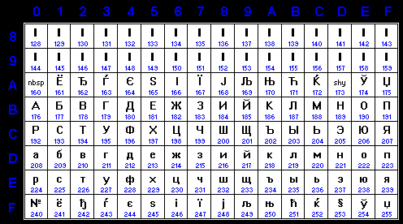
ISO8859-5

Slide 60
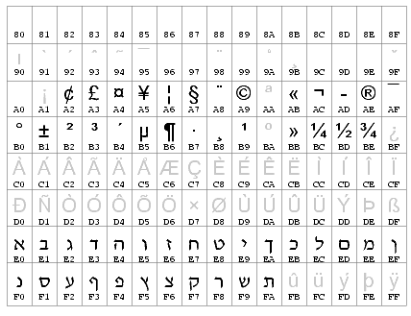
ISO8859-8

Slide 61
8-bit extended ASCII
ISO8859, Windows “code pages”
lower 128 chars are ASCII
easy to implement: just fits into existing 8bit strings
allows mix of English + ...
interpretation of 8bit string depends on which “code page” or “locale” is set, e.g. on file systems
wrong code page = mojibake

Slide 62
JAPANESE

Slide 63
Japanese character set
Japanese encoding
  ASCII
  50 Hiragana characters
  50 Katakana characters
  1945 Joyo Kanji characters
  approx. 4000 additional Kanji characters

Slide 64
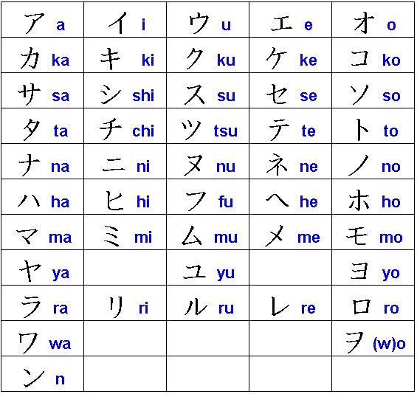

Slide 65
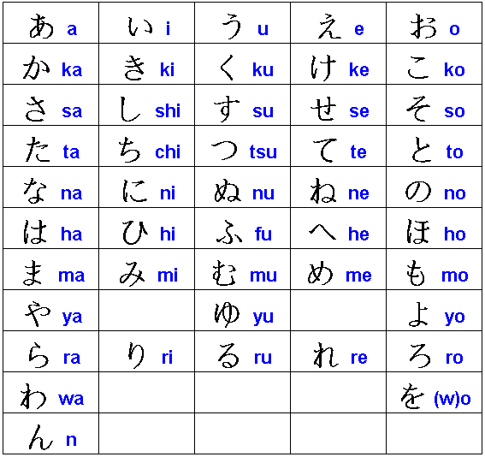

Slide 66
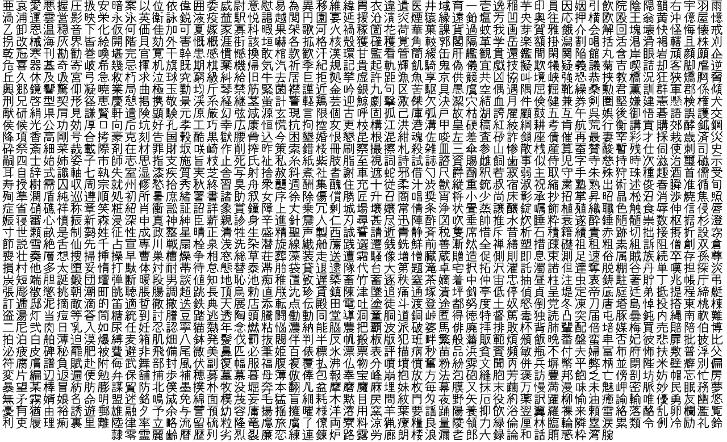

Slide 67
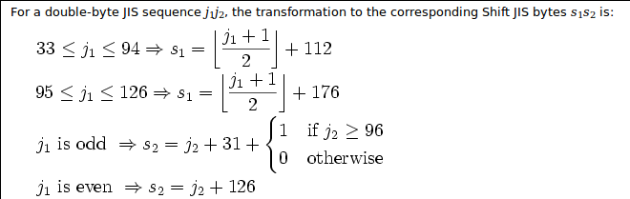
encoding
legacy 8 bit code for Katakana
8 bit too small for all Japanese chars
solution
  enumerate the characters somehow
  perform variable length encoding

Slide 68
the big mess
multiple ISO8859 standards, plus code pages
Shift-JIS for Japanese
other encodings for Chinese etc.
many incompatible 8 bit encodings
can't interpret strings without knowing the code
want a universal character set!

Slide 69
UNICODE

Slide 70
Unicode
first 128 characters remain ASCII
give a consistent numbering to all characters
switch to a 16 bit character type (=65536 characters)
cover all major languages / scripts

Slide 71
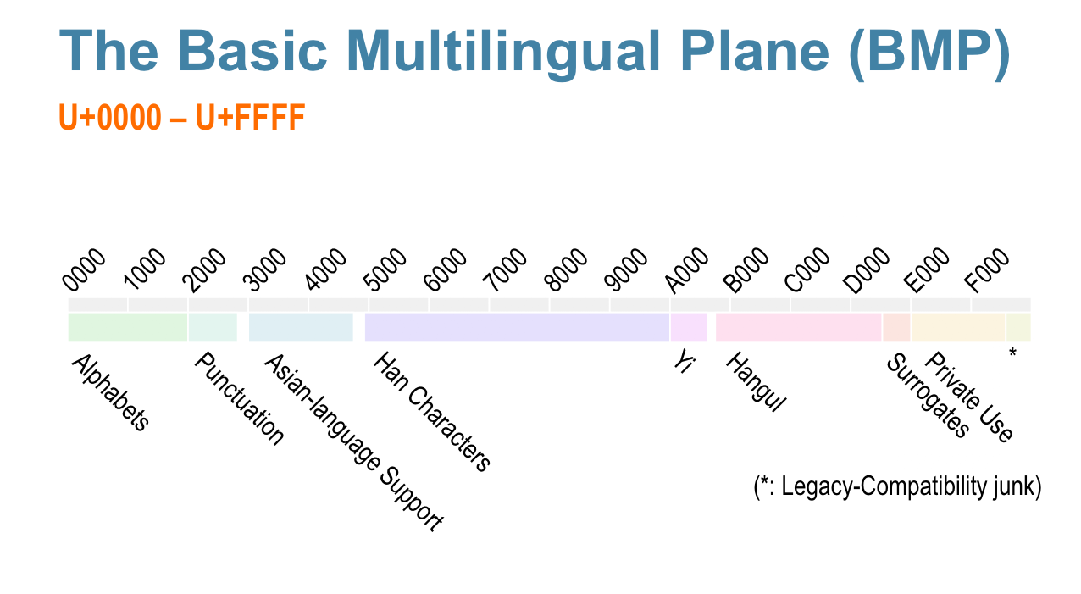
16 bit Unicode

Slide 72
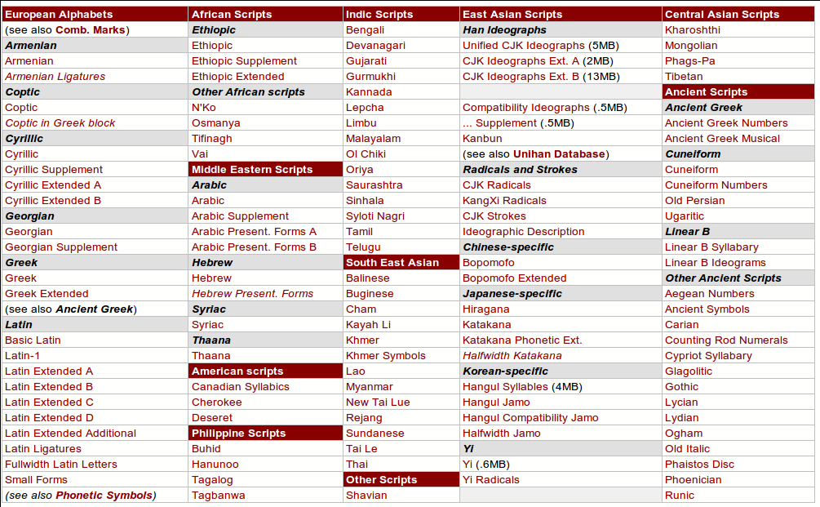

Slide 73
16 bit Unicode
this was nice
  just write code as before
  treat 16 bit characters just like 8 bit characters
  most string code (in C etc.) just keeps working
  UCS-2 strings (universal character set, 2 bytes)
but
  lots of wasted space for alphabetic languages
  lots of other issues (later)

Slide 74
16 bit Unicode
ISO/ANSI C
  let's add a wchar_t for Unicode characters
Microsoft, Oracle, Java, ...
  let's add UCS-2 APIs everywhere
  let's store UCS-2 strings directly on disk
UNIX... are you crazy?
  we're not going to rewrite everything for UCS-2
  we're not going to waste the space

Slide 75
UTF-8
original UNIX developers (Plan9)
variable length coding similar to Shift-JIS
every ASCII string is valid UTF-8
all Unicode characters can be represented
passes through “char *” APIs
  use as UNIX file names without changes
  pass around scripting languages etc.

Slide 76
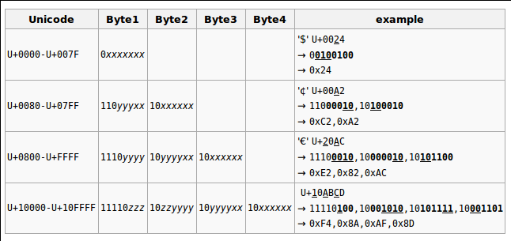
UTF-8 coding

Slide 77
oops...
65536 characters ought to be enough...
except...
  when the Japanese and Chinese sit around the same table

Slide 78
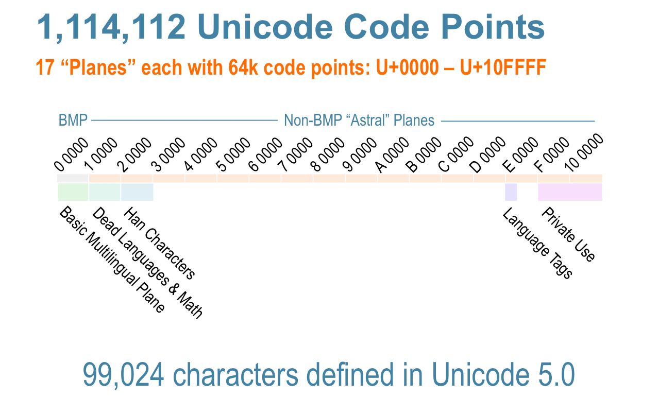
Unicode 5.0

Slide 79
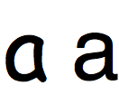
terminology
codepoint
  either a character or control code
character
  some kind of symbol “in the abstract”
letter
  a character in an alphabetic writing system
glyph
  a particular shape that represents a character visually

Slide 80
consequences of Unicode 5.0
Windows and Java are now broken
  UCS-2 can represent 65k codepoints, but we have 99k
workaround
  change UCS-2 to UTF-16
  most characters are a single codepoint, but characters on the astral planes are composed of two “surrogates”
  existing UCS-2 code will kind of continue to work, as long as it doesn't use new characters
  for UTF-8, just use a longer byte string

Slide 81
Unicode 5.0
1.1M codepoints (many unassigned)
99k characters
encodings
  UTF-8 – 8 bit strings
  UTF-16 – 16 bit strings (NB: byte order dependent)
  UTF-32 – 32 bit strings, 4 bytes = 1 character always

Slide 82
Unicode encodings
UTF-8
  de-facto standard on UNIX
  works mostly where regular ASCII strings work
  variants: CESU-8, Modified UTF-8
UTF-16
  supposedly the standard on Windows
  software often treats it as UCS-2
  also used in Java, Tcl/Tk, Python, etc.

Slide 83
wchar_t
C added wchar_t
  idea: represent the “big character set”
  Microsoft: wchar_t is 16 bit (and won't change)
  UNIX: wchar_t is 32 bit (after Unicode 5.0)
  ISO C: wchar_t is... we don't know
implications
  wchar_t is useless for Unicode in portable C

Slide 84
UNICODE IN MORE DETAIL

Slide 85
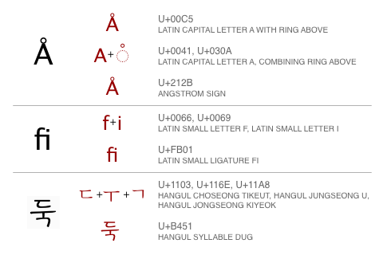
character composition

Slide 86
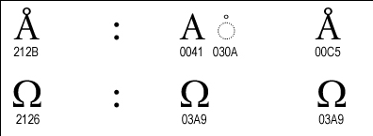
semantic distinctions
Angstrom, Ohm, Omega, A-circle letter (composed and as a letter)

Slide 87
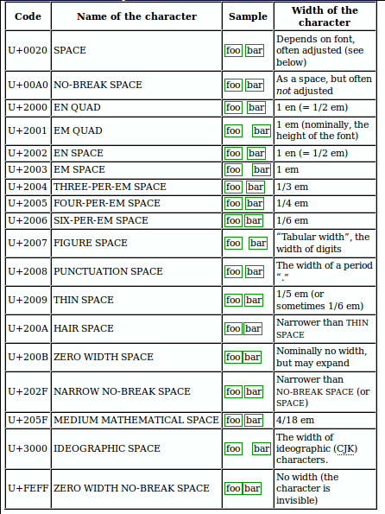
space

Slide 88
more weird characters
  left-to-right override (U+202D)
  right-to-left override (U+202E)
  interlinear Annotation Character (U+FFF9)
  interlinear Annotation Separator (U+FFFA)
  interlinear Annotation Terminator (U+FFFB)
  zero-width joiner (U+200D)
  zero-width non-joiner (U+200C)
  left-to-right mark (U+200E)
  right-to-left mark (U+200F)
  left-to-right embedding (U+202A)
  right-to-left embedding (U+202B)
  pop directional formatting (U+202C)

Slide 89
Unicode normalization
“äffin” – codepoint sequences
  “\u00E4ffin”
  “a\u0308\uFB03n”
  “\uFEFF\u00E4ffin”
  …
when are two strings equal?
  important for security/usability
    same user name?
    same file name?
    ...

Slide 90
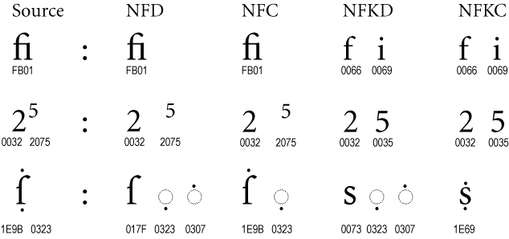
Unicode normalization
http://unicode.org/reports/tr15/
idea: “normalize” them before comparison
there are different “normalized” forms
canonical recomposition
canonical re-composition
canonical decomposition
compatibility decomposition

Slide 91
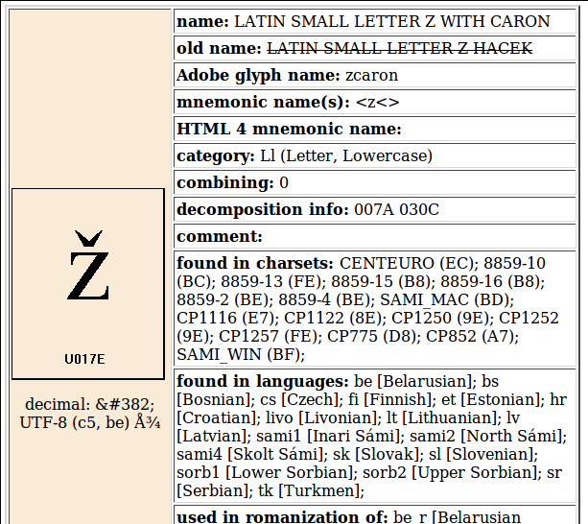
Unicode character data

Slide 92
character classes
letter or logographic symbol
digits, number, number value
punctuation
spacing
upper/lower case
what it's composed of
which language/script it belongs to
...

Slide 93
English
locale: en_US.utf8
  older: en_US.ascii
ASCII codepoints correspond to Unicode
ASCII is proper UTF-8
nothing special is needed, but...
  ligatures like “ffi” may actually occur
  some rare, optional English characters now possible: “coördinate”
  Euro, Pound, etc.

Slide 94
German
  codepoint = letter, character
  mostly uses same letters as English (mostly 1 byte)
  umlaut, ß are considered letters, pre-combined
  Fraktur: text – font variant, math – separate codes
  type using special keyboard
  use deadkeys on US-international

Slide 95
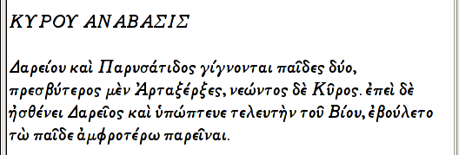
Greek
  codepoint = letter, character
  most codepoints are 0370-03FF (like ISO), for modern G.
  lots of other Greek letters through Unicode
  requires 2 bytes in UTF-8 (worse than ISO)
  type using special keyboard layout
  classical Greek has many accents

Slide 96

Arabic Script
  codepoint = letter, character
  about 250 codepoints 0600-06FF
  right-to-left writing
  consonantal diacritics are precombined
  vowels are combining diacritics
  script is shared with Urdu, Persian, others
  20000 ligatures
  construction of ligatures is left to renderer
  requires 2 bytes in UTF-8

Slide 97
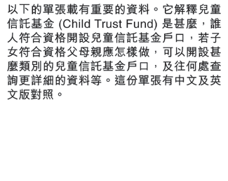
Chinese
  codepoint = letter, character
  tens of thousands of characters
  top-to-bottom writing, or left-to-right writing
  no diacritics, no variable spacing
  no ligatures (or... pre-combined radicals)
  type using complex input method
    pronunciation or radicals
    software guesses correct word from input
    user may need to select character from choices
  usually requires 3 bytes in UTF-8
  lots of other provisions to allow for Chinese typesetting
  (e.g., special Latin script characters in Chinese text)

