Slide 1
Document and Content Analysis
Language Modeling
Thomas Breuel

Slide 2
n-gram models

Slide 3
statistical language models
statistical language models assign probabilities to string
P(s) = ...

Slide 4
unigram model
look up the probability (=normalized frequency) of each word in the string
multiply together

Slide 5
bigram model
look up the probability of each word in the string, conditional on the word that precedes it
multiply together

Slide 6
n-gram model
look up the probability of each word in the string, conditional on the n-1 words that precede it
multiply together

Slide 7
uni-/bi-/tri-gram models
logical are as are confusion a may right tries agent goal the was diesel more object then information-gathering search is
planning purely diagnostic expert systems are very similar computational approach would be represented compactly using tic-tac-toe a predicate
planning and scheduling are integrated the success of naive bayes model is just a possible prior source by that time

Slide 8
probability estimates
uni/bi/trigram probabilities
  take large corpus of text
  count # occurences of uni/bi/trigram
  divide by total number of uni/bi/trigrams
there you have your probability...

Slide 9
do you?
“dwarf planet”
“dark energy”
“hockey mom”
“drill baby drill”

Slide 10
sparsity
combinations
  15000 common words
  225 million word pairs
  3.3 trillion word triples
naive assumption
  not found = probability 0 = can't occur
doesn't work... need non-zero probability for unseen n-grams

Slide 11
add-one-smoothing
usual estimate:
  p = # occurrences / # total occurrences
add-one estimate
  p = (# occurences + 1) / (# total occurences + # classes)
properties
  uniform prior in a Bayesian sense
  converges to true estimate in the case of large numbers
  all probabilities non-zero
  can use values other than 1 (e.g., 0.5)
  doesn't work all that well for language modeling

Slide 12
linear interpolation smoothing
final estimate is linear combination of uni/bi/trigram estimates
pick the c_{i} empirically to maximize overall system performance (e.g., best OCR error rate)

Slide 13
language model evaluation
good language model =
maximize the likelihood assigned to real texts
evaluate by computing P(s) on some test text s
# bits / word = -log₂ P(words) / #words
perplexity = 2 ^{#bits / word}
  average # of choices following a given word
  “branching factor”

Slide 14
evaluation of n-gram models
P(s)
  evaluate directly: iterate through words and multiply
arg max P(s)
  for OCR, we have a set of recognition alternatives
  use a dynamic programming algorithm to pick the optimal string

Slide 15
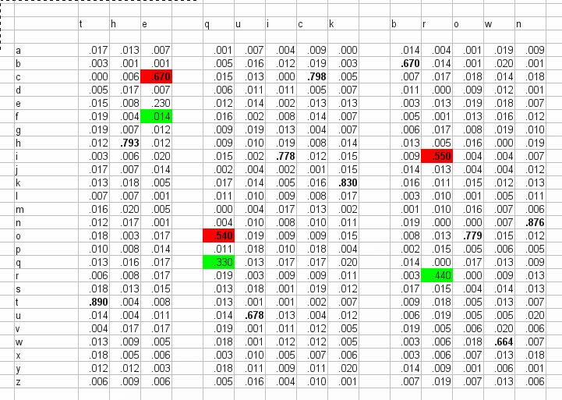
n-gram models
integrate with n-gram model using dynamic programming

Slide 16
n-gram
n-gram = sequence of n-things
  P(word | previous words)
  P(character | previous characters)

Slide 17
transducer-based language models

Slide 18
graphs as sets of strings
c
l
r
n
a
d
m
{“CLARN”, “DARN”, “CLAM”, “DAM”}

Slide 19
costs
c
l
r
n
0.1
0.3
a
0.4
d
m
0.5
0.6
P(clam) = 0.1 * 0.3 * 0.4 * 0.6
P(dam) = 0.5 * 0.4 * 0.6

Slide 20
costs
c
l
r
n
2
5
a
3
d
m
4
6
C(“clam”) = 2 + 5 + 3 + 6
C(“dam”) = 4 + 3 + 6

Slide 21
strings + weights
labeled directed graphs = sets of strings
cost of string = sum along path
lowest cost path to ... = min over all paths
(+,min) algebra
equivalent to finite state acceptors / regular languages if costs are all 0 or infinity
weighted finite state acceptors
(special case of weighted finite state transducer)

Slide 22
language models
(properly normalized) weighted finite state transducers are statistical language models
P(s) = exp(total cost along path)
n-gram models (character or word) can be represented as weighted finite state transducers

Slide 23
“intersection”
c
l
r
n
2
5
4
1
a
3
d
m
4
6
b
r
t
5
a
1
m
d
2
6
What string is possible within both graphs (transducers) and has the least total cost?

Slide 24
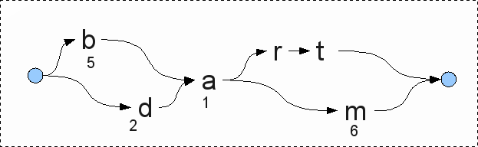
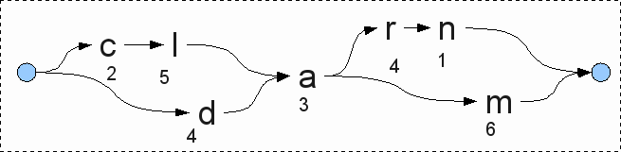
dynamic programming

Slide 25
dynamic programming
full dynamic programming
  just “push through” to the end
A* search
  use an admissible heuristic for pruning
  do you know how?
beam search
  use a finite width
  requires “scheduling”

Slide 26
OCR + language models
segmentation graph
  possible segmentations and classifications
  posterior probabilities associated with each character
language model
  possible strings in the language
  probabilities associated with each string
goal: find the best combination of the two

Slide 27
solution
represent...
  segmentation graph as weighted finite state transducer
  language model as finite state transducer
compute “intersection”
(actually, “composition”)

Slide 28
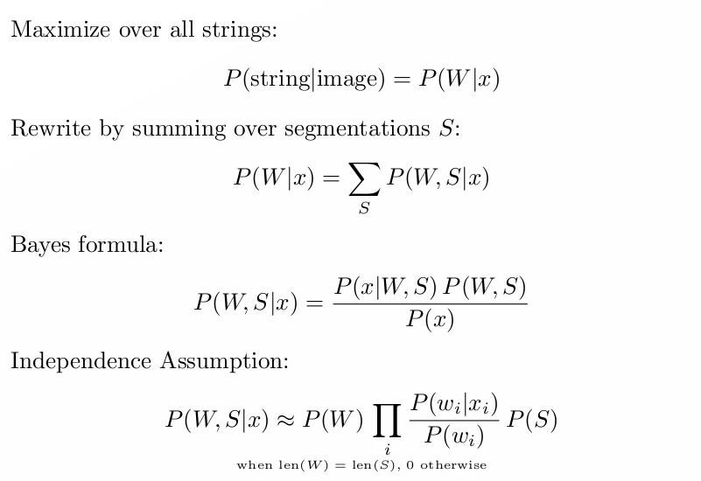
probabilistic formulation

Slide 29
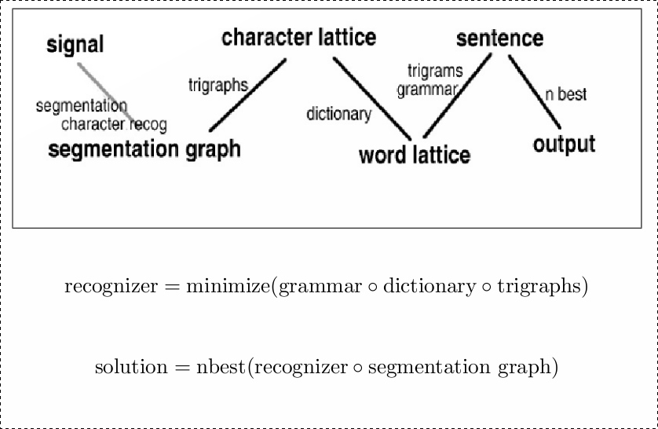
algebraic manipulation of WFSTs

Slide 30
details

Slide 31
tries
common, fast string lookup
special case of finite state acceptor
with or without probabilities
not fully minimal

Slide 32
special symbols
epsilon
  empty
sigma
  matches all symbols
rho
  matches all symbols that don't otherwise match
phi
  epsilon on failure to match anything
  used for back-off

Slide 33
semirings
usually, values are log-probabilities
  arithmetic: log-addition and addition
other choices are possible
  boolean: {0,1} (&,|)
  probability: [0,1] (+,*)
  log: R (log-+,+)
  tropical: R (min,+)
  string: strings (lcp,concatenation)

Slide 34

notation
T: transducer; x, y: input/output strings
[[T]](x,y): weight
(+), (x): semiring operations
p[x], n[x]: first/last (path), prev/next (state)
pi: path
I: initial, F: final states; P: all paths between

Slide 35
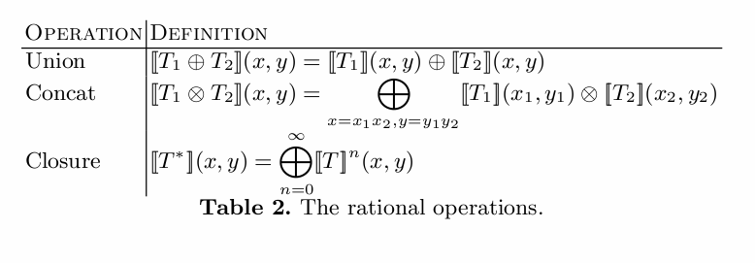
OpenFST

Slide 36
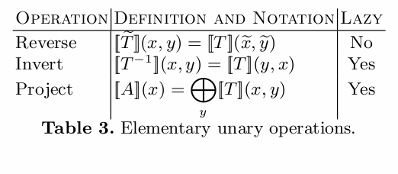
OpenFST

Slide 37
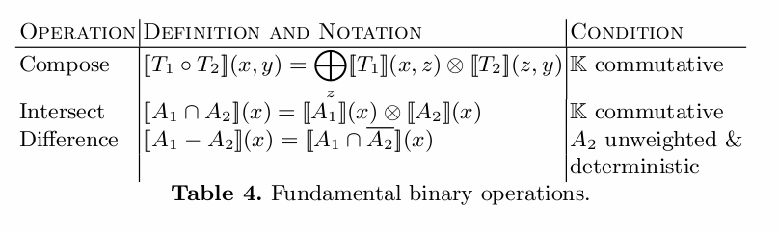
OpenFST

Slide 38
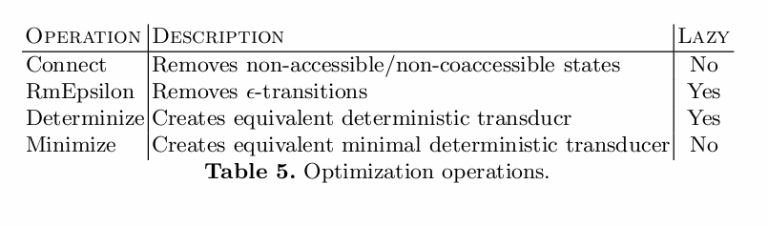
OpenFST

Slide 39
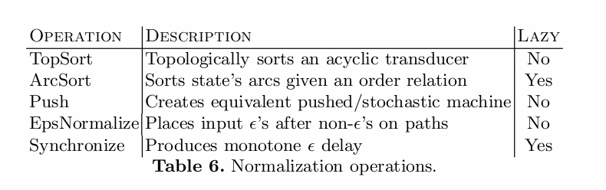
OpenFST

Slide 40
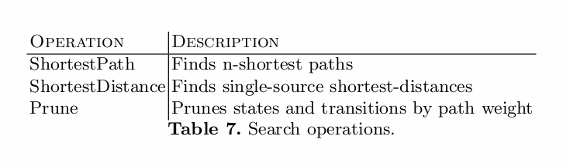
OpenFST

Slide 41
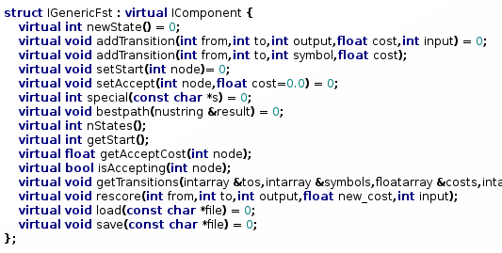
abstract FST

Slide 42
Lazy Operations
some FSTs are too large
only needs to implement abstract interface
getTransitions can be computed on the fly
works for some algorithms, not others

Slide 43
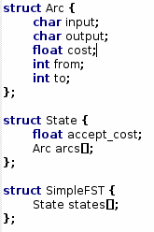
implementation

Slide 44
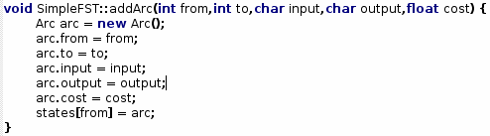
implementation

Slide 45
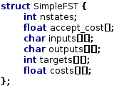
implementation (2)

Slide 46

implementation (2)

Slide 47
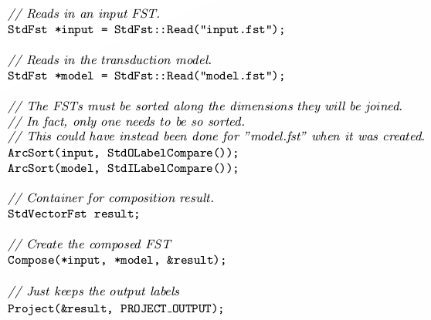
OpenFST (C++)

Slide 48
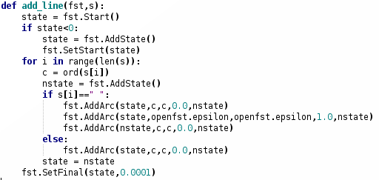
OpenFST (Python)

Slide 49
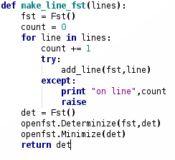
OpenFST (Python)

Slide 50
regular expressions
compact notation for acceptors
  unweighted only
some features are not finite state
  back references
  replacement syntax

Slide 51
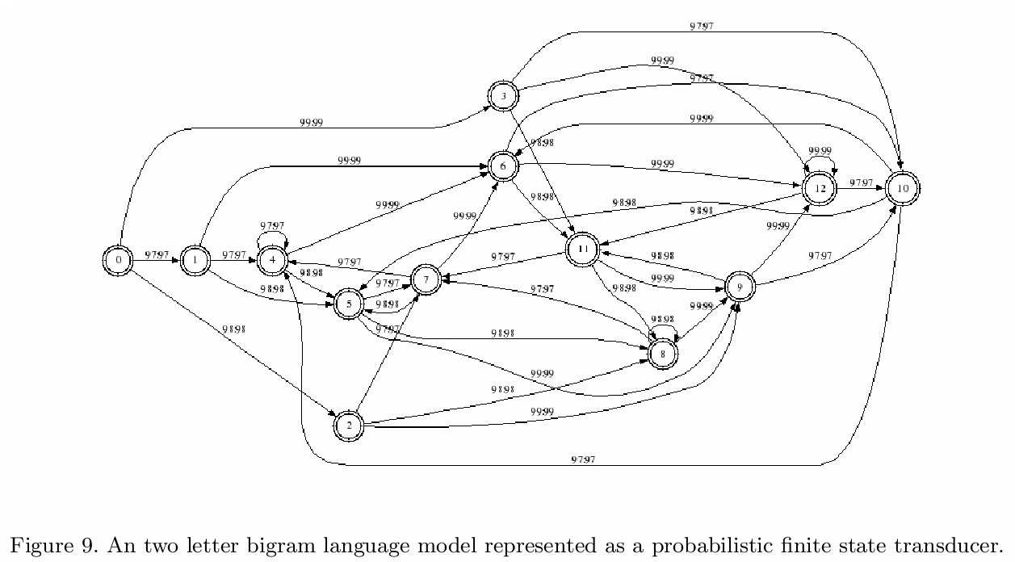
n-grams vs transducers

Slide 52
back-off vs transducers
the back-off methods described above can be approximated using FSTs
usually, use phi transitions to “glue” back-off models together

