Slide 1
Text Information Retrieval
Prof. Thomas Breuel

Slide 2
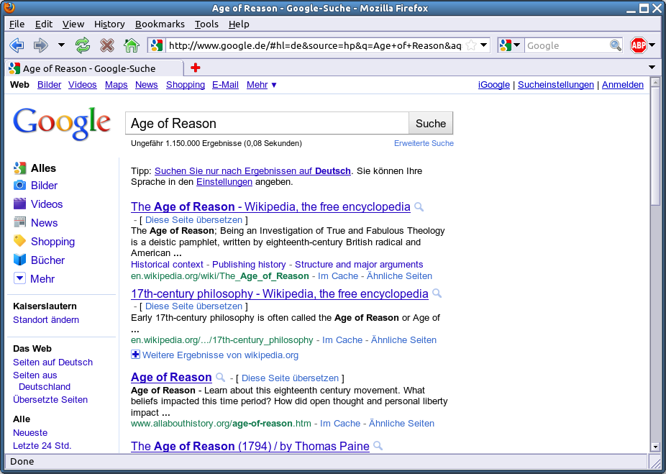

Slide 3
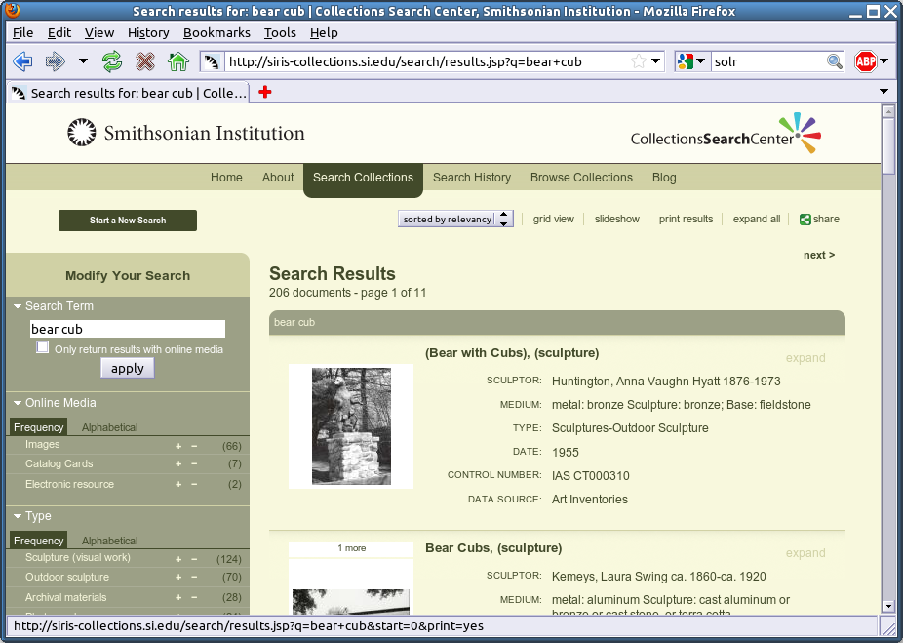
http://en.wikipedia.org/wiki/Solr
http://siris-collections.si.edu/search/results.jsp?q=bear+cub

Slide 4
EVALUATION

Slide 5
information retrieval
steps
  enter query
  get list of results
IR = retrieval of relevant results
How do we know the results are relevant?

Slide 6
evaluating relevance
for now, assume set-based results
  given a query, return a set of results (no ranking)
for each query
  manually determine relevance (yes/no) of each document
  compute precision and recall (below)

Slide 7
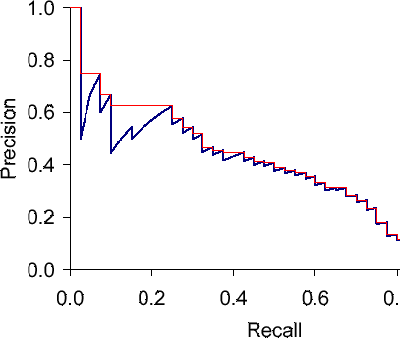
precision/recall graph based on ranks
better/worse
1 2 3 4 5 6 7 8 9
1 0 0 1 1 0 0 0 0
cutoff = 4
precision = 0.5
recall = 0.66
compute P/R cutting of at different ranks (precision-at-n’)
sawtooth from correct/incorrect results
usually interpolate these curves (red)
need to choose a tradeoff between precision and recall
multifactorial optimization
(other kinds of parameters also possible)
http://nlp.stanford.edu/IR-book/html/htmledition/evaluation-of-ranked-retrieval-results-1.html

Slide 8
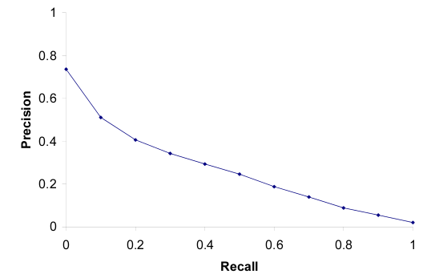
11-point p/r graph, 50 queries
evaluated at 11 points (0.0, 0.1, … 1.0)
averaged over 50 queries

Slide 9


F-measure
F_{β} measures the effectiveness of retrieval with respect to a user who attaches β times as much importance to recall as precision
Weighted harmonic mean of precision and recall.
Harmonic mean: progress first at rate 1 then at rate 2 same as progress at harmonic mean of the two rates.

Slide 10
Mean Average Precision
people want a single number for competitions
MAP score provides this
  d1 … dm : relevant documents
  R_{k} : rank of d_{k} in query results
  compute each Precision(R_{k}) for each d_{k}
  average all those precisions
  compute mean over all queries

Slide 11
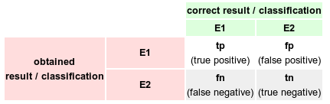


evaluating performance

Slide 12
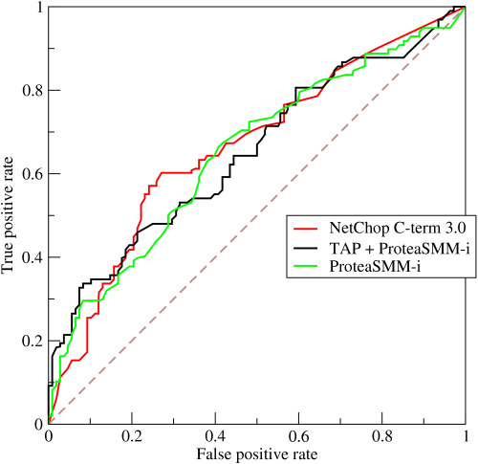
ROC curve
better/worse
similar to precision/recall curve, but TP vs FP
different axes
multifactorial optimization as well
relationship explored in paper
curves can dominate each other
don’t work well in IR because FP usually climbs very rapidly

Slide 13
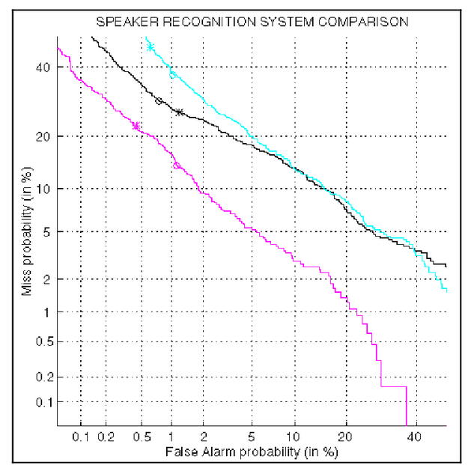
DET curve
better/worse
detection error tradeoff curve
note logarithmic scale
FN vs FP plot

Slide 14
evaluation
be able to explain
  test set
  rank vs set-based evaluation
  precision, recall, TP, FP, …
  F-score
  MAP
  tradeoffs, curves, dominance
  precision/recall curve, ROC curve, DET curve

