Slide 1
Vision and Neurobiology
Prof. Thomas Breuel

Slide 2
human visual system
better information retrieval
  take advantage of properties of the human visual system
  analogous to MP3 compression
new ideas for computational mechanisms
  parallel, distributed, robust
applications of MMIR
  medical
  research in neurobiology

Slide 3
overview
areas
  neuroanatomy
  electrophysiology
  evolution and development
  psychophysics
  psychology
  computational models
  neural models / brain simulation
goals
  give you a rough idea of different approaches
  indicate areas of applications for imaging / MMIR
  motivate bio-inspired vision

Slide 4


packaging

Slide 5
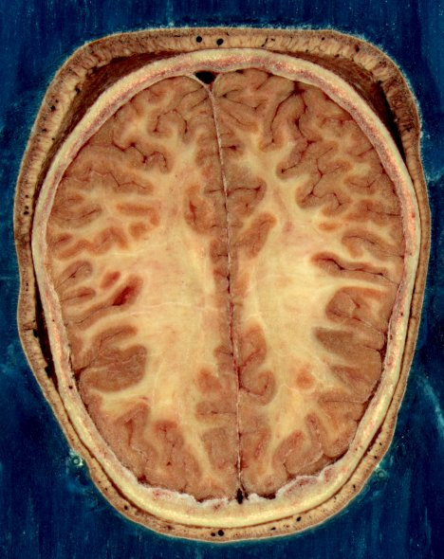
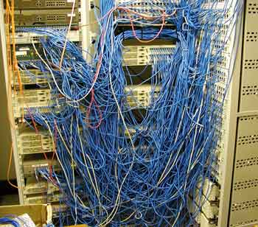
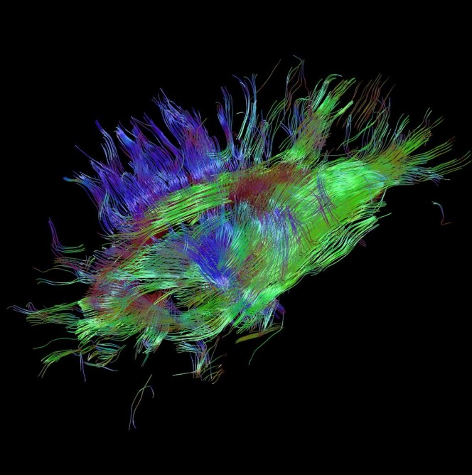
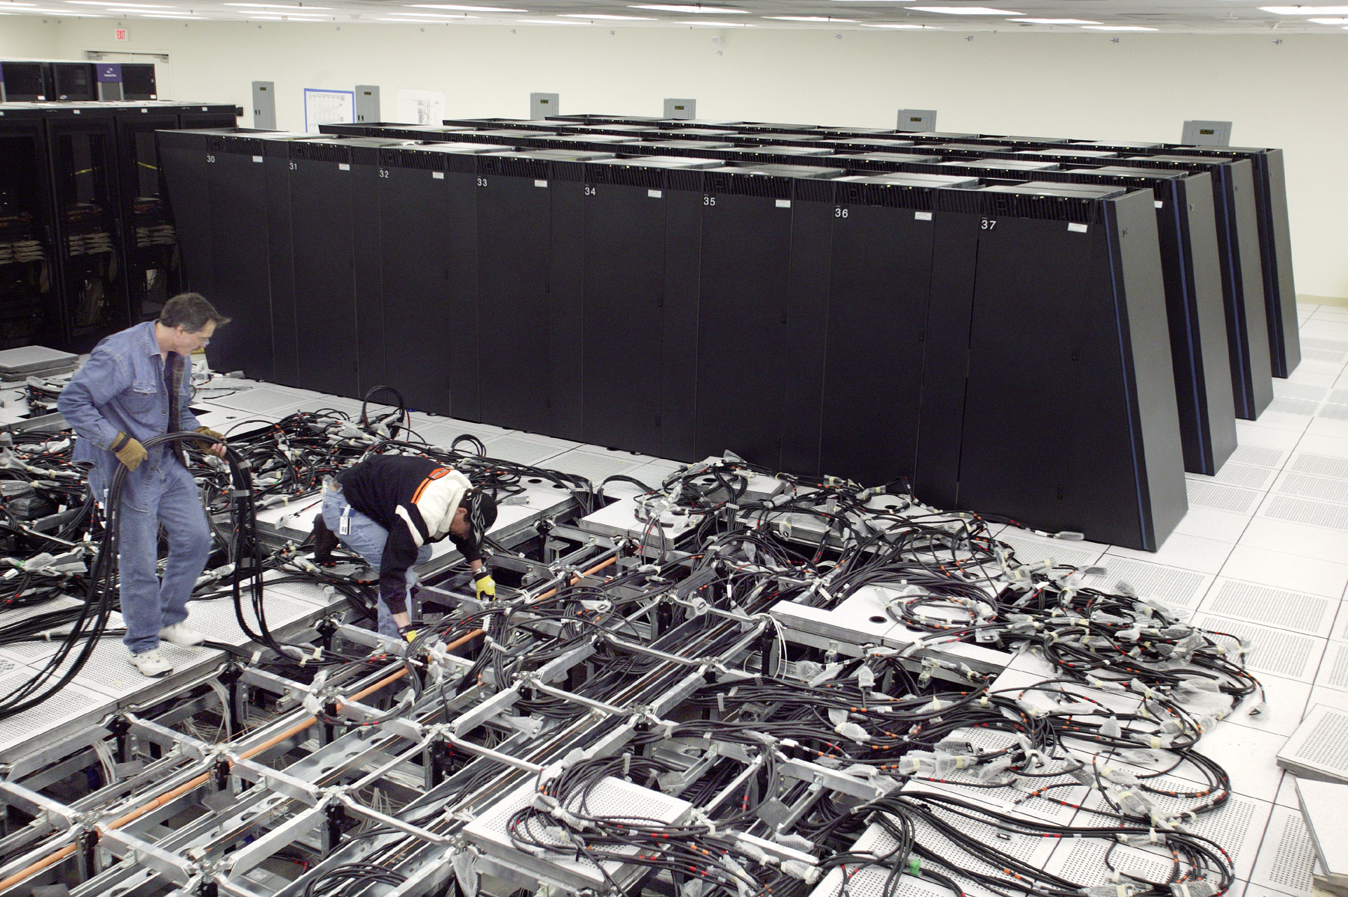
wiring
Utilizing a recently-developed technique called HARDI (High Angular Resolution Diffusion Imaging), researchers at the Eindhoven University of Technology have created a software tool that could reduce the need for exploratory brain surgery. The new technology converts MRI scans of the brain into three-dimensional images, which provide neurologists with a “road map” of the wiring of a patient’s brain.
IBM Blue Gene Computer
http://www.gizmag.com/software-creates-3d-maps-of-brain-wiring/16802/

Slide 6
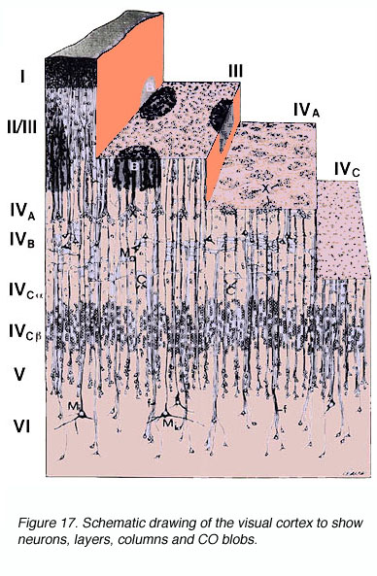
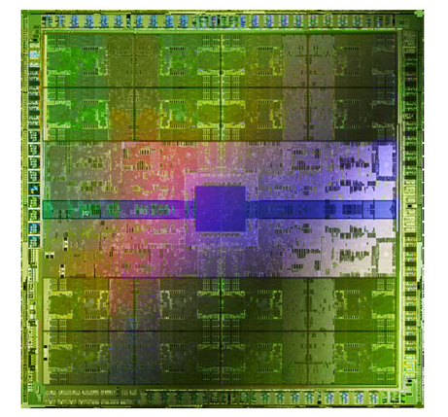
local processing
http://webvision.med.utah.edu/imageswv/FIG16Cortex3D.jpg

Slide 7
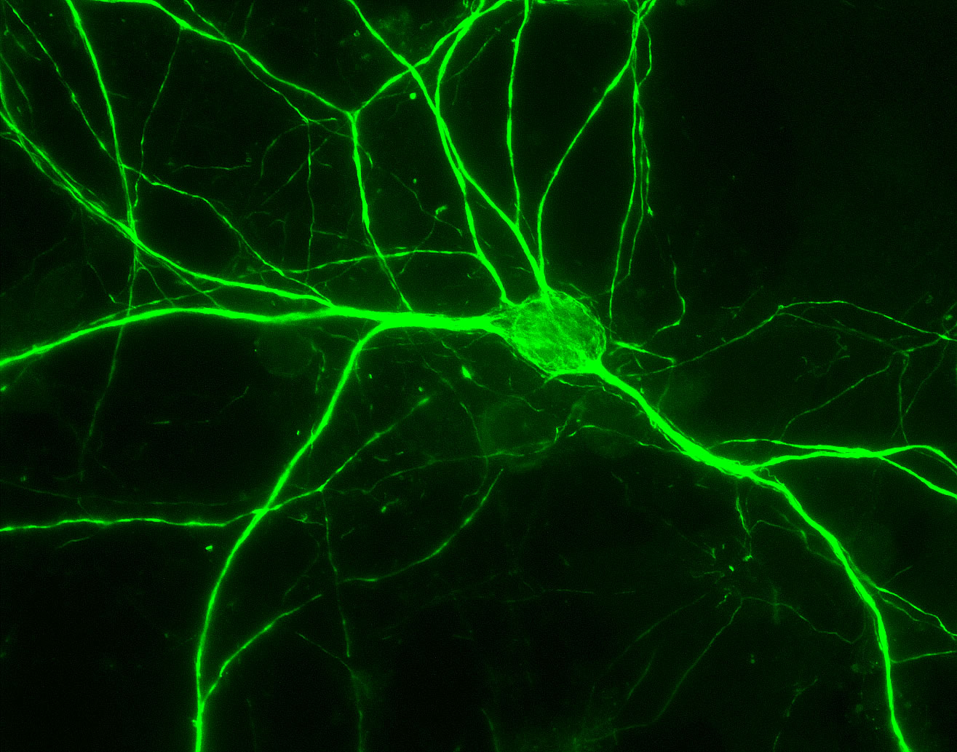
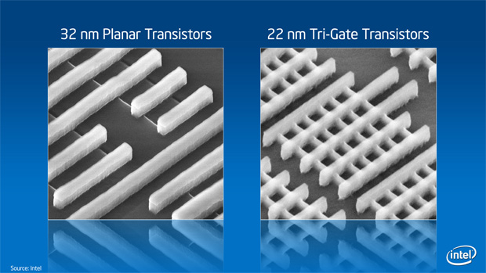
processing elements

Slide 8
brain vs computer
similar levels of organization
similar challenges
  wiring
  fault resistance, repair, maintenance
  heat dissipation
big differences
  construction
  size and connectivity of structures
  coding and representation
  clocking and synchronization

Slide 9
COARSE NEUROANATOMY

Slide 10
classical neuroanatomy
dissections + observation
fixation, staining, microscopy
correlating deficits with post mortem analysis

Slide 11
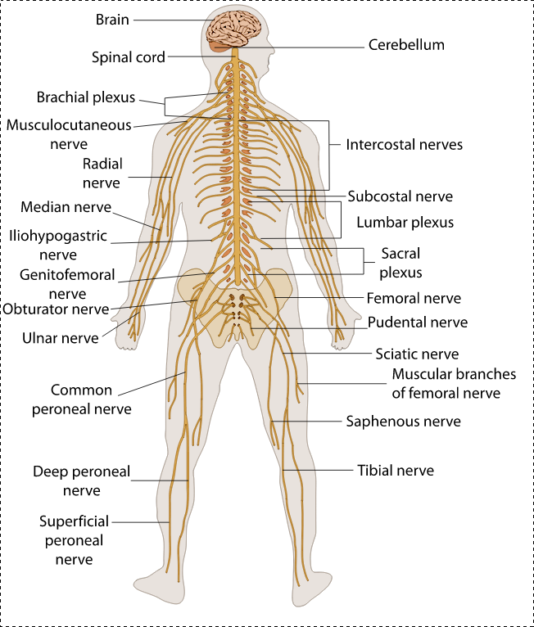
nervous system
sheep brain coming up...

Slide 12
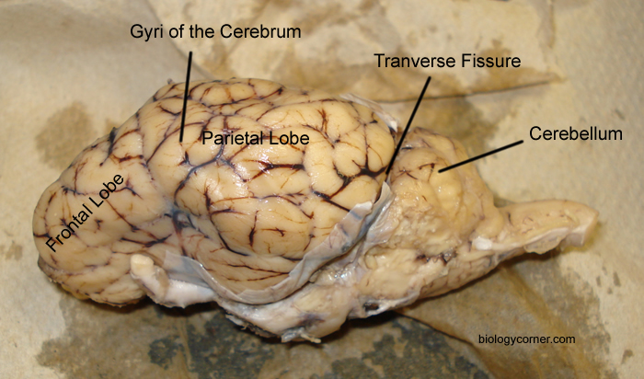
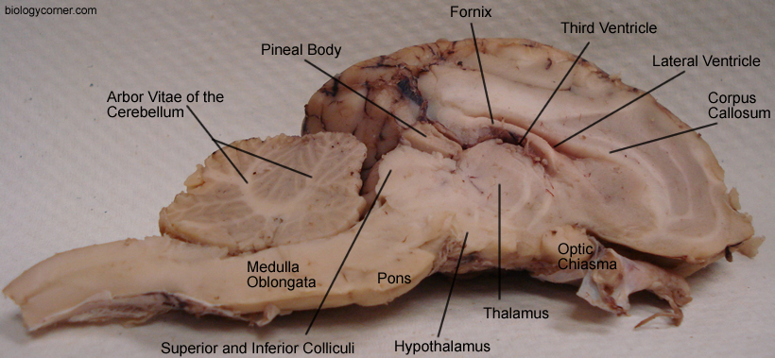
really coarse anatomy
sheep brain

Slide 13
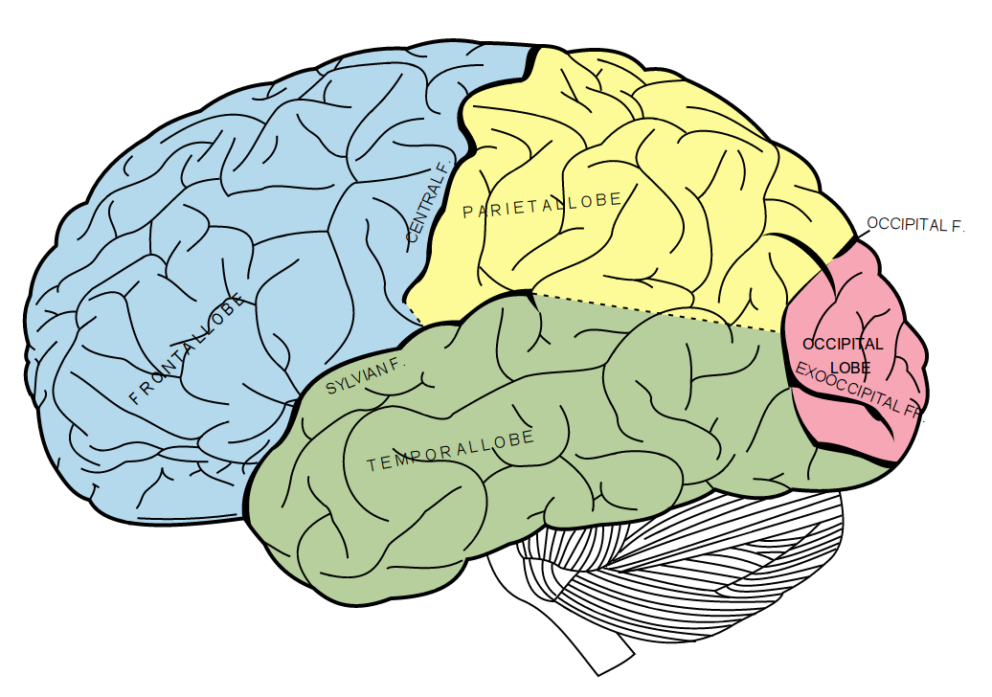
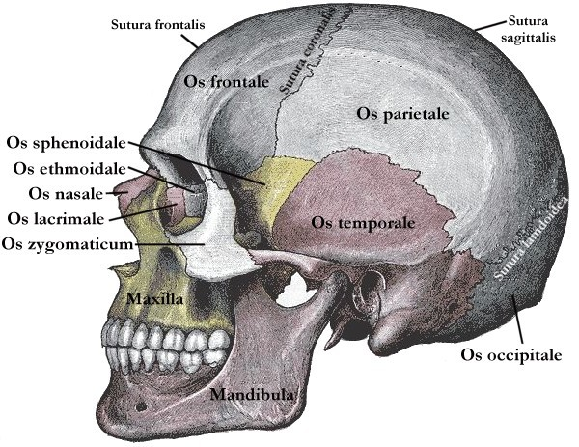
coarse brain anatomy

Slide 14
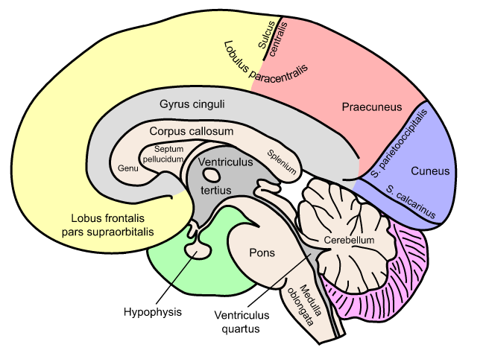
coarse brain anatomy

Slide 15
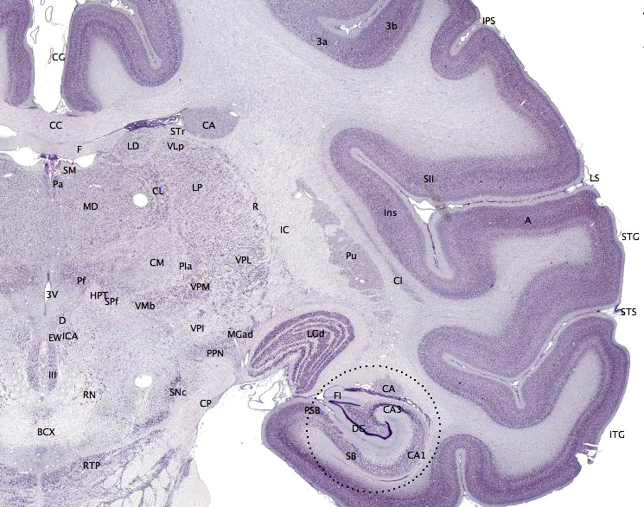
transverse slice
http://en.wikipedia.org/wiki/File:Brainmaps-macaque-hippocampus.jpg

Slide 16
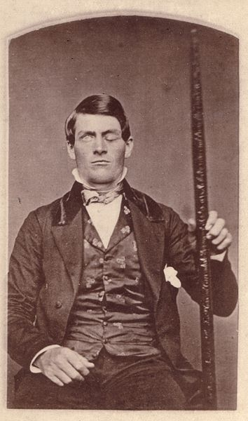

functional localization

Slide 17
observations
gray matter / white matter
nuclei / cerebral cortex / cerebellum
tube-like structure
cortex is a large sheet (folded up)
more surface area → more folding
major folds preserved
minor folds are variable

Slide 18
COARSE FUNCTION

Slide 19
WARNING FOR THE SQUEAMISH

Slide 20
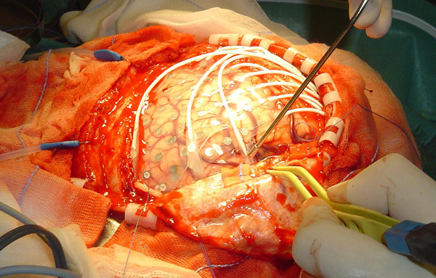
human brain stimulation

Slide 21
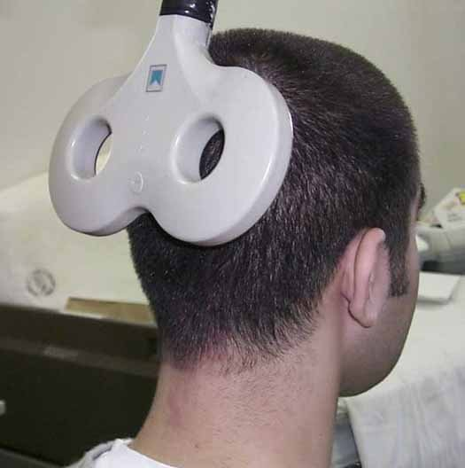
transcranial magnetic stimulation
http://www.popsci.com/science/article/2010-03/bending-morality-magnetism

Slide 22
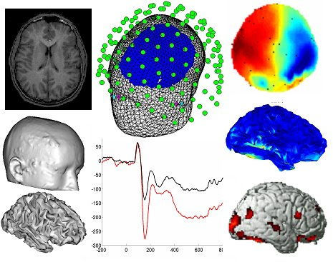
EEG etc
http://braincomputerinterfacetbc.yolasite.com/bci-systems.php

Slide 23
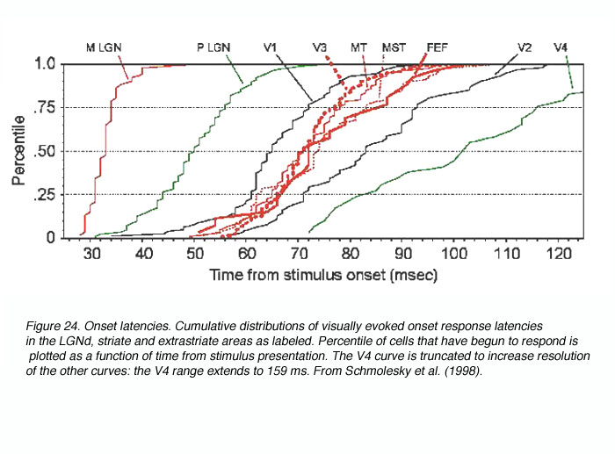
evoked potentials

Slide 24
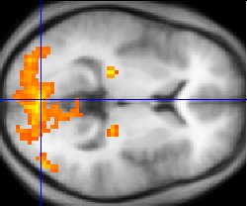
fMRI
fMRI measures blood flow → high spatial resolution (mm range), low temporal resolution.

Slide 25
CYTOARCHITECTURE

Slide 26
more detailed analysis
look at cytoarchitecture under a microscope
  this can only be done on actual tissue
  regions tend to be anatomically reproducible
careful tracing and observation
determine connectivity using transport

Slide 27
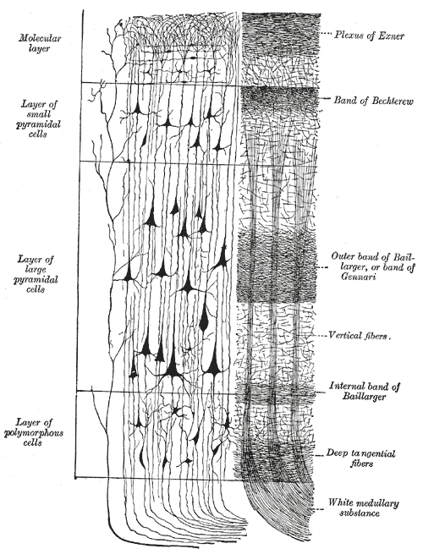
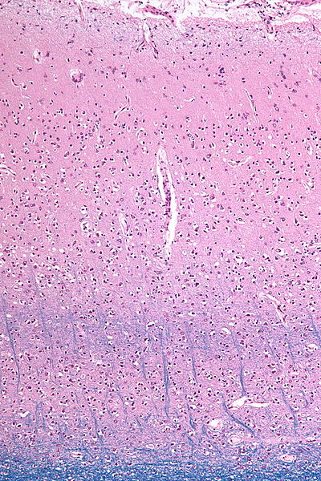
cytoarchitecture
present in
area 17,
absent in
area 18
Cytoarchitecture is consistent within a cortical area, differs between areas.

Slide 28
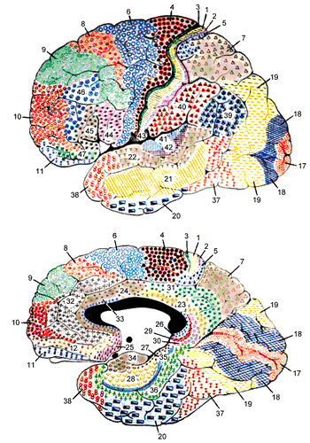
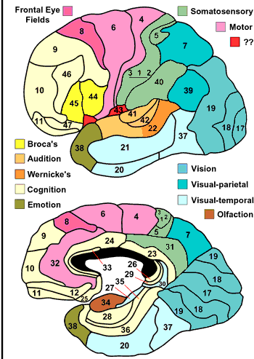
Brodmann areas
http://spot.colorado.edu/~dubin/talks/brodmann/brodmann.html

Slide 29
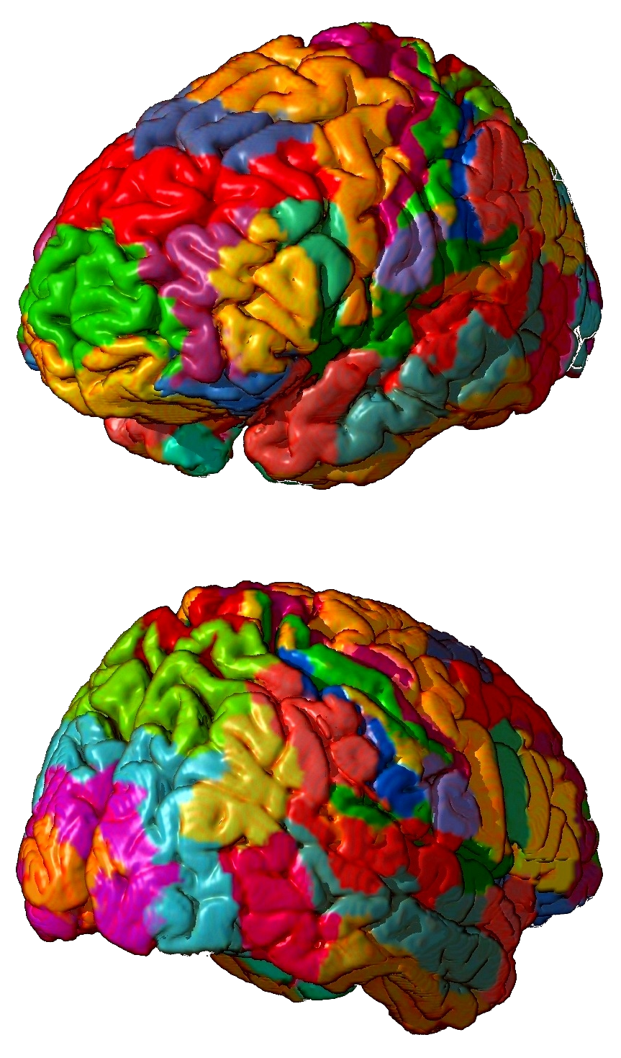
Brodmann areas (3D)

Slide 30
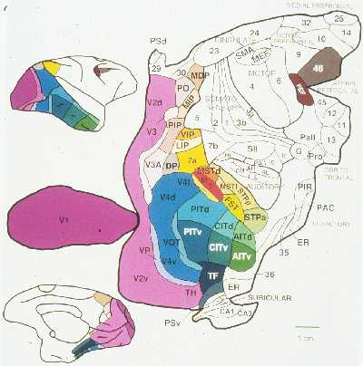
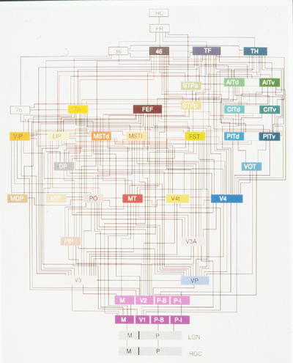
connections
Combination of microscopy, staining, anterograde staining, retrograde staining.

Slide 31
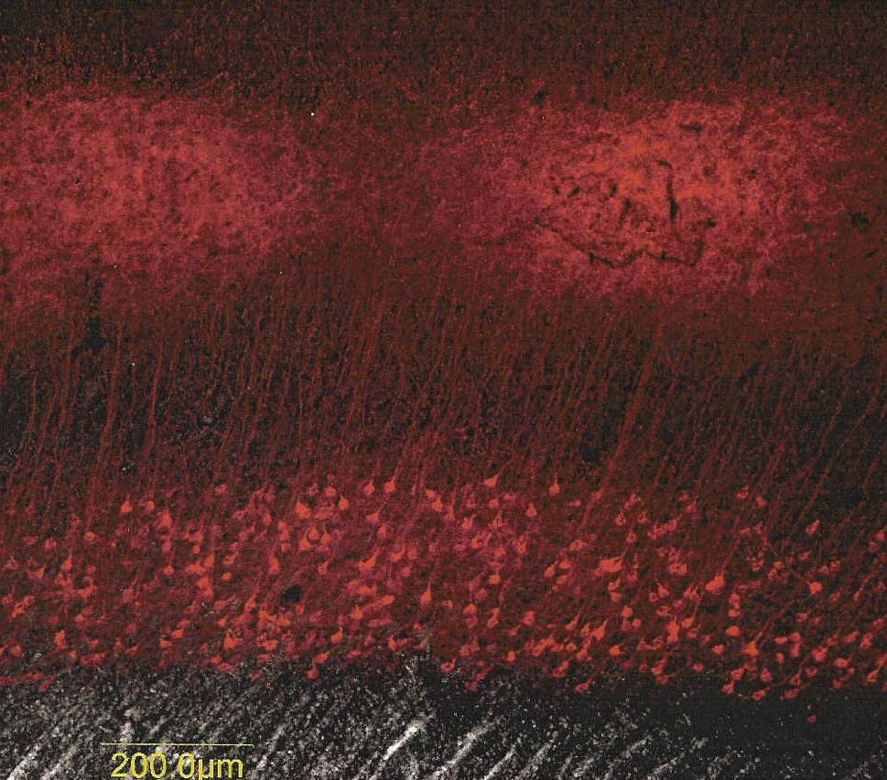
anterograde and retrograde staining
In this experiment we injected retrograde tracer in the LGN of the squirrel and then stained with antibody to the tracer (red). This section of striate cortex (V1) shows diffuse staining of the LGN axon terminals in layer 4 (fuzzy layer above), and retrogradely labelled cell bodies of the feedback neurons in layer 6 (below).
http://www-biology.ucsd.edu/labs/reinagel/RodentVision.html

Slide 32
CONNECTOMICS

Slide 33
applying computers & imaging
macro-scale connectivity
  fMRI (blood flow via MRI, low temporal resolution)
  diffusion tensor/spectrum imaging
micro-scale connectivity
  serial slicing and reconstruction
  microscopic 3D imaging

Slide 34
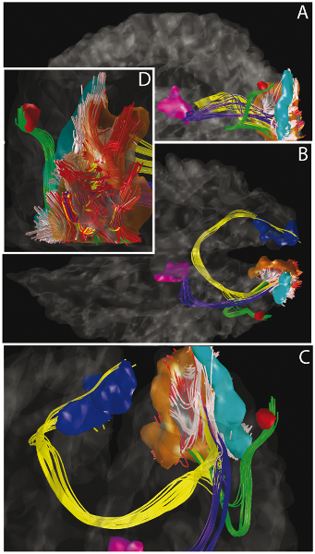
visual system connectivity (DTI)
http://www.plosone.org/article/info%3Adoi%2F10.1371%2Fjournal.pone.0000597

Slide 35
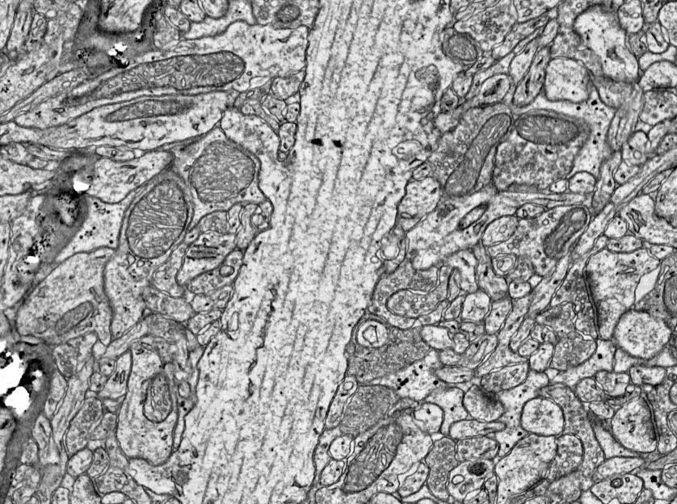
2D slices

Slide 36
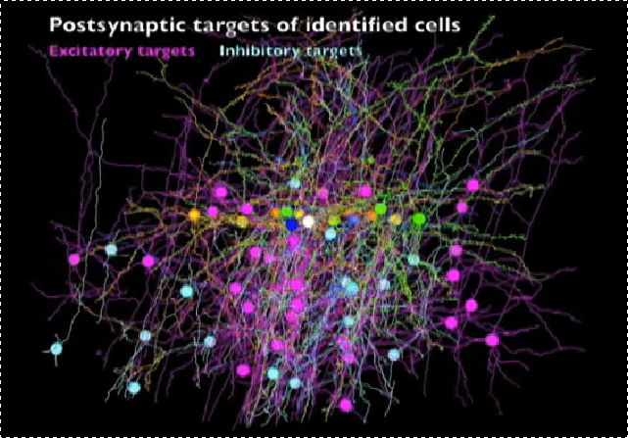
3D reconstruction
http://news.harvard.edu/gazette/story/2011/03/web-crawling-the-brain/

Slide 37
Connectomes
huge image databases (2D slices)
combination
  automatic processing
  manual annotation / alignment
  crowdsourcing
application
  visual cortex, visual processing

Slide 38
NEUROPHYSIOLOGY

Slide 39
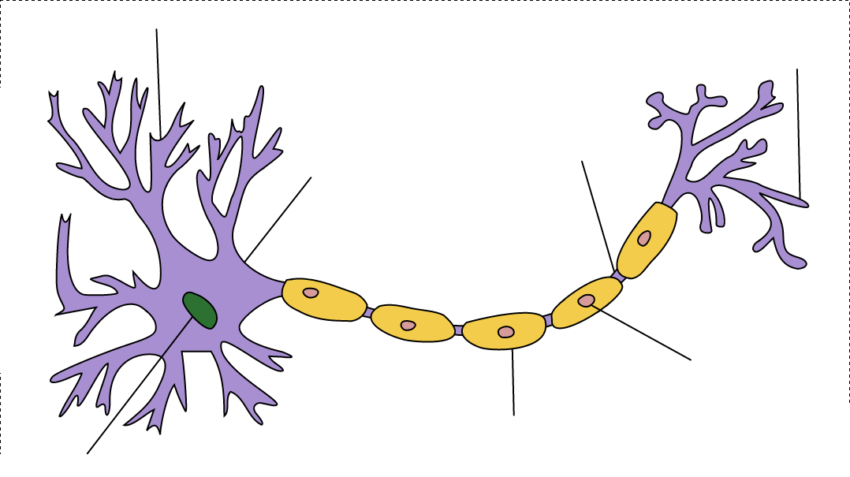
neurons

Slide 40
electrophysiology
neuron doctrine
  the brain is made of neurons
  neurons are cells
  neurons are specialized
  nucleus defines the cell
  nerve fibers are extensions of cells
  nerve cells are generated by division
  nerve cells are connected at synapses
  axons conduct in preferred directions
  contacts are excitatory or inhibitory
  synapses use a single type of transmitter

Slide 41
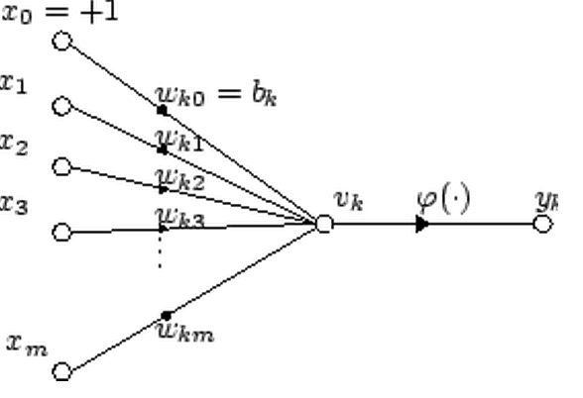
McCulloch Pitts Neuron

Slide 42
neurophysiology
(play video)

Slide 43
VISUAL SYSTEM STRUCTURE

Slide 44
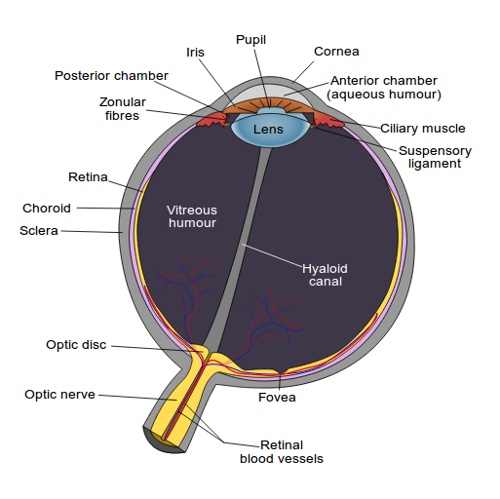
eye

Slide 45
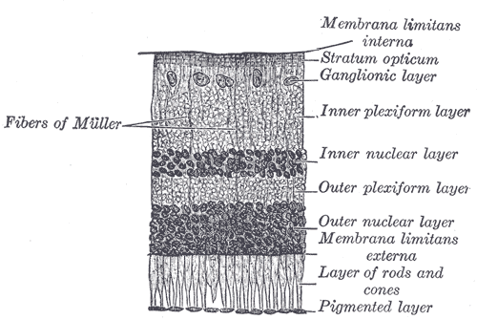
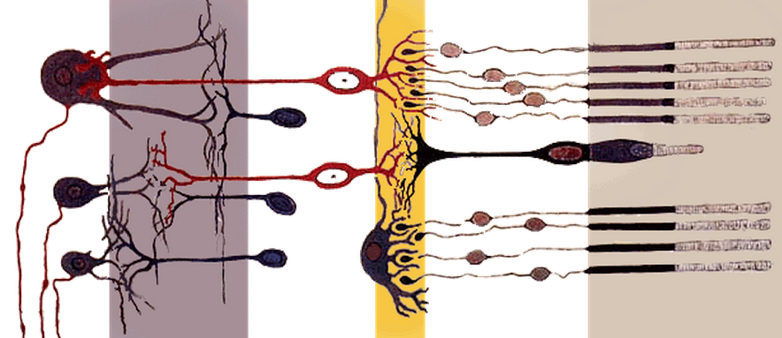
retina

Slide 46
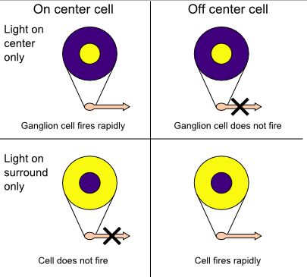
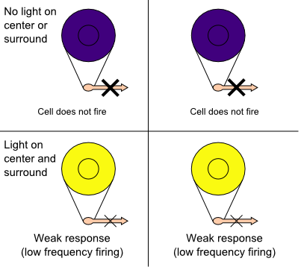
retinal neurophysiology
  100x number of receptors as fibers
  need compression for transmission
  implemented by connection strengths
  analogous to Laplacian edge detection

Slide 47
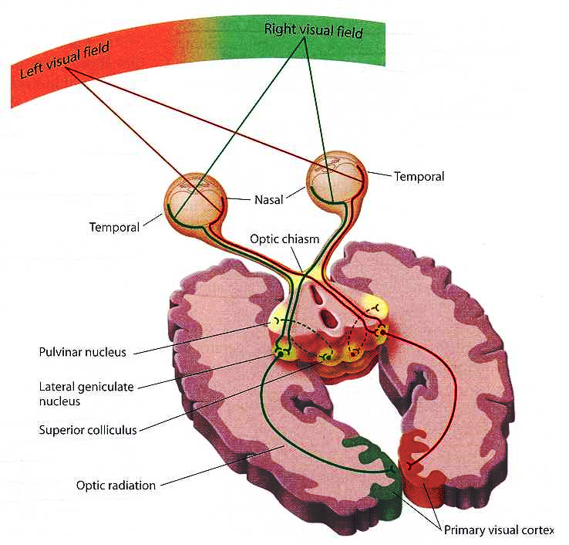
eyes to cortex

Slide 48
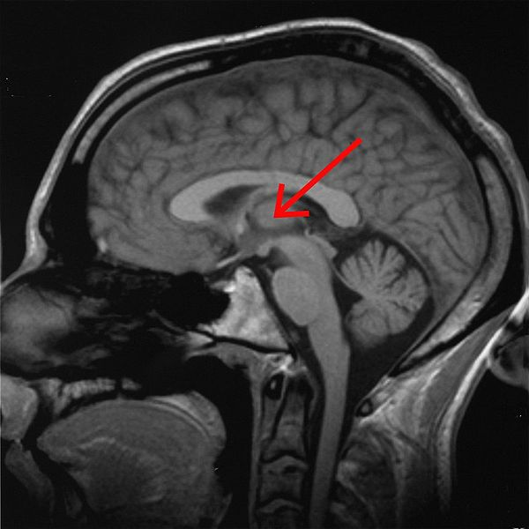
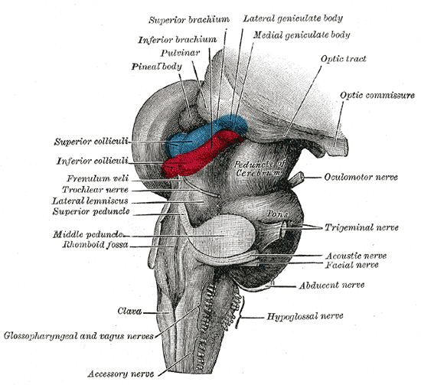
lateral geniculate nucleus (LGN)

Slide 49
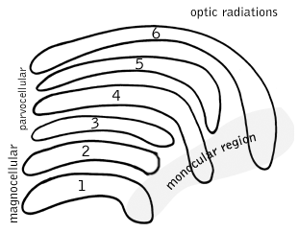
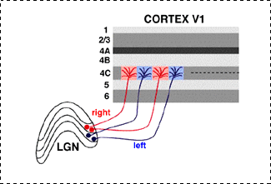
LGN structure
The eye on the same side (the ipsilateral eye) sends information to layers 2, 3 and 5 of the LGN. The eye on the opposite side (the contralateral eye) sends information to layers 1, 4 and 6.

Slide 50
blindsight
damage to V1 causes "cortical blindness"
  no conscious awareness of visual stimuli
  hierarchical processing, V1 is sole gateway
blindsight
  "you must guess" → correct guesses better than chance
  ability to walk without colliding
mediated by small number of other connections

Slide 51
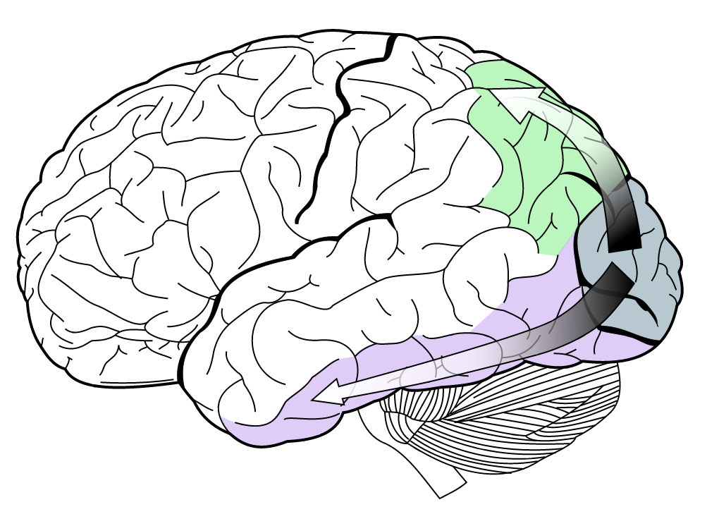
two stream hypothesis
posterior parietal
cortex
dorsal pathway
where / action
MT
V3
V2
V4
V1
inferior temporal
cortex
ventral pathway
what / perception
(probably more of an organizing principle)

Slide 52
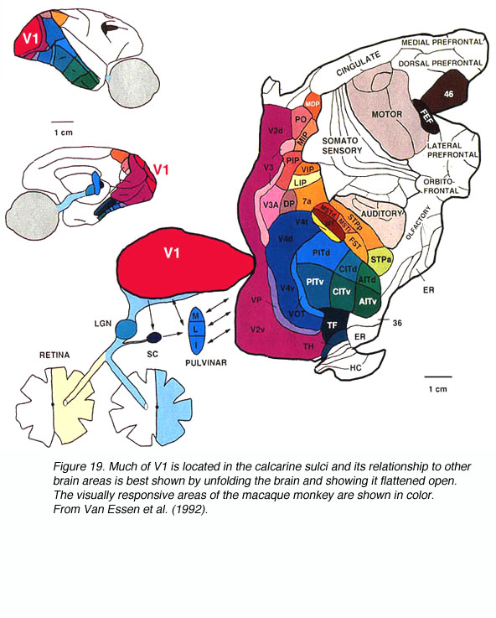
visual areas in the macaque monkey
http://webvision.med.utah.edu/book/part-ix-psychophysics-of-vision/the-primary-visual-cortex/

Slide 53
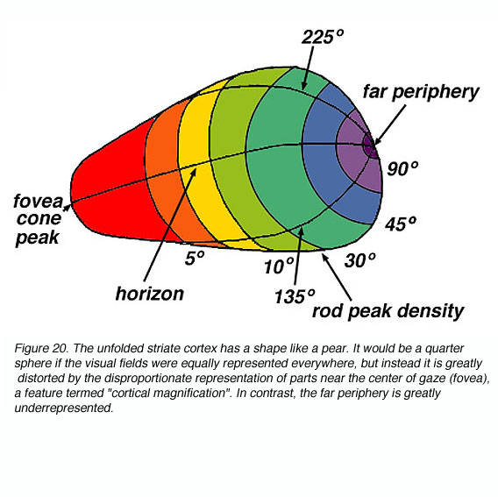
retinotopy
http://webvision.med.utah.edu/book/part-ix-psychophysics-of-vision/the-primary-visual-cortex/

Slide 54
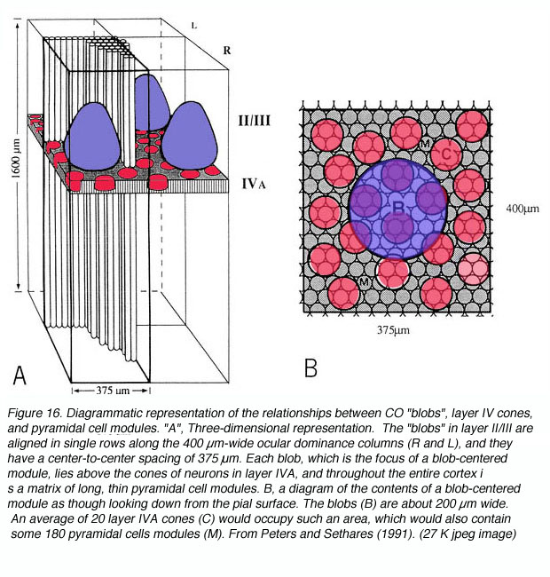
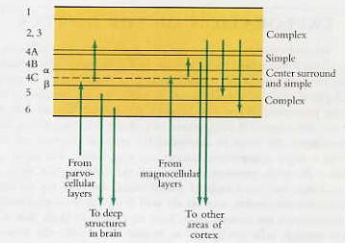
cortical structure
http://hubel.med.harvard.edu/book/b26.htm
http://webvision.med.utah.edu/imageswv/COBlobs.jpg

Slide 55
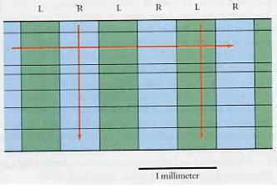



ocular dominance columns
Note the information flow, combining input from left and right – cf stereo vision.

Slide 56

spatial organization
http://webvision.med.utah.edu/book/part-ix-psychophysics-of-vision/the-primary-visual-cortex/

Slide 57

ocular dominance columns
http://webvision.med.utah.edu/book/part-ix-psychophysics-of-vision/the-primary-visual-cortex/

Slide 58
deficits vs cortical areas
prosopagnosia (face blindness) : fusiform gyrus
akinetopsia (motion blindness) : V5
cerebral achromatopsia (color blindness) : V1-V3
mental 3D rotation deficits : frontostriatal cortex

Slide 59
color blindness
retinal color blindness
  color sensors (cones) are missing
  some color differences cannot be perceived at all
cortical color blindness
  color sensors are present in the eye
  color borders are perceived, but no colors
  patients cannot sort color chips by hue
color agnosia
  color sensors are present in the eye
  different colors are perceived
  colors cannot be associated with objects or named

Slide 60
cortical neurophysiology
simple cells
  responds to oriented edges
  distinct inhibitory / excitatory regions
  summation property, mutual antagonism
complex cells
  responds to oriented edges
  invariant under small translations
  receive input from a number of simple cells
hypercomplex cells
  complex cells with ”end stopping” property
  detect ”length” as well

Slide 61
visual system structure
eye → thalamus → V1 → higher visual areas
note visual fields and crossover pattern
processing splits at higher areas
many individual deficits observed & localized
function of the different stages is partially understood
electrophysiology, cytoarchitecture, anatomy, psychophysics correlate
computational view correlates with biology
full description would be entire course...

Slide 62
PSYCHOPHYSICS & PSYCHOLOGY

Slide 63
psychophysics
relationship between physical stimuli and percepts
color, depth, shape, intensity, ...
methods
  method of limits
  method of constant stimuli
  method of adjustment
  staircase procedures
  estimation of magnitudes

Slide 64
psychology
scientifically understanding the working of the mind
visual psychology
  object recognition
  scene interpretation
  3D reasoning
  transparency
  …
experimental methods
  memory and recall
  time to completion
  error rates
  ...

Slide 65

mental rotation

Slide 66
APPLICATIONS

Slide 67
applications of vision & pat.rec
tomographic reconstruction
image enhancement for microscopy
3D microscopy
image enhancement
alignment of 3D brain scans for averaging
3D reconstruction from slices
statistical analysis of recordings
databases of slices, recordings, ...

Slide 68
applications to vision
visual system vs retrieval
  color discriminability and similarity
  color constancy
  what vs where pathway
architecture
  image processing and receptive fields
  robustness and adaptation
  contextual processing

Slide 69
open questions
function of cortical layers & columns
coding of information in neural signals
coding of memory (synaptic strenghts, etc.)
formation and maintenance of circuitry
genetic coding of the circuitry
evolution of the circuitry
purpose of massive backwards connections (10:1)
invariants
attentional mechanisms
contextual mechanisms
representation of scenes independent of eye movements
representation of symbolic concepts

Slide 70
what would answers look like?
agreement with experimental data
sensible statistical theory
ability to simulate / implement

Slide 71
DIRECT IMPLEMENTATION

Slide 72
direct implementation
bio-inspired object recognition
  uses features as observed in neurophysiology
  implemented using efficient image processing mechanisms
  achieves performance similar to existing systems

Slide 73

implementation

Slide 74

implementation

Slide 75

performance

Slide 76
issues
performs as well as SIFT / better
probably easier to compute
merely mimics features
performance far from human
many phenomena of vision not present
learning probably different from human
algorithm doesn't explain neural implementation

Slide 77
direct simulations
attempt to simulate visual systems at the neural level
levels of detail
  summarize neural activity numerically
  direct spiking simulation, but with computational model
  full membrane level physical simulation

Slide 78

cellular automata + GPU
Retina simulation using cellular automata and GPU programming
[PDF] von epfl.chS Gobron, F Devillard… - Machine Vision and Applications, 2007 - Springer

Slide 79

spiking computational model
Large-scale model of mammalian thalamocortical systems
[HTML] von pnas.orgEM Izhikevich… - Proceedings of the national …, 2008 - National Acad Sciences

Slide 80

(almost) membrane level simulation
NEURON—a program for simulation of nerve equations
[PDF] von psu.eduM Hines - Neural systems: Analysis and modeling, 1993 - Citeseer

Slide 81
SUMMARY

Slide 82
summary
better understanding vision for MMIR
applications for vision in biology and medicine
bio-mimetic algorithms and architectures
just an overview to see what's there,
each is easily a course or more...

