Slide 1
Multimedia Information Retrieval
Prof. Thomas Breuel
Dr. Muhammet Bastan
Dr. Wan-Lei Zhao

Slide 2
GROWTH OF MULTIMEDIA

Slide 3
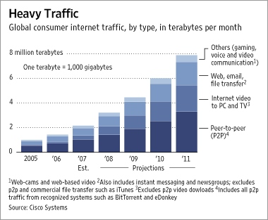

Slide 4
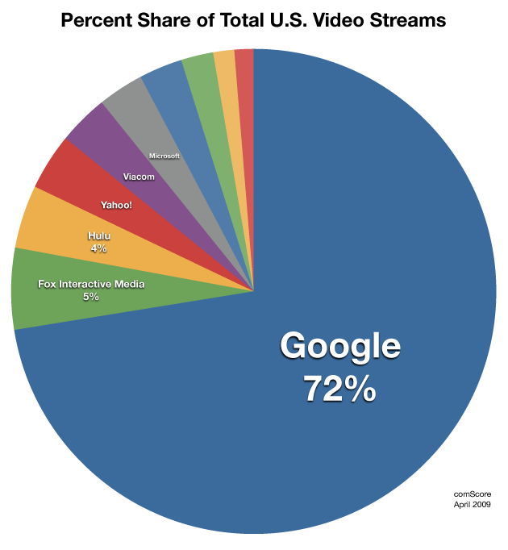
http://techcrunch.com/2009/06/09/youtube-video-streams-top-1-billionday/

Slide 5
multimedia data
Internet traffic
  predominantly video (by volume)
YouTube
  24h video uploaded / minute
Flickr
  5000 images uploaded per minute
iTunes
  >10 billion songs downloaded
Amazon
  >650000 books offered, millions of Kindles sold
  more e-books than hardcover sales

Slide 6
APPLICATIONS

Slide 7
multimedia retrieval
sample tasks
  find copies and recordings of music/video
  find all images/videos containing a person
  find audio/video containing a spoken keyword
  find music in a similar style
  find all books/newspaper articles mentioning a keyword
sample applications
  personal media management (duplicate removal, snapshots, …)
  forensic applications (illegal copies, pornography, evidence, …)
  social science research (finding people, objects, ...)

Slide 8
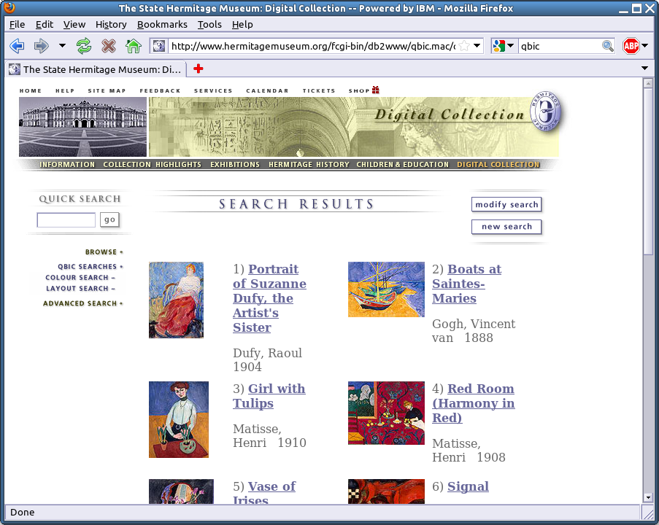
art search (QBIC, Hermitage)

Slide 9
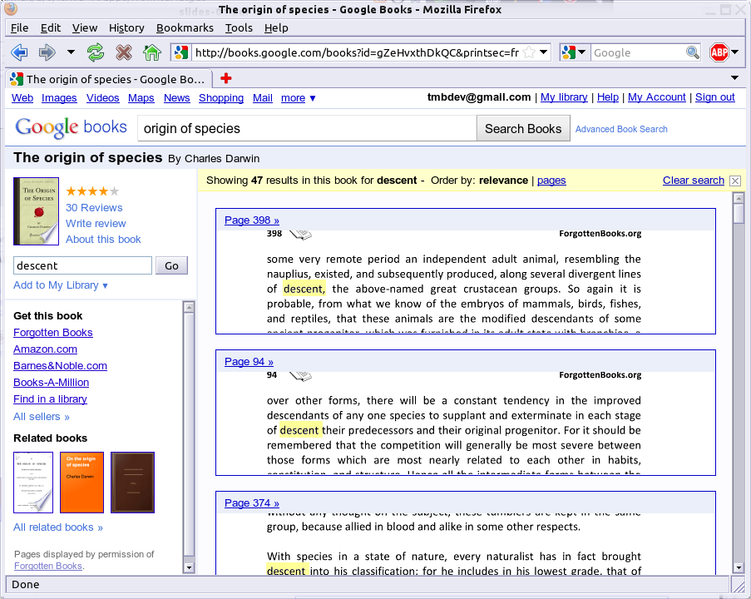
Google Books

Slide 10
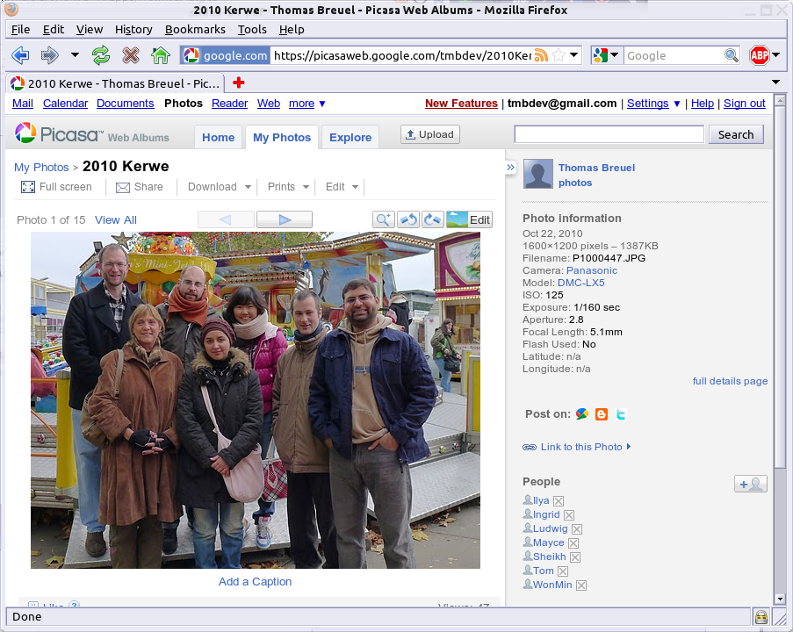
Picasa, Facebook, Flickr

Slide 11
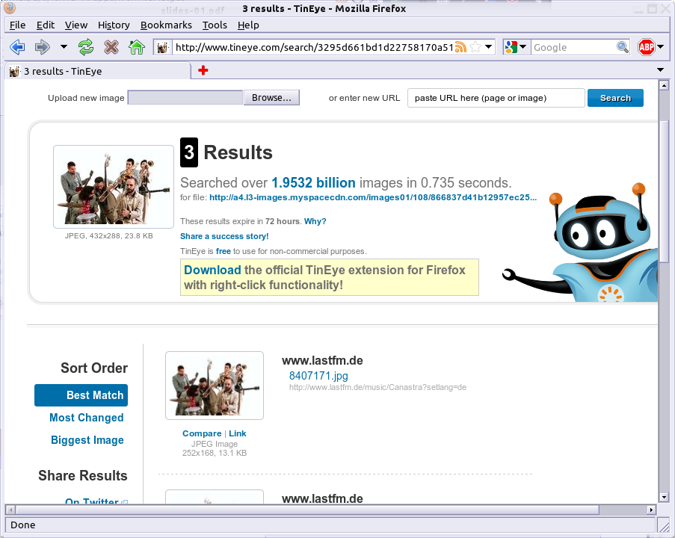
Tineye

Slide 12
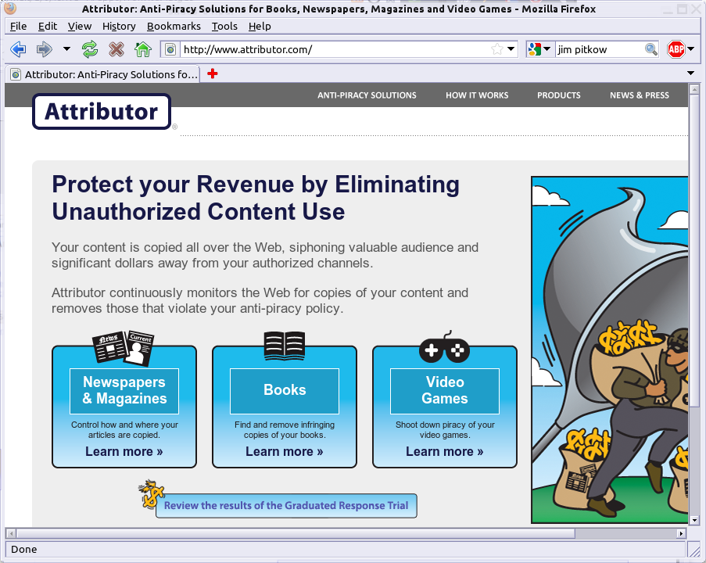
Copyright Monitoring

Slide 13
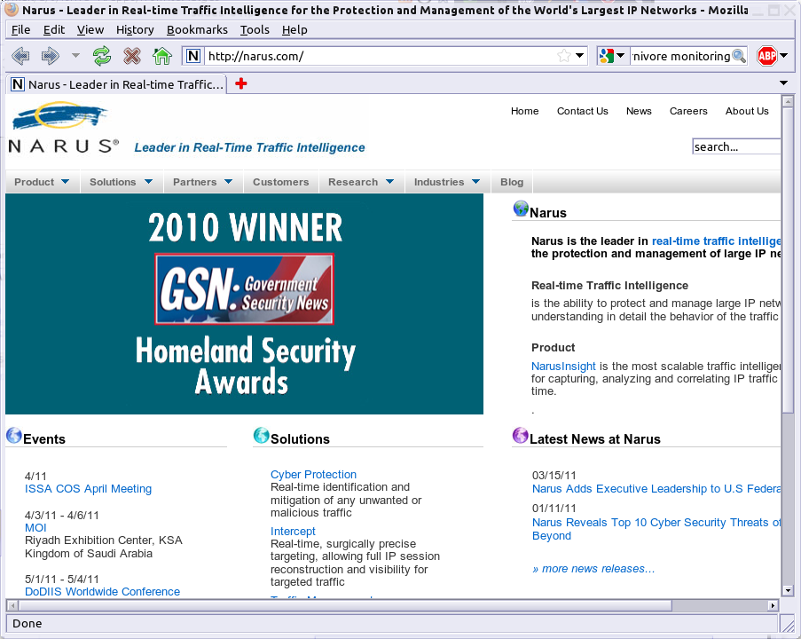
Carnivore, DCS1000, Narus

Slide 14
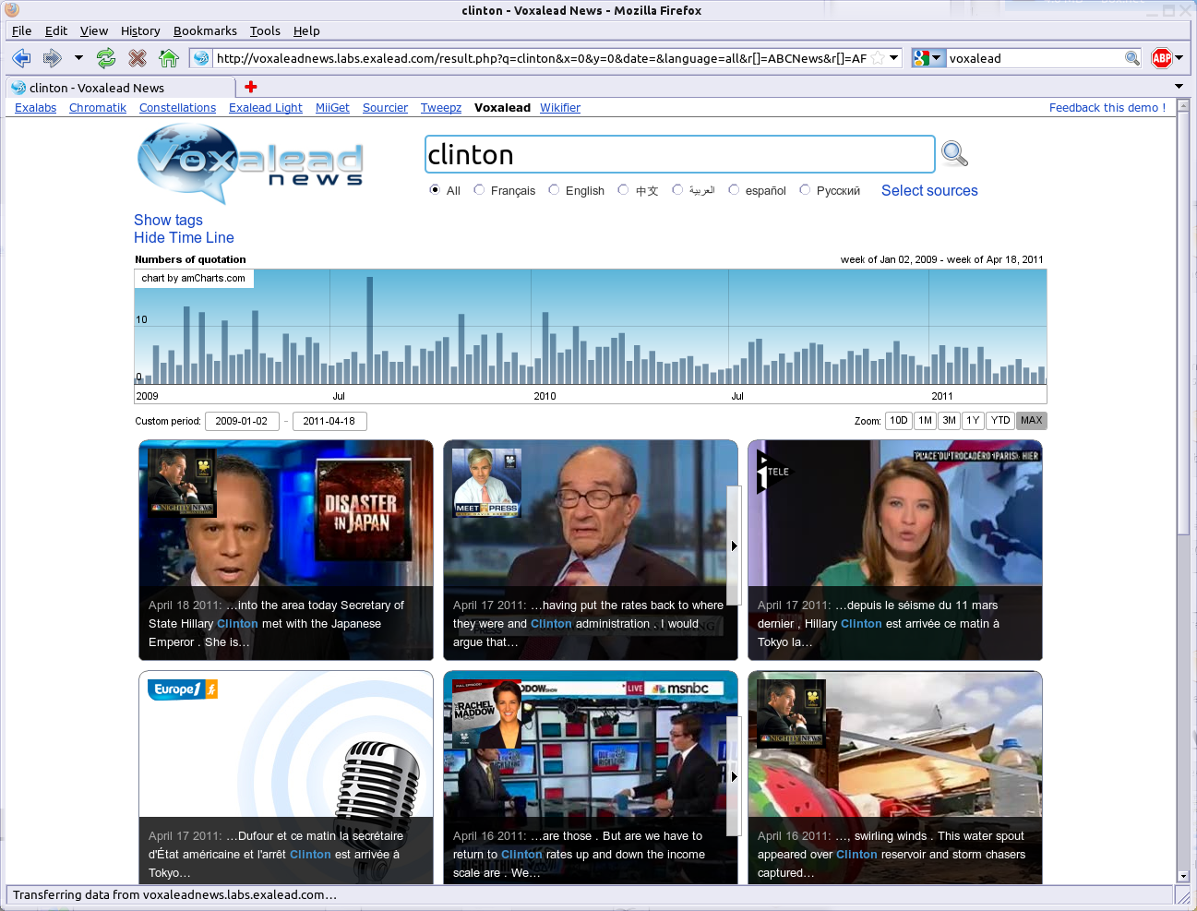
voice search (Voxalead, YouTube, QBIC)

Slide 15
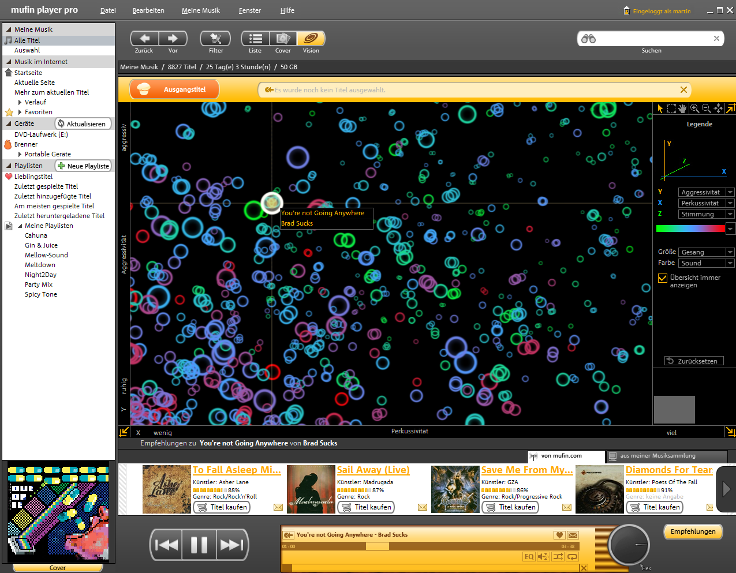
music recommendation (Mufin)

Slide 16
COURSE CONTENT

Slide 17
related fields
multimedia information retrieval...
  computer vision
  machine learning
  linguistics
  databases
  algorithms
  signal and image processing
  psychology

Slide 18
IR vs ...
information retrieval
  unstructured content: text, images, videos, audio, …
  query by keywords, examples, relevance feedback, …
  performance determined by relevance
computer vision
  interpretation and understanding of images
pattern recognition, classification
  limited set of classes
databases
  formally correct responses to well-defined queries

Slide 19
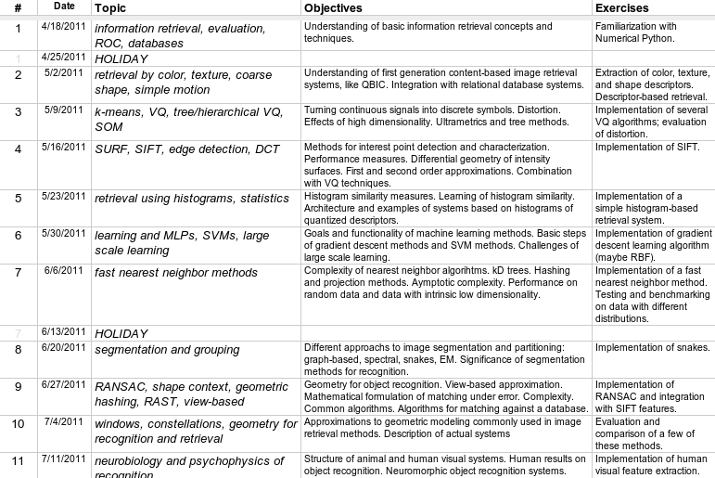
lectures

Slide 20
exercises
practical exercises every 1-2 weeks
exercises in Python, NumPy (same as used for research)

