Slide 1
Text Information Retrieval
Prof. Thomas Breuel

Slide 2
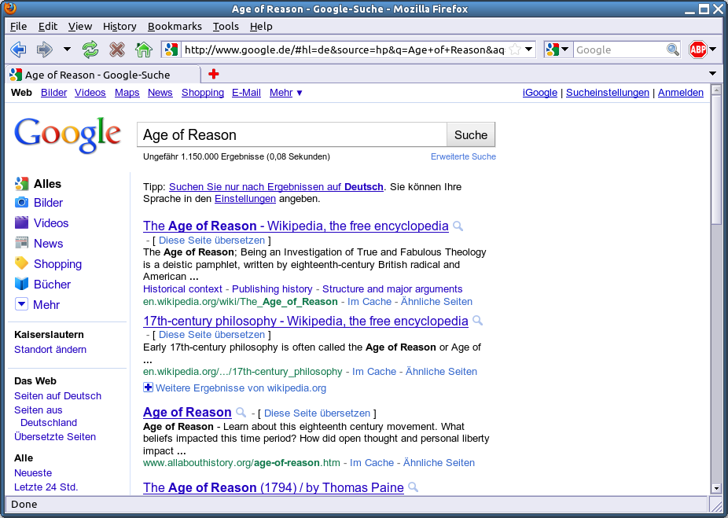

Slide 3
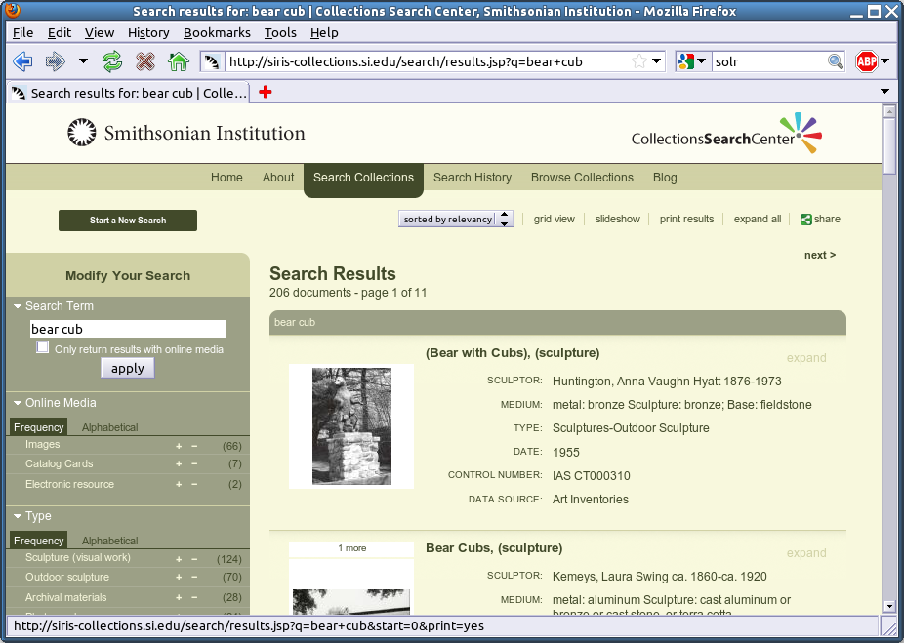
http://en.wikipedia.org/wiki/Solr
http://siris-collections.si.edu/search/results.jsp?q=bear+cub

Slide 4
EVALUATION

Slide 5
information retrieval
steps
  enter query
  get list of results
IR = retrieval of relevant results
How do we know the results are relevant?

Slide 6
evaluating relevance
for now, assume set-based results
  given a query, return a set of results (no ranking)
for each query
  manually determine relevance (yes/no) of each document
  compute precision and recall (below)

Slide 7
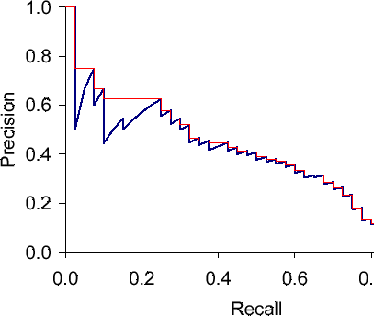
precision/recall graph based on ranks
better/worse
1 2 3 4 5 6 7 8 9
1 0 0 1 1 0 0 0 0
cutoff = 4
precision = 0.5
recall = 0.66
compute P/R cutting of at different ranks (precision-at-n’)
sawtooth from correct/incorrect results
usually interpolate these curves (red)
need to choose a tradeoff between precision and recall
multifactorial optimization
(other kinds of parameters also possible)
http://nlp.stanford.edu/IR-book/html/htmledition/evaluation-of-ranked-retrieval-results-1.html

Slide 8
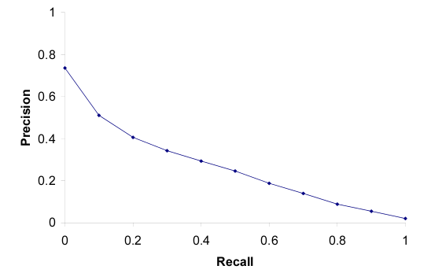
11-point p/r graph, 50 queries
evaluated at 11 points (0.0, 0.1, … 1.0)
averaged over 50 queries

Slide 9


F-measure
F_{β} measures the effectiveness of retrieval with respect to a user who attaches β times as much importance to recall as precision
Weighted harmonic mean of precision and recall.
Harmonic mean: progress first at rate 1 then at rate 2 same as progress at harmonic mean of the two rates.

Slide 10
Mean Average Precision
people want a single number for competitions
MAP score provides this
  d1 … dm : relevant documents
  R_{k} : rank of d_{k} in query results
  compute each Precision(R_{k}) for each d_{k}
  average all those precisions
  compute mean over all queries

Slide 11
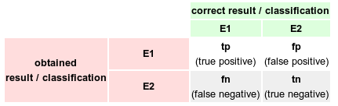


evaluating performance

Slide 12
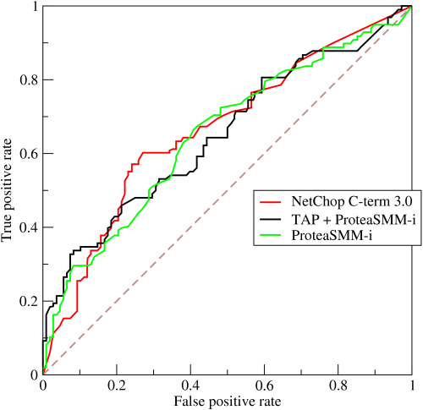
ROC curve
better/worse
similar to precision/recall curve, but TP vs FP
different axes
multifactorial optimization as well
relationship explored in paper
curves can dominate each other
don’t work well in IR because FP usually climbs very rapidly

Slide 13
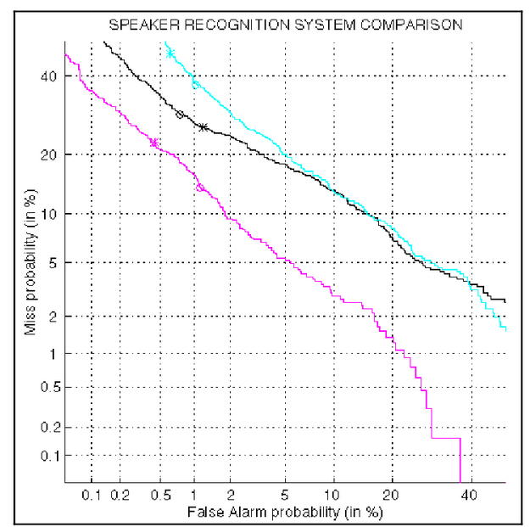
DET curve
better/worse
detection error tradeoff curve
note logarithmic scale
FN vs FP plot

Slide 14
evaluation
be able to explain
  test set
  rank vs set-based evaluation
  precision, recall, TP, FP, …
  F-score
  MAP
  tradeoffs, curves, dominance
  precision/recall curve, ROC curve, DET curve

Slide 15
VECTOR SPACE MODEL

Slide 16
text retrieval
data
  queries Q are lists/sets/multisets of words
  documents D_{i} are lists/sets/multisets of words
how do we find relevant documents?
  find all documents for which Q∩D_{i}≠∅
  find all documents for which Q∩D_{i}=Q
  find all documents for which |Q∩D_{i}| is maximal
(can you write SQL statements to do this?)

Slide 17
vector space model
representation
  transform sets Q and D_{i} into vectors q and v_{i}
  return documents for which d(q,v_{i})>𝜀 or d(q,v_{i})=maximal
  usually d(x,y) = x∙y (dot product)
transformation
  assign a number j to each word w_{j} (the term vocabulary)
  v_{ij} = 1 if w_{j} ∈ D_{j}, else 0
  v_{ij} = count of w_{j} in D_{j}
  v_{ij} = f(count of w_{j} in D_{j,} size of D_{j},...)

Slide 18
vector space model
”Some buffalo from Buffalo often buffalo other buffalo from Buffalo.”
tokenization (some=1, buffalo=2, from=3 ,...)
[1, 2, 3, 2, 4, 2, 5, 2, 3, 2]
Query
vector generation
[1, 5, 2, 1, 1]
”buffalo”
vector normalization
[0.1, 0.5, 0.2, 0.11, 0.1]
[0,1,0,0,0]
dot product
score = 0.5

Slide 19
TF-IDF model
specific method of assigning weights
  tfij : frequency of term i in document j
  idfi : log of inverse frequency of documents containing term i
  wij = tfidfij = tfij ∙ idfi
terms get high weights if...
  they occur frequently in the document
  occur rarely in the database (logarithmically weighted)
works very well in practice

Slide 20
some more details
"document" might be...
  paragraph, page, etc.
  granularity of indexing
tokenization...
  usually need morphological analysis
  sow, sown, sowed, sows, sewn → "sow"
  stemming, lemmatization, ...
  finding word boundaries in languages w/o spaces
  leave out frequent words (stop words, stop list)
  equivalences ("little", "small")
  case folding, accents, international characters, Unicode

Slide 21
comments on efficiency
document vectors are very sparse (why?)
naive representation wastes lots of space
can use sparse vectors
can compute all dot products in different order
can transform into different spaces (e.g., via PCA)
dot product x∙y closely related to distance
vector space retrieval closely related to nearest neighbor
vector representation allows applying many patrec algs

Slide 22
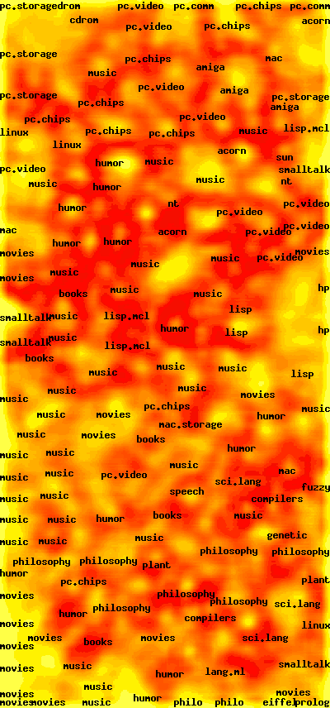
document clustering
documents are (sparse) vectors
perform clustering via...
  k-means algorithm
  self-organizing map algorithm
  hierarchical clustering
will talk about these algorithms later

Slide 23
latent semantic analysis
attempt to write all documents d_{i} as a linear combination of a small number of basis vectors b_{j}
d_{i} = ∑ λ_{ij} b_{j}
idea: each basis vector represents a kind of "topic" or "subject", and each document is a combination of topics
retrieve documents by similarity of the λ_{i} vectors
pattern recognition: PCA, information retrieval: LSA

Slide 24
PROBABILISTIC MODELS

Slide 25
probabilistic model
generation of a document
  first pick one or more topics and how much they contribute
  for each topic, randomly pick words according to that topic
parameters
  P(topic)
  P(word|topic)
variables
  sample of topics for a given document (latent)
  sample of words for a given topic (latent)
  words in a given document (observable)

Slide 26
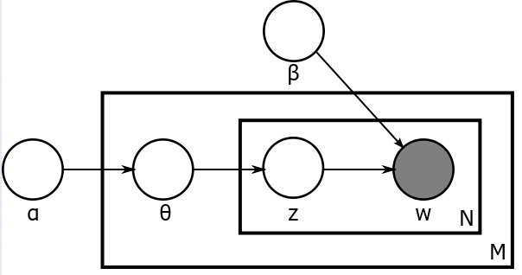
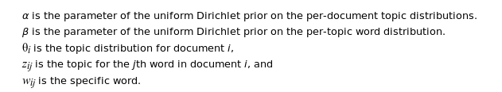
plate model
M: number of documents
N: number of words in document

