Slide 1
Introduction to the Neuron (2)
Thomas Breuel

Slide 2
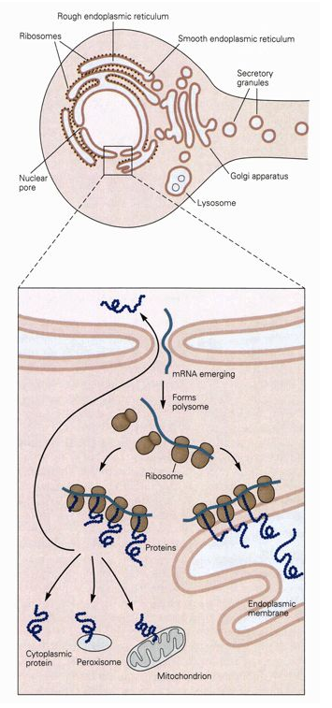
why cells?
genetic algorithms
DNA computing
bioinformatics
swarm intelligence
agent modeling
organic computing
nanocomputing

Slide 3
REVIEW AND SUMMARY

Slide 4
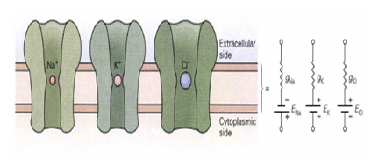
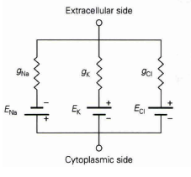
ion channels can be modeled by an equivalent electrical circuit
resistor – resistance to ion flow
battery – driving force from chemical gradient

Slide 5
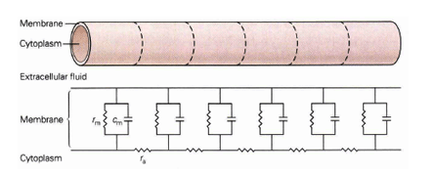
membranes can be modeled as a collection of resistors and capacitors
membrane resistance and capacitance are as before
note the axial resistance r_{a}

Slide 6
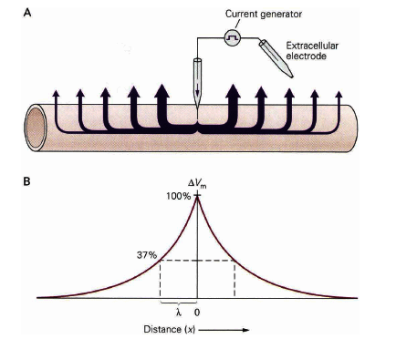
electrical signals spread passively along neural processes
note that the "current generator" may be a synapse in a biological system

Slide 7
passive spreading
passive spreading like this is important for computation in dendritic trees
spreading is modified by synapses
  excitatory synapses contribute to activation
  inhibitory synapses interfere with signal propagation somehow

Slide 8
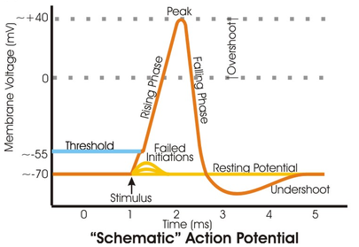
Na⁺ Cl⁻
Na⁺ Cl⁻
K⁺
K⁺
-60 mV
-70 mV
voltage change
due to input
Na⁺ Cl⁻
K⁺
-45 mV
refractory period
positive feedback
Na⁺ Cl⁻
Na⁺ Cl⁻
K⁺
+55 mV
K⁺
-75 mV
E_{Na}
E_{K}

Slide 9
key points
membrane potentials → Nernst potentials
when channels are open
sodium channels exist in 3 states
deactivated, activated, inactive
potassium channels exist in 2 states
action potential propagated via careful timing of state transitions
state transitions in aggregate represented as populations statistics

Slide 10
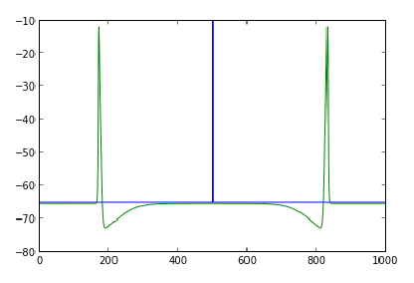

Slide 11
questions
how does this compare to electronic devices
  speed?
  power?
  speed / power tradeoffs?
what can we say about...
  power efficient computing?
  how much computation do we need to match the brain?

Slide 12
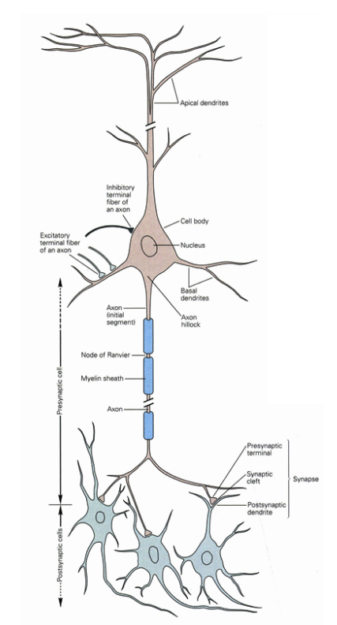
computation (so far)
passive spread
and summation
trigger zone
action potential
synaptic transmission to next neuron

Slide 13
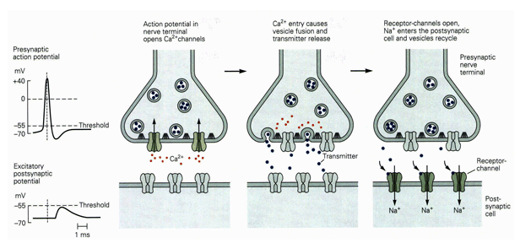
#vesicles / action potential depends on neuron; varies from an avg. of 1 to 300
each vesicle increases PSP by a fixed amount (m=150 ΔV=0.5mV)

Slide 14
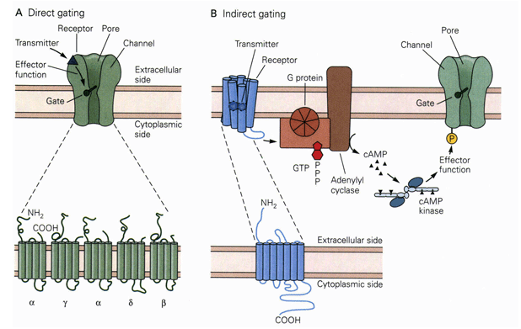
direct gating – usually fast, transient response
ionotropic receptor – receptor acts directly on ions
indirect gating – slower, longer-lasting response
metabotropic receptor – receptor activates a metabolic pathway

Slide 15
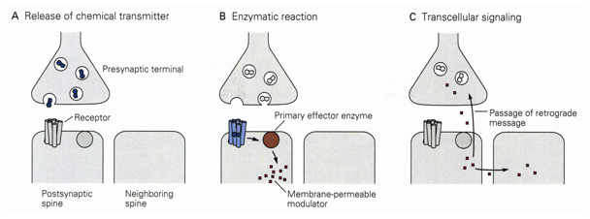
transcellular signaling – a recently discovered kind of neural signaling that is likely important for memory and learning
CS questions: where is the state? what communicates with what? what are timing constraints? what are error rates? etc.

Slide 16
integration of synaptic signals

Slide 17
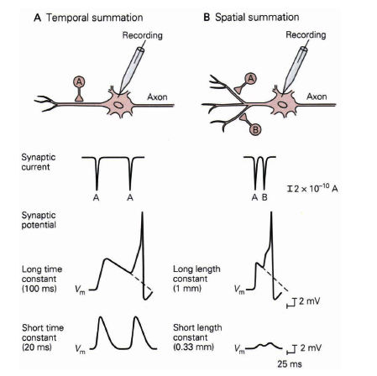

Slide 18
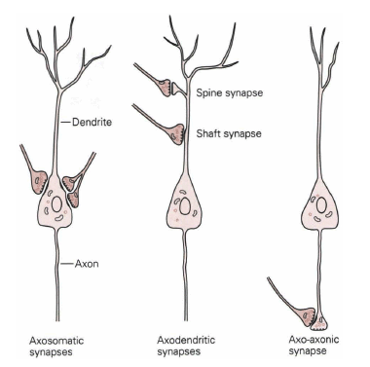

Slide 19
learning

Slide 20
synaptic changes
synaptic plasticity
  augmentation
  depression
  long-term potentiation
  long-term depression
creation/destruction of synapses
changes are activity dependent
  homosynaptic
  heterosynaptic
  retrograde messengers (in addition to transmitters)

Slide 21
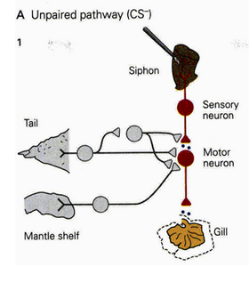
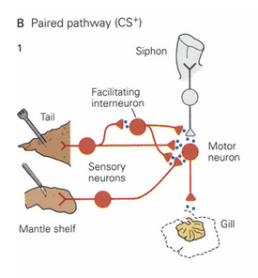
A molecular basis for classical conditioning has been worked out in these kinds of experiments.
siphon : unconditioned stimulus
gill withdrawal : response
mantle : conditioned stimulus
tail : control stimulus

Slide 22
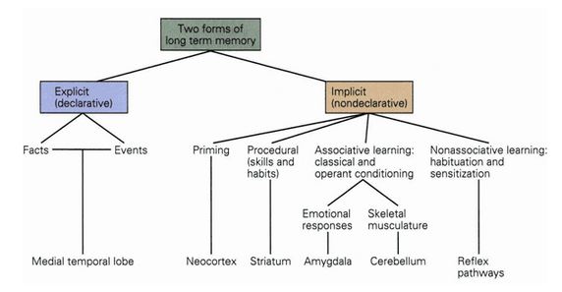
learning and memory

Slide 23
learning
learning takes place via synaptic plasticity
plasticity
  change in # vesicles released per action potential
  results in changes to strength of post-synaptic potential (PSP)
learning occurs via
  chemical modification of channels
  changes in gene expression
  creation/destruction of synapses
  changes in channels get "converted into" creation of new synapses

Slide 24
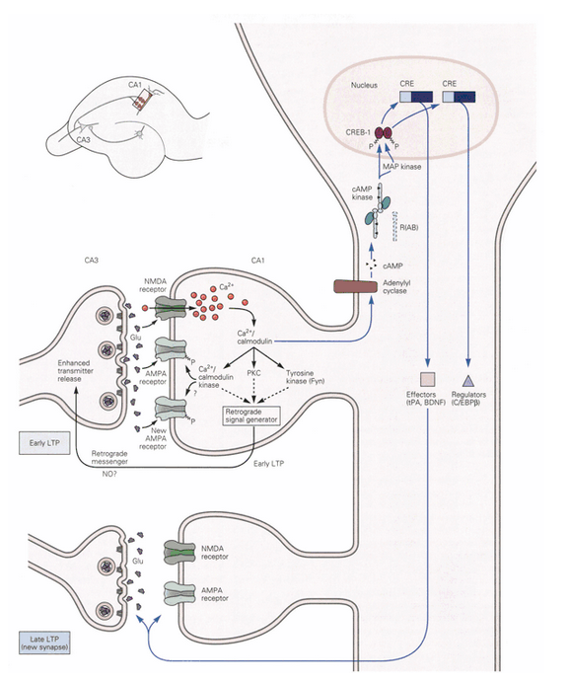

Slide 25
abstractions

Slide 26

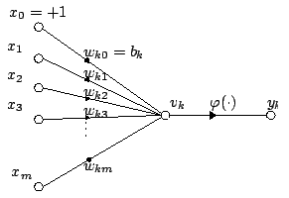
McCulloch-Pitts Neuron

Slide 27
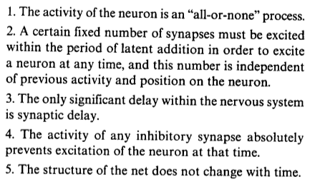
McCulloch-Pitts assumptions
"A logical calculus of the ideas immanent in nervous activity" WS McCulloch et al., Bulletin of mathematical biology, 1943

Slide 28
McCulloch-Pitts results
feed-forward nets can implement arbitrary boolean circuits
recurrent nets are computationally universal
changing the assumptions usually doesn't change these results
(NB: no learning, compute-only)

Slide 29
subsequent work
perceptrons (1960's)
backprop and MLPs (1980's)
machine learning and approximation
deep neural networks
detailed biological modeling
we'll talk a lot about these models later

Slide 30
McCulloch-Pitts assumptions
"A logical calculus of the ideas immanent in nervous activity" WS McCulloch et al., Bulletin of mathematical biology, 1943

Slide 31
does lack of realism matter?
computationally equivalent ≠
equivalent as explanatory models
differences in constants
differences in scaling

Slide 32
biological neuron models
main models
  leaky integrate and fire
  Hodking-Huxley
  cable theory
  compartmental models
modeling kind
  modeling via differential equations
  no direct connection with system-level functions

Slide 33
integrate and fire model
repeat for each simulation timestep
  maintain a total activation for the neuron
  decrease activation by a fixed amount (not below 0)
  each incoming spike input contributes a fixed activation
  (extra weight for coincidence?)
  when the activation goes above a threshold
    the neuron fires
    the activation is reset to 0
(usually expressed as differential equations)

Slide 34
more realistic models
need intermediate model
  more complex than M-P model
  (since we know that it's not expressive enough)
  less complex than full membrane simulation
  (since we know that those details don't matter)

Slide 35
current status
M-P very well characterized and has close connections to computational learning
no plausible learning rules used with M-P
simple spiking neurons used in simulations and heuristic work, some learning
models of complex neural dynamics, but little connection to computation
little modeling/theory of time scales, dendritic tree computations, plasticity
few testable predictions

Slide 36
biological reality

Slide 37
biological reality
formation of a new synapse (growth cone)
http://www.youtube.com/watch?feature=endscreen&NR=1&v=Gb0oTDQJtIU
formation of a new synapse
http://www.youtube.com/watch?v=Nze2ZsBUQtY

Slide 38
biology origins
Euglena
Paramecium
Amoeba
http://www.youtube.com/watch?v=0rNI8Bos_BQ
http://www.youtube.com/watch?v=fh_yjLppNAg
http://www.youtube.com/watch?gl=DE&v=pvOz4V699gk
photo sensors, mechanical sensors, chemical sensors, coordinated actions across the cell membrane (cilia), behaviors, motion
http://www.youtube.com/watch?gl=DE&feature=related&v=QGAm6hMysTA
http://www.youtube.com/watch?feature=fvwp&NR=1&v=7pR7TNzJ_pA

Slide 39
neurons
each neuron is as complex as one of these cells ("animals")
should we understand brains as colonies of social single-cell organisms?
connection with swarm intelligence, agent modeling

