Slide 1
Introduction to the Neuron

Slide 2
synapses

Slide 3
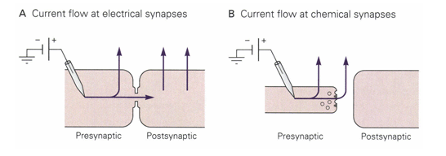

Slide 4
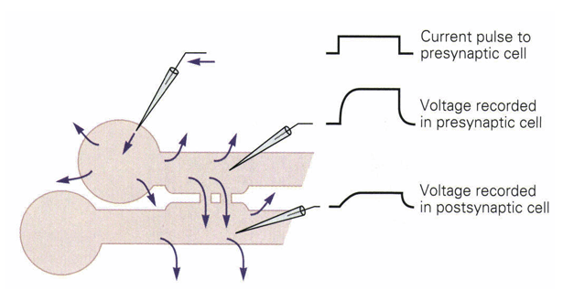
electrical synapses are instantaneous and allow neurons to fire synchronously
electrical synapses are fairly limited when it comes to information processing
gap junctions also exist in glial cells, cause signal propagation at about 1um/ms across a network of astrocytes
gap junctions may also mechanically "glue" cells together (e.g. hold Schwann cells wrapped up)

Slide 5
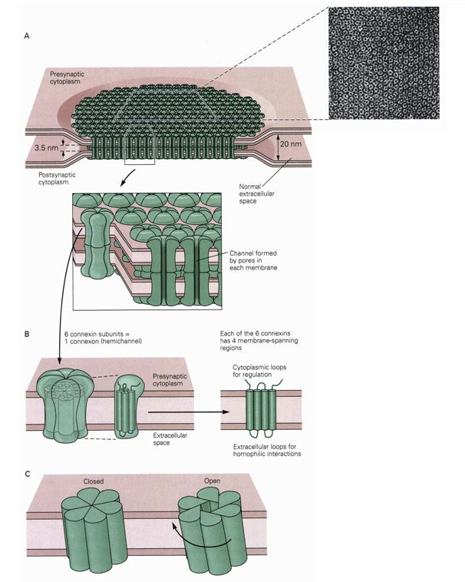
opening and closing in response to pH and Ca²⁺ concentrations

Slide 6
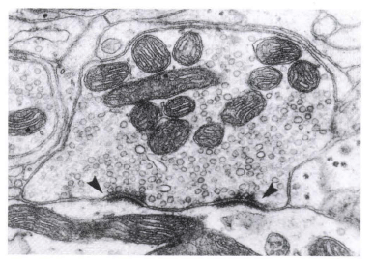
synaptic cleft – separates pre- and post-synaptic cell membranes; often is wider than the separation between cells itself; the round bodies are vesicles containing neurotransmitters, dark regions are "docking areas" for vesicles, and structures at the top are mitochondria

Slide 7
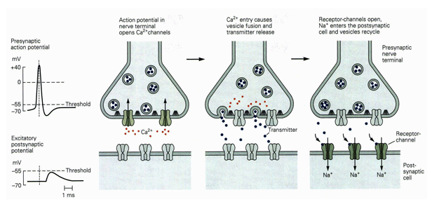

Slide 8
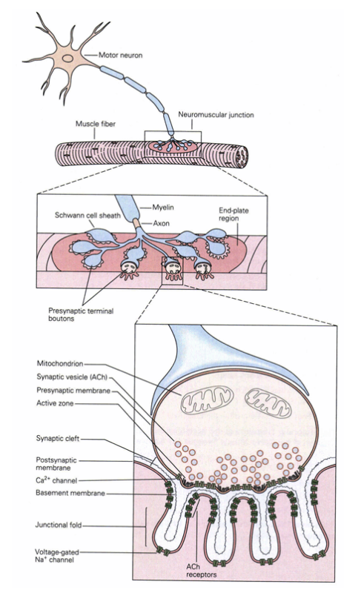
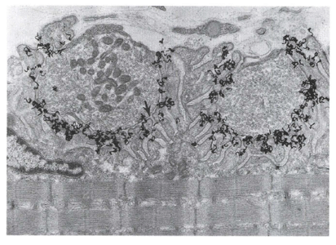
neuromuscular junction
acetylcholine is released as the neurotransmitter into the synaptic cleft
rich in ACh receptors and Na⁺ channels
gap contains acetylcholinesterase

Slide 9
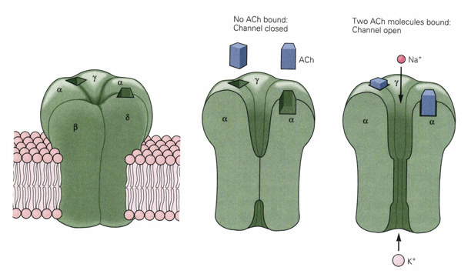

Slide 10
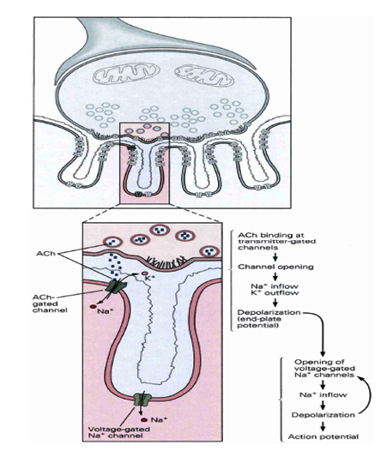

Slide 11
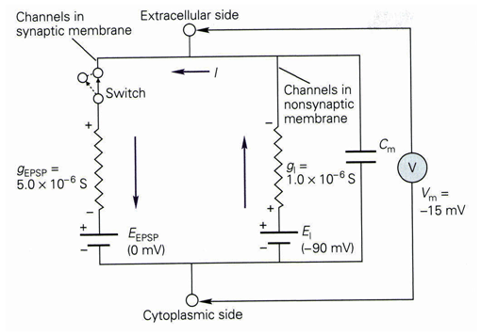

Slide 12
overall
muscle activation
  motor neurons form synapses with muscles
  action potential causes release of ACh
  ACh receptors cause depolarization
  depolarization activates voltage-gated Na⁺ channels
  ACh degraded by acetylcholinesterase
medicine
  myasthenia gravis – loss of ACh receptors
  acetylcholinesterase inhibitor – nerve agent, poison, venom
  also activated by nicotine

Slide 13
indirect gating

Slide 14
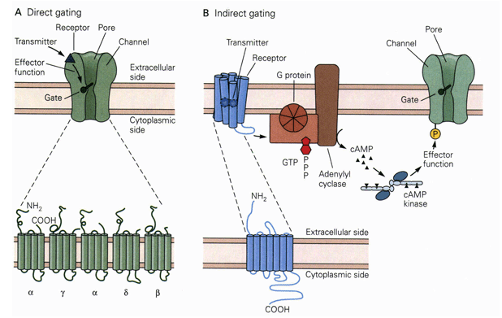
direct gating – usually fast, transient response
ionotropic receptor – receptor acts directly on ions
indirect gating – slower, longer-lasting response
metabotropic receptor – receptor activates a metabolic pathway

Slide 15
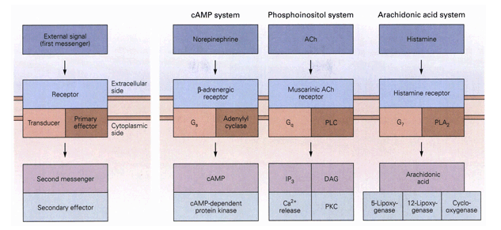
all indirect signaling systems share a common architecture
they differ in the specific chemical signals used
this type of signaling can also cause changes in intracellular biochemistry, gene expression, and cell growth

Slide 16
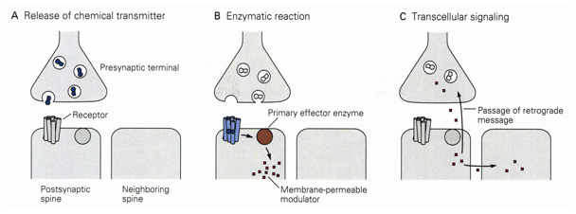
transcellular signaling – a recently discovered kind of neural signaling that is likely important for memory and learning

Slide 17
indirect gating metabotropic receptors
very complex, many different pathways
wide range of time scales
  phosphorylation
  protein synthesis
  gene regulation
  growth
potential for transcellular signaling
very important for learning, adaptation

Slide 18
complexity and variation
receptor determines kind of response
  excitatory, inhibitory, metabotropic, etc.
many neurotransmitters
  neurotransmitters can act on different receptors
  neurotransmitters have preferred kinds of receptors
  peptides, simple substances, gases (CO, NO), …
additional important components
  synthesis, degradation, reuptake of neurotransmitters
interact with drugs

Slide 19
drugs
LSD – serotonin receptor agonist
opiates – opioid receptor agonists
phenylephrine – adrenergic agonist
beta blocker – adrenergic antagonist
dextromethorphan – NMDA rec. antagonist
PCP – NMDA receptor antagonist
cannabis – cannabinoid receptor agonist

Slide 20
complexity and function
dozens of neurotransmitters
hundreds of receptors
dozens of signaling pathways
do these have a computational function?
just a historical accident?
could we simplify the system?

Slide 21
synaptic integration

Slide 22
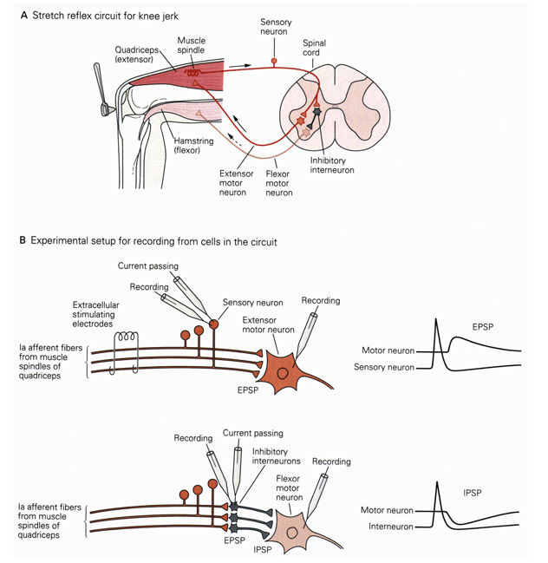
measuring neural interactions
excitatory inputs
inhibitory inputs

Slide 23
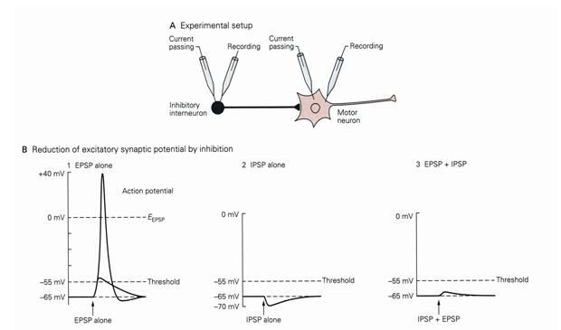

Slide 24
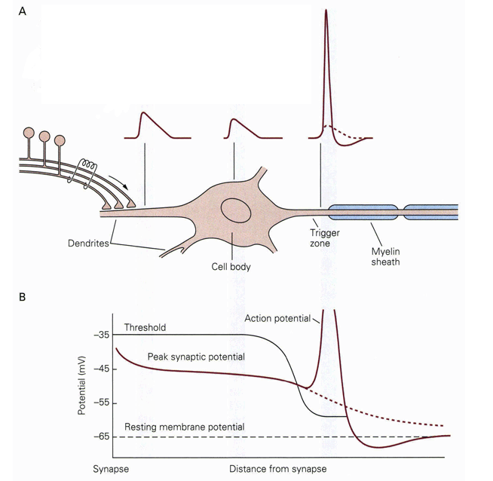

Slide 25
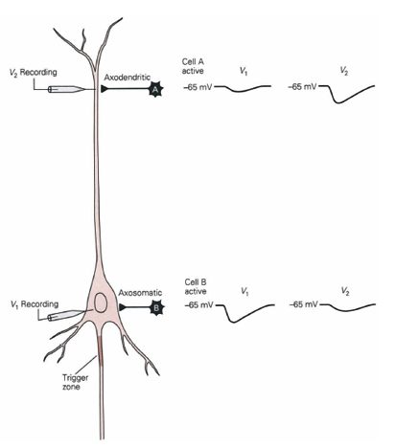
effects on inhibitory inputs depends on distance of the input from the trigger zone

Slide 26
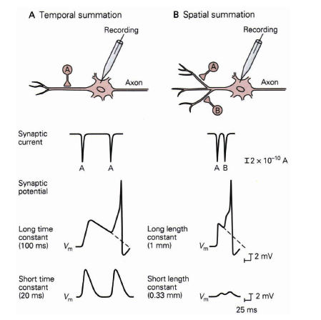

Slide 27
