Slide 1
Recurrent Neural Networks
Thomas Breuel

Slide 2
backpropagation through time
“traditional” backpropagation
output at time t becomes input at time t+1
gradient descent now needs to take time into account
“vanishing gradient problem”

Slide 3
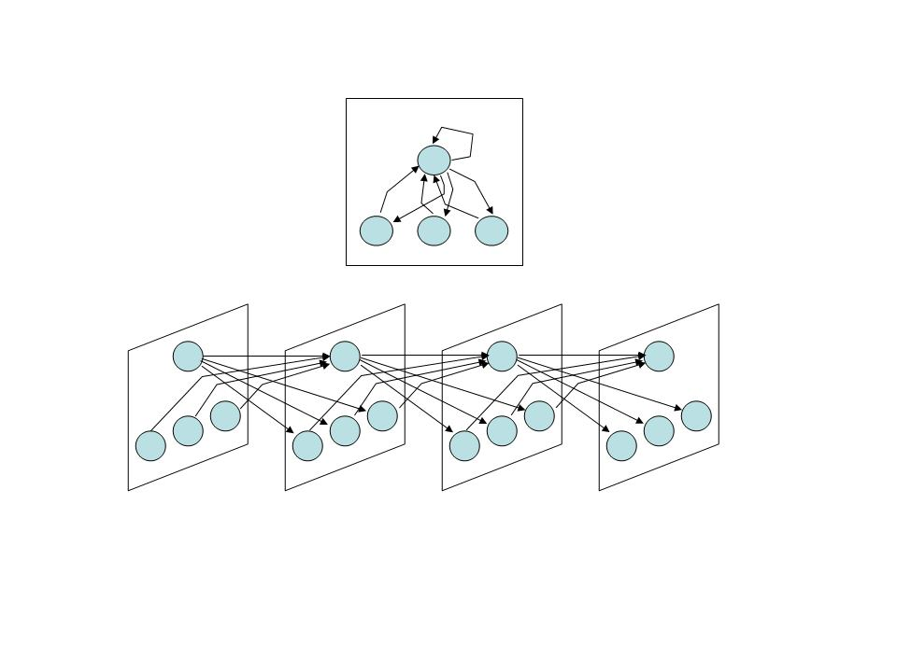
backpropagation through time
http://www.stanford.edu/group/pdplab/pdphandbook/handbookch9.html?iact=hc&vpx=232&vpy=358&dur=152&hovh=194&hovw=259&tx=133&ty=105&ei=KyjlUZ_PNYusPYPDgEA&page=1&tbnh=131&tbnw=150&start=0&ndsp=44&ved=1t:429,r:8,s:0,i:106

Slide 4
memory cell
memory
state
input
output
refresh

Slide 5
switchable memory cell
memory
state
input
output
refresh

Slide 6
trainable switchable memory cell
memory
state
input
output
refresh

Slide 7
LSTM memory cell
memory
state
input
output
refresh

Slide 8
LSTM memory...
addresses the vanishing gradient problem
solves many sequence learning tasks that are not solved by...
  fixed time window classification
  recurrent neural networks

