Slide 1
Understanding DL Models
Thomas Breuel

Slide 2
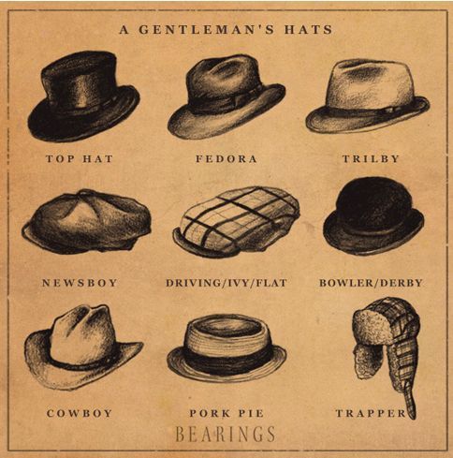
Notes:
As a deep learning guy, you need to wear many hats.
We don’t have a single methodology for DL yet, so we borrow from other fields for ideas / reasoning.
You also need this to communicate with non-DL experts, with regulators, etc.
Oh, and interviewers expect this, so you can also take this talk as a review for what you ought to know for interviews.

Slide 3
DEEP LEARNING VIEW
Notes:
Before looking at the views of DL systems from other perspectives, let’s briefly review the DL view itself.

Slide 4
Deep Learning Expert
What is an L1 loss and when would you use it?
How does batch normalization work?
Describe the architecture of a GAN and the major difficulties in training it.
How do you use autoencoding for pretraining?
Notes:
I’m going to start each section with a series of questions. I’m not going to put you on the spot, but someone with a lot of experience in the field should find these questions easy.
I will ask you afterwards whether you found these questions easy/hard; please answer, also so that I can guage the experience of people in the group.

Slide 5

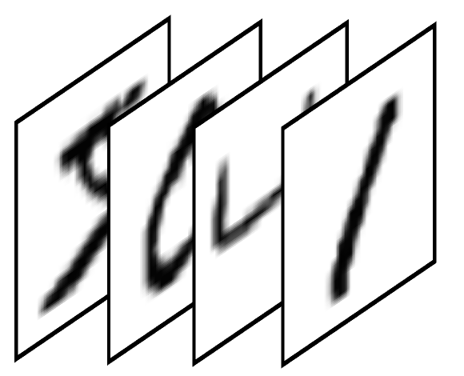

the road to deep learning
pattern recognition
machine learning
manual
feature
extraction
parametric
classifier
early neural networks
manual
feature
extraction
non
parametric
classifier
deep learning
feature
extraction
nonparametric
classifier
end to end training

Slide 6
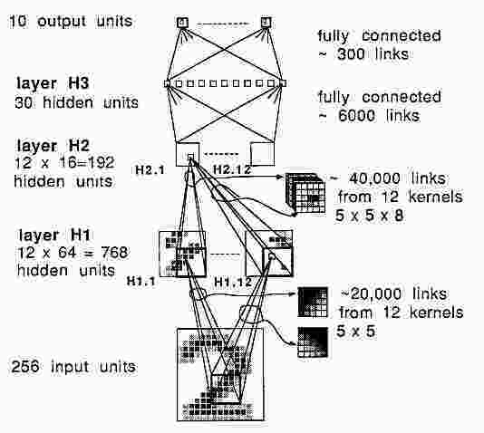
LeNet
A high impact paper that demonstrated end-to-end learning:
multilayer convolutions for feature extraction
multilayer perceptrons for the final classification step
Got off to a slow start because:
computations were costly
datasets were small
manually designed features usually still did better
LeCun, Yann, et al. "Backpropagation applied to handwritten zip code recognition." Neural computation 1.4 (1989): 541-551.
Notes:
Just as a reminder: deep learning has been around for a few decades.
One of the first successful applications was LeCun’s deep convnet for zip code recognition.
Yann has always been passionate about the importance of deep learning and establishing the field against the (then) orthodoxy of approaches like PAC learning and SVMs (which you also should understand!)

Slide 7
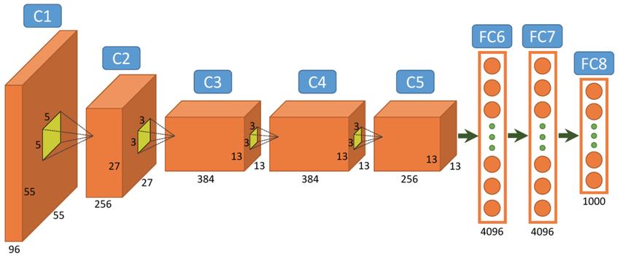
AlexNet
Very similar to LeNet
Massive impact: “Cited by 13136”
Put together a whole bunch of (existing) techniques:
GPU computing
ReLU nonlinearities
pooling layers
local response normalization
data augmentation
dropout
Demonstrated much improved performance
https://www.researchgate.net/figure/312303454_fig2_Fig-4-Architecture-of-Alexnet-From-left-to-right-input-to-output-five-convolutional
Krizhevsky, Alex, Ilya Sutskever, and Geoffrey E. Hinton. "Imagenet classification with deep convolutional neural networks." Advances in neural information processing systems. 2012.
Notes:
Things really took off with AlexNet. What had changed between LeNet and AlexNet isn’t so much the DL tech (although there were some important changes), but the availability of GPUs and large labeled training sets.
When computer vision really took off pre-DL in the 1980’s, getting large datasets was impossible, digital cameras were expensive and poor quality, and the community frowned on empirical results.

Slide 8
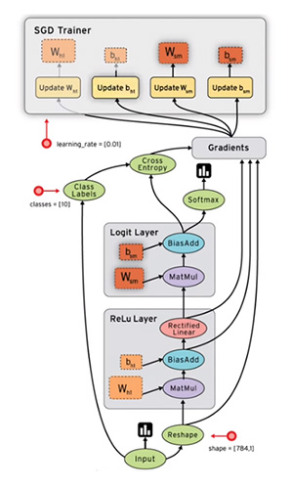
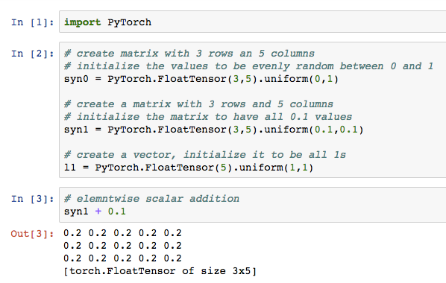
Primary Deep Learning Frameworks
PyTorch
interactive numerical computing for CPU/GPU
automatic, dynamic differentiation when desired
all of Python available at runtime
TensorFlow
compute graph execution engine
programmatic compute graph construction in Python
runtime primitives limited to available graph primitives
Question: who has used which?
Notes:
Two major frameworks: PyTorch and TensorFlow
Question: which are you using? Why?
PyTorch is more like an “interpreter” and TensorFlow is more like a kind of “compiler”, though PyTorch actually often has lower overhead than TensorFlow
Both provide:
general purpose array computing for CPU+GPU
highly optimized kernels for convolution, dense linear operations
some support for sparse operations
automatic differentiation for gradient descent optimizations
multiple gradient descent optimizers
multi-GPU support
distributed computing support
some support for distributed arrays
interactive execution and experimentation

Slide 9
pipe notation
implemented by tfspecs (TensorFlow) and dlpipes (PyTorch)
Examples:
lecun89 = Cs(12, 5)**2 | Flat() | Fs(30) | Fs(10)
alexconv = Cr(96, 11) | Mp(2) | Cr(256, 5) | Mp(2) | Cr(384) | Cr(384) | Mp(2)
alexnet = alexconv | Flat() | Fr(4096) | Fr(4096) | Fl(1000)
def blk(n, d, r=3): return Cbr(n, r)**d | Mp(2)
vggconv = blk(64, 2) | blk(128, 2) | blk(256, 2) | blk(512, 2) | blk(512, 2)
vgg13 = vggconv | Flat() | Fr(4096) | Fr(4096) | Fl(1000)
convenient shorthand for some models; expands to normal tf.slim/PyTorch
also: equivalent notation for distributed input pipelines
Notes:
I wear a “systems hat” myself some of the time, and some of the tools I create are intended to make DL easier
Two areas that are unnecessarily messy are model specifications and input pipelines.
Pipe notation allows complex models to be specified (and understood) in a few lines of code by viewing layers as stages in a pipeline
There is a similar set of tools and notations for input pipelines that allow you to build and strat large scale input pipelines easily.
I do a lot of experimentation and benchmarking, and pipe notation allows many model variants to be specified on the command line.

Slide 10
pipe notation
fully connected | Fl(n) Fr(n) Fs(n); Fbr(n)...
convolutional | Cl(n, r) Cr(n, r) Cs(n, r); Cbr(n, r)...
batch norm | Bn(...)
dropout | Do(p)
reshaping | View(...), Flat()
other | Shared(...), Par(...), Sum(...)
Notes:
Here are common components of pipe notation; these are executable. When executed, they yield standard TensorFlow or PyTorch layers.

Slide 11
distributed training
3.2 Tbps
1 Pbps
1 PFLOPS
petabytes of storage, hundreds of servers
hundreds of nodes
8 x 8-GPU nodes
Notes:
Who has trained jobs with order of 1PB of data? 100TB of training data?
Who has trained jobs with 100+ GPUs? 10+ GPU? More than one GPU?
One of the reasons for DL success is that the complicated distributed computing problems fall into simple, predictable patterns, so systems people can build good solutions to them.
Here is a typical large training job.
(Explain what’s happening here)
These systems tend to be based on Web technologies, not supercomputing technologies.
Web technologies tolerate failure and recover from them… and SGD tolerates failure and recovers.
Very different from traditional scientific ocmputing.

Slide 12
IS DL ALL YOU NEED?
Notes:
With DL successes, do you really need anything else?

Slide 13
domain-independent advances
ADAM
GPU
batchnorm
dropout
max-pool
residuals
ReLU
LeNet (1989)
LeNet-5 (1998)
AlexNet
VGG
ResNet
Notes:
It seems like a lot of the key technical advances were DL specific.

Slide 14
example: domain-independent reasoning
Dropout:
training many models and averaging them often gives better results
this may be viewed as an approximation to a fully Bayesian procedure
dropping out units and then averaging approximates this behavior
Can we solve all problems in deep learning this way?
Notes:
We can reason about many DL issues in a (seemingly) domain-independent manner

Slide 15
No Free Lunch Theorems
If an algorithm performs well on a certain class of problems then it necessarily pays for that with degraded performance on the set of all remaining problems.
Wolpert, David H. "The supervised learning no-free-lunch theorems." Soft Computing and Industry. Springer London, 2002. 25-42.
Notes:
But!

Slide 16
Related of Bayesian Theorems
For most decision rules, you can find some prior that makes that decision rule Bayes-optimal.
Berger, James O. Statistical decision theory and Bayesian analysis. Springer Science & Business Media, 2013.

Slide 17
Conclusion: There is no single universal neural network: the domain matters.

Slide 18
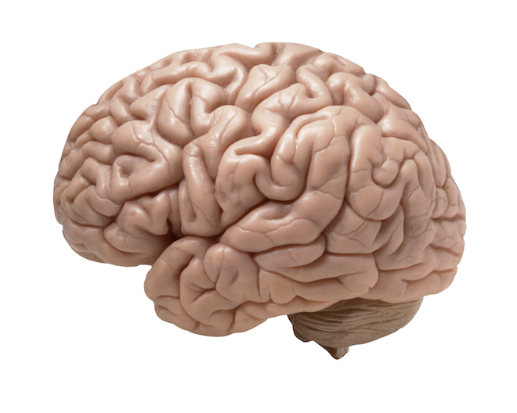
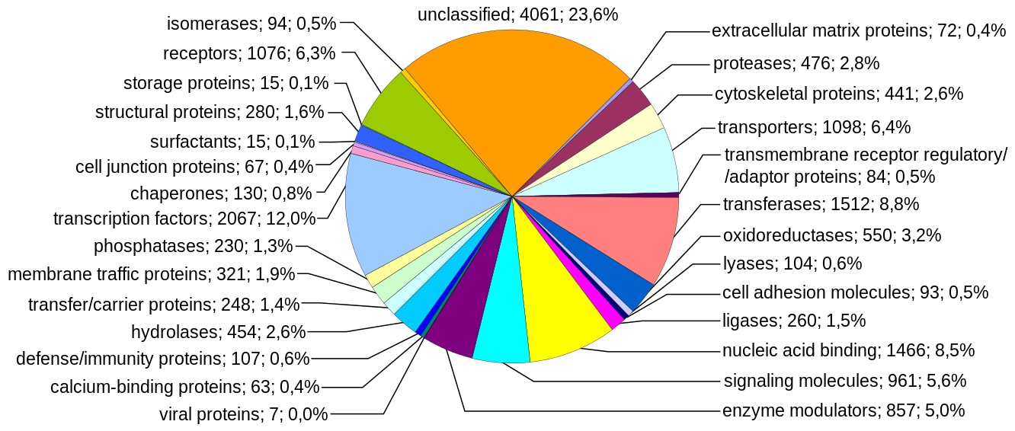
Biologist: “It sure looks to me like there is a universal neural network to me.”

Slide 19
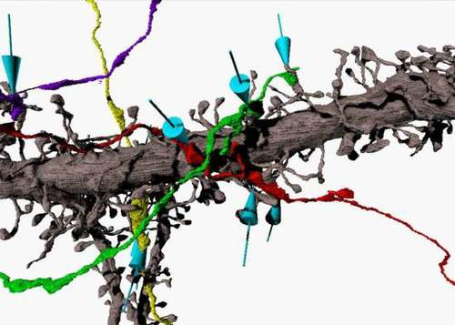
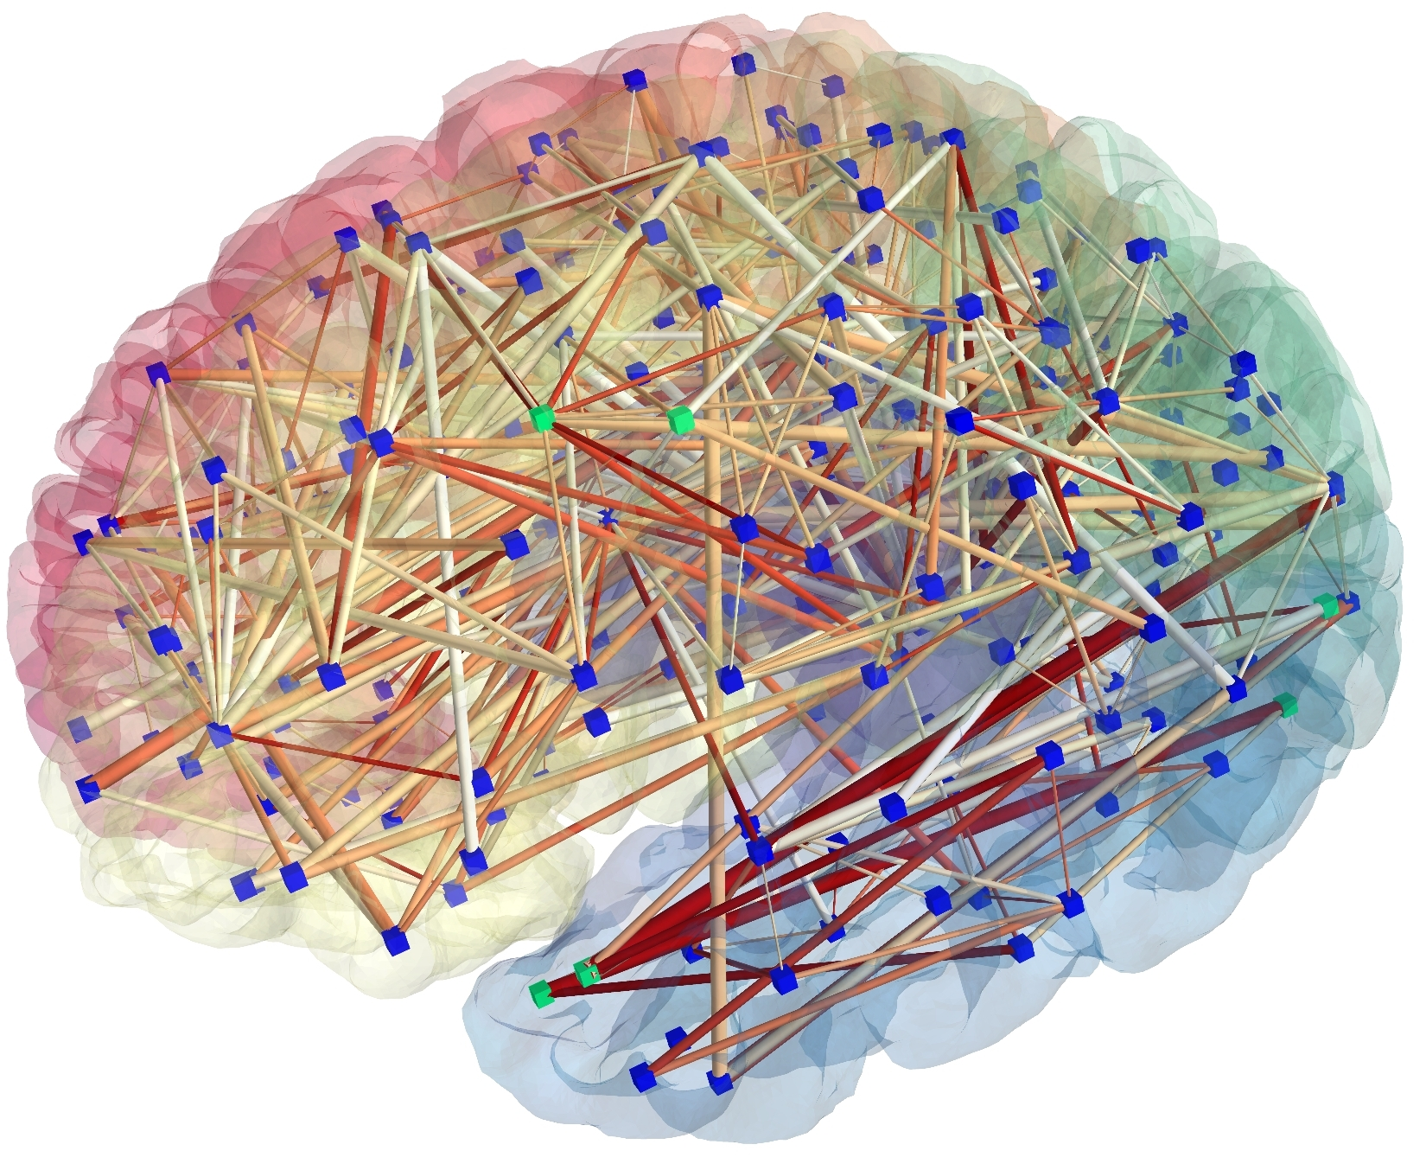
Domain Knowledge in the Brain
Brains / biology encode domain knowledge in…
large scale connectomics
replicated microcircuits
properties of receptors / synapses
effectors / sensors
environment and culture
How… we don’t know yet.

Slide 20
Nature has had a billion years.
You have to be smart.

Slide 21
rest of today
traditional computer vision
… and why DL is beating it
computer science view
pattern recognition view
signal processing view
decision theoretic view
There are more: Bayesian, game theoretic, ...

Slide 22
COMPUTER VISION VIEW

Slide 23
Computer Vision (Traditional)
What is a specularity?
Describe the Canny edge detector.
What is a Hough transform?
What is a Bayer pattern?
Notes:
Are you a computer vision guy/gal?

Slide 24
Edge Detection with Canny
Canny, John. "A computational approach to edge detection." IEEE Transactions on pattern analysis and machine intelligence 6 (1986): 679-698. (27000+ citations)
Canny:
assume noisy step edges
construct an edge detector using an optimal linear filter
This is actually a simple neural network...
Notes:
I want to go through a key result in computer vision, which illustrates the computer vision approach and how DL could beat it.

Slide 25
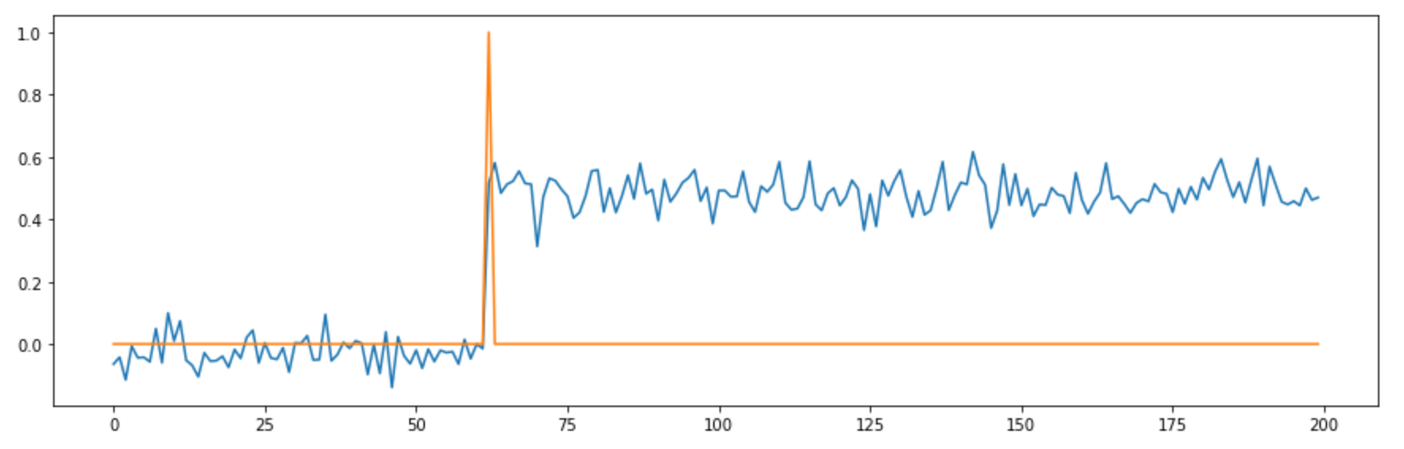
Noisy Step Edge Model
Notes:
Starting point for Canny
Motivated by image statistics

Slide 26
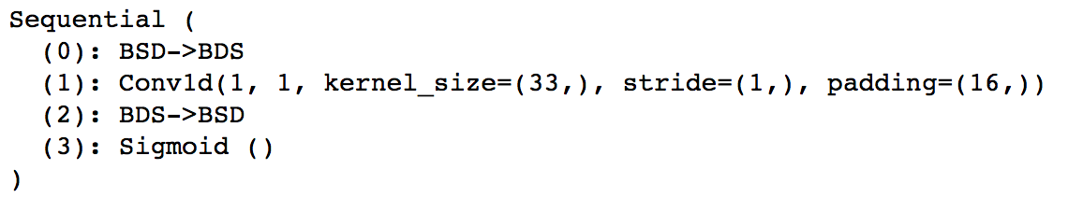
The Canny Model
Cl(1, 33) | Sigmoid()
Notes:
Canny’s model is (roughly) a very simple convnet (here in 1D: 1D is good for understanding things)

Slide 27
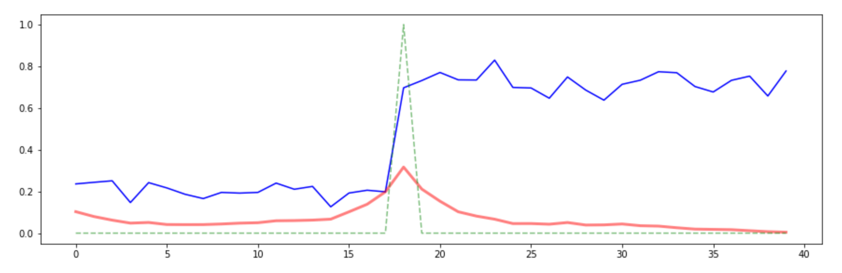
Canny Output
Canny considers different tradeoffs between localization and false alarms.
The peak is in the right place here, but the response is fairly wide.
Note the response due to zero boundary conditions (excluded from loss)
Notes:
We can train this model on simulated data
Converges to this

Slide 28
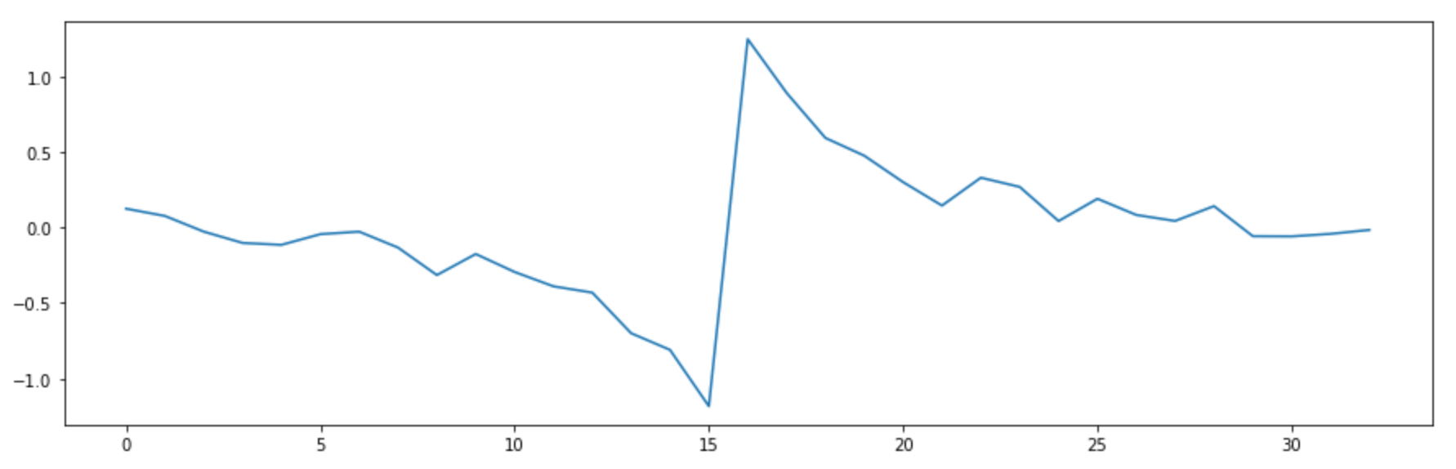
Canny Kernel
Notes:
The “optimal” canny filter

Slide 29
actual Canny edge detector
optimal linear filter
non-maximum suppression
hysteresis thresholding
thinning
sort-of optimal
inspired heuristics
Notes:
Sort-of optimal because extended to 2D
Because assumptions about nature and magnitude of noise
Because...

Slide 30
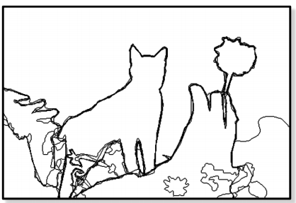
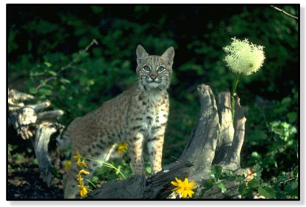
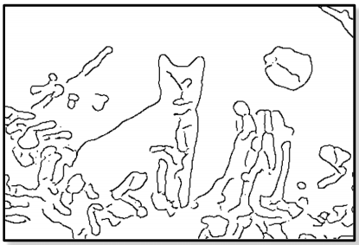
objective:
Canny:
Notes:
This is how it works… and it was a lot better than prior systems

Slide 31
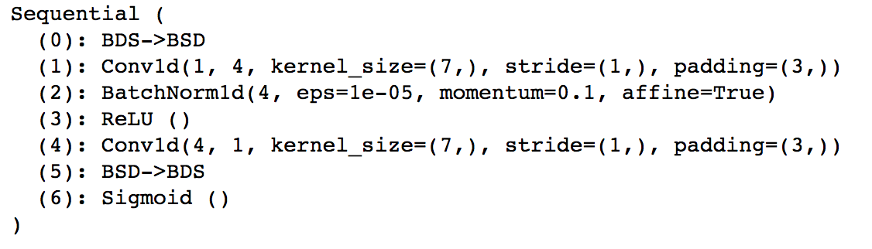
Simple DL Model
Cbr(4, 7) | Cs(1, 7)
Notes:
Let’s train a simple DL model for the same problem

Slide 32
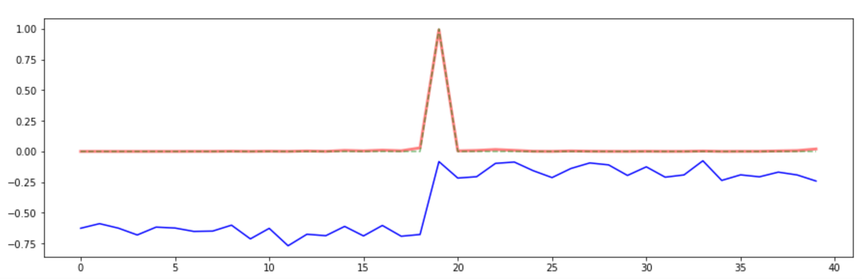
Simple DL Output
Notes:
Perfect results
Why?

Slide 33
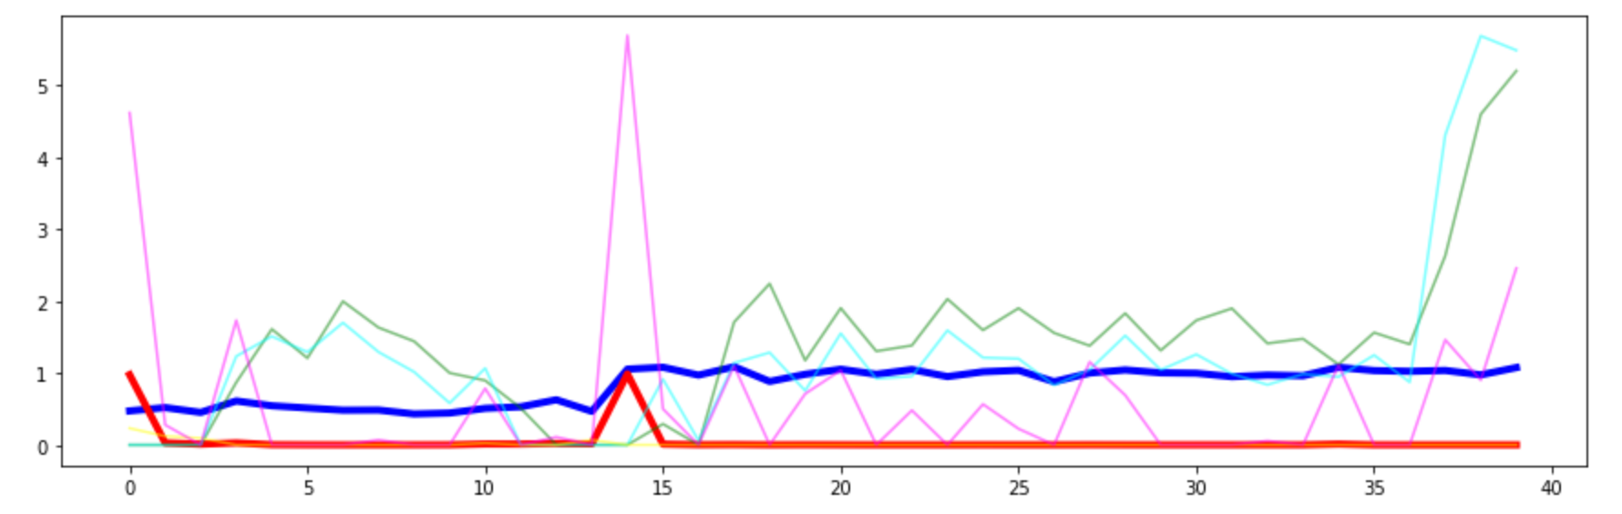
How does it work?
Instead of one filter, train multiple filters, one optimized for localization, the rest optimized for suppression.
Neat trick: Canny could have used it!

Slide 34
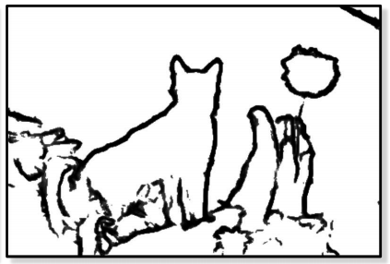
DL Edge Detector
objective:
DL:
http://www.cv-foundation.org/openaccess/content_iccv_2015/papers/Xie_Holistically-Nested_Edge_Detection_ICCV_2015_paper.pdf
Notes:
If you build a 2D edge detector on these principles, results are much better than Canny’s

Slide 35
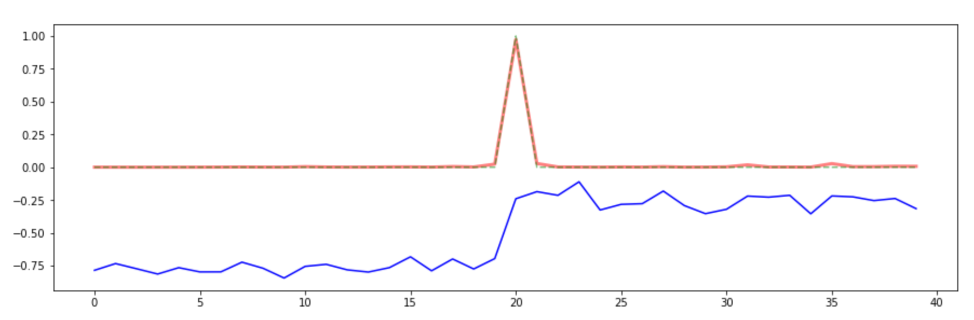
Bad Boundary Conditions
Cbr(16, 7) | Cs(1, 7)
Zero padding on the boundary creates spurious edge responses.
DL can automatically suppress these for you (beware when benchmarking)
How would you pick weights to get rid of such spurious responses?
Notes:
DL even hides bugs from you

Slide 36
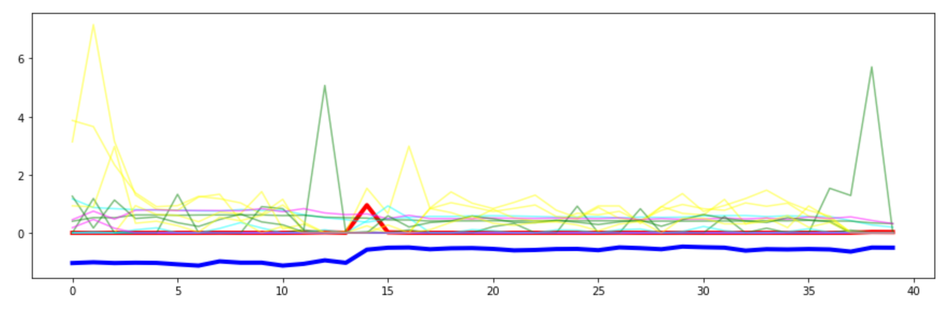
Suppression of Spurious Boundary Responses
DL discovered another neat trick: Instead of a single edge localizer, train two localization filters in the first layer (plus multiple suppression filters again).
Each localization filter is offset from the desired peak by one pixel.
The padding on the second convolutional layer means that the spurious edges on the boundary are only surrounded by one peak.

Slide 37
Lessons from Canny Example
Many old style learning algorithms:
picked a bad model
then found an optimal solution to that bad model
assumption: an optimal linear model is better than a suboptimal nonlinear one
The assumption turned out to be wrong:
Even simple suboptimal nonlinear models outperform optimal models easily.
And… by analyzing deep models carefully, we can get interesting ideas.

Slide 38
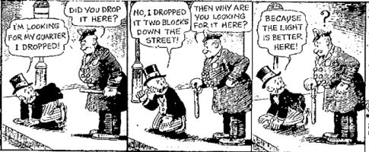
Traditional Machine Learning

Slide 39
COMPUTER SCIENCE VIEW

Slide 40
Computer Science
What is the difference between an NP-complete and an NP-hard problem?
What is computational complexity of matrix multiplication?
Give an example of an uncomputable function.
What is the class of languages recognizable by a pushdown automaton?
Notes:
You are a computer scientist… if you ask yourself whether tinker toys or quantum systems are Turing equivalent.

Slide 41
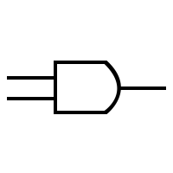

Linear Threshold Units = Logic Gates
x
x
x ∧ y
x + y > 1
x ∧ y
y
y
x
x
x ∨ y
x + y < 1
x ∨ y
y
y

Slide 42
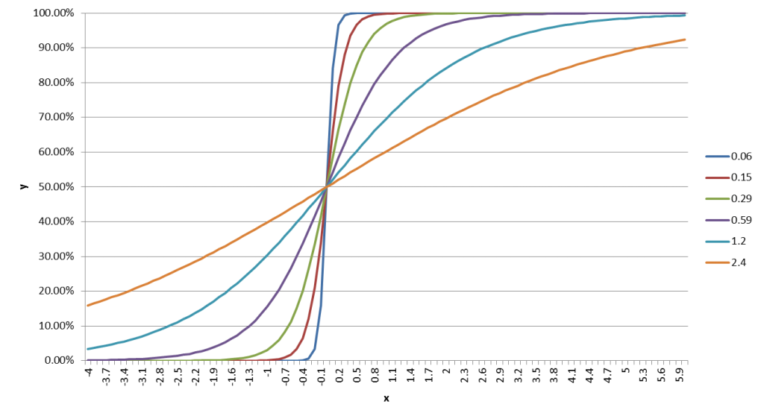


sigmoidal units converge to linear threshold units

Slide 43
neural networks as boolean circuits
Any boolean circuit has a neural network equivalent.
Any boolean formula has a neural network equivalent.
Question: does every neural network have a boolean circuit equivalent?

Slide 44
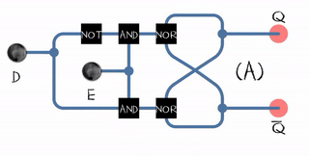
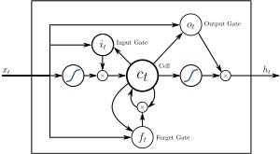
neural networks as boolean circuits
approach:
start with an algorithm or boolean circuit
binary → real, and → multiply, or → add+sigmoid
examples:
perceptrons → deep learning
one bit storage device → LSTM
Turing machine → neural Turing machine
Images: Wikipedia
Notes:
this equivalence actually gives us a good approach for designing new neural networks:
Start with a boolean circuit that roughly does what you want
Replace logic units with sigmoidal units
Sprinkle input features for automatic decision making
Train with supervision from the real system, with reinforcement learning, with training data

Slide 45
neural networks as boolean circuits
Computer science has powerful results for boolean circuits:
boolean circuit complexity
learnability of boolean functions
Do they apply to neural networks / DL networks?
generally yes (finite precision, noise robustness)
there are exceptions (e.g., LSTMs using internal counters)
but even in CS, those results are sometimes weaker than believed
Notes:
Remember how Canny’s “optimal linear filter” was far from an optimal solution?
Implicit assumptions like that also mean that an “intractable problem” may not be intractable in practice.
For many intractable problems, you are also only trying to be better than the next guy, not compete with optimal.

Slide 46
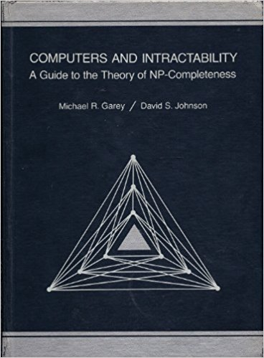
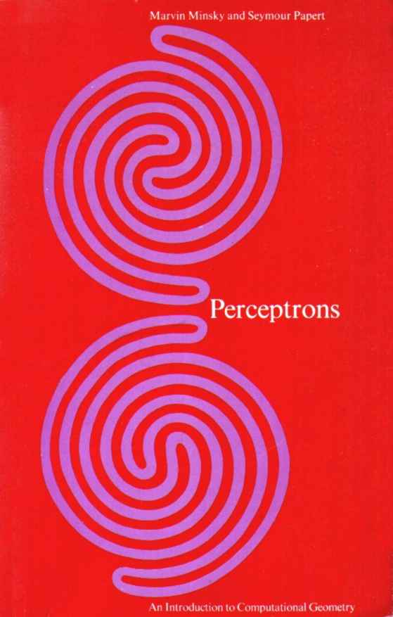
complexity
Notes:
Two key books on complexity.
First one, NP completeness and its (supposed) implications
Second one killed neural networks and deep learning (unintentionally!) in the 1960’s due to a valid (and still important) complexity argument.

Slide 47
reasoning about complexity results
is in AC0 | useful: it’s easy to compute
NP-hard | might still be easy in most cases
NP-hard, no good approximation | might still be easy in many cases
requires average circuit depth O(n) | probably a purely sequential problem
not in AC0 | can’t be solved well by common layer types
exponential worst case | might still be easy in most cases
PAC learnable | good indication that it might be learnable by DL system
not PAC learnable | suggestive that it might be hard to learn in practice, not proof
uncomputable | difficult to say (might still be learnable)
Perceptron analysis | pay attention
Notes:
Here’s a list of complexity results and their implications for DL

Slide 48
Turing universality … and its risks
Most recurrent neural networks are Turing universal (i.e., a universal computer).
Proof: by reduction to Rule 110 or directly to Turing Machine
Caveat: for fixed size and fixed precision, they are, of course finite state machines.
What does this imply?
some of their properties are uncomputable
they can compute functions that cannot be learned
(surprisingly, they can sometimes also learn functions that cannot be computed)
Question: what does it imply about the “neural Turing machine”?

Slide 49
How does complexity show up in DL?
Example:
You pick a boolean satisfiability problem.
You write down an equivalent neural network but use sigmoids and scalable weights.
You try to solve the problem by SGD.
Why doesn’t this get around the NP-hardness of satisfiabilty?
Answer:
Computational complexity problems turn into exponential numbers of local minima.
Notes:
It’s easy to see how complexity shows up in algorithms: their loops run for more and more iterations.
How does complexity show up in DL systems? What does it mean for a problem to be “NP hard” when you use SGD and/or recurrent nets?

Slide 50
summary: complexity results
Complexity results are tricky: the are often misinterpreted (“NP-hard = intractable”) but also often not paid enough attention to (“not in AC0”, average case).
Complexity results can give us useful insights into the structure of a problem.
Complexity issues often show up as large numbers of local minima (learning) or simply bad results (inference).
Attempted workarounds (graduate non-convexity, algebraic continuation, annealing, etc.) don’t solve the problem, but may result in good approximation algorithms.

Slide 51
DL as a computational tool
We can use DL as a computational tool, without any data.
Example:
want to invert a function f(x) over some domain Ω
sample x∈Ω according to an interest distribution
compute y = f(x) for each sample
train a DL model g using y as input and x as output

Slide 52
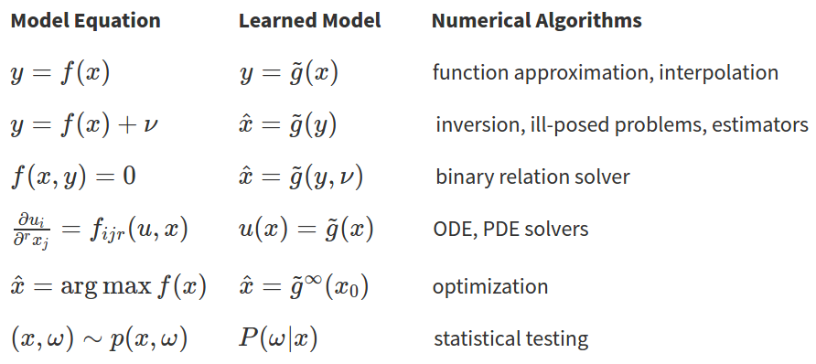
Notes:
We don’t have the time to discuss these in details, but the point is that
if we have a good function approximator (like deep learning),
then we can replace many “traditional” numerical algorithms with training the right kind of function approximator, even in the complete absence of training data.
let’s look at a simple example of this....

Slide 53
PATTERN RECOGNITION VIEW

Slide 54
Pattern Recognition (and Old Style ML)
What form do discriminant functions take for normal class conditional densities?
What is the purpose of the PCA transform?
Give a commonly used fast approximate algorithm for nearest neighbor lookup.
What is the bias/variance tradeoff?

Slide 55
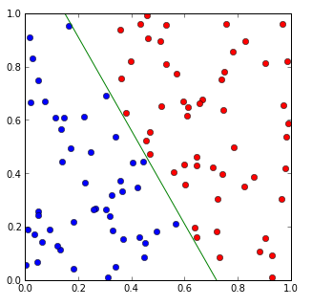
fully connected layers
I assume this has been covered at length:
linear classifiers
logistic regressors

Slide 56
What are neural network layers like?
PCA?
ICA?
fully connected layer =
VQ?
sparse coding?
plain old features?

Slide 57
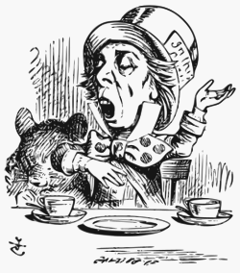
Why is a raven like a writing desk?
Notes:
you might rather feel like Alice in Wonderland… or you may think you have the answer

Slide 58
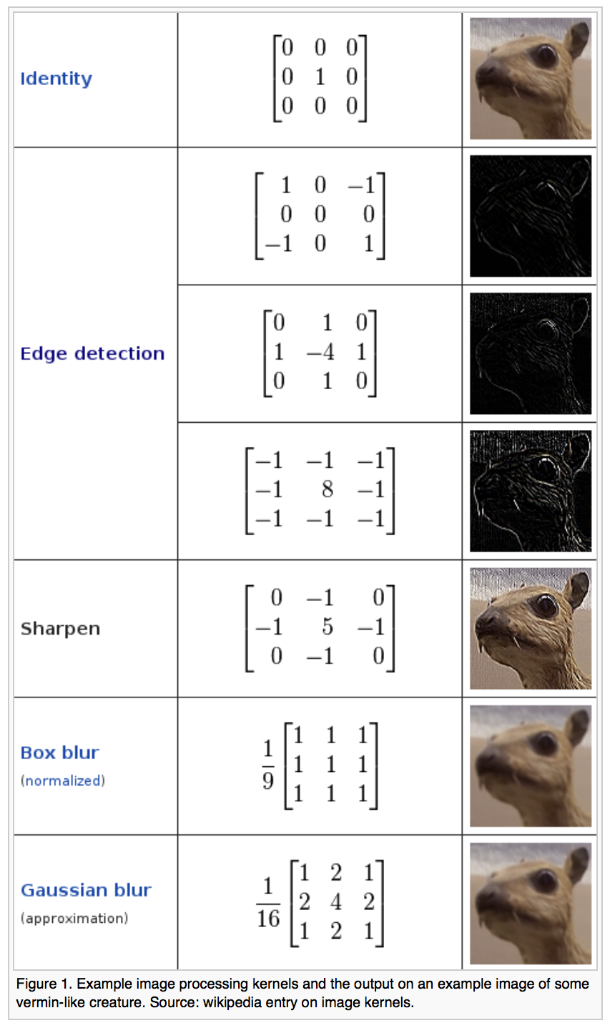
plain old features
Convolutional layers can implement common features extractors.
Reasoning: “If it’s useful for solving the problem and our optimization algorithm works well enough, then the neural network will produce these where necessary.”
Notes:
common and useful reasoning
Also applies to connecting two linear layers
But can fail in subtle ways, and not just to local minima

Slide 59
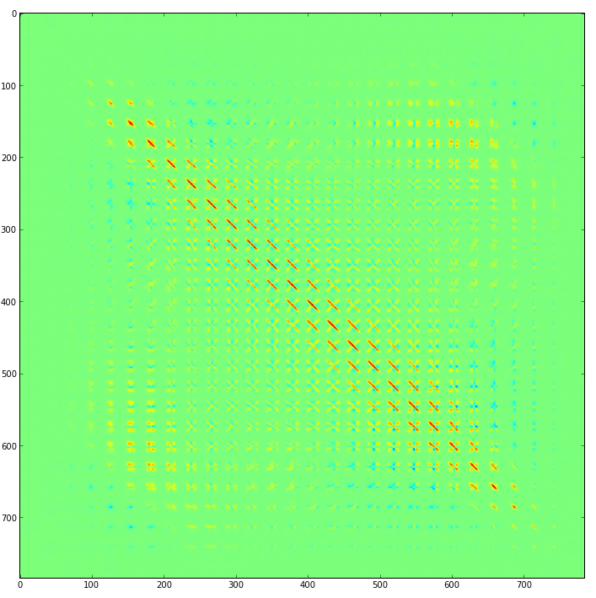
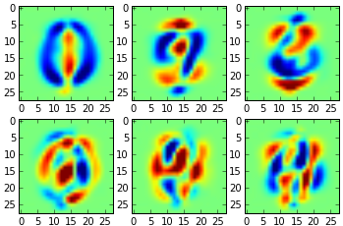
PCA
PCA is a linear decomposition of an input signal, a form of dimensionality reduction:
best linear approximation to the data
separates signal from noise (why?)
tends to make the data Gaussian (why?)
Implementation:
linear autoencoder or autoencoder in lin. regime
1000 dim → Fl(20) | Fl(1000) → 1000 dim
Question: what’s the difference between PCA and a linear autoencoder?

Slide 60
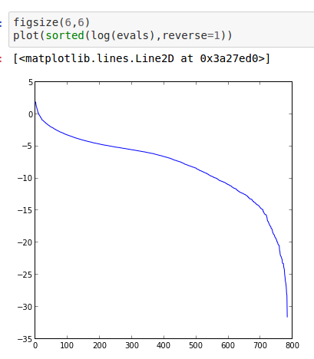
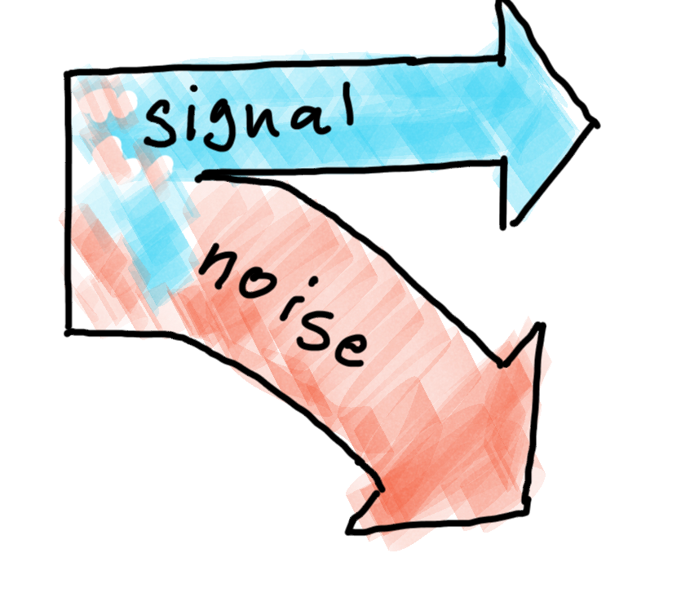
PCA and information flow
PCA can be viewed as a simple way of separating signal from noise.
We assume that the signal has a much higher variance than the noise.
Cutting off the directions corresponding to small eigenvalues then removes the noise and little of the signal.
Notes:
Reasoning about information flow is common also in neural systems.
PCA illustrates how to partition information (in this case, based on magnitude of eigenvalues)
Time scale is another common way of partitioning: fast changing vs slow changing data

Slide 61
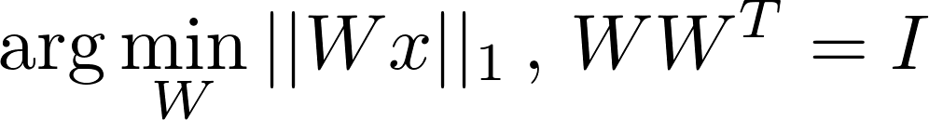
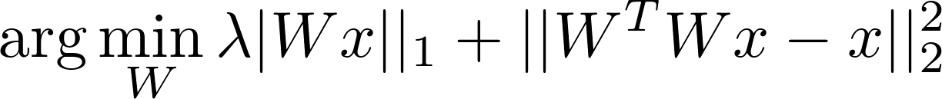
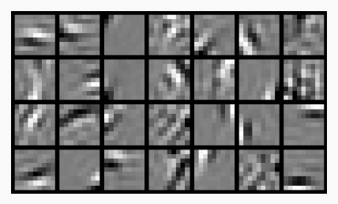
ICA (Independent Component Analysis)
a linear decomposition, like PCA
identifies non-Gaussian components
maximizes the entropy of the decomposition
can separate independent sources
RICA ≈ sparse autoencoder in linear regime
Shape(1000) | Fl(20) | Fl(1000) + L1 loss
Shape(1000) | Fs(20) | Fs(1000) + L1 loss
small weights
input should be ZCA “whitened”
Notes:
ICA is a linear decomposition just like PCA
Justification and goals are quite different
Which one is right?
Which one do you get with nnets?

Slide 62
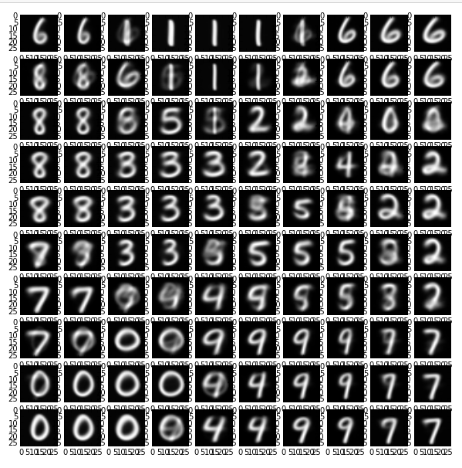
k-means vs ICA
k-means can be viewed as a special case of ICA:
require exactly one component
reconstruction weight = 1
input vectors are normalized
(or augmented with norm)
Vinnikov, Alon, and Shai Shalev-Shwartz. "K-means recovers ICA filters when independent components are sparse." International Conference on Machine Learning. 2014.
Notes:
K-means is perhaps the most intuitive of the different methods.
It’s closely related to ICA
when some technical conditions are met, this is what your input layer may give you

Slide 63
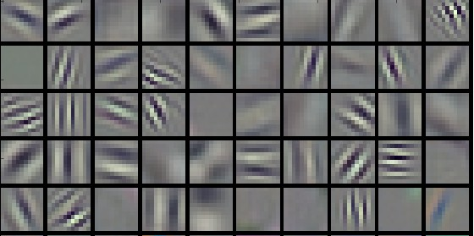
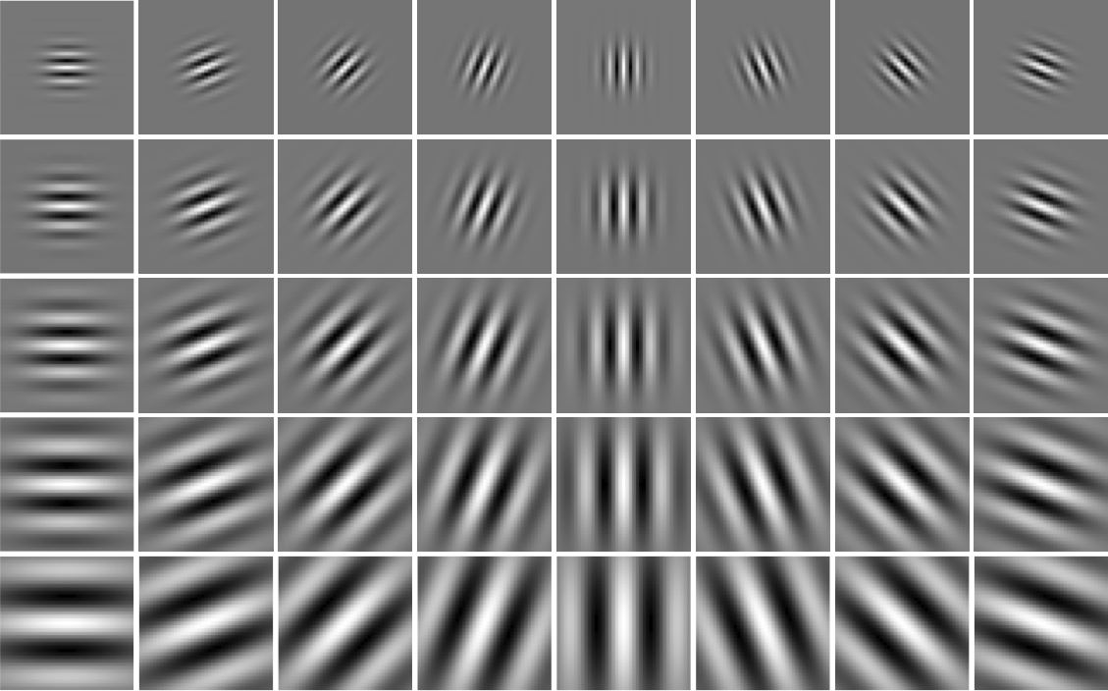
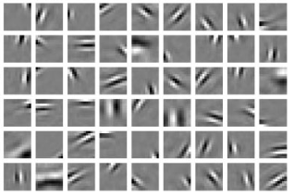
filter banks and image statistics
AlexNet input features look like a mix of DCT / PCA / ICA
No coincidence:
image statistics
mutual information
NB: these are convolutional and max-pool variants
AlexNet
Gabor Features
sparse linear decomposition
Simoncelli, Eero P., and Bruno A. Olshausen. "Natural image statistics and neural representation." Annual review of neuroscience 24.1 (2001): 1193-1216.
Notes:
Here’s another illustration of DCT, PCA, ICA, etc. have recognizable forms
Someone with pattern recognition knows image statistics well enough to tell you what a layer actually learnedthis point

Slide 64
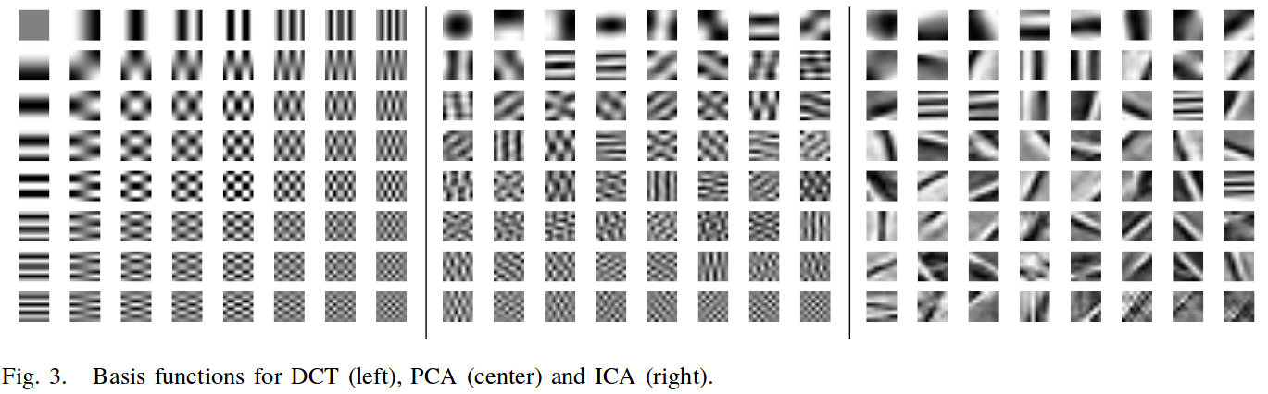
DCT, PCA, ICA
Vasconcelos, Manuela, and Nuno Vasconcelos. "Natural image statistics and low-complexity feature selection." IEEE Transactions on Pattern Analysis and Machine Intelligence 31.2 (2009): 228-244.
Notes:
Here is another illustration

Slide 65
a neural network layer...
A neural network layer is like all of the above: PCA, ICA, VQ (and more)
Which of these decompositions happens depends on:
loss function (often: mutual information or entropy maximization)
input distribution (normalize, whitened, …)
weight magnitude (weight penalties)
stride and pooling (for convolutional layers)

Slide 66
Why is a raven like a writing desk?
Because it can produce a few notes, though they are very flat; and it is NEVAR put with the wrong end in front!
Because Poe wrote on both.
Because both have inky quills.
I have no idea!
Notes:
The answer you get may not be the answer you want.
DL design is still a bit of an art, rather than a science, even if it uses science.

Slide 67
SIGNAL PROCESSING VIEW
Notes:
Another common view (and really important among NVIDIA engineers, MIT graduates, and traditional computer vision people) is signal and image processing

Slide 68
Signal and Image Processing
What does an anti-aliasing filter do in the frequency domain?
What is an impulse response?
What is the complexity of convolution when using the FFT?
What is a morphological closing?

Slide 69
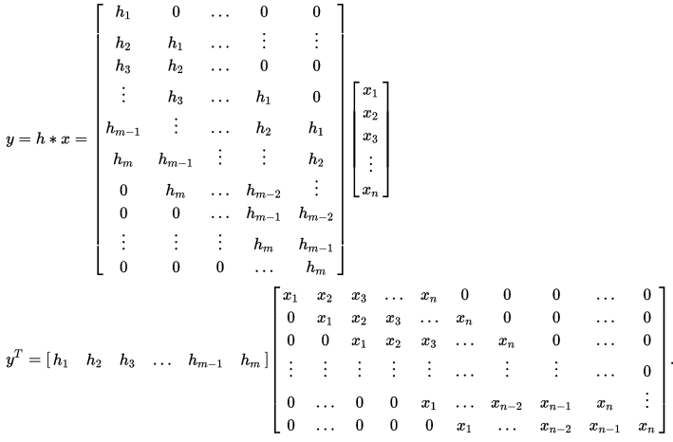
convolutions
convolutions are linear operations on the input
convolutional layers are just a special case of a fully connected layer
parameter tying
a special matrix structure
(Toeplitz matrix)

Slide 70
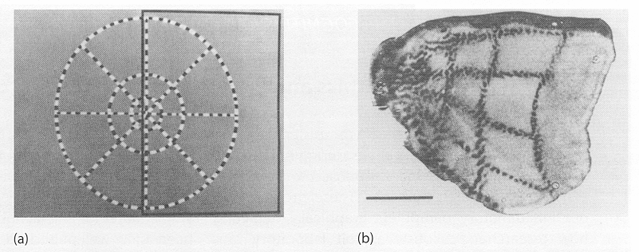
convolutional layers from data
fully connected layers can learn the Toeplitz structure from data:
train on translation invariant (or translation augmented data)
this is the underlying mechanism of retinotopic mappings and feature map construction in brains
note that retinas have non-uniform resolutions → uniform convolutions wouldn’t work anyway
Notes:
Convolutional layers can “form automatically” from fully connected layers given the right inputs

Slide 71
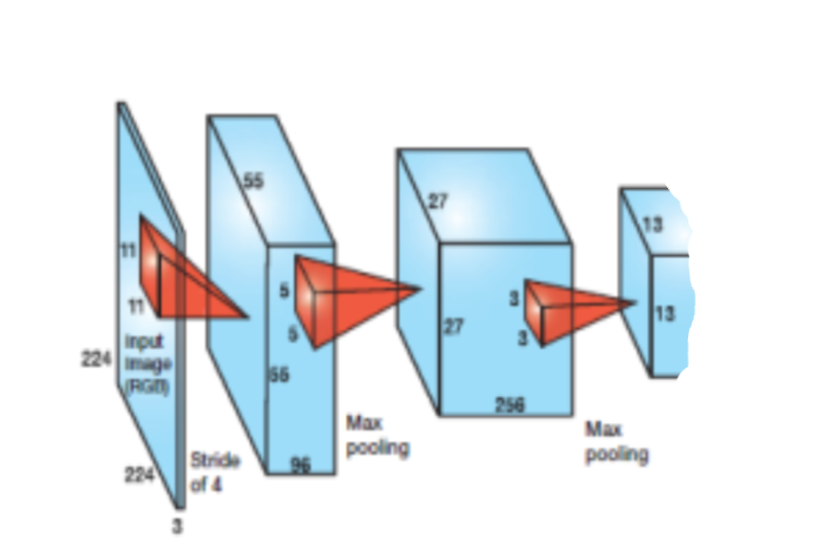
reasoning about footprint
given a stack of convolutional layers, pixels in the output (potentially) depend only a subset of the pixels of the input
this is the “footprint”
is the footprint large enough to solve your problem?
Notes:
Footprint is an important concepts for filters:
it is necessary (but not sufficient) for all the information necessary to make a decision to be available within the footprint of a filter

Slide 72
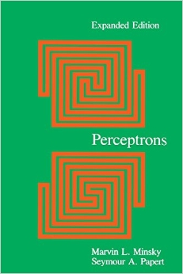
reasoning about footprint (multiple layers)
one of these figures is connected, the other is not
can a deep convolutional network solve this problem?
how would you reason this out?
(a classic problem in complexity of neural networks)
Notes:
the Perceptrons book essentially argued that connectedness requires a global footprint
but if you train a fully connected network, you need too many training samples
their conclusion: you need to adjust your architecture
The community’s conclusion: “this stuff can never work”

Slide 73


A Mystery
With careful training, max pooling can be replaced by convolutions with stride.
That’s because for known distributions, linear filters + nonlinearities can approximate common non-linear filters.
Question: Is it worth it?
Springenberg, Jost Tobias, et al. "Striving for simplicity: The all convolutional net." arXiv preprint arXiv:1412.6806 (2014).
Notes:
Everybody uses max pooling, yet one of the top CIFAR networks gets away completely without it
How does that work?
What conditions might be sufficient (and/or necessary)?

Slide 74


convolutional layers can implement nonlinear filters
standard nonlinear filters
median
percentile
morphology
main insight:
convolutional layers cannot implement such filters in general
but: for a given input distribution, they often can give good approximations
batch norm may force the distribution sufficiently
NB: layers like max-pooling implement standard non-linear filters directly
Notes:
Under certain conditions, linear filters followed by non-linearities can approximate traditional nonlinear filters well
Condition: known data distribution, combining multiple linear filters

Slide 75
DECISION THEORETIC VIEW
Notes:
Finally, an important point of view that you probably have covered but is still worth revisiting because it’s sutble

Slide 76
Decision Theory
What is a decision-theoretic loss function (as opposed to a DL loss function)?
How does Bayesian parameter estimation differ from ML parameter estimation?
How are HMMs related to graphical models?
What is an inadmissible decision procedure?

Slide 77
DL system as black box
data or probabilities
Deep Learning System
probabilities

Slide 78

risk = expected loss

Slide 79



example: self-driving car
probability estimates from neural network
P(pedestrian|image) = 0.77
pedestrian dies: $25M
P(car|image) = 0.95
P(tree|image) = 0.98
property damage: $500k
driver dies: $50M
Notes:
if you think it’s callous to assign costs to these outcomes…
decision theory tells you that any decision rule you choose amounts to a choice of costs
isn’t it better to make it explicit?
most safety systems are based on such decision theoretic reasoning and cost assignments, including transportation infrastructure and medical decision making

Slide 80

example: biased training set
Notes:
Here’s another example of reasoning about DL systems as decision theoretic black boxes
Rebalancing the training set changes the bias-variance tradeoffs for the classifier

Slide 81

example: biased training set

Slide 82
example: language modeling
speech recognizer
OCR engine
statistical language model
posterior probabilities
Notes:
Posterior probabilities and decision theory is also used extensively in hybrid systems
Here, a DL speech recognizer and/or OCR engine yields posterior probabilities that are then handled by a “classical” statistical language model

Slide 83


Bayesian decision theory
Deep Model
Bayes formula
Notes:
probably skip these

Slide 84


Bayesian neural networks
Deep Model

Slide 85

Could only scratch the surface here.
Recommendation: read Berger.
It’s not just for “weird neural network architectures”.

Slide 86
Conclusions

Slide 87
You need to wear many hats.

Slide 88

Notes:
I’m the Mad Hatter (all the best people are mad!).
Please don’t be like the Red Queen

