Slide 1
Robust, Simple Page Segmentation using Hybrid Convolutional MDLSTM Networks
Thomas Breuel
NVIDIA Research

Slide 2
Single Step Deep Learning Layout Analysis
simple deep learning approach
convolutional layers + MDLSTM layers
trainable, adapts to document databases
simultaneously performs: text/image segmentation, border noise removal, text/math segmentation, text line detection
robust to noise
can be applied directly to grayscale, photographic images
runs on GPU (1 sec / page)
comparable performance to existing layout analysis systems using just 1600 training pages

Slide 3
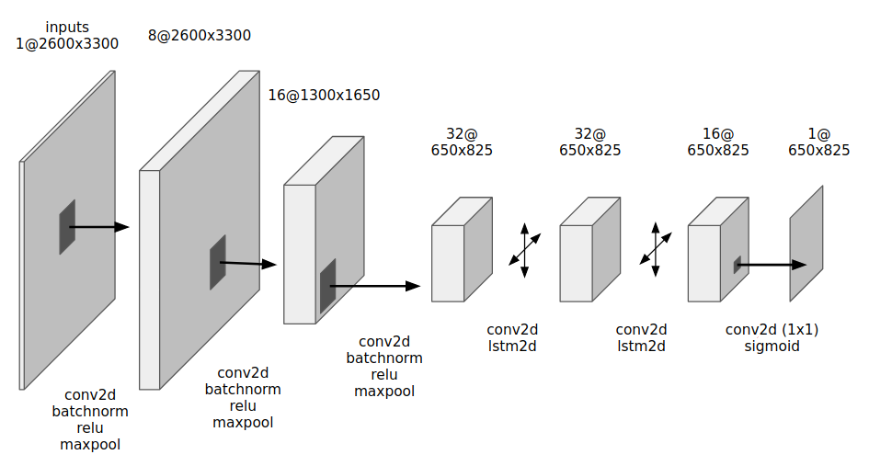
Deep Learning Architecture for Layout Analysis

Slide 4
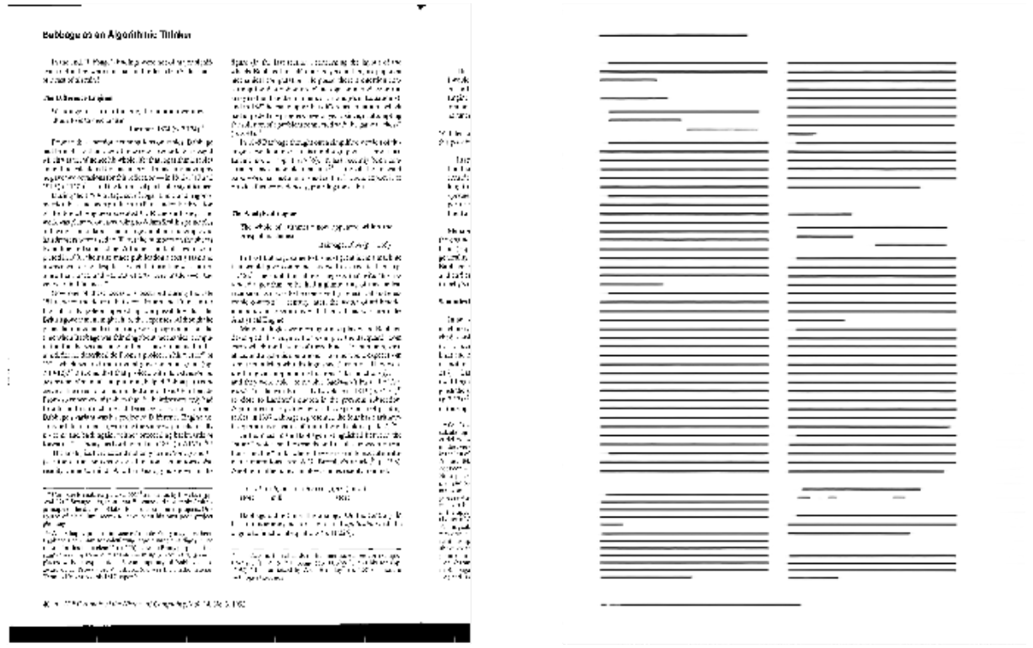
Single Step Border Removal, Multicolumn Textline Finding

Slide 5
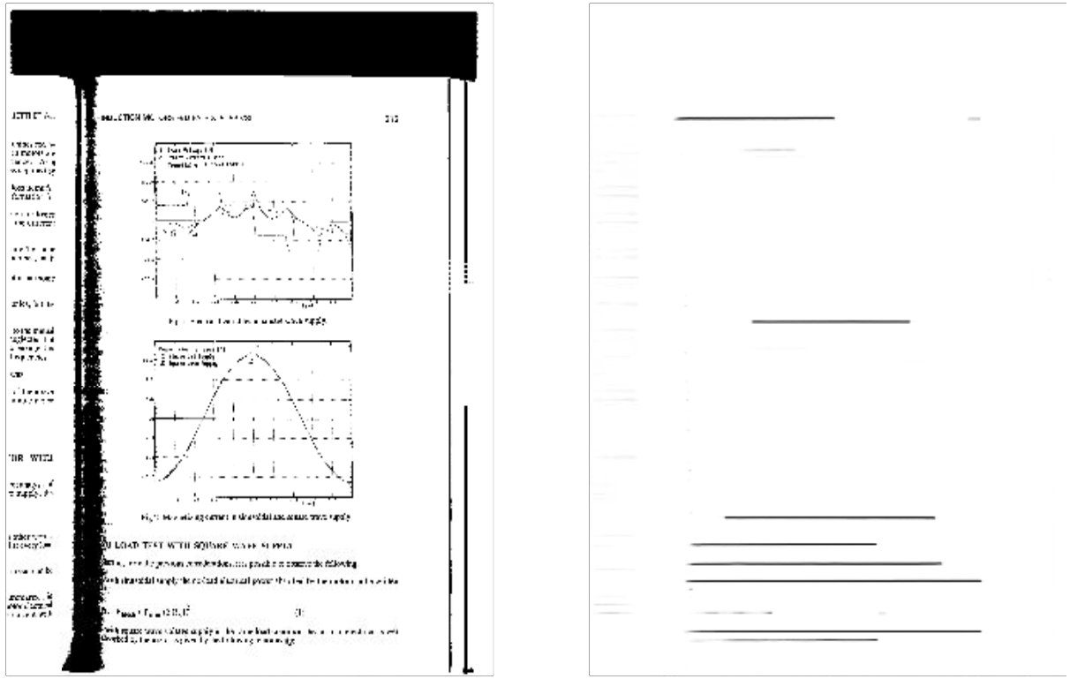
Single Step Border Removal, Math Removal, Figure Removal, Text Line Detection

Slide 6
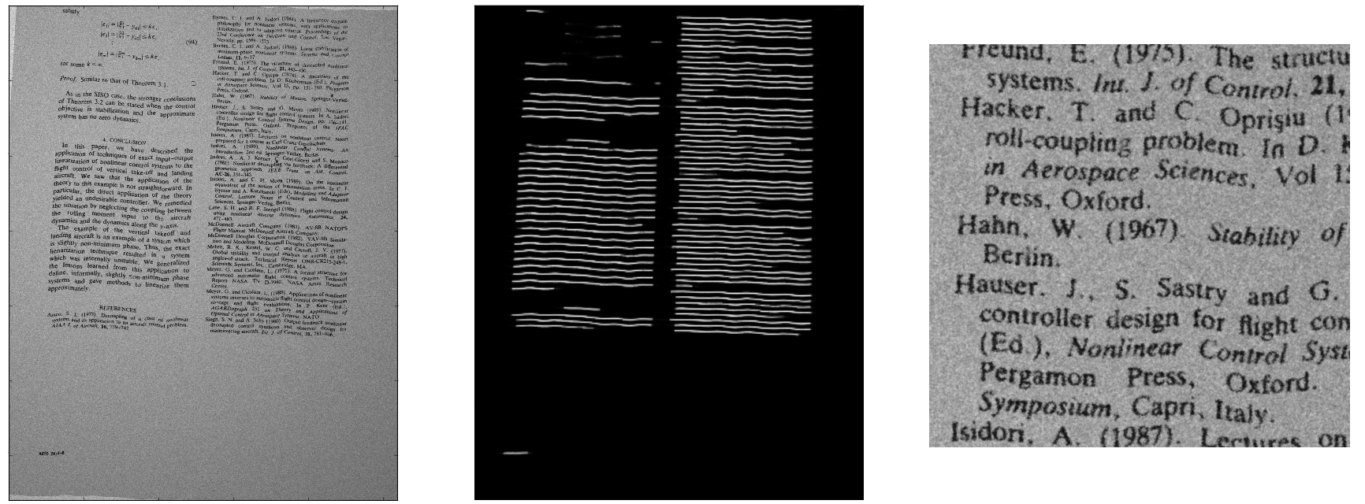
Direct Application to Grayscale Input

Slide 7
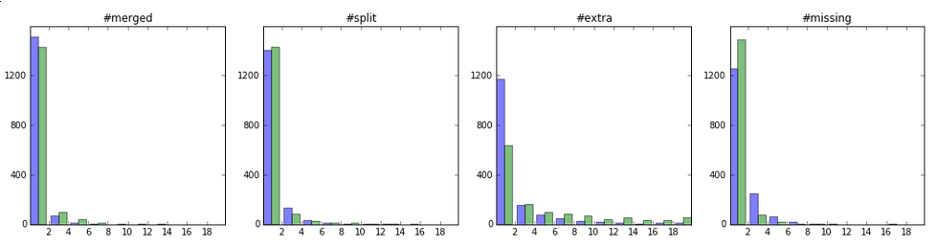
Deep Segmenter vs Tab Segmenter
The Deep Segmenter performs comparable to, or slightly better than, the Tab Segmenter.
Results on page frame only (border noise removed).

Slide 8
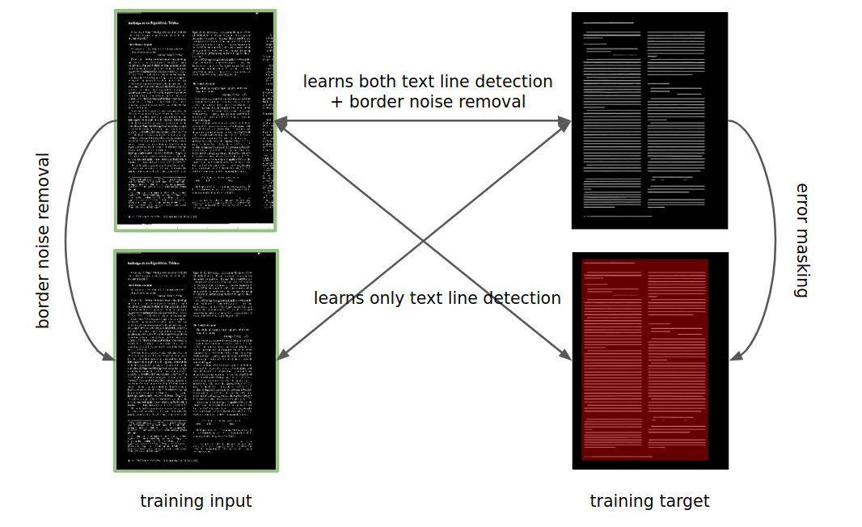
Ground Truth Prep vs Layout Analysis Training

Slide 9
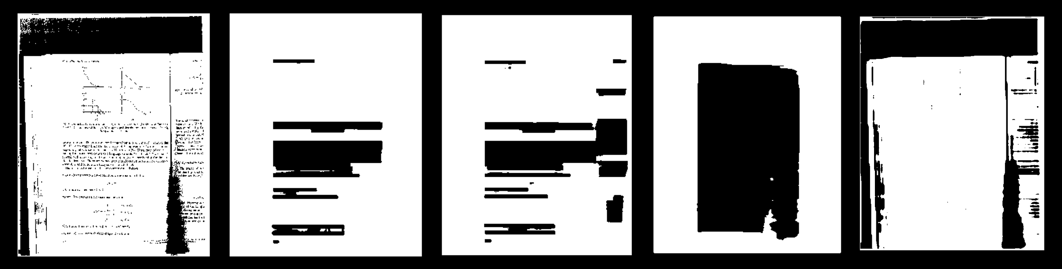
Training for Different Detection Tasks
original page
body text detection
text detection
text frame detection
border noise detection

Slide 10
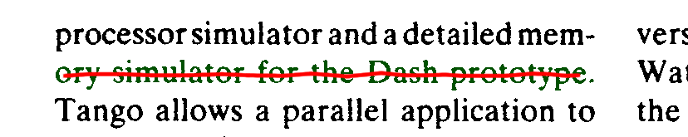
Line Extraction from Text Center Lines
The text center lines identified by the DNN are used as seeds for identifying the connected components belonging to the actual text line.
Each connected component within a halo around the text center line seed is assigned to the closest seed.

Slide 11
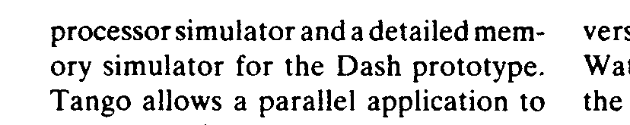

Layout Analysis with Deep Learning
Deep Neural Network computes text line centers from binary or grayscale document image. Images, math, etc. are implicitly removed.
For each identified text line center, all the closest connected components within a halo are assigned to the line.

