Slide 1
High Performance Text Recognition using a Hybrid Convolutional-LSTM Implementation
Thomas Breuel
NVIDIA Research

Slide 2
Question
“Hey, do you know anything about OCR? We need a fast, GPU-based OCR engine.”
Notes:
Just joined NVIDIA a year ago… this was one of the first questions from product groups
OCRopus (the open source OCR I have mainly been working on) and Tesseract both use custom DL libraries and don’t support GPUs well

Slide 3
Goals
Build a fast OCR engine using GPUs
Make it extensible by using standard libraries (PyTorch)
Explore more architectures (convolutional+LSTM hybrids)
100% Deep Learning, data-driven (this is new):
  Eliminate explicit normalization
  Eliminate hand-coded layout analysis (tomorrow)
Notes:
this is one of two papers
in a sense, the second one is more exciting: DL for end-to-end layout analysis
(but it’s also less mature)
we’ll see what “explicit normalization” means

Slide 4
LSTM OCR
Graves, Alex, and Jürgen Schmidhuber. "Offline handwriting recognition with multidimensional recurrent neural networks." Advances in neural information processing systems. 2009.
Breuel, Thomas M., et al. "High-performance OCR for printed English and Fraktur using LSTM networks." Document Analysis and Recognition (ICDAR), 2013 12th International Conference on. IEEE, 2013.
Yousefi, Mohammad Reza, et al. "A comparison of 1D and 2D LSTM architectures for the recognition of handwritten Arabic." DRR. 2015.

Slide 5
Scene Text / Handwriting Recognition
Scene Text / HW is broadly similar, but…
much larger range of distortions and text orientations
generally less strict requirements for error rates
even approximate binarization may be unavailable
HW uses MDLSTM to achieve invariance: does it yield competitive results for OCR?
Notes:
parallel development in DL for text recognition for text in photos, etc.
Scene text recognition methods are applicable to scanned / camera text recognition problems, but haven’t demonstrated competitive error rates so far in that domain.
Ability to generalize more, deal with more noise = less ability to make fine distinctions.
for OCR, performance really matters a great deal

Slide 6
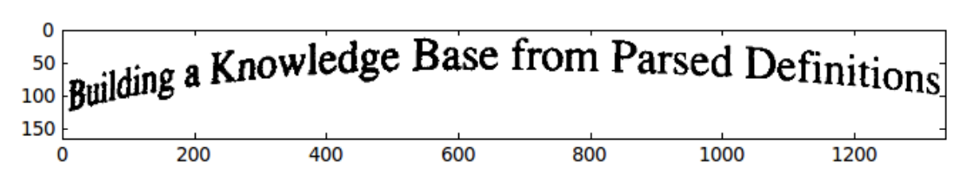
Sequential Recognition and Normalization
OCR Engine Types:
segmentation + character based
left-to-right scanning (HMM, LSTM), segmentation-free
For left-to-right scanning, columns of the image become feature vectors and need to be as invariant as possible.
Notes:
two major approaches to OCR
either try to segment into characters then recognize, or perform segmentation free recognition
segmentation free recognition has won out because segmentation introduces too many errors (too may = 1%)

Slide 7
Context Problem in OCR
Character identity is context dependent (size + position relative to baseline)
Baseline can only determined using long-range dependencies.
Translation invariant feature extraction fails to capture long-range context.
Pop’ vs pOp,
Notes:
biggest source of errors (after layout errors) in OCR systems: context dependence
upper/lower, space-vs-no-space, …
note that there is a complex interdependence between character shapes, positions, and context
that is, finding the baseline and x-height really can depend on the entire line, font style, etc.
size and position estimation also becomes harder when there are characters touching from above and below

Slide 8
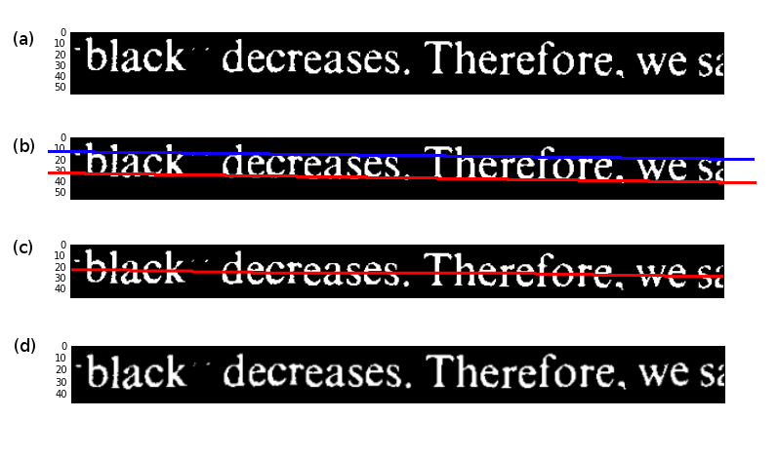
Explicit Normalization
original
baseline + x-height estimation
smooth centerline estimation
approximate normalization
Notes:
how can we deal with this context dependence? we can normalize
we can achieve invariance via explicit normalization
two major types: text line model driven and image driven
text line model drive originally was hard-coded, then based on neural networks
image driven is less accurate but more robust; LSTM can deal with accuracy issues
both methods have undesirable properties:
they generally require operating on connected components
hence they require binarization
they also require at mostly correct line segmentation from above and below

Slide 9
LSTM-based OCR With Explicit Normalization
size and position normalization
conv layers
concat along vertical
1D LSTM

Slide 10
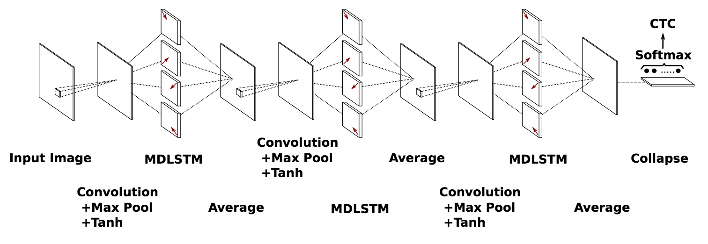
Invariance via Multidimensional LSTM (MDLSTM)
Voigtlaender, Paul, Patrick Doetsch, and Hermann Ney. "Handwriting recognition with large multidimensional long short-term memory recurrent neural networks." Frontiers in Handwriting Recognition (ICFHR), 2016 15th International Conference on. IEEE, 2016.
Notes:
for handwriting recognition, 2D invariance is achieved via 2D LSTMs followed by some kind of reduction operation
here, “collapse” along the vertical dimension

Slide 11
Separable MDLSTM
1D LSTM over rows
1D LSTM over rows
3x3 convolutional layer
transpose
transpose
1D LSTM over reversed rows
1D LSTM over reversed rows
conv layers
Notes:
the original 2D LSTM does not parallelize well, so we usually use a “separable MDLSTM”
this is simply a 3x3 convolution followed by running two BIDI LSTMs, first over rows, then over columns

Slide 12
2D LSTM + 1D LSTM
conv layers
collapse
1D LSTM
Notes:
The MDLSTM layer is capable (in principle) of context modeling and context-dependent feature extraction
This mimicks manual context modeling / dewarping
note that we don’t generate a dewarped version of the image, but instead try to train the model so that the 2D LSTM can output features somewhere along the vertical, which we then pick up during the vertical “collapse“ operation

Slide 13
Brute Force Vertical Invariance
conv layers
collapse
1D LSTM
Notes:
instead of the 2D LSTM, we can also

Slide 14
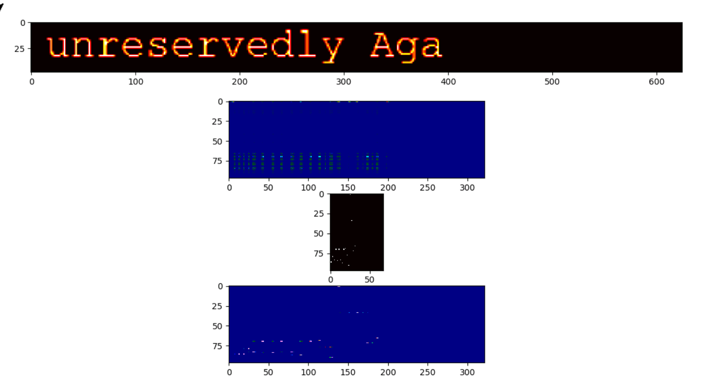
CTC (forward-backward alignment)
posterior probability at each pixel location
one-hot ground truth
CTC-aligned ground truth
Notes:
unlike speech or MT, we’re still using CTC
this is basically like HMM training using EM and the forward backward algorithm
common view of problem with this: it yields marginalized posteriors, not best paths

Slide 15
Dataset
Training and testing on University of Washington Database 3
1600 pages of scanned books, journal articles, etc.
Physical degradation (repeated copying)
About 100000 lines total (fairly small, but good for testing)
9:1 training/test split
http://tmbdev.net/ocrdata-split

Slide 16
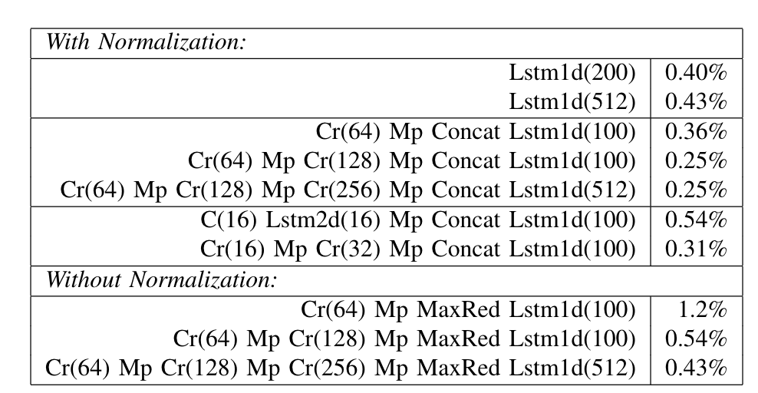
Experimental Results
lastest result
0.17%
Notes:
decoding with simple threshold decoder
no language model
what we see here is:
1D LSTM with normalization reproduces previous results
can run really large models with GPU, but doesn’t help
adding deep convolutional layers helps
need to go easy on the max pooling because we need horizontal resolution
2D LSTM performs worse even in the normalized case, suggesting that it isn’t worth using
unnormalized methods with max reduction get close to original 1D LSTM, but not as good as normalized

Slide 17
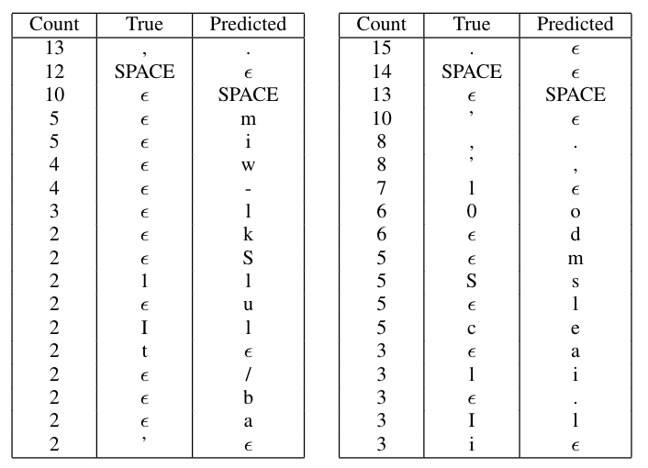
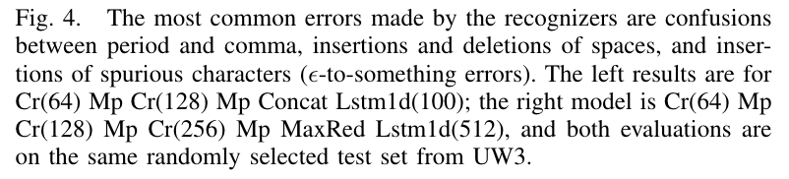
Top Confusions
Confusions due to poor context modeling.
Normalized
Collapsed
Notes:
the collapsed versions have the kind of confusions we expect, namely misrecognition of context-dependent characters
these are actually surprisingly rare, but they occur

Slide 18
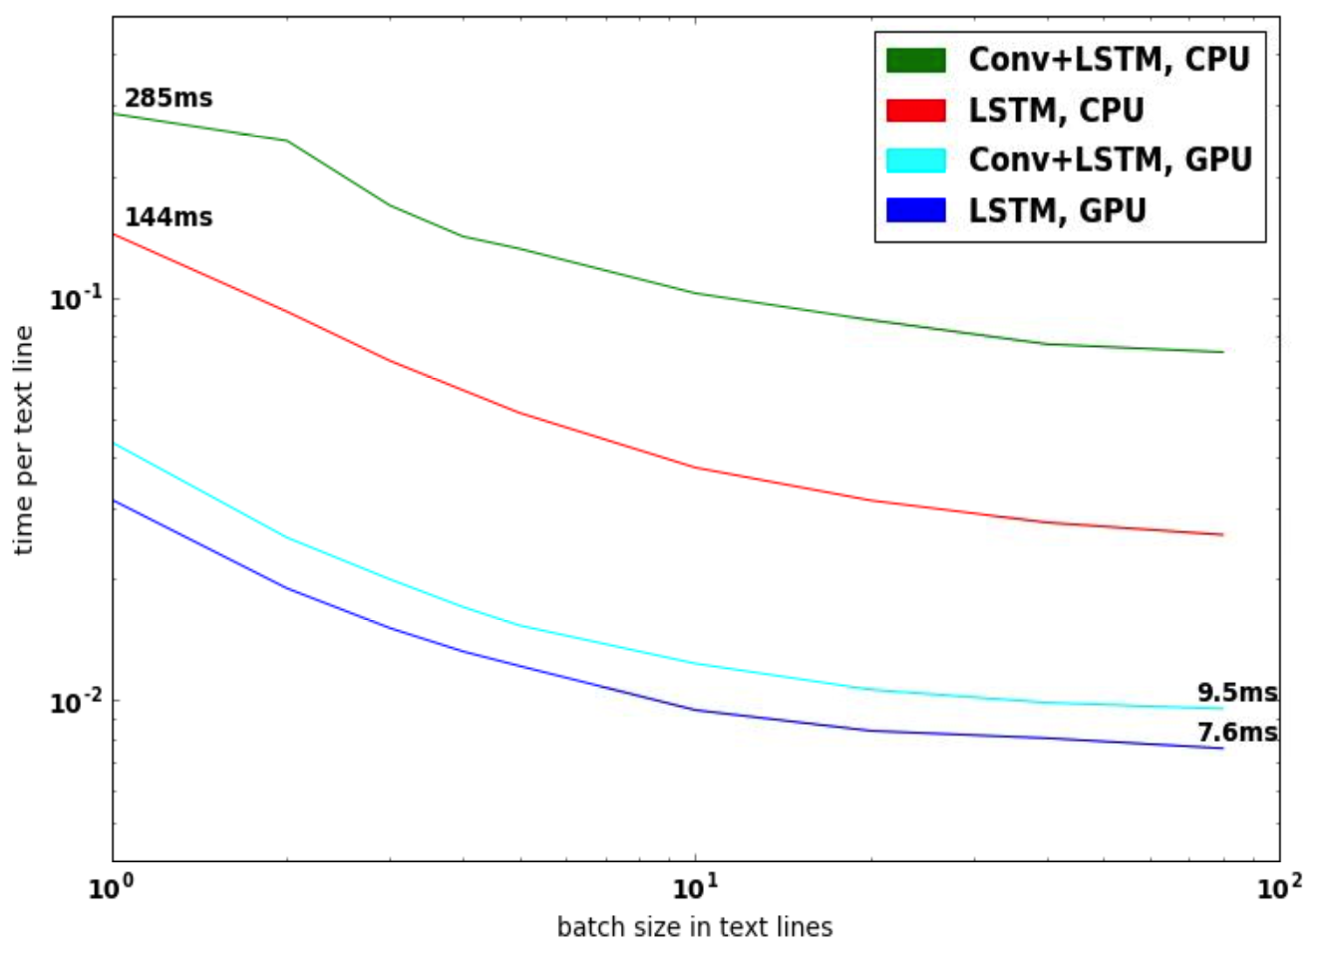
Running Times per Text Line
note log scale
Notes:
using batching and GPUs gives us a 20x speedup over CPU
batching uses line binning so that all text lines in a batch are approximately the same length

Slide 19
Open Source Status
All code written in PyTorch
Official OK for open sourcing, just cleaning it up:
dlinputs: open sharded record file inputs for distributed training
dlmodels: compact network notation with size inference
dltrainers: simple training wrappers
ocropy2: top level OCR drivers
Code on Github under NVLabs and tmbdev
Notes:
open sourcing has gone a little slower than hoped, but pieces are starting to appear on Github

Slide 20
Results
explicit 1D normalization still outperforms MDLSTM
convolutional + max pool + LSTM outperforms just LSTM
can achieve 20x speedups on GPU for LSTM / conv+LSTM

Slide 21
Next Steps
Achieve True End-to-End OCR
eliminate explicit input normalization
eliminate output decoding by thresholding
fully self-training OCR
Possible Approaches
seq2seq methods
attention
recognition lattice generation
Notes:
Problem: performance of current models is already excellent, improvements are hard
Solution: generate large amounts of distorted training data
Solution: need self-training OCR and utilize much larger datasets

Slide 22
Attentional Mechanisms (seq2seq)
conv layers
1D LSTM
Notes:
a simple seq2seq approach eliminates the need for decoding by thresholding: good thing
a more general seq2seq approach with attention would also eliminate the need for normalization by having a variable-sized sliding window

