Slide 2
Outline
Y Data – Housing
US trends
Regional trends
Regional ANOVA
X Data Potential Inputs
Line charts between inputs, X’s and Y’s
Scatterplot (if it makes sense)
Regression analysis on inputs to Y’s
Pandas change year a year over year, and subtracting the mean
Overall messages
Housing prices changes as dependent variable; change over time comparison with inputs and do regression

Slide 3
Housing Prices AGENDA
Objective
Housing Prices Analysis
Evaluation of potential inputs
Overall Summary of Findings

Slide 4
Housing Prices EXECUTIVE SUMMARY
Objective
Identify potential leading or lagging indicators of home prices in the United States
Quantify the significance of the correlation between the input, X, and the housing prices, Y
Source Data
Data imported from FRED – Federal Reserve Bank of St. Louis
Pulled United States average housing prices by Quarter from January 1, 1975 through October 1, 2018
Pulled regional housing prices (Northeast, South, Midwest, West) by Quarter over the same time period
Summary of House Price Analysis
Trend charts for price over time by region
Variance analysis between regions
Calculated percent change Quarter over Quarter
Normalized Data by removing the average change over the entire timespan for each region

Slide 5
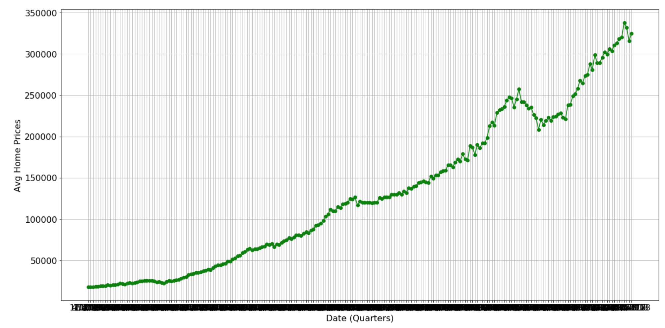
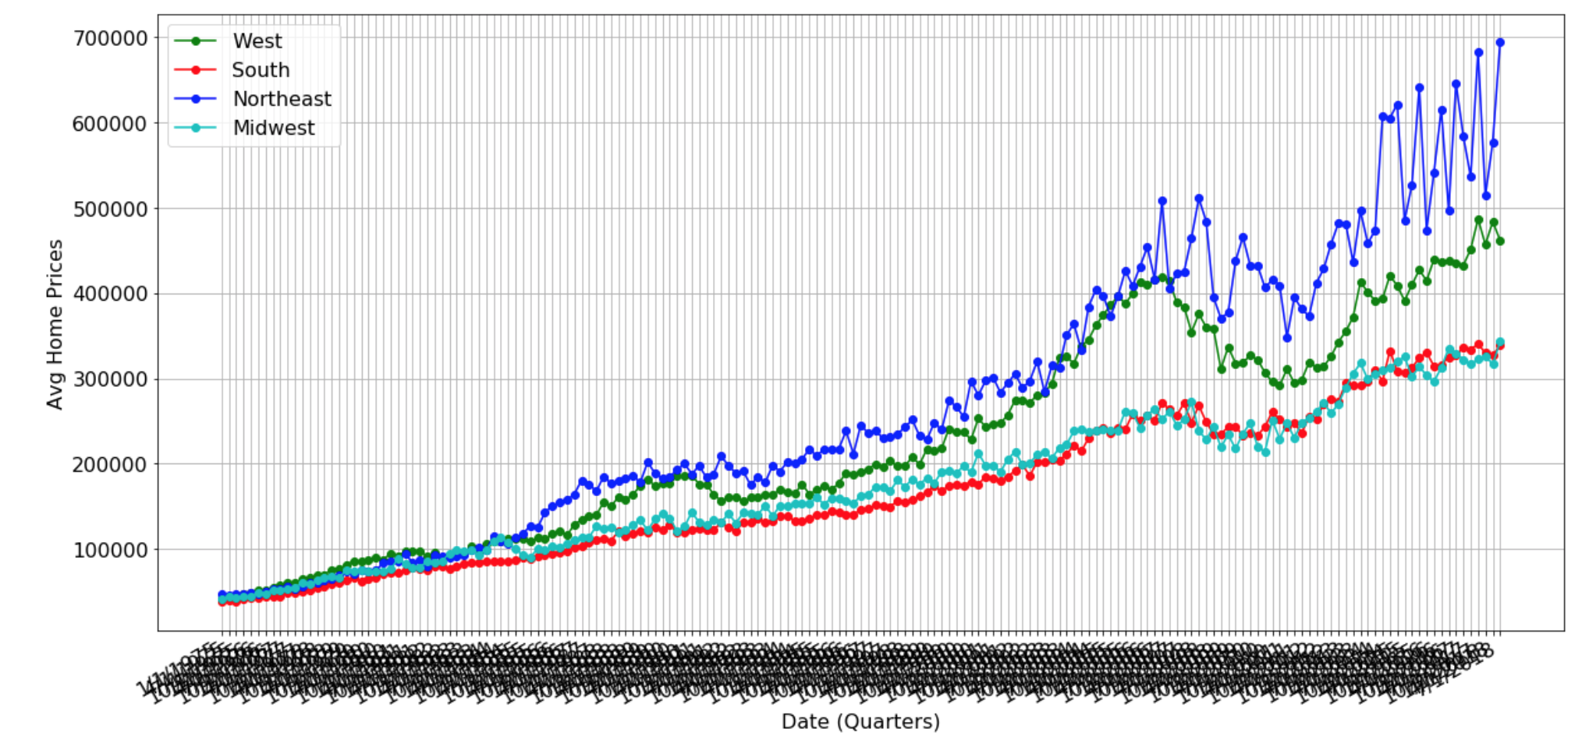
Housing Prices NATIONAL - 40 YEAR TREND

Slide 6
Housing Prices REGIONAL - 40 YEAR TREND
ANOVA statistics indicates a significant difference of variances of at least 1 of the subsets

Slide 7
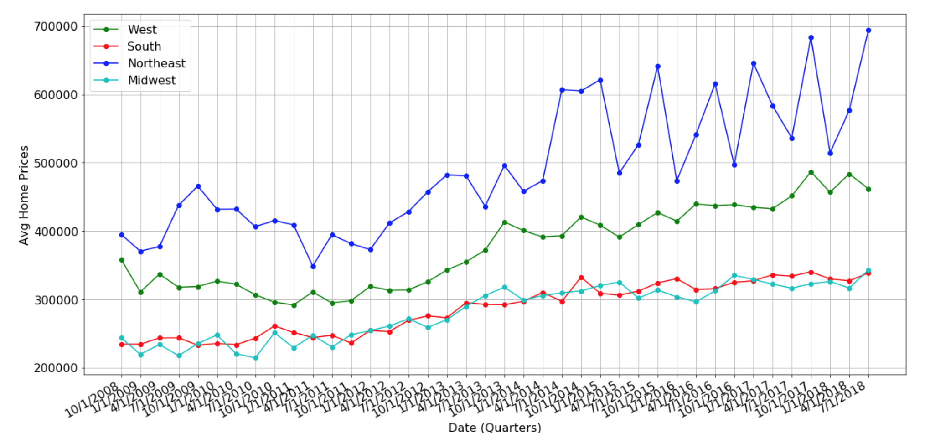
Housing Prices REGIONAL - 10 YEAR TREND
Further analysis reveals that only the South and Midwest regions have similar variances
All Regions
South & Midwest Regions

Slide 8
Potential Housing Price Inputs
Fed Funds Rate
Employment Rate
Stock Indices
Monthly supply of houses (on Fred)
Also has sales index by state

