Slide 1
Software Design Patterns

Slide 2
What is a Pattern
A pattern is a proven solution to a recurring problem in a certain context
Three important facts
Proven Solution
Recurring Problem
Certain context

Slide 3
What a Pattern is not
A one for all solution
The first thing thought about
The answer of life, the Universe and Everything.. (thats 42)

Slide 4
Brief history
Started from a architect in the 60s, named Christopher Alexander in his book “The timeless way of build”
His work inspired Gamma, Helm, Johnson and Vlissides (Gang of four) to write Design Patterns…
Wrote in the 90s and still important today

Slide 5
Proven Solution
Its not new, many examples have already been proved to be valid
A great idea is not a pattern
Should feel familiar

Slide 6
Reoccurring Problem
The problem isn’t a once off
The problem can be encountered again and again sometimes in different forms
With slight differences (Class coupling, overlapping business logic)

Slide 7
Certain Context
“ A pattern is not a one for all solution”
The pattern fits into a specific context
The context varies so does the application of patterns

Slide 8
Key properties of a Pattern
More than just a good idea
Can’t be applied blindly – rather tailored to fit their context
I like to say that patterns are "half baked," meaning that you always have to finish them of - Joshua Kerievsky, Refactoring to Patterns
The pattern should give you the Quality without a name feeling
Patterns aren’t new, they should feel familiar

Slide 9
Describing a pattern
Broken into 5 category's
Name
Problem -> What does it solve
Context -> Why is it right to have it
Solution -> How you implement it
Consequences -> What’s the pro’s and con’s
Often the consequences in the most important decision

Slide 10
Gang of Four
Design Patter, Elements of Reusable Object-Orientated software
Wrote in the 90s and one of the most important aspects of modern development.
Over 22,700 citations (Einstein's most famous paper only has 11,675)

Slide 11
GoF Patterns
Creational | Structural | Behavioural
Factory | Adapter | Interpreter
Abstract Factory | Bridge | Template
Builder | Composite | Chain of Resp
Prototype | Decorator | Command
Singleton | Façade | Mediator
 | Proxy | Memento
 |  | Flyweight
 |  | Observer
 |  | State
 |  | Strategy
 |  | Visitor
 |  | Iterator

Slide 12
Bring it back into context
Patterns are used everywhere in software
Silverlight MVVM is based on the Observer
IEnummerable/System.Linq uses the Iterator
Our IPersistence is an application of the Memento Pattern – (Albeit loosely applied)
Silverlight main App class is a Singleton

Slide 13
Practical Example
Strategy /Template - Behavioural
Decorator/Composite - Structural
Factory /Abstract Factory - Creational

Slide 14
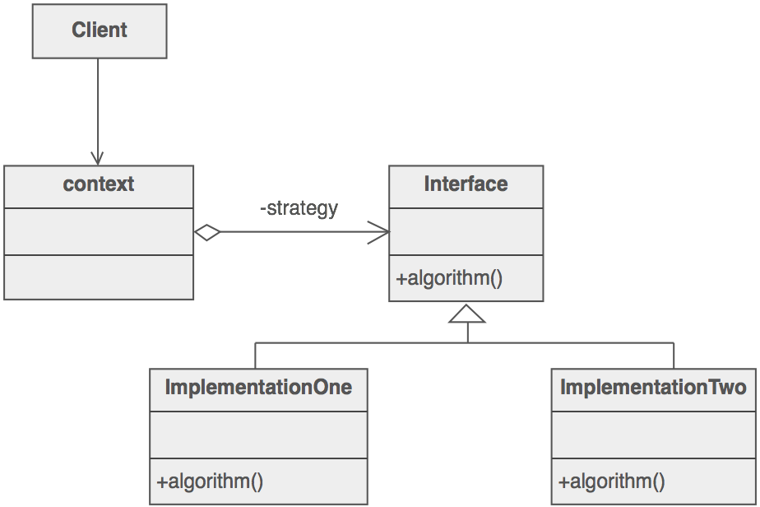
Strategy Example

Slide 15
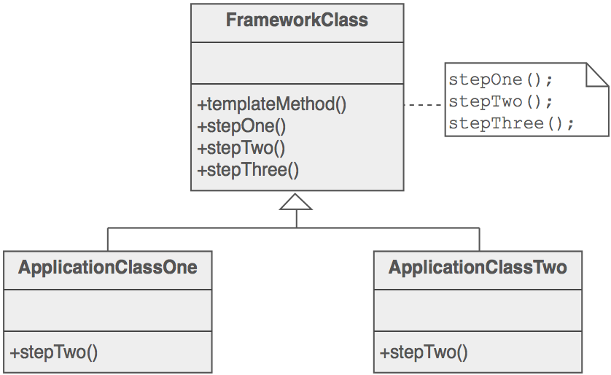
Template Example

Slide 16
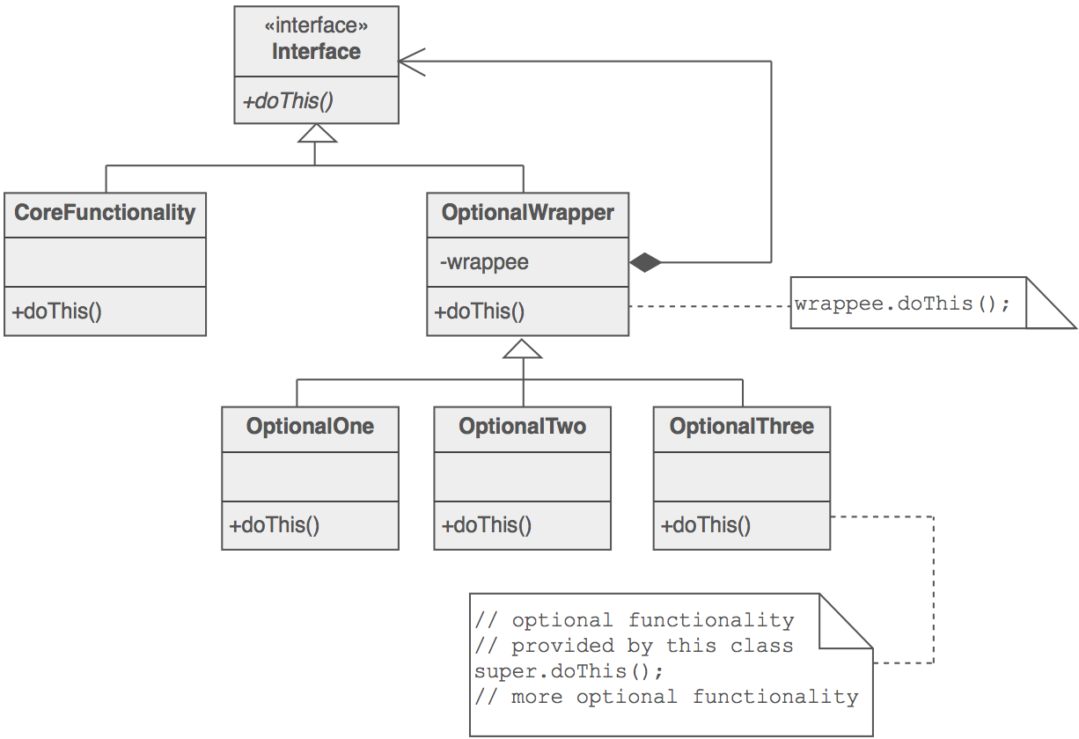
Decorator Example

Slide 17
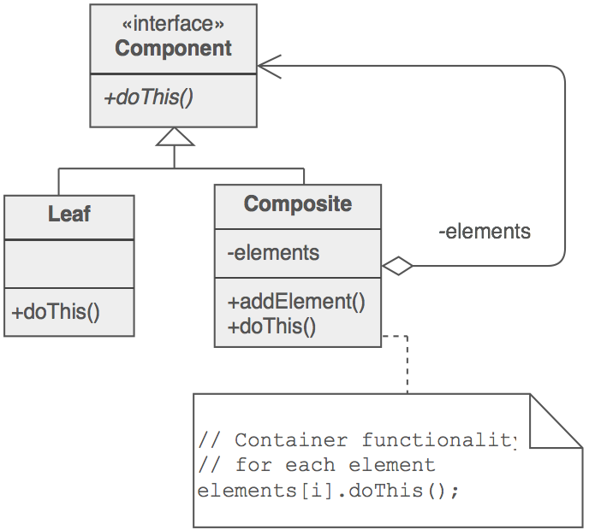
Composite Example

Slide 18
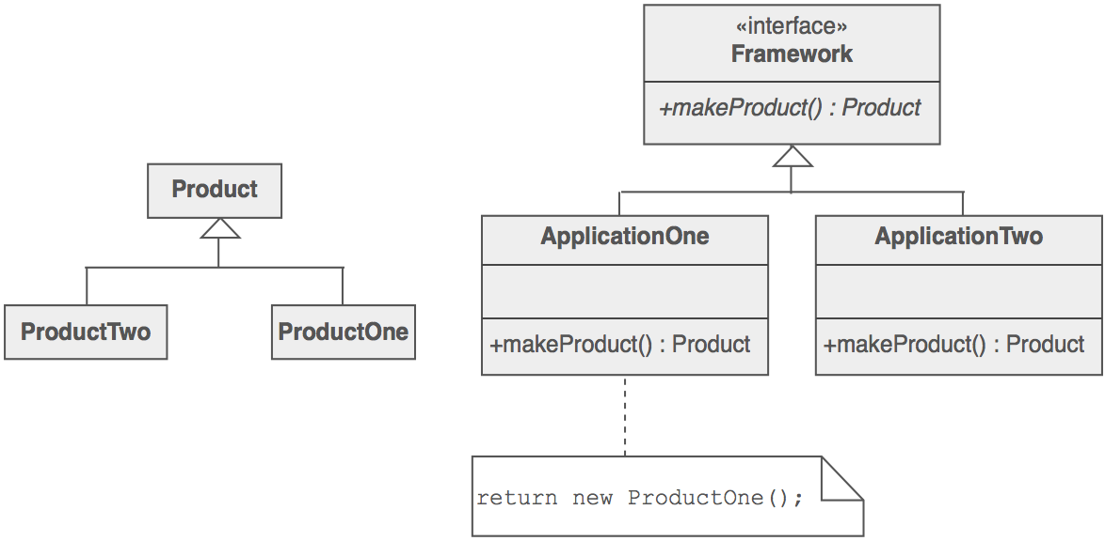
Factory Example

Slide 19
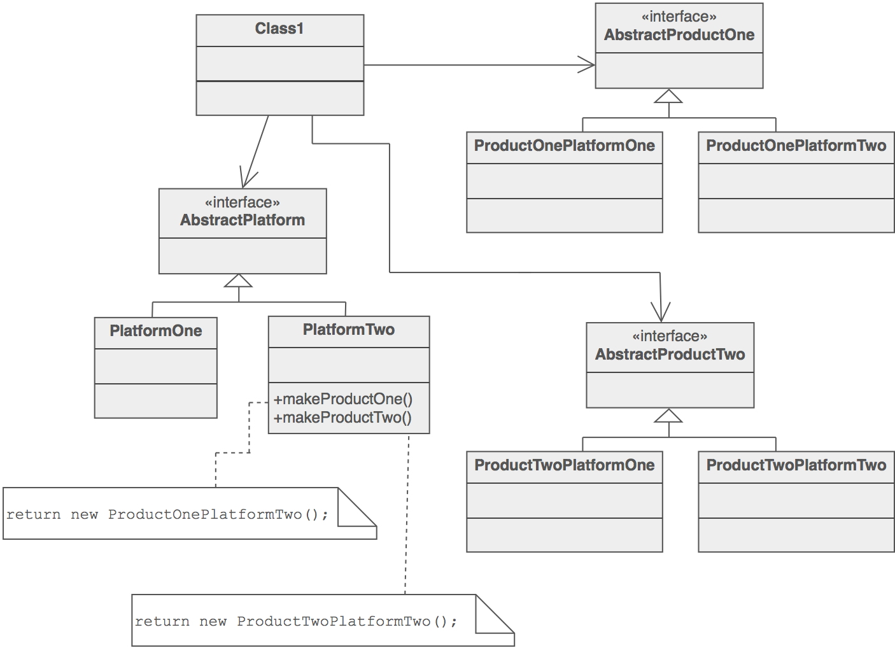
Abstract Factory Example

Slide 20
Stuff to look at
Design patterns – GoF Book
www.dofactory.com
C#/ Javascript examples of GoF patterns
http://sourcemaking.com/
Language independent
Refactoring to Patterns - Joshua Kerievsky

