Slide 1

Defi Lending & Borrowing Platform Analysis
By Tyrell McCurbin
co:rise Web 3 Applications & Filecoin/IPFS
August 2022

Slide 2



Motivation
Radiant (radiant.capital) was launched on Arbitrum in late July 2022
Compare Radiant to its original fork, Geist (geist.finance)
Compare Radiant to its popular competitor Aave (aave.com)
Geist
Radiant
Aave

Slide 3
Scraping the Blockchain Explorers
with Beautiful Soup

Slide 4
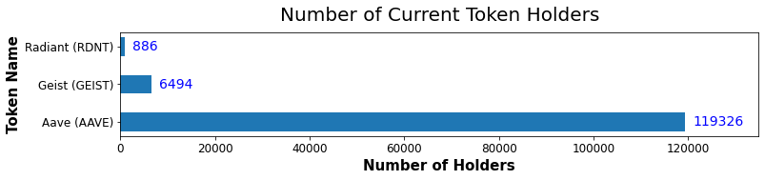
How Many Token Holders?

Slide 5
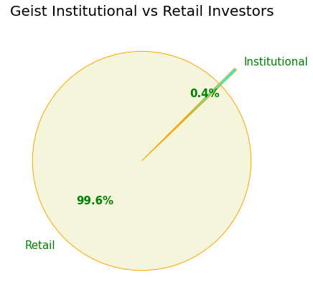
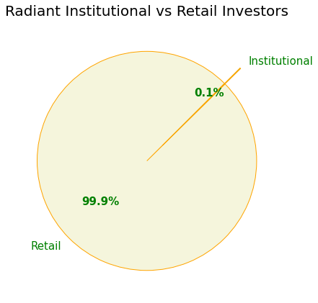
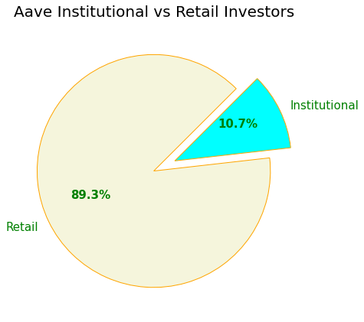
Retail vs Institutional Investors

Slide 6
Comparing Financial Incentives

Slide 7
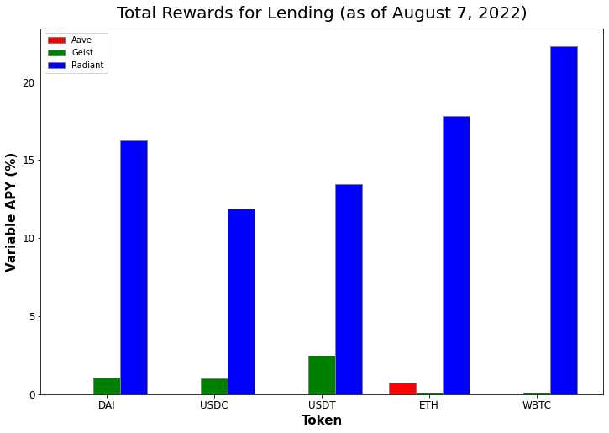
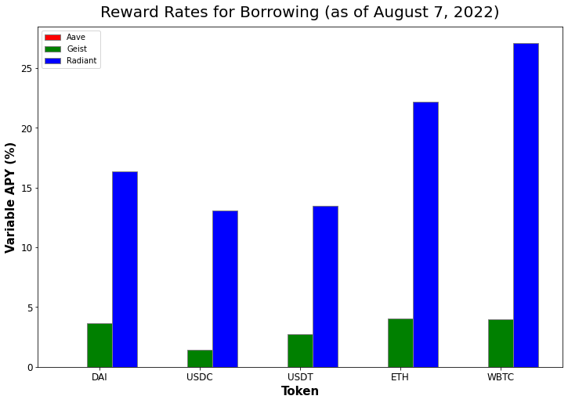
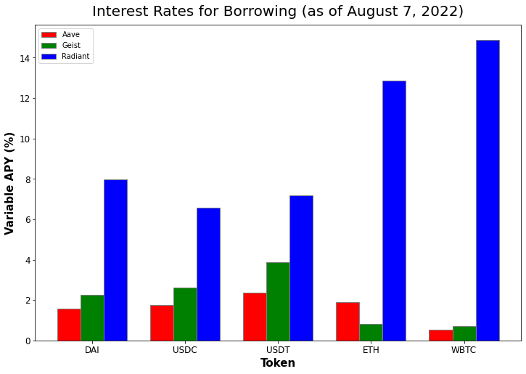
Borrowing and Lending

Slide 8
Summary
Fewer Radiant investors due to:
Recent launch
Bear market
Fewer users on Arbitrum
Geist fork going to zero
Institutional investors are avoiding Radiant and Geist
Radiant’s rewards are high, but uncertainty in RDNT price makes it high risk
Prediction: RDNT will have long-term value if…
Cross-chain functionality is implemented
Giving users easier access to high rewards

