Slide 1
Night light project
Design Gallery

Slide 2
Available designs
Unicorn
Donkey (R)
Donkey (L)
Spongebob
Minion
C3-P0
Sheep
Teddy
Gyroscope
Dolphin
Racing car
Rabbit
Hot air balloons
T-rex
Torus
Brian
Spiderman
Mickey Mouse
Bambi
Soccer ball
Prime mover
Basketball
Plant/flower
Tulips
Batman sign
Christmas tree

Slide 3
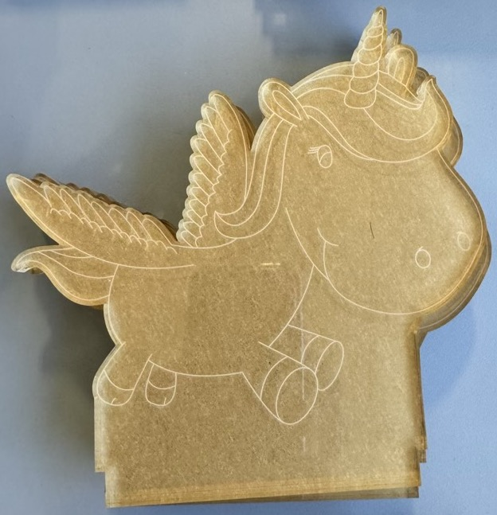
Unicorn

Slide 4
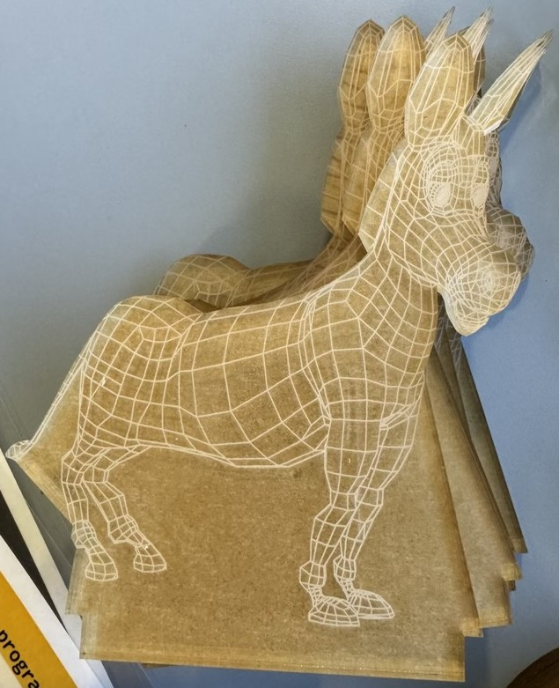
Donkey (right)

Slide 5
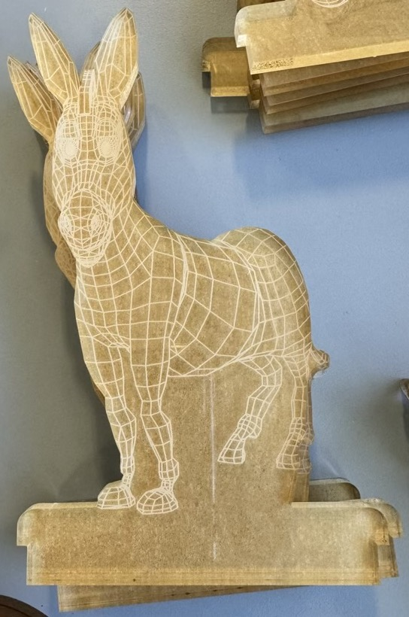
Donkey (left)

Slide 6
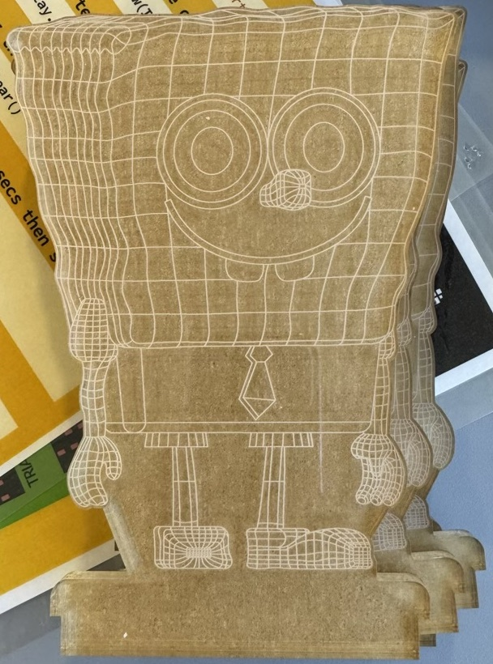
Spongebob Squarepants

Slide 7
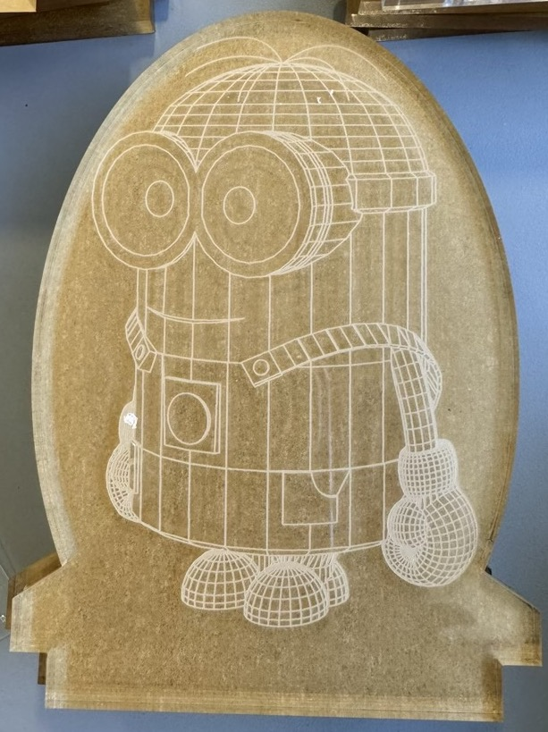
Dave the Minion

Slide 8
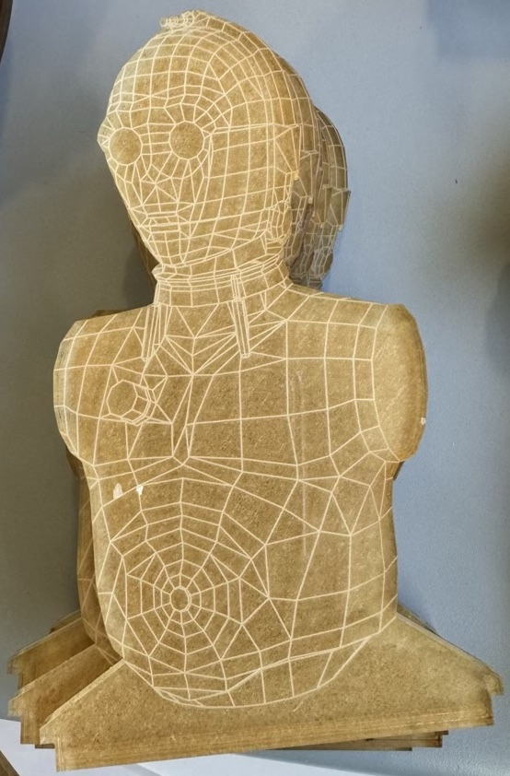
See Threepio (C3-P0)

Slide 9
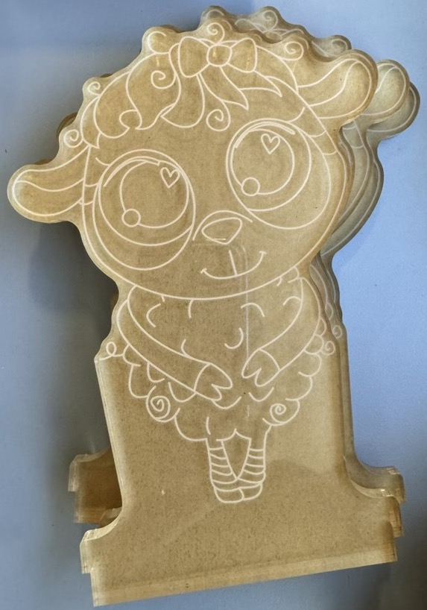
Sheep

Slide 10
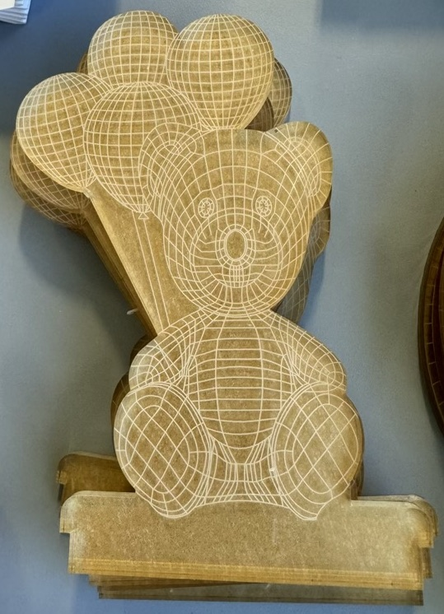
Teddy with balloons

Slide 11
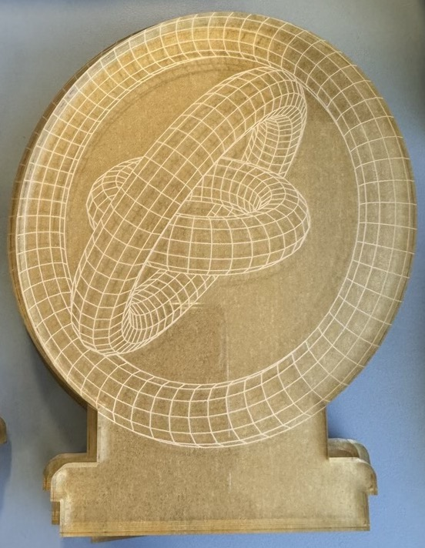
Gyroscope

Slide 12
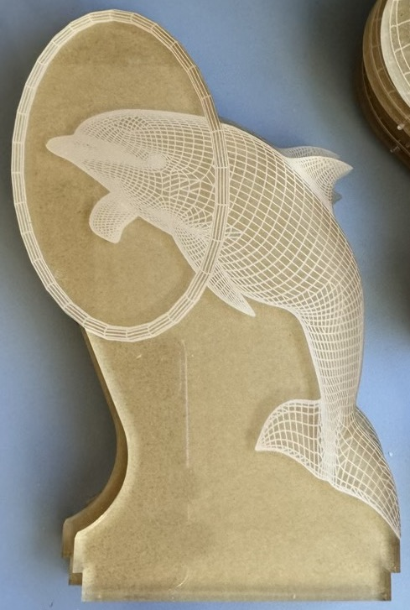
Performing dolphin

Slide 13
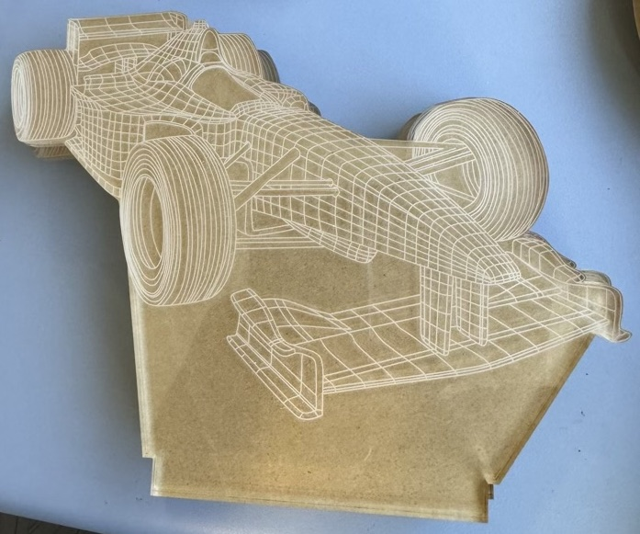
Racing car

Slide 14
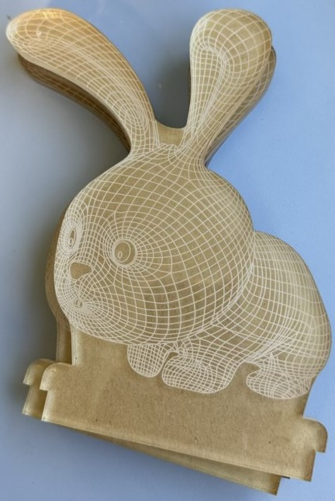
Rabbit

Slide 15
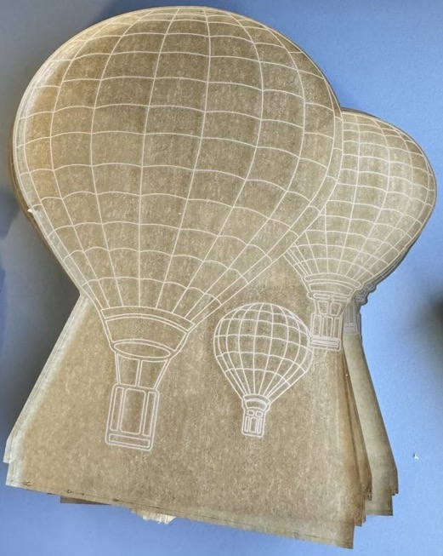
Hot air balloons

Slide 16
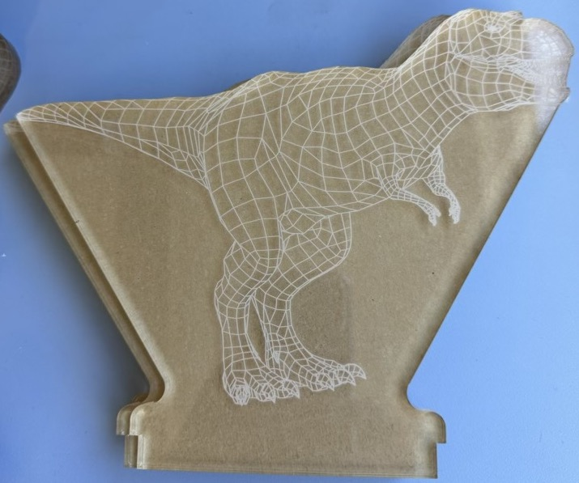
Tyrannosaurus Rex

Slide 17
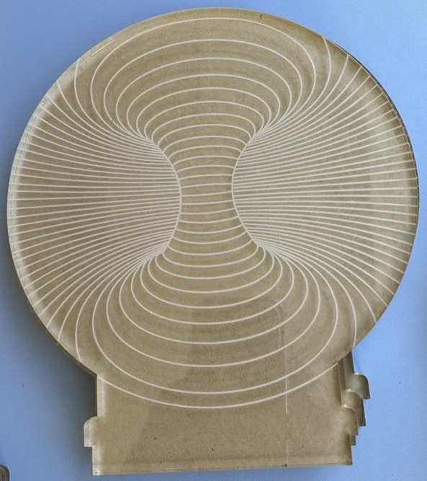
Torus

Slide 18
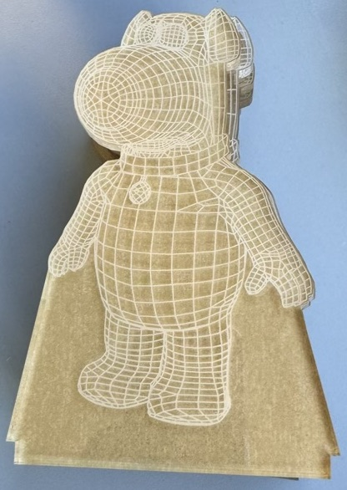
Brian the dog

Slide 19
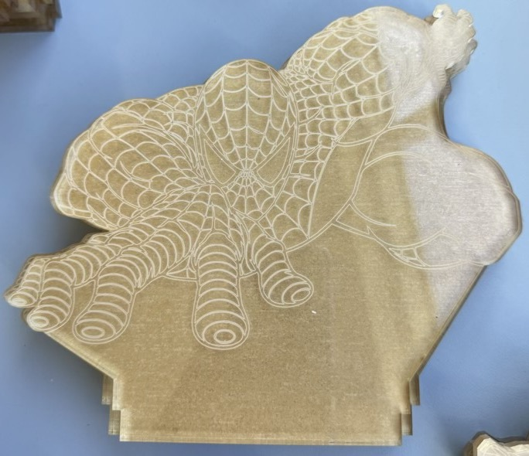
Spiderman

Slide 20
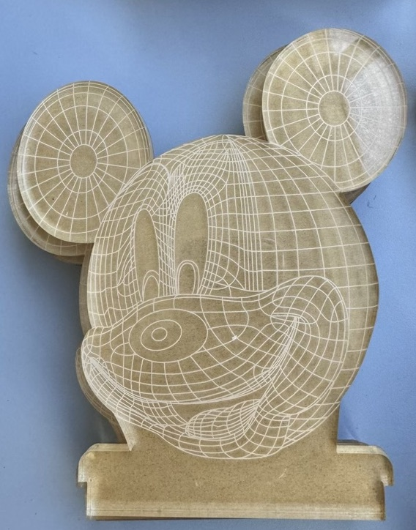
Mickey Mouse

Slide 21
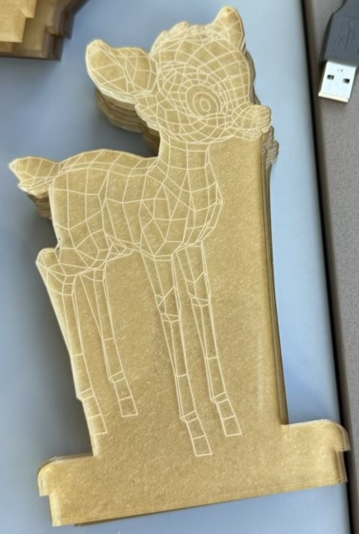
Bambi the fawn

Slide 22
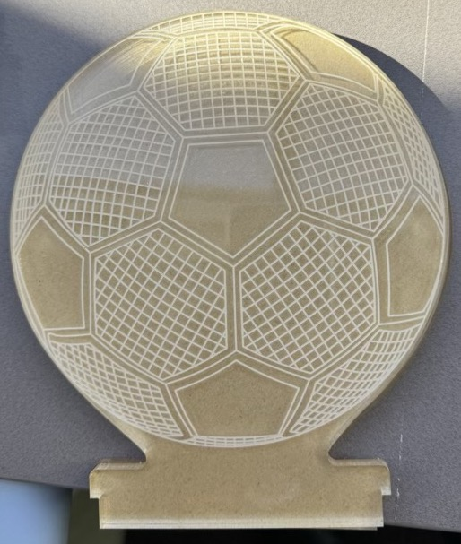
Soccer ball (or football, for the purists)

Slide 23
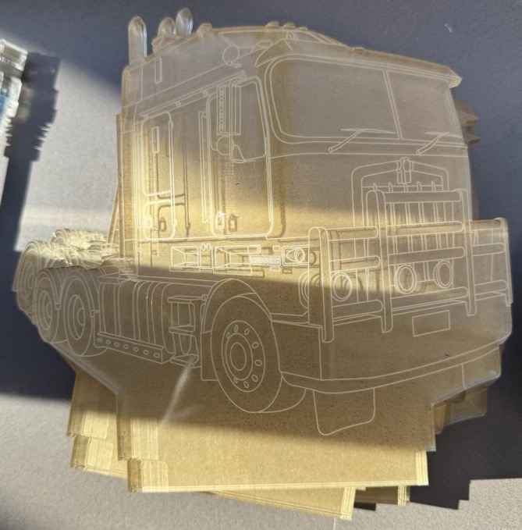
Prime mover

Slide 24
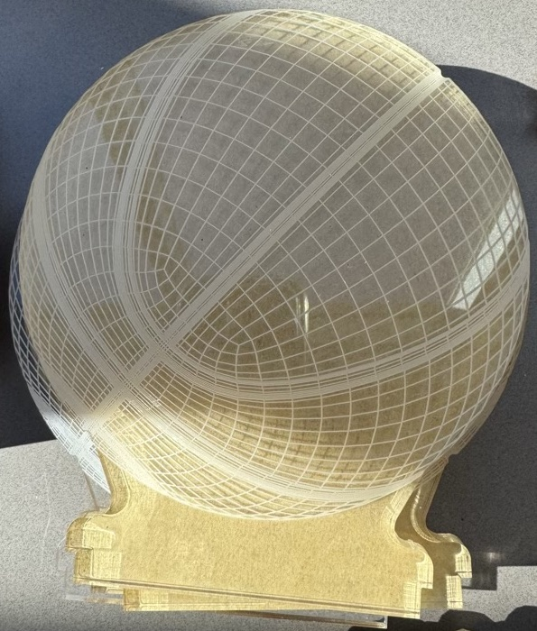
Basketball

Slide 25
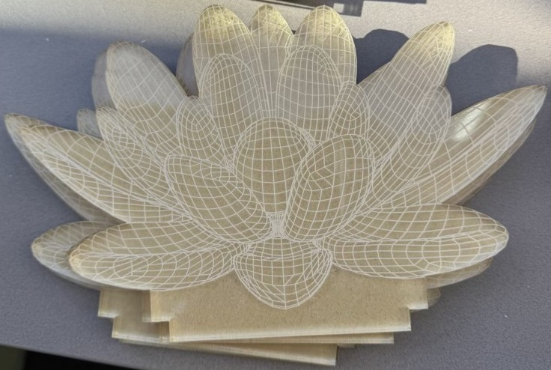
Lotus flower

Slide 26
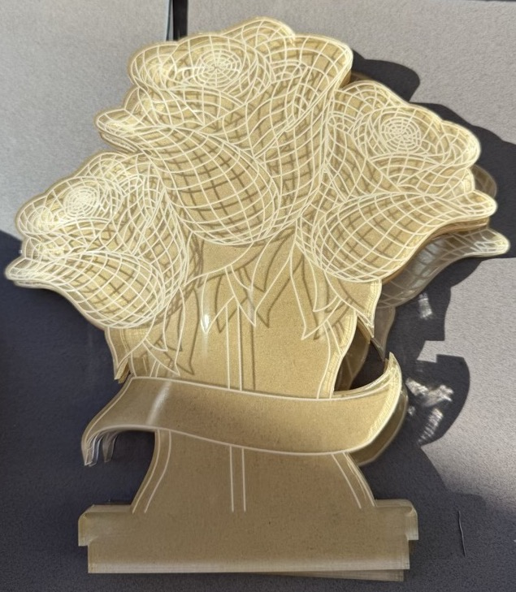
Roses with ribbon

Slide 27
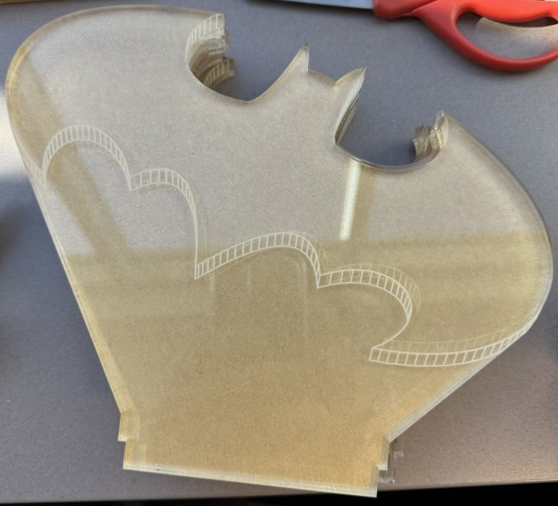
Batman sign

Slide 28
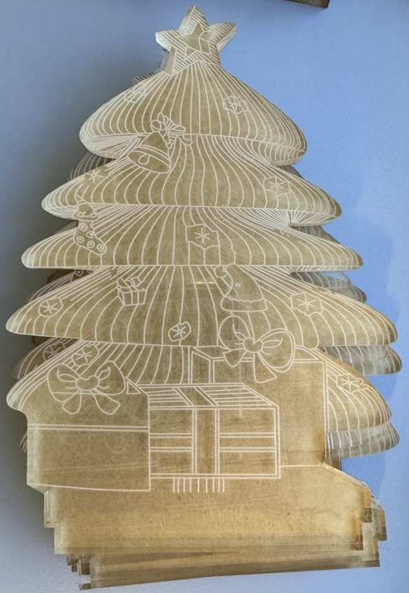
Christmas tree

