Slide 1
Game Analysis
Game 1:

Slide 2
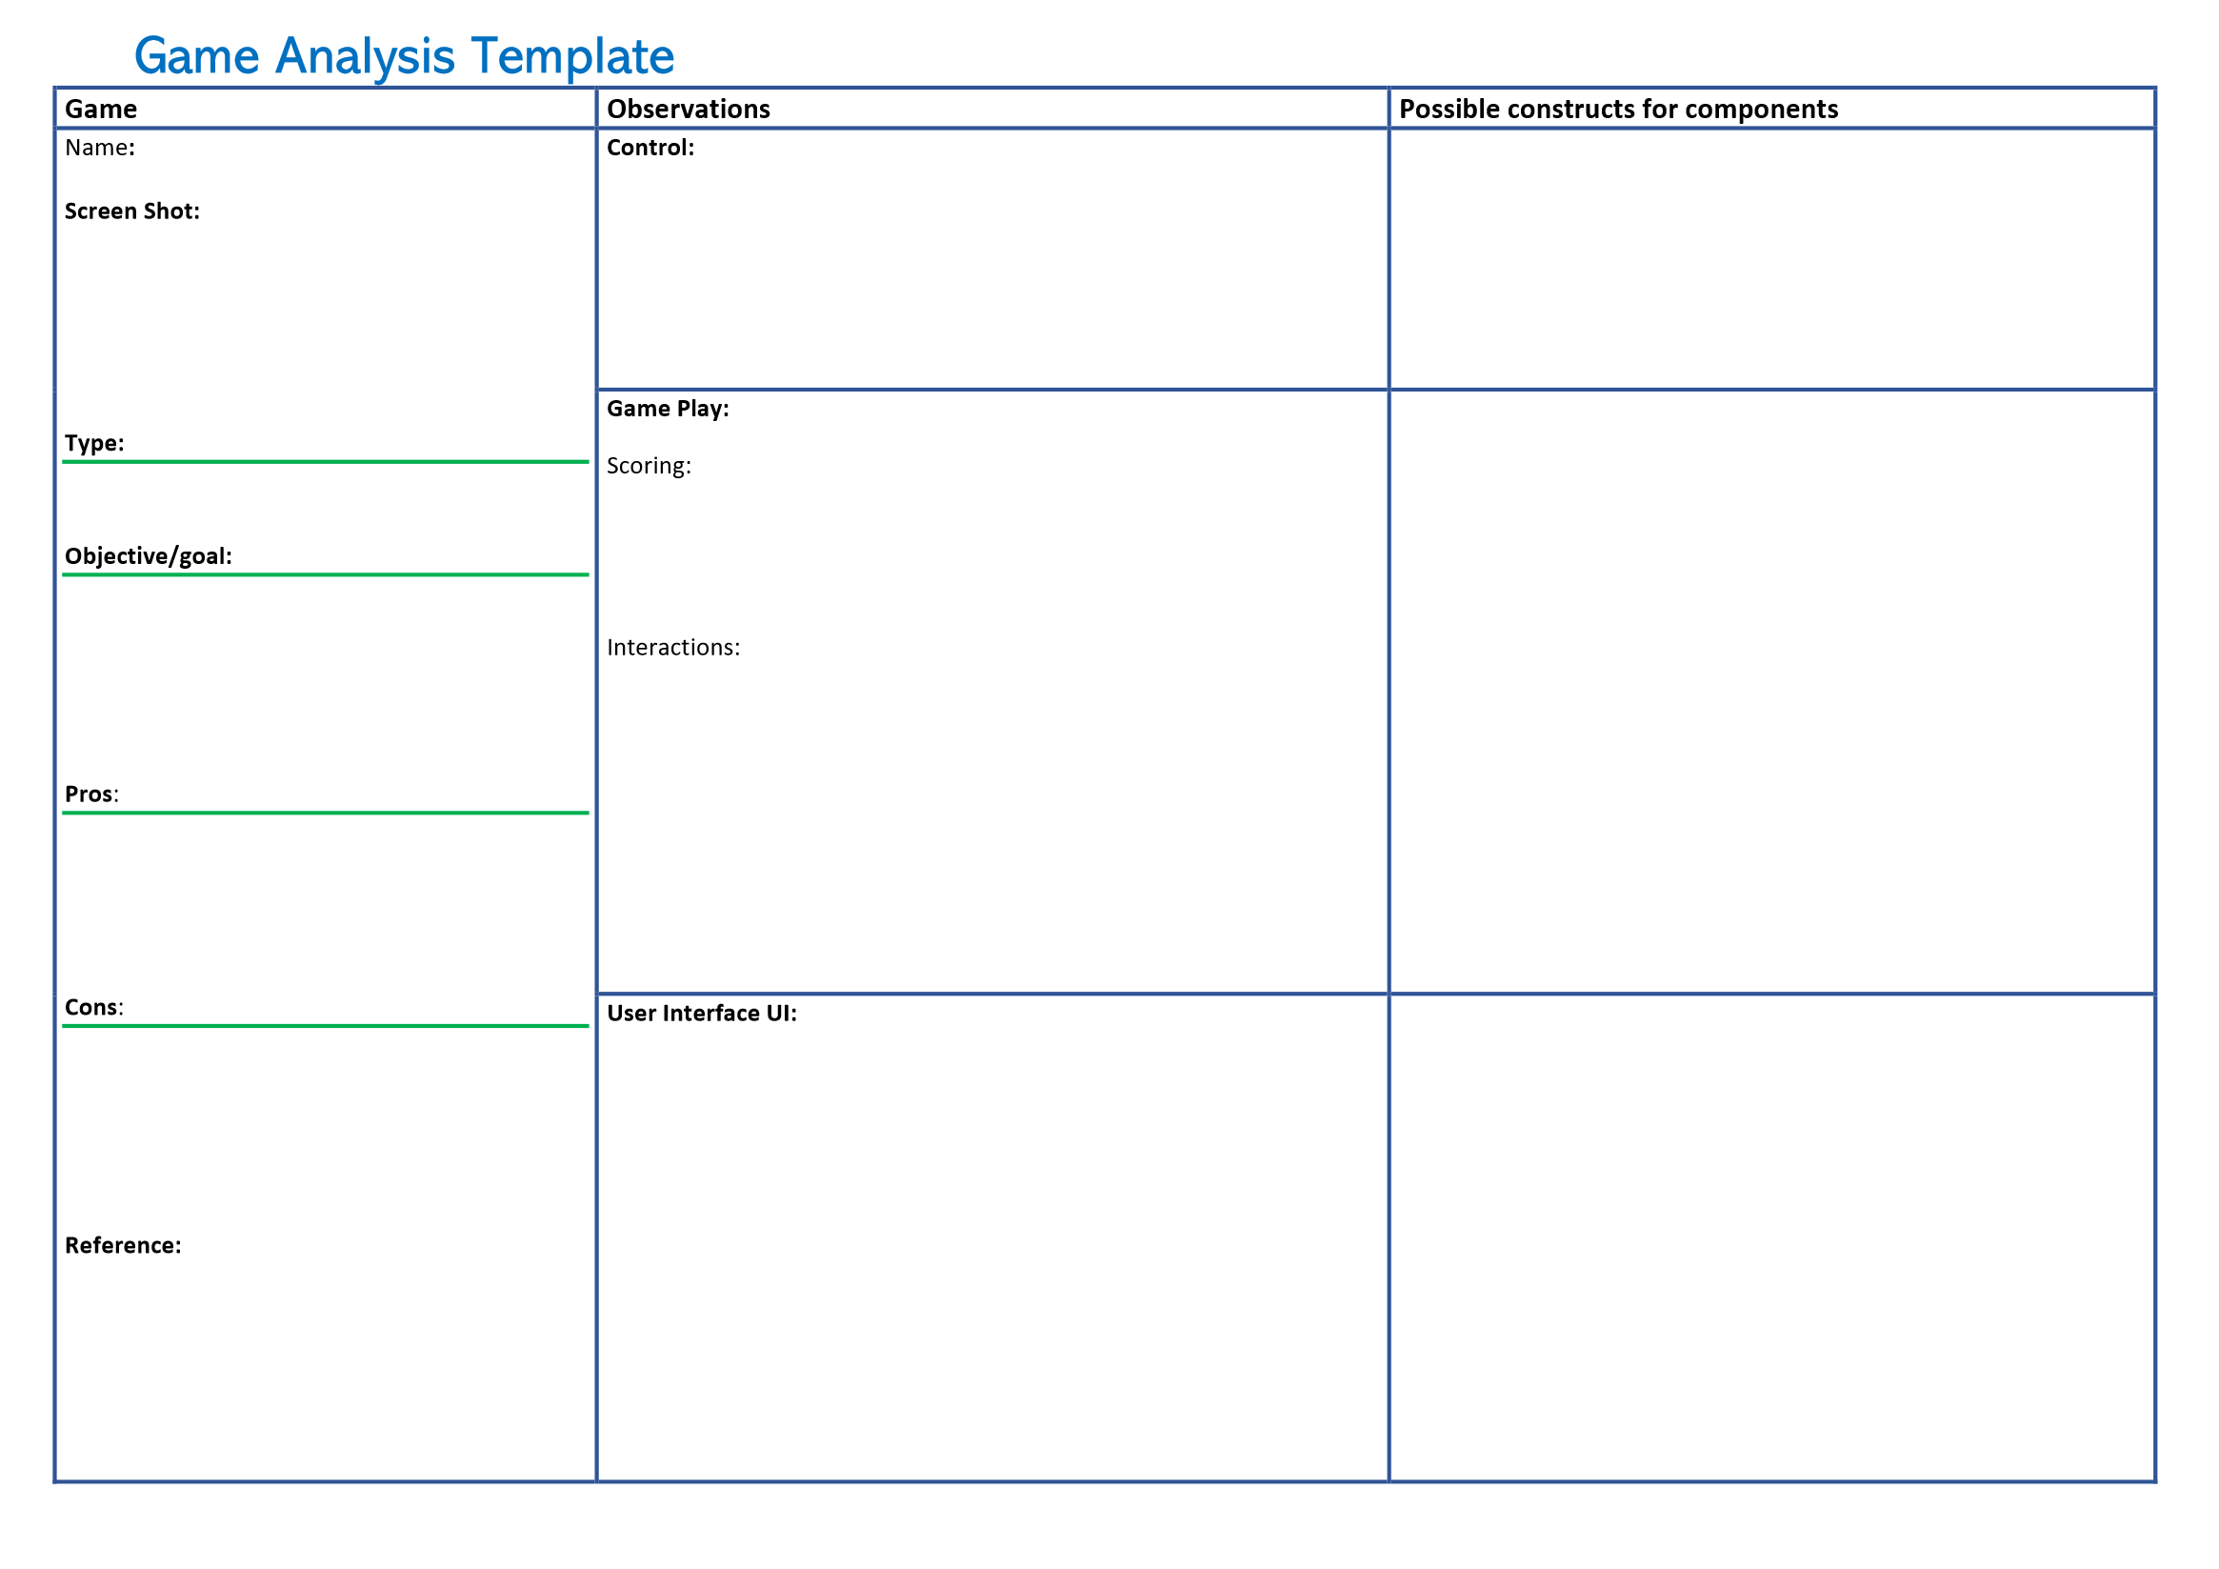

Slide 3
Game Analysis
Game 2:

Slide 5
Game Analysis
Example 1: Doodle jump

Slide 6
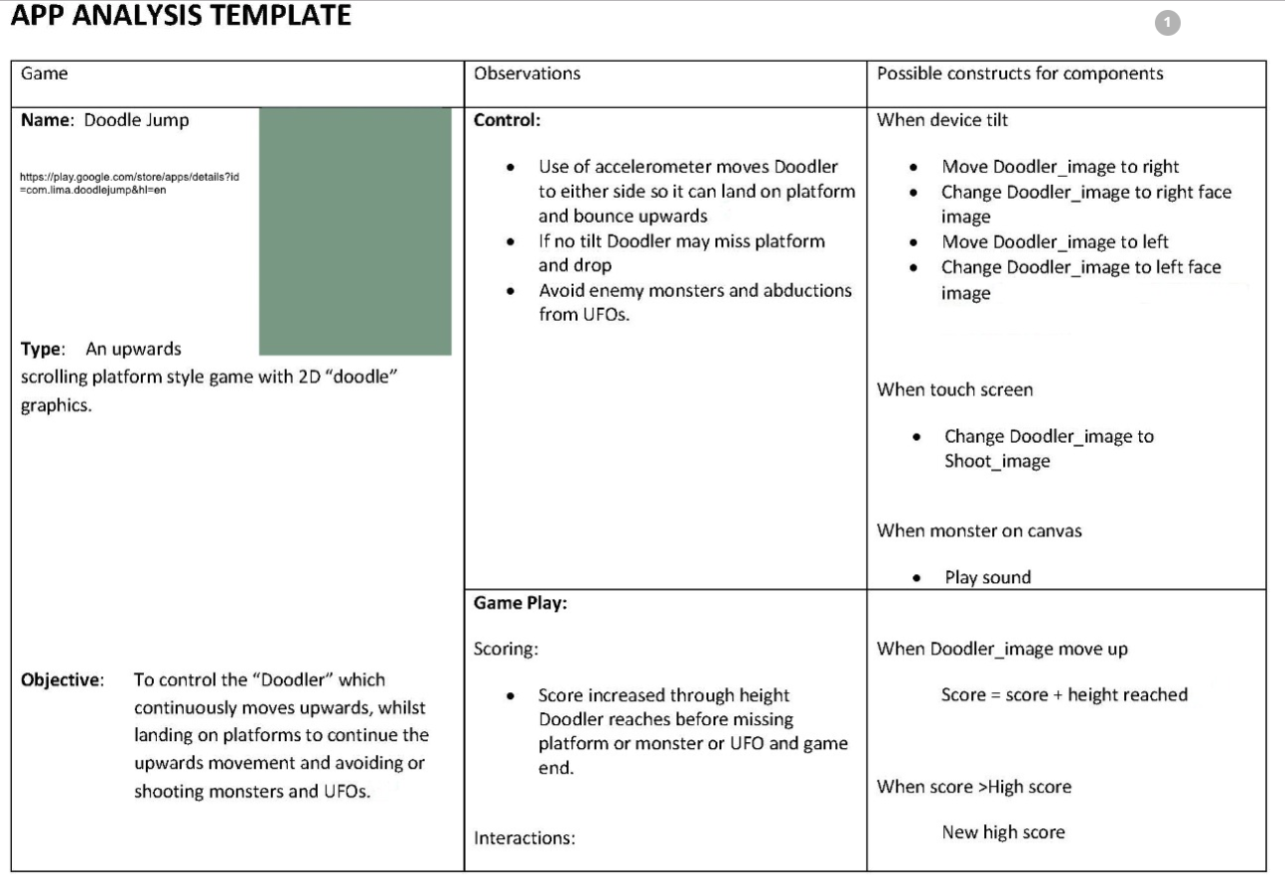
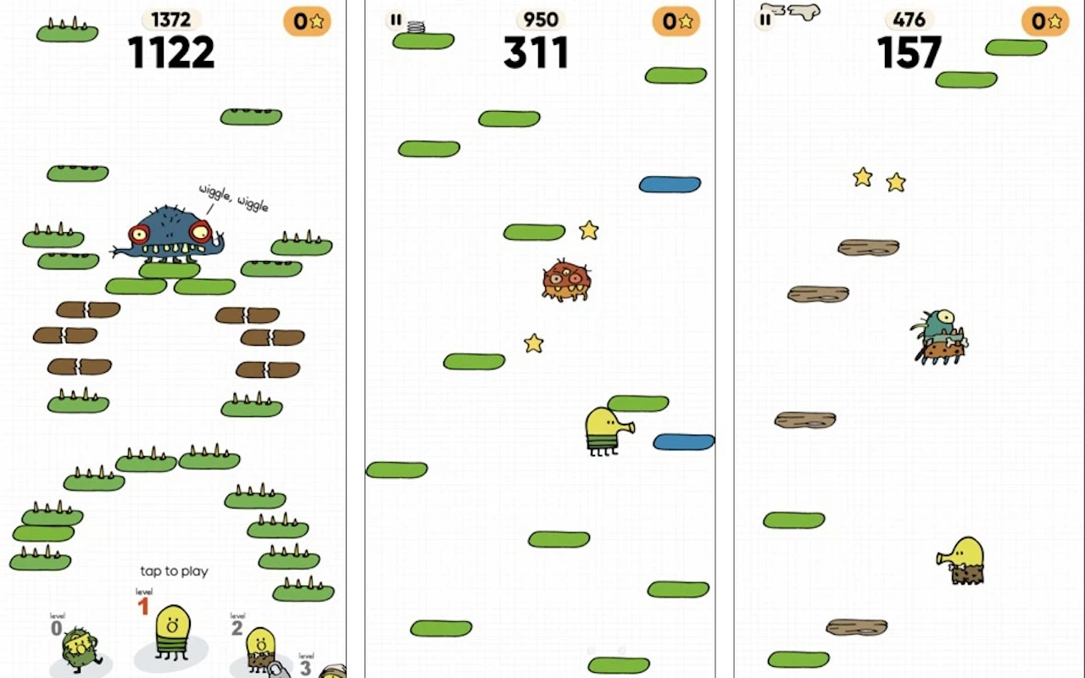

Slide 7
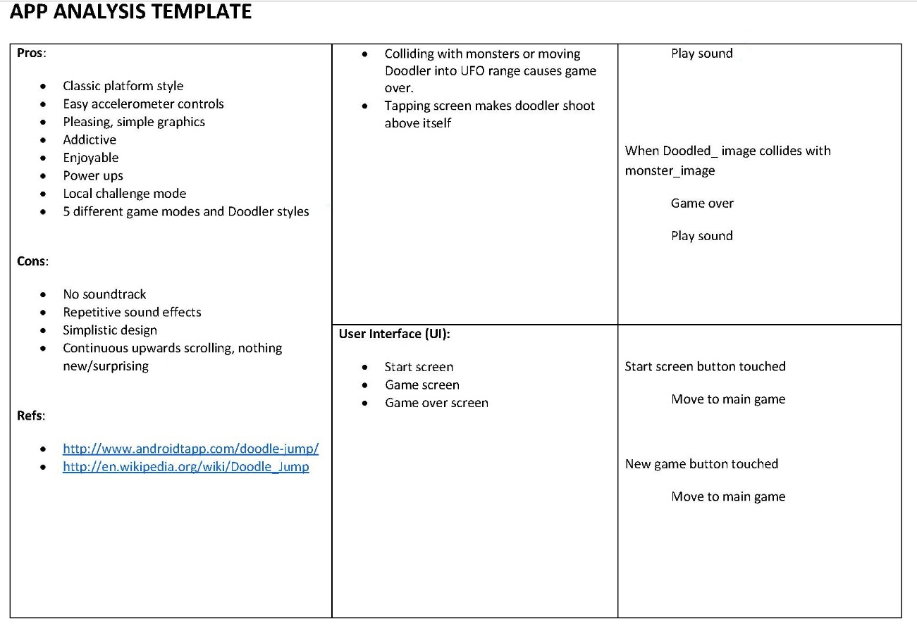

Slide 8
Game Analysis
Example 2: 2048

Slide 9
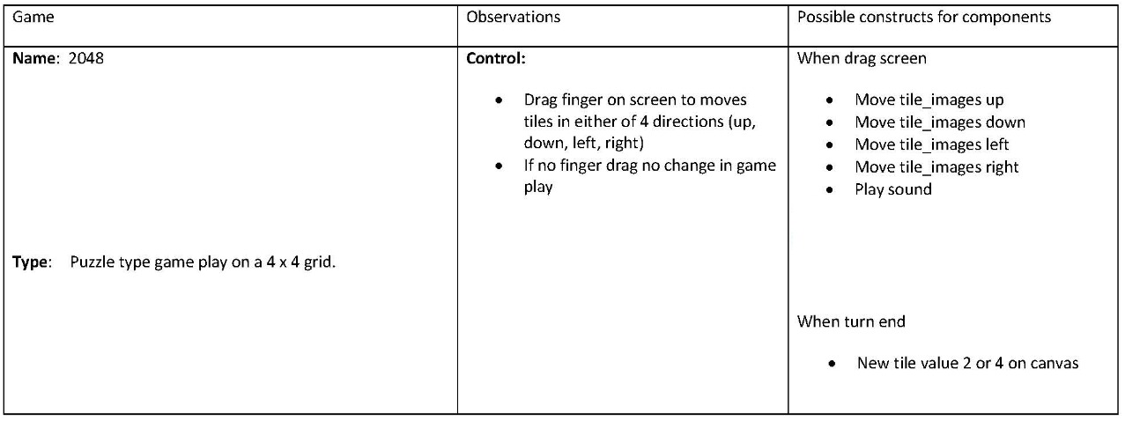
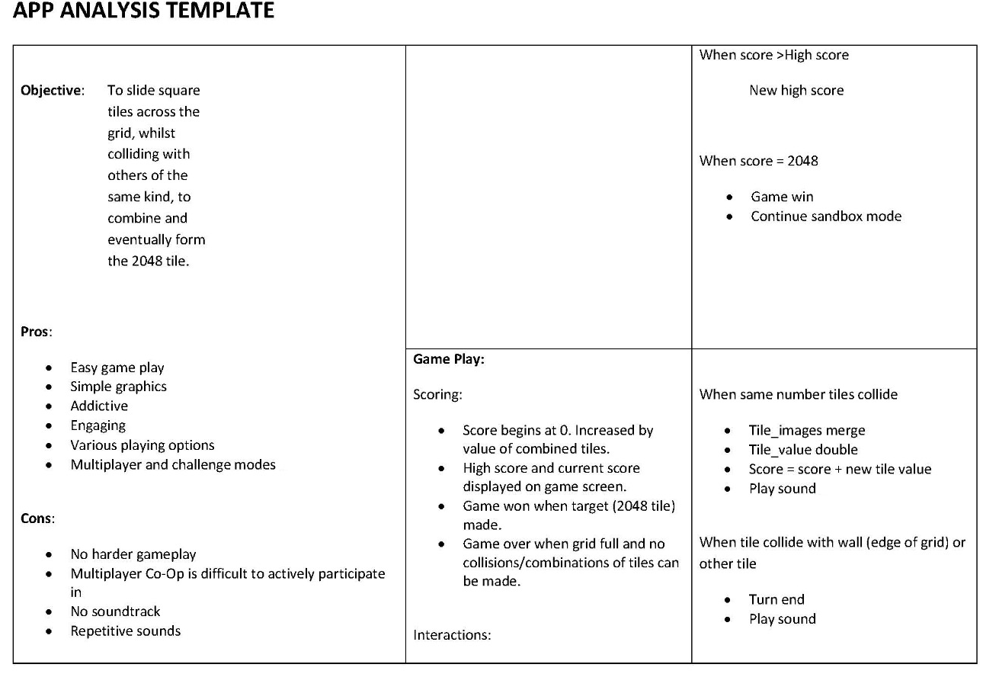

Slide 10
