Slide 1
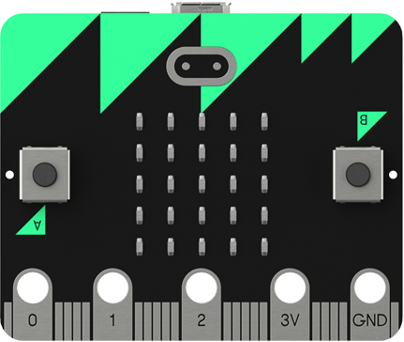
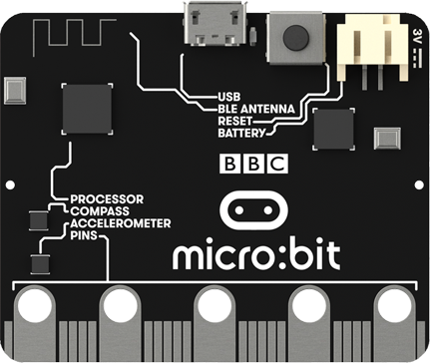

Lesson 1
BBC Micro:bit
Sequencing

Slide 2
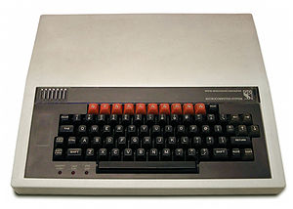
What is it?
The micro:bit is a handheld, fully programmable computer. It’s 70 times smaller and 18 times faster than the original BBC Micro computers used in schools in the 1980s.
This little device has an awful lot of features, like 25 red LED lights that can flash messages. There are two programmable buttons that can be used to control games or pause and skip songs on a playlist. The BBC micro:bit can even detect motion and tell you which direction you’re heading in.

Slide 3
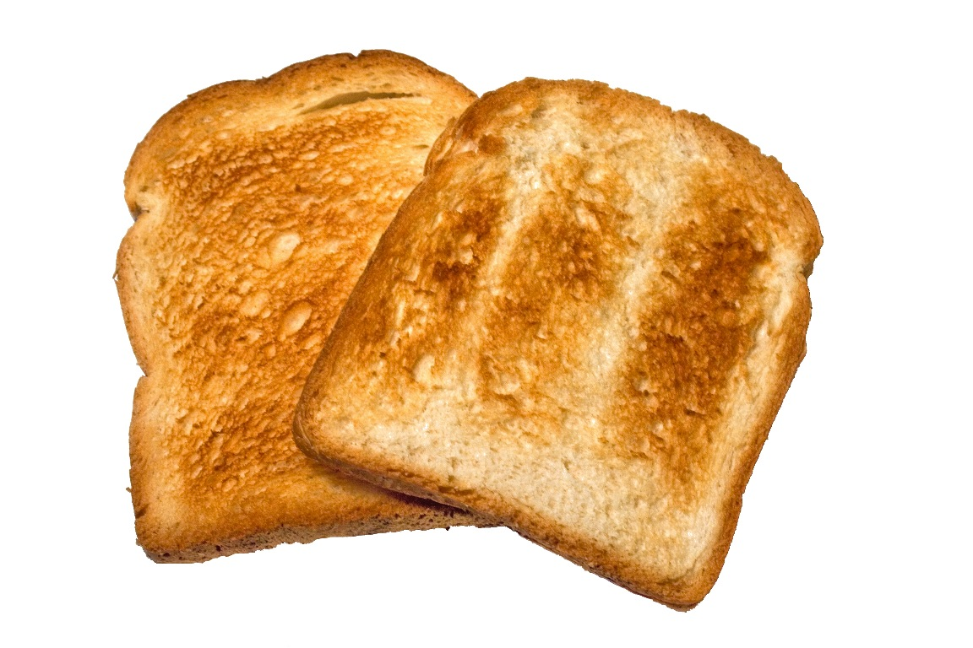
Algorithms
An algorithm is a set of instructions that can be followed to solve a problem. Here is a simple algorithm for making toast:
Start
Slice the bread
Toast the bread
Butter the toast
Spread the jam
This algorithm is in the form of a flow chart which is a way of designing an algorithm.
End

Slide 4
Sequencing
The most simple type of algorithm uses sequencing, a set of instructions carried out one after another.
Start
This is an design for an algorithm which will display the text “Computer”, “Science”, “Rocks” on the micro:bit.
Display “Computer”
We can turn an algorithm into a computer program using a programming language such as Python.
Display “Science”
Python is a common programming language that is used a lot for web development.
Display “Rocks”
End

Slide 5


Activity 1.1
Match the Python code to correct part of the flow chart.
Start
Display “Computer”
Display “Science”
Display “Rocks”
End

Slide 6
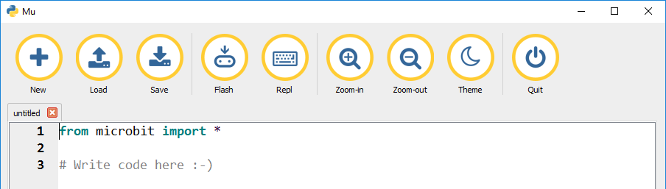
Mu Editor
You are going to use the Mu editor to program your micro:bit.
Click this button to load your program onto your micro:bit.
You always need this line at the start of every program.
Write your code here.

Slide 7

Displaying Text
You can display text on the micro:bit using the display.scroll command.
This code will output the text “Hello” and “World” on the micro:bit. Try it out for yourself.

Slide 8
Activity 1.2
Create a program that will display the text “Computer” “Science” “Rocks” on the micro:bit. Use this example code to help you.
Place a screenshot of your code here.

Slide 9
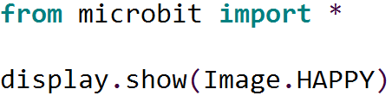
Images
MicroPython (the version of Python the micro:bit uses) comes with lots of built in images.
Try creating a new program with the code shown below and load it onto your micro:bit.

Slide 10
Built In Images
Here is a list of the built in images in Micro Python:
Image.HEART
Image.HEART_SMALL
Image.HAPPY
Image.SMILE
Image.SAD
Image.CONFUSED
Image.ANGRY
Image.ASLEEP
Image.SURPRISED
Image.SILLY
Image.FABULOUS
Image.MEH
Image.YES
Image.NO
Image.TRIANGLE
Image.TRIANGLE_LEFT
Image.CHESSBOARD
Image.DIAMOND
Image.DIAMOND_SMALL
Image.SQUARE
Image.SQUARE_SMALL
Image.RABBIT
Image.COW
Image.MUSIC_CROTCHET
Image.MUSIC_QUAVER
Image.MUSIC_QUAVERS
Image.PITCHFORK
Image.XMAS
Image.PACMAN
Image.TARGET
Image.TSHIRT
Image.ROLLERSKATE
Image.DUCK
Image.HOUSE
Image.TORTOISE
Image.BUTTERFLY
Image.STICKFIGURE
Image.GHOST
Image.SWORD
Image.GIRAFFE
Image.SKULL
Image.UMBRELLA
Image.SNAKE
Image.CLOCK12 (clock at 12 o' clock, others from 1–11)
Image.ARROW_N (arrow pointing north, others replace N with NE, E, SE, S, SW, W, NW)

Slide 11
Activity 1.3
Create a program to display a built in image of your choice. Use this example code to help you:
Place a screenshot of your code here.

Slide 12
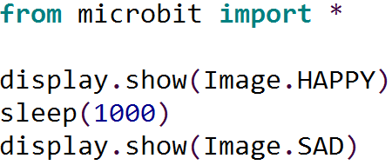
Delays
You can create a delay between lines of code in Python.
The code below will show a happy face for 1 second before switching to a sad face. Try it for yourself.

Slide 13
Activity 1.4
Create an animation using the different built in images. Use the sleep function to create a pause between the images.
Place a screenshot of your code here.
Use this example code as a starting point:

