Slide 1
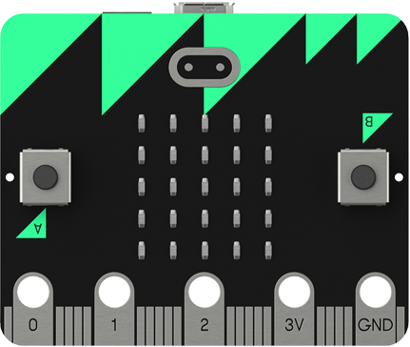
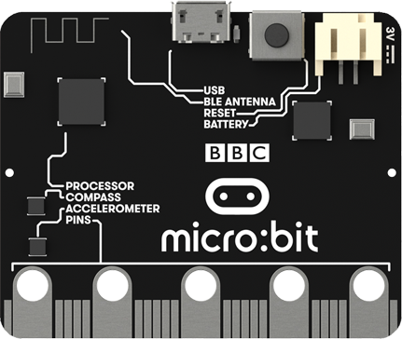

Lesson 2
BBC Micro:bit
Variables and Lists

Slide 2

Variables
When programming it is often necessary to store a value for use later on in the program.
A variable is a label given to a location in memory containing a value that can be accessed or changed.
Think of a variable as a box with a label that you can store information in.
Name

Slide 3
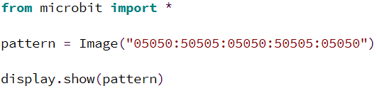
Drawing Your Own Images
Each LED pixel on the micro:bit display can to set to one of ten values (0 to 9). 0 is off and 9 is the brightest setting.
This program creates a checkerboard image and stores it in a variable called pattern. It then displays the image on the LED display. Try it for yourself.

Slide 4
Activity 2.1
Design your own image that you could display on the micro:bit by shading in the cells in the grid.
Turn your design into a form the micro:bit will understand by placing a number between 0 and 9 in each cell.

Slide 5
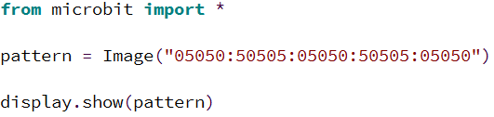
Activity 2.2
Create a program that will display the image you designed in Activity 2.1. Use the code shown below as a starting point:
Place a screenshot of your code here.

Slide 6
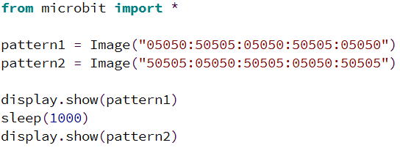
Activity 2.3
Define two more custom images and display them with a pause between each one. Use this code as a starting point:
Place a screenshot of your code here.

Slide 7

Lists
Lists in Python allow you to store multiple items, for example images. If you store a set of images in a list you can tell Micro Python to animate the list.
This example program uses a list to store the happy, sad and angry images. It them animates them with a delay of 0.1 seconds between each image. Try it yourself.

Slide 8
Built In Images
Here is a list of the built in images in Micro Python:
Image.HEART
Image.HEART_SMALL
Image.HAPPY
Image.SMILE
Image.SAD
Image.CONFUSED
Image.ANGRY
Image.ASLEEP
Image.SURPRISED
Image.SILLY
Image.FABULOUS
Image.MEH
Image.YES
Image.NO
Image.TRIANGLE
Image.TRIANGLE_LEFT
Image.CHESSBOARD
Image.DIAMOND
Image.DIAMOND_SMALL
Image.SQUARE
Image.SQUARE_SMALL
Image.RABBIT
Image.COW
Image.MUSIC_CROTCHET
Image.MUSIC_QUAVER
Image.MUSIC_QUAVERS
Image.PITCHFORK
Image.XMAS
Image.PACMAN
Image.TARGET
Image.TSHIRT
Image.ROLLERSKATE
Image.DUCK
Image.HOUSE
Image.TORTOISE
Image.BUTTERFLY
Image.STICKFIGURE
Image.GHOST
Image.SWORD
Image.GIRAFFE
Image.SKULL
Image.UMBRELLA
Image.SNAKE
Image.CLOCK12 (clock at 12 o' clock, others from 1–11)
Image.ARROW_N (arrow pointing north, others replace N with NE, E, SE, S, SW, W, NW)

Slide 9
Activity 2.4
Create an animation using the different built in images. Use a list to store the images you want to use.
Place a screenshot of your code here.

Slide 10
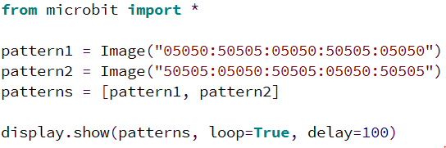
Activity 2.5
Define three new custom images and store them in a list. Create an animation using the list. Use this code as a starting point:
Place a screenshot of your code here.

