Slide 1
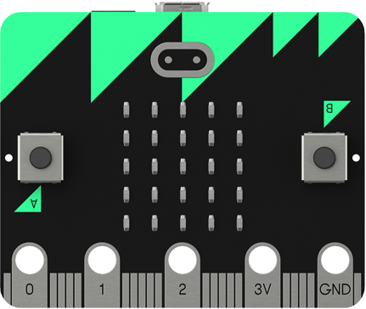
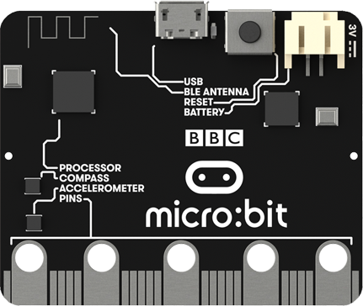

Lesson 3
BBC Micro:bit
Iteration and Selection

Slide 2
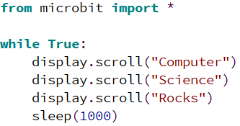
Iteration
We use iteration to prevent typing the same code out many times and to make our code more efficient.
This example program uses a while loop to repeat the “Computer” “Science” “Rocks” message forever.
The code that you want to repeat has to be indented after the while True: statement.
Try the code out for yourself.

Slide 3
Activity 3.1
Create a program that displays your name and repeats it at 2 second intervals. Use the example code to help you.
Place a screenshot of your code here.

Slide 4
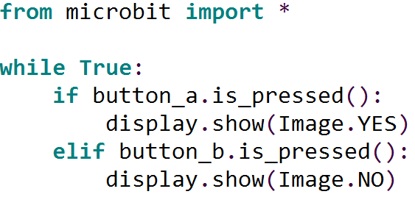
Selection
With selection the path through a program can be changed depending of the result of a condition.
The conditions are written using if statements.
This example program uses an if statement to check if either of the buttons on the micro:bit have been pressed. If button a is pressed a tick is displayed, if button b is pressed a cross is displayed.
Try the code out for yourself.

Slide 5
Built In Images
Here is a list of the built in images in Micro Python:
Image.HEART
Image.HEART_SMALL
Image.HAPPY
Image.SMILE
Image.SAD
Image.CONFUSED
Image.ANGRY
Image.ASLEEP
Image.SURPRISED
Image.SILLY
Image.FABULOUS
Image.MEH
Image.YES
Image.NO
Image.TRIANGLE
Image.TRIANGLE_LEFT
Image.CHESSBOARD
Image.DIAMOND
Image.DIAMOND_SMALL
Image.SQUARE
Image.SQUARE_SMALL
Image.RABBIT
Image.COW
Image.MUSIC_CROTCHET
Image.MUSIC_QUAVER
Image.MUSIC_QUAVERS
Image.PITCHFORK
Image.XMAS
Image.PACMAN
Image.TARGET
Image.TSHIRT
Image.ROLLERSKATE
Image.DUCK
Image.HOUSE
Image.TORTOISE
Image.BUTTERFLY
Image.STICKFIGURE
Image.GHOST
Image.SWORD
Image.GIRAFFE
Image.SKULL
Image.UMBRELLA
Image.SNAKE
Image.CLOCK12 (clock at 12 o' clock, others from 1–11)
Image.ARROW_N (arrow pointing north, others replace N with NE, E, SE, S, SW, W, NW)

Slide 6
Activity 3.2
Change the example program to display different images when each of the buttons are pressed. Use the example code to help you.
Place a screenshot of your code here.

Slide 7
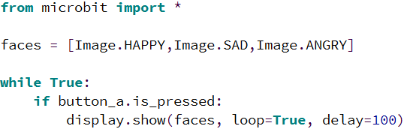
Activity 3.3
Create a program that will play two different animations, one when button a is pressed and one when button b is pressed.
Use this code as a starting point.
():
Place a screenshot of your code here.

Slide 8
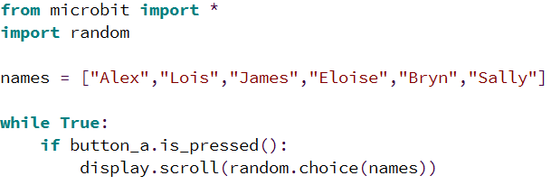
Random
The random module in Python can be used to generate random numbers or select random items from a list.
This example program displays a random name from the list when the micro:bit is shaken.
Try it out for yourself (you can change the names).

Slide 9
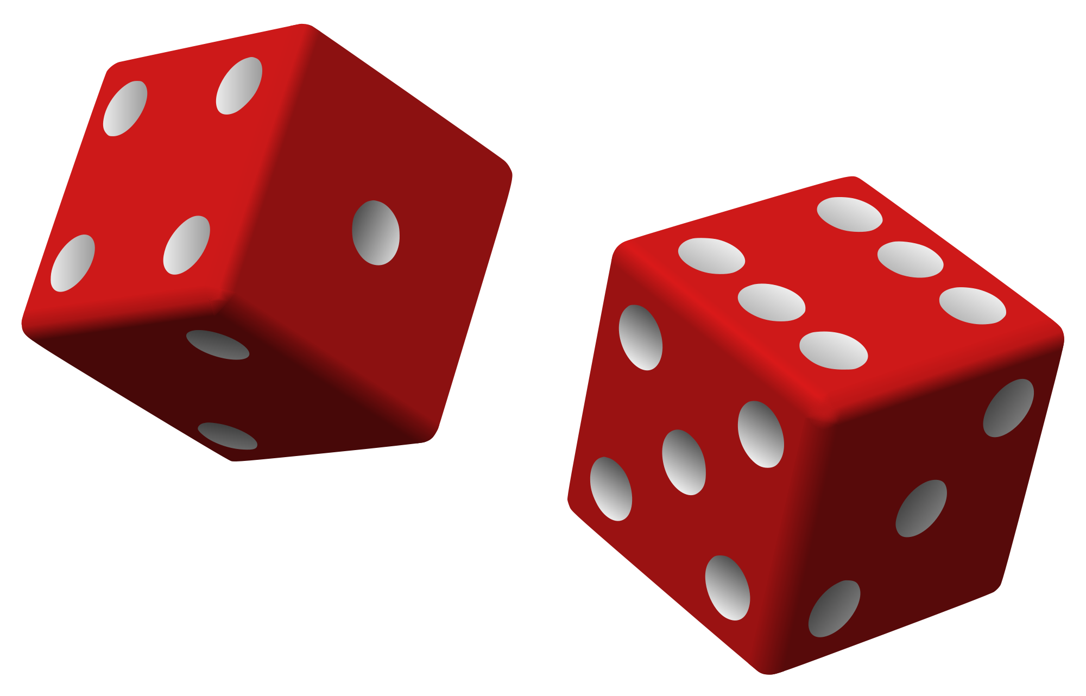
Activity 3.4
Using the example program as a starting point create a program that turns the micro:bit into an electronic dice (when shaken it should output a number between 1 and 6).
Place a screenshot of your code here.

