Slide 1
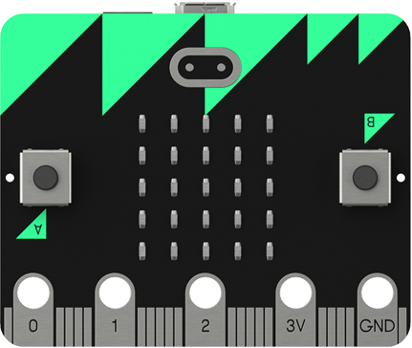
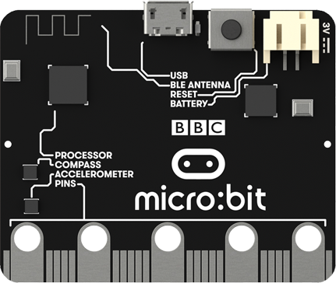

Lesson 4
BBC Micro:bit
Accelerometer

Slide 2
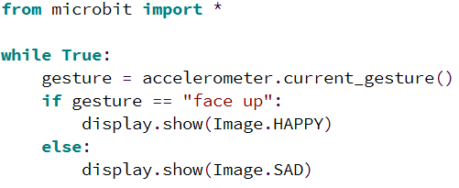
Gestures
The in built accelerometer can be used to detect movement and direction. This allows the micro:bit to recognise the following gestures.
This example program displays a happy face if the micro:bit is facing up, otherwise it displays a sad face. Try it for yourself.
up
down
left
right
face up
face down
shake

Slide 3
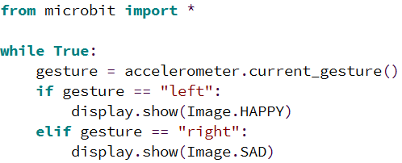
Activity 4.1
Create a program that will show different images when different gestures are detected. Use this code as a starting point:
Place a screenshot of your code here.

Slide 4
Activity 4.2
You are going to create a rock, paper, scissors game using your micro:bit. The first thing you need to do is design the images.
Rock
Paper
Scissors
Shade in
Values 0-9

Slide 5
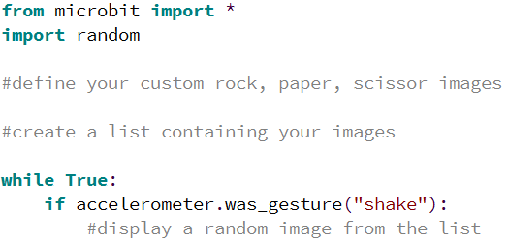
Activity 4.3
This is the incomplete code for the rock, paper, scissors game. You need to replace the comments with appropriate lines of code.
Place a screenshot of your code here.

Slide 6
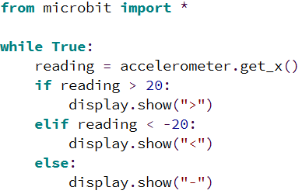
Accelerometer
The accelerometer can be used to detect precise movement along three axes:
X – tilting from left to right
Y – tilting forwards and backwards
Z – moving up and down
When the reading is 0 you are “level” along that axis.
This program acts like a basic spirit level. Displaying – if the micro:bit is level, < if it is tilted to the left and > if it is titled to the right.
Try it out for yourself.

Slide 7
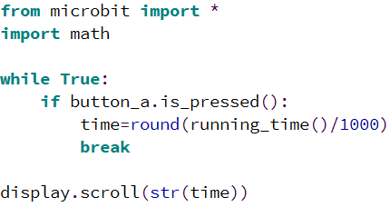
Running Time
The micro:bit keeps track of the amount of time it has been running.
This example program has a while loop that will keep running until button a is pressed. The running time is then calculated in seconds and displayed on the screen.
The break command is used to break out of a loop.
Try it out for yourself.

Slide 8
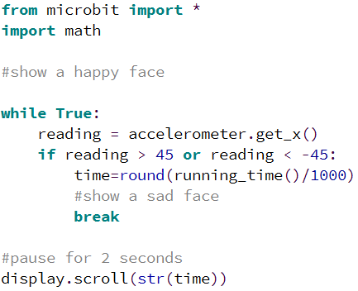
Activity 4.4
This is the incomplete code for a game. The aim is to hold the micro:bit level for as long as possible. It’s incomplete, you need to replace the comments with appropriate lines of code.
Place a screenshot of your code here.

Slide 9
Extension
Change the sensitivity of the game to make it harder.
Place a screenshot of your code here.

