Slide 1
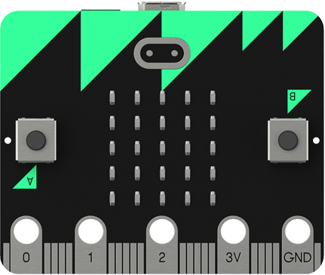
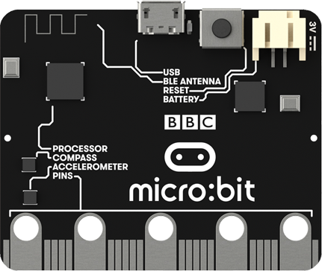

Lesson 6
BBC Micro:bit
Networking

Slide 2
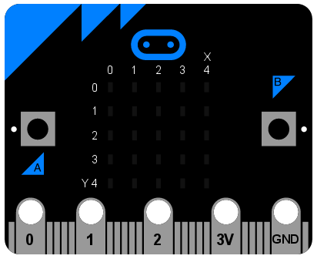
Networking
Digital devices can be networked together to exchange data. You are going to create a very simple network using two micro:bits.
Connect the two micro:bits with crocodile clips as shown.

Slide 3
Protocols
Devices need to follow a set of rules to communicate over a network, each device on the same network must follow the same set of rules. This set of rules is known as a protocol.
Here is the protocol we are going to use on our micro:bit network:
Transmit a 0 by sending a signal through pin 1 for 200 milliseconds
Transmit a 1 by sending a signal through pin 1 for 400 milliseconds
If a signal is detected on pin 1 for 200 milliseconds interpret it as a 0
If a signal is detected on pin 1 for 400 milliseconds interpret it as a 1

Slide 4
Activity 6.1
Below is a list of common protocols, use internet research to help you to complete the table.
Protocol | Description
TCP/IP
HTTP
HTTPS
SMTP
POP3
FTP

Slide 5
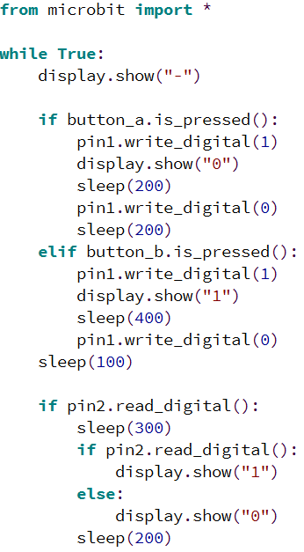
Writing the Protocol
This program creates the protocol that will allow the micro:bits to communicate.
If button A is pressed a signal will be sent through pin 1 for 200 milliseconds and the other micro:bit will display a 0 on the screen.
If button B is pressed a signal will be sent through pin 2 for 400 milliseconds and the other micro:bit will display a 1 on the screen.
Note: this program works best if both micro:bits are plugged into a USB port.

Slide 6
Activity 6.2
Implement the protocol program shown on the previous slide and test it. Comment the code explaining what each part does.
Place a screenshot of your code here.

Slide 7
Representing Characters
We can now send sequences of binary digits between our micro:bits but how can we turn these into characters?
Computers use coding systems to represent characters using binary numbers, one of these systems is ASCII (American Standard Code for Information Interchange).
This table shows some of the binary codes used to represent characters using ASCII.
100000 | SPACE | 1001101 | M
101110 | . | 1001110 | N
1000001 | A | 1001111 | O
1000010 | B | 1010000 | P
1000011 | C | 1010001 | Q
1000100 | D | 1010010 | R
1000101 | E | 1010011 | S
1000110 | F | 1010100 | T
1000111 | G | 1010101 | U
1001000 | H | 1010110 | V
1001001 | I | 1010111 | W
1001010 | J | 1011000 | X
1001011 | K | 1011001 | Y

Slide 8
Activity 6.3
Write a short message, convert it into ASCII codes and send it to your learning partner using your micro:bit network.
Character | Character Code

Slide 9
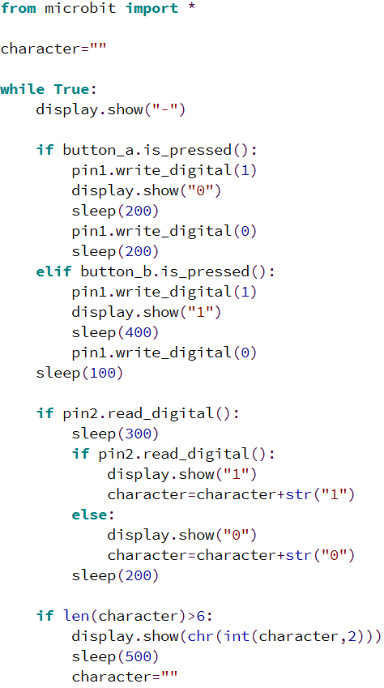
Automatic Conversion
We can change the program so that it automatically converts the binary code into a character.
Each time the micro:bit receives 1 bit it adds it to the character variable until there are 7 bits.
When there are 7 bits they will be converted into a character and displayed.
Update your program, the code you need to change/add is highlighted.

Slide 10
Activity 6.4
Update your protocol program as shown on the previous slide. Comment the code to explain what each part does.
Place a screenshot of your code here.

Slide 11
Extension
Improve your protocol program to make it play one sound when a 0 is received and another sound when a 1 is received.
Place a screenshot of your code here.

