Slide 1
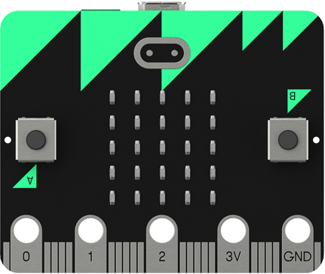
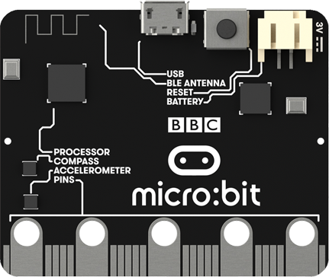

Lesson 5
Music

Slide 2
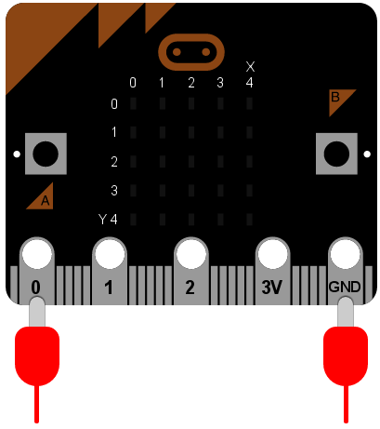
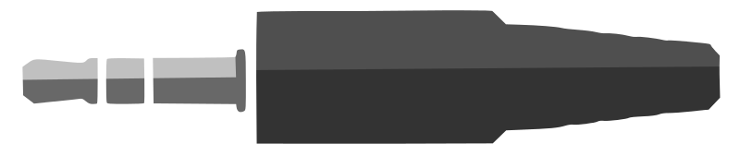
Music
The micro:bit can generate music if it is connected to a speaker or headphones.
Connect your headphones to the micro:bit using crocodile clips as shown in the diagram.

Slide 3
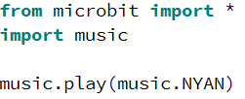
Example
Here is an example program that makes the micro:bit play music. Try it for yourself:
music.DADADADUM
music.ENTERTAINER
music.PRELUDE
music.ODE
music.NYAN
music.RINGTONE
music.FUNK
music.BLUES
music.BIRTHDAY
music.WEDDING
music.FUNERAL
music.PUNCHLINE
music.PYTHON
music.BADDY
music.CHASE
music.BA_DING
music.WAWAWAWAA
music.JUMP_UP
music.JUMP_DOWN
music.POWER_UP
music.POWER_DOWN
WARNING: Do not put the headphones in your ears as the music will be very loud.
This is a list of all the built-in melodies, try some of them out.

Slide 4
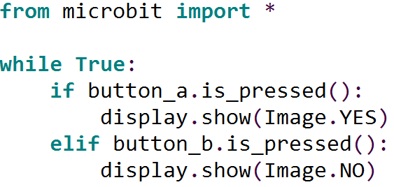
Activity 5.1
Creature a program that makes the micro:bit play different melodies when buttons A and B are pressed. Use this program for displaying different images as a starting point:
Place a screenshot of your code here.

Slide 5
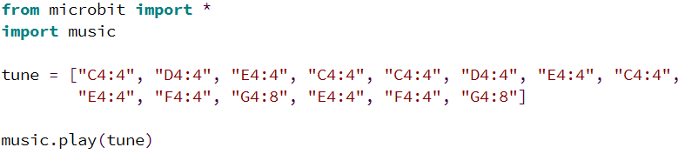
Writing Your Own Melodies
You can also write your own melodies for the micro:bit to play.
Each note has a name like C or C#, an octave (how high or low the note should be played) and a duration. For example “A1:4” refers to note A in octave 4 played for a duration of 4.
Notes can be placed in a list to create a melody as shown in the example below:
Try it for yourself.

Slide 6
Activity 5.2
Here are the notes that make up the melody for Twinkle Twinkle Little Star. Create a program to play the melody on the micro:bit. Use 4 as the octave and duration of each note.
C C G G A A G
F F E E D D C
G G F F E E D
G G F F E E D
C C G G A A G
F F E E D D C
Place a screenshot of your code here.

Slide 7
Activity 5.3
There are only three unique sets of notes in the Twinkle Twinkle Little Star melody. Make your program more efficient by creating a separate list for each unique set of notes and playing each list when needed.
C C G G A A G
F F E E D D C
G G F F E E D
G G F F E E D
C C G G A A G
F F E E D D C
Place a screenshot of your code here.

Slide 8
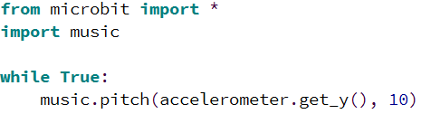
Accelerometer
You can make use of the accelerometer to play random notes as the micro:bit moves.
This program uses the reading from the y axis as the pitch. Try it for yourself.

Slide 9
Extension
Find the notes for another song on the internet and create a program to play it.
Place a screenshot of your code here.

