Slide 1
Predicting Beijing Air Quality
Tamara Monge
Capstone 2
Springboard Data Science
June 25, 2018

Slide 2
The Project
Beijing’s Air Quality
PM 2.5 = particulate matter having a diameter < 2.5 microns
High concentrations have been linked to respiratory diseases
Beijing’s PM 2.5 concentrations have been notoriously high due to industrialization
Concentrations have decreased in past 5-10 years, but are still worrisome most days of the year
Project outcomes
Identify patterns in PM 2.5 concentration
Predict future PM 2.5 concentration

Slide 3
The Client
Population of Beijing
Health concerns related to high PM 2.5:
Asthma
Bronchitis
Lung Disease

Slide 4
The Data
Freely available at UCI Machine Learning Repository
Hourly observations over 5 years
Jan. 1, 2010 – Dec. 31, 2014
Fields: datetime
PM 2.5 concentration (ug/m3)
Temperature (C)
Dewpoint Temperature (C)
Pressure (hPa)
Combined wind direction (deg)
Cumulated wind speed (m/s)
Cumulated hours of snow
Cumulated hours of rain
n = 43,824 observations (~2 MB)

Slide 5
Wrangling Steps
Dataframe index = datetime
Dropped records missing (pm25) (~5%)
Renamed columns for convenience

Slide 6
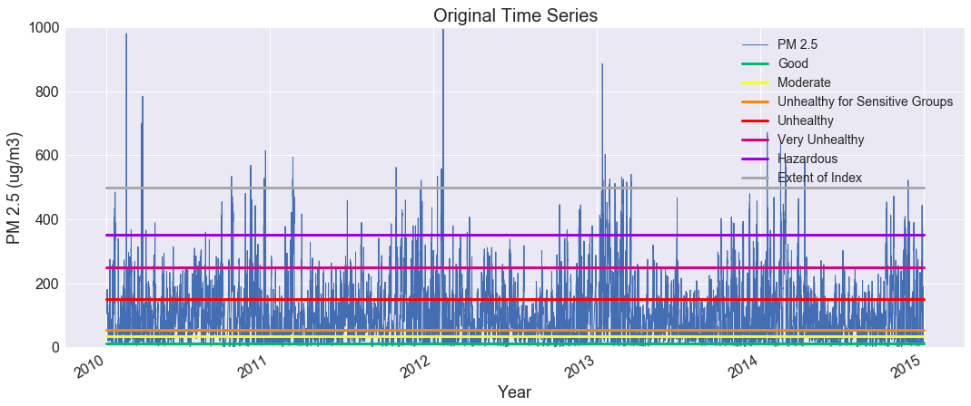
Exploratory Data Analysis
Legend is based on the US EPA’s Air Quality Index

Slide 7
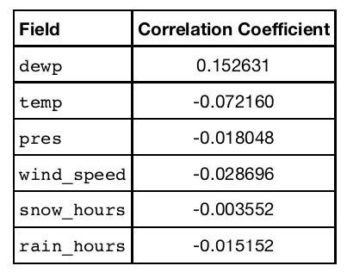
Exploratory Data Analysis
Correlation between PM 2.5 and the other time series, after seasonal and trend effects have been removed

Slide 8
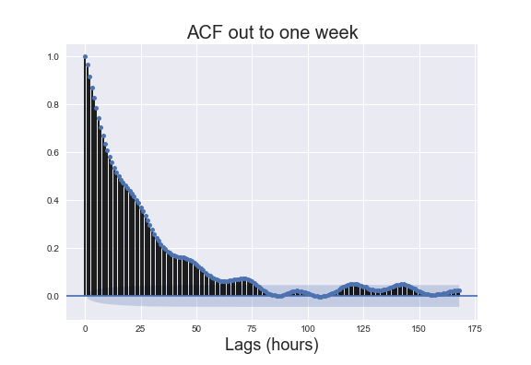
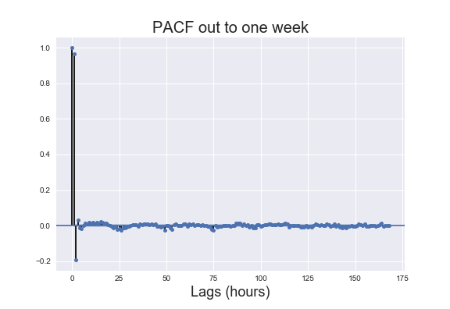
Time Series Analysis
- ACF: gradual decay with significant auto-correlation out to 82 lags
- PACF: most auto-correlation can be explained by first 2 lags

Slide 9
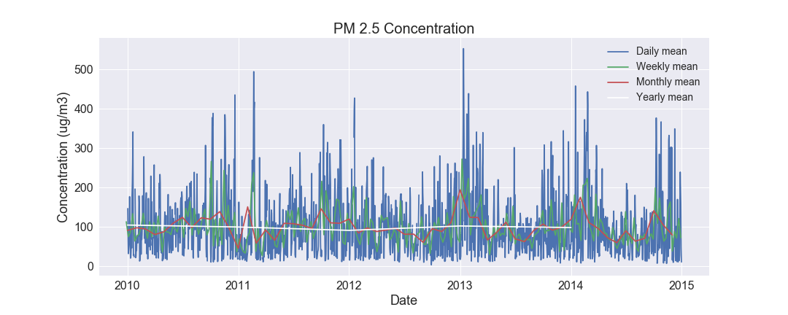
Test for Stationarity
Augmented Dickey Fuller: PM 2.5 time series stationary with 99% confidence. No transformations necessary.

Slide 10
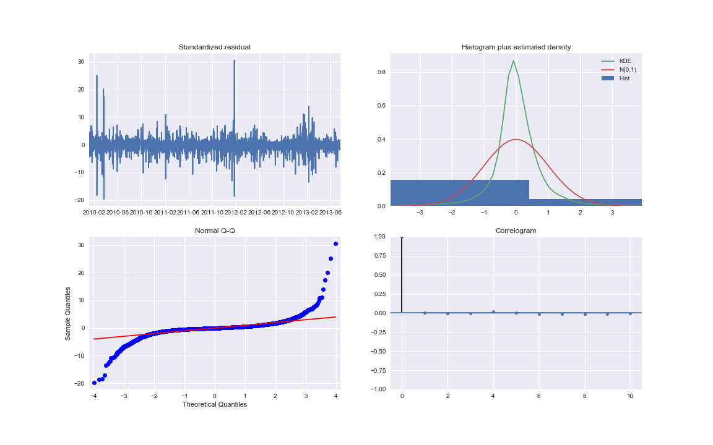
Forecasting Method 1: Seasonal ARIMA
Seasonal Auto-regressive integrated moving-average model
Systematic grid search found best parameters to be
(2, 0, 1)x(2, 1, 1, 24)
Most important component: auto-regression at lag-1
Residuals not quite normally distributed – performance is not ideal

Slide 11
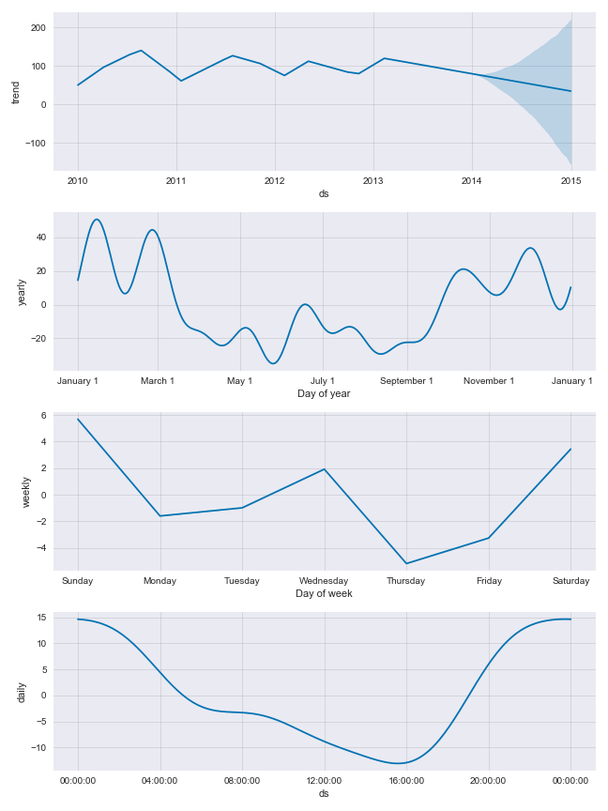
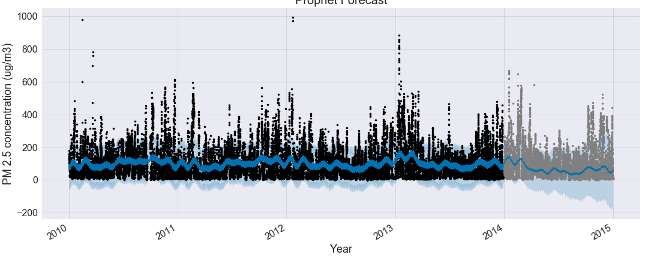
Forecasting Method 2: Prophet Model
Trained on 2010-2013 data
Forecast for 2014 is very accurate
Non-parametric regression model
Found significant daily, weekly, and annual cycling in PM 2.5

Slide 12
Forecasting Method 3: Supervised Regression
y = pm25
X = [pm25 and dewp at lags up to one week ]
Data randomly split into train-test sets (70%-30%)
Algorithms:
Linear Regression
KNN
Stochastic Gradient Descent
Decision Tree
Random Forest
Multi-layer Perceptron (neural network)

Slide 13
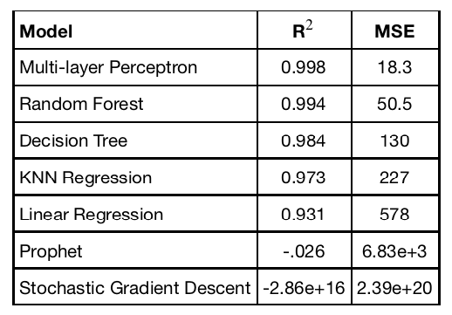
Model Selection
Performance on training set
Multi-Layer Perceptron (neural network) wins!

Slide 14
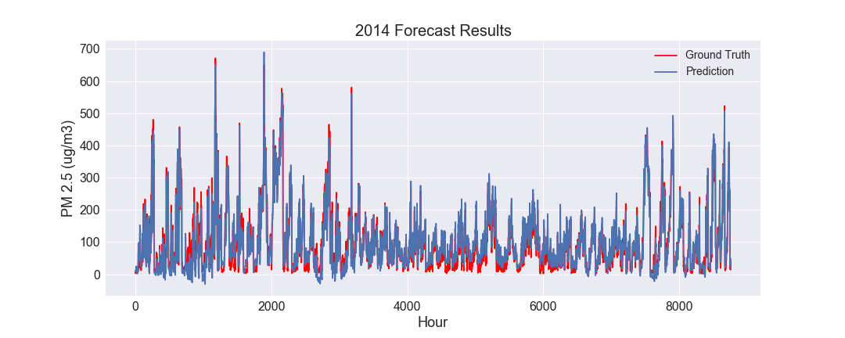
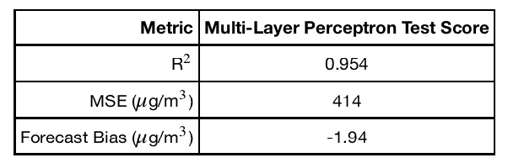
Multi-Layer Perceptron Prediction Results
Performance on unseen test set
Model captures 95.4% of the variance on out-of-sample PM 2.5 concentration.
Tends to underforecast with a 2% bias.

Slide 15
Limitation
Possible unknown pattern (e.g., very high PM 2.5 concentration) to the records that lacked pm25 information.

Slide 16
Recommendation to Client
For fast, accurate forecasting that is less computationally expensive than traditional physics-based air quality models, the client should deploy the multi-layer-perceptron (neural network) model developed here. In addition to providing high-quality forecasts, it can also quickly learn on new observations

Slide 17
Acknowledgements
Springboard
My mentor, Amir Ziai
UCI machine learning repository

