Slide 1

CSCE 222 Discrete Structures
Logic – Part 1
Dr. Tim McGuire
Grateful acknowledgement to Professor Bart Selman, Cornell University, and Prof. Johnnie Baker, Kent State, for some of the material upon which these notes are adapted.

Slide 2
Goals of CSCE 222
Introduce students to a range of mathematical tools from discrete mathematics that are key in computer science
Mathematical Sophistication
How to write statements rigorously
How to read and write theorems, lemmas, etc.
How to write rigorous proofs
Areas we will cover:
Logic and proofs
Set Theory
Induction and Recursion
Counting and combinatorics
Probability theory
Number Theory (if time permits)
Practice works!
Actually, only practice works!
Note: Learning to do proofs from
watching the lecture is like trying to
learn to play tennis from watching
it on TV! So, do the exercises!
Aside: We’re not after the shortest or most elegant proofs;
verbose but rigorous is just fine! ☺

Slide 3
Topics CSCE 222
Logic and Methods of Proof
Propositional Logic --- SAT as an encoding language!
Predicates and Quantifiers
Methods of Proofs
Sets
Sets and Set operations
Functions
Counting
Basics of counting
Pigeonhole principle
Permutations and Combinations
Number Theory (if time permits)
Modular arithmetic
RSA cryptosystems

Slide 4
Topics CSCE 222
Probability
Probability Axioms, events, random variable
Independence, expectation, example distributions
Birthday paradox
Monte Carlo method
Graphs and Trees (light coverage if time permits. Covered in Data Structures and Algorithms)
Graph terminology
Example of graph problems and algorithms:
graph coloring
TSP
shortest path

Slide 5
Based on Chapter 1 of Rosen Discrete Mathematics and its Applications

Slide 6
Introduction to Logic
We will approach logic in a fairly intuitive fashion.
In this module we will prescribe certain rules of logic which we will follow through the rest of this course.
They should be self-evident. We won’t attempt to prove these rules.
The rules we present here are universally accepted in mathematics and in most of science and analytic thought.

Slide 7
Introduction to Logic
We begin with sentential logic and elementary connectives.
This is called propositional logic (to distinguish it from predicate logic, which will be treated later.)
In other words, we will be discussiong propositions which are built up from atomic statements and connectives.
The elementary connectives include “and”, “or”, “not”, “if-then”, and “if-and-only-if”
Each of these have a precise meaning and will have exact relationships with the other connectives.

Slide 8
Introduction to Logic
An atomic statement is a sentence with a subject and a verb (and sometimes an object) but no connectives (and, or, etc.)
For example, these are all atomic statements.
Juan is good
Mary has bread
Lavinia reads books

Slide 9
Introduction to Logic
Later, we will look at the quantifiers “for all” and “there exists” and their relationships with the connectives.
These give rise to predicate logic.
Connectives and quantifiers will prove to be the building blocks for all of of study in this course.

Slide 10
1.1 Propositional Logic

Slide 11
Syntax: Elements of the language
A proposition is a declarative statement that is either true or false (but not both).
Primitive propositions --- statements like:
Bob loves Alice
Alice loves Bob
P
Propositional Symbols
(atomic propositions)
Q
Compound propositions
Bob loves Alice and Alice loves Bob
P ∧ Q (∧ - stands for and)

Slide 12
Connectives
¬ - not
∧ - and
∨ - or
→ - implies
↔ - equivalent (if and only if)

Slide 13
Syntax
Syntax of Well Formed Formulas (wffs) or sentences
Atomic sentences are wffs:
Examples: P, Q, R, BlockIsRed; SeasonIsWinter;
Complex or compound wffs examples, assuming that w1 and w2 are wwfs:
¬ w1 (negation)
(w1 ∧ w2) (conjunction)
(w1 ∨ w2) (disjunction)
(w1 → w2) (implication; w1 is the antecedent; w2 is the consequent)
(w1 ↔ w2) (biconditional)

Slide 14
Propositional logic: Examples
Additional Examples of wffs
P ∧ Q
(P ∨ Q) → R
P ∨ Q → P
(P → Q) → (¬Q → ¬P)
¬ ¬P
Comments:
Atoms or negated atoms are called literals;
Examples: p and ¬p are literals.
P ∧ Q is a compound statement or compound proposition.
Parentheses are important to ensure that the syntax is unambiguous. Quite often parentheses are omitted;
The order of precedence in propositional logic is (from highest to lowest): ¬ ,∧, ∨, →, ↔

Slide 15
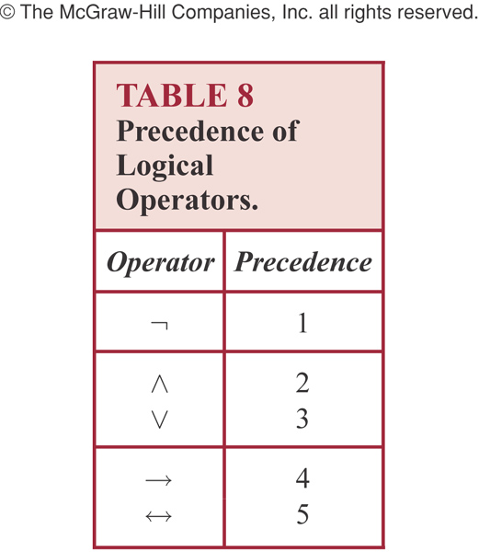

Slide 16
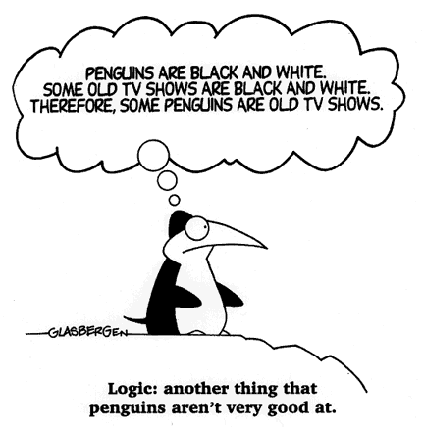
© Randy Glasbergen used by permission

Slide 17
Propositional Logic: Syntax vs. Semantics
Syntax involves whether notation is correctly formed
Semantics has to do with “meaning”:
it associates the elements of a logical language with the elements of a domain of discourse.
Propositional Logic – involves associating atomic sentences with propositions or assertions about the world (therefore called “propositional logic”).

Slide 18
Truth Assignment to Propositions
Interpretation or Truth Assignment:
In an application, a truth assignment (True or False) must be made to each proposition.
So if for n atomic propositions, there are 2^{n} truth assignments or interpretations.
This makes the representation powerful: the propositions implicitly capture 2^{n} possible states of the world.

Slide 19
Sematics Example
We might associate the atom (just a symbol!) BlockIsRed with the proposition: “The block is Red”,
However, we could also associate it with the proposition “The block is Black” even though this would be quite confusing…
BlockIsRed has value True just in the case the block is red; otherwise BlockIsRed is False.
Computers manipulate symbols. The string “BlockIsRed” does not “mean” anything to the computer.
Meaning has to come from how to come from relations to other symbols and the “external world”. Hmm

Slide 20
Sematics Example (cont.)
How can a computer / robot obtain the meaning ``The block is Red’’?
The fact that computers only “push around symbols” led to quite a bit of confusion in the early days or Artificial Intelligence, Robotics, and natural language understanding.

Slide 21
The Statement/Proposition Game
“Elephants are bigger than mice.”
Is this a statement?
yes
Is this a proposition?
yes
What is the truth value
of the proposition?
true

Slide 22
The Statement/Proposition Game
“520 < 111”
Is this a statement?
yes
Is this a proposition?
yes
What is the truth value
of the proposition?
false

Slide 23
The Statement/Proposition Game
“y > 5”
Is this a statement?
yes
Is this a proposition?
no
Its truth value depends on the value of y, but this value is not specified.
We call this type of statement a propositional function or open sentence.

Slide 24
The Statement/Proposition Game
“The year is 2019 and 99 < 5.”
Is this a statement?
yes
Is this a proposition?
yes
What is the truth value
of the proposition?
false

Slide 25
Propositions Review
Which ones are propositions?
Texas A&M University is in College Station, Texas
1 + 1 = 2
what time is it?
2 + 3 = 10
watch your step!

Slide 26
Propositions Review
What is the negation of the proposition “At least ten inches of rain fell today in Miami”?

Slide 27
Propositions Review
What is the negation of the proposition “At least 10 inches of rain fell today in Miami”?
It is not the case that at least 10 inches of rain fell today in Miami
(Simpler) Less than 10 inches of rain fell today in Miami.

Slide 28
Logical Operators (Connectives)
We will examine the following logical operators:
Negation (NOT, ¬)
Conjunction (AND, ∧)
Disjunction (OR, ∨)
Exclusive-or (XOR, ⊕ )
Implication (if – then, → )
Biconditional (if and only if, ↔ )
Truth tables can be used to show how these operators can combine propositions to compound propositions.

Slide 29
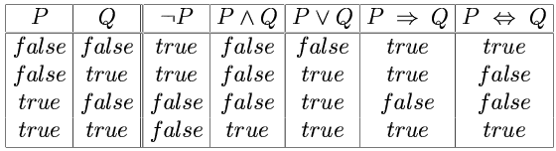
Propositional Logic: Semantics
Truth table for connectives
Given the values of atoms under some interpretation, we can use a truth table to compute the value for any wff under that same interpretation; the truth table establishes the semantics (meaning) of the propositional connectives.
→
↔
We can use the truth table to compute the value of any wff given the values of the constituent atom in the wff. Note: In table, P and Q can be compound propositions themselves.
Note: Implication is not necessarily aligned with English usage.

Slide 30
Implication (p → q)
This is only False (violated) when q is False and p is True.
Related implications:
Converse: q → p;
Contra-positive: ¬q → ¬ p;
Inverse ¬ p → ¬ q;
Important: only the contra-positive of p → q is equivalent to p → q (i.e., has the same truth values in all models); the converse and the inverse are equivalent;

Slide 31
Implication (p → q)
Implication plays an important role in reasoning. A variety of terminologies are used to refer to implication:
conditional statement
if p then q
if p, q
p is sufficient for q
q if p
q when p
a necessary condition for p is q (*)
p implies q
p only if q (*)
a sufficient condition for q is p
q whenever p
q is necessary for p (*)
q follows from p
Note: the mathematical concept of implication is independent of a cause and effect relationship between the hypothesis (p) and the conclusion (q), that is normally present when we use implication in English.
Note: Focus on the case, when is the statement False. That is, p is True and q is False, should be the only case that makes the statement false.
(*) assuming the statement true, for p to be true, q has to be true

Slide 32
Implication Questions
Let P be the statement “Rock the Good Ag learns discrete mathematics” and Q the statement “Rock the Good Ag will find a good job”. Express P→Q as a statement in English.
You can access the internet from campus only if you are a computer science major or you are not a freshman

Slide 33
Implication Question (cont.)
Question:
Let P be the statement “Rock the Good Ag learns discrete mathematics” and Q the statement “Rock the Good Ag will find a good job”. Express P→Q as a statement in English.
Solution: Any of the following.
If Rock learns discrete mathematics, then he will find a good job.
Rock will find a good job when he learns discrete mathematics
For Rock to get a good job, it is sufficient for him to learn discrete mathematics.

Slide 34
Second Conditional Question
You can access the internet from campus only if you are a computer science major or you are not a freshman.
Solution:
Let a, c and f represent “you can access the Internet from campus” , “you are a computer science major”, and “you are a freshman”.
Then above statement can be stated more simply as “You can access the internet implies that you are a computer science major major or you are not a freshman
a→(c ∨ ¬f)

Slide 35
Bi-Conditionals (p ↔ q)
Variety of terminology :
p is necessary and sufficient for q
if p then q, and conversely
p if and only if q
p iff q
p ↔ q is equivalent to (p→q) ∧ (q →p)
Note: the if and only if construction used in biconditionals is rarely used in common language;
Example: “if you finish your meal, then you can play;” really means: “If you finish your meal, then you can play” and ”You can play, only if you finish your meal”.

Slide 36
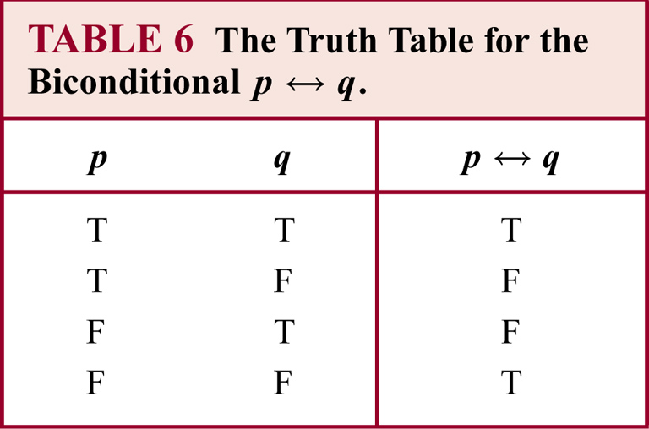

Slide 37
Exclusive Or
Truth Table
P Q P ⊕ Q
_____________
T T F
T F T
F T T
F F F
P ⊕ Q is equivalent to (P ∧¬Q) ∨ (¬P∧Q)
and also equivalent to ¬ (P ↔ Q)
Use a truth table to check these equivalences.

Slide 38
Propositional Logic: Satisfiability and Models
Satisfiability and Models
An interpretation or truth assignment satisfies a wff, if the wff is assigned the value True, under that interpretation.
An interpretation that satisfies a wff is called a model of that wff.
Given an interpretation (i.e., the truth values for the n atoms) then one can use the truth table to find the value of any wff.

Slide 39
Tautologies and Contradictions
The first rule of Tautology Club is the first rule of Tautology Club
A tautology is a statement that is always true.
Examples:
R∨(¬R)
¬(P∧Q) ↔ (¬P)∨(¬ Q)
A contradiction is a statement that is always false.
Examples:
R∧(¬R)
¬(¬(P ∧ Q) ↔ (¬P) ∨ (¬Q))
The negation of any tautology is a contradiction, and the negation of any contradiction is a tautology.

Slide 40
1.2 Propositional Equivalences: Inconsistency (Unsatisfiability) and Validity
Inconsistent or Unsatisfiable set of WFFs
It is possible that no interpretation satisifies a set of wffs
In that case we say that the set of wffs is inconsistent or unsatisfiable or a contradiction
Examples:
1 – {P ∧ ¬P}
2 – { P ∨ Q, P ∨¬Q, ¬P ∨ Q, ¬P ∨¬Q}
(use the truth table to confirm that this set of wffs is inconsistent)
Validity (Tautology) of a set of WFFs
If a wff is True under all the interpretations of its constituents atoms, we say that the wff is valid or it is a tautology.

Slide 41
Showing a Set of wwfs are Inconsistent
Consider { P ∨ Q, P ∨¬Q, ¬P ∨ Q, ¬P ∨¬Q}
Must show that the following wwf is unsatisfiable
(P ∨ Q) ∧ (P ∨¬Q) ∧ (¬P ∨ Q) ∧ (¬P ∨¬Q)
List the following 11 terms in your truth table in following order:
P Q ¬P ¬Q (P ∨ Q) (P ∨¬Q) (P ∨ Q) ∧ (P ∨¬Q)
(¬P ∨ Q) (¬P ∨¬Q) (¬P ∨ Q) ∧ (¬P ∨¬Q)
(P ∨ Q) ∧ (P ∨¬Q) ∧ (¬P ∨ Q) ∧ (¬P ∨¬Q)

Slide 42
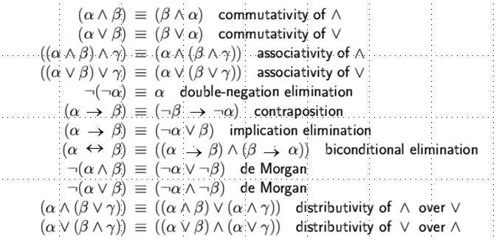
Logical equivalence
Two sentences p an q are logically equivalent (≡ or ⇔) iff p ↔ q is a tautology
(and therefore p and q have the same truth value for all truth assignments)
Note: logical equivalence (or iff) allows us to make statements about propositional logic, pretty much like we use = in in ordinary mathematics.

Slide 43
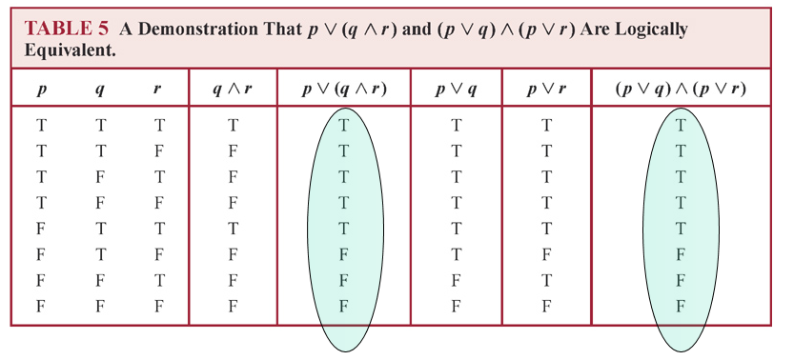
The truth table method
The distributive law of OR over AND
(Propositional) logic has a “truth compositional semantics”:
Meaning is built up from the meaning of its primitive parts (just like English text).

Slide 44
Truth Tables
Truth table for connectives
We can use the truth table to compute the value of any wff given the values of the constituent atom in the wff.
Example:
Suppose P and Q are False and R has value True.
Given this interpretation, what is the truth value of [( P → Q) → R ] → P?
False
If a system is described using n features (corresponding to propositions), and these features are represented by a corresponding set of n atoms, then there are 2^{n} different ways the system can be. Why? Each of the ways the system can be corresponds to an interpretation. Therefore there are 2^{n} interpretations.

Slide 45
Logic and Bit Operations
Computers represent information using bits.
A bit has only two possible values, namely 0 and 1.
A 1 represents T (true) and 0 represents F (false)
A variable is called a boolean variable if its value is either true or false.
By replacing true by 1 and false by 0, a computer can perform logical operations.
These replacements provides the following table for bit operators.
x | y | x∨y | x∧y | x⊕y
0 | 0 | 0 | 0 | 0
0 | 1 | 1 | 0 | 1
1 | 0 | 1 | 0 | 1
1 | 1 | 1 | 1 | 0

Slide 46
Example: Binary valued featured descriptions
Consider the following description:
The router can send packets to the edge system only if it supports the new address space. For the router to support the new address space it is necessary that the latest software release be installed. The router can send packets to the edge system if the latest software release is installed. The router does not support the new address space.
Features:
Router
P - router can send packets to the edge of system
Q - router supports the new address space
Latest software release
R – latest software release is installed

Slide 47
Formal:
The router can send packets to the edge system only if it supports
the new address space. (constraint between feature 1 and feature 2)
If Feature 1 (P) (router can send packets to the edge of system) then P → Q
Feature 2 (Q) (router supports the new address space )
For the router to support the new address space it is necessary that the
latest software release be installed. (constraint between feature 2 and feature 3);
If Feature 2 (Q) (router supports the new address space ) then
Feature 3 (R) (latest software release is installed) Q → R
The router can send packets to the edge system if the latest software release
is installed. (constraint between feature 1 and feature 3);
If Feature 3 (R) (latest software release is installed) then
Feature 1 (P) (router can send packets to the edge of system) R → P
The router does not support the new address space. ¬ Q

Slide 48
Section 1.5 Rules of Inference

Slide 49
1.5 Propositional logic: Rules of Inference or Methods of Proof
How to produce additional wffs (sentences) from other ones? What steps can we perform to show that a conclusion follows logically from a set of hypotheses?
Example
Modus Ponens (the law of detachment)
P
P → Q
∴ Q
The hypotheses (premises) are written in a column and the conclusions below the bar
The symbol ∴ denotes “therefore”. Given the hypotheses, the conclusion follows.
The basis for this rule of inference is the tautology (P ∧ (P → Q)) → Q)
[aside: check tautology with truth table to make sure]
In words: when P and P → Q are True, then Q must be True also. (meaning of second implication)

Slide 50
Propositional logic: Rules of Inference or Methods of Proof
Example: Modus Ponens
If you study the CSCE 222 material → You will pass
You study the CSCE 222 material
∴ you will pass
Nothing “deep”, but again remember the formal reason is that
((P ^ (P → Q)) → Q is a tautology.

Slide 51
Propositional logic: Rules of Inference
See Table 1, sec. 1.5, Rosen.
Rule of Inference | Tautology (Deduction Theorem) | Name
P ∴ P ∨ Q | P → (P ∨ Q) | Addition
P ∧ Q ∴ P | (P ∧ Q) → P | Simplification
P Q ∴ P ∧ Q | [(P) ∧ (Q)] → (P ∧ Q) | Conjunction
P P→Q ∴ Q | [(P) ∧ (P→ Q)] → P | Modus Ponens
¬ Q P → Q ∴ ¬P | [(¬Q) ∧ (P→ Q)] → ¬P | Modus Tollens
P → Q Q → R ∴ P→ R | [(P→Q) ∧ (Q → R)] → (P→R) | Hypothetical Syllogism (“chaining”)
P ∨ Q ¬P ∴ Q | [(P ∨ Q) ∧ (¬P)] → Q | Disjunctive syllogism
P ∨ Q ¬P ∨ R ∴ Q ∨ R | [(P ∨ Q) ∧ (¬P ∨ R)] → (Q ∨ R) | Resolution

Slide 52
Valid Arguments
An argument is a sequence of propositions. The final proposition is called the conclusion of the argument while the other proposition are called the premises or hypotheses of the argument.
An argument is valid whenever the truth of all its premises implies the truth of its conclusion.
How to show that q logically follows from the hypotheses (p₁ ∧ p₂ ∧ …∧p_{n})?
Show that
(p1 ∧ p2 ∧ …∧p_{n}) → q is a tautology
One can use the rules of inference to show the validity of an argument.

Slide 53
Arguments
Just like a rule of inference, an argument consists of one or more hypotheses (or premises) and a conclusion.
We say that an argument is valid, if whenever all its hypotheses are true, its conclusion is also true.
However, if any hypothesis is false, even a valid argument can lead to an incorrect conclusion.
Proof: show that hypotheses → conclusion is true using rules of inference

Slide 54
Arguments
Example:
“If 101 is divisible by 3, then 101² is divisible by 9. 101 is divisible by 3. Consequently, 101² is divisible by 9.”
Although the argument is valid, its conclusion is incorrect, because one of the hypotheses is false (“101 is divisible by 3.”).
If in the above argument we replace 101 with 102, we could correctly conclude that 102² is divisible by 9.

Slide 55
Arguments
Which rule of inference was used in the last argument?
p: “101 is divisible by 3.”
q: “101² is divisible by 9.”
p
p → q
_____
∴ q
Modus ponens
Unfortunately, one of the hypotheses (p) is false.
Therefore, the conclusion q is incorrect.

Slide 56


Slide 57
Review: Modus ponens
modus ponens (Latin for "mode that affirms”)
The modus ponens argument is built in the following way:
A) If x [is true], then y [is true]. B) x [is true] C) Therefore, y [is true].
Let’s flesh this out in an example:
A) If Fido is a dog, then Fido is an animal. B) Fido is a dog. C) Therefore, Fido is an animal.
In AI, modus ponens is often referred to as “forward chaining”

Slide 58
Arguments
Another example:
“If it rains today, then we will not have a bonfire today. If we do not have a bonfire today, then we will have a bonfire tomorrow. Therefore, if it rains today, then we will have a bonfire tomorrow.”
This is a valid argument: If its hypotheses are true, then its conclusion is also true.

Slide 59
Arguments
Let us formalize the previous argument:
p: “It is raining today.”
q: “We will not have a bonfire today.”
r: “We will have a bonfire tomorrow.”
So the argument is of the following form:
Hypothetical syllogism is the transitive application of modus ponens
p → q
q → r
______
∴ p → r
Hypothetical syllogism

Slide 60
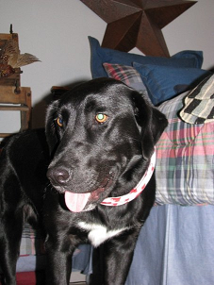
Review: Disjunctive Syllogism
Remember that “disjunction” is just a big word meaning “OR”
This argument is built in the following way:
A) Either x [is true] or y [is true] B) ¬ x [x is not true] C) Therefore, y [is true].
Let’s flesh this out in an example:
A) Libby is a dog or Libby is a cat. B) Libby is not a cat. C) Therefore, Libby is a dog.

Slide 61
Review: Modus tollens
modus tollens (Latin for "mode that denies”)
The modus tollens argument is built in the following way:
A) If x [is true], then y [is true]. B) ¬ y [y is not true] C) Therefore, ¬ x [x is not true].
Let’s flesh this out in an example:
A) If Fido detects an intruder, then Fido will bark. B) Fido did not bark. C) Therefore, Fido did not detect an intruder.

Slide 62
Arguments
Another example:
Rock the Good Ag is either intelligent or a good actor.
If Rock the Good Ag is intelligent, then he can count from 1 to 10.
Rock the Good Ag can only count from 1 to 3.
Therefore, Rock the Good Ag is a good actor.
i: “Rock the Good Ag is intelligent.”
a: “Rock the Good Ag is a good actor.”
c: “Rock the Good Ag can count from 1 to 10.”

Slide 63
Arguments
i: “Rock the Good Ag is intelligent.” a: “Rock the Good Ag is a good actor.” c: “Rock the Good Ag can count from 1 to 10.”
Step 1: ¬ c Hypothesis (Rock can only count to 3)
Step 2: i → c Hypothesis
Step 3: ¬ i Modus tollens Steps 1 & 2
Step 4: a ∨ i Hypothesis
Step 5: a Disjunctive Syllogism Steps 3 & 4
Conclusion: a (“Rock the Good Ag is a good actor.”)

Slide 64
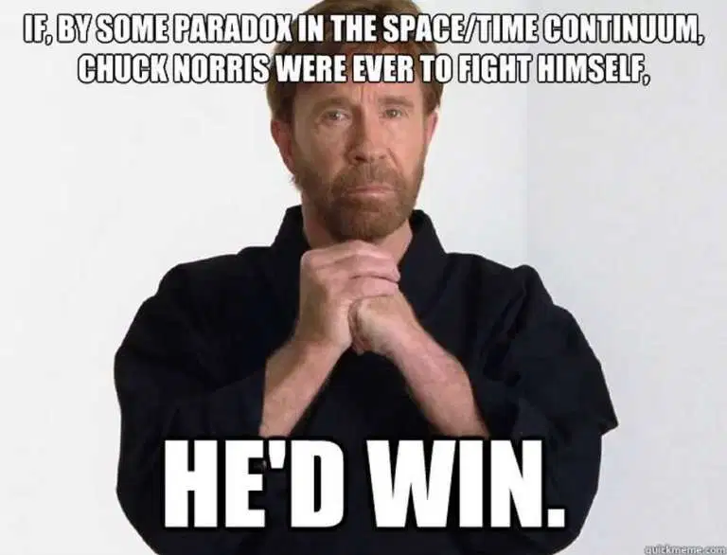

Slide 65
Arguments
Yet another example:
If you listen to me, you will pass CSCE 222.
You passed CSCE 222.
Therefore, you have listened to me.
Is this argument valid?
No, it assumes ((p → q) ∧ q) → p.
This statement is not a tautology. It is false if p is false and q is true.

Slide 66
1.3-1.4 Beyond Propositional Logic: Predicates and Quantifiers

Slide 67
Predicates
Propositional logic assumes the world contains facts that are true or false.
But let’s consider a statement containing a variable:
x > 3 since we don’t know the value of x we cannot say whether the expression is true or false
x > 3 which corresponds to “x is greater than 3”
Predicate, i.e. a property of x

Slide 68
“x is greater than 3” can be represented as P(x), where P denotes “greater than 3”
In general a statement involving n variables x₁, x₂, … x_{n} can be denoted by
P(x₁, x₂, … x_{n} )
P is called a predicate or the propositional function P at the n-tuple ( x₁, x₂, … x_{n} ).

Slide 69
Propositional Functions & Predicates
Propositional function (open sentence):
statement involving one or more variables,
e.g.: x-3 > 5.
Let us call this propositional function P(x), where P is the predicate and x is the variable.
What is the truth value of P(2) ?
false
What is the truth value of P(8) ?
false
What is the truth value of P(9) ?
true
When a variable is given a value, it is said to be instantiated
Truth value depends on value of variable

Slide 70
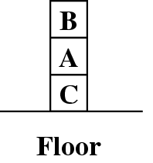
A predicate (aka propositional function) becomes a proposition when all its variables are instantiated.
Predicate: On(x,y)
Propositions:
ON(A,B) is False (in figure)
ON(B,A) is True
Clear(B) is True

Slide 71
Variables and Quantification
How would we say that every block in the world has a property – say “clear”? We would have to say:
Clear(A); Clear(B); … for all the blocks… (it may be long or, worse, we may have an infinite number of blocks…)
What we need is: Quantifiers
∀ Universal quantifier
∀x P(x) - P(x) is true for all the values x in the universe of discourse
∃ Existential quantifier
∃x P(x) - there exists an element x in the universe of discourse
such that P(x) is true
(Note: ∀x P(x) is either true or false, so it is a proposition, not a propositional function.)

Slide 72
Universal quantification
Everyone in Aggieland is smart:
∀x In(x,Aggieland) → Smart(x)
Implicitly equivalent to the conjunction of instantiations of Predicate “In"
In(Demelza,Aggieland) → Smart(Demelza)
∧ In(Ross,Aggieland) → Smart(Ross)
∧ In(José,Aggieland) → Smart(José)
∧ …

Slide 73
A common mistake to avoid
Typically, → is the main connective with ∀
Common mistake: Using ∧ as the main connective with ∀:
∀x In(x,Aggieland) ∧ Smart(x)
means:
“Everyone is in Aggieland and everyone is smart.”

Slide 74
Existential quantification
Someone in Aggieland is smart:
∃x (In(x,Aggieland) ∧ Smart(x))
∃x P(x) “ There exists an element x in the universe of discourse such that P(x) is true”
Equivalent to the disjunction of instantiations of P
(In(Demelza,Aggieland) ∧ Smart(Demelza))
∨ (In(Ross,Aggieland) ∧ Smart(Ross))
∨ (In(José,Aggieland) ∧ Smart(José))
∨ ...

Slide 75
Quantification
Another example:
Let the universe of discourse be the real numbers.
What does ∀x∃y (x + y = 320) mean ?
“For every x there exists a y so that x + y = 320.”
Is it true?
yes
Is it true for the natural numbers?
no

Slide 76
Another common mistake to avoid
Typically, ∧ is the main connective with ∃
Common mistake: using → as the main connective with ∃:
∃x In(x,Austin) → Smart(x)
When is this true?
Is true if there is either (anyone who is not in Austin) or (there is anyone who is smart)
Above is equivalent to
∃x [¬ In(x,Austin) ∨ Smart(x)]

Slide 77
Properties of quantifiers
∀x ∀y is the same as ∀y ∀x
∃x ∃y is the same as ∃y ∃x
∃x ∀y is not the same as ∀y ∃x
∀x ∃y Loves(x,y)
“Everyone in the world is loves at least one person”
“Everybody loves somebody sometime” – Dean Martin (1964)

Slide 78
Properties of quantifiers
∃y ∀x Loves(x,y)
Quantifier duality: each can be expressed using the other
∀x Likes(x,IceCream) ¬∃x ¬Likes(x,IceCream)
∃x Likes(x,Broccoli) ¬∀x ¬Likes(x,Broccoli)
“There is a person who is loved by everyone in the world”

Slide 79
Love Affairs Loves(x,y) x loves y
Everybody loves Raymond
∀x Loves (x, Raymond)
Everybody loves somebody
∀x ∃y Loves (x, y)
There is somebody whom somebody loves
∃y ∃x Loves (x, y)
Nobody loves everybody
¬ ∃x ∀y Loves (x, y) ≡ ∀x ∃y ¬Loves (x, y)
There is somebody whom Lydia doesn’t love
∃y ¬Loves (Lydia, y)
Note: flipping quantifiers when ¬ moves in.

Slide 80
Love Affairs continued…
There is somebody whom no one loves
∃y ∀x ¬Loves (x, y)
There is exactly one person whom everybody loves (uniqueness)
∃y (∀x Loves(x,y) ∧ ∀z((∀w Loves (w ,z) → z=y))
There are exactly two people whom Lynn Loves
∃x ∃y ((x≠y) ∧ Loves(Lynn,x) Loves(Lynn,y) ∧
∀z( Loves (Lynn ,z)→ (z=x ∨ z=y)))
Everybody loves himself or herself
∀x Loves(x,x)
There is someone who loves no one besides herself or himself
∃x ∀y Loves(x,y) ↔(x=y) (note biconditional – why?)

Slide 81
Let Q(x,y) denote “x+y =0”; consider the domain of discourse the real
numbers
What is the truth value of
a) ∃y ∀x Q(x,y)?
b) ∀x ∃y Q(x,y)?
False
True (additive inverse)

Slide 82
Statement | When True | When False
∀x ∀y P(x,y) ∀y ∀x P(x,y) | P(x,y) is true for every pair | There is a pair for which P(x.y) is false
∀x ∃y P(x,y) | For every x there is a y for which P(x,y) is true | There is an x such that P(x,y) is false for every y.
∃x ∀y P(x,y) | There is an x such that P(x,y) is true for every y. | For every x there is a y for which P(x,y) is false
∃x ∃ y P(x,y) ∃y ∃ x P(x,y) | There is a pair x, y for which P(x,y) is true | P(x,y) is false for every pair x,y.

Slide 83
Negation
Negation | Equivalent Statement | When is the negation True | When is it False
¬∃x P(x) | ∀x ¬P(x) | For every x, P(x) is false | There is an x for which P(x) is true.
¬ ∀x P(x) | ∃x ¬P(x) | There is an x for which P(x) is false. | For every x, P(x) is true.

Slide 84
The kinship domain:
Brothers are siblings
∀x,y Brother(x,y) → Sibling(x,y)
One's mother is one's female parent
∀m,c Mother(c) = m ↔ (Female(m) ∧ Parent(m,c))
“Sibling” is symmetric
∀x,y Sibling(x,y) ↔ Sibling(y,x)

Slide 85
Rules of Inference for Quantified Statements
(∀x) P(x) ∴P(c) | Universal Instantiation
P(c) for an arbitrary c ∴(∀x) P(x) | Universal Generalization
∃(x) P(x) ∴ P(c) for some element c | Existential Instantiation
P(c) for some element c ∴ ∃(x) P(x) | Existential Generalization

Slide 86
Example:
Let CSCE222(x) denote: x is taking the CSCE222 class
Let CSE(x) denote: x is taking a course in CSE
Consider the premises ∀x (CSCE222(x) → CSE(x))
CSCE222(Rock)
We can conclude CSE(Rock)

Slide 87
Arguments
Argument (formal):
Step Reason
1 ∀x (CSCE222(x) → CSE(x)) premise
2 CSCE222(Rock) → CSE(Rock) Universal Instantiation
3 CSCE222(Rock) Premise
4 CSE(Rock) Modus Ponens (2 and 3)

Slide 88
Example
Show that the premises:
1- A student in this class has not read the textbook;
2- Everyone in this class passed the first homework
Imply
Someone who has passed the first homework has not read the textbook

Slide 89
Example
Solution:
Let C(x) denote that x is in this class;
T(x) denote that x has read the textbook;
P(x) denote that x has passed the first homework
Premises:
∃x (C(x) ∧ ¬T(x))
∀x (C(x) → P(x))
Conclusion: we want to show ∃x (P(x) ∧ ¬T(x))

Slide 90
Step Reason
1 ∃x (Cx ∧¬T(x)) Premise
2 C(a) ∧ ¬T(a) Existential Instantiation from 1
3 C(a) Simplification 2
4 ∀x (C(x)→P(x)) Premise
5 C(a) → P(a) Universal Instantiation from 4
6 P(a) Modus ponens from 3 and 5
7 ¬T(a) Simplification from 2
8 P(a) ∧¬ T(a) Conjunction from 6 and 7
9 ∃x P(x) ∧¬T(x) Existential generalization from 8
Next: methods for proving theorems.

Slide 91
Possible Classroom Examples
What is the negation of “There is no pollution in New Jersey”.
p denote “The election is decided” and q denote “The votes have been counted. Express ¬p→ ¬ q as an English Sentence
For hiking on the trail, it is necessary but not sufficient that berries not be ripe along the trail and for grizzly bears not to have been seen in this area.
Determine the truth value of 1 + 1 = 3 if and only if monkeys can fly.
Determine if the exclusive or is intended:
You can pay using dollars or euros.
To take discrete mathematics, you must have taken a course in calculus or a course in computer science
Use a truth table to verify the first De Morgan law
¬(p ∧ q) ≡ ¬ p ∨ ¬q

