Slide 1
…if it was so, it might be; and if it were so, it would be: but as it isn’t, it ain’t. That’s logic… --Tweedledee in Through the Looking-Glass by Lewis Carroll (1832-1898)

Slide 2

CSCE 222 Discrete Structures
Logic – Part 2
Dr. Tim McGuire
Grateful acknowledgement to Professor Bart Selman, Cornell University, and Prof. Johnnie Baker, Kent State, for some of the material upon which these notes are adapted.

Slide 3
Mathematical Reasoning
Rosen, 8th Edition, section 1.7

Slide 4
Mathematical Reasoning
We need mathematical reasoning to
determine whether a mathematical argument is correct or incorrect and
construct mathematical arguments.
Mathematical reasoning is not only important for conducting proofs and program verification, but also for artificial intelligence systems (drawing logical inferences from knowledge and facts).
We focus on deductive proofs

Slide 5
Terminology (1.7.2)
An axiom is a basic assumption about mathematical structure that needs no proof.
Things known to be true (facts or proven theorems)
Things believed to be true but cannot be proved
We can use a proof to demonstrate that a particular statement is true. A proof consists of a sequence of statements that form an argument.
The steps that connect the statements in such a sequence are the rules of inference.
Cases of incorrect reasoning are called fallacies.

Slide 6
Terminology
A theorem is a statement that can be shown to be true.
A lemma is a simple theorem used as an intermediate result in the proof of another theorem.
A corollary is a proposition that follows directly from a theorem that has been proved.
A conjecture is a statement whose truth value is unknown. Once it is proven, it becomes a theorem.

Slide 7
Proofs
A theorem often has two parts
Conditions (premises, hypotheses)
conclusion
A correct (deductive) proof is to establish that
If the conditions are true then the conclusion is true
I.e., Conditions → conclusion is a tautology
Often there are missing pieces between conditions and conclusion. Fill it by an argument
Using conditions and axioms
Statements in the argument connected by proper rules of inference

Slide 8
Valid Arguments
(reminder)
Recall:
An argument is a sequence of propositions. The final proposition is called the conclusion of the argument while the other propositions are called the premises or hypotheses of the argument.
An argument is valid whenever the truth of all its premises implies the truth of its conclusion. How to show that q logically follows from the hypotheses (p₁ ∧ p₂ ∧ …∧p_{n})?
Show that
(p₁ ∧ p₂ ∧ …∧p_{n}) → q is a tautology
One can use the rules of inference to show the validity of an argument.
Vacuous proof - if one of the premises is false then (p₁ ∧ p₂ ∧ …∧p_{n}) → q
is vacuously True, since False implies anything.

Slide 9
Arguments involving universally quantified variables
Note: Many theorems involve statements for universally quantified variables:
e.g., the following statements are equivalent:
“If x>y, where x and y are positive real numbers, then x² > y² ”
“∀x∀y (if x > y > 0 then x² > y²) ”
Quite often, when it is clear from the context, theorems are proved without explicitly using the laws of universal instantiation and universal generalization.

Slide 10
Methods of Proof (1.7.4)
Direct Proof
Proof by Contraposition
Proof by Contradiction
Proof of Equivalences
Proof by Cases
Exhaustive Proof
Existence Proofs
Uniqueness Proofs
Counterexamples

Slide 11
Direct Proof (1.7.5)
Proof of a statement p → q
Assume p
From p derive q.

Slide 12
Direct Proof
Direct proof:
An implication p → q can be proved by showing that if p is true, then q is also true.
Example: Give a direct proof of the theorem “If n is odd, then n² is odd.”
Idea: Assume that the hypothesis of this implication is true (n is odd). Then use rules of inference and known theorems of math to show that q must also be true (n² is odd).

Slide 13
Example - direct proof
Here’s what you know:
Premises:
Mary is a Math major or a CS major.
If Mary does not like discrete math, she is not a CS major.
If Mary likes discrete math, she is smart.
Mary is not a math major.
Can you conclude Mary is smart?
Let
M - Mary is a Math major
C – Mary is a CS major
D – Mary likes discrete math
S – Mary is smart
Informally, what’s the chain of reasoning?
((M ∨ C) ∧ (¬D → ¬C) ∧ (D → S) ∧ (¬M)) → S
?

Slide 14
Example - direct proof
In general, to prove p → q, assume p is true and show that q must also be true
Since, p is a conjunction of all the premises, we instead make the equivalent assumption that all of the following premises are true
M ∨ C
¬D → ¬C
D → S
¬M
Then the truth of these premises are used to prove S is true
((M ∨ C) ∧ (¬D → ¬C) ∧ (D → S) ∧ (¬M)) → S
?
Notes:
hese

Slide 15
Example - direct proof
1. M ∨ C Given
2. ¬D → ¬C Given
3. D → S Given
4. ¬M Given
5. C
Disjunctive Syllogism (1,4)
6. D
Modus Tollens (2,5)
7. S
Modus Ponens (3,6)
Mary is smart!
QED
QED or Q.E.D. --- quod erat demonstrandum
“which was to be demonstrated”
or “I rest my case” ☺

Slide 16
Direct Proof
(Reminder) Direct proof:
An implication p → q can be proved by showing that if p is true, then q is also true.
Example: Give a direct proof of the theorem “If n is odd, then n² is odd.”
Idea: Assume that the hypothesis of this implication is true (n is odd). Then use rules of inference and known theorems of math to show that q must also be true (n² is odd).

Slide 17
Proving Theorems
n is odd.
Then n = 2k + 1, where k is an integer.
Consequently, n² = (2k + 1)².
= 4k² + 4k + 1
= 2(2k² + 2k) + 1
Since n² can be written in this form, it is odd.

Slide 18
Proving Theorems (1.7.6)
Indirect proof:
An implication p → q is equivalent to its contra-positive ¬q → ¬p. Therefore, we can prove p → q by showing that whenever q is false, then p is also false.
Example: Give an indirect proof of the theorem “If 3n + 2 is odd, then n is odd.”
Idea: Assume that the conclusion of this implication is false (n is even). Then use rules of inference and known theorems to show that p must also be false (3n + 2 is even).

Slide 19
Proving Theorems
n is even.
Then n = 2k, where k is an integer.
It follows that 3n + 2 = 3(2k) + 2
= 6k + 2
= 2(3k + 1)
Therefore, 3n + 2 is even.
We have shown that the contrapositive of the implication is true, so the implication itself is also true (If 3n + 2 is odd, then n is odd).

Slide 20
Proving Theorems (1.7.7)
Indirect Proof is a special case of proof by contradiction
Suppose n is even (negation of the conclusion).
Then n = 2k, where k is an integer.
It follows that 3n + 2 = 3(2k) + 2
= 6k + 2
= 2(3k + 1)
Therefore, 3n + 2 is even.
However, this is a contradiction since 3n + 2 is given to be odd, so the conclusion (n is odd) holds.

Slide 21
Proof by Contradiction
A – We want to prove p.
We show that:
¬p → F (i.e., a False statement , say r ∧¬r)
We conclude that ¬p is false since (1) is True and therefore p is True.
B – We want to show p → q
Assume the negation of the conclusion, i.e., ¬q
Show that (p ∧ ¬q ) → F
Since ((p ∧ ¬q ) → F) ⇔ (p → q) (why?) we are done
((p ∧ ¬q ) → F) ⇔ ¬(p ∧ ¬q )
⇔ p → q

Slide 22
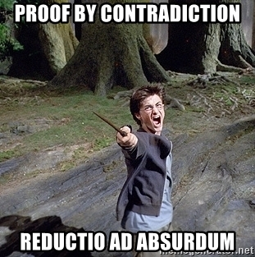
Section 1.7.7

Slide 23
Example: Proof by Contradiction
Classic proof that √2 is irrational.
Suppose √2 is rational. Then √2 = a/b for some integers a and b (relatively prime; no factor in common).
It’s quite clever!!
Note: Here we again first go to the definition of concepts (“rational”). Makes sense! Definitions provide information about important concepts. In a sense, math is all about “What follows from the definitions and premises!
√2 = a/b implies
2 = a²/b²
2b² = a²
a² is even, and so a is even (a = 2k for some k)
But if a and b are both even, then they are not relatively prime!
Q.E.D.
2b² = (2k)² = 4k²
b² = 2k²
b² is even, and so b is even (b = 2k for some k)
Notes:
ion

Slide 24
Example2: Proof by Contradiction
You’re going to let me get away with that? ☺
Lemma: a² is even implies that a is even (i.e., a = 2k for some k)??
Suppose to the contrary that a is not even.
Then a = 2k + 1 for some integer k
Then a² = (2k + 1)(2k + 1) = 4k² + 4k + 1 = 2(2k² + 2k) + 1
and a² is odd.
Then, as discussed earlier, a² is not even
contradiction
So, a really is even.
Corollary: An integer n is even if and only if n² is even
Why does the above statement follow immediately from previous work???

Slide 25
Example 3: Proof by Contradiction
Theorem:
“There are infinitely many prime numbers”
Proof by contradiction
Let P – “There are infinitely many primes”
Assume ¬P, i.e., “there is a finite number of primes” , call largest p_r.
Let’s define R the product of all the primes, i.e, R = p_1 × p_2 × … × p_r.
Consider R + 1.
Now, R+1 is either prime or not:
If it’s prime, we have prime larger than p_r.
If it’s not prime, let p* be a prime dividing (R+1). But p* cannot be any of p_1, p_2, … p_r (remainder 1 after division); so, p* not among initial list and thus p* is larger than p_r.
This contradicts our assumption that there is a finite set of primes, and therefore such an assumption has to be false which means that there are infinitely many primes.
(Euclid’s proof, c 300 BC)
One of the most famous
early proofs. An early
intellectual “tour the force”.
(Clever “trick”. The key to the proof.)
See e.g. http://primes.utm.edu/notes/proofs/infinite/euclids.html
Notes:
For more details, see
http://odin.mdacc.tmc.edu/~krc/numbers/infitude.html
Or
http://primes.utm.edu/notes/proofs/infinite/euclids.html

Slide 26
Example 4: Proof by Contradiction
Theorem “If 3n+2 is odd, then n is odd”
Let p = “3n+2 is odd” and q = “n is odd”
1 – assume p and ¬q i.e., 3n+2 is odd and n is not odd
2 – because n is not odd, it is even
3 – if n is even, n = 2k for some k, and therefore 3n+2 = 3 (2k) + 2 = 2 (3k + 1), which is even
4 – So, we have a contradiction, 3n+2 is odd and 3n+2 is even.
Therefore, we conclude p → q, i.e., “If 3n+2 is odd, then n is odd”
Q.E.D.

Slide 27
Proof of Equivalences
To prove p ↔ q
show that p →q
and q →p.
The validity of this proof results from the fact that
(p ↔ q) ↔ [ (p →q) ∧ (q →p)] is a tautology

Slide 28
Counterexamples
Show that ∀(x) P(x) is false
We need only to find a counterexample.

Slide 29
Counterexample
Show that the following statement is false:
“Every day of the week is a weekday”
Proof:
Saturday and Sunday are weekend days.
☺

Slide 30
Proof by Cases
To show
(p₁ ∨ p₂ ∨…∨ p_{n} ) → q
We use the tautology
[(p₁ ∨ p₂ ∨…∨ p_{n} ) → q ] ↔ [(p₁ → q ) ∧ (p₂ → q) ∧…∧ (p_{n} → q )]
A particular case of a proof by cases is an exhaustive proof in which all the cases are considered

Slide 31
Theorem
“If n is an integer, then n² ≥ n ”
Proof by cases
Case 1 n=0 0² = 0
Case 2 n > 0, i.e., n ≥ 1. We get n² ≥ n since we can multiply both sides of the inequality by n, which is positive.
Case 3 n < 0. Then n×n > 0×n since n is negative and multiplying both sides of inequality by n changes the direction of the inequality). So, we have n² > 0 in this case.
In conclusion, n² ≥ n since this is true in all cases.

Slide 32
Existence Proofs
Existence Proofs:
Constructive existence proofs
Example: “there is a positive integer that is the sum of cubes of positive integers in two different ways”
Proof: Show by brute force using a computer 1729 = 10³ + 9³ = 12³ + 1³
Non-constructive existence proofs
Example: “∀n (integers), ∃p so that p is prime, and p > n.”
Proof: Recall proof used to show there were infinitely many primes.
Very subtle – does not give an example of such a number, but shows one exists. (Let P = product of all primes < n and consider P+1. )
Uniqueness proofs involve
Existence proof
Uniqueness proof

Slide 33
Example - Existence Proof
∀n (integers), ∃p so that p is prime, and p > n.
Proof: Let n be an arbitrary integer, and consider n! + 1. If (n! + 1) is prime, we are done since (n! + 1) > n. But what if (n! + 1) is composite?
If (n! + 1) is composite then it has a prime factorization, p₁p₂…p_{n} = (n! + 1)
Consider the smallest p_{i}, and call it p. How small can it be?
Can it be 2?
So, p > n, and we are done. BUT WE DON’T KNOW WHAT p IS!!!
Can it be 3?
Can it be 4?
Can it be n?

Slide 34
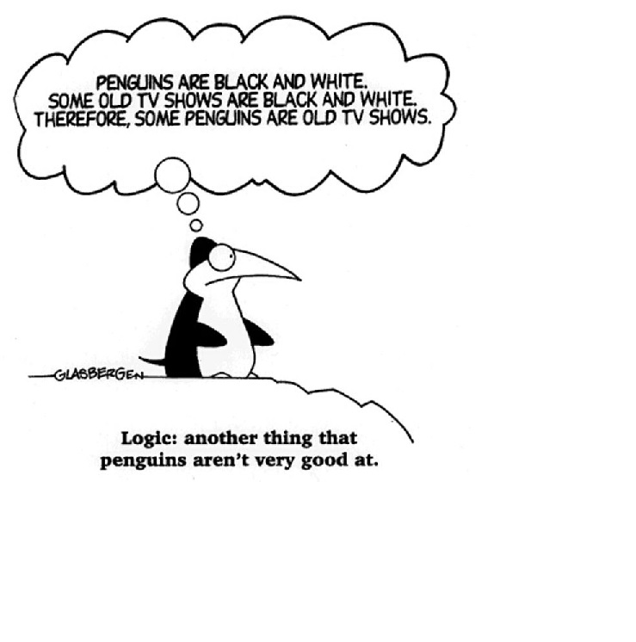
Fallacies
Fallacies are incorrect inferences. Some common fallacies:
The Fallacy of Affirming the Consequent
The Fallacy of Denying the Antecedent
Begging the question or circular reasoning

Slide 35
The Fallacy of Affirming the Consequent
If the butler did it he has blood on his hands.
The butler had blood on his hands.
Therefore, the butler did it.
This argument has the form
P→Q
Q
∴ P
or ((P→Q) ∧ Q)→P which is not a tautology and therefore not a valid rule of inference

Slide 36
The Fallacy of Denying the Antecedent
If the butler is nervous, he did it.
The butler is really mellow.
Therefore, the butler didn't do it.
This argument has the form
P→Q
¬P
∴ ¬Q
or ((P→Q) ∧ ¬P)→ ¬Q which is not a tautology and therefore not a valid rule of inference

Slide 37
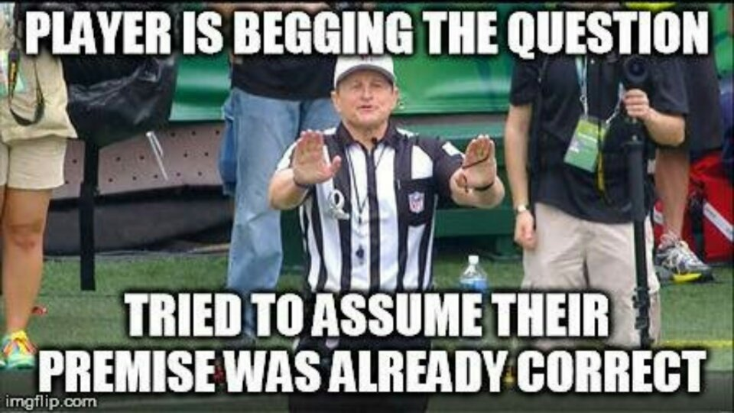

Slide 38
Begging the question or circular reasoning
This occurs when we use the truth of the statement being proved (or
something equivalent) in the proof itself.
Example:
Conjecture: if n² is even then n is even.
Proof: If n² is even then n² = 2k for some k. Let n = 2m for some m. Hence, x must be even.
Note that the statement n = 2m is introduced without any argument showing it.

Slide 39
Exhaustive Proof
Proof by Cases
Existence Proofs
Uniqueness Proofs
All of these are important, but more so to mathematicians than to computer scientists, so we will skip section 1.8

Slide 40
Additional Proof Methods Covered in CSCE 222
Induction Proofs
Combinatorial proofs
But first we have to cover some basic notions on sets, functions, and counting.

